Slide 1
OUR MISSION:
LEADING SUSTAINABLE COMMUNITY PRACTICES TO REDUCE HOMELESSNESS

Slide 2
We accomplish our mission in three ways:
Effective, engaging, nonjudgmental, consistent street outreach.
(PATH, UCM, H.O.T. teams)
Efficient systems development, management, training and implementation practices. Coordinated Entry, Homeless Management Information System, Lead Agency for the Interagency Council on Homelessness.
The development of housing for people experiencing homelessness. Low barrier housing with a “housing first approach”, wrap around services and case management support.

Slide 3
2023 Point in Time Count Results 745
2024 Point In Time Count Results 579
=
22.5% reduction
579 = unduplicated people who are unsheltered, people in emergency shelters and transitional shelters.
This represents a 22.5% reduction in people experiencing homelessness since the last Point in Time Count in 2023.
The Homeless Management Information System 2023 Annual service count = 6,525 people
Of the 6,525 people who accessed the homeless service system, 2497 people accessed homeless prevention services and supportive services only (people who were not experiencing homelessness).
Of the 6,525 people served in 2023, 1666 people exited the system to permanent housing- approximately 25.5%.
Of the 6,525 people, 288 people gained housing through the Coordinated Entry Continuum of Care housing application process for permanent supportive housing.
37% of the 6,525 people accessing the homeless service system reported having a disabling condition.

Slide 4
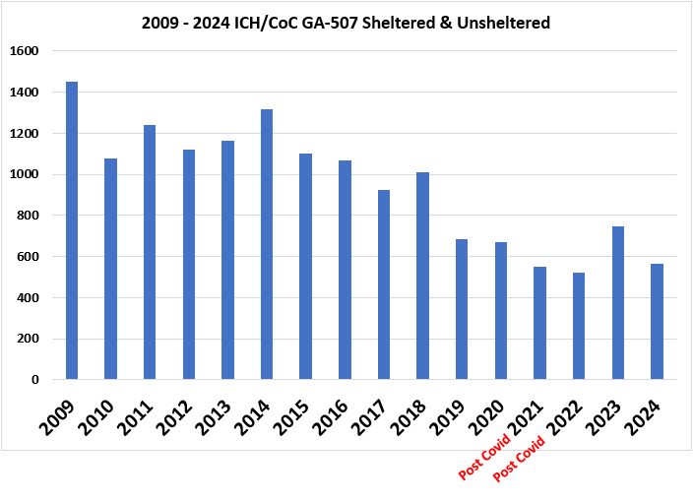

Slide 5
What is Chronic Homelessness?
HUD defines someone as chronically homeless when they have at least one disabling condition (i.e., a substance use disorder, mental illness, chronic health condition, disability, etc.) AND have been consecutively homeless for at least one year OR have been homeless at least four times in the past three years, with a cumulative time of at least one year.

Slide 6
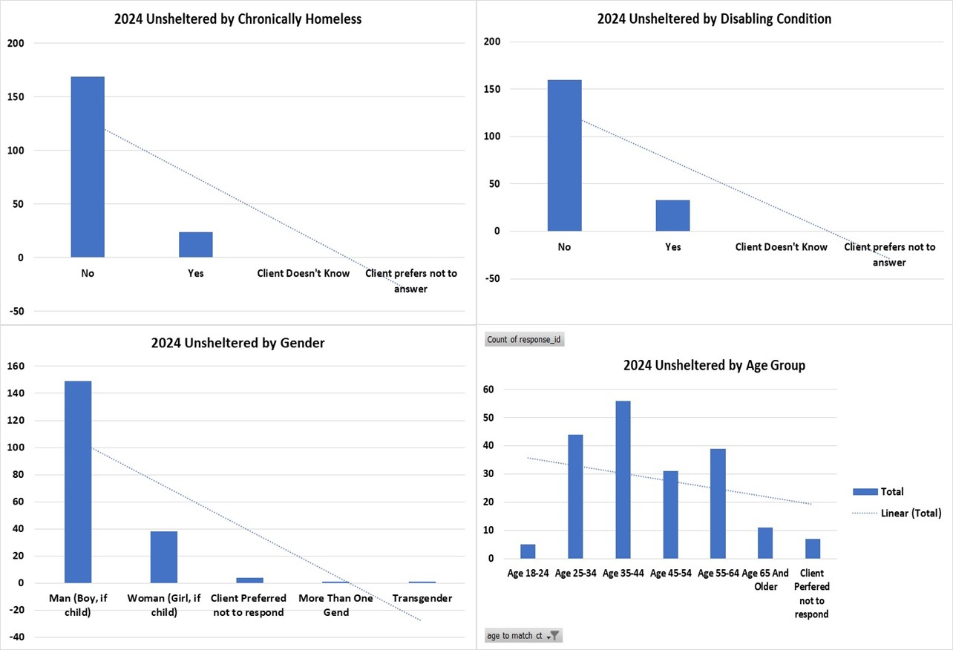
Chatham Savannah Point in Time Count 2024 UNSHELTERED unduplicated total
193

Slide 7
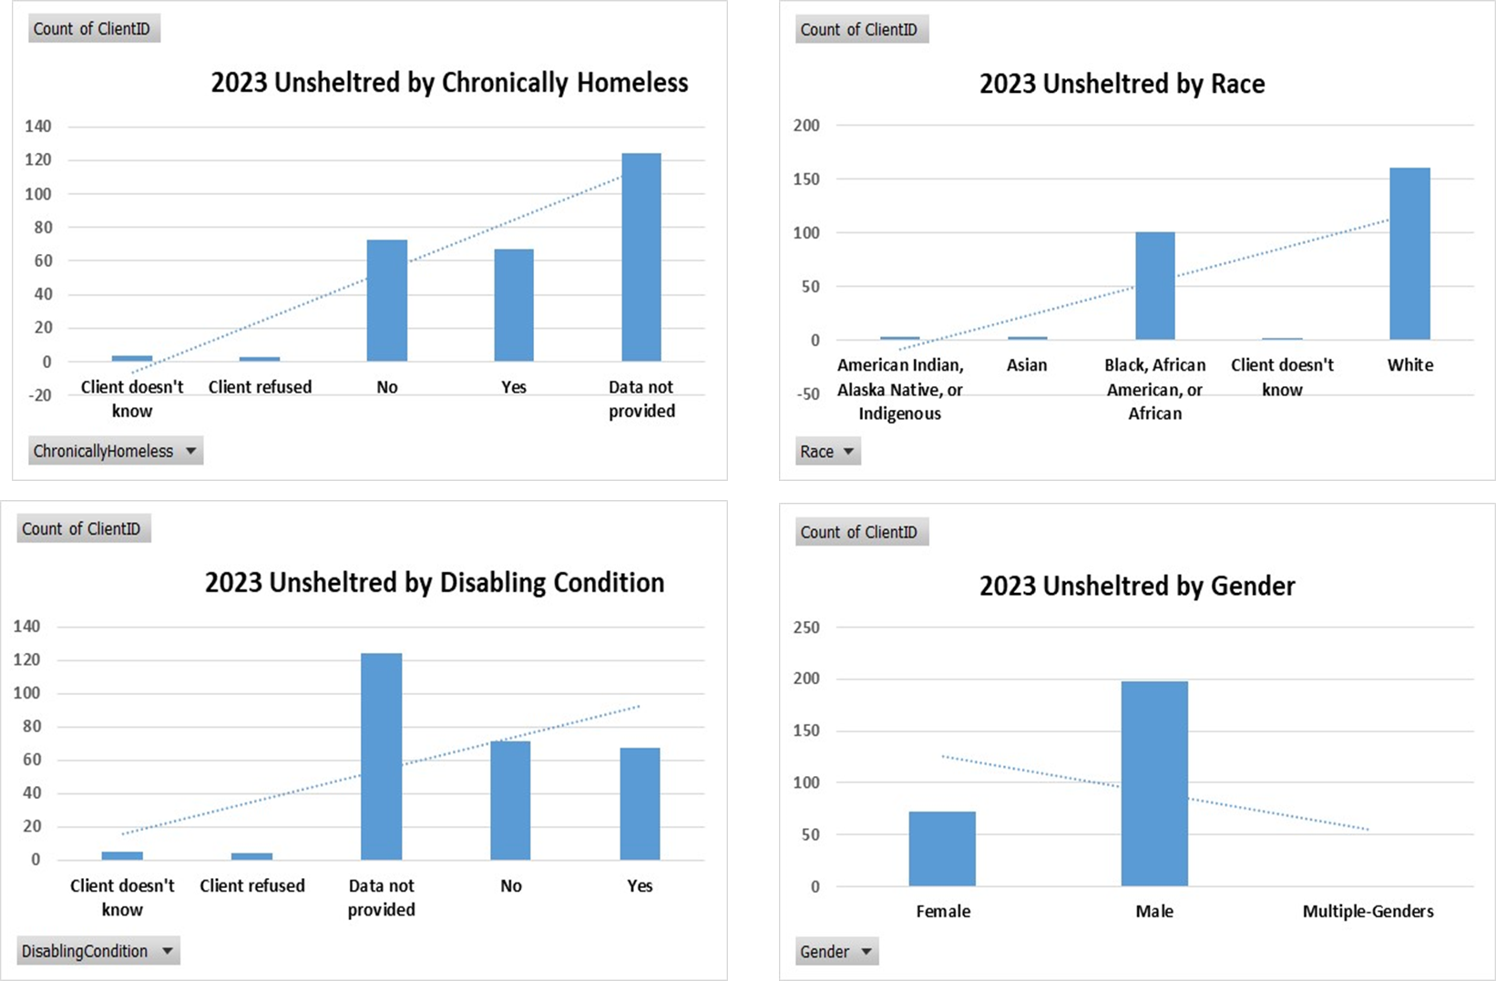
Chatham Savannah Point in Time Count 2023 UNSHELTERED unduplicated total 271

Slide 8
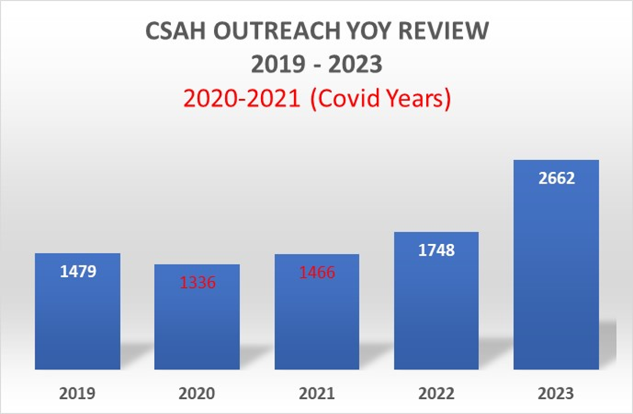
CSAH Street Outreach by the numbers (HMIS data)

Slide 9
“Change comes at the speed of TRUST.”
Our mission is to prepare unsheltered residents for shelter and housing opportunities by meeting basic human needs, while partnering with law enforcement to enhance public safety.
Our Social Work Street Outreach Teams
Build relationships and rapport: we learn the stories of our most guarded citizens.
Assess the needs of each unhoused individual
Arrange for provision of appropriate services and transportation when needed
Provide access to long distance travel to reunify unhoused people with family or friends in safe, stable housing.
Follow up to ensure service delivery
Track progress
Gather and compile data
Incorporate and collaborate with all homeless providers
During inclement weather, we strive to provide real-time resources, support and communications to our partner agencies and our unhoused citizens. We lead the coordination of additional services throughout Chatham/Savannah.
We work directly with our faith community leaders and local houses of worship to coordinate resources for our unhoused citizens.

Slide 10
Multi agency Street Outreach efforts reduced the number of encampments from 87 in 2023 to 51 in 2024
Our outreach approach is nonjudgmental conversation coupled with rapport and relationship building while engaging with citizens living in places not meant for human habitation. Trauma informed, de-escalation trained professional team members work to gain trust through consistent interactions with our unsheltered community members. Client information is tracked in our community data platform (Homeless Management Information System).
PATH Mental Health outreach staff partners directly with CCPD, SPD, BHU, BHCC, American Works and JC Lewis medical outreach.
Homeless Outreach Team (H.O.T.) partners directly with SPD, BHU, BHCC, American Works and JC Lewis medical outreach.
Unified Case Management Outreach- includes assisting with housing applications, various public benefit enrollments, coordination of mental health and health assessments in the field.
Inclement weather: coordination activities for our unsheltered citizens including direct communications for vital resources and transportation when needed.
Encampments: Offer services and linkages to vital resources prior to camp closure, provide coordination support and transportation for residents during the process; development of a camp closure policy for local government consideration.

Slide 11
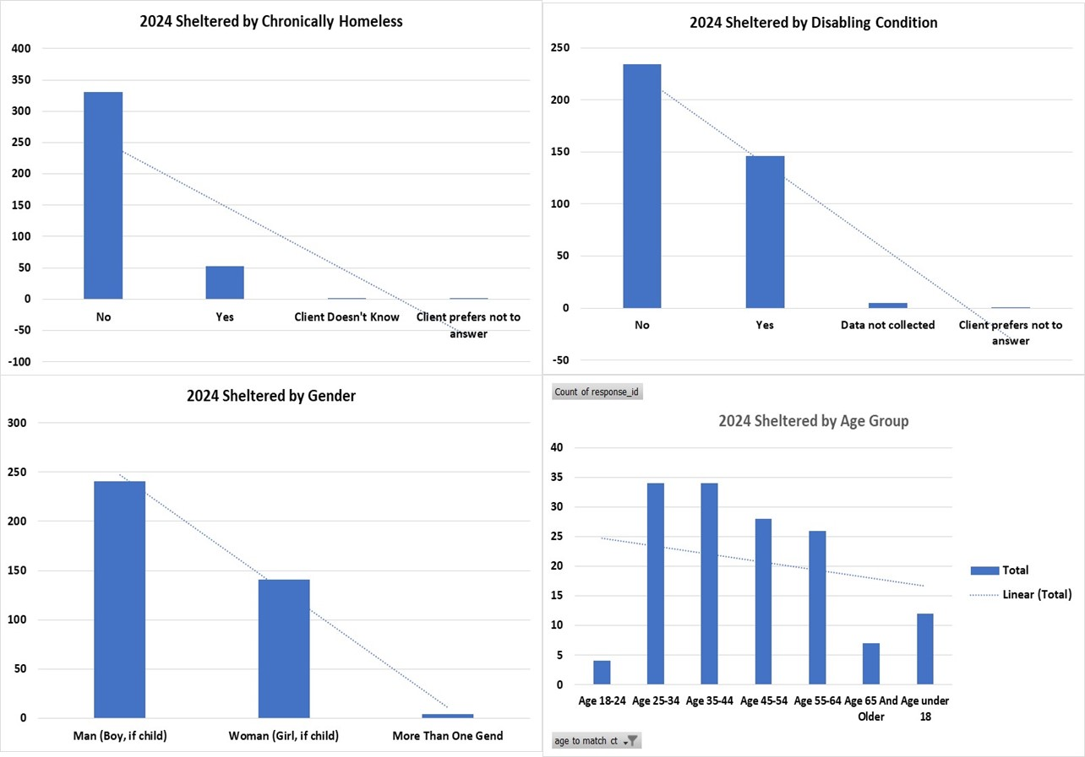
Chatham Savannah Point in Time Count 2024
SHELTERED unduplicated total
386

Slide 12
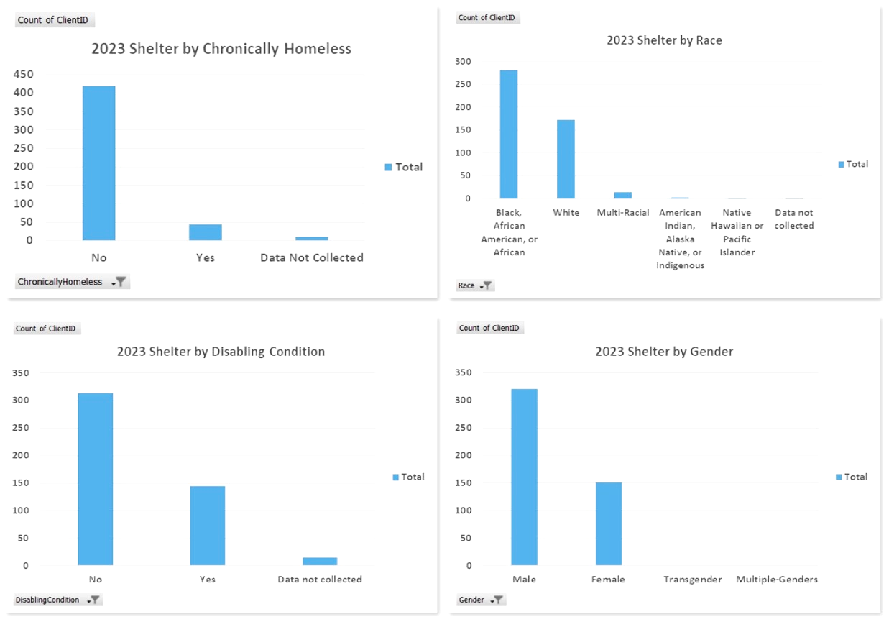
Chatham Savannah Point in Time Count 2023 SHELTERED unduplicated total 474

Slide 15
McKinney Vento Definition (Students)
The McKinney-Vento Act defines homeless children and youth as individuals who lack a fixed, regular, and adequate nighttime residence. This definition also includes Children and Youth who are sharing the housing of other persons due to loss of housing, economic hardship, or a similar reason. (Nov 29, 2022)

Slide 16
Mckinney Vento Student P.I.T 2024 Data
Chatham County School System reported 719 students registered in the Mckinney Vento program.
Of the 719 students, 129 were living in a hotel/motel.

Slide 17
Our Community Challenge.
EXITING HOMELESSNESS HAS BECOME MORE COMPLEX DUE TO INFLATION AND STAGNANT WAGES.
Savannah has a high percentage of people living in poverty (20%), stagnant wages and a critical shortage of affordable homes. Minimum wage in Georgia has been $7.25/hour since 2018. Inflation in 2022 was 14% across the board, with greater increases in both rent and fuel for vehicles. Everyone has been affected by the rising cost of living.
A SHORTAGE OF AFFORDABLE RENTALS CONTRIBUTES TO HOUSING INSTABILITY.
Low-income workers would have to work 186 hours per WEEK to afford the average two-bedroom rental of $1305/month. The waiting list for Section 8 housing vouchers has 6,000 names one it. This results in many people renting substandard housing for lack of affordable options. The Eviction Lab at Princeton University calculated that there are 28 evictions each DAY in Chatham County.
HOMELESSNESS IS ALSO A RACIAL EQUITY ISSUE.
Neighborhoods with more racial diversity continually experience higher rates of evictions and people of color are overrepresented in the homeless population. The demographics of people served in 2023: 72% Black, 20% White, 5% Multi-racial, 1% Native American. People of Hispanic/Latinx ethnicity comprised 2%.
FAMILIES WITH CHILDREN HAVE FEW OPTIONS WHEN FACED WITH HOMELESSNESS.
There are six shelter beds available for single adults for every one available shelter space for families with children. The Georgia state McKinney Vento Report for 2023 notes that 71% of families experiencing homelessness are “doubling up” with friends and relatives, rather than being out on the street or living in a shelter.
MOST PEOPLE EXPERIENCING HOMELESSNESS ARE GOING THROUGH A ROUGH PATCH.
Many people who received services in 2023 through the ICH/CoC are NOT “chronically” homeless. This means they are experiencing homelessness for the first time, and/or did not experience homelessness more than once in the past two years and do not have a diagnosed disability. Many of these households are considered A.L.I.C.E. Asset Limited Income Constrained Employed. More than 40% of the households in our region are ALICE.

Slide 18
Innovative community work currently under development
Chatham County Community Information Exchange (CIE) Data Integrations Model. CSAH as the HMIS CoC lead agency (Ga 507) will be the first in the country to successfully integrate HMIS (Homeless Management Information System )into a Community data platform.
HMIS Client Track ID Cards with barcode scanners currently being implemented throughout the CoC.
Familiar Faces: A case conferencing initiative for people with complex mental health and health needs in partnership with the Behavioral Health Unit, Gateway, Emergency Medical Services, CCPD, SPD, Chatham County Jail, Memorial Health, JC Lewis Health and Chatham Savannah Authority for the Homeless.
Homeless Court Initiative: removing barriers for justice involved people who are also experiencing homelessness.
Mobile shower facility : Chatham County BOC and Chatham Savannah Authority for the Homeless with support from City of Savannah.
Homeless Outreach Officers: Increasing the number of homeless outreach officers at both Savannah Police Department. and Chatham County Police Department coordinating efforts with CSAH outreach teams.
Ga Legal Services Vital documents and Records Restriction Project on site at CSAH open access center providing access to birth certificates and vital records
Social Security/Disability Legal Support Program with CSAH: pro-bono attorney, Don Ramsey.

