Slide 1


Coastal Georgia Regional Surface Water Supply Overview
March 13, 2025

Slide 2
Acronyms
WTP – Water Treatment Plant
I&D – Savannah Industrial & Domestic Surface WTP
MGD – Million Gallons Per Day
$M – $Million
GEFA – Georgia Environmental Finance Authority
O&M – Operations and Maintenance

Slide 3
Coastal Georgia Water Supply Needs
Projected ~6 MGD of near-term water demand for North Bryan County to be initially met with new groundwater wells
  Draft permit limited use to less than 25 years
  Revised permit limits use to less than 15 years
Forecasted growth over the next ~15 years necessitates a significant increase in surface water supply to the Savannah region
  Groundwater withdrawal permit reductions require additional surface water supply to meet both existing and future demands

Slide 4
Coastal Georgia Surface Water Supply Proposal
Increase surface water supply to Savannah region via the following:
2025-2030
  Enhancements to the existing Savannah I&D WTP to increase surface water supply by 8 – 10MGD to meet near term regional demands
  Construct a new Effingham County WTP with initial capacity of 12MGD
2030+
  Operate Effingham County WTP at 12MGD (expandable to 24MGD)
  Provide ~8MGD from increased Savannah I&D surface water supply for ongoing regional flex supply
  Reduced reliance on groundwater supply in the region

Slide 5
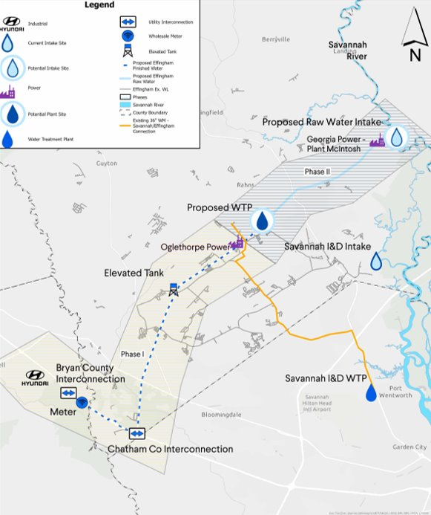
Project Area Map – Phases I & II
State Funded Plan – Phase I
Expand Savannah I&D Water Production and Pumping Capacities
Construct Effingham and Bryan County Transmission Facilities (Blue Dash)
Construct Elevated Water Towers
State Funded Plan – Phase II
Construct Effingham County Raw Water Intake & WTP
Construct Raw Water Transmission Facilities
Proposed Effingham WTP
Proposed
Proposed
Elevated Tank
Proposed
Elevated Tank

Slide 6
Project Area Map – Prior Planning
Original Plan: Savannah Funded Water Transmission Line (Red Dash)
Savannah to Construct 81,000 Linear Feet of 30 to 36-inch Water Transmission Main
Route: I&D Facility to West Chatham
Construct New Pumping Infrastructure & Facilities
Long Term Operation & Maintenance (O&M) of Future Large Transmission Main
Positive Financial Implications
Construction Savings = $125M (est)*
O&M Savings Annual Expense Reduction
Proposed Effingham WTP
Proposed
Proposed
Elevated Tank
Proposed
Elevated Tank

Slide 7
Project Area Map – Future Conditions
State Funded Plan: Future Benefits to the Savannah Water System & Customers
Water Supply to Effingham County via Existing Delivery Point (2002)
Reallocate Funds (~$125M) to Savannah Water System Improvements
Increase Water Supply to Existing Savannah Service Area (Blue Lines)
Water Supply Redundancy with Effingham County Water System
Proposed Effingham WTP
Proposed
Effingham Co Interconnection
Proposed
Elevated Tank
Proposed
Elevated Tank

Slide 8
State of Georgia Funding Breakdown
Total Amount of Allocated Funding = $501.7M
Funding Mechanism: GEFA Loans and State Direct Investment (SDI)
  $319.0M – Effingham County
    New Raw Water Intake
    Surface WTP Design and Construction
    Water Transmission Infrastructure
  $146.0M – City of Savannah (50/50)*
    Raw Water Pumping Upgrades to Meet Increased Demands
    Surface WTP (I&D) Upgrade & Expansion
    Water Transmission Pump Station Upgrades
    Two Water Towers
  $36.7M – Bryan County
    Water Transmission Infrastructure
    High Service Booster Station

Slide 9
Questions and Discussion

