Slide 1
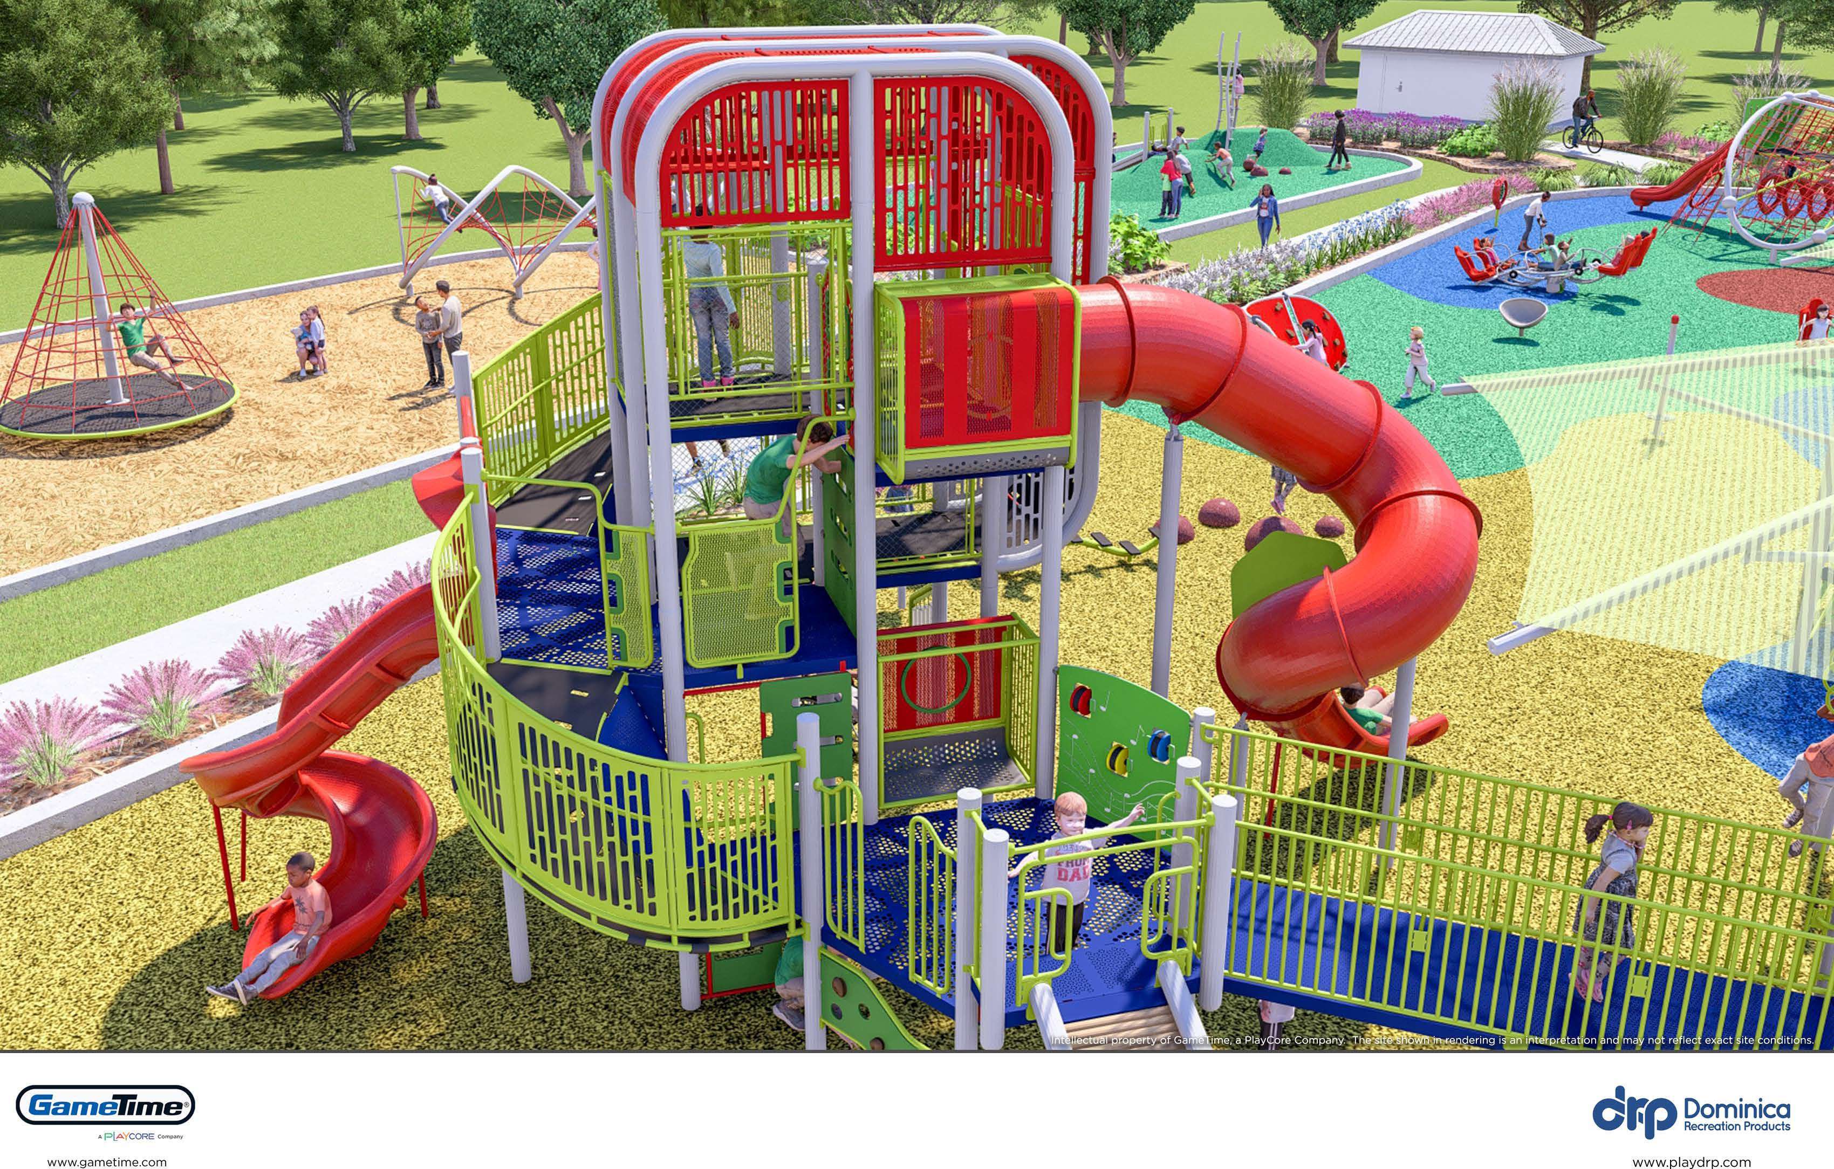
Daﬃn Park Signature Playground Concept
Signature: A distinguishing style
[The Free Dictionary]
City Council Workshop
November 26,2024

Slide 2
About CORE
Best Practice Research
Independent, Validated, Relevant
GameTime parent company, PlayCore, is committed to researching and advocating for play and recreation to create a healthier, happier society through their Center for Outreach, Research, and Education (CORE)
CORE comprises four distinct service areas to share scholarly, evidence-based research, build informed advocacy, and help empower communities with tools and data to create and measure great play, recreation, and outdoor spaces.
As a PlayCore company, GameTime leverages the deep knowledge of CORE’s Research Institute.
The Institute is comprised of leading experts, universities, and research centers who work with PlayCore.
The research also helps drive our product development and play space design.
Source: gametime.com

Slide 3
Inclusive Playground Design
Inclusive playgrounds value meaningful play experiences for people of all ages and abilities.
The 7 Principles of Inclusive Playground Design® is a comprehensive design guide for creating inclusive play spaces. It was created by researchers, architects, and play experts at Utah State University Center for Persons with Disabilities in partnership with PlayCore.
Be Fair | 2. Be Included | 3. Be Smart | 4. Be Independent | 5. Be Safe | 6. Be Active | 7. Be Comfortable
Create Equitable Opportunities Physical Cognitive Communication Social/ Emotional Sensory | Access Flexibility Ramps Climbers Links Transfer platform | Simple & Intuitive Design Behavioral clues Sensory feedback Well organized Reinforce play patterns Set clear expectations | Individual Exploration Accessible surfaces Accessible routes of travel Slide transfers | Safety Standards & Comfort Comfortable supervision areas Clear visibility Cozy spots Jump-in points | Accommodate Diverse Needs Sustained physical activity Cooperation Socialization | Space for Movement & Gathering Comfortable for diverse sensory needs Comfortable approach and reach Environmental relief
Source: gametime.com

Slide 4
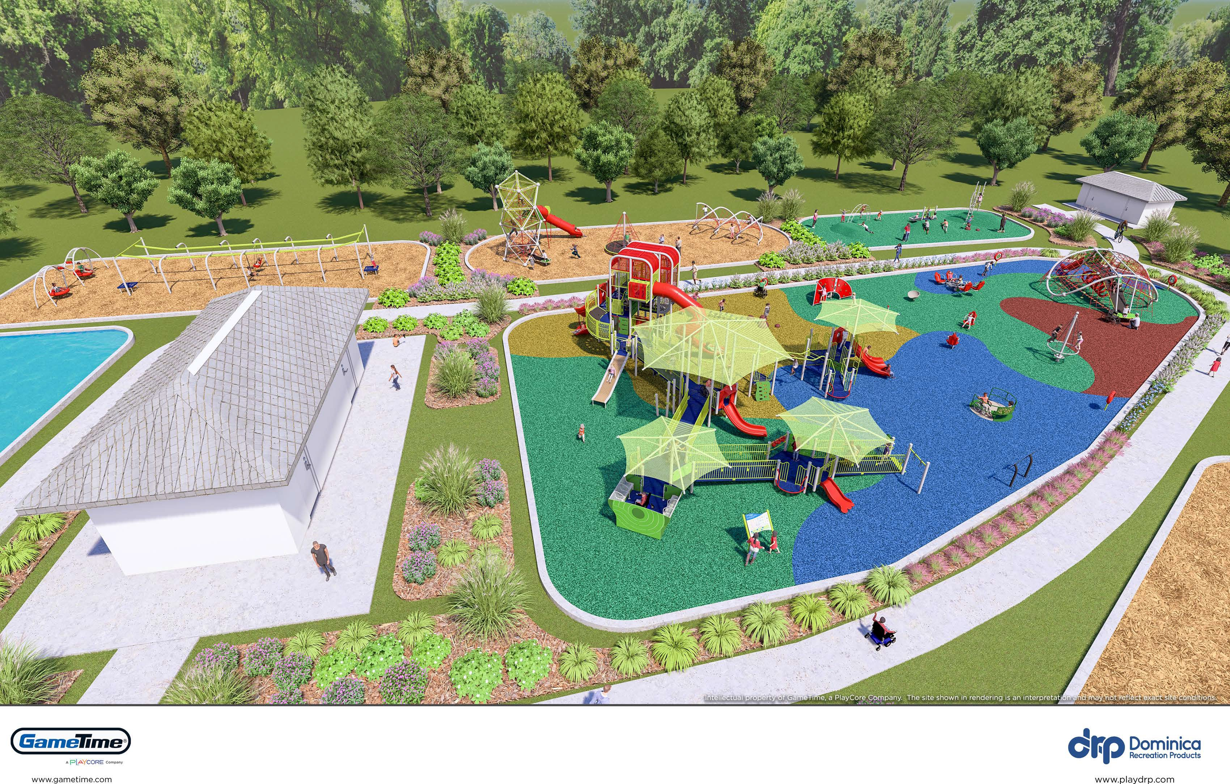
Daffin Park Signature Playground is the city’s first
large-scale, multi-play zone, inclusive playground of its kind.
TWIST-N-TURN ZONE
BUMP-N-JUMP ZONE
SLIDE-N-GLIDE ZONE
Shed
SPLISH-N-SPLASH ZONE
MEGA ZONE
STORYTIME ZONE
Restrooms
Building will be smaller
in size to allow for
picnic tables and umbrellas
SWINGS-N-THINGS ZONE

Slide 5
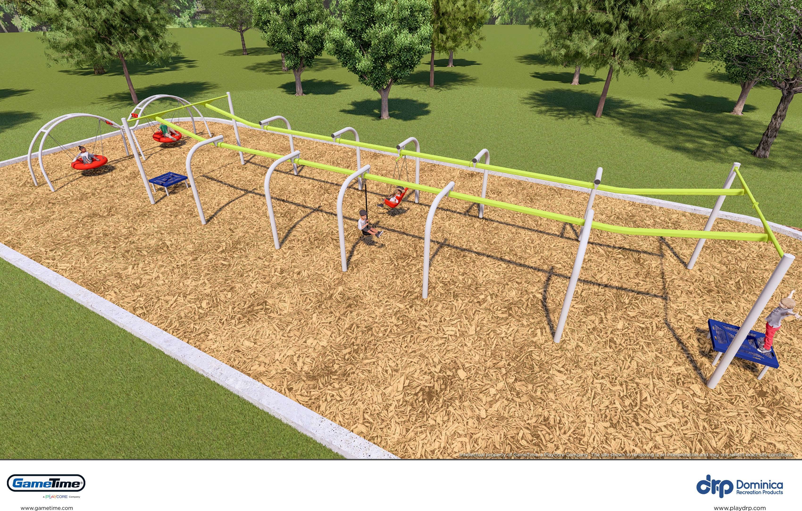
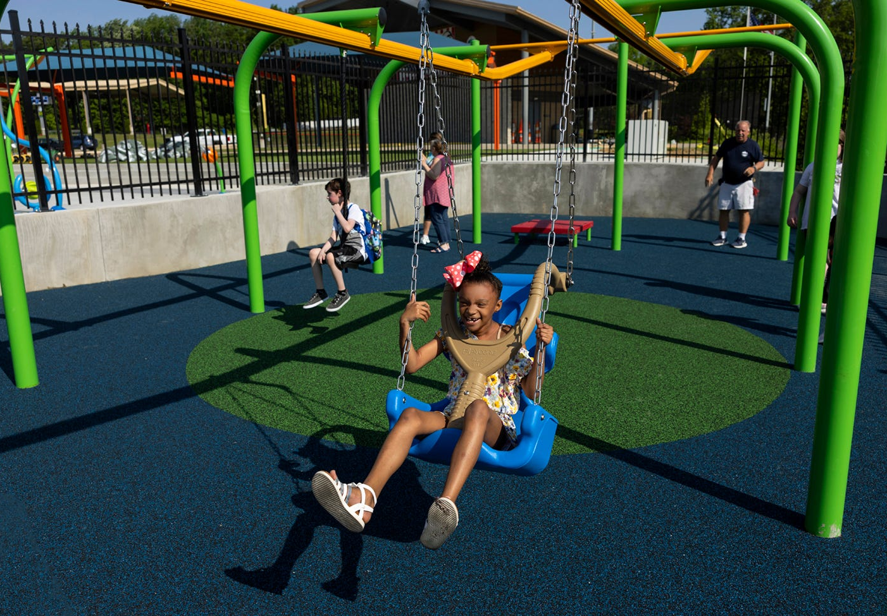
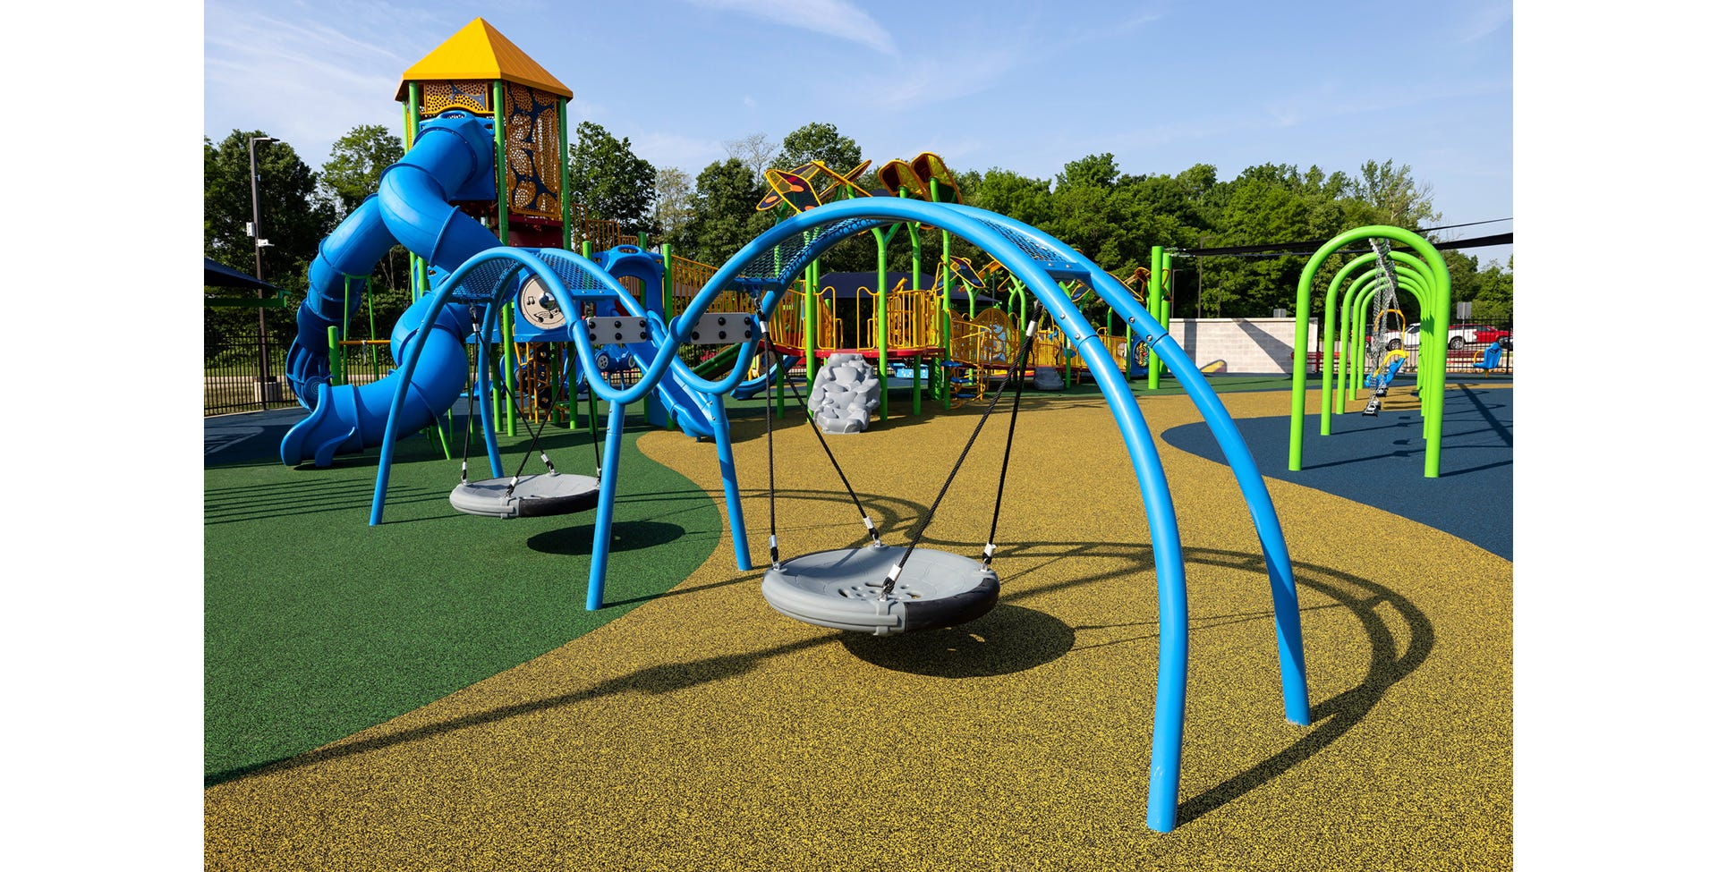
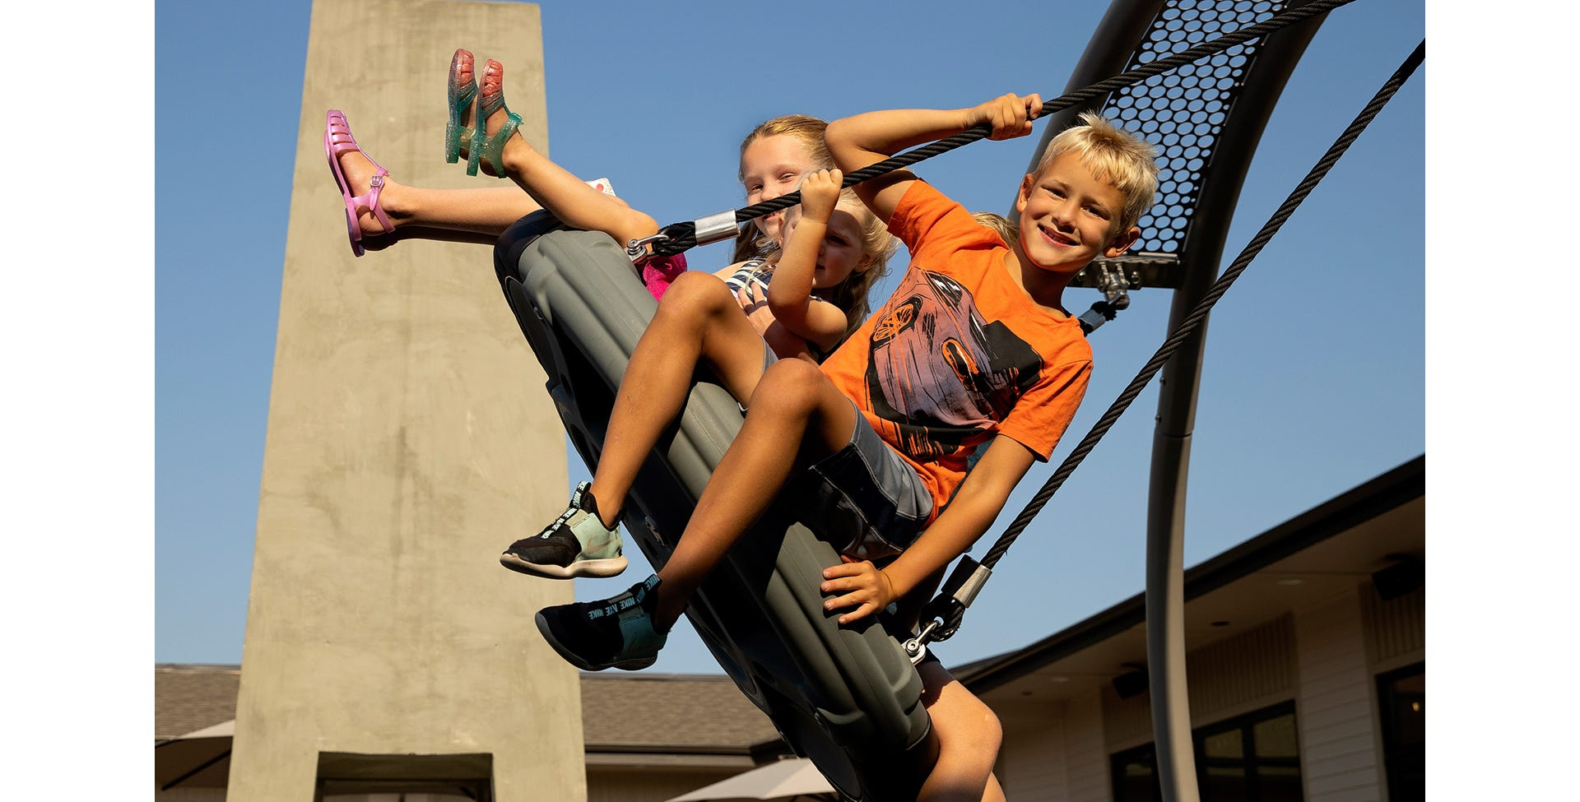
Slide-n-Glide Zone
Features:
Double arch saucer swings that accommodate multiple riders
Dual ziplines with seating that accommodates independent and assisted riders

Slide 6
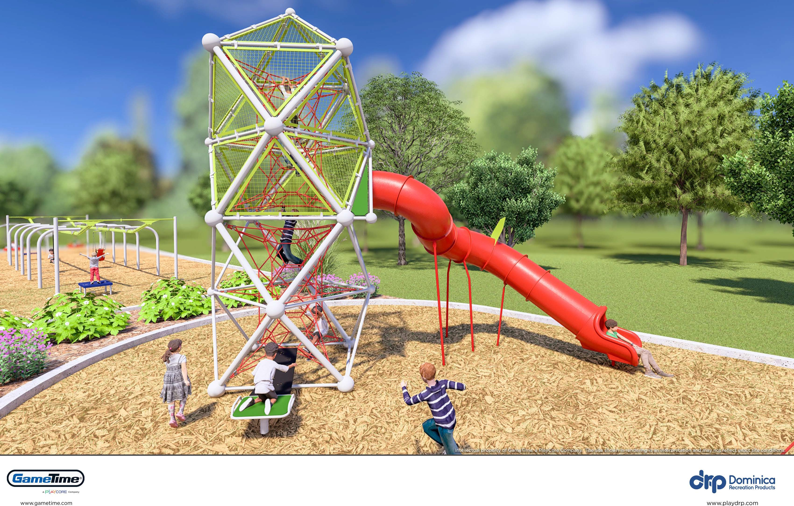
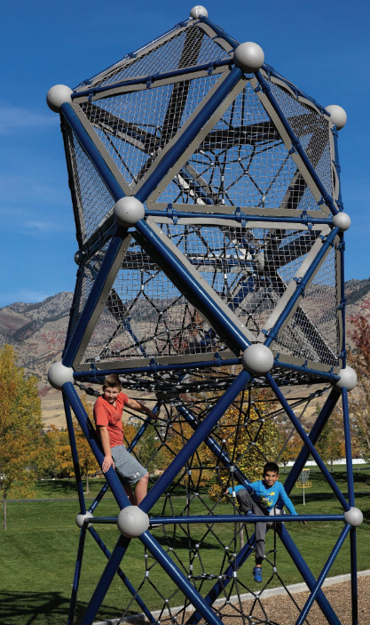
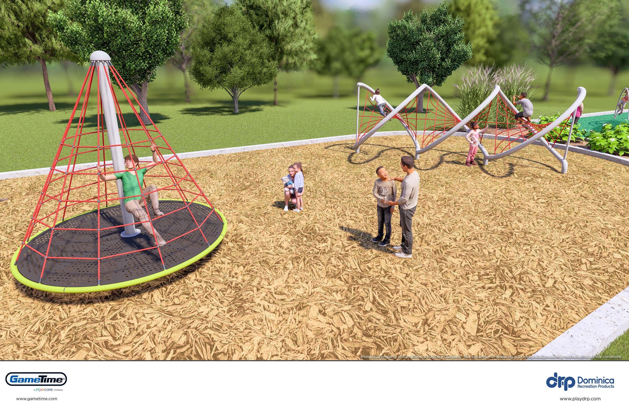
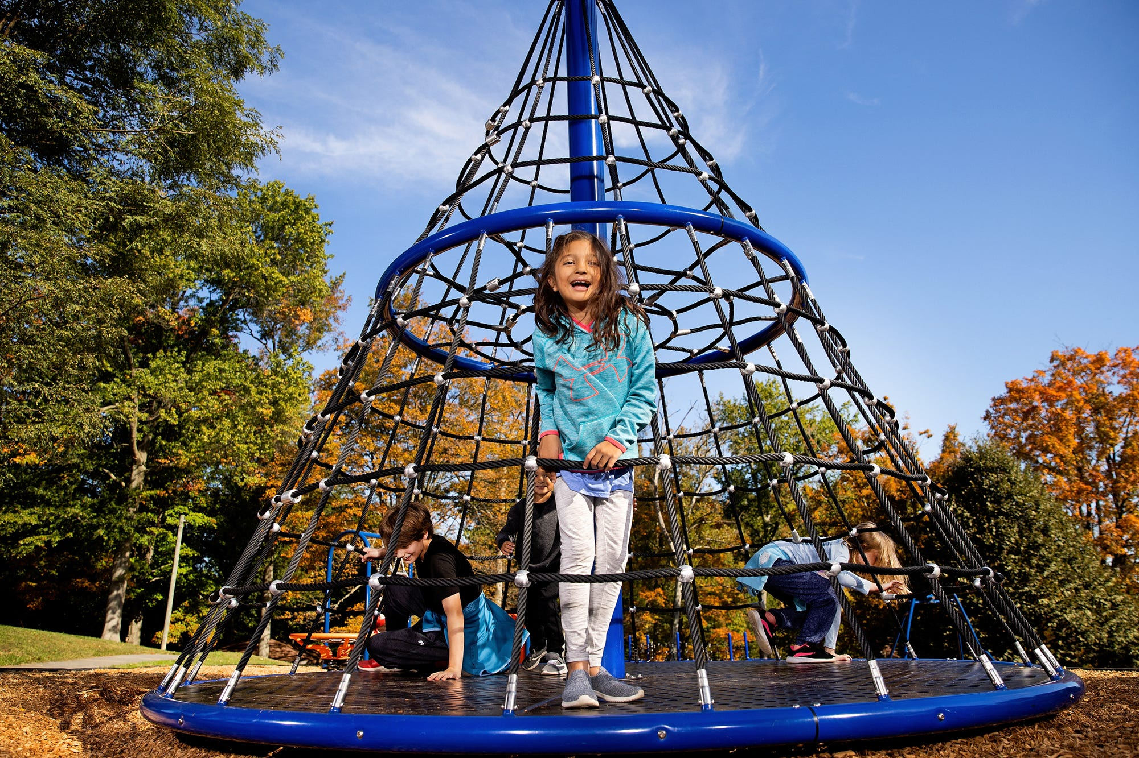
Twist-n-Turn Zone
Features:
VistaRope twist tower with tube slide, combination spinner/climber, and rope racer

Slide 7
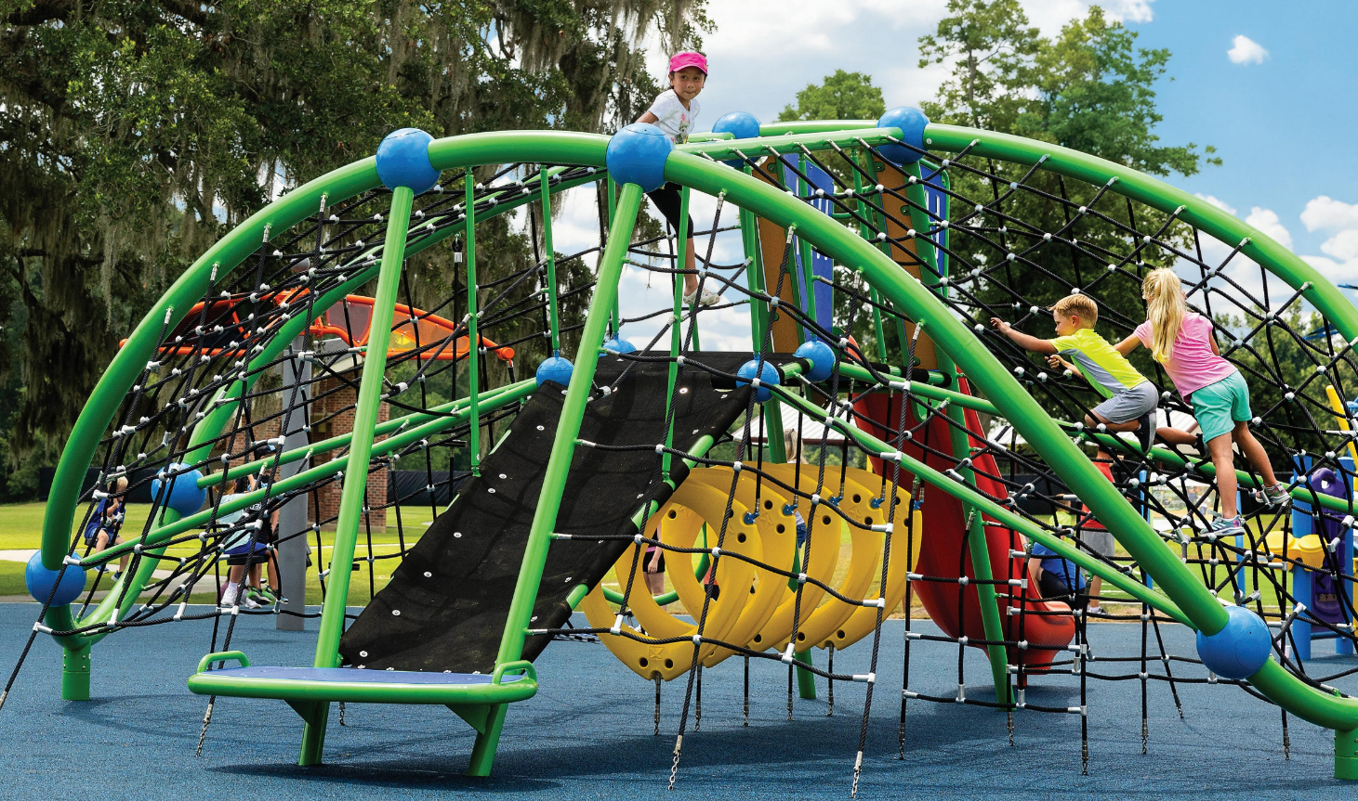
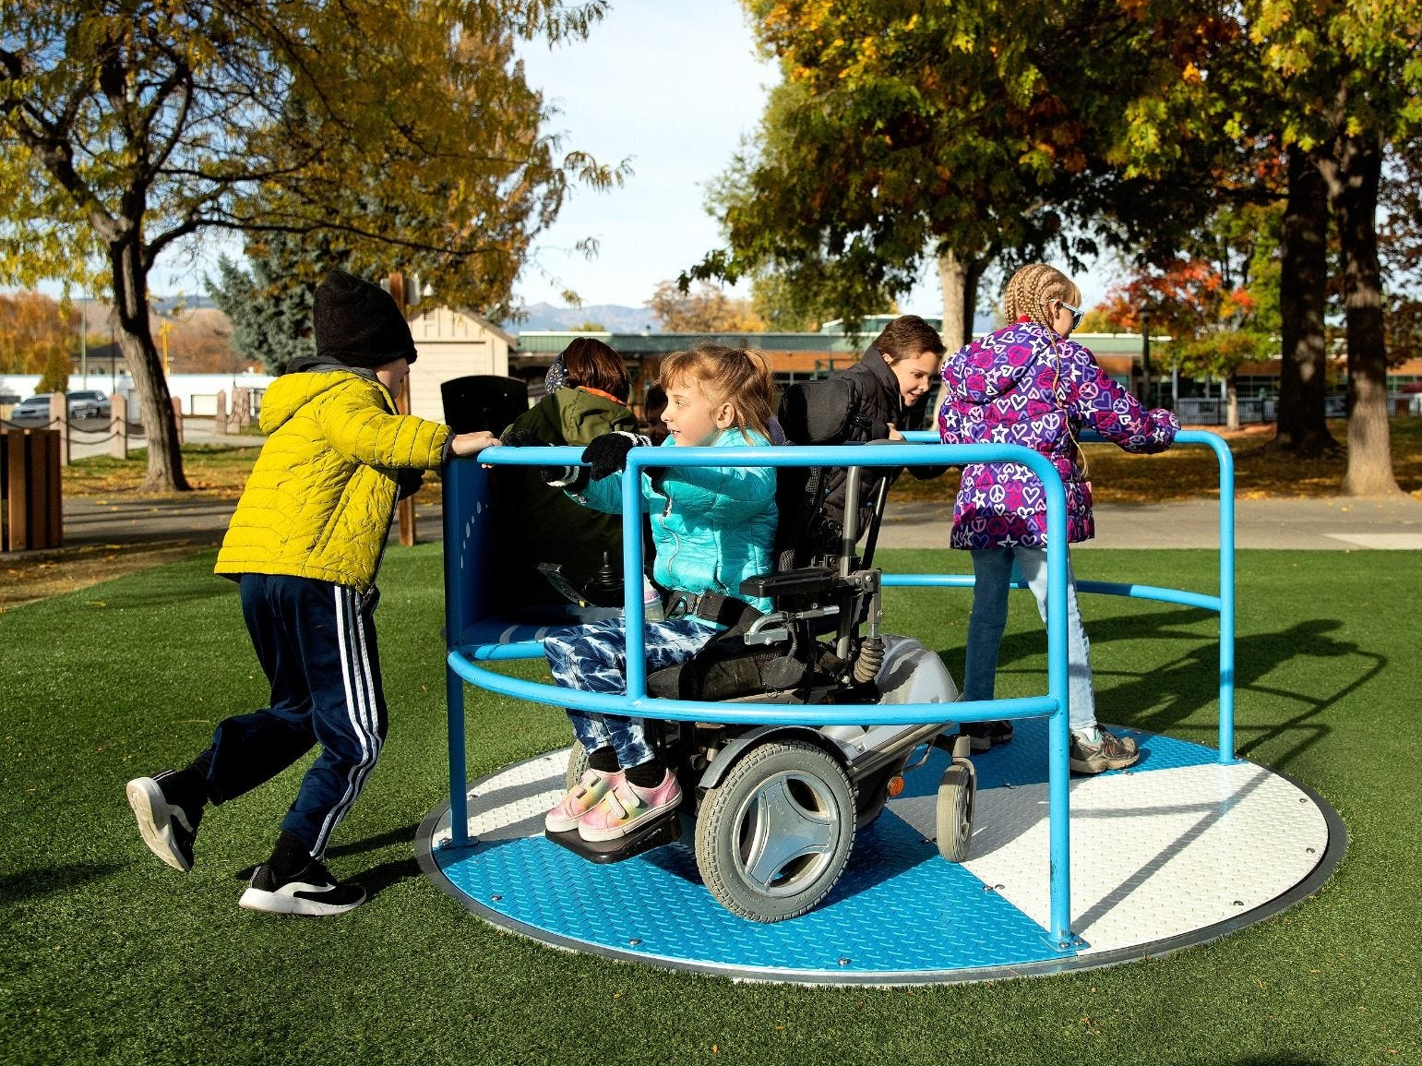
MEGA ZONE
Features:
Two large, inclusive climbing units with multiple activity stations and slides, inground whirl, seesaw, rockers, climbing wall, shade cover, poured-in-place surfacing and more!

Slide 8
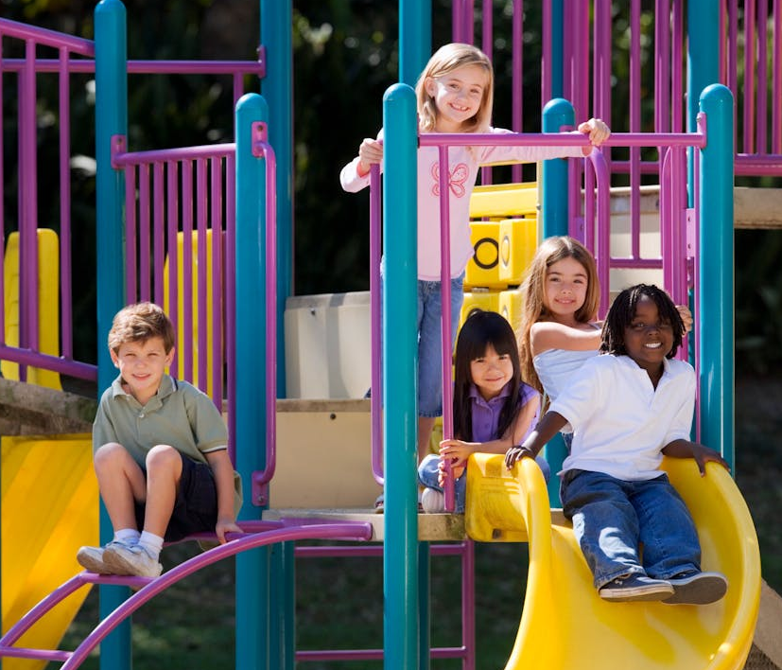
Play areas for age 6 months to 12 years
Adaptive swing seats including multi-generational dual swings
Fully ADA compliant surfacing
Quiet Time, Storytelling Zone
Tactile and visual experiences for kids
Integrated musical components
Splashpad
Fully fenced play area with gated entry
Picnic tables, walkways and seating throughout
Public restrooms with adult changing tables
OTHER KEY
PLAYGROUND FEATURES
Anticipated Completion: Fall, 2025

