Slide 1
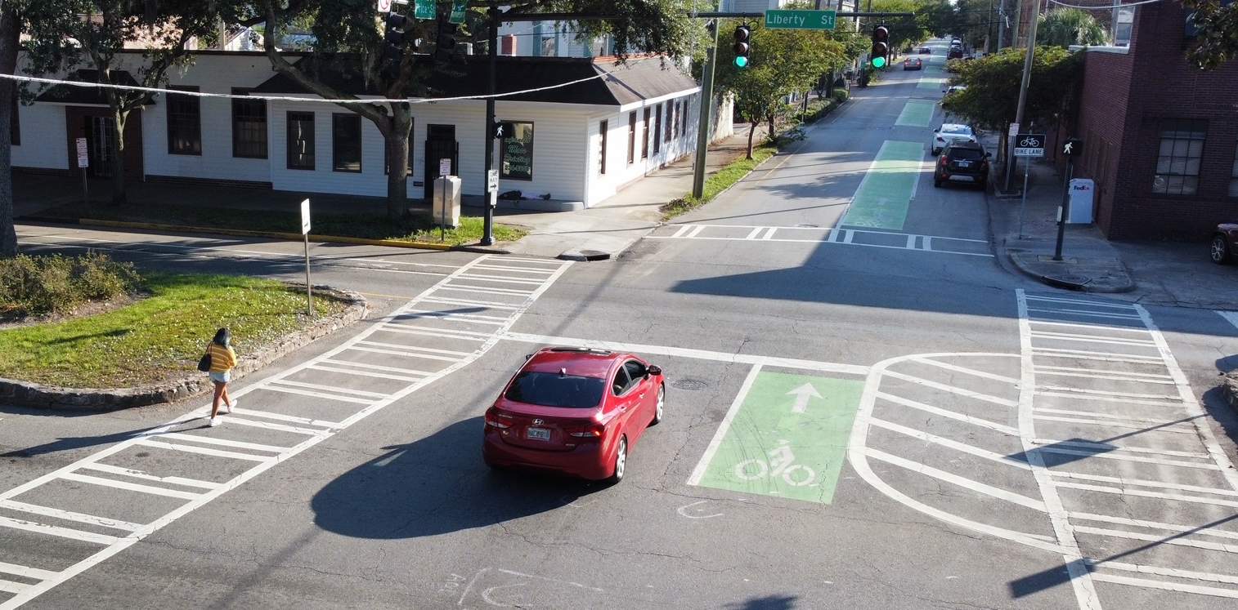
Safe Streets for All
aka Vision Zero
City of Savannah / Office of Infrastructure & Development / Transportation Services

Slide 2
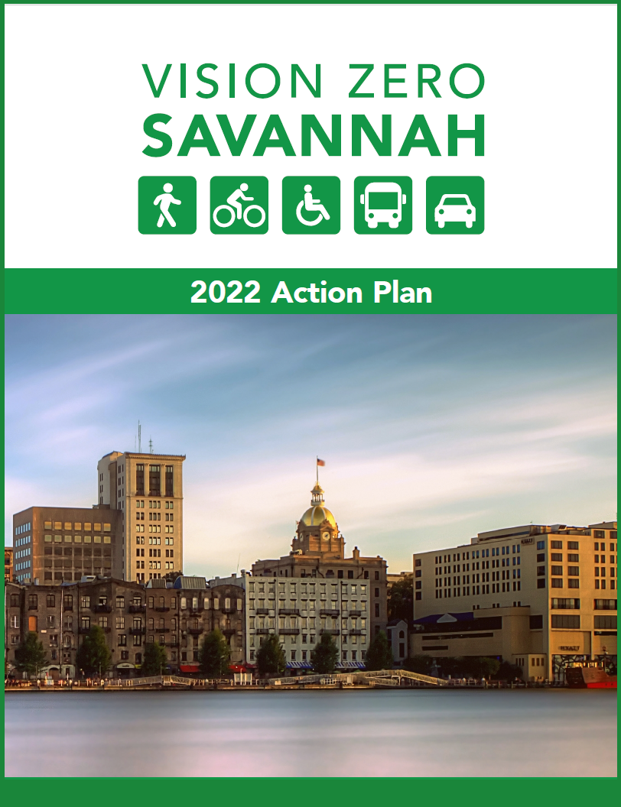
Vision Zero Resolution & Action Plan
Council approved Vision Zero Resolution on February 24, 2022
Vision Zero is the City’s strategy to eliminate fatalities and severe injuries, while increasing safety, mobility, and equity for all road users.
A Vision Zero Action Plan was developed over the summer and recently finalized but will remain a “living” document.
Vision Zero priorities include:
Building and sustaining leadership, collaboration, and accountability among a diverse group of stakeholders to advance traffic safety.
Continuous data collection and analysis to identify safety concerns and opportunities for improvement.
Prioritizing actions that provide a safe and equitable transportation system for all users.
Leading with roadway design that prioritizes safety.
Promoting robust community engagement to ensure transparency.
City of Savannah / Office of Infrastructure & Development / Transportation Services

Slide 3
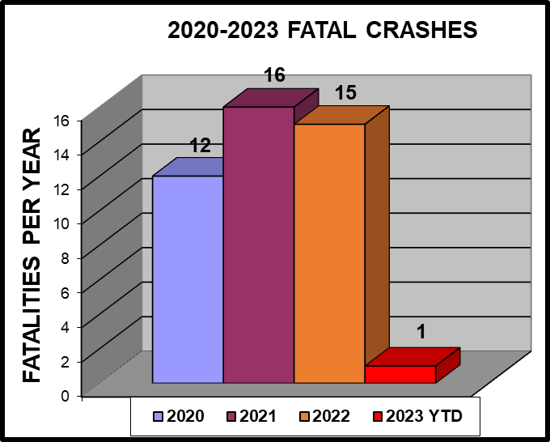
Savannah Fatalities – All Streets
Unvetted crash data is available to the public via the Georgia Department of Transportation’s Numetric program. Information is pulled directly from reports submitted by law enforcement agencies. GDOT does not review or vet the reports for accuracy, and errors are common.
Correct crash data is critical for making decisions and recommendations for engineering improvements. To that end, Transportation Services staff has vetted the 2020 – 2022 fatality reports submitted to GDOT.

Slide 4
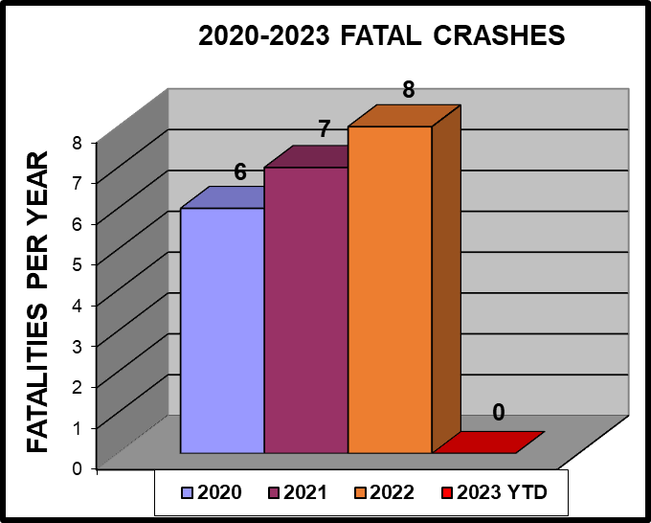
Savannah Fatalities – City Streets
Some of the reasons for fatalities being removed from the final working data set include:
Occurred outside of the City of Savannah
Occurred on private property
Driver had a medical condition and expired prior to the collision
Error in reporting a crash as fatal when it was not.
One-third of fatalities on City streets were DUI related.

Slide 5
Evaluation
Evaluate data to identify locations in need of safety enhancements.
Enforcement
Enforce traffic laws and continue to support safety initiatives.
Equity
Ensure that safety resources are committed to the most vulnerable neighborhoods & road users.
Engagement
Promote a culture change that prioritizes safety by educating all road users.
Emergency Response
Promote emergency response approaches to reduce the severity of collision injuries.
Engineering
Design & construct improvements to enhance roadway safety and accessibility.
Our Approach: THE 6 Es
City of Savannah / Office of Infrastructure & Development / Transportation Services

Slide 6
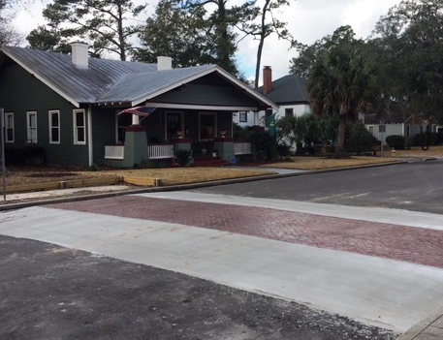
The City’s Transportation Department has and continues to be focused on safety for all road users. Ongoing, data-driven safety programming includes:
What is being done
Top 20 Crash Location investigation and safety improvement implementation.
Bicycle lane installation and upgrades.
Implementation of the City’s Traffic Calming Program, including plan development and construction of neighborhood approved traffic calming measures.
City of Savannah / Office of Infrastructure & Development / Transportation Services

Slide 7
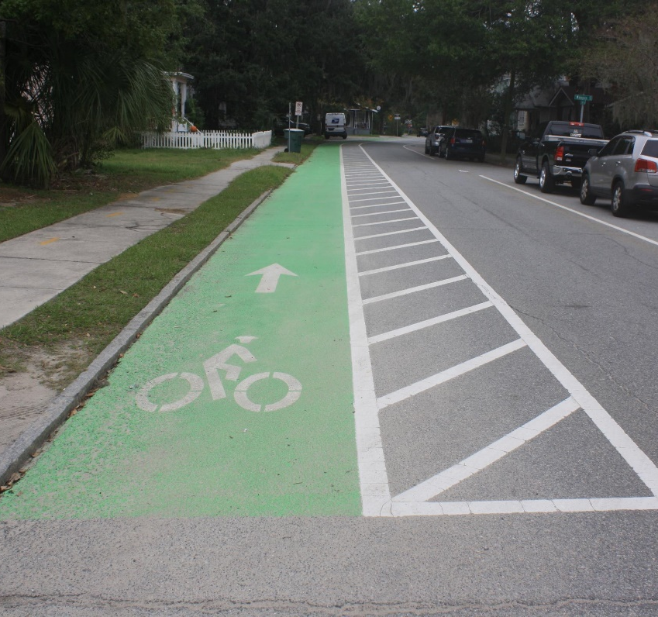
New FTEs in 2023 will provide direct support to Vision Zero initiatives
Help is on the Way
The recently approved Vision Zero Coordinator and GIS Analyst positions will provide needed support for not only updating the action plan but will assist with annual activities, including the following:
Annual development of Top 20 Crash Locations
Review and target high crash locations for in-depth analysis and develop plans for implementation of available engineering solutions to address safety and operational improvements
Update and maintain Savannah’s High Injury Network Map
Updating the City Radar Permit to lower speed limits on local/residential streets
City of Savannah / Office of Infrastructure & Development / Transportation Services

Slide 8
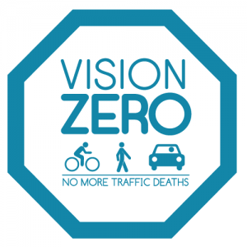
Purpose The Vision Zero Task Force will provide input and help advance key VZ strategies, policies, and recommendations. Primary Responsibilities
Vision Zero Task Force
Identify multi-year strategies and benchmarks for reducing crashes and getting to zero
Make recommendations for policies, outreach and education, design improvements and enforcement strategies
Evaluate data and best practices
Identify resources and partnerships
Update Vision Zero Action Plan
Members The Task Force will bring together key City Officials and community members, ensuring representation from multiple disciplines and sectors, including Transportation, Law Enforcement, Health, Education, and many more.
City of Savannah / Office of Infrastructure & Development / Transportation Services

Slide 9
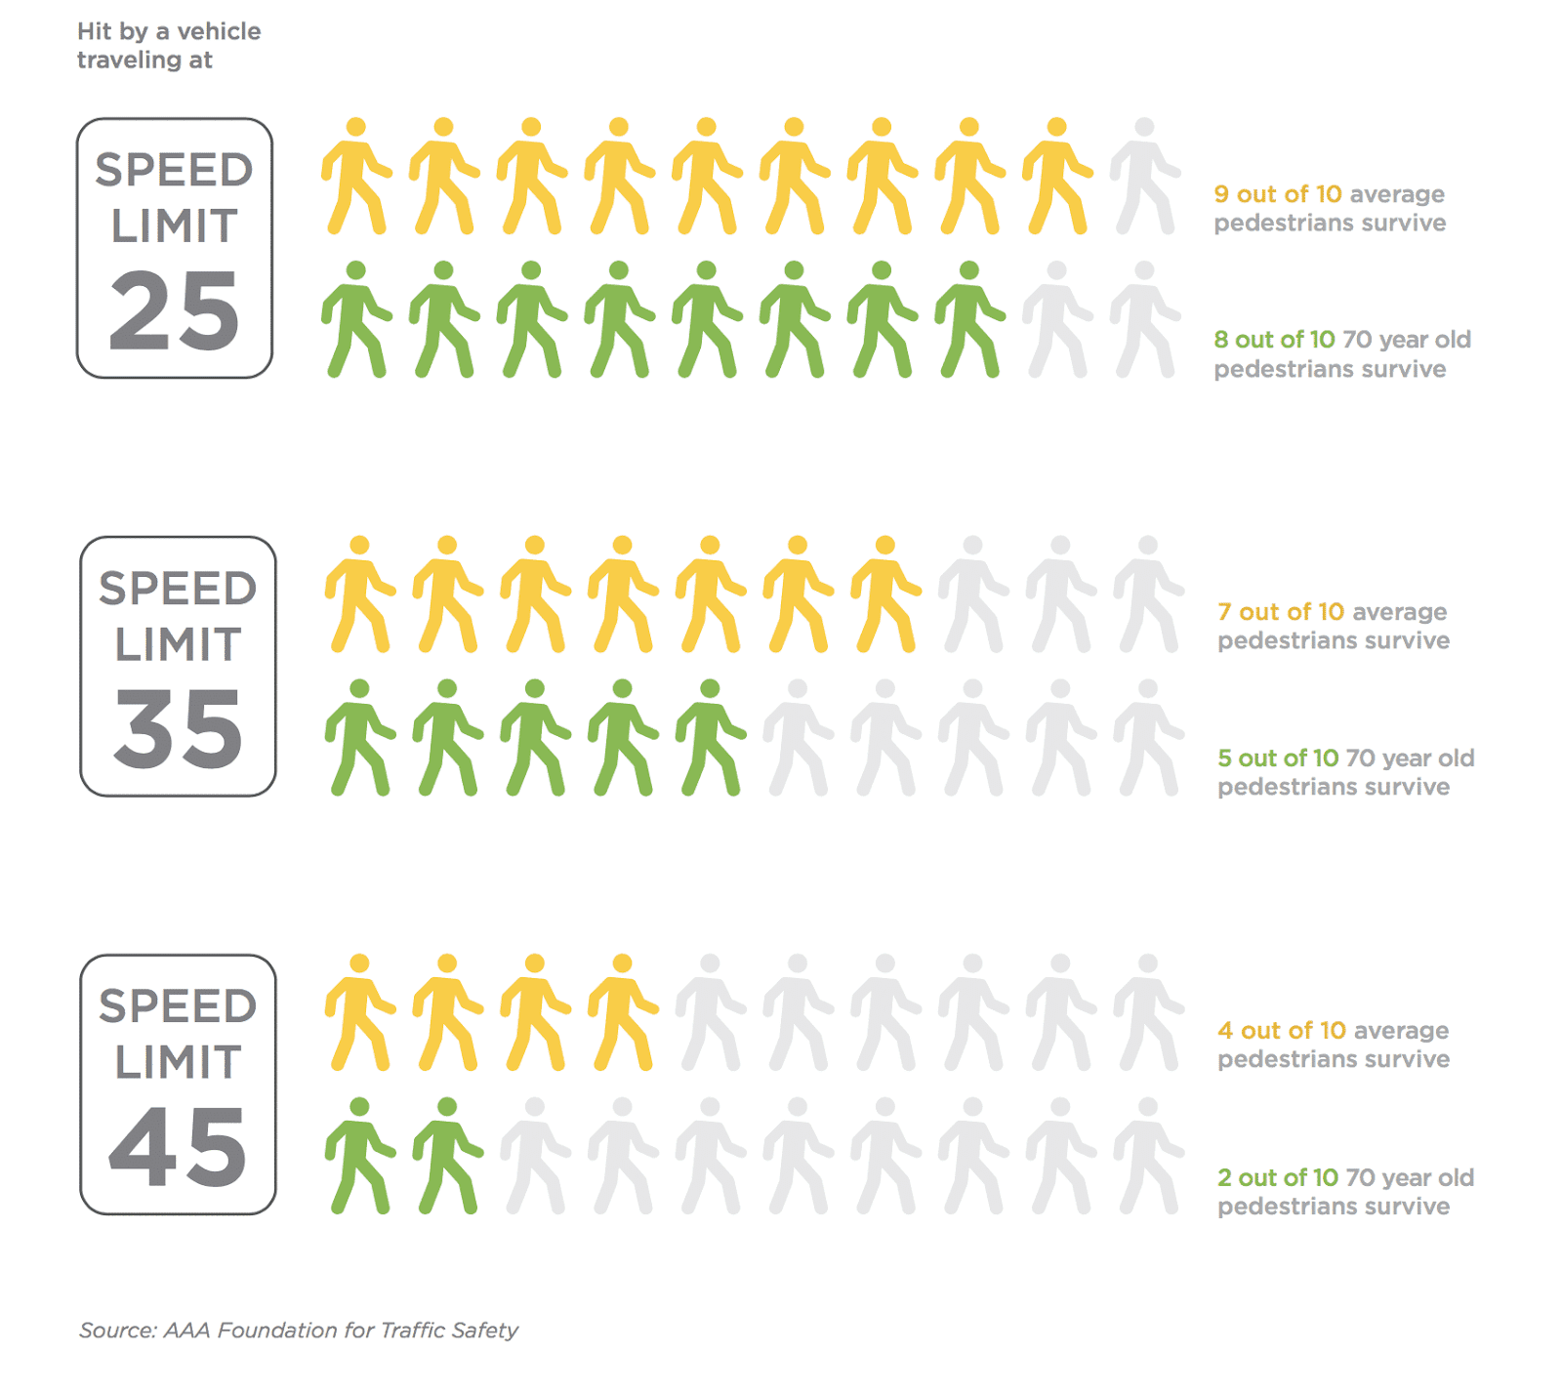
To address resident concerns and as part of its Vision Zero initiative, Savannah’s Transportation Services Department is reducing speed limits on neighborhood streets to 25 miles per hour. The speed reduction program aligns with the City’s Vision Zero strategy to create safe streets for all users while improving street safety measures and managing speed. Importance of reducing speed limits At lower speeds, drivers have a wider field of view and are more likely to notice other road users, including pedestrians and bicyclists. This is especially important in neighborhoods where more people are walking, biking, scootering, or playing.
We're slowing things down
City of Savannah / Office of Infrastructure & Development / Transportation Services

Slide 10
City of Savannah / Office of Infrastructure & Development / Transportation Services

Slide 11
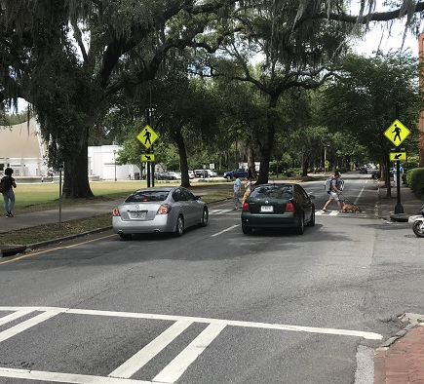
N E X T S T E P S
The following initiatives need to be carried out by the Mayor and Aldermen of Savannah, City Manager’s Office, and City staff to establish best practices, and plan and design for people of all ages, abilities, and backgrounds to create safer streets:
Institutionalize Vision Zero throughout the City of Savannah’s governmental operations.
Work with leaders to coordinate safety activities with fair and equitable enforcement.
Further develop speed management program with a focus on High Injury Network City streets.
Evaluate Traffic Calming efforts.
Promote transportation safety and mobility.
Evaluate Vision Zero efforts.
City of Savannah / Office of Infrastructure & Development / Transportation Services

Slide 12
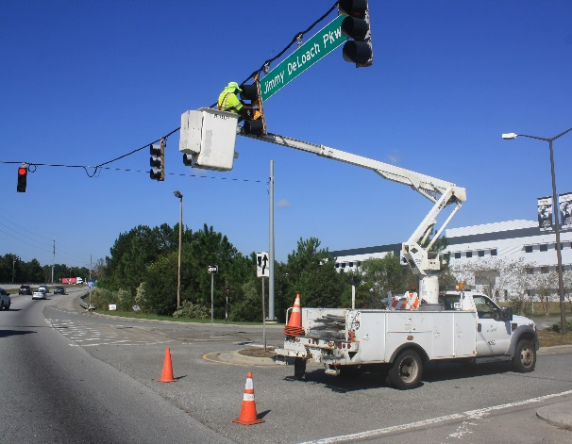
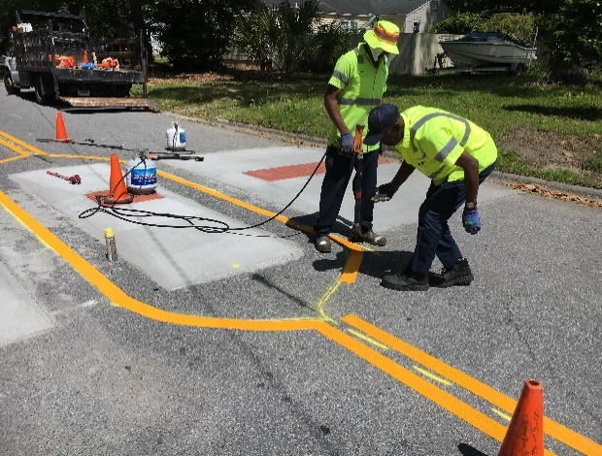
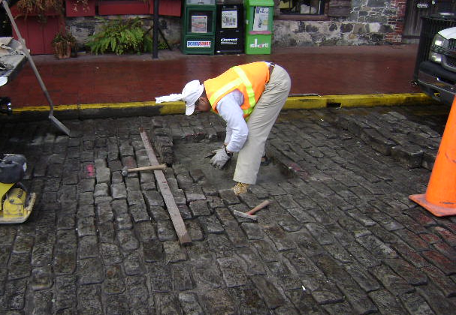
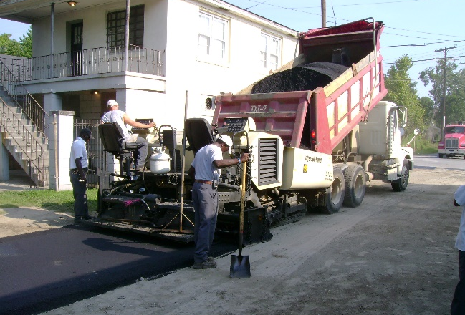
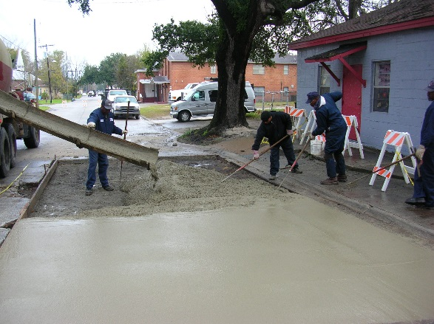
LEGISLATIVE AND BUDGET CONSIDERATIONS
The following actions should be considered to modify or introduce laws, policies, and budget resources to support Vision Zero initiatives and strengthen the City’s safety efforts and programs.
Establish and support policies, regulations, or laws that support a Safe Systems approach and increase the safety culture.
Identify fiscal opportunities and establish budgetary support for an ongoing and sustainable Vision Zero program.
Identify partnership opportunities and establish budgetary support for Vision Zero programs that support the design of transportation systems that are safe for all users.
Promote a culture of safety across City.
Implement safety treatments on the High Injury Network
City of Savannah / Office of Infrastructure & Development / Transportation Services

