Slide 1
City of Savannah Roadbotics

Slide 2
The Challenge…In 2018
Previously the City of Savannah recruited, trained and managed interns to assess our roads.
Time - Six interns assessed one-third of the city’s roads each year. It took the city three years to complete one road condition assessment.
Subjectivity- Because of the complexity of the task, interns rated the roads differently regardless of the training that was provided. Moreover, despite their best efforts, using 18 different interns to assess roads over three years led to highly subjective assessments.
Cost - The necessary intern approach included recruitment, training, providing equipment, supervision, and compensation: a total cost of approximately $130,000 over three years.
Savannah’s use of interns to assess their entire road network was the best option at the time, when weighing up their approach against other expensive alternatives. This was an inefficient process which was expensive, highly subjective and time intensive.
City of Savannah / Office of Infrastructure & Development / Transportation

Slide 3
Automation and Artificial Intelligence (AI)
RoadBotics by Michelin’s using smartphones, AI-based condition assessment of the collected data and delivery of the final assessment on
RoadWay – RoadBotics by Michelin’s GIS data visualization platform

Slide 4
The Solution…Roadbotics by Michelin
Time - 700+ miles in approximately 6 months
The city’s roads were evaluated in two phases - the first 350 miles were completed in under three months in 2018. The second half of the project was completed in early 2019 again for under three months.
Subjectivity- Removes all subjectivity
RoadBotics by Michelin’s pavement assessment is an automated process that uses A.I. algorithms to determine the condition rating of the road. These algorithms are trained from RoadBotics by Michelin’s global library of pavement distresses which allows the A.I. to evaluate roads anywhere in the world from a universal perspective. Most importantly, the automated process removes all the subjectivity that comes with visual inspections.
Cost – $50,000
RoadBotics by Michelin provided a comprehensive assessment of Savannah’s entire 700-mile road network for a price of $50,000. The City saved over $80,000.
City of Savannah / Office of Infrastructure & Development / Transportation

Slide 5
Roadbotics Video

Slide 6
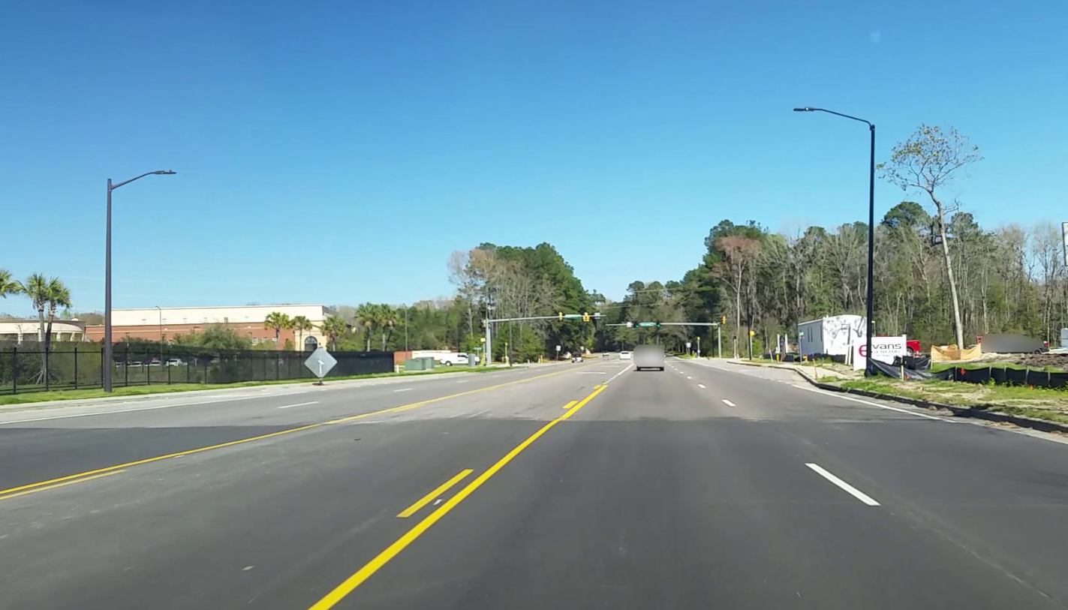
Road Network Score
So how were we doing in 2018?
City of Savannah / Office of Infrastructure & Development /Transportation
Notes:
Chatham Parkway

Slide 7
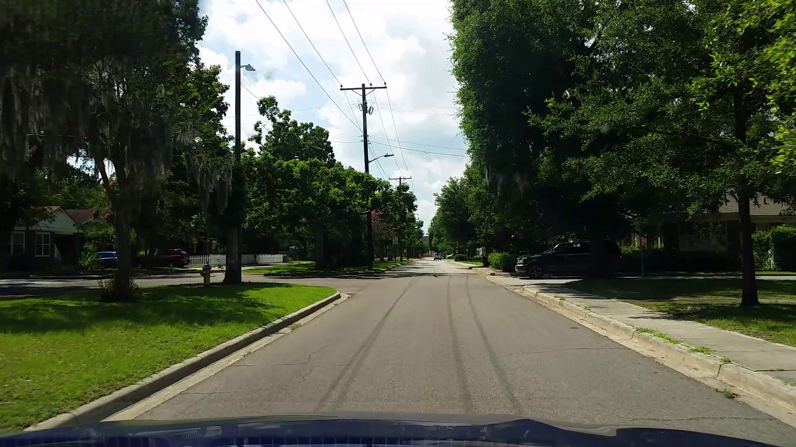
Notes:
Kinzie Avenue (3rd District)

Slide 8
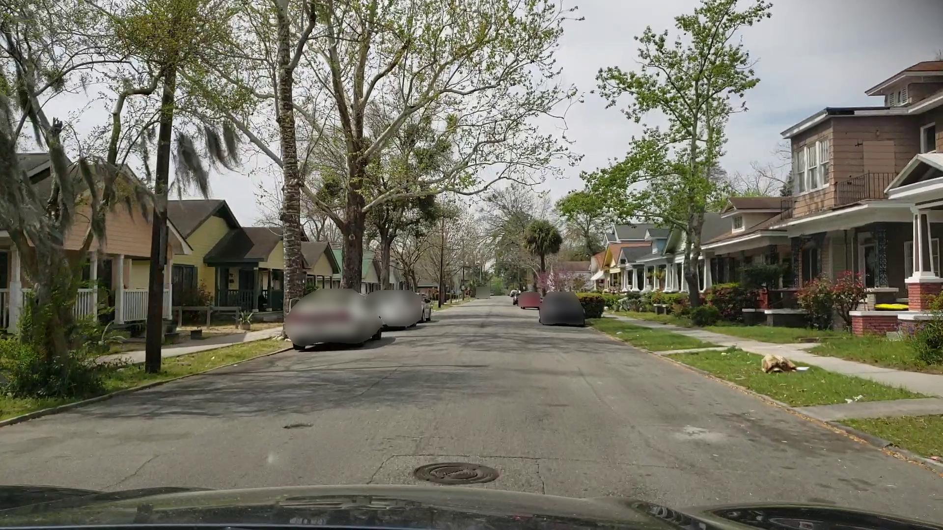
Notes:
West 40th Street

Slide 9
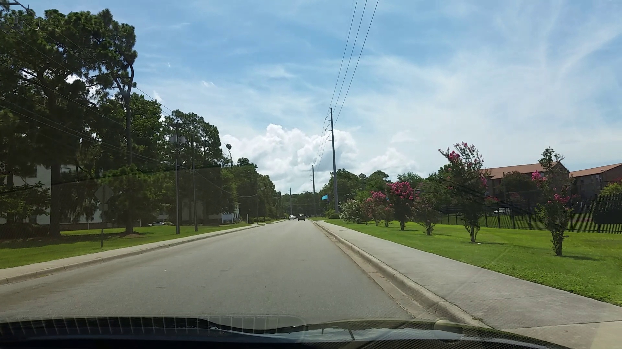
Notes:
Shawnee Street

