Slide 1
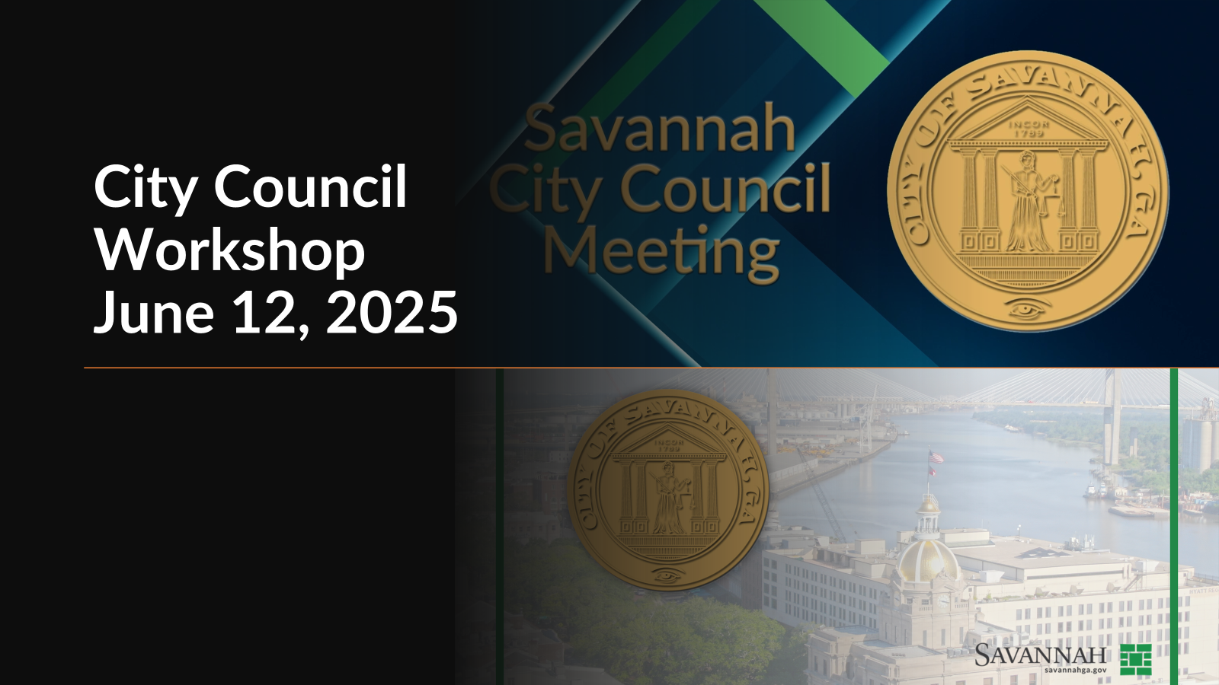

Slide 2

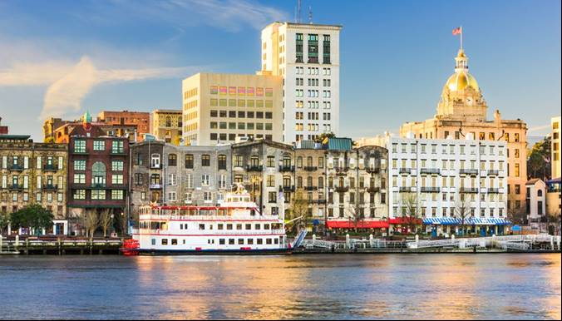

Savannah, Georgia
Financial & Compliance Audit - December 31, 2024
Presented by:
Trey Scott
(912) 232-0475

Slide 3
Purpose of Today’s Presentation
Overview of:
Mauldin & Jenkins
Audit Opinion (Financial / Compliance)
Financial Statement Highlights
Other Audit Communications
Other Matters (New Standards)

Slide 4
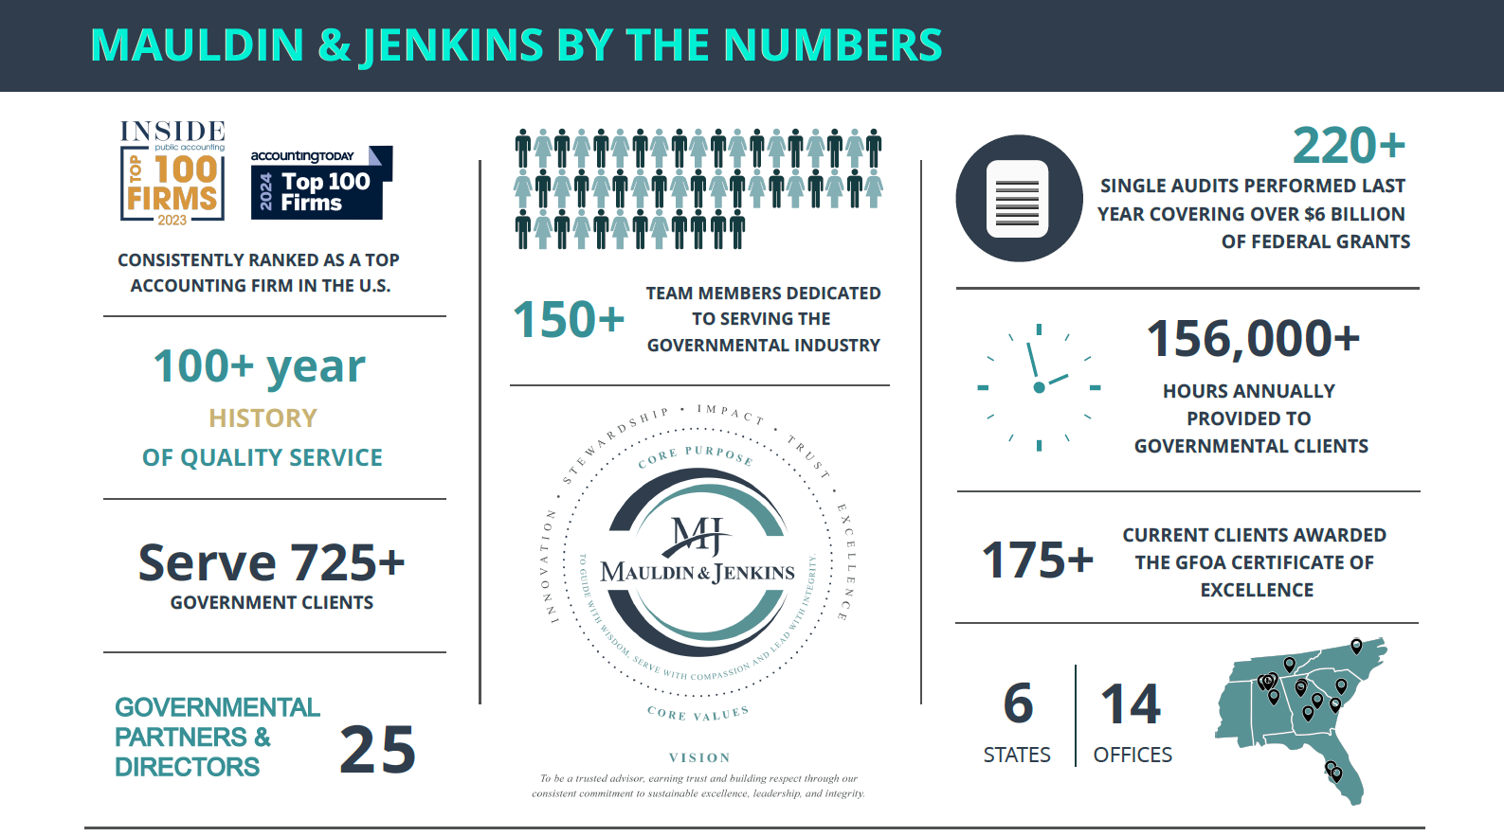
Engagement Team = Large Regional Firm
Notes:
4 offices in Georgia including Savannah.
4 other offices in the Southeast.

Slide 5
Audit Opinion
City = responsible for financial statements (ACFR).
M&J = to express an opinion.
Auditing Standards = GAS and GAAS
Clean Opinion =
Financial Statements - The financial statements of Savannah, Georgia are considered to present fairly, in all material respects …...
Federal Pgms. of ~$13.9M with 3 Major Programs (HOME; WIA; HUD) = ~$7.2M - Complied, in all material respects…..
Notes:
Savannah’s Finance Department led by David Maxwell puts the CAFR together and we do the audit.

Slide 6

Award for ACFR
Savannah has prepared an Annual Comprehensive Financial Report FY 2024.
Awarded Certificate of Achievement for Excellence in Financial Reporting from the Government Finance Officers Association (GFOA).
Notes:
Savannah’s Finance Department led by David Maxwell puts the CAFR together and we do the audit.

Slide 7
Entity-Wide Financial Statements
$2.8 billion = total assets
$1.8 billion = capital assets, net of A/D
$.6 billion = total liabilities
$2.2 billion = net position (or equity)
$664 million = revenues (~$97 M inc.)
$477 million = expenses (~$34M inc.)
$187 million = result = net change
Notes:
Savannah is a very large city government, and the numbers support that notion.
Bottom line is very much needed when you look to the future cash flows needs.

Slide 8
Capital Asset Activity – Govt Wide – Last 6 Years

Slide 9
General Fund Financial Statements
$242.3 million = total assets
$178.1 million = total liabilities
$64.2 million = fund balance (3.1 months = 96 days)
$59.6 million = unassigned (2.9 months = 89 days)
$305.9 million = revenues & other fin sources
$299.4 million = expenditures & transfers out
$6.5 million = net increase in fund balance
Notes:
12/31 = fattest time of year.
Income and Expenses Include transfers in and out …….
Savannah has around 80 days of fund balance.
Good but not Great.

Slide 10
Revenues & Expenditures Over the Past 6 Years
Notes:
Upward trend noted and needed for plans and commitments looking forward.
Prepare for disaster contingencies, recessions and other matters could develop.

Slide 11
Water / Sewer Financial Statements
$712.2 million = total assets ($541M = net capital assets)
$64.1 million = total liabilities
$648.1 million = net position (or equity)
$147.1 million = total revenues & other sources
$92.2 million = total expenses & other uses
$54.9 million = increase in net position
$.7 million = Dec. in Cash ($41 M gen. from ops)

Slide 12
Pension & OPEB Trust Funds Financial Statements
$582.8 million = net position (or equity) available to fund participants
$26.6 million = total contributions
$56.0 million = net investment income
$49.0 million = total benefit & admin expenses
$33.6 million = increase in net position
Pension 72% funded ($558 Liab. – $407 Funded = $151 Net Liab.)
OPEB 121% funded ($77 Liab. - $93 Funded = $16 Net Asset)
Notes:
Look long-term to evaluate current status.

Slide 13
Pension and OPEB Funding –
Past 6 Plan Years
Notes:
Upward trend noted and needed for plans and commitments looking forward.
Prepare for disaster contingencies, recessions and other matters could develop.

Slide 14
Other Communications
We are required to present information relative to the audit process and its results.
Significant areas addressed in our reports:
Judgments & estimates;
Audit adjustments;
Independence;
Other.

Slide 15

New Financial Reporting GASB Standards
#102 – Certain Risk Disclosures (2025)
#103 – Financial Reporting Model Improvements (2026)
#104 – Disclosure of Certain capital Assets
Notes:
M&J Partner Joel Black just took the helm as Chairman of GASB.
We are encouraged with GASB’s future.

Slide 16
Newsletters, Free Continuing Education, Closing
Newsletters
Written by M&J on topics pertinent
to local governments in Georgia.
Free Continuing Education Since March 2009, quarterly continuing education is provided
by M&J to government clients.
Closing
Thanks, Questions, Thoughts.

Slide 17
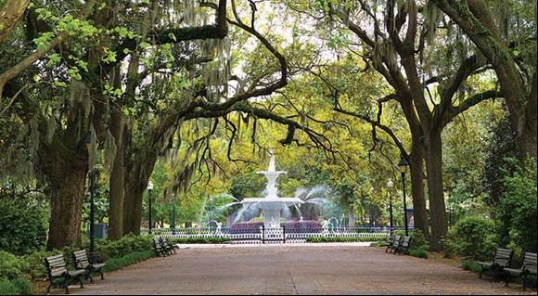
Savannah, Georgia
Financial & Compliance Audit - December 31, 2024
Presented by:
Trey Scott

