Slide 1
Pension Plan Update
City of Savannah Employees’ Retirement Plan

Slide 2
City of Savannah Retirement Plan History
In 1857, New York City established the first U.S. public employee pension plan for its policemen.
On September 21, 1887, the first public employee pension plan in Georgia was enacted by the City of Savannah for its policemen.
Provided half-pay for policemen with 30 years service who were certified as disabled
In 1894, Savannah began pension coverage for its firemen
Savannah followed its 1887 plan in 1919 with a general retirement system for all City employees – again the first Georgia city to do so.
A survey by the U.S. Commissioner of Labor indicated that during the first years of the 20th century, Savannah was one of only two cities in Georgia providing a public employee retirement plan of any kind.
The City’s current plan was adopted in 1972 and is included in the City’s charter. The plan has been amended from time to time through the years to improve the benefits provided to members.

Slide 3
Plan Membership and Benefits Provided
As of 1/1/2022 Valuation:
1,719 retired participants and beneficiaries (currently receiving benefits)
207 inactive vested participants (former employees with 5 years of service)
2,230 active participants (current employees contributing to the plan)
Benefits Provided:
Normal and early retirement pension benefits
Occupational disability benefits
Survivor’s benefits
Non-occupational disability and death benefits

Slide 4
Benefit Structure
Benefit Structure:
Under the plan, pension benefits vest after five years of service. Normal retirement for general employees is age 57. Normal retirement for uniformed public safety employees (police and fire) is age 55. The normal monthly benefit is calculated as follows:
Final average earnings times
2.1% for each year of service earned before 1-1-2000, plus 2.3% for each year of service earned after 1-1-2000 (to a maximum of 30 years of service) plus
1.0% of final average earnings times years of service in excess of 30 years to a maximum of 100%.
Final average earnings is defined as the average monthly salary for the highest sixty consecutive months during the last ten years of employment.
In 1999, the plan added a provision for automatic post-retirement pension increases. Once a pensioner reaches the age of 65 and has received pension benefits for at least five years, an increase of 5% is automatically given to the pensioner. Every year thereafter an automatic increase of 1% is granted to the pensioner.
In 2000, the plan was further enhanced to allow accumulated sick leave as pensionable service for eligibility and benefit purposes.

Slide 5
Plan Funding
employer contributions
investment returns
$
$
$
$
$
$
employee contributions
$
$
$
$
$
$
$
$
$
$
$
$
Assets
$
$
$
PENSION
FUND
$
$
$
$
$
$
$
expenses
$
$
benefits

Slide 6
Plan Funding
Plan funding consists of 3 components:
Employer Contributions
Participant Contributions
Investment Returns
Contributions:
The annual contribution amounts are actuarially determined, and the City is required by state law to contribute the actuarially determined amount each year.
Active employees are required to contribute 6.65% of their earnings on a pre-tax basis.
Recent contributions have been as follows:
Employers Members
2018 $ 10,331,820 $ 7,459,327
2019 10,643,079 7,222,808
2020 11,243,151 7,903,062
2021 12,019,866 7,572,831
2022 12,258,946 7,883,418
2023 11,475,840

Slide 7
Plan Funding
Plan assets are invested in stocks, bonds, real estate and other investments at the discretion of the Pension Board as allowed by state law.
The current allocation targets are:
Asset Class Target Allocation
Domestic equity 40.00%
International equity 12.50
Emerging markets equity 7.50
Fixed income 20.00
Core real estate 5.00
Short-term fixed income 5.00
Private equity 10.00
The plan’s actuary assumes a 7.25% return from investments

Slide 8
Investment Performance
Investment Returns and Money Weighted Rate of Return
2018 loss of $11,332,027 return of -3.1%
2019 gain of $72,761,682 return of 20.6%
2020 gain of $62,207,444 return of 15.7%
2021 gain of $61,559,295 return of 13.3%
2022 loss of $78,177,688 return of -15.2%

Slide 9
City of Savannah Retirement Plan History
Various benefit changes occurred as follows:
In 1987 the normal retirement age was lowered from 65 to 62 for general employees
In 1995 the normal retirement age was lowered from 62 to 60 for general employees and from 60 to 58 for uniformed employees
In 1995 the benefit formula was changed to provide 2.0% for the first 30 years
In 1995 the first post retirement benefit increase was implemented.
In 1999 the post retirement benefit increase provision was improved

Slide 10
Comparison of COLA Adjustments -From Segal Study dated 3/23/2012
Notes:
Both Chattanooga and Jacksonville have modified their post retirement COLA provisions since this study was conducted in order to control the on-going cost of their plans.
Chattanooga retirees are now getting an average of 1.5% with a three year waiting period after retirement. Also, Chattanooga employees are now contributing 11% of pay, up from 9.0%.
Jacksonville closed their plans to new entrants in 2017 and increased employee contributions to 10%, up from 7.7%. New hires are now in a defined contribution plan.

Slide 11
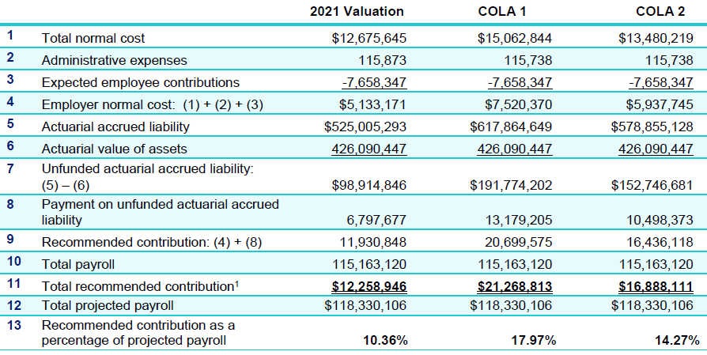
Cost of Increasing a Post Retirement COLA
Requested COLA studies performed by the plan’s actuary
An annual CPI-based COLA is granted 12 months after retirement.
The current COLA structure remains in place, but the 1% annual increase is replaced with a CPI-based increase.
Notes:
The plan’s current inflation assumption is 2.75%, therefore this is the assumption used for the CPI in these studies.
COLA 1 would increase the 2022 employer contribution by $9.0 million or 73.5%
COLA 2 would increase the 2022 employer contribution by $4.6 million or 37.8%

