Slide 1
Keeping Youth Alive, Out of Jail, and Safe…
…at home, in school, and in the workplace.
January 26, 2023
John Bush, ONSE Director

Slide 2
Addressing Youth Violence
Four Priority Areas
Violence Prevention
Violence Intervention
Youth Redirection
Long-Term Progression
Progression: Moving gradually towards a more advanced state;
forward or onward movement.
Prevention: The act of stopping something from happening or arising.
Increasing
Youth
Success
Decreasing
Youth
Violence
Redirection: Directing something to a new or different place or purpose.
Intervention: Taking action in order to affect an outcome.

Slide 3
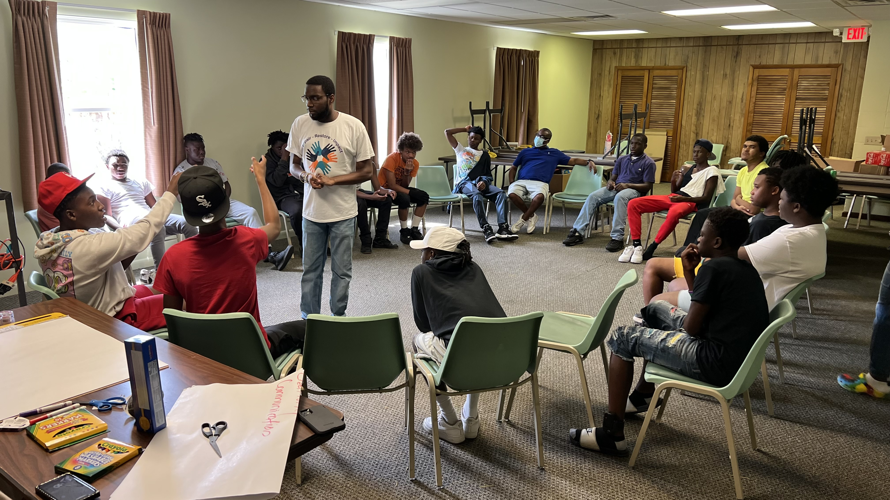
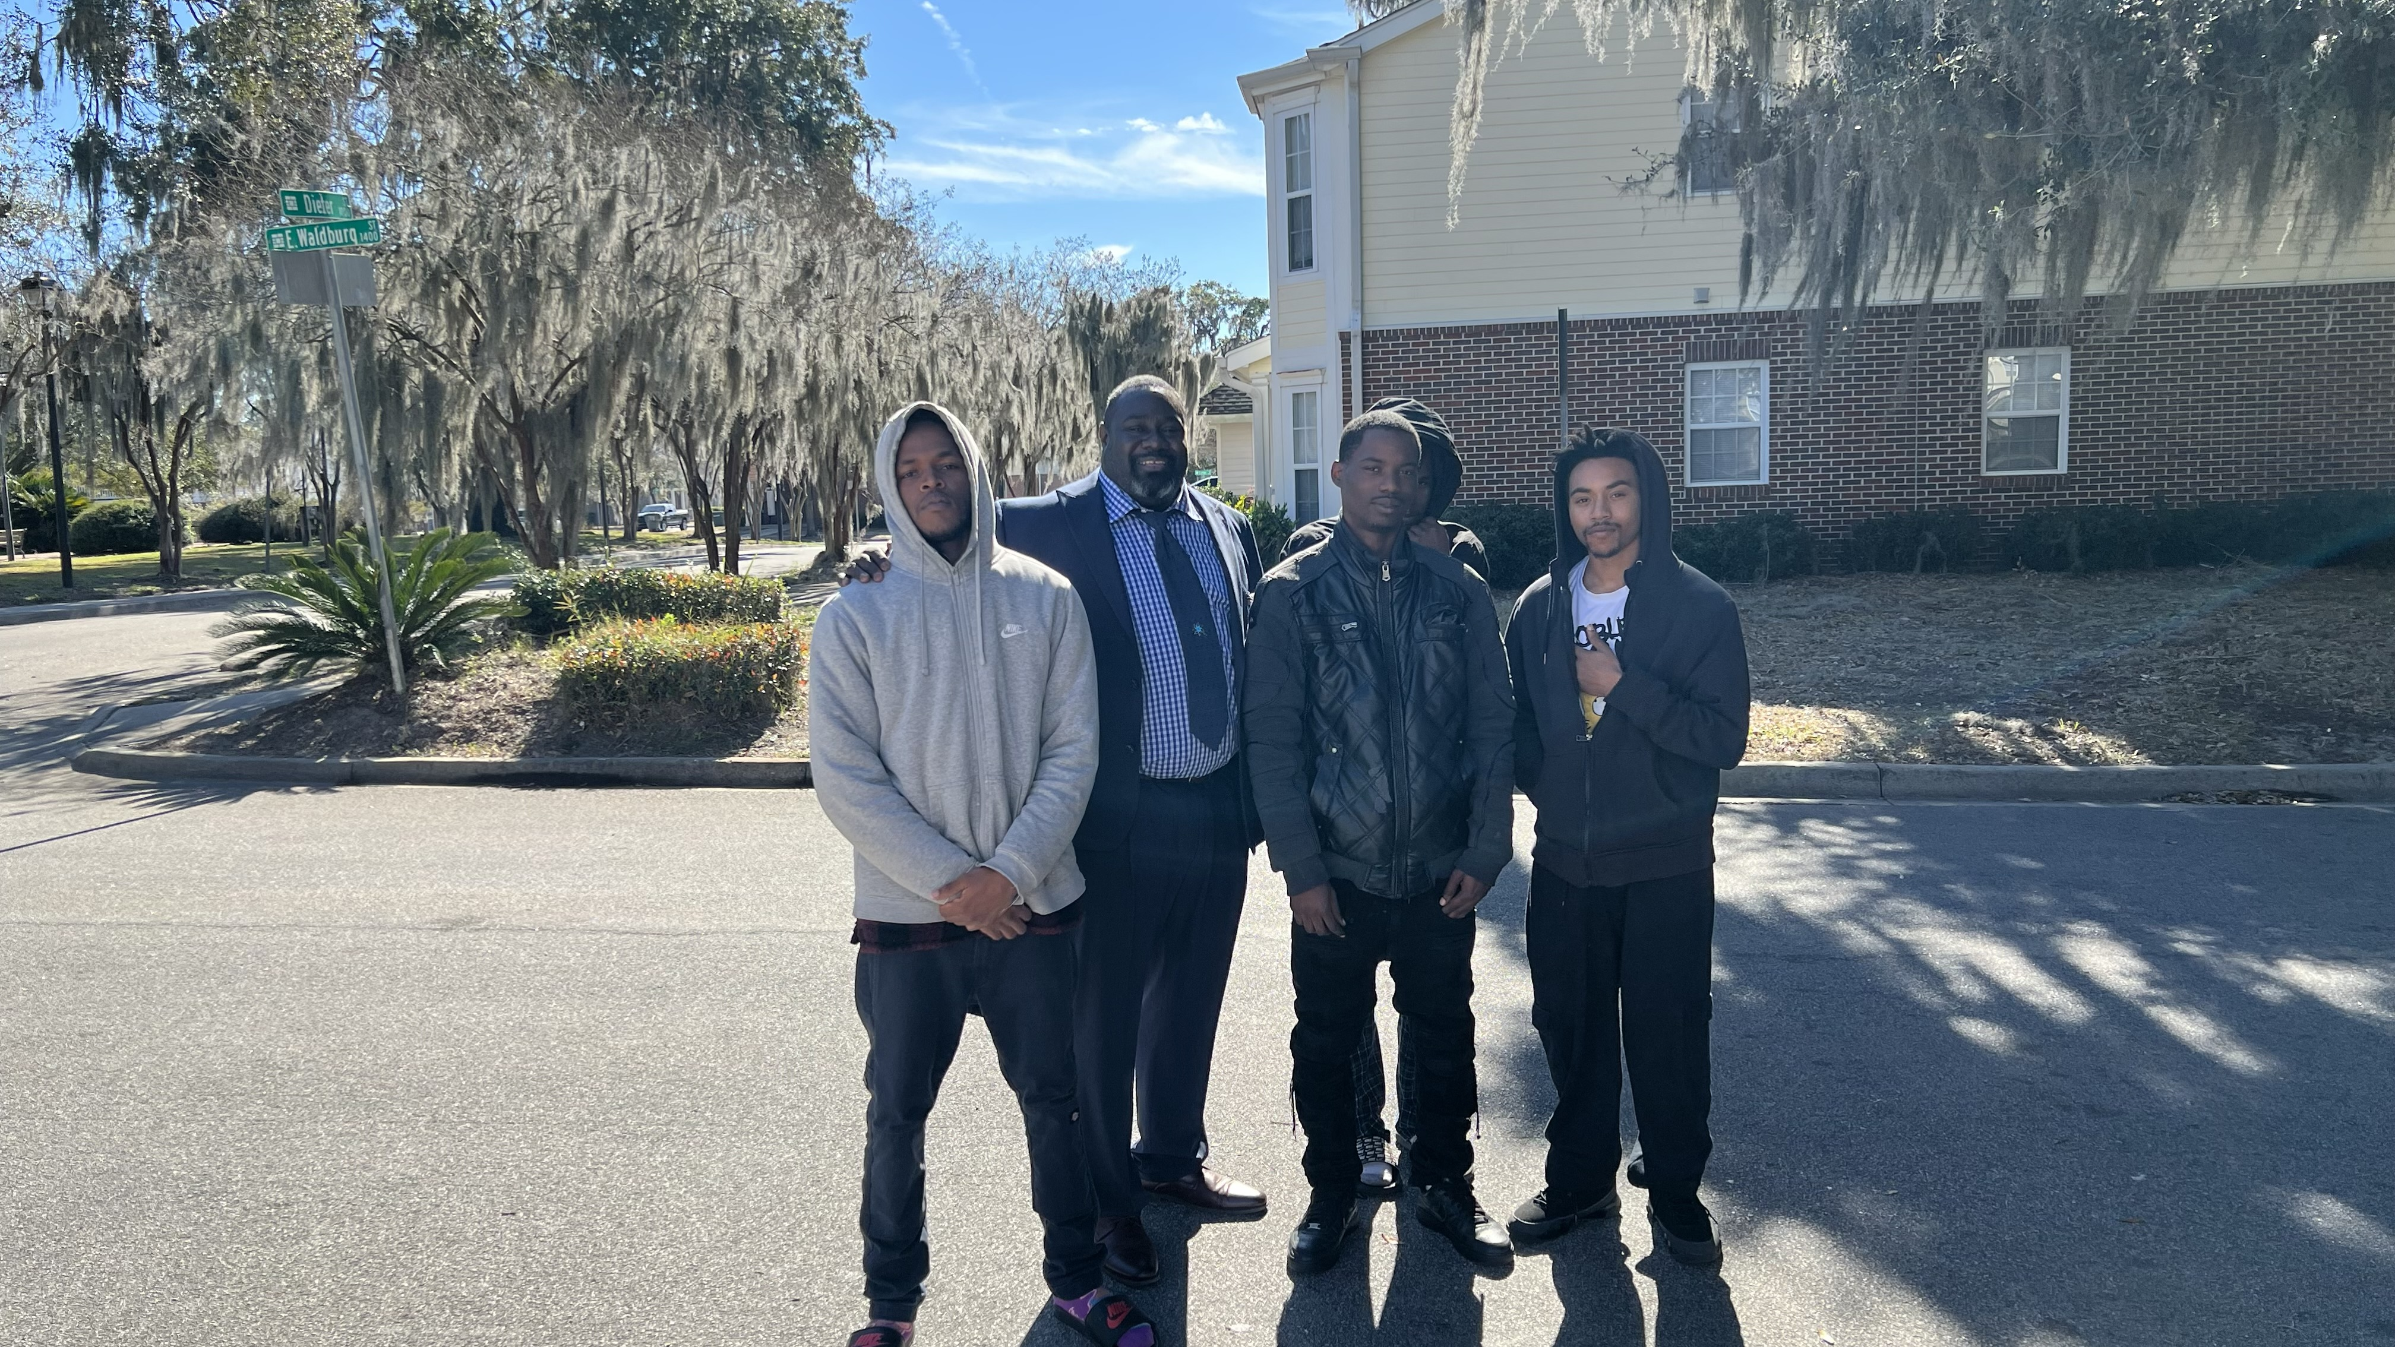
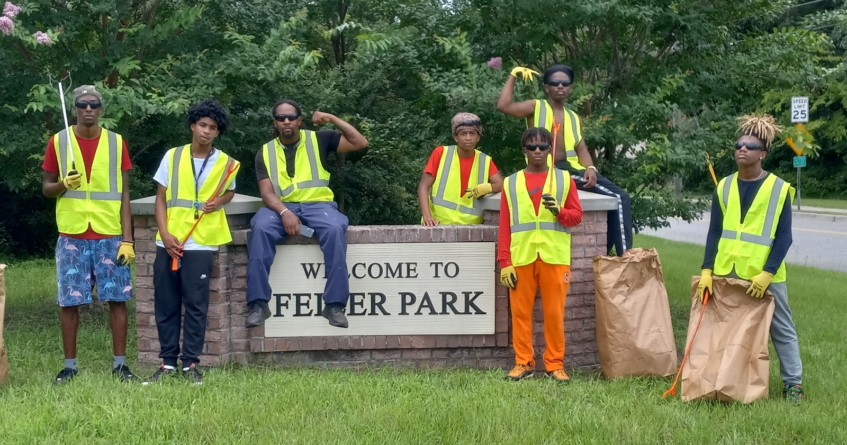
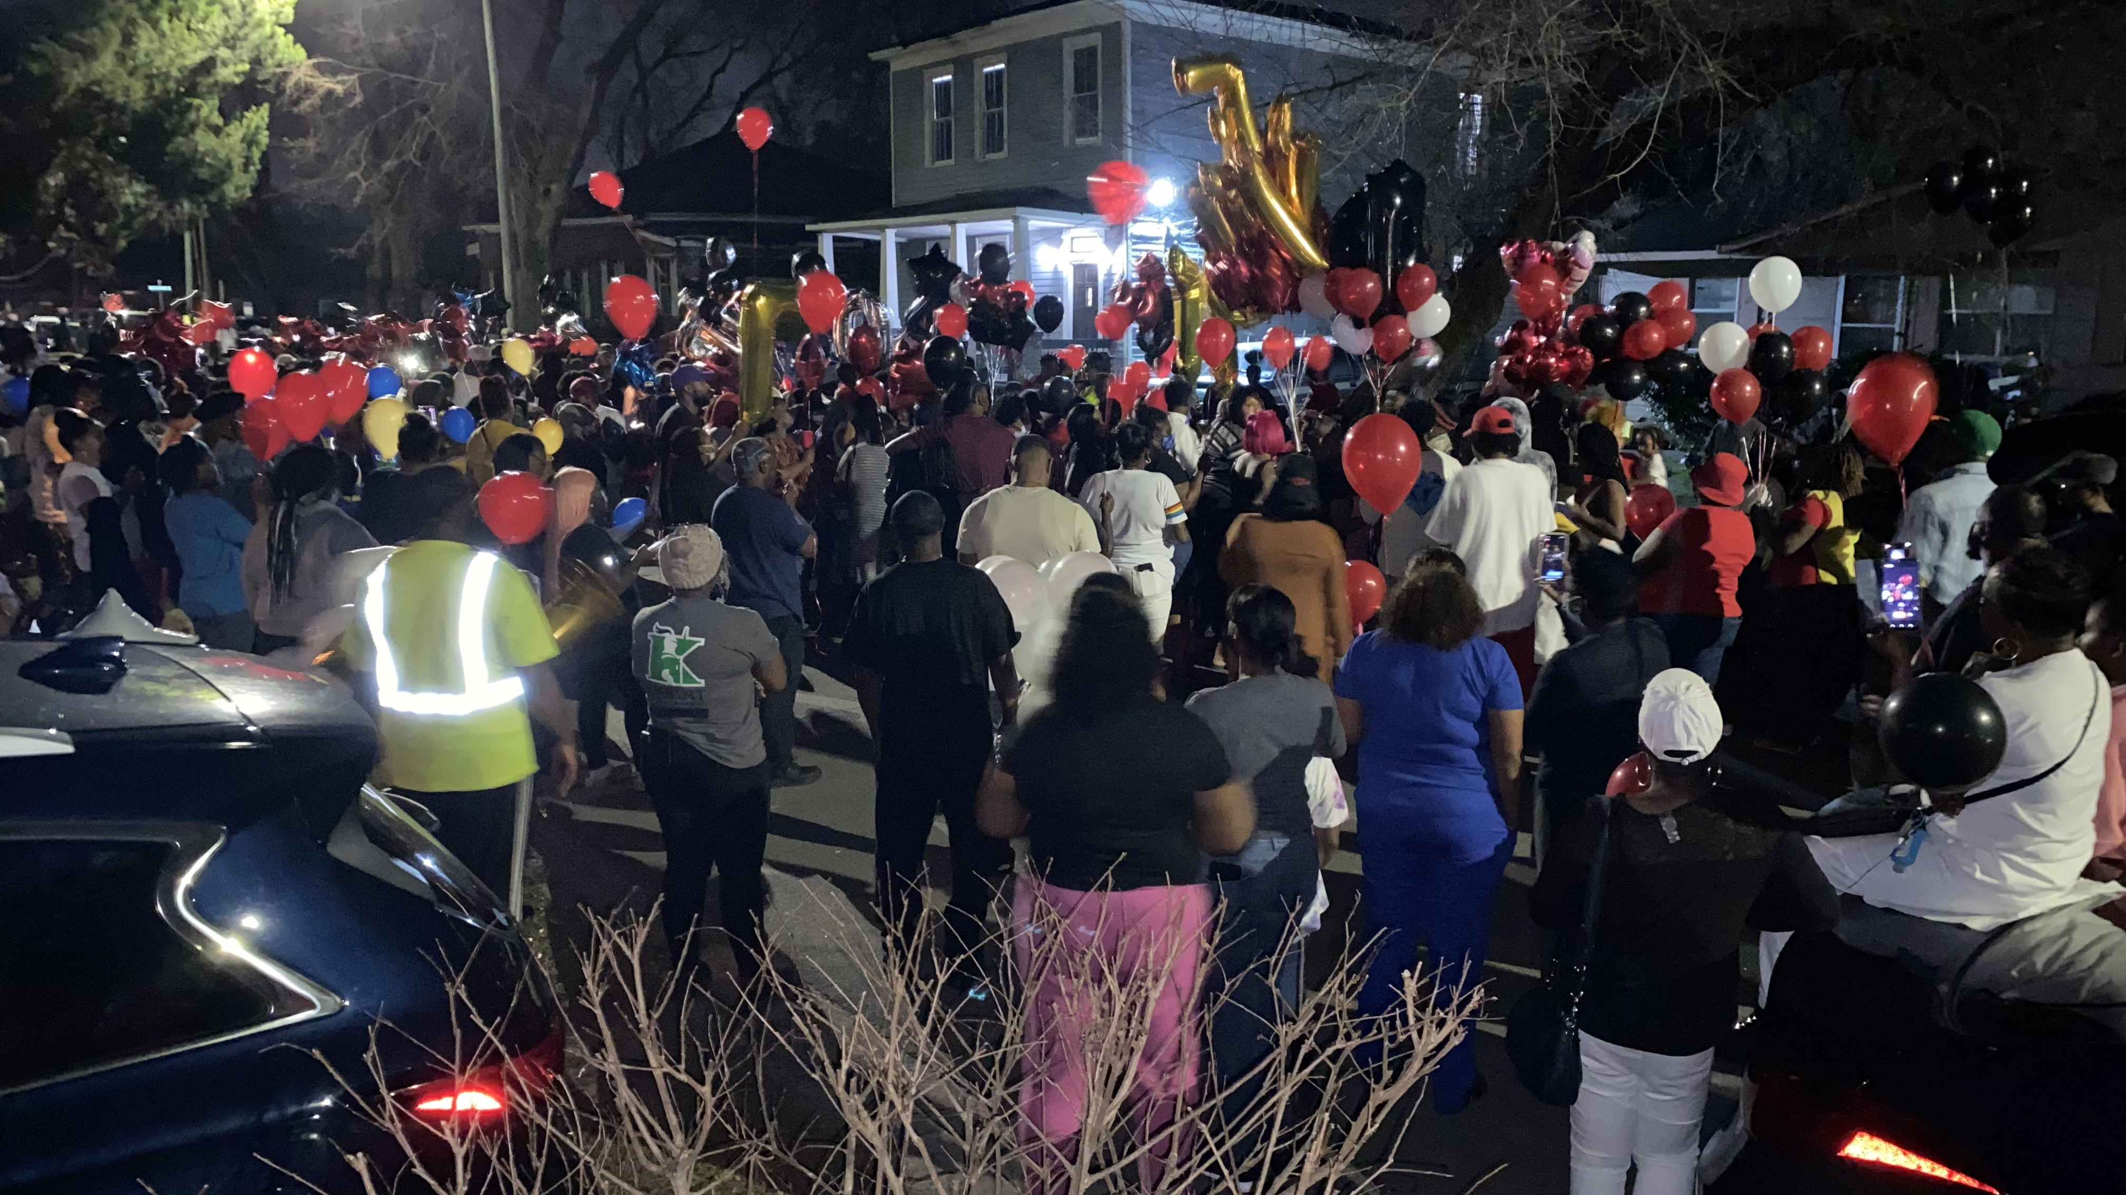
OFFICE OF NEIGHBORHOOD SAFETY AND ENGAGEMENT
Status Update
ONSE 2022 – 2023 Direct Engagement
Reconnection Retreat 2022
Anti- Gun Violence Pledge
Neighborhood Improvement Team
Consequences of Your Actions

Slide 4
OFFICE OF NEIGHBORHOOD SAFETY AND ENGAGEMENT
Teamwork
ONSE Collaborative Partnerships
The Coffee Foundation
Frank Callen Boys and Girls Club
Heads-Up Guidance Services
Life Skills for Empowerment Center
The Mediation Center
Savannah Royal Lions
Talented Individuals with Power
Urban Mentoring Academy
We Love Cann Park
Loop It Up Savannah
LB3 Foundation
Savannah Learning Academy
Offenders Alumni Association
Savannah Feed the Hungry
Savannah Youth City
League of Brawn
DEEP Center
Wesley Community Center
Georgia Legal Services
Court Appointed Special Advocates
Savannah Chatham County Public Schools
Chatham County Juvenile Court
Department of Juvenile Justice
Victims Witness
Savannah State University
Georgia Southern University
Savannah Technical College
Memorial Health University Medical Center
St. Joseph’s / Candler Hospitals
Coastal Georgia Indicators
Gateway Community Service Board
Youth to Adult
APEX
Club House
Individual, Group, and Family Counseling
Savannah Pastors Alliance
Innovative Workforce Development
Chatham County Safety Net Planning Council
Georgia Department of Labor
Goodwill of the Coastal Empire
The Front Porch
Youth Intercept Program
Operation Kid Forward
Park Place
Youth Emergency Shelter
Families Always Matter
Street Outreach
Rapid Re-Housing Program
Transitional Living Program
Youth Advocacy Program
Primal Behavior
Dismas Charities
Step-Up Savannah
Live Oaks Public Library
CORE Response
Youth Challenge Academy
The Front Porch Improv
WorkSource Coastal
ShotSpotter
NAMI of Georgia

Slide 5
OFFICE OF NEIGHBORHOOD SAFETY AND ENGAGEMENT
Status Update
ONSE 2022 – 2023 Direct Engagement
 | 2022 Actual | 2023 YTD | 2023 Projection
Number of Youth Engaged | 308 | 47 | 500
Number of Partnership Meetings | 22 | 2 | 45
Number of Outreach Events Hosted | 4 | 2 | 8
Number of Community Events / Meetings Attended | 11 | 4 | 55
Victim Assistance Referrals | 26 | 0 | 40
Job Referrals | 17 | 3 | 96
Referrals for Services (Non-Victim Related) | 14 | 11 | 120

Slide 6
OFFICE OF NEIGHBORHOOD SAFETY AND ENGAGEMENT
Coming Soon
ONSE 2023 Program Calendar
Road Maps Academy – ONSE staff and partners will undergo Violence Reduction Training offered by Cities United.
Reconnection Tour – Youth will explore local history and surrounding communities as it relates to the social determinants of health that impact the lives of Savannah’s youth.
Reconnection Weekend – Youth will establish meaningful connections with community leaders for the purposes of mentoring youth in specific areas of need.
Reconnection Retreat – An isolated week of life skills, enrichment and social development for high-risk youth.
Neighborhood Improvement Teams – Hosting jobs for at-risk teens in their communities.
Youth Services Provider Annual Training Program – Developing skills among service providers to establish a Community-wide “Trauma Sensitive” protocol and partnership
Summer Engagement Events – Community-wide social summer events for youth citywide.
Savannah Teen Art, Music, and Performance (STAMP) – Therapeutic arts program for at-risk youth.

Slide 7
Implementation of Group Violence Initiatives
Community-Based Violence Intervention
CVI
School-Based Violence Intervention
SVI
Hospital-Based Violence Intervention
HoVI

Slide 8
Group Violence Initiatives
Community-Bases Violence Intervention
CVI
School-Based Violence Intervention
SVI
Hospital-Based Violence Intervention
HoVI
2022
Installed
Focus for
2023
In Progress
(Work Ongoing)
2024
On Going
(Add Capacity)

Slide 9
Community-Based Violence Intervention
CVI
Program Rollout :
Jun. 2021 – The City of Savannah approved the Cure Violence Global Model
Jan. 2022 –O.N.S.E. initiated
Apr. 2022 – The Youth Advocacy Program was contracted to implement the CVG model
Aug. 2022 – Hiring process began
Oct. 2022 – Soldiers Against Violence conducted the first community event
Dec. 2022 – Violence Interrupters began regularly conducting and reporting activities
Jan. 2023 – Savannah State University began assisting Violence Interrupters
Initial Data Report:
7 – Direct Violence Intervention
56 – Violent Community Member Engagement
153 – Community Activity Participants

Slide 10
School-Based Violence Intervention
SVI
Primary Partners: Various Community Partners

Slide 11
School-Based Violence Intervention
SVI
Various Community Partners

Slide 12
School-Based Violence Intervention
SVI
Primary Partners: Youth Advocacy Program

Slide 13
School-Based Violence Intervention
SVI
Primary Partners: SCCPSS

Slide 14
School-Based Violence Intervention
SVI
Primary Partners: Juvenile Court and SCCPSS

Slide 15
School-Based Violence Intervention
SVI
Primary Partners: SSU and SCCPSS

