Slide 1
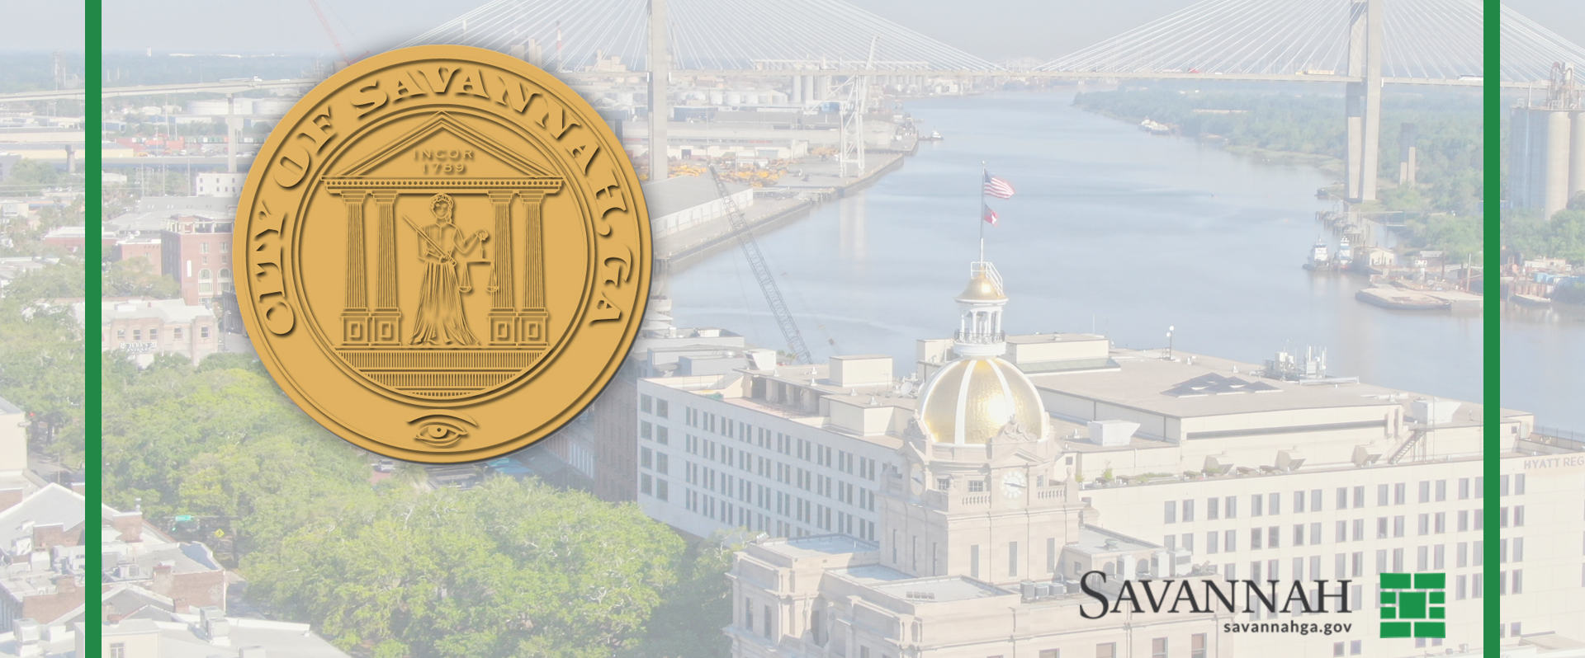
City Council Meeting
May 22, 2025

Slide 2
SAVANNAH GPS
Your City. Your Future. Your Voice.
May 2025

Slide 3
Today’s Agenda
What We “Thought” We Knew
“What We Heard”
“What We Learned”
Presentation of Draft Strategic Plan
Questions
Leading Indicators

Slide 4
City Council’s Direction
In March 2024, City Council convened a Visioning Session to determine priorities for the City.
The two-day meeting resulted in 166 priorities, which were refined to 6 Goals and 8 Organizational Values.
City Council directed the City Manager to perform a strategic planning process with the community.

Slide 5
What We “Thought” We Knew
SAVANNAH GPS

Slide 6
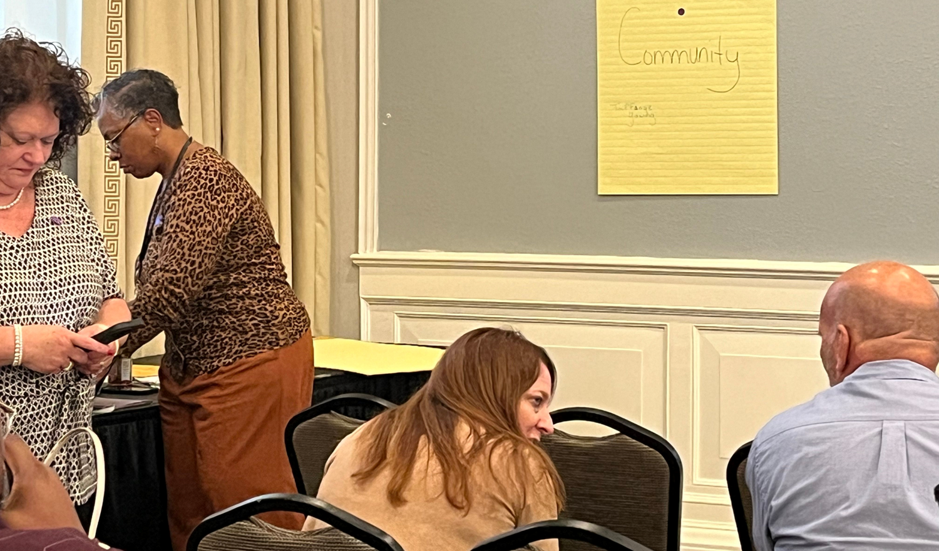
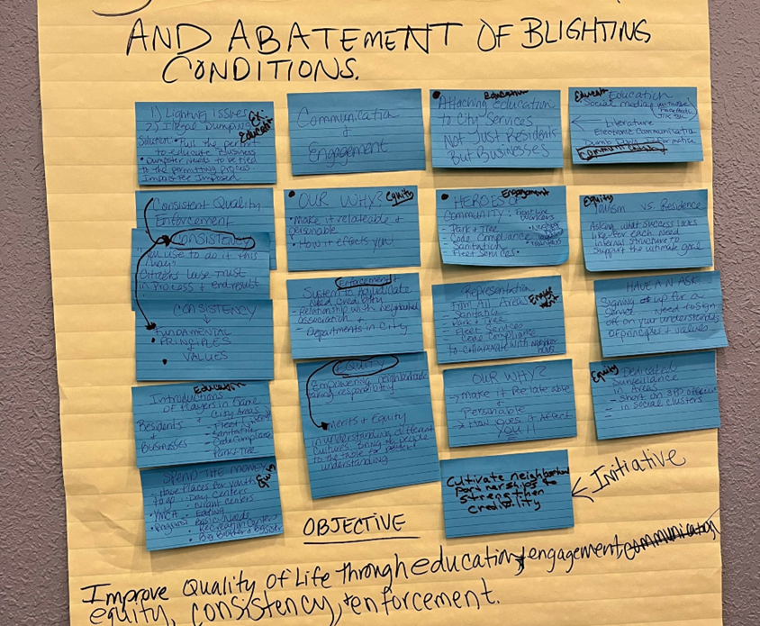
Internal City Staff Meetings 2024
Executive Leadership Team & City Departments
Creation of Draft Strategic Plan
Representing
What We “Thought” We Knew

Slide 7
“What We Heard”
SAVANNAH GPS

Slide 8
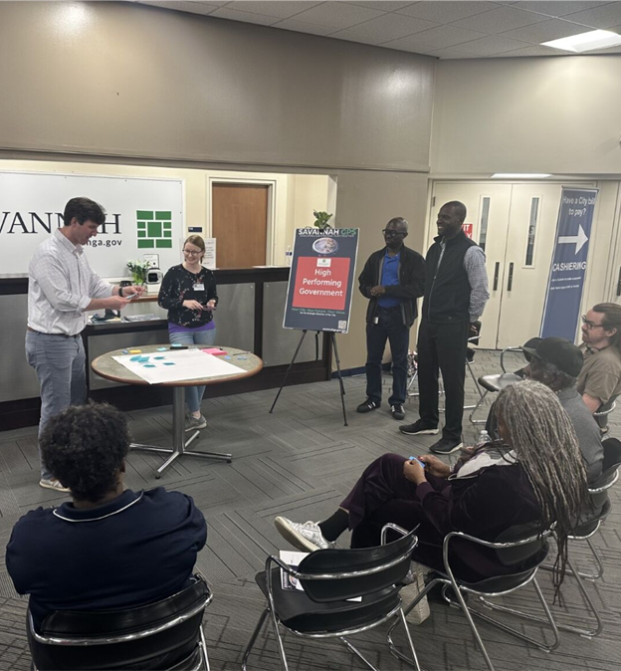
Community Engagement
Virtual Kick-Off Session & Six Public Meetings
Feb. 3rd – 10th, 2025

Slide 9
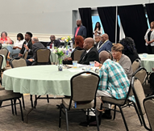
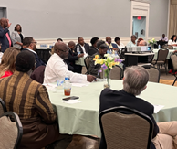
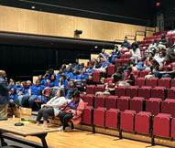
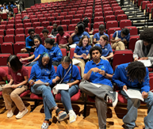
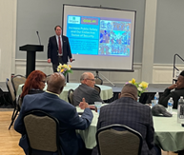
Youth & Clergy Meetings
April 2025

Slide 10
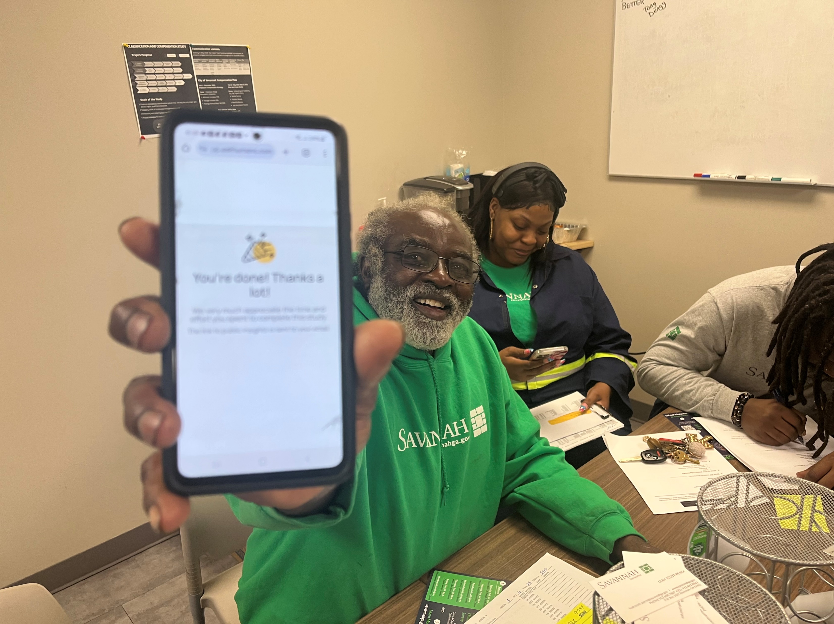
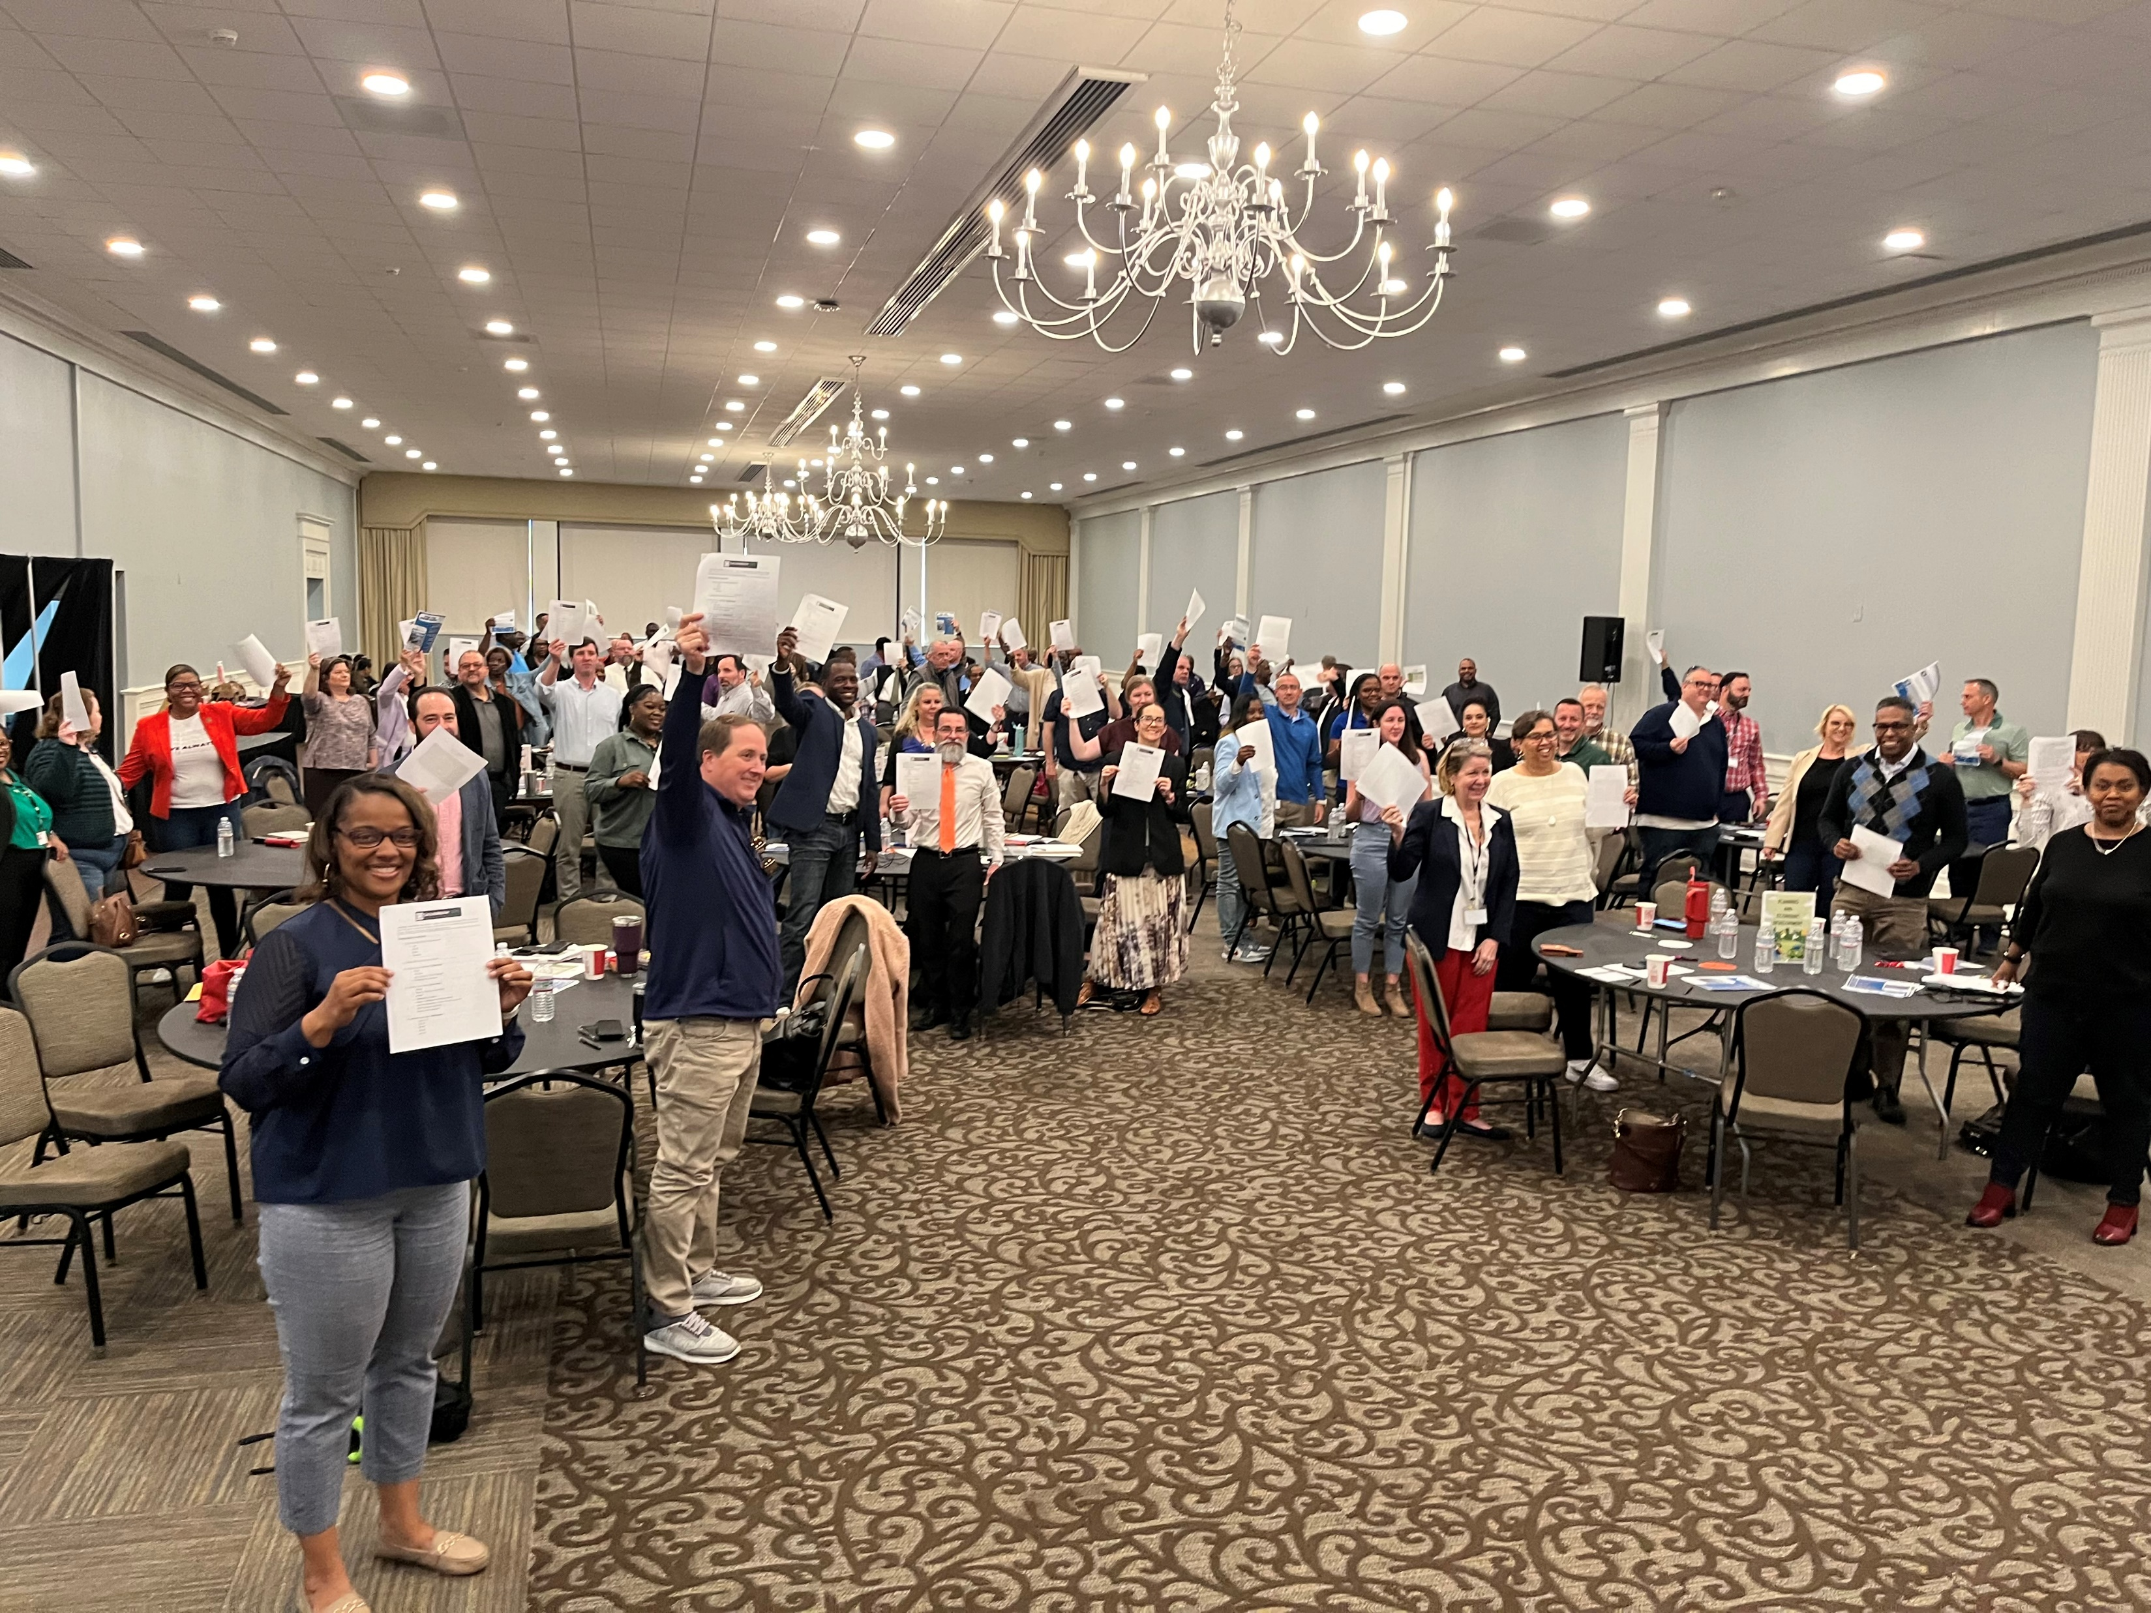
Employee Engagement & Feedback
Department Outreach

Slide 11
Online Survey
February – April 2025

Slide 12
Feb 2025 Community Meeting Feedback
Online Survey Feedback
What We Heard

Slide 13
Planning for Action
Values & Goals
Vision-based
Reevaluated every Council
Objectives & Strategies
Outcome-based
Initiatives & Activities
Process-based
Evaluated Constantly
Evaluated Annually
Clear Performance Metrics
Leading Indicators
City Vital Signs
Today’s Focus

Slide 14
Timeline
Community Meetings & Survey Period
Analyze Feedback
Draft Plan
Present for City Council Adoption
Implementation
& Evaluation
Spring 2025

Slide 15
Community Meeting Feedback

Slide 16
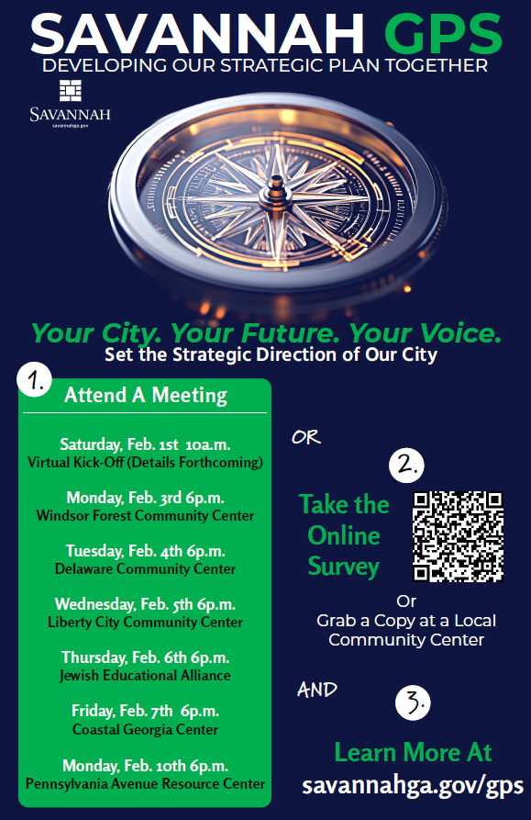
Community Meetings - Overview
Nearly
300
attendees
Provided
1,512
Comments

Slide 17
Community Meetings - Results
35% of Community Meeting Feedback Received Focused on INFRASTRUCTURE

Slide 18
Community Meetings – Key Themes by Priority
Public Safety
Mental Health Crisis Response
Crime Surveillance & Deterrence
Community Development & Resiliency
Housing Preservation & Affordability
Neighborhood Conditions
Economic Access, Opportunity and Vitality for All
Small Business Support
Workforce & Skills Development
Livable Environments & Infrastructure
Quality of Life
High-Performing Government
Cultural Inclusivity
Communication
Fiscal Responsibility & Tax Equity
Service Delivery & Efficiency
Communication & Transparency
Roads & Traffic
Water & Drainage
Community Access
Community-Based Approaches
Infrastructure Maintenance for Livability
Accessibility
Targeted Services & Green Space

Slide 19
Community Meetings – Key Themes by Location
District 1
District 2
District 3
District 4
District 6
Infrastructure Maintenance for Livability
Neighborhood Conditions
Communication & Transparency
Mental Health Crisis Response
Infrastructure Maintenance for Livability
City Employee Compensation
Service Delivery & Efficiency
Fiscal Responsibility & Tax Equity
Infrastructure Maintenance for Livability
District 5
Water & Drainage
Service Delivery & Efficiency
Infrastructure Maintenance for Livability
Communication
Infrastructure Maintenance for Livability
Housing Preservation & Affordability
Handicapped Accessibility
Infrastructure Maintenance for Livability
More Recognition of Public Safety Top Performers
Communication

Slide 20
Online Survey Feedback

Slide 21
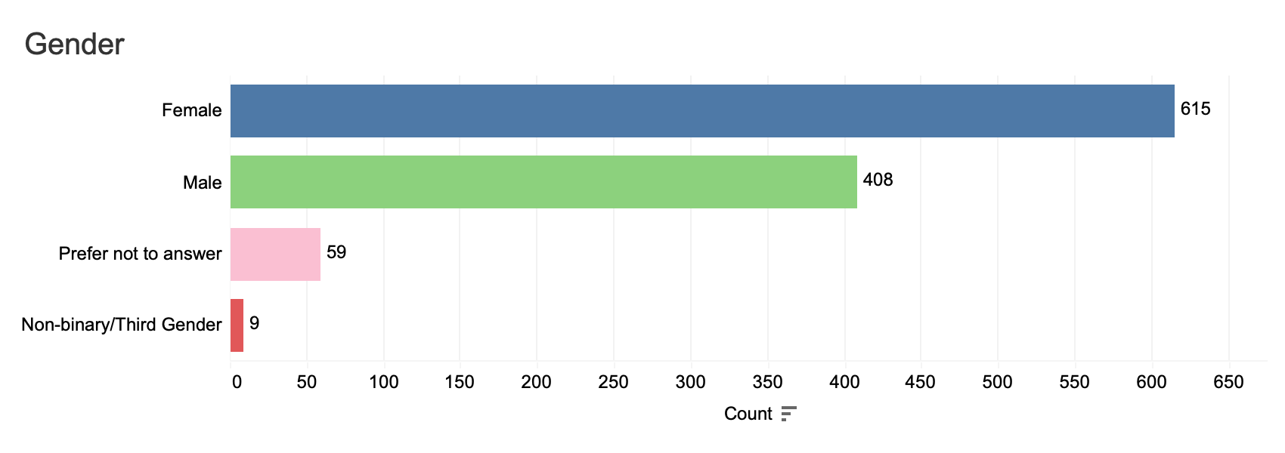
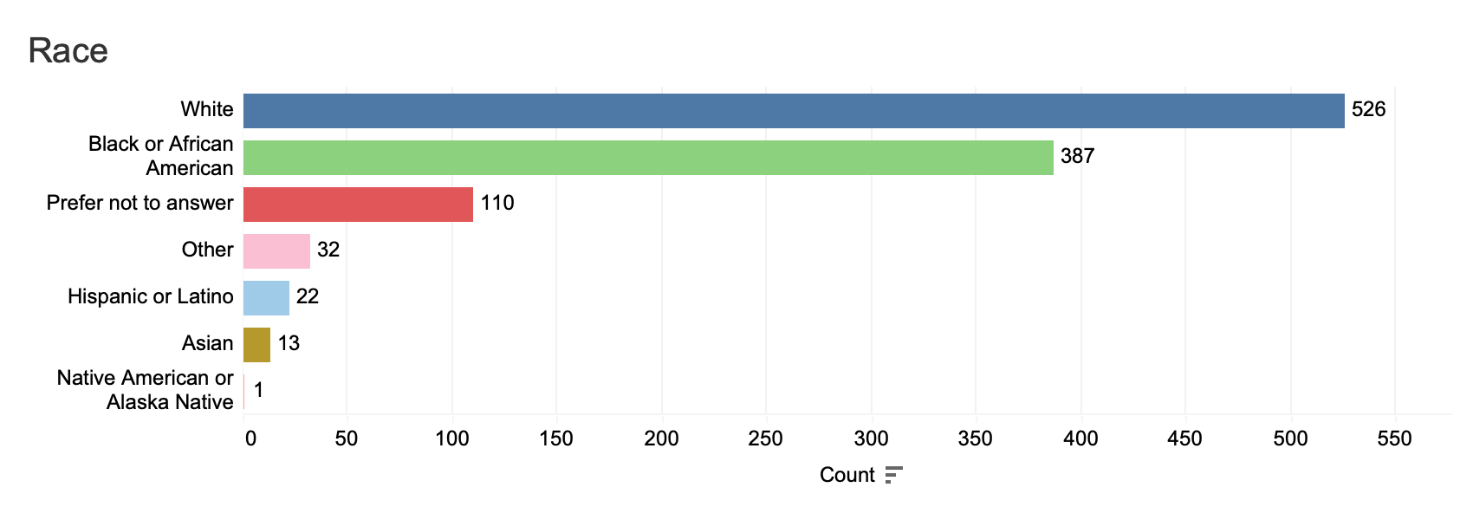
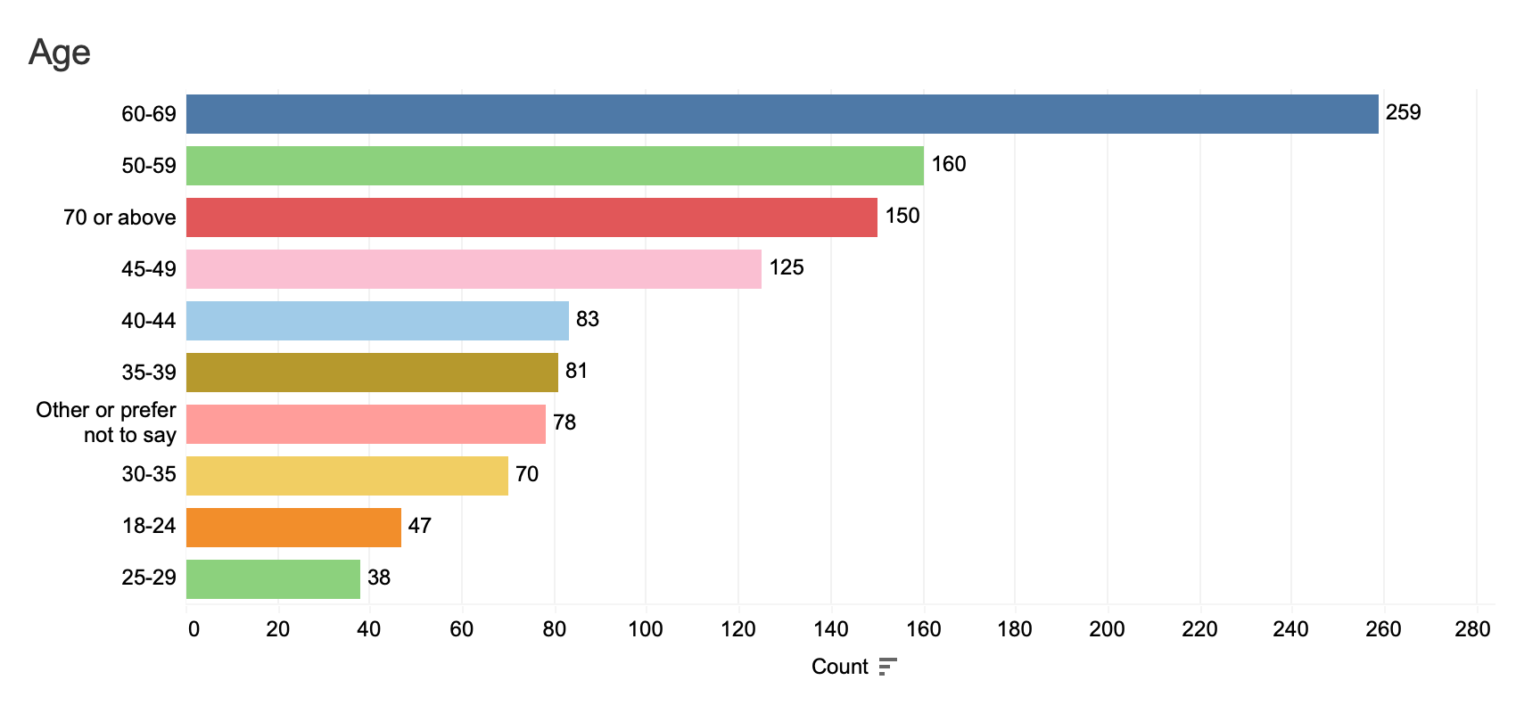
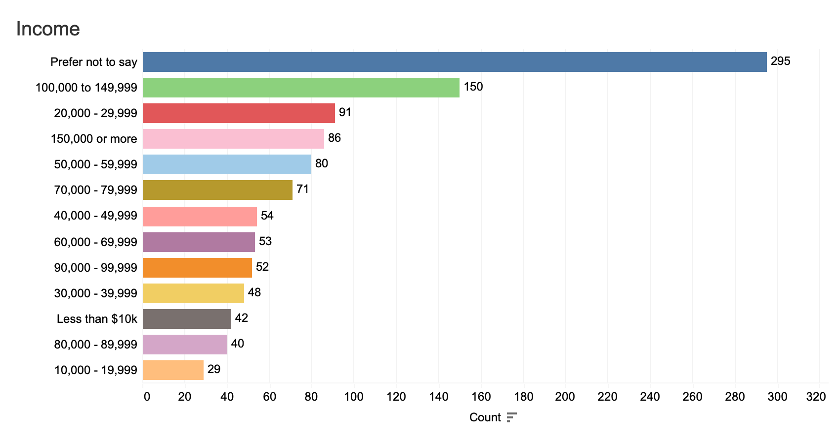
Online Survey - Demographics
1,229
Responses
Gender: Female
Race: White
Live & Work in Savannah
Age: 60-69
Income: Prefer Not to Say/$100 - $145K

Slide 22
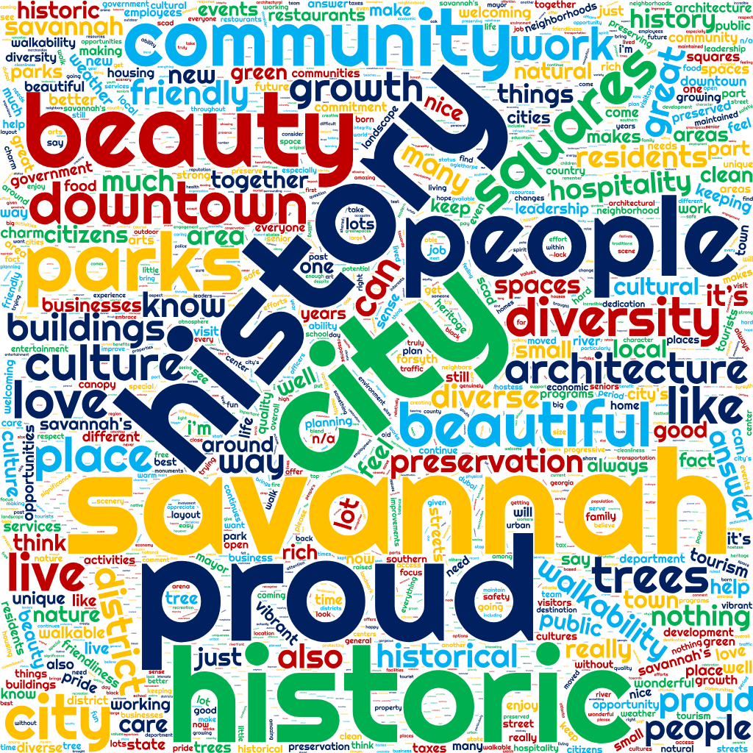
Q1: What are You Most Proud Of?

Slide 23
Q2: What is the Most Pressing Issue Facing Our City?

Slide 24
Q3: What actions would show the City is being fair & equitable to all residents? What is getting in the way?
Recommendations
Perceptions
Historical neglect of certain (often minority) communities leading to current disparities.
Systemic bias & racism influencing decision-making
Prioritization of the tourism industry and historic downtown over residents' needs
Political decision-making influenced by special interests or the "old guard“
Lack of adequate resident input and transparency in decision-making
Implicit bias affecting resource allocation and policy
Fair allocation of city funds & services
Targeted investment in historically underserved communities & blight removal
Ensure equitable access to affordable housing and public services
Improved communication from the City and engagement
Transparency in decision-making processes
Diverse representation in city government & processes
Fair & consistent enforcement of laws and city codes
Support for local businesses, particularly those owned by minority groups

Slide 25
Q4: What Issues are Most Important to You for Your Quality of Life? How could the City Work to Improve?
Safety & Crime
Cleanliness & Environment
Infrastructure
Housing (Affordability and Availability)
Traffic & Transportation
Community & Neighborhoods
Cost of Living
Focus on Improving Public Safety Measures
Increase Availability of Affordable Housing Options
Enhance the Cleanliness & Maintenance of Public Spaces
Make Strategic Investments in Infrastructure
Improve & Expand Transportation Options
Support & Invest in Local Neighborhoods
Manage Impact of Tourism on Resident’s Daily Lives such as Noise & Congestion

Slide 26
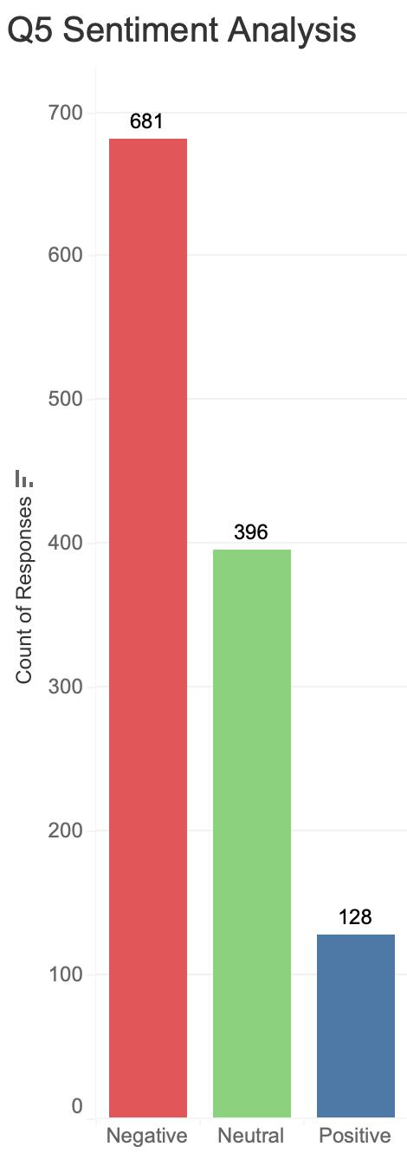
Q5: How Concerned are you about Homelessness in Savannah? How should the City respond to homelessness? – 57% expressed negative sentiments
Recommendations
Increase the number of available beds in emergency shelters.
Provide more options for transitional housing
Develop long-term housing solutions combined with supportive services
Address underlying issues: mental health services, substance abuse treatment, job training
Implement systemic approaches, foster partnerships, and improve leadership
Increase resources and make programs more accessible
Utilize evidence-based solutions, including targeted prevention and supportive services
Prioritize compassionate, resource-based solutions over solely enforcement-focused approaches

Slide 27
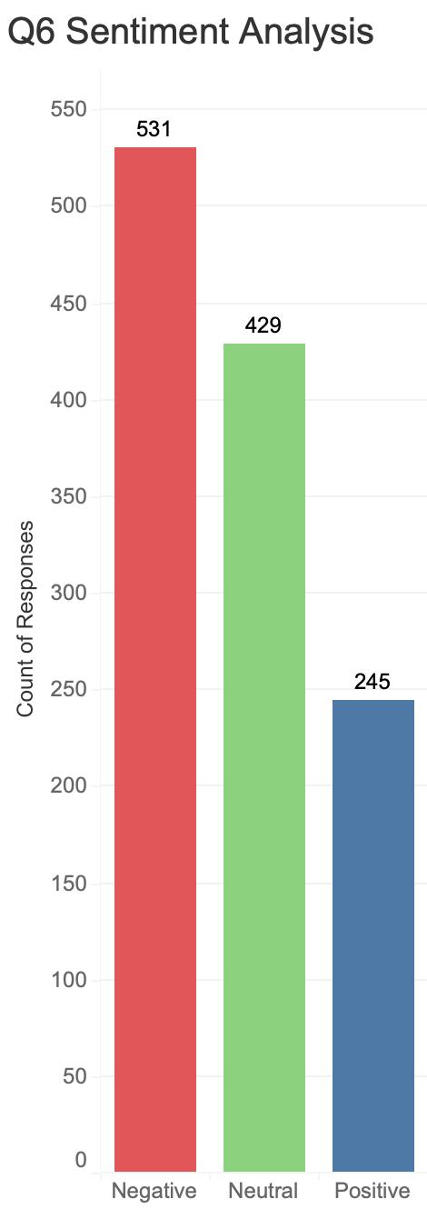
Q6: How Concerned are you about Public Safety in Savannah? Do you feel safe in your Neighborhood? What should the City do to Improve Public Safety? - 44% expressed negative sentiments
Recommendations
Address underlying issues contributing to crime (poverty, lack of opportunity, drug addiction, mental health, unemployment).
Improve street lighting in neighborhoods and public areas
Implement focused attention on reducing gun violence
Improve prosecution of crimes
Adopt a balanced approach incorporating compassion and accountability

Slide 28
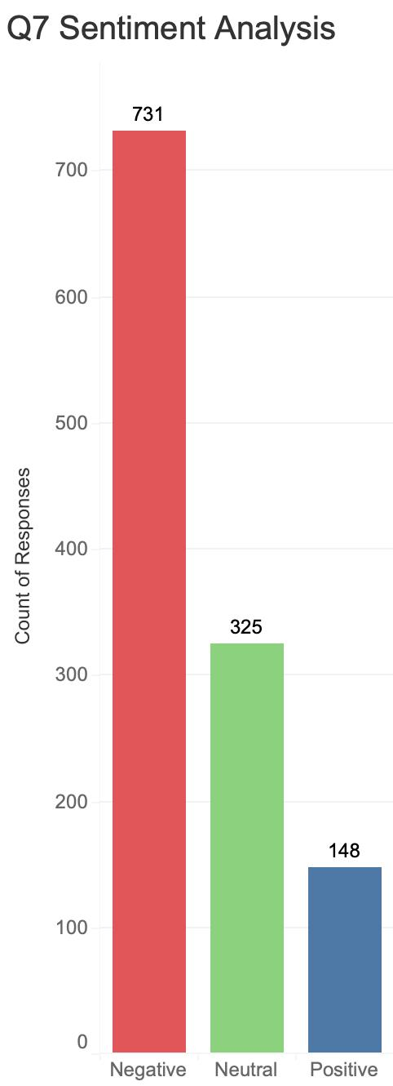
Q7: How Concerned are you about Affordable Housing in Savannah? How should the City respond to this problem? 61% expressed negative sentiments
Recommendations
Construct more affordable units
Offer incentives to developers to include affordable housing in their projects
Support diverse housing types, such as tiny homes, accessory dwelling units, and duplexes/triplexes
Rehabilitate existing blighted properties for housing
Regulate short-term rentals through increased enforcement, limiting numbers (especially in residential areas), and increasing fees/taxes to potentially fund affordable housing
Implement rent control or stabilization measures
Reform zoning regulations to allow for more diverse and affordable housing options
Utilize city-owned land for affordable housing development
Provide property tax relief for residents
Increase support for homeownership initiatives
Focus affordable housing efforts on middle-income workers in addition to the lowest income brackets

Slide 29
Q8: What could the City of Savannah do to improve transportation? What would you like to see more of in Savannah: bus routes, bike lanes, walking and bike paths, traffic calming, and road improvement projects?
Enhance public transportation options.
Expand and improve bike lanes and paths to create a connected network.
Complete the Tide to Town project.
Increase walkability through better pedestrian infrastructure.
Implement regional transit planning.
Invest in multimodal transportation options.
Prioritize and expedite road repairs.
Implement traffic calming measures.
Improve the frequency and reliability of public transit.
More Bike Lanes & Paths

Slide 30
Q9: How often do you use public parks and recreation facilities? How could the City improve public spaces?
Improvement Recommendations
Rarely
(Highest Category)
Enhanced maintenance and cleanliness.
Increased safety measures and better lighting, especially at night.
Upgraded amenities such as benches, public restrooms, and water fountains.
More diverse programming and events to attract a wider range of users.
Improved accessibility for individuals with disabilities.
Creation of more parks and green spaces, particularly in underserved areas.
Preservation of existing green spaces to prevent development.

Slide 31
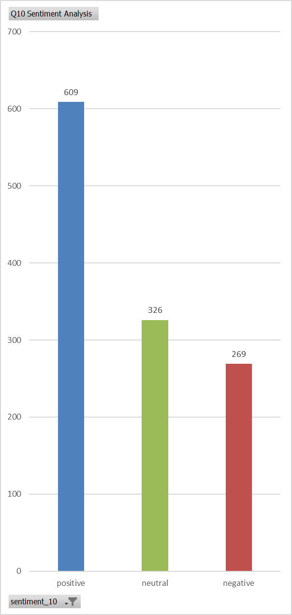
Q10: How important is having a strong local economy to you? How would you like to see the City support local economic growth and vitality? - 51% expressed positive sentiments
Recommendations
Support local and small businesses through reduced bureaucracy, financial assistance, and promotion
Invest in workforce development and provide support for entrepreneurs
Reduce barriers to opening local businesses, particularly by addressing high commercial rent costs
Diversify the economy by attracting and supporting industries beyond tourism, such as technology, manufacturing, healthcare, and the arts, to create more stable, higher-paying jobs
Provide targeted support, resources, and opportunities for minority-owned (particularly Black-owned) businesses
Ensure economic growth initiatives consider the impact on residents' quality of life, infrastructure capacity, and housing affordability

Slide 32
Q11: How often do you interact with City employees? How could the City improve interactions with City employees?
Improvement Recommendations
Customer Service Focus
Improved Responsiveness and Follow-Up
Enhanced Employee Training
Increased Transparency
Greater Accountability
More Community Input
Improved Accessibility
Enhanced Communication
Daily
(Highest Category)

Slide 33
“What We Learned”
SAVANNAH GPS

Slide 34
Themes that Helped Us Fill In the Gaps
Public Safety & Crime Prevention
Increase street lighting
Better enforcement of laws
City takes more of a lead role in addressing homelessness
Pet/animal control and abuse prevention
Infrastructure & Maintenance
Road repairs and traffic flow improvements
Drainage and water leak responses
Street and park lighting
Concerns about petty crimes and panhandling

Slide 35
Themes that Helped Us Fill In the Gaps
Housing & Zoning
Rental property upkeep
Zoning changes to incentivize residential development
Education & Youth Programs
Funding for public schools
High-school partnerships

Slide 36
Themes that Helped Us Fill In the Gaps
Government Transparency & Accountability
Clear communication from government
Equitable code enforcement
Engagement with local communities and nonprofits
Transportation & Traffic
Street calming and traffic signals
Bike lanes and pedestrian infrastructure (everywhere not only to provide access to transit)
Metrics of success/Performance Management
Transparency and reporting

Slide 37
Themes that Helped Us Fill In the Gaps
Health & Environment
Water quality and pressure
Tree maintenance and wildlife control
Business & Economic Development
Limit hotel development

Slide 38
Themes that Helped Us Fill In the Gaps
Community Engagement
More Town halls
Faith-based and volunteer collaboration
Technology & Services Access
Access to public WiFi
More efficient permitting and license processes
City’s website
Language Accessibility

Slide 39
Presentation of Draft Strategic Plan
SAVANNAH GPS

Slide 40
GOAL 1: Increase Public Safety and Our Collective Sense of Security
The City of Savannah will strive to enable Savannahians to live, work, and play in safe neighborhoods and have a strong sense of community safety through key investments in effective public safety initiatives.
Drive Down Violent Crime, End Preventable Deaths, and Improve Community Safety.
End gun violence by partnering with community organizations to engage in targeted outreach, enacting common sense policies and ordinances, enforcing gun safety laws, and focusing on confiscating illegal firearms from the streets.
End preventable deaths from fires through data-driven expansion of public education initiatives, expanding household fire safety programs, and enforcing fire safety rules and regulations.
End preventable deaths from traffic accidents by improving transportation infrastructure, enhancing traffic management, strengthening law enforcement, and expanding public education through the implementation of the Vision Zero initiative, which aims to protect human lives.
Foster safe behaviors in young people by supporting programs and services to help them reach their full potential, such as mentorship, job training, violence prevention programs, and other supportive services.
Collaborate with federal agencies and local prosecutors to prioritize successful prosecution of all violent offenders.

Slide 41
GOAL 1: Increase Public Safety and Our Collective Sense of Security
Build stronger community partnerships and improve transparency.
Strengthen community policing by enhancing initiatives such as the Community Specialist Program to increase police presence to focus on enforcing ordinance violations and quality of life issues.
Develop interactive online public engagement tools to display public safety trends, policies, and safety data to encourage citizen feedback and engagement.
Improve public communication during emergencies as well as routine public safety interactions.
Collaborate with local nonprofits, schools, and businesses to strengthen the network of support and resources that address community safety and engagement needs.
Ensure public safety policies, such as those related to use of force, community policing, mental health crisis response, and fire safety are reviewed and updated regularly with our community to ensure best practices and improved outcomes.

Slide 42
GOAL 1: Increase Public Safety and Our Collective Sense of Security
Provide public safety personnel with necessary tools, resources, and training to effectively meet modern challenges and enhance community protection.
Expand the public safety technology program by enhancing the real-time safety center and leveraging advanced data analytics.
Modernizing public safety facilities and upgrade safety equipment and fleet apparatus.
Expand wellness and resilience programs to better support the mental and physical health of public safety personnel.
Increase and diversify training and certification opportunities, including specialized programs.
IV. Develop, implement, and maintain a comprehensive strategy to recruit, retain, and develop a diverse and highly qualified public safety workforce.
Update staffing and hiring processes, strategically recruit diverse candidates, refine onboarding procedures, and implement comprehensive career development and succession planning.
Use proven recruitment strategies to attract and keep young people in public safety careers and create programs that help develop local talent through community partnerships.
Continue enhancing rewards and incentive programs.

Slide 43
GOAL 2: Invest in Equitable Community Development & Resiliency
The City of Savannah is dedicated to building strong neighborhoods, protecting housing, and promoting the well-being of all residents while celebrating our unique and diverse cultures and supporting individuals, families, and communities.
Expand access to housing affordability and availability, address homelessness.
Implement programs and partner with organizations to build, retain, and improve affordable and workforce housing options for individuals and families.
Update housing policies and ordinances to remove barriers and offer incentives that encourage the development of affordable housing.
Work with local partners to make homelessness rare, brief, and nonrecurring by developing an effective crisis response system, improve connections to permanent housing and services, and continually addressing public health and safety issues that are present in areas where homelessness persists.

Slide 44
GOAL 2: Invest in Equitable Community Development & Resiliency
Implement initiatives that build resilience, improve health, and foster stronger community connections and civic responsibility.
Promote and advocate for better access to health resources and provide programs that promote active lifestyles and address physical and mental health needs.
Invest in world-class, community-based recreation resources and programming that is available and accessible for all Savannahians.
Develop training and resources that empower neighborhood associations and build the capacity of residents, community organizations, and local nonprofits to effectively address community needs.
Promote civic engagement and volunteerism through improved citizen board and commission training, onboarding and support, and expand informal opportunities to participate in local service and governance.
Outreach to underserved and underrepresented communities to educate, inform and engage individuals on issues and opportunities to improve quality of life.
Celebrate Savannah’s unique and diverse cultures by promoting the arts and celebrating our diverse communities.
Identify and protect Savannah's diverse local history and culturally significant assets, including the renovation and restoration of the Savannah Civic Center to a world class facility that serves the entire community.
Implement projects that support local arts, creative works, and innovative reuse of materials.
Host programs and events that expand access and attract diverse audiences to learn, share and celebrate art, local cultures and history.
Develop and implement a Public Art Master Plan.

Slide 45
GOAL 3: Expand Economic Access, Opportunity & Vitality for All
The City of Savannah is dedicated to expanding economic security for all residents by ensuring everyone has fair access to economic opportunities. We strive to grow our local economy by supporting local businesses and entrepreneurs and spearheading programs, policies, and actions that create and protect good-paying jobs and make it easier to do business in the City of Savannah.
Enhance financial security for low-wealth households by improving access to jobs, resources, and economic opportunities.
Invest in meaningful workforce development programs that train and place Savannahians in high-demand, high-paying jobs with clear career pathways.
Support programs that empower residents to build long-term wealth through homeownership, savings, and investments by leveraging grants and partnerships.
Collaborate with partners and local businesses to foster economic opportunity by implementing effective economic development incentive programs, streamlining permit and license processes, and building needed infrastructure to support local economic growth.

Slide 46
GOAL 3: Expand Economic Access, Opportunity & Vitality for All
Support local, small, and minority-owned businesses and entrepreneurs.
Establish and support business incubators and strengthen partnerships to expand opportunities for certified DBE and small businesses.
Expand business training and offer incentives to encourage small business growth, bringing more jobs to the community.
Partner with local neighborhoods to invest and incentivize local business growth along historic and emerging neighborhood commercial corridors.
Meaningfully prioritize certified DBE and local business in City procurement processes.
Promote sustainable and equitable development by leveraging community assets and historic preservation.
Advance strategic community-based initiatives that enhance public spaces, improve neighborhood corridors, and boost local quality of life through sustainable development.
Implement incentives that spur investment in underinvested areas and prevent forced displacement and the negative impacts of gentrification.
Use place-based planning and land-use policies, like neighborhood and small area plans, to drive redevelopment efforts that prioritize equity, sustainability, and the preservation of historic neighborhoods.

Slide 47
GOAL 3: Expand Economic Access, Opportunity & Vitality for All
Expand access to public transit and mobility options.
Partner with local organizations to inform residents about available public transit options.
Support infrastructure improvements such as sidewalks, bike paths, and pedestrian crossings to provide safe and convenient access to public transit stops.
Work with Federal, State, Regional and Local Partners to provide maximum access to transportation options for low-income residents.
Promote the development of housing and commercial spaces near transit hubs.

Slide 48
GOAL 4: Develop World Class Livable Environment & Infrastructure
The City of Savannah will make equitable investments in our infrastructure and built environment to create strong, resilient communities, support a thriving economy, and protect our environment.
Build better, stronger infrastructure to handle the needs of a growing community and changing climate.
Develop a comprehensive stormwater master plan to guide the design and construction of infrastructure that reduces flooding and mitigates the impacts of 100-year storm events, hurricanes, heatwaves, and other extreme weather conditions.
Invest in advanced infrastructure for all City systems, using technology to monitor their condition in real time.
Maintain full compliance with regulatory requirements and best practices by integrating environmental, public health, and safety standards into infrastructure planning, operations, and maintenance.
Update building standards to support safe, resilient, and sustainable construction practices by incorporating industry standards, best practices, green design principles, and environmental sustainability.
Maximize the lifespan of our infrastructure by implementing comprehensive asset management and proactive preventative maintenance programs.

Slide 49
GOAL 4: Develop World Class Livable Environment & Infrastructure
Create and maintain world class public spaces that are safer, more accessible and welcoming for all.
Deliver consistent, high-quality maintenance services in all neighborhoods to uphold equity, preserve community assets, and enhance quality of life citywide.
Enhance the City’s transportation system through appropriate traffic management and traffic calming strategies to increase safety and reduce crashes, while improving connections across neighborhoods.
Prioritize street and sidewalk maintenance throughout the City.
Use urban and architectural design and the management of built and natural environments, to improve quality of life and public safety, including installing better lighting, advanced security systems, and emergency stations.
Upgrade and modernize public spaces to meet current and future community needs, and prioritize street, trail, and sidewalk maintenance throughout the City.

Slide 50
GOAL 4: Develop World Class Livable Environment & Infrastructure
Be a leader in establishing environmentally healthy policies and equitable land use plans that protect our natural and cultural resources.
Engage the community in the planning and design of all public spaces and comprehensive zoning and land use plans.
Continue and potentially expand the 100% Savannah Clean Energy plan and sustainability programs.
Support community-led efforts such as tree planting, habitat restoration, and clean-up events, while strengthening community engagement and education campaigns and programs to raise awareness about environmental issues.
Collaborate with neighboring jurisdictions to take a leadership role in regional planning initiatives.
Strengthen and expand existing initiatives to preserve historic sites, restore historic buildings, and further promote Savannah’s cultural history.
Support the use of recycled, locally sourced materials in construction, and encourage practices that reduce waste, save energy, and protect the environment.

Slide 51
GOAL 5: Improve Quality of Life by Raising Municipal Service Standards
The City of Savannah is committed to improving the quality of life for residents by raising the standard of upkeep and maintenance of public spaces and rights-of-way, and by providing high-quality residential services that promote healthy, vibrant and peaceful neighborhoods.
I. Improve neighborhood quality and livability.
Strengthen enforcement of quality-of-life codes and effectively enforce City Ordinances that protect the use of public spaces for the enjoyment of all.
Prioritize initiatives for reducing blight, removing graffiti, and supporting beautification programs such as Keep Savannah Beautiful.
Monitor and assess neighborhood conditions, addressing issues like litter, speeding and noise on a regular basis.
Continue collaborating with residents and organizations to promote neighborhood cleanliness through education and active engagement.
Conduct tri-annual reviews of quality-of-life codes and standards.

Slide 52
GOAL 5: Improve Quality of Life by Raising Municipal Service Standards
Keep public spaces and infrastructure safe, clean, and well-maintained.
Equip staff with appropriate training and tools to enhance upkeep, address issues, and to maximize customer service quality.
Strengthen standards for maintaining public spaces to ensure facility accessibility, functionality, useability and quality for citizens and visitors.
Leverage new technology to streamline and improve processes to maximize maintenance efficiencies and minimize cost.
Deliver exceptional and personalized customer service efficiently and equitably.
Enhance efforts to provide timely updates on schedules for routine municipal services—like trash collection, recycling pickups, and street cleaning.
Enhance and expand the City’s 311 system to serve as a centralized platform for capturing, integrating, and tracking service requests from all sources; use this data to monitor service levels, identify changing service demand trends, and engage and educate the community on City services and responsiveness.
Use tools and surveys to measure customer satisfaction and establish a “push” notification to inform residents about things that may impact their service schedule.
Establish a customer service program that trains employees and holds them accountable.

Slide 53
GOAL 6: Always Be a High-Performing Government
The City of Savannah will provide exceptional municipal services that are responsive, inclusive, and innovative. We will partner with citizens and businesses in the development of solutions for the community, practice sound fiscal management and do all things with integrity, transparency, and accountability.
Ensure every dollar of public funds is spent wisely, transparently, and to the maximum benefit of our community.
Exercise prudent and long-term focused fiscal practices that keep property tax rates as low as possible, maintain reserves, sustain a high credit rating, and diversifies revenue streams.
Transparently align budget resources with the City’s key priorities.
Save money to the taxpayer by implementing operational efficiencies, eliminating redundancy and waste, and optimizing partnerships to leverage shared services.

Slide 54
GOAL 6: Always Be a High-Performing Government
Use the latest technology to make city services fast, easy and accurate.
Enhance utility billing processes, implement user-friendly payment options and upgrade to digital records.
Implement a new Enterprise Resource Planning (ERP) System.
Launch data and performance management initiatives to monitor performance through open portal dashboards and trend analysis.
Build a talented team of great public servants committed to providing exceptional services to residents.
Maintain a disciplined employee performance review process that builds professional strengths and holds team members accountable for expected job performance.
Integrate Diversity, Equity and Inclusion principles in hiring and promotion processes.
Refine and advance a comprehensive compensation strategy.
Offer training and professional growth opportunities to employees.
Celebrate employee achievements and improve internal communication.
Implement a citywide succession plan and Workspace Master Plan.
See upcoming Equity Strategic Plan

Slide 55
Leading Indicators
SAVANNAH GPS

Slide 56
Understanding Strategic Progress Measurement

Slide 57
Goal 1: Increase Public Safety and Our Collective Sense of Security
Community Safety Perception Index
Annual survey measuring residents' sense of safety in neighborhoods, downtown, and parks
Crisis Response Effectiveness Ratio
Percentage of mental health and non-violent crisis calls resolved without arrest/force

Slide 58
Goal 2: Invest in Equitable Community Development & Resiliency
Housing Affordability Index:
Homelessness Rate Reduction:
Percentage of households spending less than 30% of income on housing by neighborhood
Annual percentage change in total homelessness based on point-in-time counts
Community Health Disparities Index:
Inclusive Community Engagement Measure:
Measures gaps in key health outcomes between neighborhoods
Assessment of demographic representativeness in public participation across city activities

Slide 59
Goal 3: Expand Economic Access, Opportunity & Vitality for All
Household Financial Stability Index
Small Business Vitality Index
Local Economic Impact Measure
Commercial District Vitality Score
Percentage of households with emergency savings and positive net worth
Measures new business formation, survival rates, and diversity of business ownership
Percentage of total city spending captured by local businesses
Measures vacancy rates, business diversity, pedestrian activity, and property values
Jobs-Housing Balance Ratio
Relationship between jobs and housing within neighborhoods

Slide 60
Goal 4: Develop World Class Livable Environs & Infrastructure
Public Space Access and Quality
Index
Water System Performance Index
Infrastructure Equity Score
Percentage of residents with quality public spaces within 10-minute walk
Composite score of water quality, system reliability, and customer satisfaction
Ratio of infrastructure condition and investment across neighborhoods

Slide 61
Goal 5: Improve Quality of Life by Raising Municipal Service Standards
Service Equity Index
Quality of Life Compliance Effectiveness
Blight Reduction Rate
Public Space Experience Rating
Measures disparities in service delivery times, quality, and outcomes across neighborhoods
Number of blighted properties rehabilitated or addressed by neighborhood
Ratio of resolved quality of life complaints to total complaints
Composite score of cleanliness, safety, accessibility, and amenity quality
Resident Satisfaction Index
Annual survey assessing satisfaction with municipal services

Slide 62
Goal 6: Always Be a High-Performing Government
Government Effectiveness Rating
Financial Performance Rating
Savannah's performance on key services against benchmark cities
Composite of bond ratings, reserve levels, revenue diversity, and liability management
Digital Service Adoption and Satisfaction
Percentage of transactions completed digitally and satisfaction ratings
Operational Excellence Measure
Annual cost savings and service improvements from efficiency initiatives

Slide 63
Next Steps and Implementation
Strategic Plan Integration
Incorporate feedback into final plan
2
Measurable Metrics
Develop specific activities and dashboards
Implementation Framework
3
Assign responsibilities and timelines
Continued Engagement
Regular updates and feedback mechanisms
Annual Review
Evaluate progress and adjust strategies

Slide 64
Thank You!
SAVANNAH GPS

Slide 65
City Council Meeting
May 22, 2025

