Slide 1
City Hurricane Preparedness
A Prepared and Adaptive Savannah
City of Savannah/Emergency Planning Division/City Hurricane Preparedness

Slide 2
Agenda
Hurricane Season Basics
Preparedness
Response
Recovery
What Can You Do

Slide 3
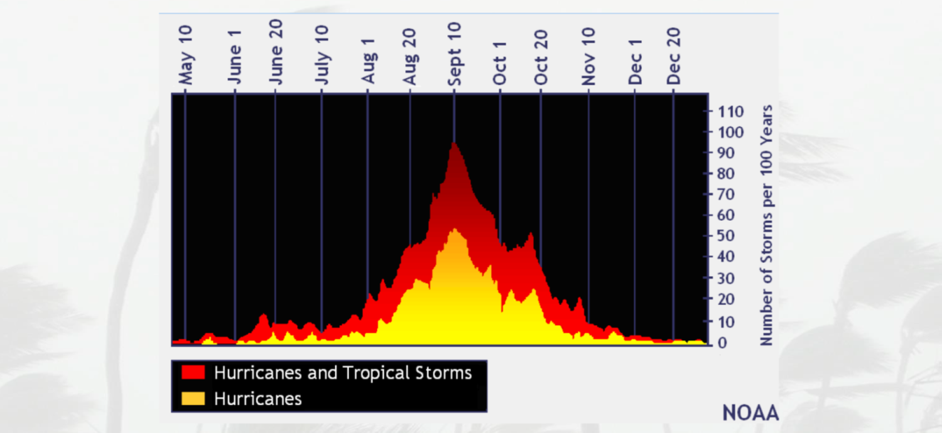
Hurricane Season
June 1st – November 30th
Peak around September 10th
Notes:
Hurricane Season runs June 1st to November 30th with the peak being around September 10th.
However, we have had tropical cyclones in every month of the year.

Slide 4
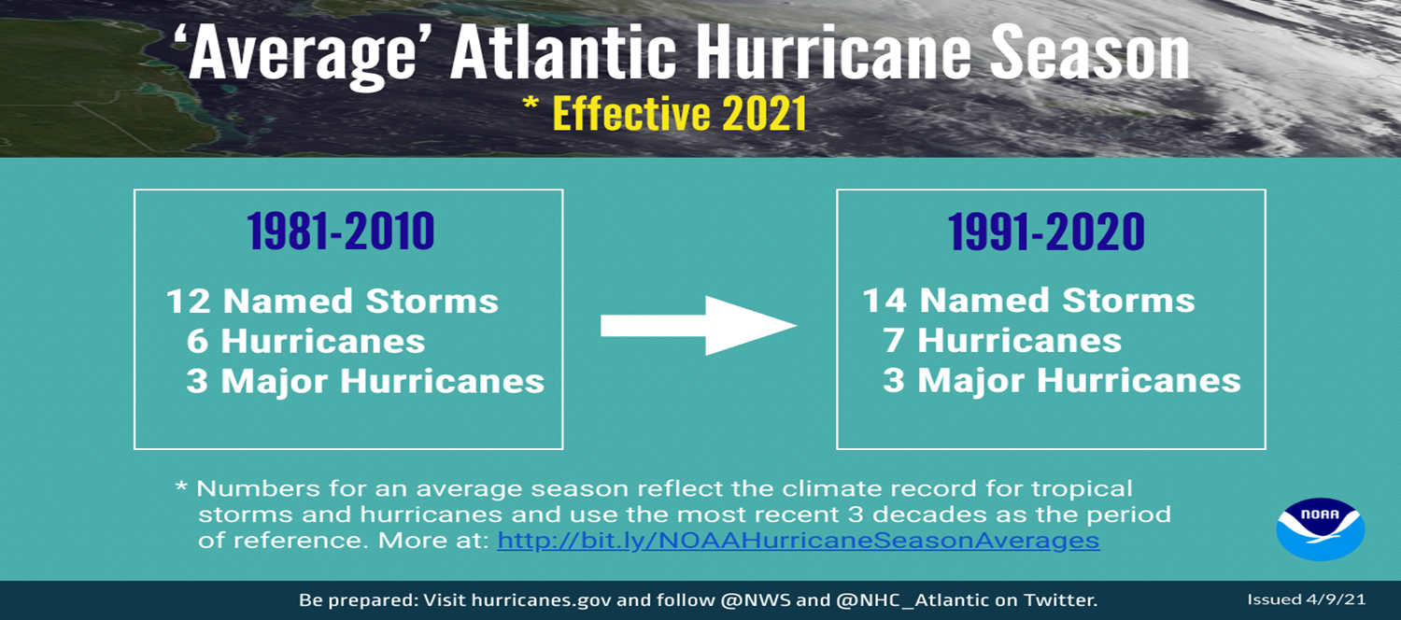
Hurricane Season
Average Year
  14 Named
  7 Hurricanes
  3 Majors
Notes:
To date we have had four named storms which is above average activity at this point.
Hurricane Don was longest lasting storm on record for July.

Slide 5
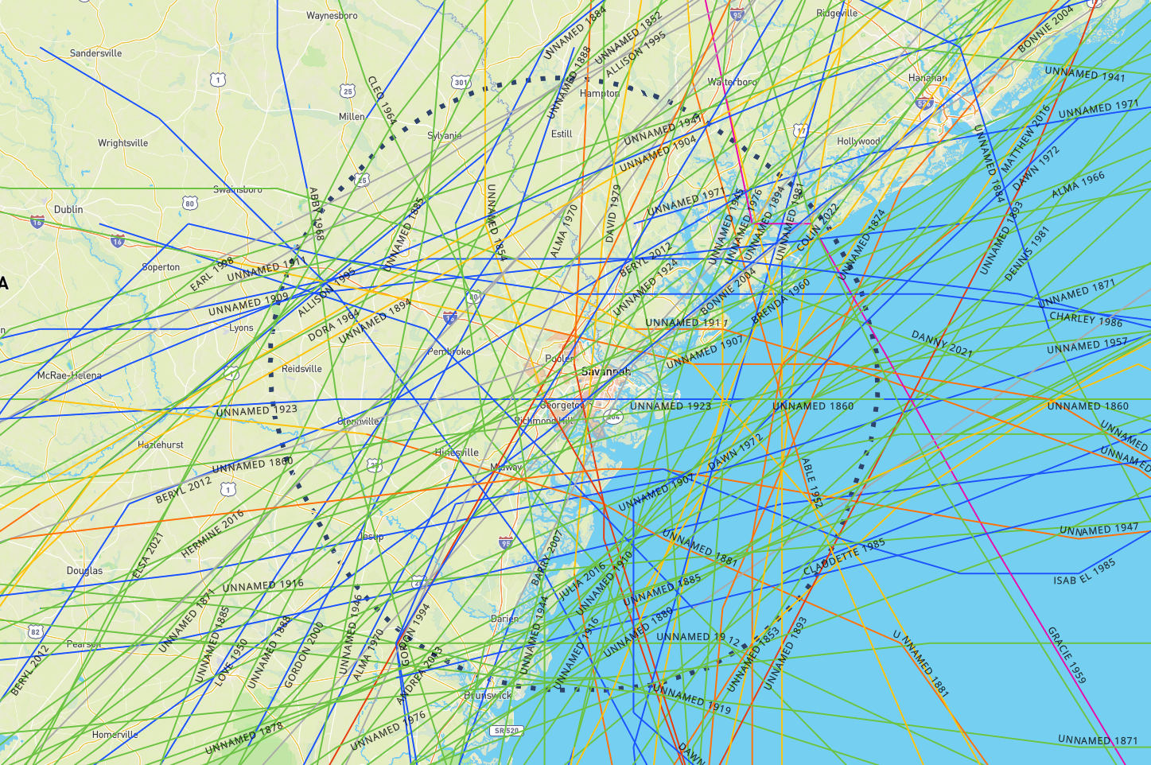
Tropical Cyclones - SAV
Notes:
All TCs w/in 50 miles

Slide 6
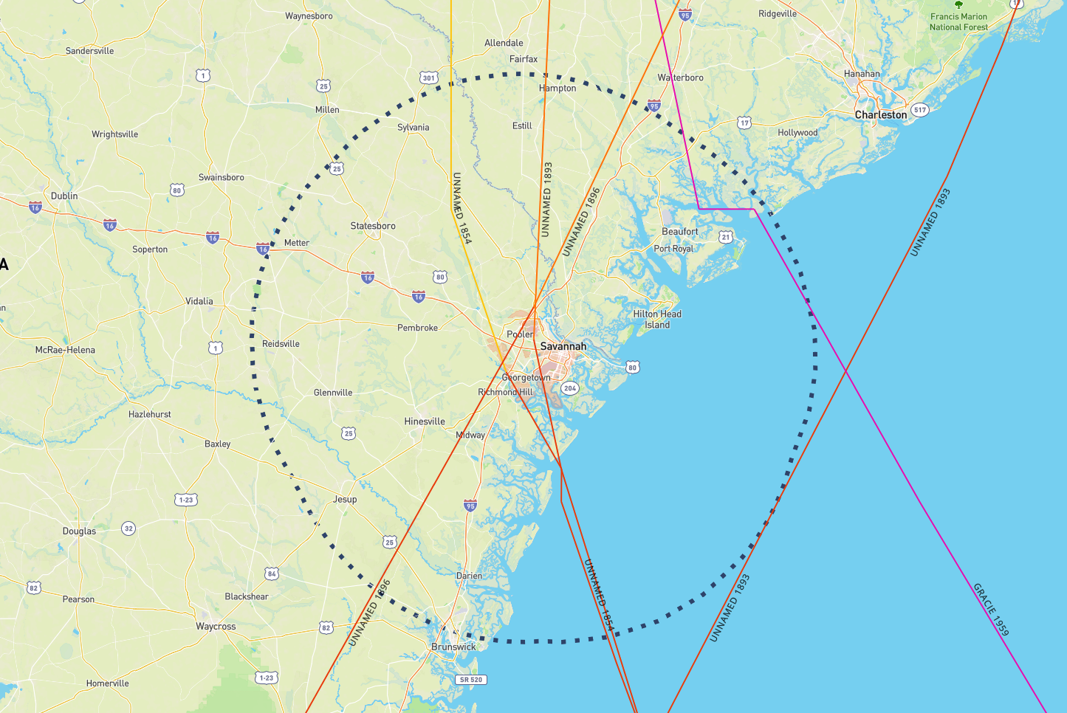
Major Hurricanes - SAV
Notes:
All Cat 3+ to hit SAV; Has Happened – Likely to Happen again

Slide 7
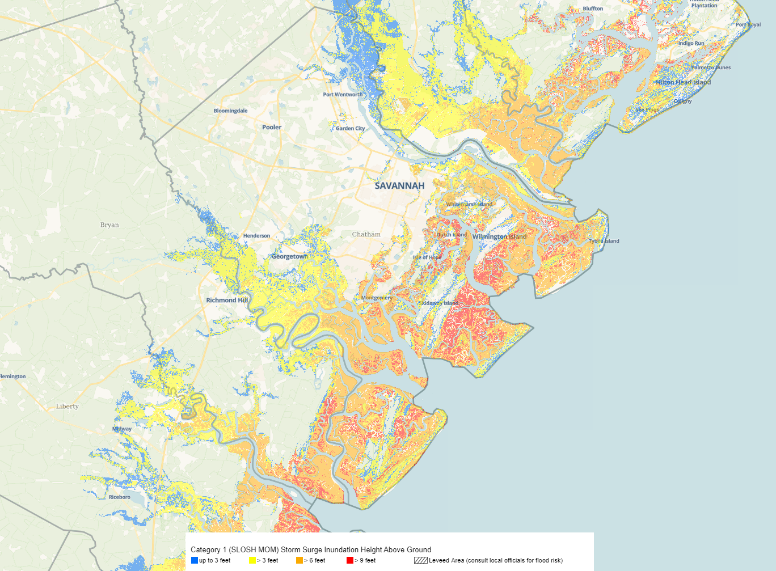
Category 1 Storm Surge
Notes:
Category one storm surge
Worse case storm to our south moving up Ogeechee River

Slide 8
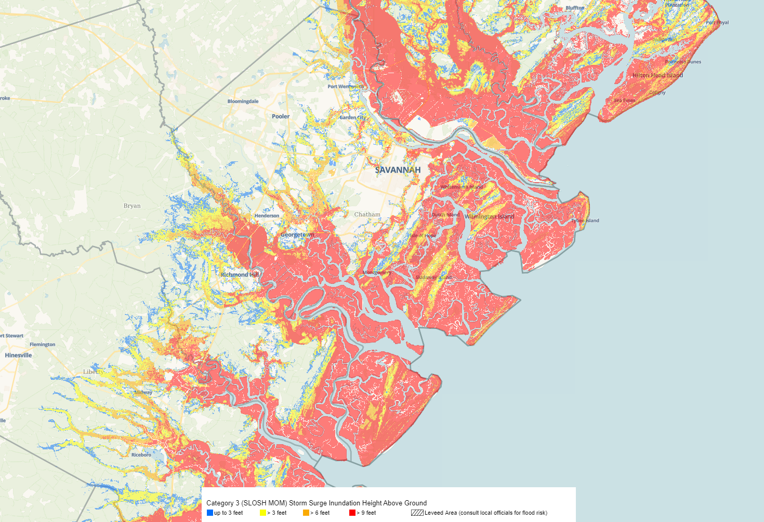
Category 3 Storm Surge
Notes:
Category 3 storm surge
1893 sea islands hurricane 20 foot a surge

Slide 9
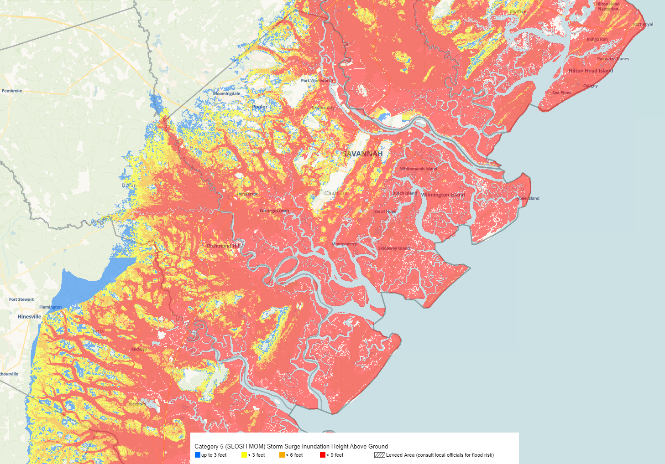
Category 5 Storm Surge
Notes:
Category 5 storm surge

Slide 10
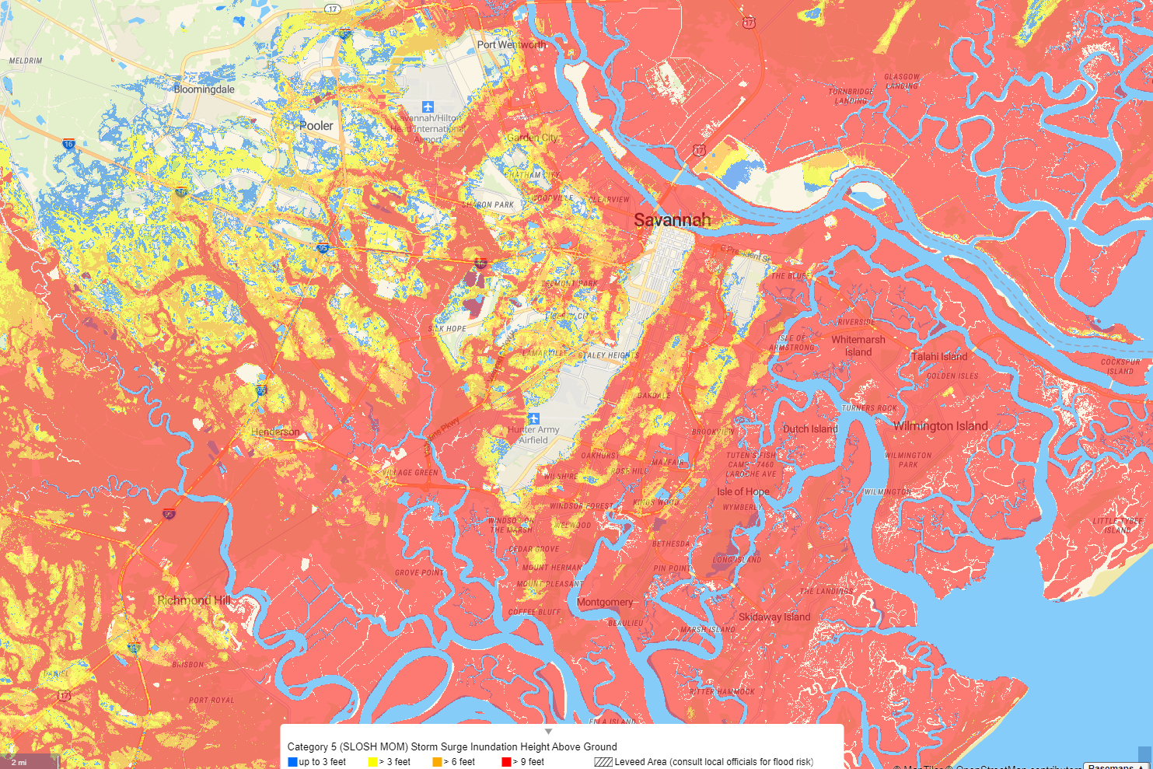
Category 5 Storm Surge
Notes:
Category 5 storm surge zoom in

Slide 11
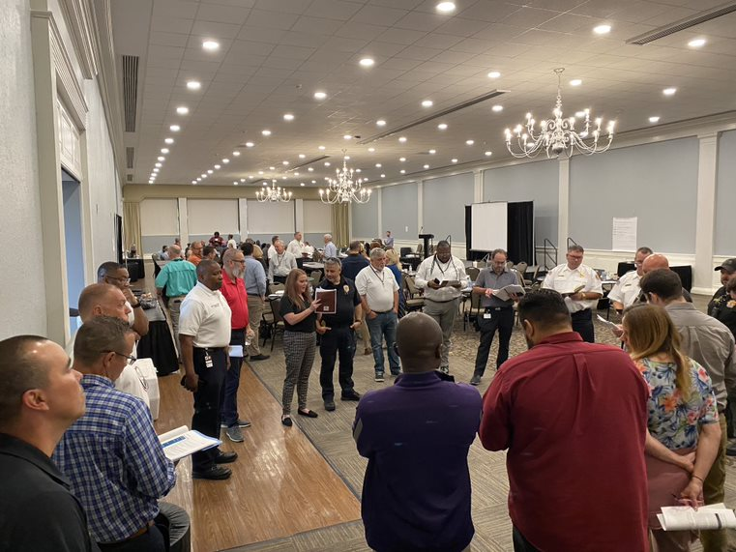
City Preparedness

Slide 12
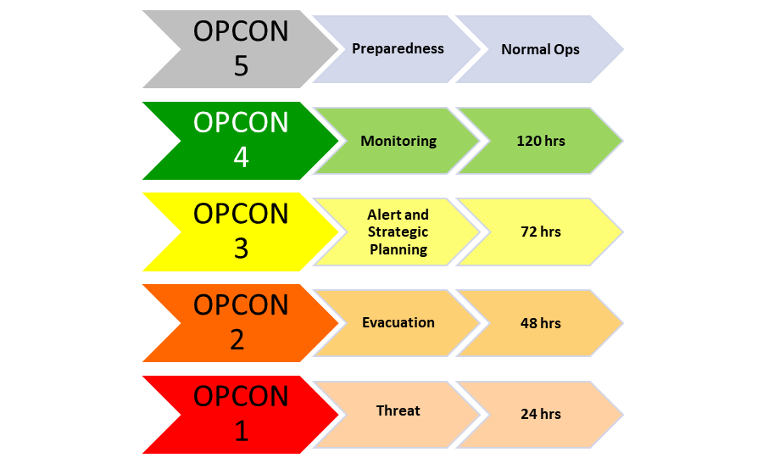
Operating Conditions (OPCONs)
Notes:
In Georgia, we base our preparations and response on operating conditions or OPCONs.
These OPCONs reflect timeframes for planned activities such as staging equipment, supplies, vehicles, the prepping of facilities and the movement of people.

Slide 13
OPCON 5 - Preparedness
Normal Day-to-Day Operations
  Planning
  Teams
  Training
  Exercises
  Agreements
Notes:
Some say OPCON 5 is June first to November 30th.
However, I would say OPCON 5 is all year round because we have other hazards we need to prepare for and if we wait till June first to prepare for hurricanes, we are behind the power curve.
City staff has developed plans to deal with a multitude of hazards to include hurricanes.
Teams have been developed in order to carry out those plans.
These teams meet monthly to train on the plans.
The city holds a hurricane exercise annually as well as others.
The city has agreements with partner agencies and vendors to provide items such as shelters for critical workforce, food, transportation, and lodging.

Slide 14
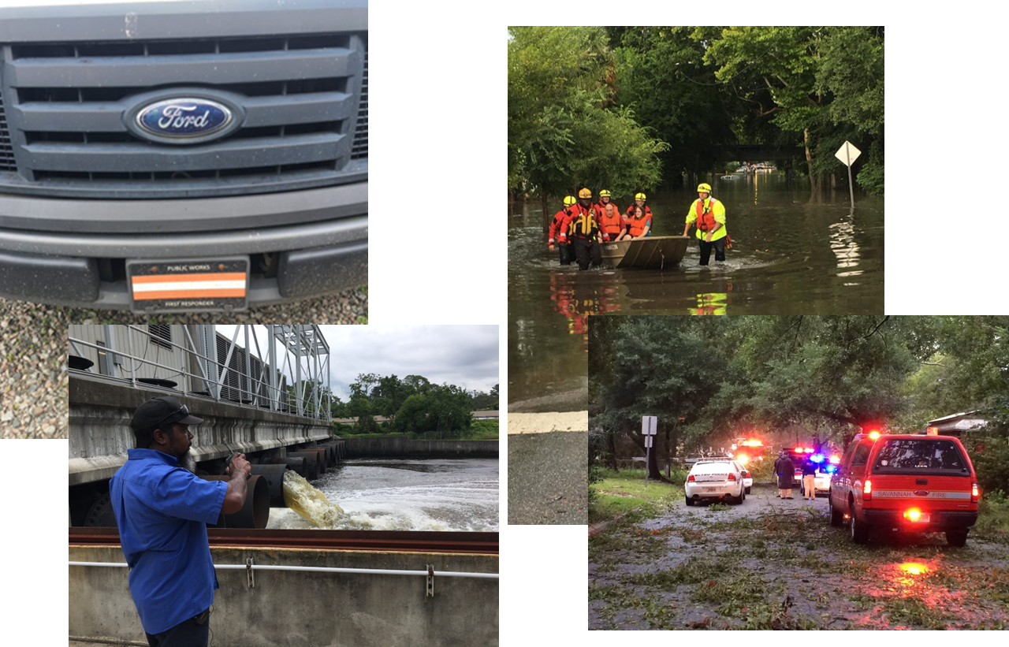
Response

Slide 15
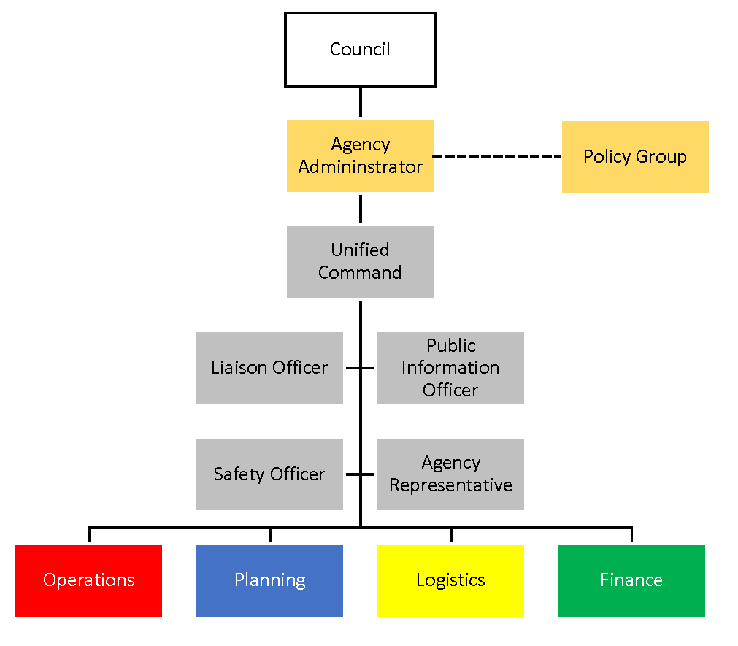
Savannah Command
Notes:
Savannah has adopted the national incident management system and thereby the incident command system in order to manage incidents and disasters.
The policy group is made-up of the city manager, city attorney, and business center chiefs as well as the PIO, HR director, and myself.
The policy group advises the agency administrator which is the city manager preparations and response activities leading up to a storm. This would also include policy direction.
The city incident management team led by unified command, which is made-up of fire, infrastructure and police reports to the city manager.
All departments would communicate with the team their situational status and resource needs.

Slide 16
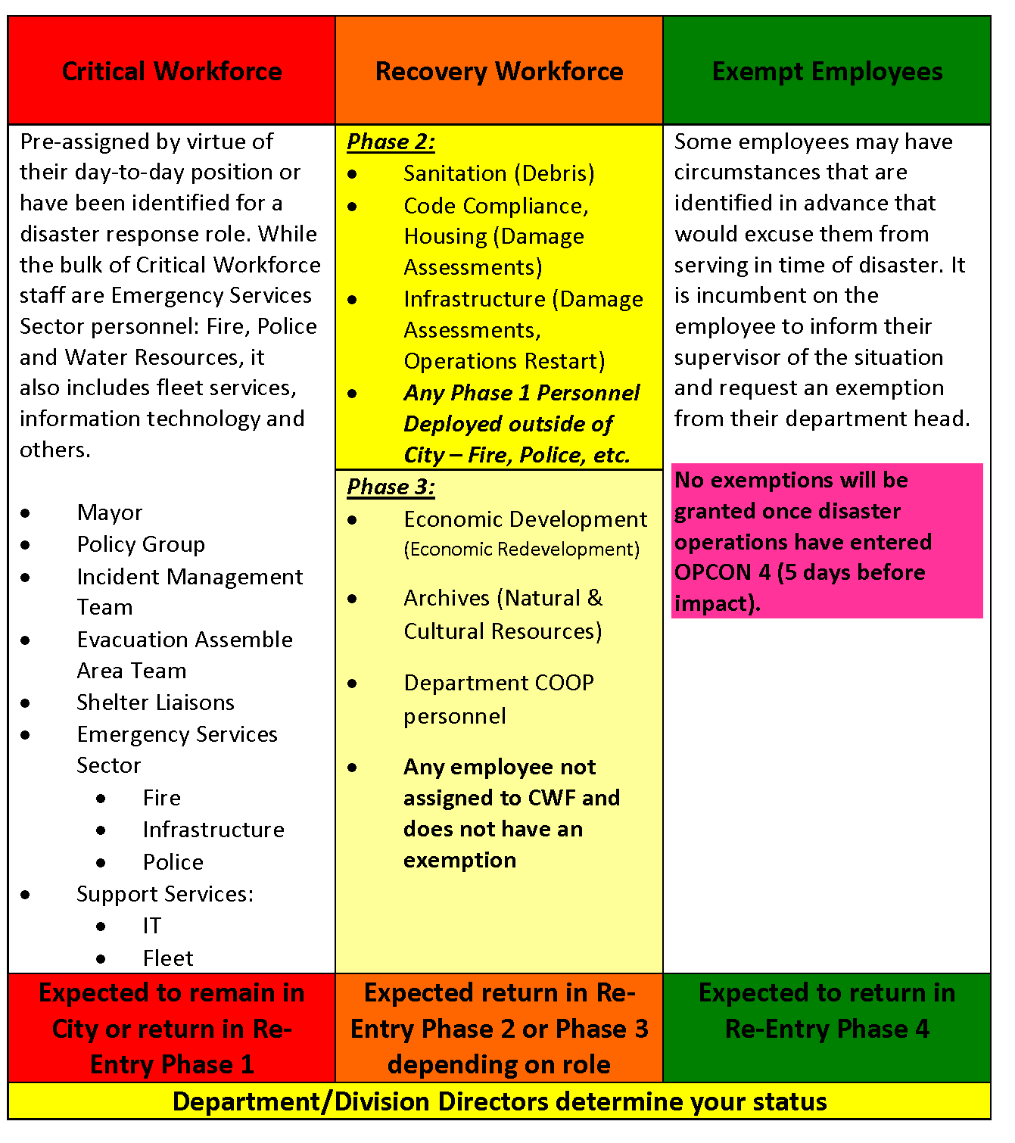
Critical Workforce
Notes:
Mayor is critical workforce by virtue of being on County Command Policy Group. Aldermen are not CWF and should follow evacuation/re-entry orders as residents.

Slide 17
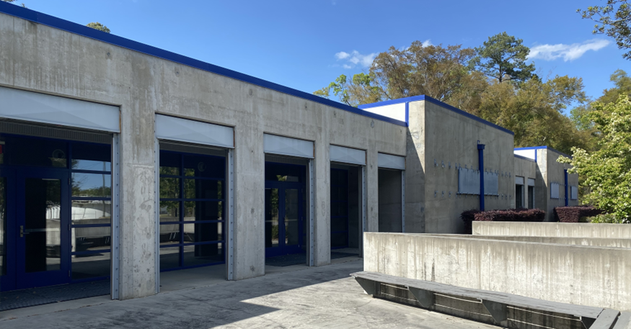
Critical Workforce Shelters
MOUs/MOAs
  Georgia Southern
  St. Joseph-Candler
  Mercer University
Notes:
We are working to add the airport.
GSU – up to 600
Mercer – up to 300 in Cat 4/5
SJC – up to 80 Police only

Slide 18
Know Your Zone

Slide 19
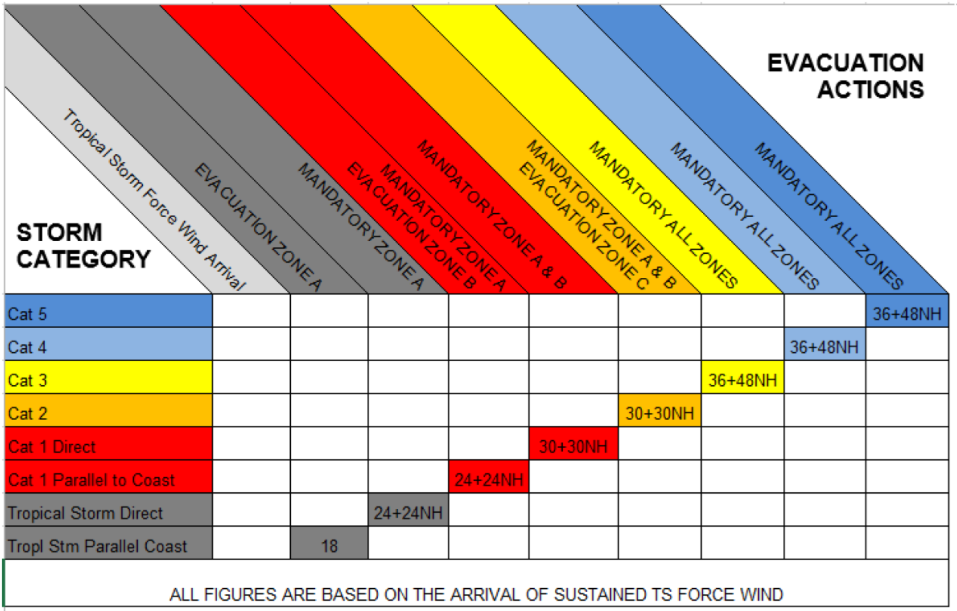
Evacuation Guidelines
Notes:
Starting with category one direct we would evacuate the majority of the county

Slide 20
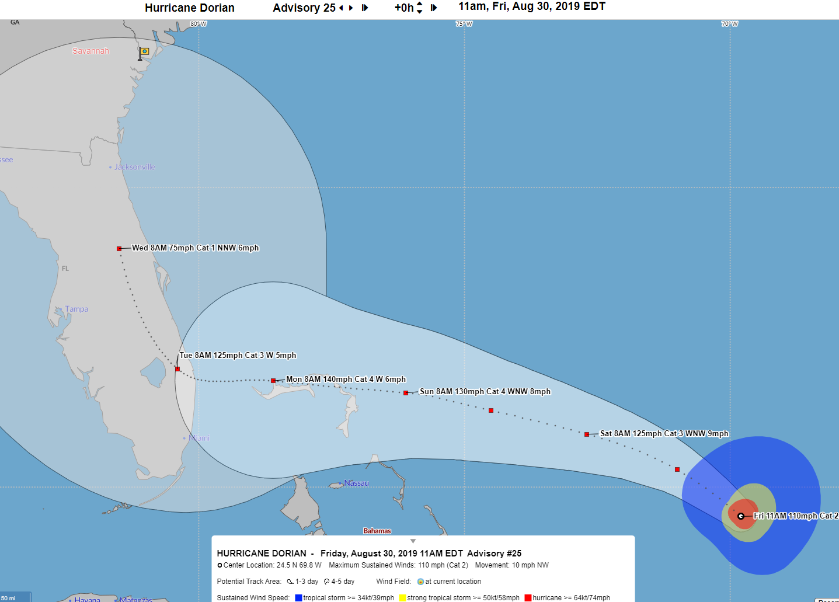
OPCON 4 – 120 hours
Notes:
120 to Tropical Storm Force Winds

Slide 21
OPCON 4 – Monitoring contd.
120 hours until Tropical Storm Winds
  Activate Planning & Logistics (@ 96 hrs)
  Threat information to staff
  Coordination Calls
  Disaster Contracts on standby

Slide 22
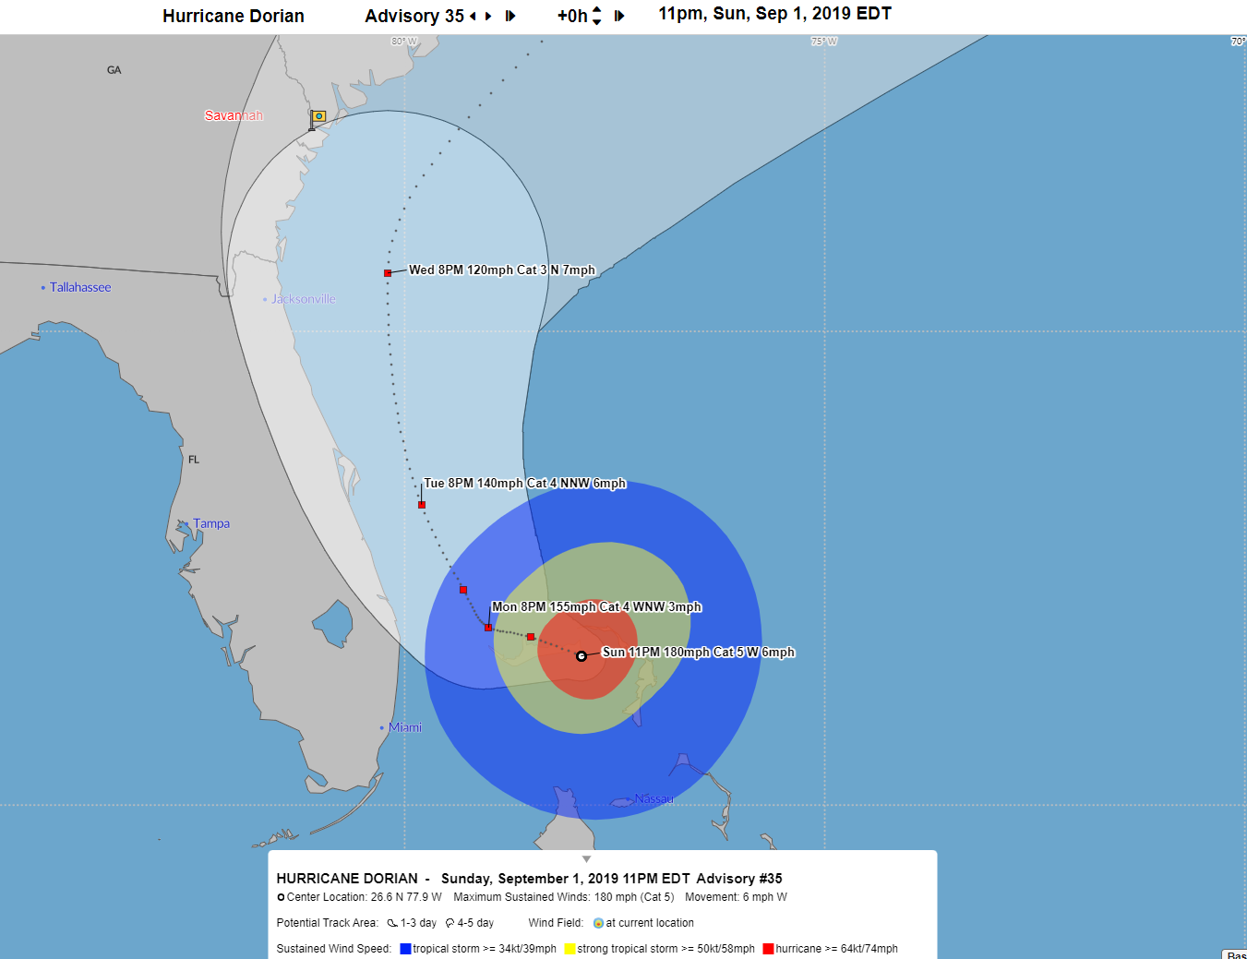
OPCON 3 – 72 hours

Slide 23
OPCON 3 – Alert and Strategic Planning
72 hours until Tropical Storm Winds
  Command Post – Partial Activation
  Coordination Calls
  Prepare Facilities/Homes
  Evacuation Decision and timeline
  Activate disaster contracts
  Mayor declares state of emergency
Notes:
Partial activation will have command and general staff working.
Allow staff to go prep homes and families.

Slide 24
OPCON 2 – Evacuation
48 hours until Tropical Storm Winds
  Command Post – Full Activation
  Alpha-Bravo Shifts (12 on/off)
  City office closures, release staff
  Evacuation Assemble Area opens
  Continue Preparations at Facilities
  Move vehicles, records and equipment
  Disaster Pay Enacted
Notes:
Current time to evacuate the whole county is 36 hours. HCFs 48 hours
We will not start evacuations at night

Slide 25
OPCON 1 – Threat
24 hours until Tropical Storm Winds
  Command Post – Full Activation
  Critical Workforce moves to shelters
  Evacuation Assemble Area closes (@ 6 hrs.)
  Finalize Preparations at Facilities
  Suspend public safety response

Slide 26
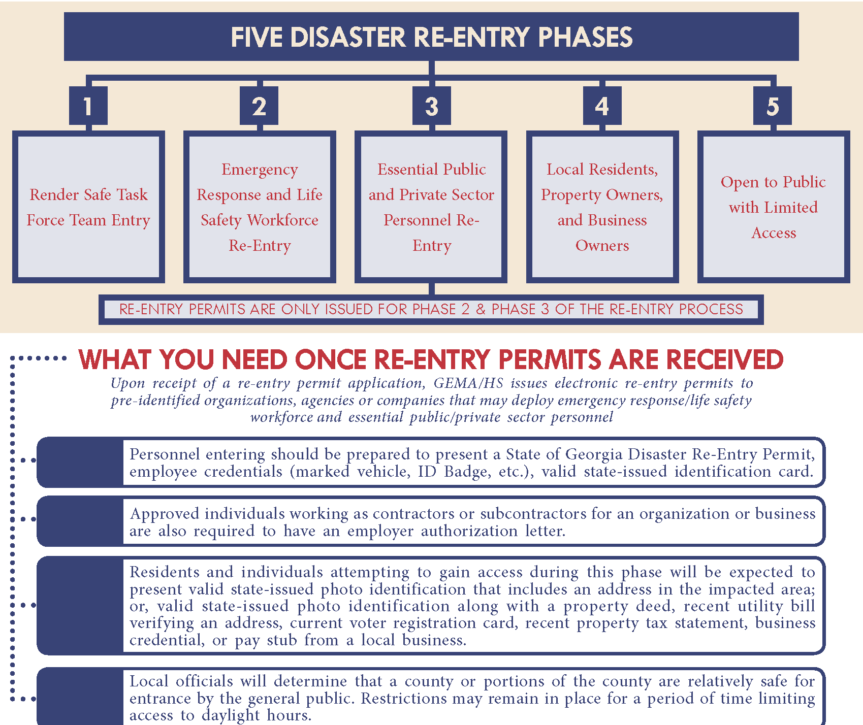
Re-Entry

Slide 27
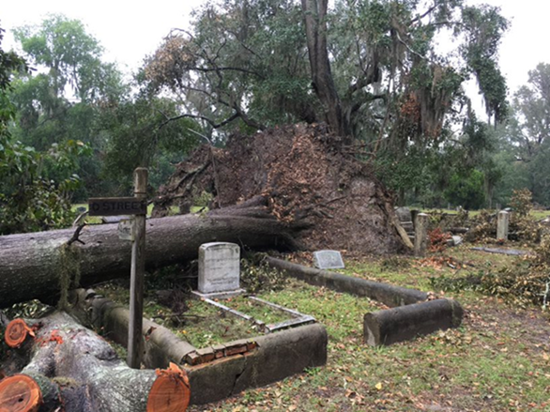
Recovery
Damage Assessment
Debris Management
Natural and Cultural Resources
Economic Redevelopment
Notes:
Damage Assessment covers two areas: residential and public infrastructure. Both rely on determining insured vs. uninsured/under insured losses.
Debris is handled by Sanitation which has contracts in place for pick up and monitoring of operations as required by FEMA.
Damages to historical properties will slow down both processes due to additional regulations.
People will need jobs, housing and schools plus transportation.

Slide 28
Presidential Declaration
Public Infrastructure, uninsured losses
County ($4.44) - $1,285,215.72
State ($1.77) - $18,956,700
Notes:
The disaster declaration process is predicated on damages to city owned facilities that are not insured.
Chatham pop – 289,463
GA pop - 10,710,000
$1.77 $4.44 $3,800 $1,000,000**
$34K is max grant from FEMA to individuals.

Slide 29
Council Responsibilities
Operating Condition (OPCON) | Responsibilities
5 – Preparedness (all year) | Normal Responsibilities
4 – Monitoring (120 hrs.) | Normal Responsibilities Increase Awareness Daily briefs start
3 - Alert and Strategic Planning (72 hrs.) | Daily briefs continue Recommendation to Mayor re. State of Emergency Share critical info broadly with constituents
2 – Evacuate (48 hrs.) | Briefs 2x daily Alderpersons evacuate IAW orders (same as residents) Mayor remains as member of CPG* Share critical info broadly with constituents
1 – Threat (24 hrs.) | Briefs 2x daily Mayor goes to CWS Share critical info broadly with constituents
Notes:
Mayor is critical workforce by virtue of being on County Command Policy Group. Aldermen are not CWF and should follow evacuation/re-entry orders as residents.

Slide 30
Council Responsibilities cont'd
Post Storm Phase | Responsibilities
Re-Entry | Briefs 2x daily Alderpersons return during re-entry phase 4 (same as residents) Share critical info broadly with constituents
Recovery | Briefs 2x daily and others as needed Council convenes as normal to address policy items Share critical info broadly with constituents

Slide 31

Residents
Prepare Now:
  Have A Plan
  Get A Kit
  Be Informed/Know Your Zone
  Insurance
  Heirs Property
  Evacuations
  Re-Entry
Notes:
Preparedness
Get A Plan
Get A Kit
Be Informed / Know Your Zone
Insurance – Flood Insurance
Evacuations

Slide 32
Resources
Get A Kit
  https://www.ready.gov/kit
CEMA Alerts
  https://www.smart911.com/smart911/ref/reg.action?pa=chathamcounty
Medical Registry
  https://www.chathamemergency.org/PrepareNow/HurricaneRegistry

Slide 33
Questions?
Dave Donnelly
Savannah Emergency Preparedness
912.652.3812
ddonnelly@savannahga.gov

Slide 34
Thank you

