Slide 1
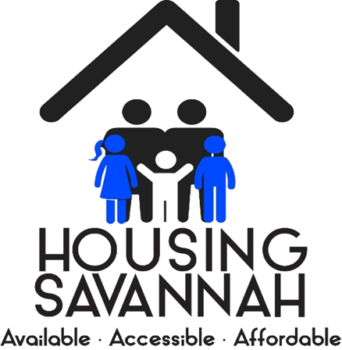

Housing Savannah Action Plan
Update: October 24, 2024
City Council
Workshop Presentation
Housing Savannah Action Plan
3-Year Progress Report
(2022-2024)

Slide 2
Housing Savannah Action Plan
Update: October 24, 2024
Background
2020 40-Member Citizen Task Force Appointed to Prepare Action Plan
2021 City Council Adopted 10-Year Housing Savannah Action Plan
      5 Strategies
      43 Action Items
2022 Action Plan Launched with a $7 Million City SAHF Investment

Slide 3
Housing Savannah Action Plan
Update: October 24, 2024
Findings
Housing costs outpaced incomes by at least 2:1 over 30 years.
21,000 (40%) Savannah households could not afford housing.
This includes households with incomes below $55,000 (now $65,000).
Need more affordable housing of all types and for all incomes.
Need to significantly increase SAHF investments and leveraging.
Need to adopt affordable housing friendly policies and incentives.

Slide 4
Housing Savannah Action Plan
Update: October 24, 2024
Goals
Increase SAHF investments to $10+ million annually by 2032.
Leverage $90+ million annually in additional investments by 2032.
Assist 1,500+ households improve housing annually by 2032.

Slide 5
Housing Savannah Action Plan
Update: October 24, 2024
3-Year Action Plan Goals & Results
Includes total all City, SAHF, and Private Investments
City Investments include HUD CDBG/HOME & SPLOST

Slide 6
Housing Savannah Action Plan
Update: October 24, 2024
3-Year Action Plan Activities & Investments
Includes total all City, SAHF, and Private Investments

Slide 7
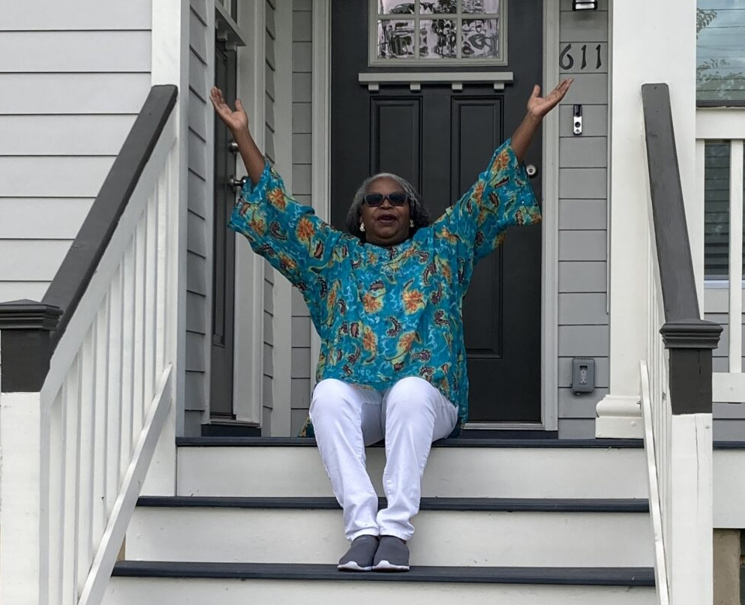
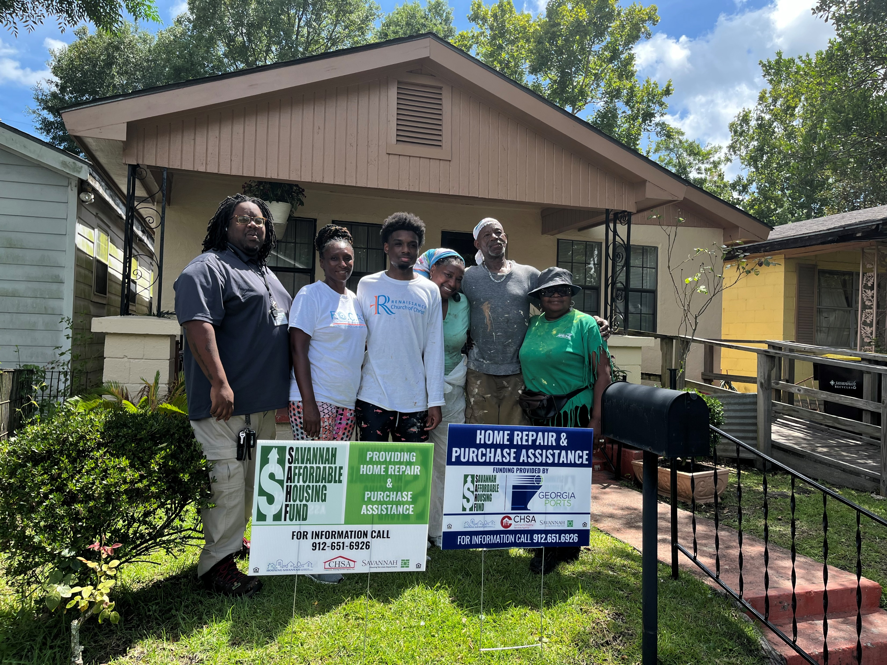
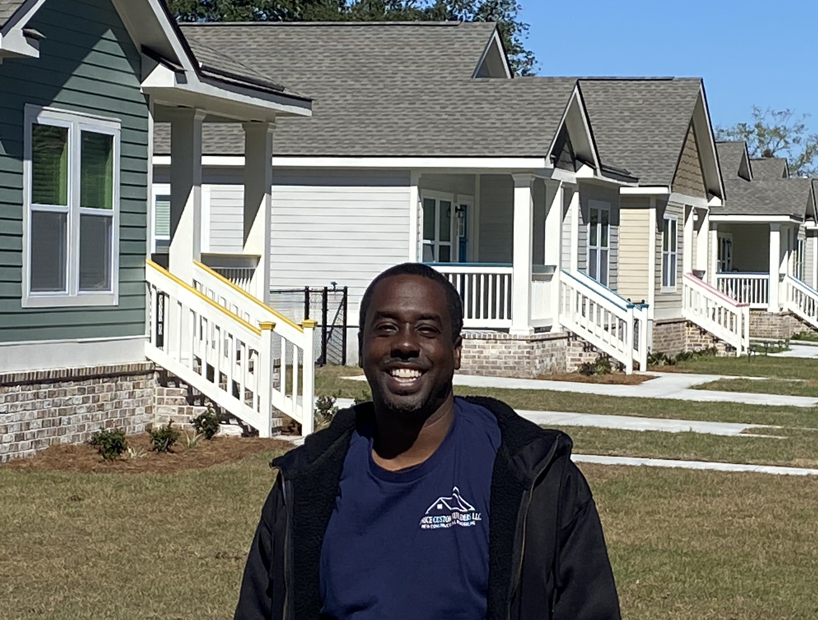
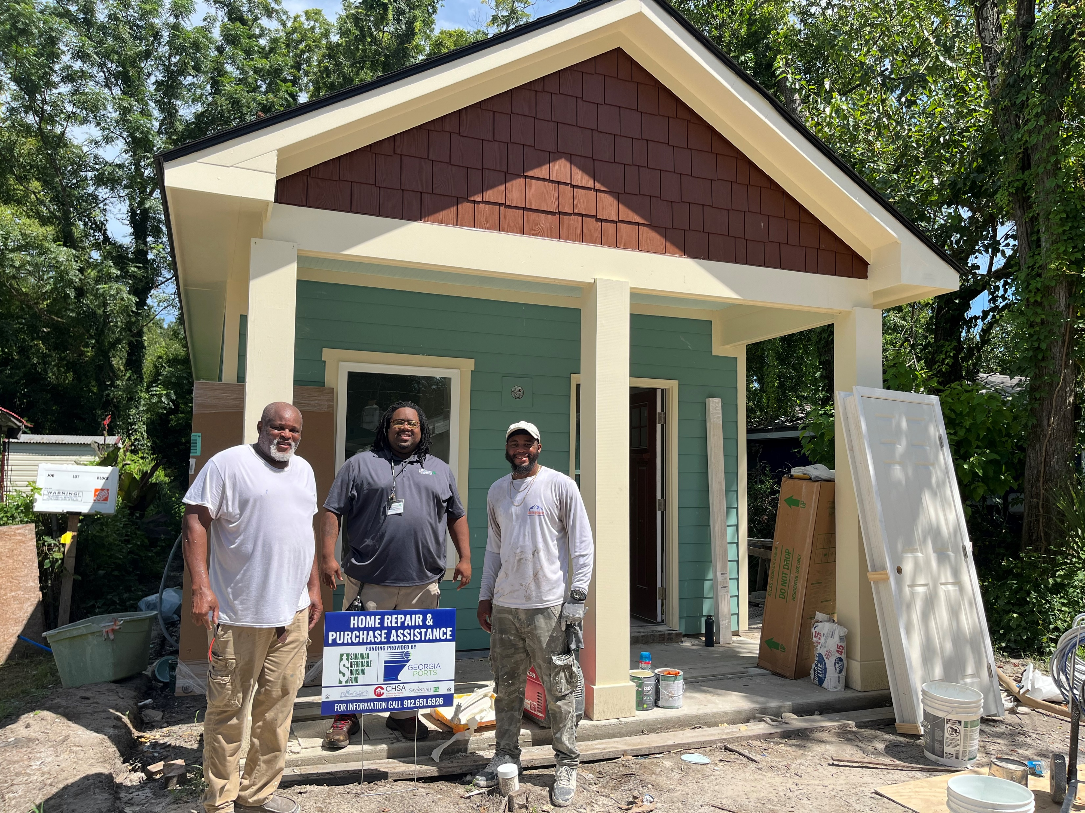
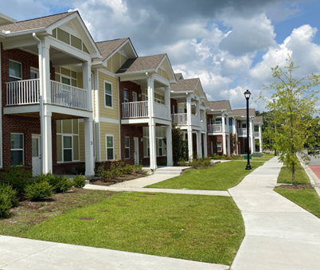
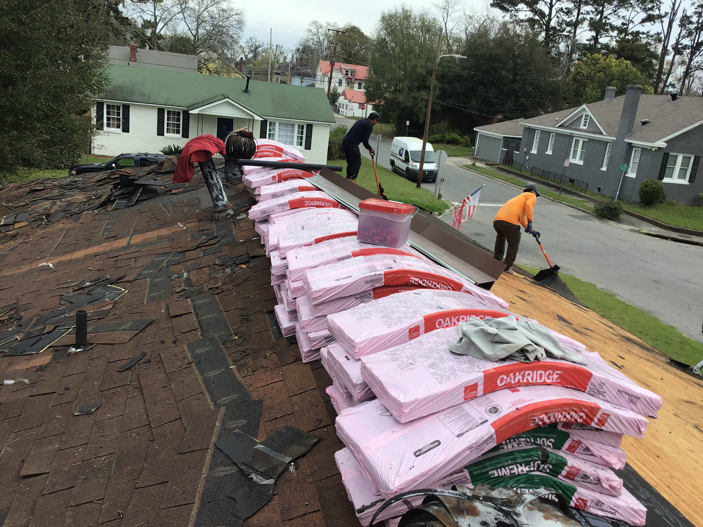
Housing Savannah Action Plan
Update: October 24, 2024
3 -Year Action Plan Participants

Slide 8
Housing Savannah Action Plan
Update: October 24, 2024
3-Year SAHF Deposits

Slide 9
Housing Savannah Action Plan
Update: October 24, 2024
Major Construction Projects Beginning in 2024-2025
1826 Florance Street – 4 Apartments for Medically Fragile Persons – In Permitting
916 MLK Jr. Blvd. – 16 Apartments for Households Exiting Homelessness – Out for Pricing
Dawes Avenue – 25-30 Single Family Homes – Finalizing Infrastructure Engineering
Fairgrounds Phase I – 30 Single Family Homes & 20 Townhomes – Plans Being Prepared
Fairgrounds Phase II – 64 Senior Apartments – Tax Credits Just Awarded

Slide 10
Housing Savannah Action Plan
Update: October 24, 2024
Defining Common Terms Associated with Housing
Affordable Housing is quality housing considered most affordable when, regardless of income, it can be rented or purchased by a household paying no more that 30% of its gross household income for housing. It is most often needed by households with incomes up to 120% of the Area Median Income (AMI) with the need increasing as household income decreases. Savannah households with annual incomes currently below $65,000 tend to be most in need.
Naturally Occurring Affordable Housing is typically older rental housing that is affordable without the need for government assistance. This housing is lost when upgraded and converted to higher priced housing in robust real estate markets.
Workforce Housing is Affordable Housing, sometimes referred to as Missing Middle Housing, needed by members of a community’s workforce with incomes between 80% and 120% AMI who typically have incomes above those eligible to receive federal government housing assistance yet below those required to afford market rate housing. Missing Middle Housing is also used, sometimes, to refer to housing with two or more dwellings in largely single-family neighborhoods.

Slide 11
Housing Savannah Action Plan
Update: October 24, 2024
Common Terms Associated with Housing
Low & Moderate Income Housing is Affordable Housing needed by community members, including members of its workforce, with incomes between 50% and 80% AMI who typically need moderate levels of housing assistance to afford housing.
Very Low Income Housing is Affordable Housing needed by community members, including members of its workforce, with incomes between 30% and 50% AMI who frequently need significant levels of housing assistance to afford housing.
Extremely Low Income Housing is Affordable Housing available to community members, including members of its workforce, with incomes below 30% AMI who frequently need heavily subsidized housing assistance.
Income Based Housing typically refers to housing that can be attained without a household paying more than 30% of its income for housing and is frequently associated with deep housing subsidies and/or rental payment vouchers like those of the Housing Choice Voucher program.

Slide 12
Housing Savannah Action Plan
Update: October 24, 2024
Upcoming Opportunities for City Council Support of Affordable Housing Friendly Policies and Incentives
Continue City Investment in the Savannah Affordable Housing Fund
Will be seeking the next installment of the City’s investment in the SAHF--$3M in 2025.
Expand & Preserve Naturally Occurring Affordable Rental Housing
The City and Land Bank Authority (LBA) are investigating partnership opportunities to retain and improve Naturally Occurring Affordable Housing and to support the development of new rental housing that receives affordability period property tax exemption in return for an ownership interest.
Protect Generational Property Ownership, Assets, and Options
The City is developing a plan that includes free Will preparation, title clearing assistance where possible, and the acquisition of vacant, unoccupied, and blighted property that clears title problems and provides interested heirs an opportunity to acquire the property with clear title. This initiative will also focus on speculator property that sits vacant, blighted, and is harming neighborhoods.

Slide 13
Housing Savannah Action Plan
Update: October 24, 2024
Upcoming Opportunities for City Council Support of Affordable Housing Friendly Policies and Incentives
Support Affordable Housing Zoning & Fee Reduction Initiatives
City staff are reviewing the zoning ordinance and current fee structure in search of opportunities to make housing retention, improvement, and development more affordable. In the coming weeks, it expects to present City Council with requests to support the following:
Affordable Housing Resolution describing different levels of affordable housing, supporting continued implementation of the HSAP, and encouraging the City Manager and staff to make affordable housing supportive policy and ordinance enhancements. (Nov 7)
Affordable Housing Discount Impact Fee Enhancement Resolution (Nov 7)
Zoning Ordinance Text Amendment Providing Affordable Housing Opportunity (Nov 7)
Draft Inclusionary Zoning Ordinance in support of affordable housing. (2025)

Slide 14
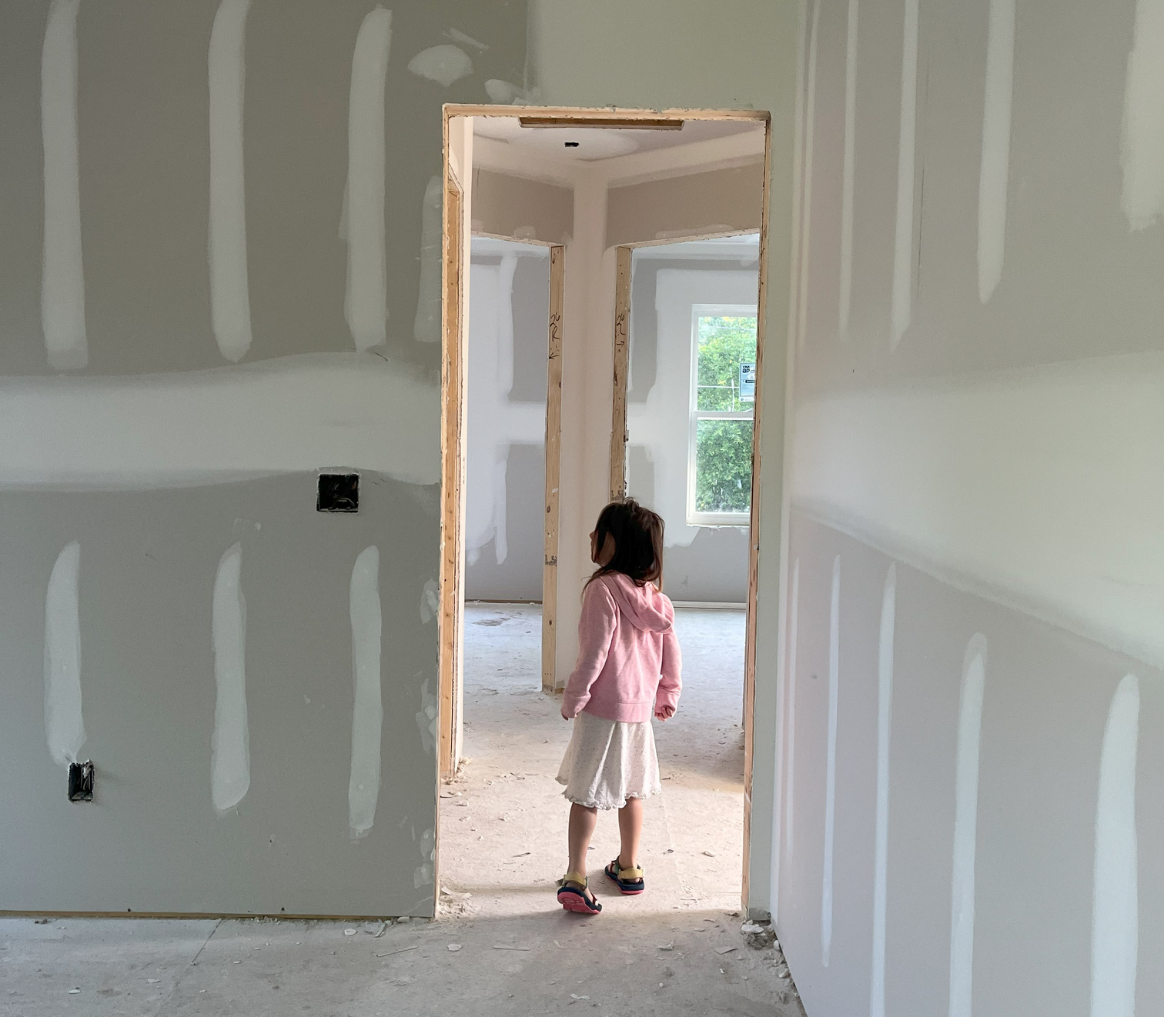
DENSITY BONUS
FOR
AFFORDABLE HOUSING
Authored by Briana Paxton, in partnership with the City of Savannah Planning Department and Chatham County - Savannah Metropolitan Planning Commission

Slide 15




The Problem
Current zoning prohibits “varying” density
Cannot rebuild missing middle housing (duplexes, triplexes, quads) in areas they already exist
Many households cannot find housing they can afford

Slide 16
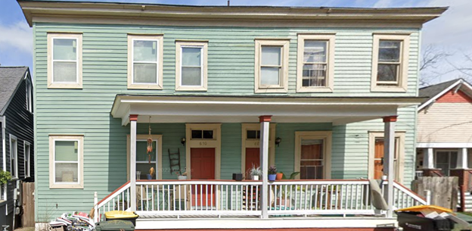
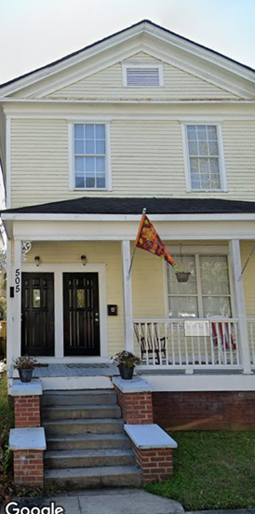
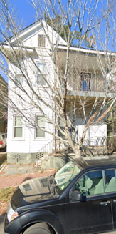
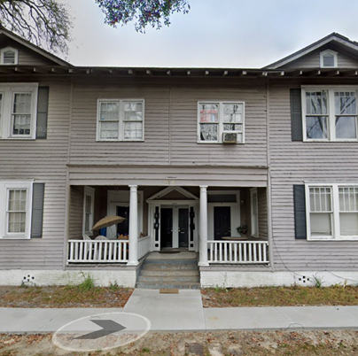
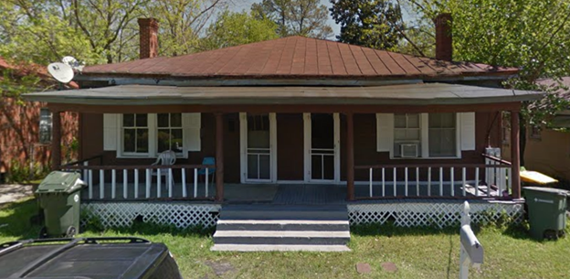
Why Missing?
All of these structures, located in the TC, TN, and TR districts are currently illegal to build due to the restrictions on density.

Slide 17
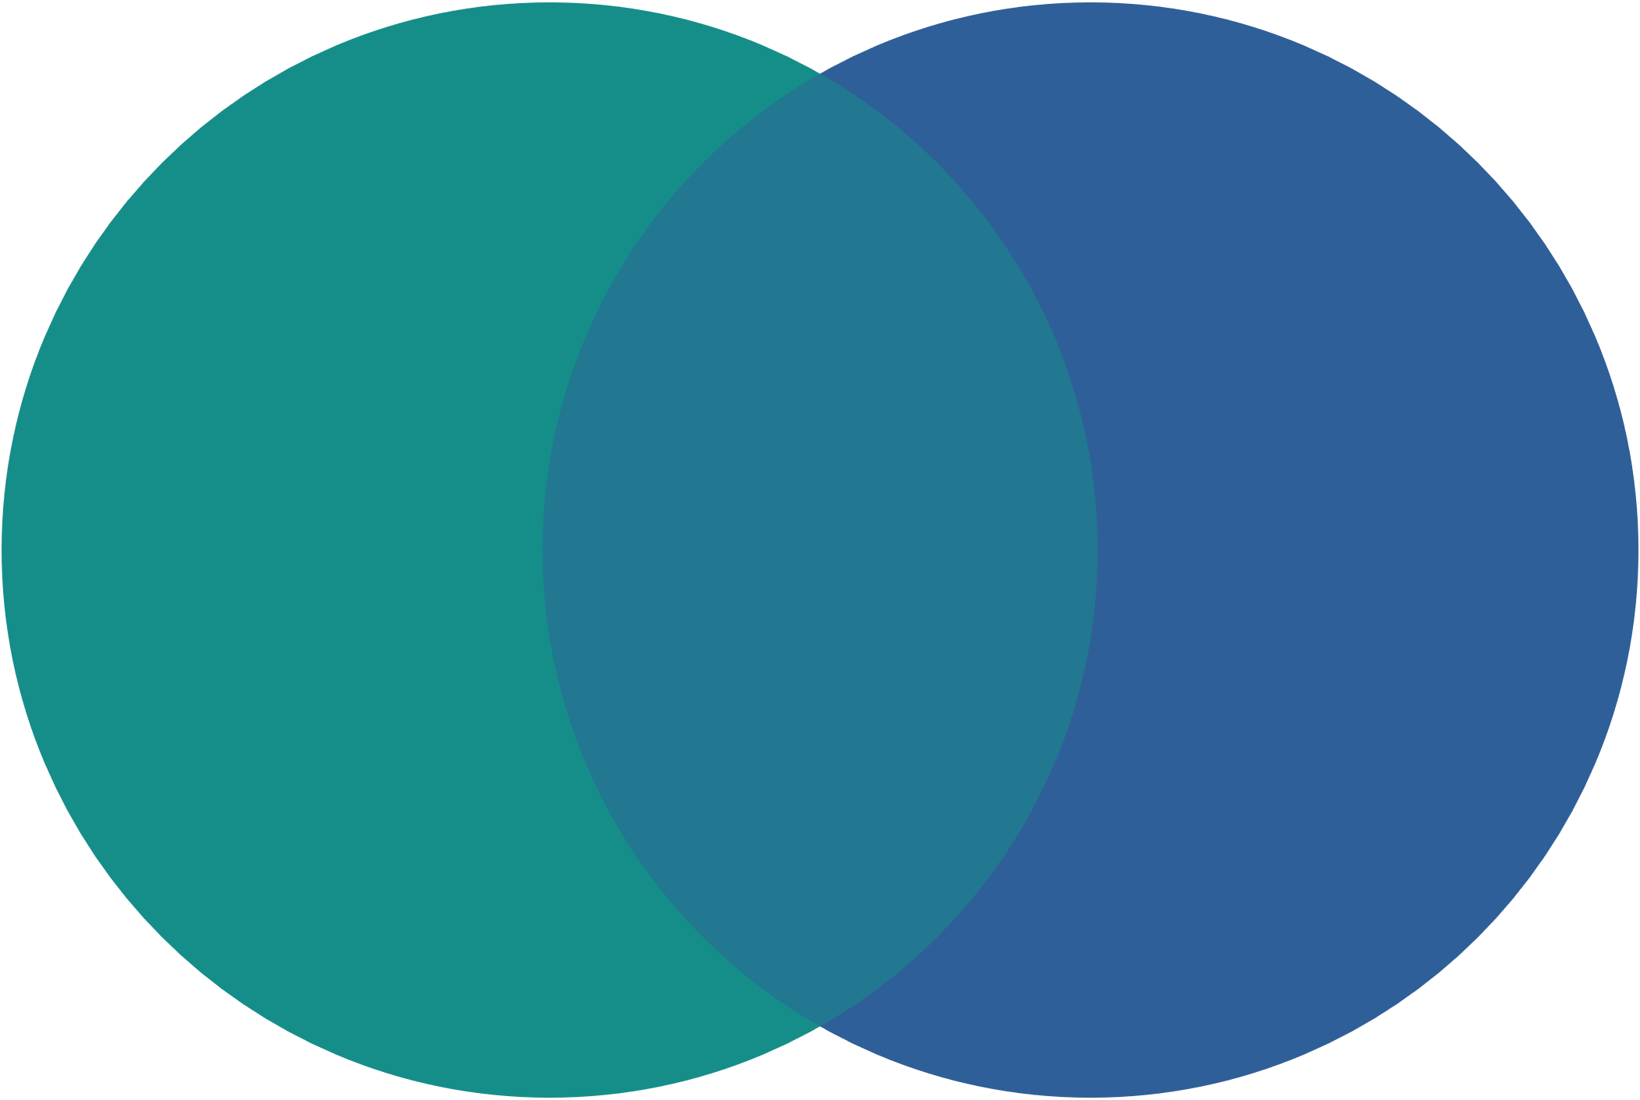

Why More Affordable Housing?
Savannah Area Median Income = $56,823
as quantified by U.S. Department of Housing and Urban Development
Homeowners
Renters
Affordability
Gap
Median Household Income
for Families with Children
Affordability Gap
Married Couple
Single Female HOH
Single Male HOH
$106,958
$23,584
$41,473
<150% AMI
>50% AMI
>75% AMI
$140,722
Affordable to Household Earning AMI
Median Housing Costs
(Rent+ Est. Utilities)
$527
Affordable to
Renter at AMI
Median Sale Price
$324,990
$202,268
$1797
per month
$1270
Affordability Gap
$241,040
Affordable to Single Female HOH with Children at >50% AMI
Median Sale Price
$324,990
$83,950
Research & Graphics by Emma Covello

Slide 18
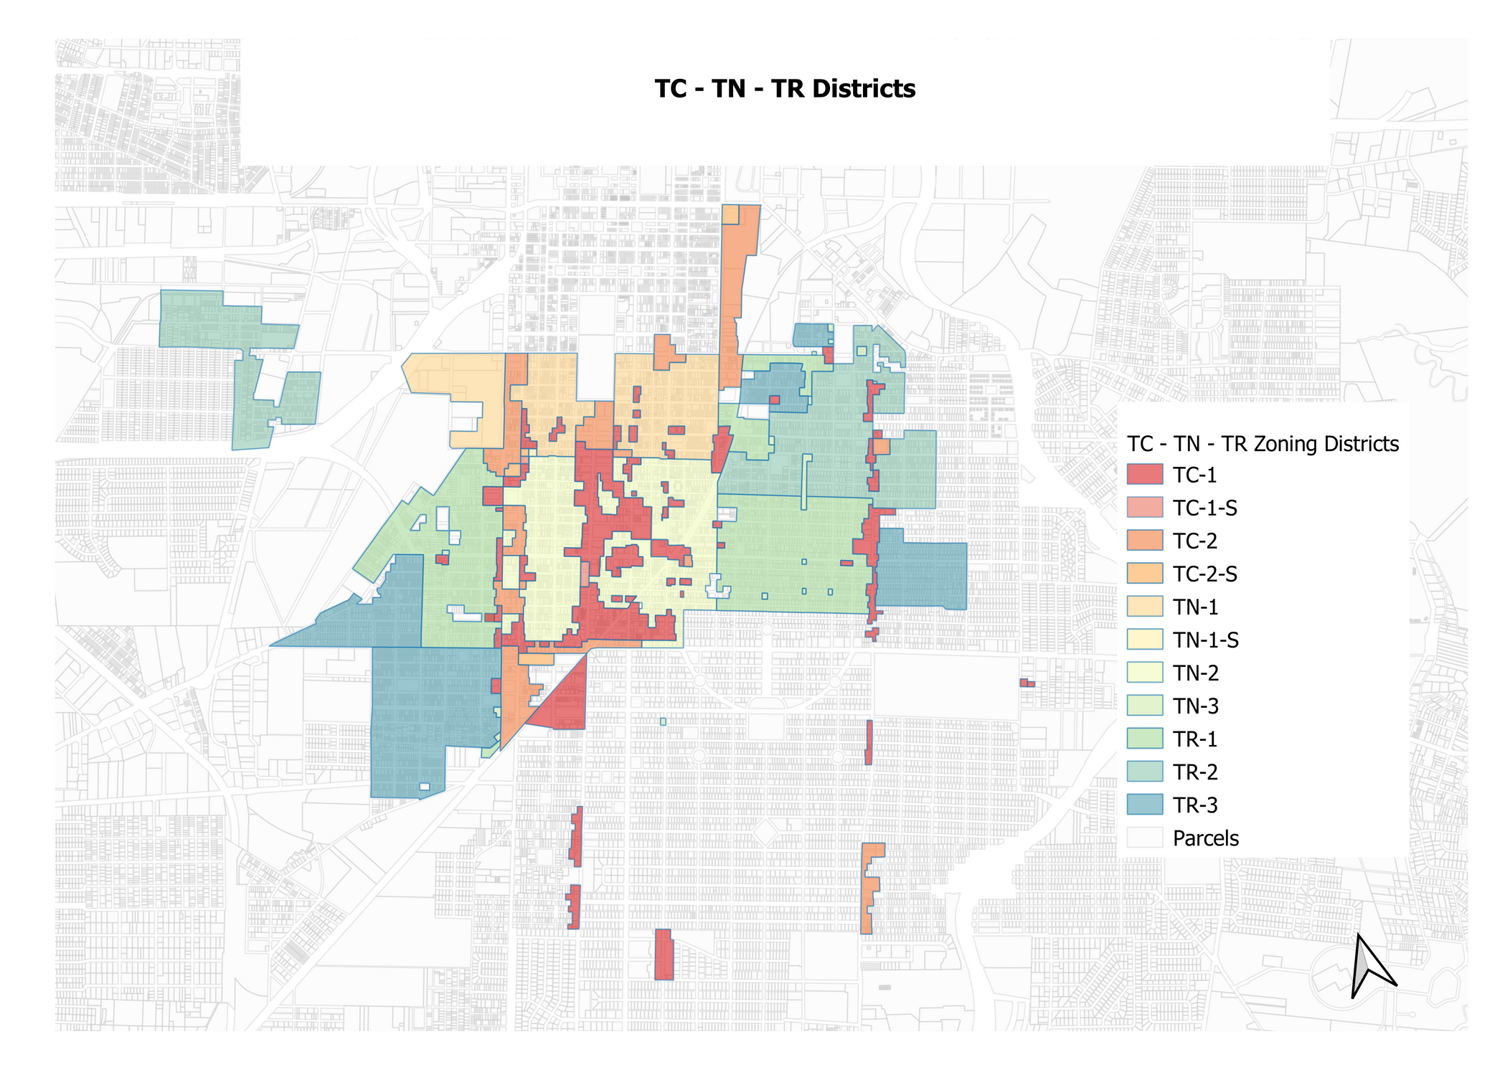
Applicable Zoning Districts

Slide 19


Other Materials in Progress
Design Guidelines for projects outside of local historic district overlay zones
Updated program guidelines for the City Manager or their designee to certify affordable housing

Slide 20





Supporting Organizations/Individuals
Victorian Neighborhood Association
Live Oak Neighborhood Association
The Reddick Foundation

Slide 21
Zoning Revisions for Affordable Housing

Slide 22
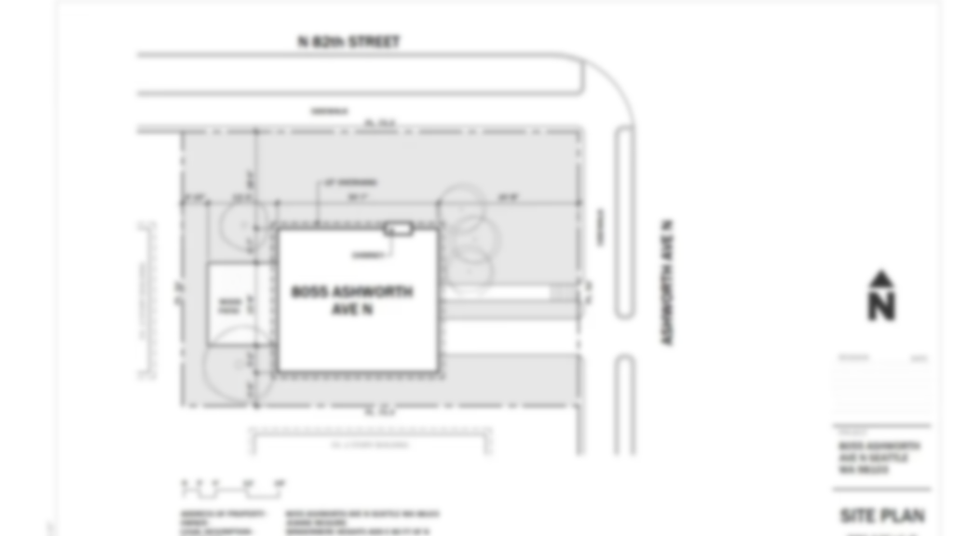
Existing Modification Processes

Slide 23
Existing Modification Processes
Variance
Can be reviewed by Zoning Board of Appeals, Planning Commission, or Historic District Board of review
Allows modifications to a wide range of standards, degree of modification is not limited
Some types of variances are expressly prohibited
Review criteria are applied to the decision
Special Exception
Can be reviewed by the Planning Commission, Historic District Board of Review, or Historic Preservation Commission
Allowed modifications are narrowly defined
Review criteria are less stringent than for variances

Slide 24
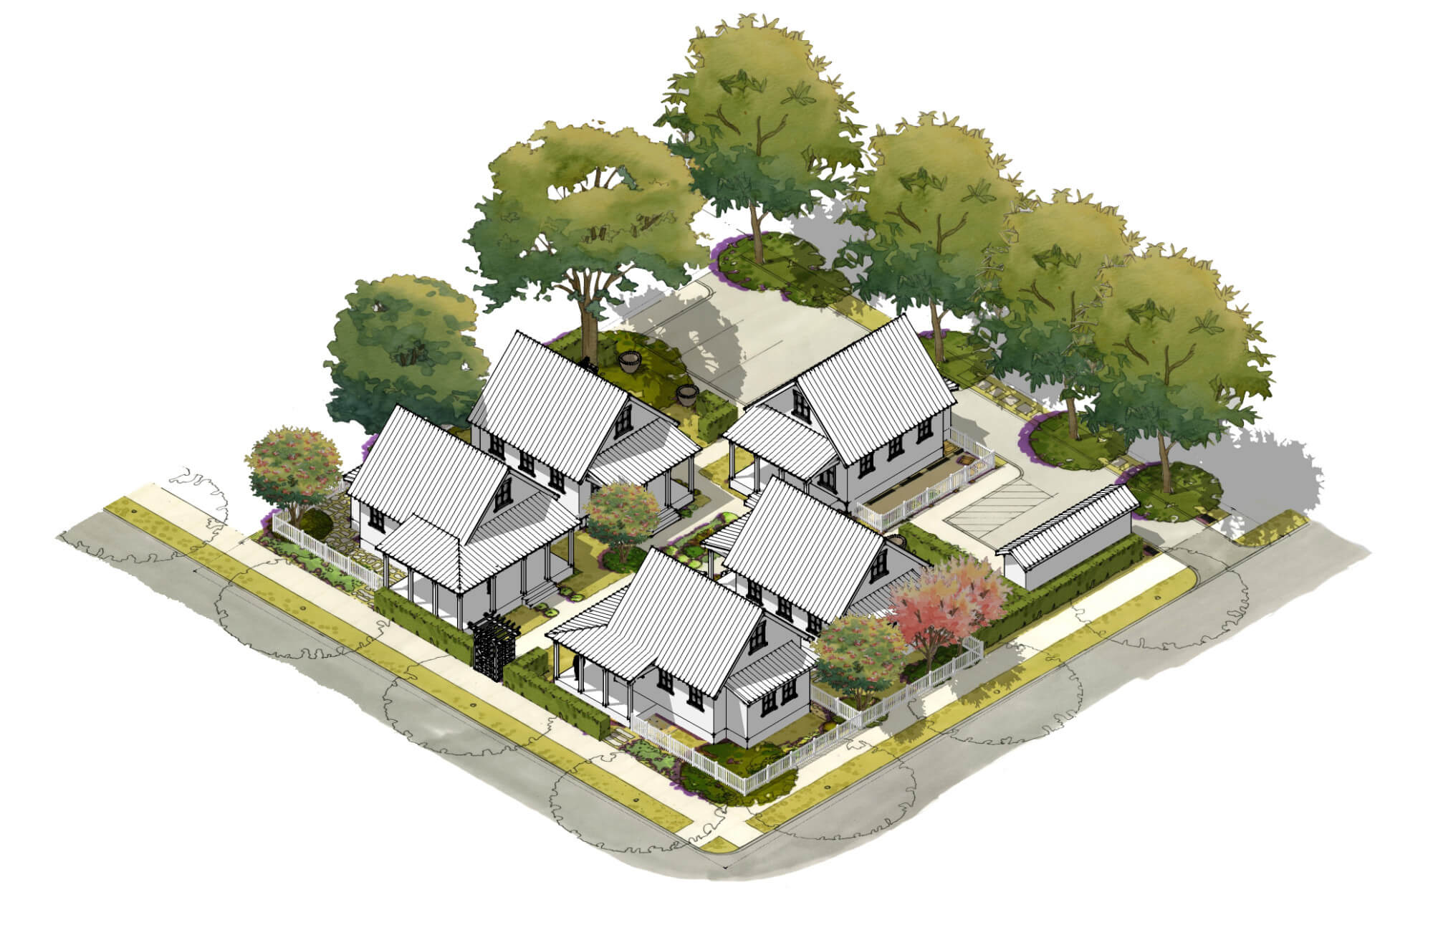
Prohibited Variances
Allowing uses that are not allowed in the zoning district
Lot area per unit
Height variances in the Downtown historic district
Variances to conditions of rezonings or other approvals

Slide 25
Zoning Revisions for Affordable Housing

Slide 26
Affordable Housing Revisions
Two proposed methods of modifying zoning standards
  “By-right”: Minor modifications that can be approved by staff without a review board
  Special Exception: Allow larger modifications through the special exception process, reviewed by Planning Commission
Either option requires verification by the City that affordable housing will be included in the development
Housing Services will also apply affordable housing standards supplementing the zoning process

Slide 27
Affordable Housing Definition
Housing Services will review projects to verify affordable housing will be provided
Housing Services development standards :
  Time period of affordability
  Income levels of affordability
  Proportion of affordable units
  Maximum site area
  Neighborhood design standards
  Enforcement mechanism

Slide 28
Example Scenario

Slide 29
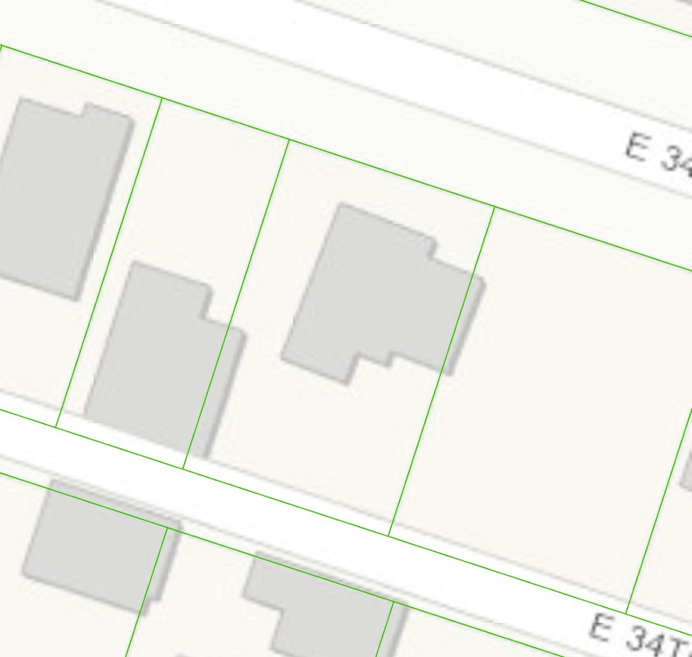
By-Right Option
Example: Four-Family
57.6 ft
92 ft
5,299 sq ft

Slide 30
By-Right Option
Example 2: Four-Family
Four-Family | Typical Zoning Standard | Modified By-Right Standard
Lot area per unit | 1,800 | 900
Lot width per unit | 15 | 10
Total lot area req’d | 7,200 | 3,600
Total width req’d | 60 | 40
Example Lot 2 area | 5,299
Example Lot 2 width | 57.6
Approved | No | Yes
Total units allowed by-right | 2 | 4
Affordable units | 0 | 1

Slide 31
Housing Savannah Action Plan
Update: October 24, 2024
Questions?
Thank You for Your Continued Support!

