Slide 1
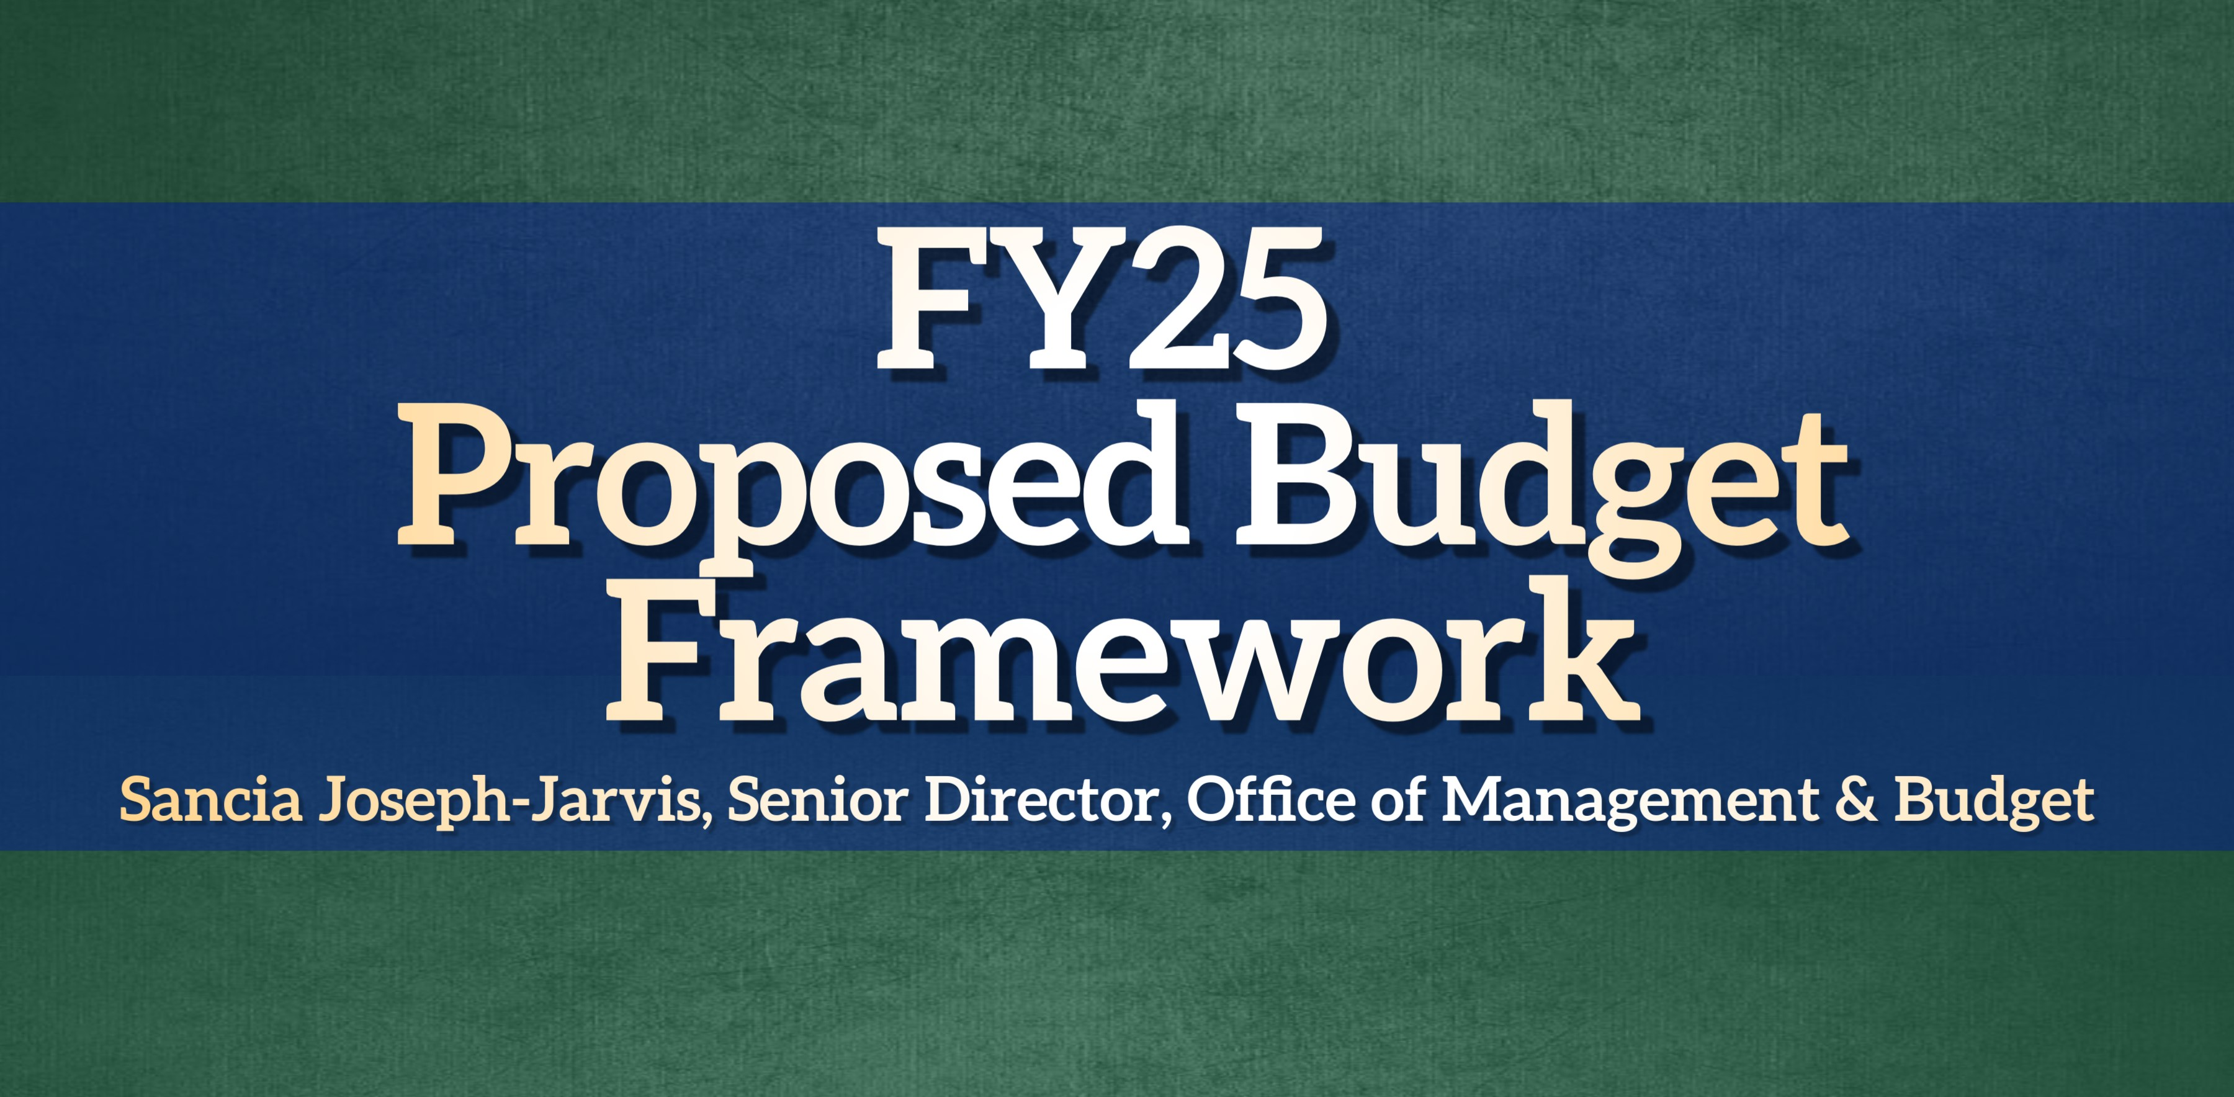



Slide 2
FY25 Budget Foundations
$602 million proposed budget is balanced and delivers high-quality and improved services to improve the lives of residents
No tax rates increases and no planned draws from the General nor Enterprise Fund reserves
Maintains millage rate at 12.20
Approximately $78.3 million in planned capital spending
Reserves maintained at 19%, covering about 60 days of general operating costs
Responsible contributions into City’s pension plan and addressing issues of compensation plan stagnation

Slide 3








Budget Priority Goals
Invest in Equitable Community Development & Resiliency
Improve Quality of Life by Raising Municipal Service Standards
Increase Public Safety & Our Collective Sense of Security
Expand Economic Access, Opportunity, & Vitality for All
Plan & Build World Class Livable Environments & Infrastructure
Always Be a High-Performing Government

Slide 4







Survey By The Numbers
61
5
3,973
783
756
Days
Open
Social Networks & Media Outlets
Survey
Views
Total Submissions
Community Submissions

Slide 5

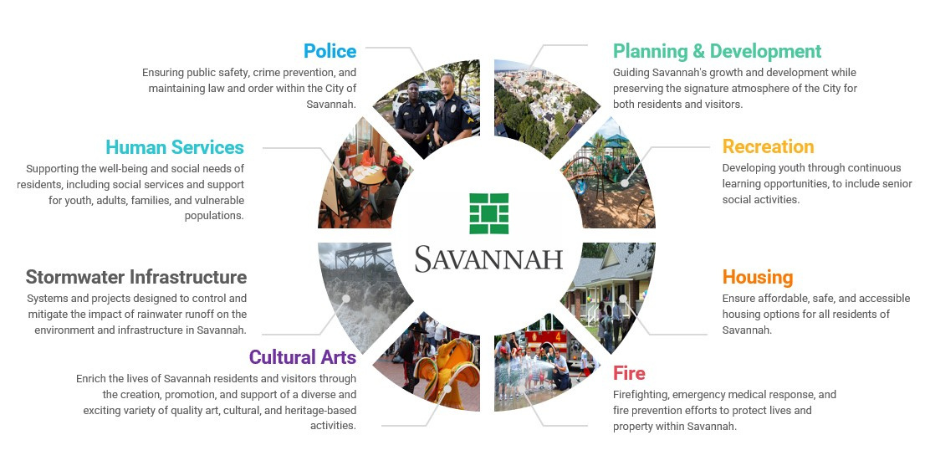
Service Areas Defined

Slide 6
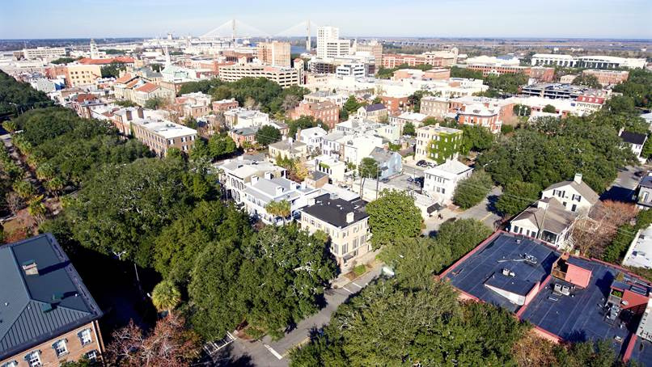
Top Priorities
#1
Stormwater Infrastructure
Systems and projects designed to control and mitigate the impact of rainwater runoff on the environment and infrastructure in Savannah
#2
Housing
Ensure affordable, safe, and accessible housing options for all residents of Savannah
#3
Human Services
Supporting the well-being and social needs of residents, including social services and support for youth, adults, families, and vulnerable populations

Slide 7
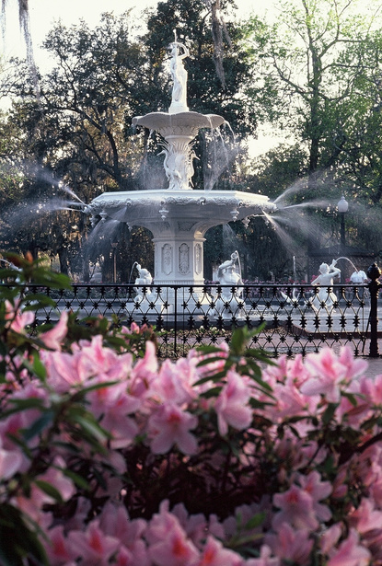
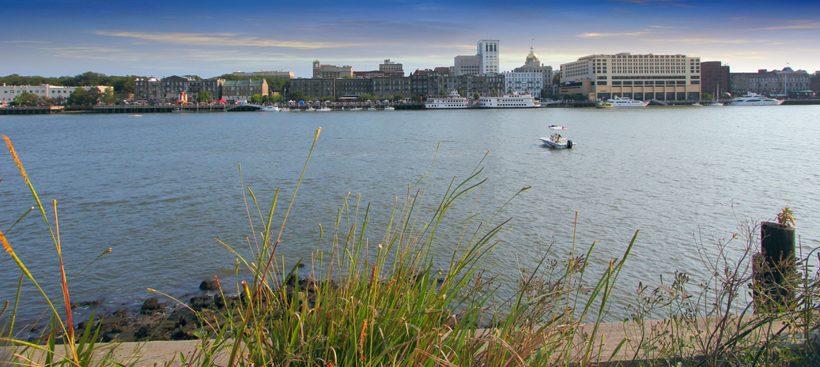
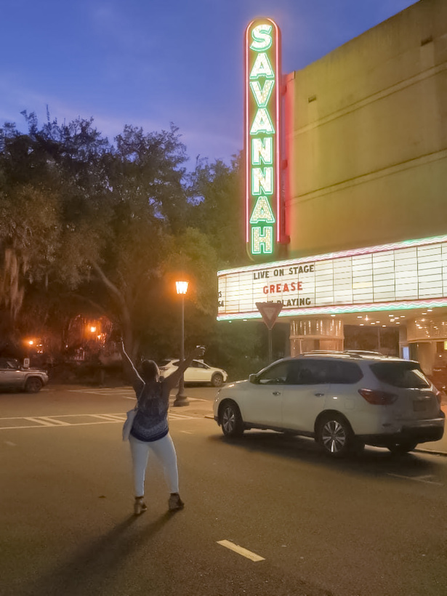
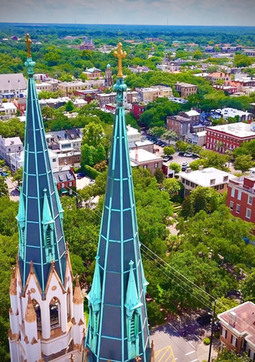
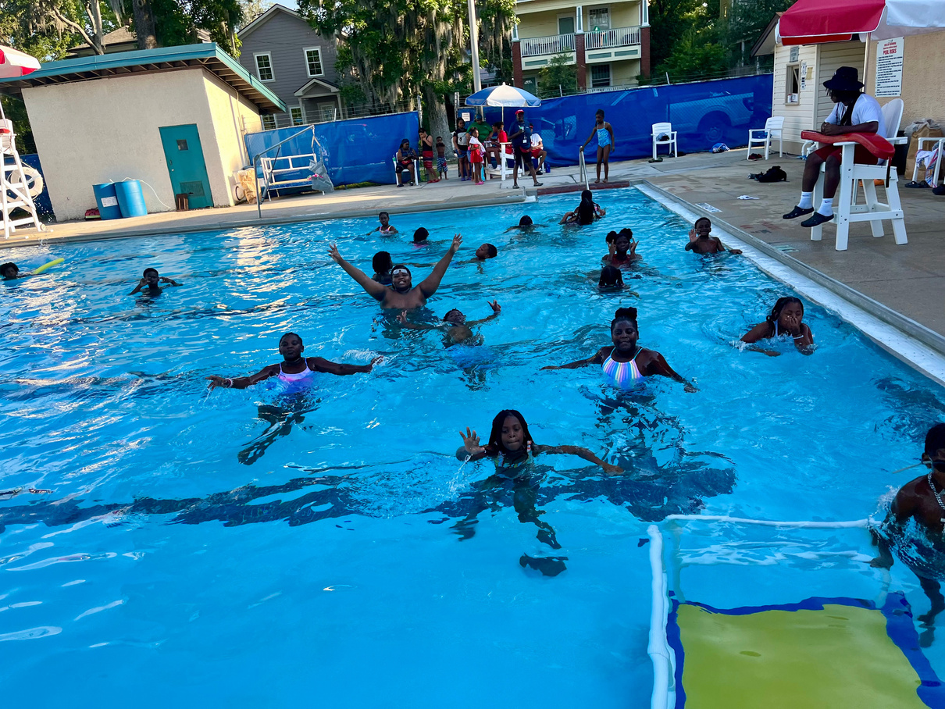
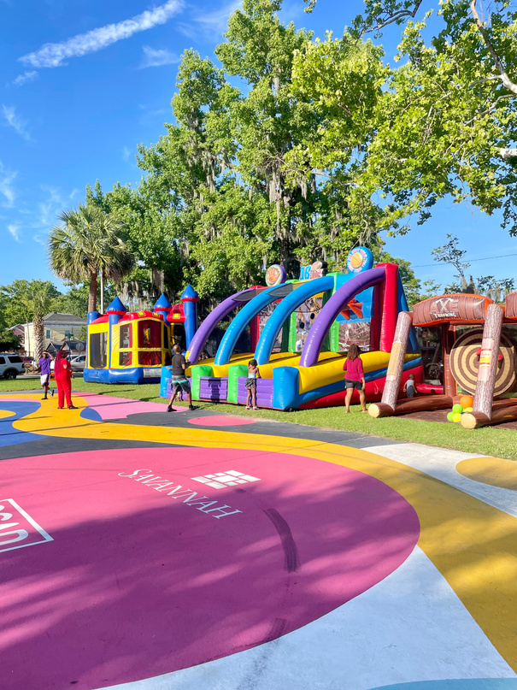
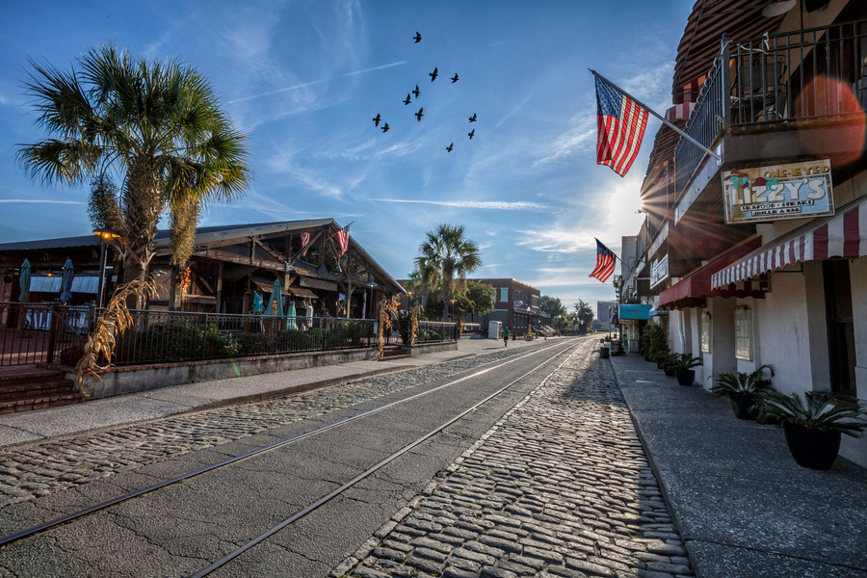
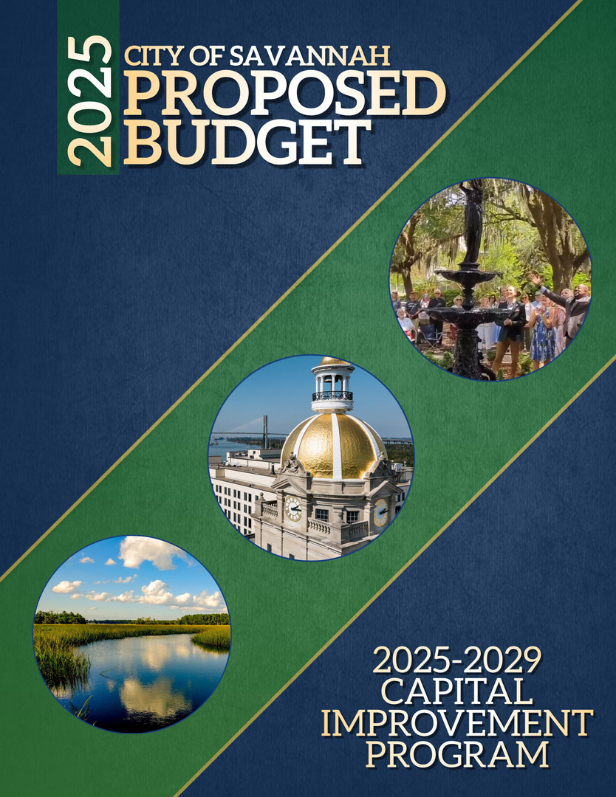




Thank You
for your engagement and
For Making Your Voices Heard!
Questions
Access the Budget
Mail
Website
budgetQ&A@savannahga.gov
www.savannahga.gov/budget

Slide 8


Budget by the Numbers
$11.1M
3% Salary Adjustment & Classification and Compensation Study
12.20
Budgeted Millage Rate
$291M
of General Fund Spending
$602M
NO DRAW
on General nor Enterprise Fund Reserves
$143M
of Capital Improvements Projects
*Includes Potential Bond Issuances
$109.8M
of Property Tax Revenue
Fiscal Year 2025 City Council Budget Retreat

Slide 9


City-Wide Revenues
Revenue Source | FY23 Actual | FY24 Projected | FY25 Proposed | % Change 2024 - 2025
Taxes | 228,645,480 | 252,179,191 | 259,223,755 | 2.8
User Fees | 49,483,171 | 48,922,671 | 49,164,235 | 0.5
Civic Ctr Revenue | 2,252,447 | 1,342,647 | 1,594,000 | 18.7
I&D Revenue | 10,736,660 | 11,673,383 | 13,413,314 | 14.9
Parking Service Rev | 20,060,997 | 22,309,512 | 23,054,808 | 3.3
Sanitation Revenue | 27,034,659 | 28,780,090 | 29,242,406 | 1.6
Water Service Rev | 38,218,038 | 37,857,652 | 39,110,060 | 3.3
Sewer Serv Revenue | 56,440,271 | 54,745,218 | 58,663,870 | 7.2
Other Enterprise Rev | (306,394) | (50,000) | (50,000) | -
Interfund | 55,264,857 | 60,734,436 | 69,865,350 | 15.0
Grants | 19,850,164 | 19,798,042 | 19,824,149 | 0.1
Interest | 15,001,638 | 18,241,710 | 6,712,500 | (63.2)
Other | 33,130,077 | 27,199,713 | 28,162,926 | 3.5
SUBTOTAL | 555,812,065 | 583,734,265 | 597,981,373 | 2.4
Draw/(Contribution) | (14,698,582) | 31,344,064 | 3,651,234 | (88.4)
Total Revenues | $541,113,483 | $615,078,329 | $601,632,607 | (2.2)
FY25 Revenue Highlights
Business Activity Revenues represent 27.4% of total revenues
Parking Fund
Water and Sewer Fund
Sanitation Fund
2.2% over FY24 projected collections
Taxes represent 43.4% of total revenues
Civic Center Fund
I&D Water Fund

Slide 10




City-Wide Expenses
Expenditures by Fund | Actual 2023 | Projected 2024 | Proposed 2025 | %Change 2024 - 2025
General Fund Total | $273,046,077 | $285,994,916 | $290,544,556 | 1.6
Special Revenue Funds
Hazardous Material Services | 715,018 | 905,482 | 803,933 | (11.2)
Recorder's Court Technology | 341,814 | 68,000 | 75,000 | 10.3
Grant | 6,713,961 | 10,625,988 | 11,121,037 | 4.7
Community Development | 9,624,945 | 10,925,585 | 10,629,737 | (2.7)
Hotel Motel Tax | 39,101,330 | 48,000,000 | 49,440,000 | 3.0
Per Occupied Room | 1,852,060 | 1,700,000 | 1,751,000 | 3.0
Motor Vehicle Rental | 3,202,762 | 3,328,000 | 3,361,280 | 1.0
Special Revenue Fund Total | $61,551,890 | $75,553,055 | $77,181,987 | 2.2
Enterprise Funds
Sanitation Services | 39,018,167 | 51,063,165 | 43,086,357 | (15.6)
Civic Center Services | 5,710,318 | 5,415,495 | 5,725,422 | 5.7
Water & Sewer Services | 99,377,490 | 105,042,087 | 101,469,735 | (3.4)
I&D Water Services | 10,442,438 | 11,970,023 | 13,659,770 | 14.1
Parking Services | 27,250,961 | 24,313,741 | 24,211,405 | (0.4)
Enterprise Fund Total | $181,799,374 | $197,804,511 | $188,152,689 | (4.9)
Internal Services Funds
Internal Services | 19,330,932 | 20,834,845 | 22,445,201 | 7.7
Computer Purchase | 1,699,264 | 1,525,369 | 1,255,330 | (17.7)
Vehicle Purchase | 3,433,647 | 33,161,172 | 21,865,344 | (34.1)
Radio Purchase | 252,299 | 204,461 | 187,500 | (8.3)
Internal Services Fund Total | $24,716,142 | $55,725,847 | $45,753,375 | (17.9)
Total Expenditures | $541,113,483 | $615,078,329 | $601,632,607 | (2.2)
FY25 Expense Highlights
FY25 Expense Highlights
2.2% Total decrease over FY25 projected expenditures
4.9% Total Decrease in Enterprise Fund
2.2% Increase in Special Revenue Fund
17.9.% Decrease in Internal Services Funds

Slide 11


General Fund Revenues
Where Does the Money Come From?
FY25 Revenue Highlights
Revenue Proposed to Increase by 1.6%when compared to FY24 Projected Collection
3.0% Tax Revenue Increase
Millage rate remains the same at 12.20
Steady Growth in property tax digest
2.8% Increase in Taxes
City’s Share of LOST will decrease to 52.2%
Fiscal Year 2025 City Council Budget Retreat

Slide 12
General Fund Revenues
Revenues | FY23 Actual | FY24 Projected | FY25 Proposed | %Change 2023 – 2024
Taxes | 186,341,391 | 200,851,191 | 206,422,475 | 2.8
User Fees | 44,918,819 | 43,330,546 | 44,398,606 | 2.5
Business Activity | 56,652 | 30,980 | 15,000 | (51.6)
Interfund | 6,545,596 | 7,813,314 | 9,896,949 | 26.7
Grants | 6,943,357 | 4,612,751 | 4,671,526 | 1.3
Interest | 8,145,361 | 10,481,134 | 5,700,000 | (45.6)
Other | 24,834,723 | 18,875,000 | 19,440,000 | 3.0
Draw/(Contribution) | (4,739,822) | - | - | -
Total | 277,785,899 | 285,994,916 | 290,544,556 | 1.6
Fiscal Year 2025 City Council Budget Retreat

Slide 13
General Fund Revenues
Fiscal Year 2025 City Council Budget Retreat

Slide 14

Property Tax Rate History
Fiscal Year 2025 City Council Budget Retreat

Slide 15

Hotel/Motel Revenues
FY25 Revenue Highlights
3% Total Increase over FY24 Projected Collection
Full Year tax collection at 8%
General Fund
Hotel/Motel tax is collected at 8.0% by the City of Savannah as authorized by state law. The City’s General Fund receives 37.5% of the revenue generated by the tax. The remaining revenue supports the trade center and convention/tourism marketing and development.
Fiscal Year 2025 City Council Budget Retreat

Slide 16



General Fund Expenses
FY25 Expense Highlights
Salary Adjustment/ Classification and Compensation Study
1.5M Increase in Internal Services
Where Does the Money Go?
51.3% Decrease in Interfund Transfers
Fiscal Year 2025 City Council Budget Retreat

Slide 17



General Fund Operating Cost
 | FY23 Actual | FY24 Projected | FY25 Proposed | %Change 2024 – 2025
Personnel | 131,300,384 | 147,619,698 | 166,064,376 | 12.5
Outside Services | 32,553,714 | 37,790,402 | 37,939,723 | 0.4
Commodities | 8,407,990 | 9,940,705 | 10,641,795 | 7.1
Internal Services | 29,891,439 | 31,111,058 | 35,769,098 | 15.0
Capital Outlay | 316,077 | 810,238 | 435,576 | (46.2)
Interfund Transfer | 56,660,180 | 45,556,023 | 22,189,694 | (51.3)
Other | 13,916,293 | 13,166,792 | 17,504,294 | 32.9
Grand Total | $273,046,077 | $285,994,916 | $290,544,556 | 1.6
FY25 Expense Highlights
Personnel represent 57.2% of total General Fund expenses
Conservative Budgeting as the economic climate is uncertain
1.6% overall increase

Slide 18
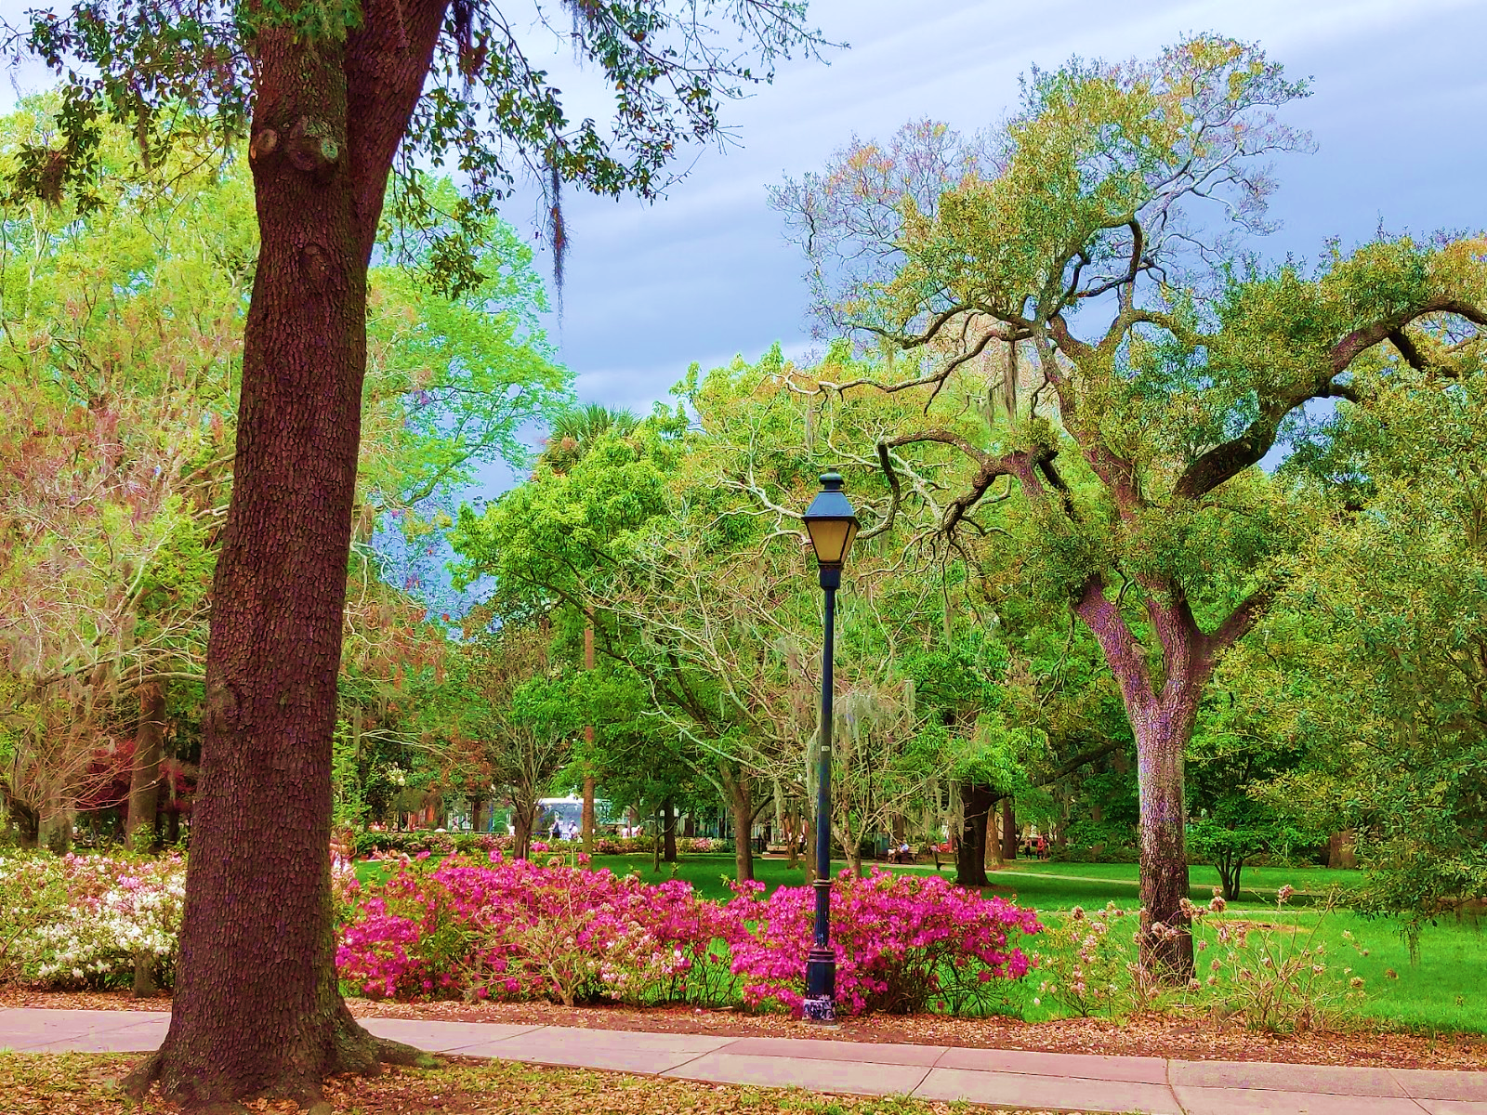
Proposed FY25-FY29
Capital Improvement Program
Victoria Keller, Principal Budget Analyst

Slide 19
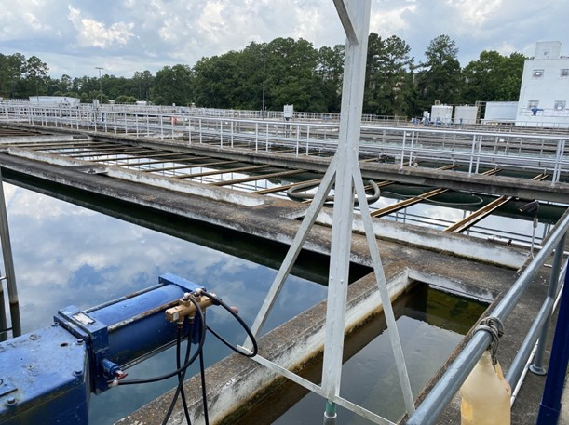
Key Discussion
Active Ledger
5-year Plan by Fund
FY25 Detail
Notes:
This presentation will provide an overview of the capital program including the current active ledger, 5-year plan for new investment, and a detailed look at the FY25 allocations.

Slide 20
Key Discussion
Active Ledger
271 Active Projects
>$340M Balance
  $63M – Drainage
  $41M – Mobility
  $21M – Recreation
savannahga.gov/
  2450/Capital-Projects-Management
  3635/Capital-Projects-Semi-Annual-Reports
  3766/Get-Project-Updates
Notes:
Because projects can take several years to complete, the five-year capital budget allocations will not show all the initiatives that are currently funded with work in-progress. As of September 30th, 2024, the City’s capital ledger had a balance totaling more than $340 million with 271 active projects, including $63M remaining for active drainage projects, $41M for Traffic Management, Streets, & Sidewalks, and $21M for Recreation Improvements. The rest of this presentation focuses only on NEW allocations proposed, but it is important to note that unlike the operating budget, we are not starting fresh from $0. Project managers and other staff provide reports regarding project implementation status. The Public can access active project information including semiannual updates and contact information for the Capital Projects Liaison on the City of Savannah website. All of the information in this presentation and more can be found in the FY25 Proposed Capital Improvement Program section of the Budget Book, starting at page 281.

Slide 21
FY25-FY29 Capital Improvement Plan
5-year Highlights
5-year pay-go plan totals $260M
General Fund contribution set at $8.1M
SPLOST VII authorization expires in FY26
Significant bond issuances projected
Notes:
Some highlights of the 5-year plan – the 5-year pay-go plan totals approximately $260M across all funding sources. The General Fund contribution is set at a 1-mill equivalent of $8.1M. Authorization to collect SPLOST VII expires in 2026, which is a primary driver of the overall decrease in the out-years. In addition to the pay-go plan, we also have significant bond issuances projected over the next five years.

Slide 22
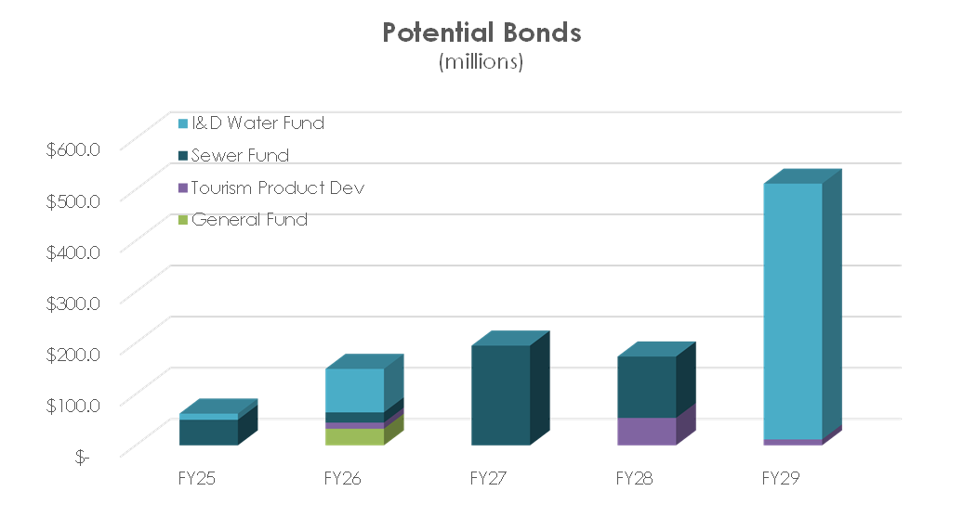
FY25-FY29 Capital Improvement Plan
5-year Highlights
5-year pay-go plan totals $260M
General Fund contribution set at $8.1M
SPLOST VII authorization expires in FY26
Significant bond issuances projected
  89.9% Water & Sewer
  General Fund – Municipal Space Planning
  TPD
    Tide to Town
    Savannah Waterfront Redevelopment
    Waterworks Building Redevelopment
Notes:
Over $1 billion in potential debt issue is projected to support the FY25-FY29 capital plan. Nearly 90% is supported by the I&D Water & Sewer funds. The potential General Fund bond in FY26 would support municipal space planning, although alternative funding sources such as SPLOST are still being considered. Bond issuance is also being considered to facilitate the implementation of priority Tourism Product Development projects as specified in Council’s May 25th, 2023 resolution, although neither the General Fund nor the TPD plans anticipate any debt issue in FY25.

Slide 23
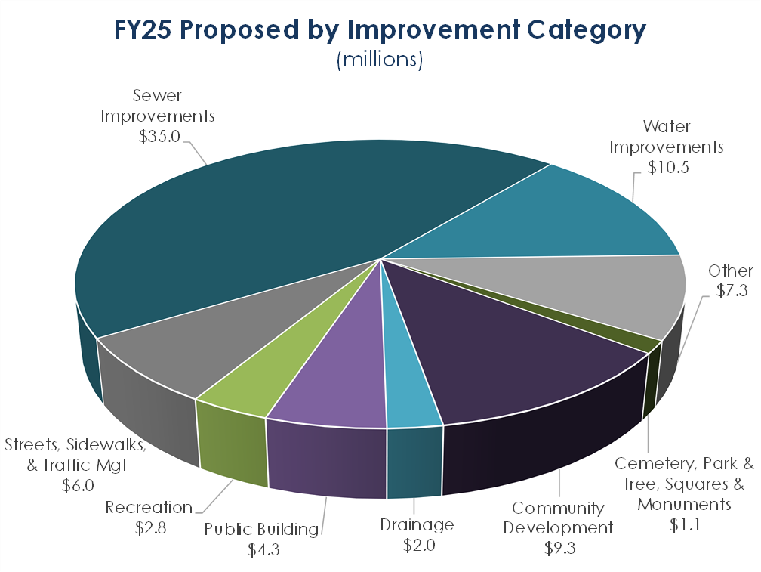
Key Discussion
FY25 Detail
78 Projects
$78.3M
Project Descriptions
  Improvement Category Overview p. 293
  Fund Descriptions & Project Listings p. 295
  Project Pages p. 297
Notes:
78 projects are proposed for new allocations in FY25 totaling approximately $78.3M. Projects are described and listed in detail in the FY25-FY29 Proposed Capital Improvement Plan. A description of the improvement categories begins on page 293. Descriptions of the funds begin on page 295 including a listing of each project proposed for funding in FY25, followed by project pages for each project proposed for funding in FY25. Project pages include information such as the project scope, improvement category, objective, strategic alignment, funding and expense schedule, benefits, and operating budget impact.

Slide 24
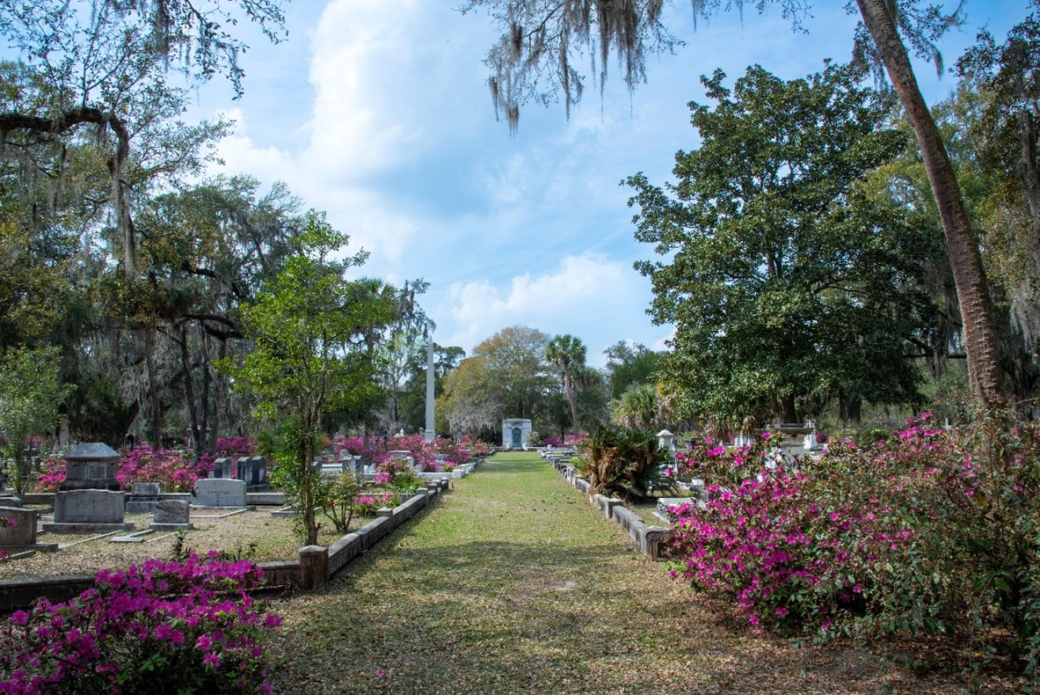
Additional Resources
FY25 Proposed Budget available at http://www.savannahga.gov/budget
Print version of the Proposed City Budget on display at:
  City Clerk’s Office, 1st floor, City Hall
  Bull Street Library
  West Chatham Library
Active capital site: https://savannahga.gov/2450/Capital-Projects-Management
Citizens can submit inquiries to budgetqa@savannahga.gov

