Slide 1
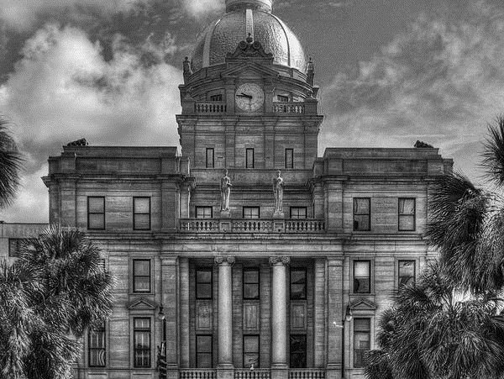
2024 MID-YEAR
FINANCIAL UPDATE
MELISSA CARTER
SENIOR BUDGET DIRECTOR
savannahga.gov

Slide 2
Agenda
State of the Budget
Enterprise Funds
Planned Projects
01
02
03
04
05
06
FY24 Adopted Budget recap
General Fund
Millage Rate

Slide 3
FY24 Adopted Budget Recap
69.97 FTEs New Positions Added to the Workforce
$275M of General Fund Spending
No Draw on General Fund Reserves
12.20 Budgeted Millage Rate
$560M
$80M of Capital Improvements Projects
$100M of Property Tax Revenue
Strengthening Our Focus Through People Power and Civic Infrastructure
Notes:
In December 2023, Council adopted the FY24 Budget, which included 69.97 new positions, $275M of General Fund spending, where the millage rate remained at 12.200, which estimated property tax collection of $100M and there were no draw on the General Fund reserves. The budget also included $80M of planned spending for capital improvement projects. The budgeted included the financial, human, and capital resources dedicated to advancing Council’s priorities and the collective goals of our community.

Slide 4
FY24 Adopted Budget Recap
Expenditures by Fund | FY24 Proposed
General Fund Total | $274,736,829
Special Revenue Funds
Hazardous Material Services | 690,959
Recorder's Court Technology | 100,000
Grant | 7,867,172
Community Development | 9,703,227
Hotel Motel Tax | 45,000,000
Per Occupied Room | 1,928,160
Motor Vehicle Rental | 3,328,000
Special Revenue Fund Total | $68,617,518
Enterprise Funds
Sanitation Services | 40,979,254
Civic Center Services | 5,627,087
Water & Sewer Services | 99,733,941
I&D Water Services | 10,576,224
Parking Services | 23,636,325
Enterprise Fund Total | $180,552,831
Internal Services Funds
Internal Services | 20,100,524
Computer Purchase | 1,320,369
Vehicle Purchase | 15,189,343
Radio Purchase | 187,500
Internal Services Fund Total | $36,797,736
Total Expenditures | $560,704,914
Revenue Source | FY24 Proposed
Taxes | 248,113,084
User Fees | 48,423,492
Civic Ctr Revenue | 1,379,999
I&D Revenue | 10,355,191
Parking Service Rev | 22,759,032
Sanitation Revenue | 27,171,881
Water Service Rev | 36,279,934
Sewer Serv Revenue | 54,207,386
Other Enterprise Rev | (50,000)
Interfund | 60,675,429
Grants | 14,661,461
Interest | 2,786,500
Other | 27,199,110
SUBTOTAL | $553,962,499
Draw/(Contribution) | 6,742,415
ARPA | -
Total Revenues | $560,704,914
Notes:
All in all, Council adopted at budget of $560.7M citywide balanced with expenses which strengthening our foundations and positioning us strategically to meet the current and future demands of our growing City.

Slide 5
State of the Budget
Sales Taxes; Strained by Inflation & Other Contract Costs
49% of General Fund Expended
Overall Finances are on Solid Footing
Rate of Return on Investments are Up
Debt Service is
Funded Adequately
Pension is Healthy
& Stable
Rising Electricity
Costs
Overtime
Utilization
53% Excise Tax Revenue Collected
AA+ Credit
Worthiness
General Fund Revenue Collection
reached 45%
Regional Capacity showing signs of strain;
internal/external
Notes:
Generally there are four financial metrics which are core barometers of the City’s fiscal health and sustainability: Pensions, Debt, Stability of Reserves and the Structural balance between revenues and expenditures.
Through the first half of the year, our finances remain on solid footing with the Adopted financial plan, realizing favorable spending results.
Pension stability is in tact and

Slide 6
Where Does The Money Come From?
Notes:
The City’s General Fund revenue portfolio is quite diversified. About 73% of all annual revenues are from taxes such as Property Tax, Sales Tax, or Other Taxes. The remaining revenue sources include fees and charges from residents and businesses, charges to other funds for services provided, and outside funding, like grants.

Slide 7
General Fund All Revenues- January through June
Notes:
So how are we doing so far? As of June 30, 2024 the General Fund has collected $122.7M or 5% more than the 2023 collections for the same time period. With the exclusion of 2022, when the City of Savannah received ARPA funding, this is the highest collection to date from 2019, when the General Fund collection was $92M, in just 5-years the General Fund has experienced 33% growth.

Slide 8
General Fund All Revenues- January through June
Taxes
Notes:
Now that we know where the General Fund revenue stands when compared to previous years, we can look at where the revenues come from. Like any other municipal government, the City of Savannah generates most of its revenues from taxes. This year and every year prior, over half of the General Fund Revenue are generated from taxes. In 2024, taxes make-up approximately 68% of the revenues collected year-to date. These taxes include property tax, sales tax and excise tax.

Slide 9
General Fund Revenue Variances-2023 vs 2024
Major Category | June 2023 | June 2024 | Variance
Property Taxes | 37,601,446.36 | 41,554,892.62 | 3,953,446.26
Sales Tax | 33,022,159.88 | 33,681,530.07 | 659,370.19
Other Taxes | 7,646,101.73 | 7,238,279.42 | (407,822.31)
Licenses & Permits | 11,862,400.36 | 12,351,662.36 | 489,262.00
Fines & Penalties | 2,185,568.95 | 2,934,915.03 | 749,346.08
Inspect. & Dev. Fee | 3,501,919.07 | 2,965,953.34 | (535,965.73)
Leisure Service Fees | 534,799.93 | 493,096.48 | (41,703.45)
Fees For Oth Srvc-GF | 1,431,878.41 | 1,407,035.00 | (24,843.41)
Other User Fees | 1,404,306.46 | 542,950.98 | (861,355.48)
Other Grant Revenue | 597,926.93 | 1,186,981.41 | 589,054.48
Interfund Services | 3,272,781.06 | 3,906,658.56 | 633,877.50
Sanitation Revenue | 47,929.95 | 31,539.32 | (16,390.63)
Parking Services Rev | - | (20.00) | (20.00)
Civic Ctr Revenue | 15,775.00 | 7,800.00 | (7,975.00)
Interest/Dividends | 3,437,094.43 | 4,612,814.37 | 1,175,719.94
Gain/Loss Surplus Property | 255,025.00 | 275,054.00 | 20,029.00
Contribution From Other Fund | 9,992,471.28 | 9,497,421.99 | (495,049.29)
Grand Total | 116,809,584.80 | 122,688,564.95 | 5,878,980.15

Slide 10
General Fund Share of Hotel/Motel Taxes & Sales Taxes January through June
Notes:
Year-over-year trends for LOST and Hotel/Motel/Auto revenue collections through June demonstrate the link between our tourism industry and our sales tax performance, with Local Option Sales Tax showing nominal growth although the City’s LOST collection reduced in 2024. With the City experiencing significant growth in overall Hotel/Motel Tax collection, the GF portion of this revenue source is slightly above collections in 2023. This time last year the 50% of Hotel/Motel collection was allocated to the GF, while in 2024 37.5% is allocated to the GF.

Slide 11
Legislative Changes Impacting Local Government Revenue
Development Fees
Recorder’s Court Fees
HB 461 is a new State Law impacting local fee assessments
Revises methodology to calculate regulatory inspection and permit fees for renovation projects valued below $75K
Impacts residential and commercial project inspections, plan reviews, and various permitting revenue streams
HB 926 is a new State Law impacting Court Fines & Penalties
Reinstatement of a suspended driver’s license faster and affordable after a missed court date
Re-docking fee eliminated

Slide 12
General Fund Expenditure Performance 2022-2024 Year-over-Year
($ in Millions) | 2022 June Act a | 2023 June Act b | 2024 June Act c | Variance to 2022 c-a | Variance to 2023 c-b
Personnel Services | $ 57.30 | $ 59.49 | $ 73.24 | $ 15.95 | $ 13.76
Outside Services | 12.22 | 15.68 | 16.10 | 3.88 | 0.42
Commodities | 3.54 | 3.96 | 4.39 | 0.85 | 0.43
Internal Services | 14.36 | 14.46 | 15.55 | 1.20 | 1.09
Capital Outlay | 0.08 | 0.09 | 0.16 | 0.08 | 0.08
Interfund Transfers | 57.51 | 8.21 | 21.47 | (36.04) | 13.26
Other Expenses | 4.90 | 6.83 | 6.19 | 1.29 | (0.64)
Total | $ 149.89 | $ 108.71 | $ 137.11 | $ (12.79) | $ 28.40
Notes:
Now that we have reviewed the revenue flows in, let’s look at the other side of the coin, which is cash going out. When we look at how our operating costs are performing through the first six months of 2024 as compared to the two prior fiscal periods, we can start to see trends in how the our operations are impacted, specially with the most recent investment in Team Savannah. The FY24 budget included a structural shift in our compensation plan that moved Team Savannah members to their target salaries based on days in the position. Our investment is quite evident when comparing personnel numbers in the previous 2 years vs this 2024. This year we have spent $15M more in personnel services than 2022 and more than any other year prior.

Slide 13
General Fund Expenditure Performance January through June 2019-2024
Notes:
Personnel costs continue to be the largest of expense of the General Fund. As to June 30, 2024, the General Fund expended approximately $73M or 53% of total expenses on personnel cost to include salaries and wages, overtimes, and benefit costs. The past five-years has demonstrated this is the nature of our business and will continue as the City of Savannah continue to make strives to attract and retain the most qualified workforce. Our second largest expense category includes our interfund transfer expenses. In the first half of fiscal year 2024, the General Fund has transferred $11M to the Capital Improvement Fund, $2.5M to the Affordable Housing Fund, and another $312K to Housing Savannah.

Slide 14
Enterprise Funds-Revenue June 2023 vs June 2024
Notes:
The Enterprise Funds growth through the first half of 2024 is overall nominal when compared to 2023. Overall collection is $81.5M in 2024 vs $81M in 2023, which the Sanitation Fund indicating the most growth at a 12% increase. Unfortunately, on the other hand, the Civic Center Fund is experiencing a 69% decrease when compared to 2023, primarily driven by the newly executed Hotel/Motel agreement, which eliminated the Civic Center as recipient of the taxes collected.

Slide 15
Enterprise Funds-Expenditure Performance June 2023 vs June 2024

Slide 16
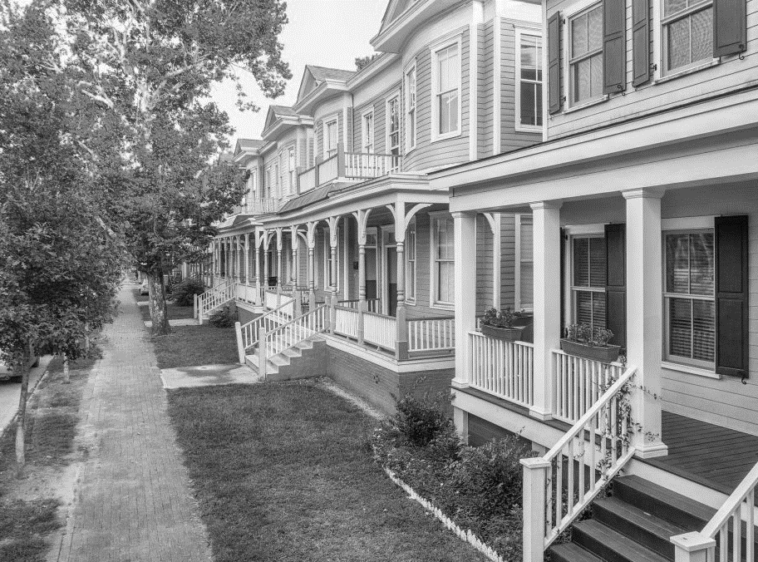
FISCAL YEAR 2024
MILLAGE RATE
savannahga.gov

Slide 17
Property Tax Millage Rate History

Slide 18
Property Tax Revenue
Property Tax Category | 2024 Revenue Projection | 2024 Adopted Budget | Variance
Real Property Tax | $88,048,872 | $80,917,007 | $7,131,865
Personal Property Tax | $8,322,767 | $8,345,362 | ($22,595)
Public Utility Tax | $1,937,406 | $1,936,708 | $698
Mobile Home Tax | $26,137 | $28,882 | ($2,745)
Motor Vehicle Tax | $275,029 | $290,883 | ($15,854)
Heavy Duty | $2,274 | - | $2,478
Total | $98,612,687 | $91,518,842 | $7,093,845

Slide 19
2024 Millage Rate Utilization
Drainage
$3.5M
Transportation Safety (Vision Zero) $2.0M
Public Safety Compensation Adjustment
$1.6M
Bar Screen Replacement at the Fell Street Station
Raise Public Safety Starting Salary and Hiring Bonuses
Mills B. Lane Drainage Improvement
Install Thermoplastic Pavement Markings, Crosswalks and Improve Pedestrian Lighting and Other Safety Improvements
Revised Compensation Plan
 | 1/1/2024 | 9/1/2024
Police Officer | $51,263 | $53,826
Firefighter | $49,200 | $51,660
Lateral Entry | $7,500 | $10,000
Hiring Bonus | $5,000 | $7,500
Drainage Improvement in Woodville Community
Drainage Improvement in Sylvan Terrace Community
Tremont Road Drainage Improvement

Slide 20
2024 Millage Rate Timeline
01
02
03
04
Public Hearing #1 July 11, 2024
10:00 A.M.
Public Hearing #2 July 11, 2024 6:00 P.M.
Public Hearing #3 July 25, 2024
2:00 P.M.
Adoption July 25, 2024

Slide 21
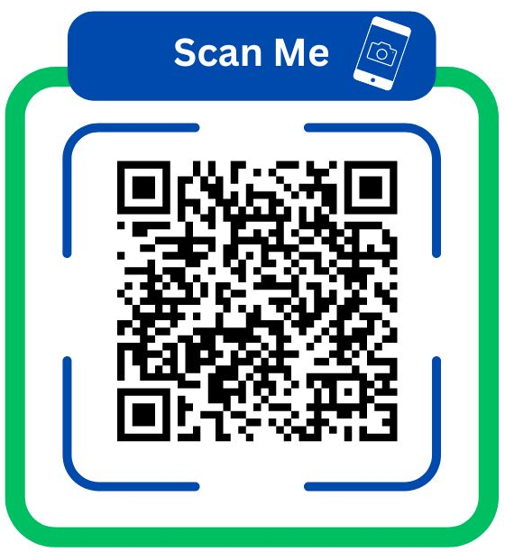
Citizens’ Voices Will Be Heard!
We want to hear from citizens on what matters most to our community!
Help us prioritize the FY25 Budget for Savannah, Scan the QR code and take the Budget Priority Survey.
Feedback will shape how we invest in our city's future!

