Slide 1

City of Savannah
FY23 MID-Year Financial Update
FY 23 MID YEAR
June 22, 2023
Melissa Carter, Sr. Budget Director
Office of Management & Budget
Notes:
Good afternoon, I am the Budget Director, Melissa Carter. I am pleased to present the FY23 Mid-Year Financial Update to provide general information on the current state of the City Budget.

Slide 2
Agenda
State of the Budget
General Fund
Enterprise Funds
Millage Rate
Planned Projects
Notes:
Our Agenda will include these components of our financial landscape and portfolio. General Operations, Business-Type Activity Trends, the Millage Rate and Planned Investments.

Slide 3

FY23 MID Year Financial Update
Current State of the City’s Budget
City finances remain on solid footing, with favorable operating results recorded through the first five months of FY 2023.
General Fund Operations are currently at 37% of adopted financial plan
Business-type Activities are currently at 38% of the adopted financial plan
Special Revenue Funds are 32% of the adopted financial plan.
Pension is healthy and stable.
Notes:
You know, the City Budget works a lot like any household, just bigger. Revenue comes in and Expenses go out and just like you, the City can’t spend more money than it makes. Of course, it can borrow money, but paying it back (what we call Debt Service) has to be factored in over time.
Generally there are four financial metrics which are core barometers of the City’s fiscal health and sustainability: Pensions, Debt, Stability of Reserves and the Structural balance between revenues and expenditures.
Through the first half of the year, our finances remain on solid footing with the Adopted financial plan, realizing favorable spending results. General operations, Business-type Activities and special revenue funds are trending between 32 and 38% of the Adopted Budget.
Pension stability is in tact and
The 2023 Financial Plan was developed from the City Manager’s philosophy that (1) budgets are not just math problems, they are value statements; (2) we would always look internally first to make government work more efficiently before we would ever ask taxpayers to do more; and (3) by making the tough but correct fiscal choices, we would create more opportunities for investments in our city.

Slide 4
FY23 MID Year Financial Update
Current State of the City’s Budget
Debt Service is funded adequately
Credit worthiness of the City is good.
Notes:
And Debt Service Obligations for the current year are adequately funded.
The most recent Credit-rating decisions handed down by Moody’s and the S&P 500 tout the history of stable financial operations supported by conservative management, very strong liquidity, a strong debt profile, low-fixed costs and well-funded pension. Why do these rating updates on our fiscal stability and fiscal discipline matter? Because fiscal stability pays for city investments that continue to make Savannah competitive on the state and national landscape. Much like the way improving your credit scores lowers your interest rate and monthly mortgage payments, higher ratings lower the City’s borrowing costs and goes a long way to free up dollars to fund city investments.

Slide 5


FY23 MID Year Financial Update
Budget by the Numbers
FY 2023 Totals at a Glance
FY 2023 Approved Budget
FY 2023
Authorized
Positions
FY 2023 Funding Sources
Tax Supported 41.9%
Fees/Other 36.2%
Grants 4.5%
$493 Million
2,539 FTEs FTE
Notes:
The 2023 Financial Plan was developed from the City Manager’s philosophy that (1) budgets are not just math problems, they are value statements; (2) we would always look internally first to make government work more efficiently before we would ever ask taxpayers to do more; and (3) by making the tough but correct fiscal choices, we would create more opportunities for investments in our city.
The Foundation of the Financial Plan relies upon 2,539 FTE positions and $493 Million dollars across All governmental funds; 42% of which are supported by tax revenue streams, 36% supported by user fees, service charges, and other administrative fees with app. 5% supported by grant revenues that are offsetting operating costs.

Slide 6
General Fund
Governance
Strategic Services
Public Safety
Municipal Operations
Government Operations
Community Services
Infrastructure & Development
Notes:
The General Fund it is the City’s largest and most flexible operating fund. It is responsible for supporting operations within every Service Center Area across the municipality.

Slide 7
FY23 MID Year Financial Update
2023 Adopted General Fund
Budget Overview
Budget Goals
Equitable Path to Sustained Recovery & Growth
Healthy & Vibrant Neighborhoods
Gun/Violent Crime Reduction
Affordable Housing Investments & Homelessness Solutions
Effective & Reliable City Services
Organizational Investments
Notes:
The FY23 Adopted Budget allocated $239M and was balanced with a millage rate of 12.20 mills which maintained the prior year millage rate reduction which saved taxpayers .54 mills contingent upon property assessed valuations. About $111M of the General Fund Budget is allocated to Police, Fire and Emergency Planning functions with about $51M appropriated to Community Services, Culture, Recreation and maintenance of City grounds, assets and waterways. Approximately $12M of this plan directly supports Affordable Housing efforts, support to families and human services. Transportation, infrastructure and development, drainage, neighborhood planning and zoning were allocated $37.2M and there is about $28M slated for transfers to fund a range of other investments and service delivery supports.
Overall, the investments City Council Adopted in this budget are to strengthen our organizational foundation, advance key priorities with a focus on results and invests in our neighbors and our neighborhoods through Accountability, Caring and Thought-Partnership.

Slide 8
FY23 MID Year Financial Update
General Fund
All Revenues - January through May
$91M
Notes:
So how are we doing so far?
The economic recovery trends we saw in FY22 continued through May of FY23, with General Fund revenues actualizing at their highest level at $91M since 2018. This is a 13% increase when compared to the first 5 months of 2022.

Slide 9
FY23 MID Year Financial Update
General Fund
All Revenues - January through May
Taxes
Notes:
Now that we know where the General Fund revenue stands when compared to previous years, we can look at where the revenues come from. Like any other municipal government, the city of Savannah generates most of its revenues from taxes, which is highlighted in the light green section of the graph.

Slide 10
FY23 MID Year Financial Update
General Fund Expenditures
3-Year History
Personnel
Notes:
As we look at our expenditures from the previous 3-years, it is evident, 2022 is an outlier. This is due the capital investments associated with the ARPA. Looking at present year 2023, expenditures are less than 2022, but exceed 2021 expenditures by 16%. As usual, the General Fund’s biggest expenditures are personnel related costs, including salaries and benefits.

Slide 11
Enterprise Funds
Civic Center
I&D Water
Parking Services
Sanitation
Water & Sewer
Notes:
The 2023 Financial Plan was developed from the City Manager’s philosophy that (1) budgets are not just math problems, they are value statements; (2) we would always look internally first to make government work more efficiently before we would ever ask taxpayers to do more; and (3) by making the tough but correct fiscal choices, we would create more opportunities for investments in our city.

Slide 12
FY23 MID Year Financial Update
Enterprise Funds
Revenue Performance
Notes:
As of May 2023, the Enterprise Funds collectively, Civic Center, I&D Water, Parking, Sanitation, and Water & Sewer Fund, have collected ($66M) of their adopted budget allocation ($355,382,351). The Water and Sewer Fund remains the City’s largest enterprise fund, which has collected $36M as of May 2023. Currently, the enterprise fund are trending well, and no problems are forecasted into the future. However, Please be reminded, the Civic Center Fund will no longer receive revenues from the Hotel/Motel starting Sept. 2023, as a result, the GF will probably need to contribute to the Civic Center Fund in 2024.

Slide 13
FY23 MID Year Financial Update
Enterprise Funds
Expenditure Performance
Notes:
Like the General Fund, the largest expense in the enterprise funds is personnel, where it accounts for 18%-30% of the expenses. When analyzing revenues collected through the first half of the year against operating costs incurred, we are seeing narrow margins through May, with the exception of the Water Utility, so we will continue to monitor these business-type activities as we head into the third quarter to identify whether the General Fund will need to provide any subsidies.

Slide 14
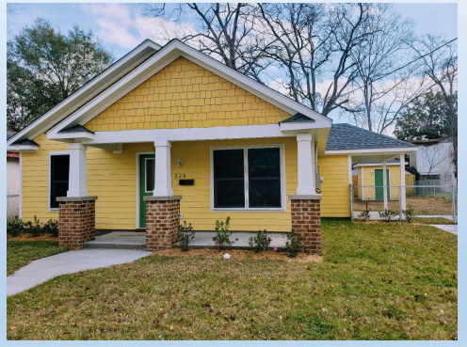
Millage Rate

Slide 15
FY23 MID Year Financial Update
Millage Rate
Modest growth has occurred each year since 2018, annual average of 8%
Much of the growth in 2023 is attributable to significant increases in reassessment value
The assumed collection rate for projections is 88%
Notes:
What would that mean? Well based on the updated 2023 Property Tax Digest developed by the County Board of Assessor’s Office, there is approximately 12% growth in property assessed valuations within the City of Savannah jurisdiction. More than half of the new growth in 2023 is attributed to revaluations, while a little more than 2% is attributed to new growth in the area. With the primary factor based on re-evaluations which are subject to appeals, staff are cautionary which projections and have assumed a collection rate of 88% for this projection.
The taxable digest increased by 12.63% in 2023 compared to 2022. Of this increase, 9.98 points is attributable to revaluations and 2.65 points is attributable to new growth. New growth increased by $195,523,579 and equates to $2,385,388 in new property taxes for 2023 and is factored into the calculation of the 2023 rollback rate of 11.119 mills. One mill is worth $7,283,151 for 2023.
Although, the five-year average growth is 8%, in years 2022 and 2023 the City has experience growth of 15% and 13% respectively.

Slide 16
FY23 MID Year Financial Update
Property Tax Millage Rate
Notes:
This 23 year history depicts the City commitment to make tough but necessary decisions around millage rates with tax payer impacts in mind. We are proposing to set the final millage rate in line with our adopted budget basis and we would naturally carry that millage rate forward as our basis for FY24 budget development efforts currently underway.

Slide 17
Homestead Property
Implied FMV | 2022 Stephens Day Taxable Value | 2023 Taxable Value Increase | 2022 Total Taxes at 12.2 mills | 2023 Total Taxes at 12.2 mills | 2023 Tax Difference
$ 170,000 | $ 68,000 | 0.00% | $ 830 | $ 830 | $ -
170,000 | 68,000 | 1.00% | 830 | 838 | 8
170,000 | 68,000 | 2.00% | 830 | 846 | 17
170,000 | 68,000 | 3.00% | 830 | 854 | 25
170,000 | 68,000 | 4.00% | 830 | 863 | 33
170,000 | 68,000 | 5.00% | 830 | 871 | 41
170,000 | 68,000 | 6.429% | 830 | 883 | 53
Commercial Property
2022 Fair Market Value | 2022 Total Taxes at 12.2 mills | 2023 Total Taxes at 11.119 mills (rollback rate) | 2023 Tax Difference
$ 250,000 | $ 1,220 | $ 1,112 | $ (108)
500,000 | 2,440 | 2,224 | (216)
750,000 | 3,660 | 3,336 | (324)
1,000,000 | 4,880 | 4,448 | (432)
1,500,000 | 7,320 | 6,671 | (649)
2,000,000 | 9,760 | 8,895 | (865)
10,000,000 | 48,800 | 44,476 | (4,324)
Notes:
The FY22 and 23 budgets have been Adopted with a tentative millage rate of 12.20 mills. In the next few weeks, the City Manager is proposing to continue that trend and set the final millage rate in line with the adopted budget, which again is 12.20 mills.

Slide 18
FY23 MID Year Financial Update
Property Tax Millage Rate
 | 2023 Adopted Budget | 2023 Revenue Projection | Variance
Real Property Tax | $71,967,786 | $78,776,421 | $6,808,635
Personal Property Tax | $7,171,606 | $7,850,088 | $678,482
Public Utility Tax | $1,648,000 | $2,029,868 | $381,868
Mobile Home Tax | $24,811 | $27,760 | $2,949
Motor Vehicle Tax | $270,513 | $259,818 | ($10,695)
Heavy Duty | 0 | $1,198 | $1,198
Total | $81,082,716 | $88,945,154 | $7,862,438
Notes:
Overall, maintaining the budgeted millage rate with the anticipated growth in the County Digest, will yield approximately $7.8M in additional property tax revenue.
Early on, I spoke to you about those core barometers of the fiscal health and sustainability. Does anyone remember what they were? They were Pension, Debt, Stability of reserves and Structural balance between revenues and expenditures. I also mentioned why our fiscal stability and fiscal discipline matter.
Fiscal stability pays for city investments. So just as we have worked together to weather impacts from a global pandemic, economic volatility and even LOST negotiations while looking internally first to make government work more efficiently and by Not just treating the Budget as a simple math problem, but by making the tough but correct fiscal choices, we have created and can create more opportunities for investments in our City.

Slide 19
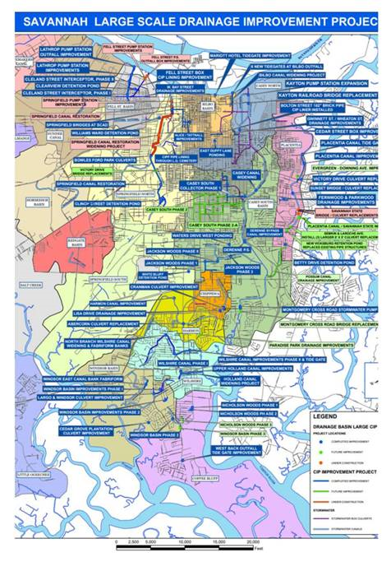
FY23 MID Year Financial Update
2023 Planned Projects
Victory Drive Drainage Improvements
(Springfield Canal)- $3M
Liberty City Improvements
(Springfield Canal)- $862,438
Montgomery Crossroads
(Hayner’s Creek)- $4M
Millage Rate 12.2 $7,862,438
Notes:
So we propose to set the final millage rate at 12.20 mills and to allocate projected revenue to critical capital infrastructure investments to better manage drainage and flooding in support of community health and environment efforts specifically in these areas shown here.

Slide 20
FY23 MID Year Financial Update
Questions?
The City of Savannah is pleased to present this Mid-Year Budget Update to provide general information about the history and future of major components of the city’s budget. The information presented is as of the date of publication or, if such information is dated, as of its date.
Our discussion today includes forward-looking statements based on current beliefs and expectations about future events. Those events are uncertain and do not consider events that may alter actual outcomes; their outcome may differ from current expectations which may in turn significantly affect expected results.
Notes:
The City of Savannah is pleased to present this Mid-Year Budget Update to provide general information about the history and future of major components of the city’s budget. The information presented is as of the date of publication or, if such information is dated, as of its date.
Our discussion today includes forward-looking statements based on current beliefs and expectations about future events. Those events are uncertain and do not consider events that may alter actual outcomes; their outcome may differ from current expectations which may in turn significantly affect expected results.

