Slide 1
Education & Outreach
Strategies

Slide 2
Education & Outreach
Strategies

Slide 3
WASTE IN ITS PLACE

Slide 4
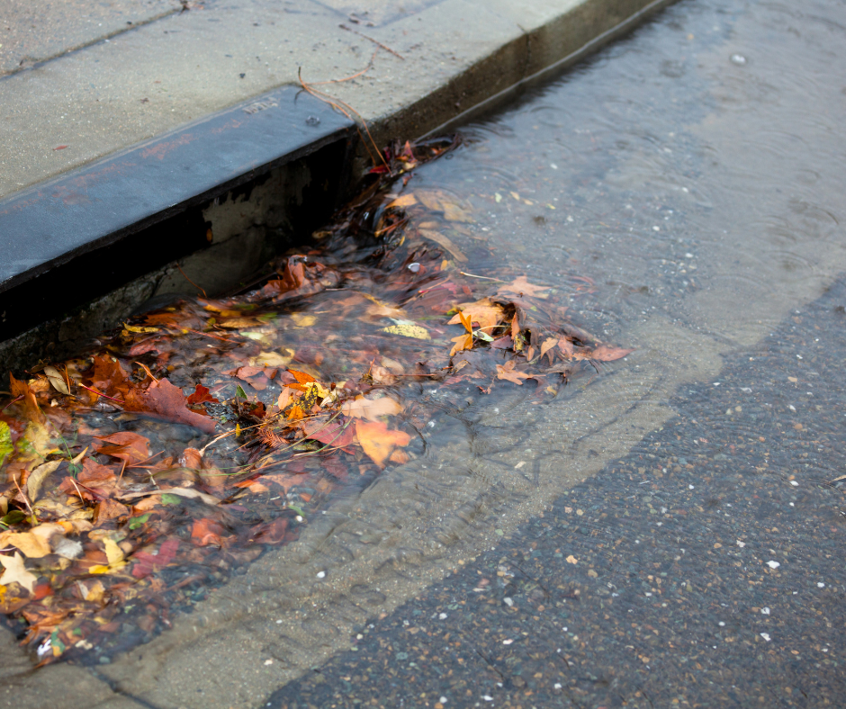
THE PROBLEM
Flooding in Savannah neighborhoods is increasingly exacerbated by the improper disposal of grass clippings and yard waste, contributing to significant environmental impacts.

Slide 6
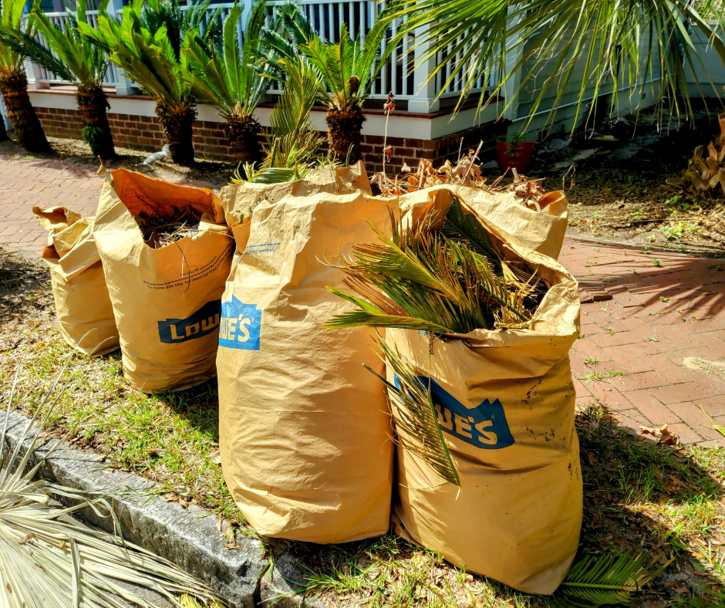
THE SOLUTION
Foster an informed community around flood prevention, emphasizing the importance of proper waste disposal practices. Through education and outreach, the initiative seeks to cultivate responsible behaviors that protect local waterways from pollution.

Slide 8
Outreach Strategies
Website Enhancements
Community Outreach
Include detailed information on Sanitation's webpage specifically related to the collection and proper disposal of grass clippings and yard waste.
Distribute diverse printed materials at community meetings, events, and annual cleanup activities organized by Keep Savannah Beautiful.
Social Media
Partnerships/Collaborations
Utilize the City of Savannah's social media platforms to post infographics, reminders, videos, and photographs, educating citizens on flood prevention and the importance of keeping storm drains clear.
Sanitation will collaborate with internal and external partners to develop innovative solutions and provide educational outreach to the community.

Slide 9
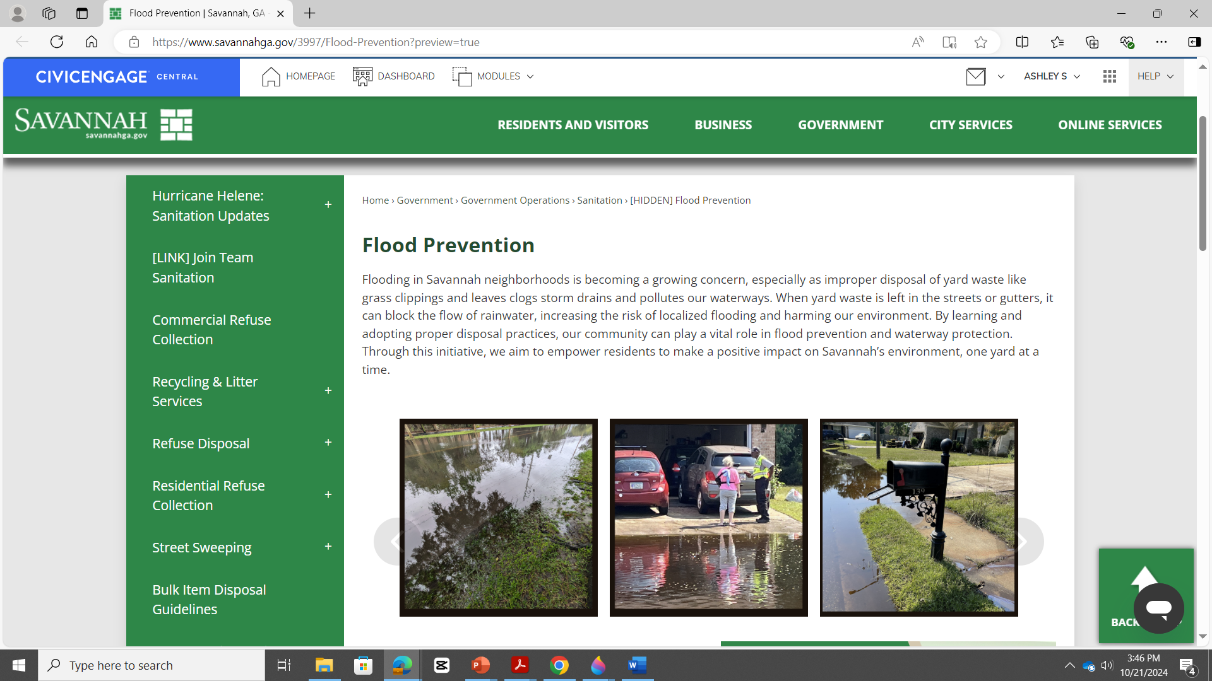
ebsite

Slide 10
ebsite

Slide 11
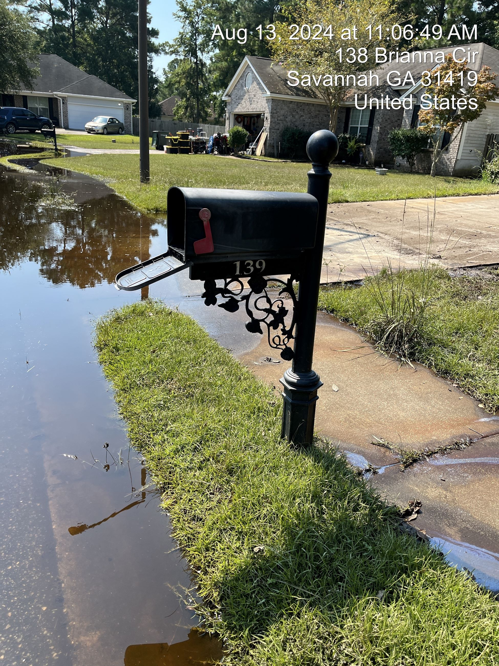
esources

Slide 12
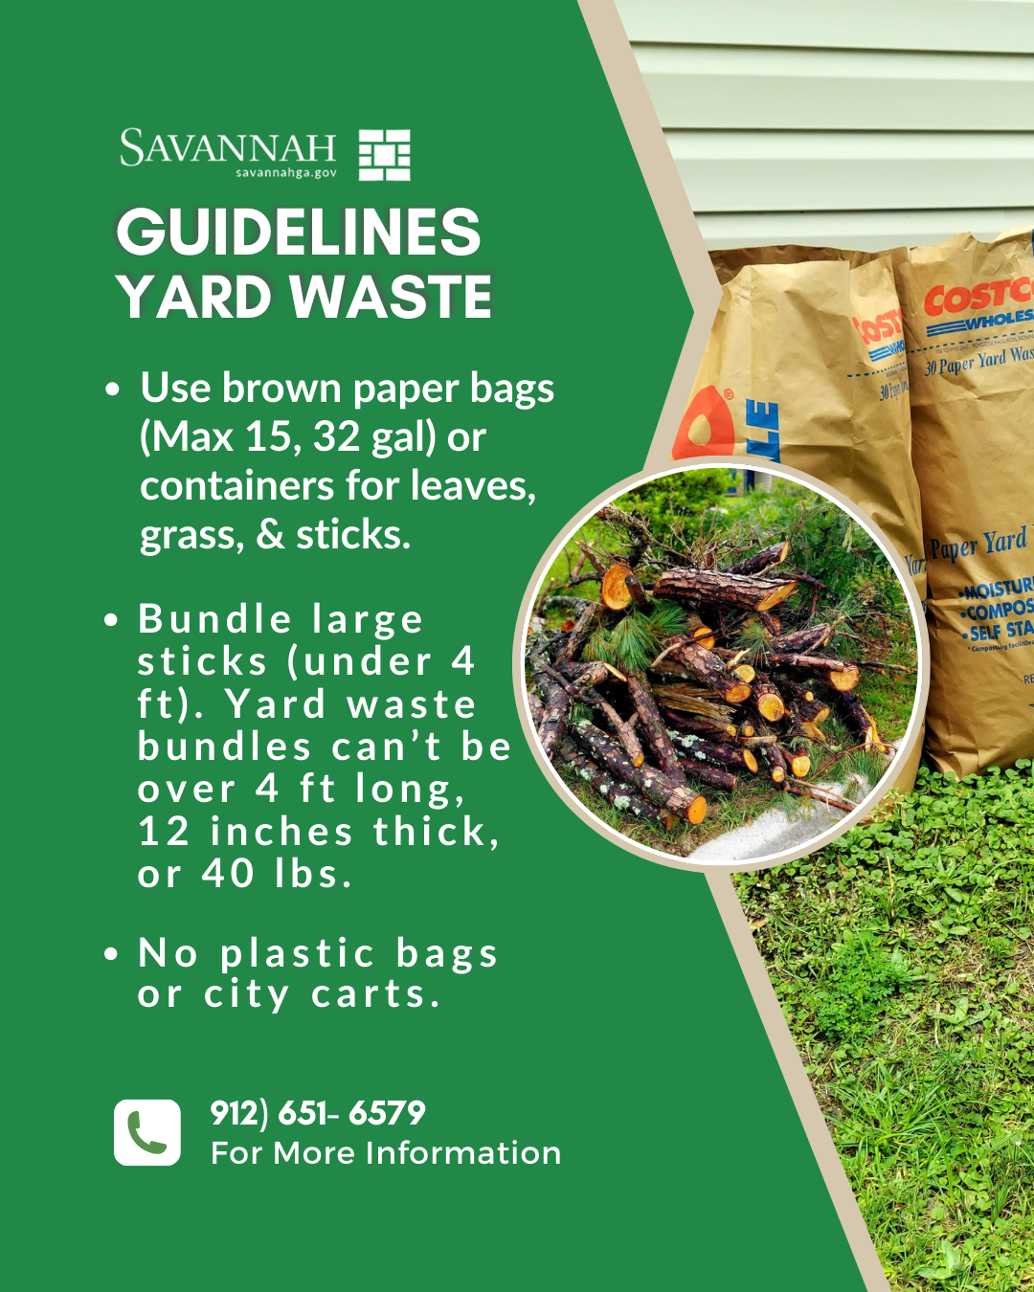

Slide 17
THANK YOU
WASTE IN ITS PLACE

Slide 18
THANK YOU
WASTE IN ITS PLACE

