Slide 1
Fairgrounds Project Update
City Council Workshop
Thursday April 25, 2024

Slide 2
Fairgrounds Timeline 2014 - 2024
August 2015 | Savannah City Council enters negotiations with Exchange Club to purchase Fairgrounds property.
August 5, 2016 | Savannah City Council approved the purchase of the Fairgrounds property for $2.9 million.
September 1, 2016 | City Staff presents future development concepts for the Fairgrounds which include housing and recreational uses..
October 10, 2016 | City Manager Stephanie Cutter retires, and City Manager Ron Hernandez begins.
October 19, 2017 | Savannah City Council rejects proposal to sell 15 acres of Fairgrounds to Aerospace Studios.
May 10, 2019 | Savannah City Council rejects plan to build Girls and Boys Club on Fairgrounds Site.
April 12, 2019 | City Manager Ron Hernandez resigns, and Pat Monahan assumes Manager role.
June 19, 2020 | City releases a ‘Request For Proposals’ to develop site under Public Private Partnership model
August 18, 2020 | RFP closes and three proposals received by City.
October 23, 2020 | City Manager Pat Monahan retires; Michael Brown assumes City Manager role.
April 2, 2021 | “Best and Final Offer” (BFO) amendment released with Compulsory requirements.
June 1, 2021 | Best and Final Offer Closes.
July 2021 | Two Townhall meetings to review proposals.
July 22, 2021 | City Manager Michael Brown retire; Heath Lloyd assumes interim City Manager role.
September 10, 2021 | Jay Melder assumes City Manager role.
October 28, 2021 | City Council accepts proposal from P3 Joint Venture Group, LLC..
March 24, 2022 | City Council rezoned 3.85 acres of the Fairgrounds Property RMF2
May 12, 2022 | City Council adopts Tatemville Neighborhood Redevelopment Plan.
April 15, 2023 | City Council approves PSA with P3 Venture Group at proposed price of $2 Million with uses to include residential and mixed-use development.
April 18, 2024 | ‘One Georgia’ Grant Awarded from State of Georgia for $2.5M to assist with infrastructure.
April 25, 2024 | Development Agreement and 1st Amendment to PSA submitted to City Council for Approval.

Slide 3
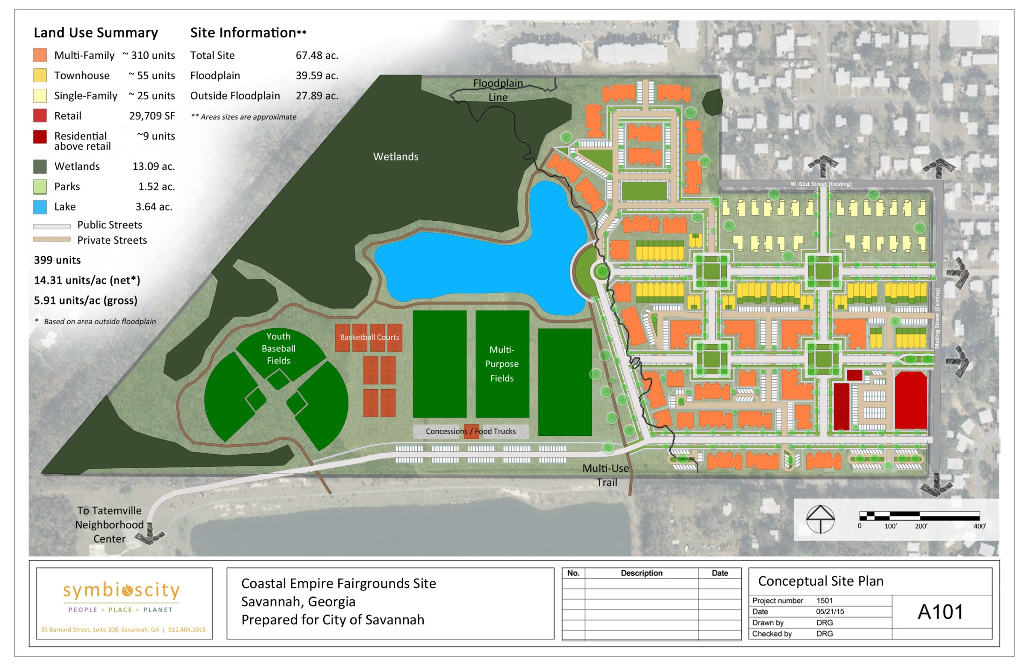
The Original Vision (2015)
Phase 1
Phase 2
Phase 3
Phase 4

Slide 4
Extensive Public Engagement Completed
April 25, 2017 | District 5 Town Hall Meeting discussing Fairgrounds
May 15, 2017 | District 5 Town Hall Meeting discussing Fairgrounds
June 7, 2018 | District 5 Town Hall Meeting discussing Fairgrounds
February 26, 2019 | District 5 Town Hall Meeting discussing Fairgrounds
February 12, 2020 | District 5 Town Hall Meeting discussing Fairgrounds
July 13, 2021 | Open House Public Meeting to explore 3 proposals
July 14, 2021 | Open House Public Meeting to explore 3 proposals
October 21, 2021 | Community at Liberty City Community Center
January 5, 2022 | Meeting with 5th District Coalition Leaders
January 12, 2022 | Public Meeting at Savannah Civic Center to review P3 Joint Venture Group concept
February 24, 2022 | Meeting with 5th District Coalition Leaders
April 12, 2022 | Feiler Park Neighborhood Meeting
May 2, 2022 | Tour of Senior Housing developed by WH Gross Construction
October 17, 2022 | Tatemville Neighborhood Meeting
July 7, 2023 | Town Hall Meeting at Liberty City Community Center

Slide 5
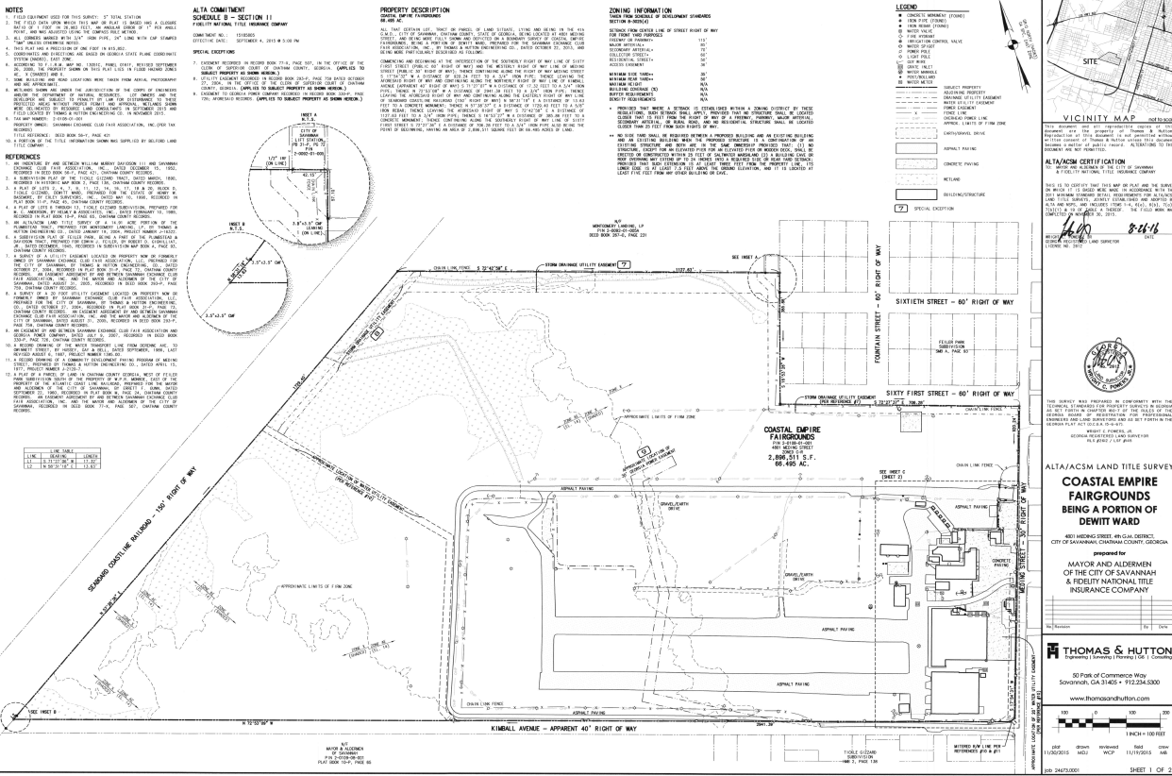
Extensive Due Diligence Completed
Geotechnical Engineering Investigation
Environmental Site Assessments (Ph1/Ph 2)
Lead-based Paint and Asbestos Assessments
Title search and abstract
ALTA Survey
Land Use and Zoning Review
Wetland Site Analysis and Jurisdictional Determination of Wetland Areas by US Army Corps of Engineers
Water/Sewer Capacity Review
Stormwater and Hydrology Report
Neighborhood Asset Review
Neighborhood Housing Analysis
Tatemville Neighborhood Redevelopment Plan
Traffic Impact Report
PSA and DA Negotiations/Contracts
One Georgia Grant Award $2.5M

Slide 6
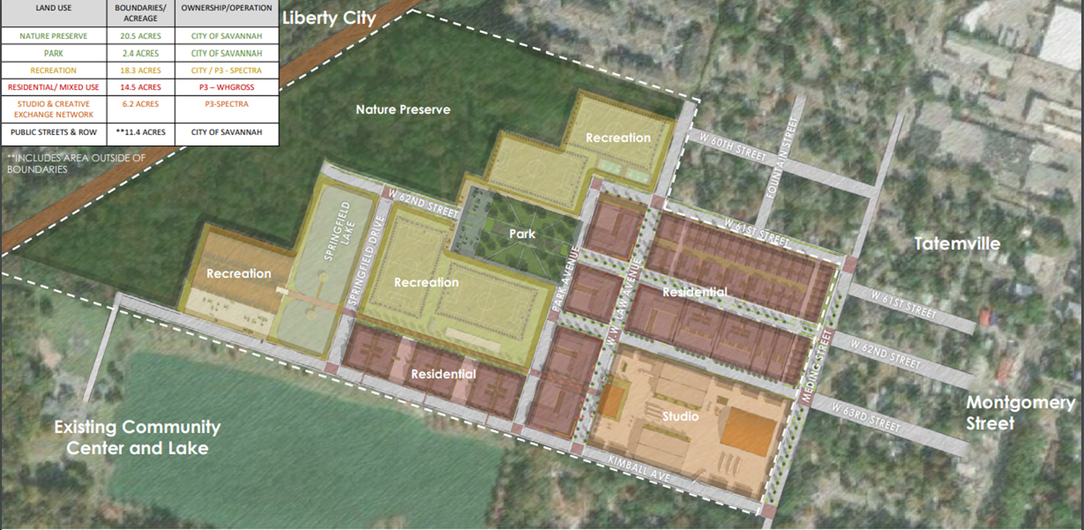
P3 Joint Venture Group Proposed Plan (2020)

Slide 7
P3JVG Land Uses Proposed

Slide 8
Purchase and Sale Agreement
ORIGINAL
1st AMENDMENT
April 2023
Price: $2M as follows
Ph 1: $192,250
Ph 2: $592,250
Ph 3: $574,000
Ph 4: $216,500
Ph 5: $425,000
Size: 66.5 Acres
Sellout: 35 Months
April 2024
Price: $2M as follows:
Ph 1: $200,000
Ph 2: $280,000
Ph 3: $350,000
Ph 4: $290,000
Ph 5: $880,000
Size: 65 Acres
City retains 1.5 Acres for Meding Street Widening
Sellout: 43 Months

Slide 9
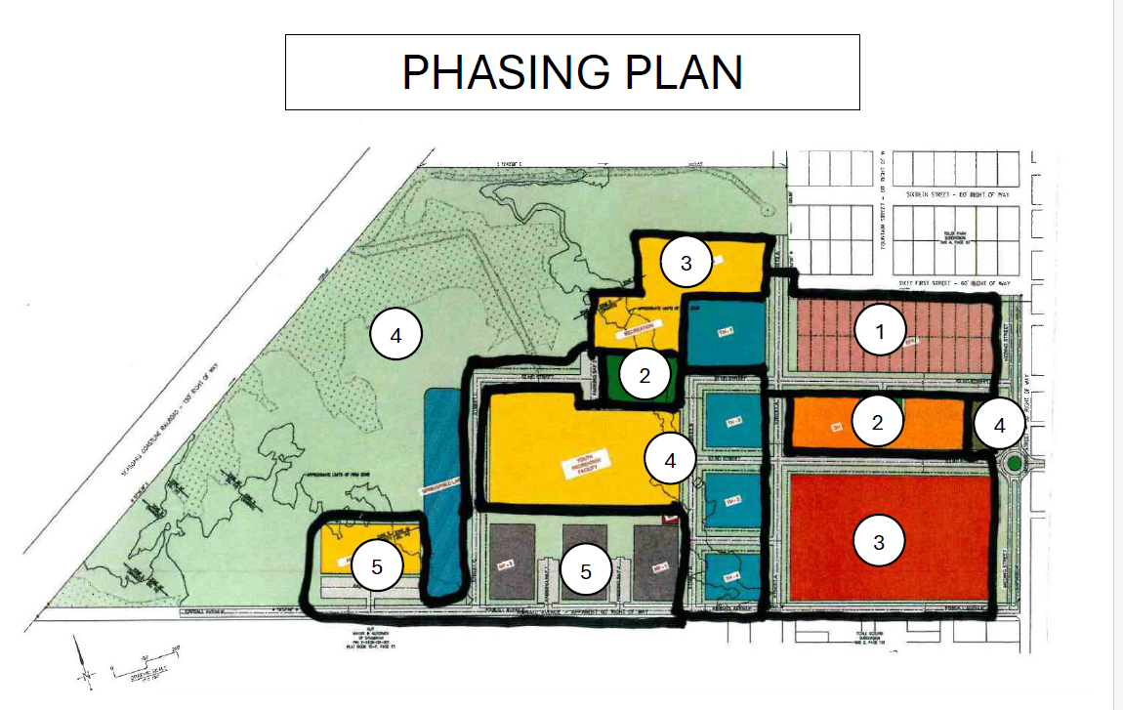
Final Takedown Phases (2024)
Ph 1: 30 Single Family and 20 Townhomes
Ph 2: 70 Affordable Sr. Apartments and 2.4 Ac Park
Ph 3: Studios, Sport Fields, and Basketball Courts
Ph 4: 60 Townhomes, Commercial, Sport Fields, Nature Preserve
Ph 5: 220 Apts and Indoor Rec Facility

Slide 10
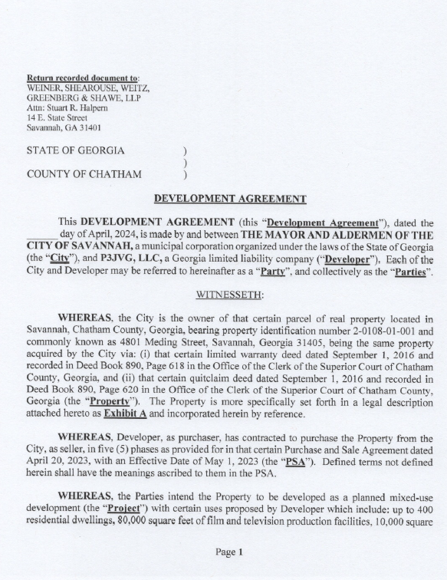
Development Agreement
Developer will develop all on-site infrastructure, parks, housing units, and other buildings.
City will build off-site infrastructure for sewer capacity and road widening, re-zone property, and create subdivision plats.
Establishes process for negotiating the allocation of cost sharing by phase.
Provides termination and reversionary rights to City to ensure performance of Developer.
Establishes easements, covenants, and restrictions.

Slide 11
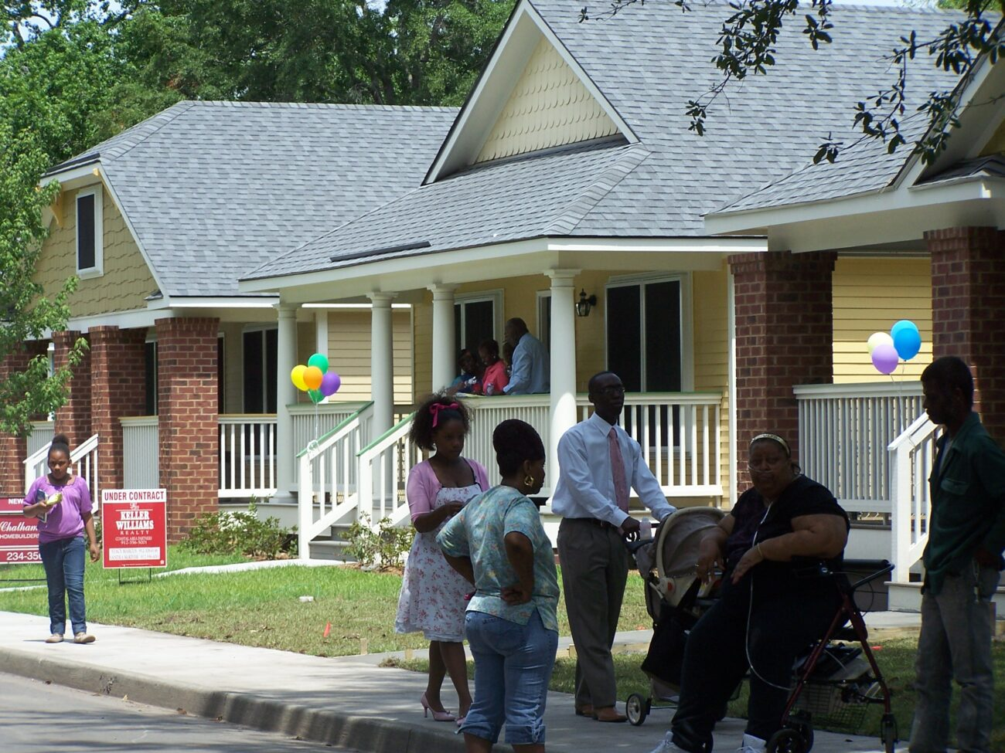
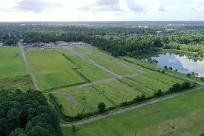
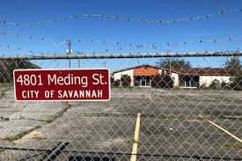
Covenants
Housing Affordability

Slide 12
Phase 1 Cost Allocations
(Estimates Pending Design and Bid)
Developer
City of Savannah
On-Site Infrastructure (roads, utilities, etc.) | $3,000,000
50 Housing Units | $11,000,000
Subtotal | $14,000,000
Plus Land Cost | $200,000
TOTAL | $14,200,000
Sewer Lift Station and Force Main Extension | $3,000,000
Meding Street Widening/Traffic Calming | $3,000,000
Subtotal | $6,000,000
Less Land Sale Revenue | $200,000
TOTAL | $5,800,000
‘One Georgia Grant’ | ($2,500,000)

Slide 13
Upon Approval of City Council First Phase Closing Will be within 60 Days (June 30)
Next Step

