Slide 1
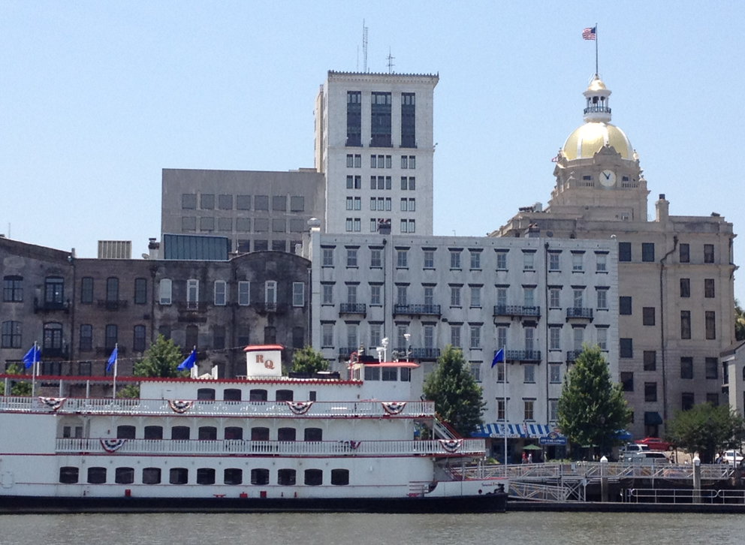
CITY OF SAVANNAH CAPITAL PROJECTS
UPDATE
CITY COUNCIL WORKSHOP
JUNE 8, 2023
City of Savannah / Office of Infrastructure & Development/ Office of Capital Projects Management

Slide 2
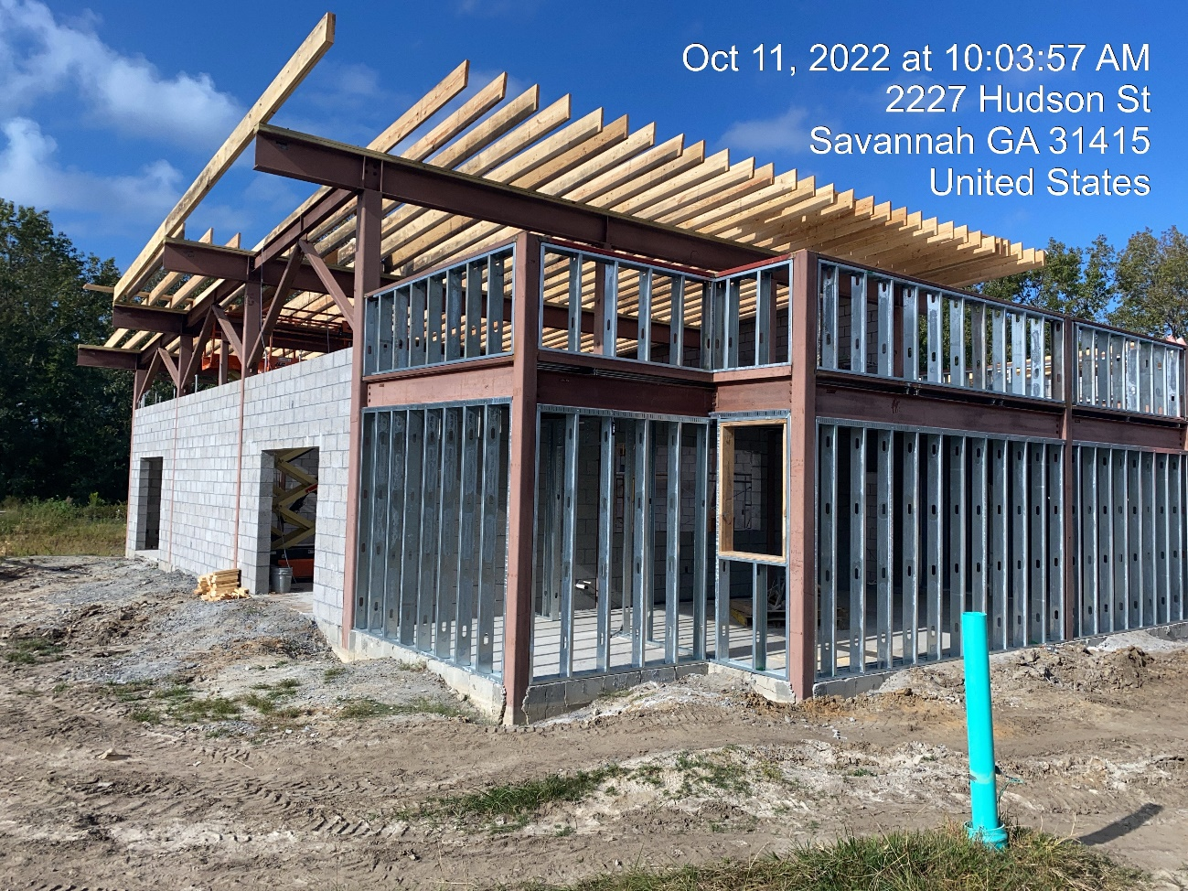
CAPITAL PROJECT
A capital project is a long-term capital-intensive investment project with a purpose to build upon, add to, or improve a capital asset.
A capital project can be new construction, renovation, or a replacement project for an existing facility or facilities.
Project costs can include the cost of land, planning, engineering, architecture, construction, and other services needed to complete the project.
Hudson Hill Community Center
City of Savannah / Office of Infrastructure & Development/ Office of Capital Projects Management

Slide 3
CAPITAL IMPROVEMENT PROGRAM OVERVIEW – Q1 2023
288 Total Projects Citywide
25 Project Managers Citywide
$444,456,764
Total Budget of All Capital Projects
City of Savannah / Office of Infrastructure & Development/ Office of Capital Projects Management

Slide 4
PROJECT MANAGERS ACROSS THE CITY
City of Savannah / Office of Infrastructure & Development/ Office of Capital Projects Management

Slide 5
OFFICE OF CAPITAL PROJECTS MANAGEMENT
Senior Director
Cristy Lawrence, P.E.
Construction Inspector
Jim Wood
Contract Coordinator
Amber Williams
4 Capital Project Managers
Leif Blomberg
Carol Moon
Dan Reel
Byron Stiles
Senior Capital Project Manager
Doug Patten, P.E.
Senior Admin
Jenneida White
Capital Projects Liaison Philip Kalogitonas
5 Project Managers
49 Active Projects
$303,733,237
Total Project Budget
City of Savannah / Office of Infrastructure & Development/ Office of Capital Projects Management

Slide 6
Develop overall programming needs: who & what needs to go into facility
Community Engagement
Collect Site/Building Information
Develop Conceptual Cost Estimates
Procure Architect/Engineer/Design Consultant
Planning (Pre-design)
Design & Permitting
Pre-Construction
(Procurement)
Construction
Finalize Programming
Prepare Schematic Design
Prepare Final Design (Construction Documents)
Obtain Necessary Permits
Prepare bid documents
Advertise for Bid
Review & Evaluate Bids
Obtain Approval of Procurement by City Council
Execute Contract
CAPITAL PROJECT ROADMAP
Issue Notice to Proceed
Pre-Construction Meeting
Construction
Final Inspections
Occupancy

Slide 7
EXAMPLE CAPITAL PROJECT TIMELINES
PROJECT PHASES:
Planning & Community Engagement
Design & Permitting & Continued Community Engagement
Procurement
Construction
*Note: When needed, Value Engineering typically adds 1-2 months
TYPICAL FIRE STATION/COMMUNITY CENTER – Total Time to Complete = 3 – 3 ½ YEARS*
9 Months
11-12 Months
4 Months
14-16 Months
TYPICAL BUILDING RENOVATION – Total Time to Complete = 2 ½ – 3 ½ YEARS*
9 Months
9-15 Months
4 Months
9-15 Months
TYPICAL PARK IMPROVEMENT – Total Time to Complete = 1 ½ – 2 ½ YEARS*
6-9 Months
6-9 Months
4 Months
3-6 Months
City of Savannah / Office of Infrastructure & Development/ Office of Capital Projects Management

Slide 8
CAPITAL PROJECT TIMELINES – ACTIVE LARGE CONSTRUCTION PROJECTS
PROJECT PHASES:
Planning & Community Engagement
Design & Permitting & Continued Community Engagement
Procurement
Construction
TODAY
Placentia Canal Drainage Improvements Phase 5 (Semken & LaRoche Ave Bridge Replacements)
7 Months
Estimated Completion Q1 2024
New Hampstead Temporary Joint Public Safety Facility (Highgate Blvd.)
3 Mos
4 Months
6 Months
Estimated Completion Summer 2024
Police Headquarters Renovation
15 Months
Estimated Completion Summer 2024
Lift Station #23 Upgrades
19 Months
Estimated Completion Q4 2024
City of Savannah / Office of Infrastructure & Development/ Office of Capital Projects Management

Slide 9
CAPITAL PROJECT TIMELINES – ACTIVE LARGE CONSTRUCTION PROJECTS
PROJECT PHASES:
Planning & Community Engagement
Design & Permitting & Continued Community Engagement
Procurement
Construction
TODAY
Truman Linear Trail Phase 2B:
5 Months
18 Months
Estimated Completion Summer 2025
Gamble Building Renovation:
6 Months
4 Months
15 Months
Estimated Completion Summer 2025
DeLesseps Avenue Widening
2 ½ Years
Estimated Completion Q4 2025
Springfield Canal Phase 1 Drainage Improvements (Wetland Park)
7 Months
4 Months
2 Years
Estimated Completion Q2 2026
City of Savannah / Office of Infrastructure & Development/ Office of Capital Projects Management

Slide 10
CAPITAL PROJECT TIMELINES – ACTIVE LARGE CONSTRUCTION PROJECTS
PROJECT PHASES:
Planning & Community Engagement
Design & Permitting & Continued Community Engagement
Procurement
Construction
TODAY
New Hampstead Permanent Joint Public Safety Facility (Little Neck Rd.)
2 Mos
4 Months
12 Months
4 Months
19 Months
Estimated Completion Q4 2026
Procurement of Design
Procurement of Construction
Casey South Phase 3 Drainage Improvements (Deep Tunnel) (Note: Funding must be identified prior to start of construction)
4 Months
14 Months
4 Months
2 Years
Procurement of Design
Procurement of Construction
Estimated Completion Q2 2027
Springfield Canal Phase 2 Drainage Improvements (Canal Walls)
9 Months
4 Months
3 Years
Estimated Completion Q3 2027
Casey South Phase 2-1 & 2-2 Drainage Improvements
4 Months
4 Years
Estimated Completion Q4 2027
City of Savannah / Office of Infrastructure & Development/ Office of Capital Projects Management

Slide 11
TYPICAL PROJECT CHALLENGES
Weather delays
Unsuitable soils
Geotechnical reports based on soil samples
Unknowns under the ground
i.e. debris, utilities, abandoned storage tanks, environmental concerns (contamination)
Unknowns in existing buildings in renovation projects
Asbestos/lead
Mold
Missing structural components
Mechanical, electrical & plumbing systems
City-requested changes/additions to scope during design or construction

Slide 12
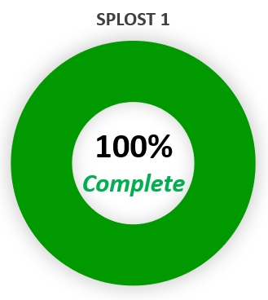
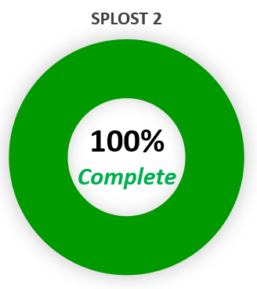
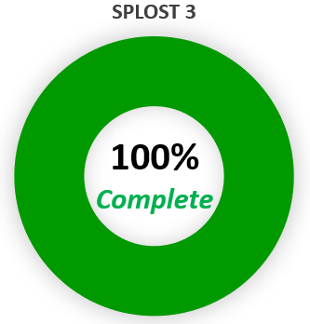
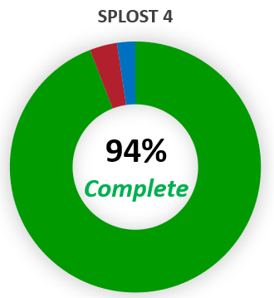
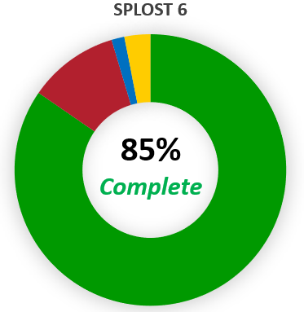
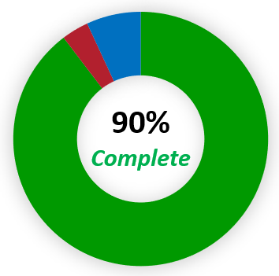
Status of Special Purpose Local Option Sales Tax (SPLOST) Projects*
SPLOST 1
(1985-1993)
SPLOST 2
(1993-1998)
SPLOST 3
(1998-2003)
SPLOST 4
(2003-2008)
SPLOST 5
(2008-2014)
SPLOST 6 (2014-2020)
*Excluding SPLOST 7 (2020 – 2026)

Slide 13
REMAINING SPLOST PROJECTS
SPLOST 4 2003-2008 STATUS
Stormwater Brick Line Replacement Ongoing
Springfield Drainage Improvements Under Construction
DeLesseps Avenue Widening Under Construction
W.W. Law Collection Archival Implementation
SPLOST 5 2008-2014 STATUS
37th Street Corridor Signal Improvement In Design (SS4A Grant)
Casey South Drainage Phase II Phase 1 Under Construction
Street Lighting Upgrade Ongoing

Slide 14
REMAINING SPLOST PROJECTS
SPLOST 6 2014-2020 STATUS
Wireless/Fiber Infrastructure Conceptual/Planning
Atlantic Park Improvements Conceptual/Planning
Project DeRenne Design/Preconstruction
Wheelchair Access Ramps Under Construction
Coastal Heritage Society Improvements Under Construction
Highlands Park Phase 1 Under Construction
Drainage Box Rehabilitations Under Construction
Placentia Basin Drainage Improvements Under Construction
Pedestrian Wayfinding Signage Under Construction
Victory Drive Landscaping & Irrigation Under Construction

Slide 15
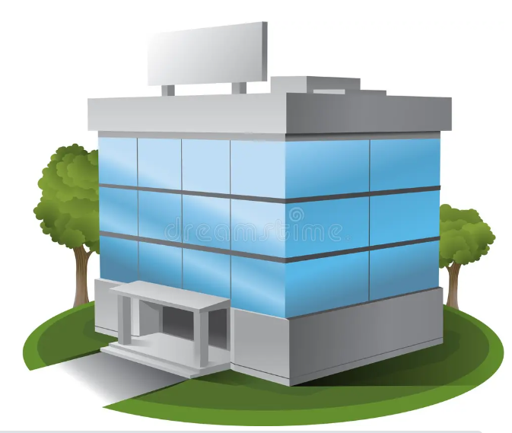
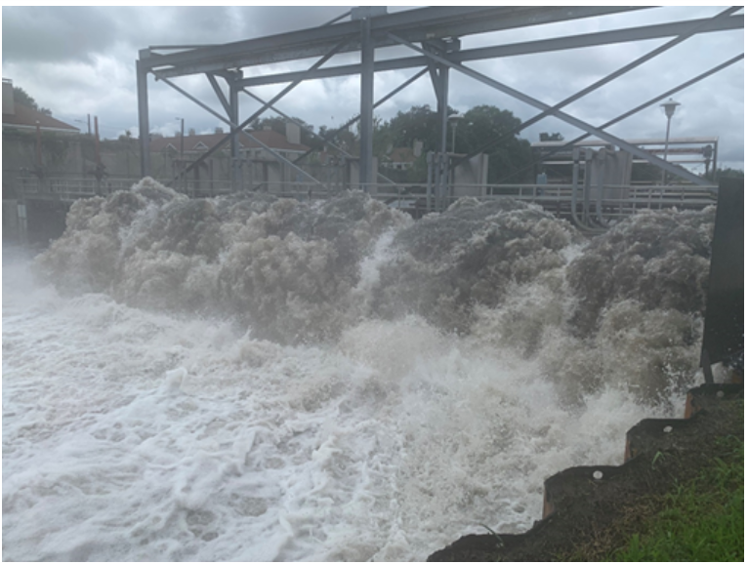
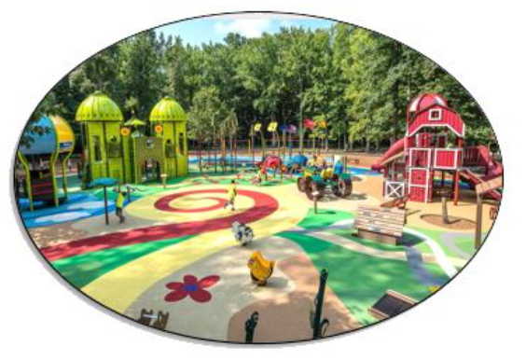
FUTURE CAPITAL NEEDS
Municipal Space Needs
Public Safety
Drainage
Mobility/Transportation
Recreation

Slide 16
PROJECTS COMPLETED IN 2020
Twickenham Greenspace
Fire Dock Replacement
Bonaventure Cemetery Restroom Building
Holly Heights Park Improvements
State Street Garage MPC Office Repairs
Recreational Dock Gangway Replacement
Liberty Street Garage 5th Floor Structural Repairs
Highlands Drive Sign Repair
Fire Station Headquarters Chimney Repair
Silverton Sign Demo
Glynnwood
Sign
Alfred Street Culvert Extension
Factors Walk - Barnard Ramp Repairs
Crusader Center Basketball Resurfacing
SPD Special Operations Storage Building – FEMA Repairs
Bryan Street Garage Beam Spalling Repairs
Robinson Garage Elevator Modernization
Summerside Park
FEMA - Hurricane Matthew Repairs - Paulson Recreational Complex Roof Repair
Cloverdale Sign Repair
Eastern Wharf Dock Repair
Colonial Cemetery Lighting
*SPLOST Projects
City of Savannah / Office of Infrastructure & Development/ Office of Capital Projects Management

Slide 17
PROJECTS COMPLETED IN 2021
Paradise Park Sign Insert Replacement
WW Law Center Roof Replacement
Highlands Fire Station
Woodville-Sidewalk on Alfred Street between King Street and Lissner Street
Riverwalk Wharf Repairs
Floyd Adams Complex
Ogeecheeton Park ADA Repair
Abercorn Creek Municipal Water Intake - FEMA - Hurricane Matthew Repairs
Police Memorial Trail Repairs
Mohawk Park
3rd Floor City Hall Offices
Jan Street Improvements
*SPLOST Projects
City of Savannah / Office of Infrastructure & Development/ Office of Capital Projects Management

Slide 18
PROJECTS COMPLETED IN 2022
Emergency Repair of Recreational Dock
Savannah Gardens Phase 3B Master Infrastructure
Fernwood Bridge Deck Replacement
Arena City Lot "Waterworks Lot Site Development"
Sanitation Headquarters Renovation
Arena, Canal Bulkhead, & Force Main
Arena Marquee Sign
Greenwich Cemetery Section 6 Expansion
Waters Ave Streetscapes Phase III
Arena Parking Garage
Cedar Street Improvements Phase III
Arena Pedestrian Bridge
Factors Walk 316 E. Bay Street Stair Replacement
Truman Parkway and President Street Clearing and Fencing
*SPLOST Projects
City of Savannah / Office of Infrastructure & Development/ Office of Capital Projects Management

Slide 19
PROJECTS COMPLETED IN 2023 (TO DATE)
Grant Center Gymnasium
Waters Avenue Shopping Center Savannah Impact Program (SIP) Buildout
Delaware Center Renovation
Stiles Avenue Phase 1
Broughton Streetscapes Phase 1
Leedsgate Gazebo
Fleet Services Renovation – 8 Interchange Court
Joe Tribble Park Lake Repairs
Fire Support/ Code Compliance Renovation
Riverwalk Extension
*SPLOST Projects
City of Savannah / Office of Infrastructure & Development/ Office of Capital Projects Management

Slide 20
PROJECTS TO BE COMPLETED IN 2023 BY YEAR END
Dundee Cottage Infrastructure
Highlands Park Phase 1
President Street Plant Freight Elevator Repair
IT Ring Generators
Municipal Archives Upgrades
Fleet Maintenance Sallie Mood Roof Repairs
Cultural Arts Center Atrium Rigging
Hudson Hill Community Center
Coastal Heritage Society Storehouse Roof Replacement
Entrepreneurial Center Building Envelope Repairs
Fleet Maintenance Automatic Transfer Switch Replacement
*SPLOST Projects
City of Savannah / Office of Infrastructure & Development/ Office of Capital Projects Management

Slide 21
Capital Project Highlights

Slide 22
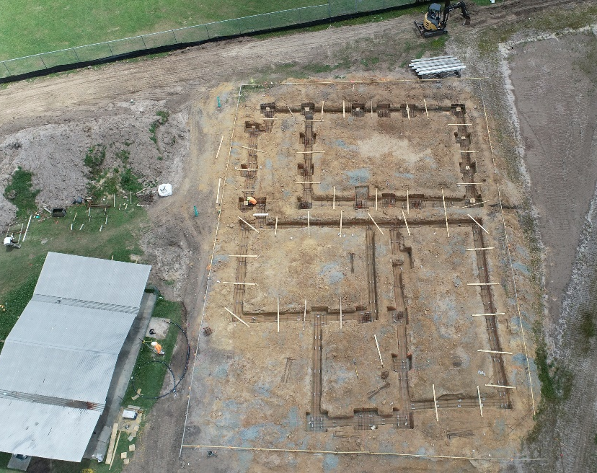
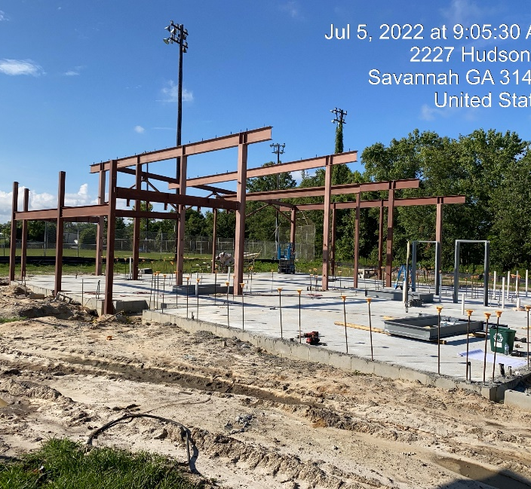
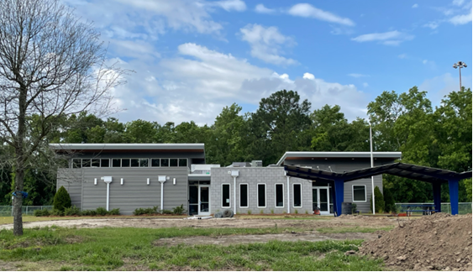
HUDSON HILL COMMUNITY CENTER
Estimated Project Budget: $3.3 Million
Estimated Project Schedule:
Completion Date – June 2023
Project Scope:
New 4,600 sq. ft. Community Center with classrooms, offices, a large assembly space with commercial kitchen, and increased parking
City of Savannah / Office of Infrastructure & Development/ Office of Capital Projects Management

Slide 23
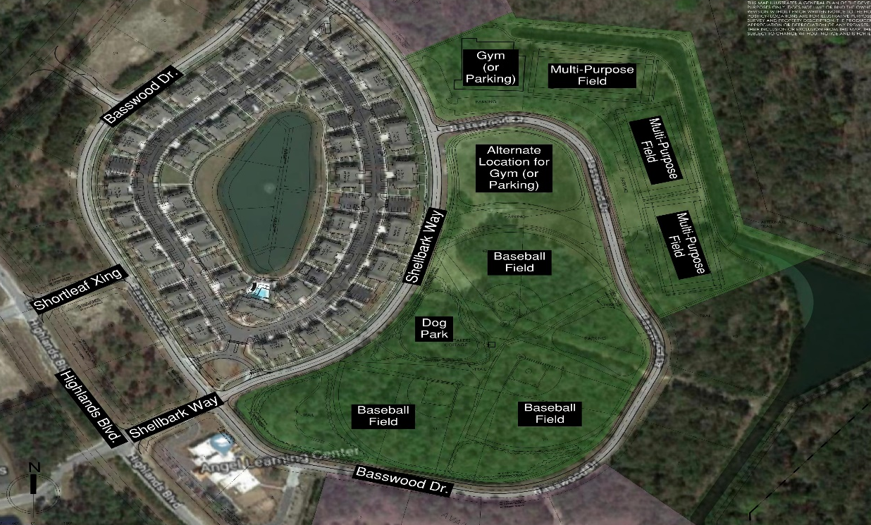
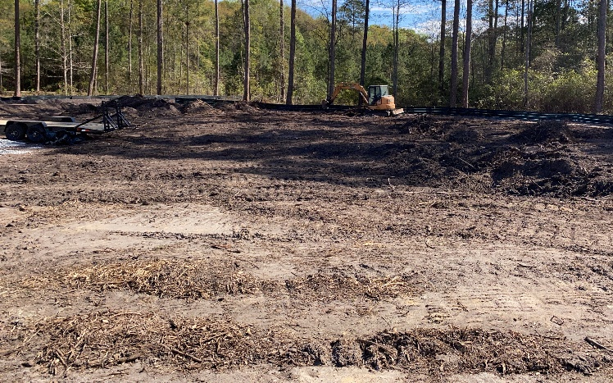
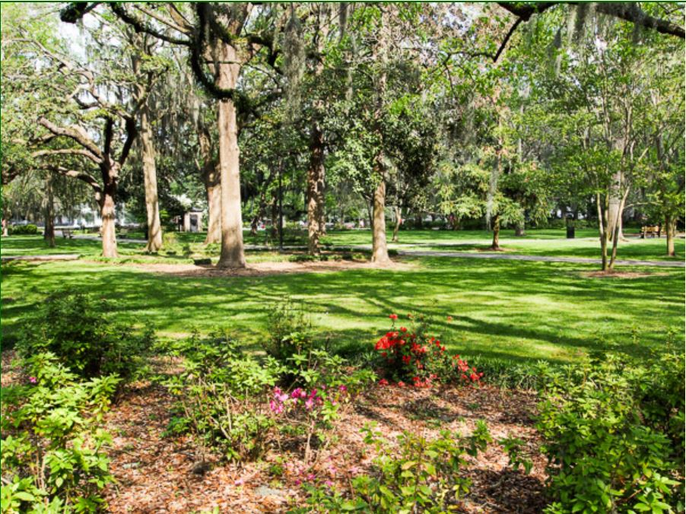
Highlands Park Phase 1
Project Scope:
Phase 1 of the park is a half-mile walking trail and parking lot along the northside of the property, north of Basswood Drive
Highlands Park will be a planned 33-acre large regional park
Estimated Phase 1 Project Budget: $1.3 Million
Estimated Project Schedule:
Completion Date – June 2023
City of Savannah / Office of Infrastructure & Development/ Office of Capital Projects Management

Slide 24
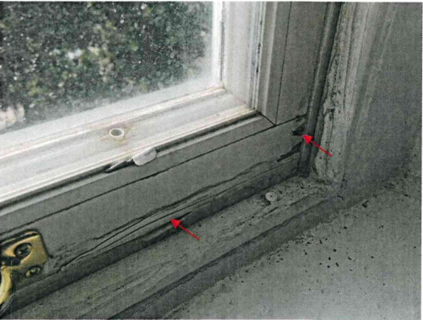
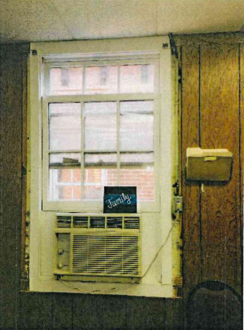
Police Headquarters Renovations
Project Scope:
Building envelope repairs include new windows, HVAC system, and exterior wall insulation.
Interior renovation includes updated office layout, new ceiling tile, paint, flooring, lighting upgrade to LED lights, and IT infrastructure.
Window moisture damage containing rot
Estimated Project Budget: $8.5 Million
Estimated Project Schedule:
Completion Date – Summer 2024
Window units causing
moisture accumulation and mildew
Plaster deterioration and openings in wall
City of Savannah / Office of Infrastructure & Development/ Office of Capital Projects Management

Slide 25
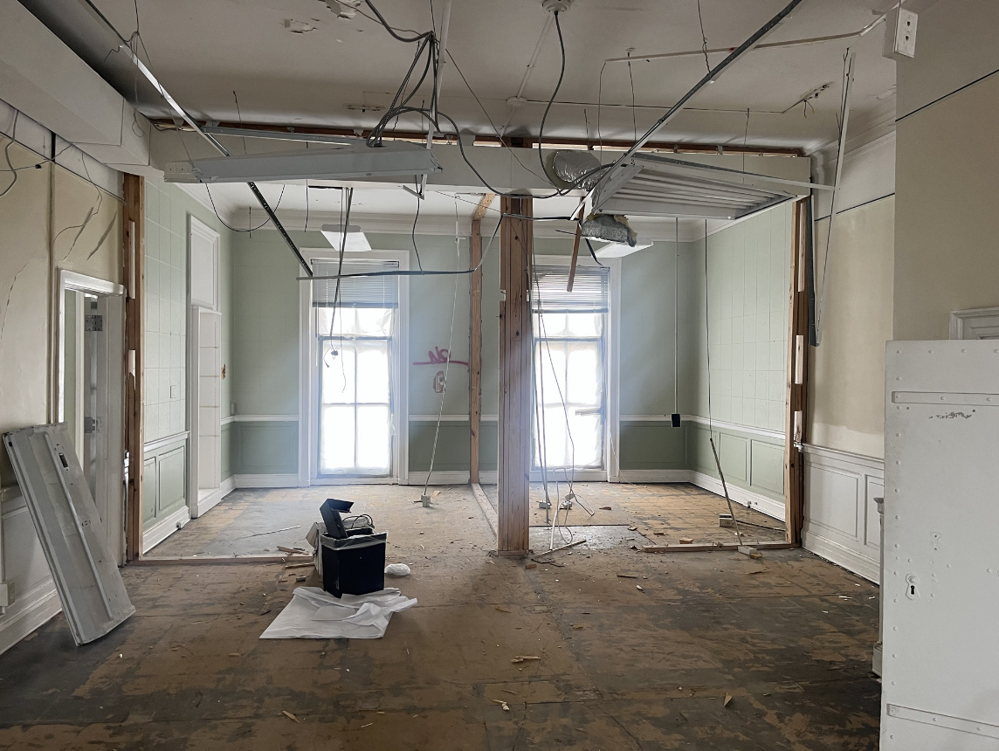
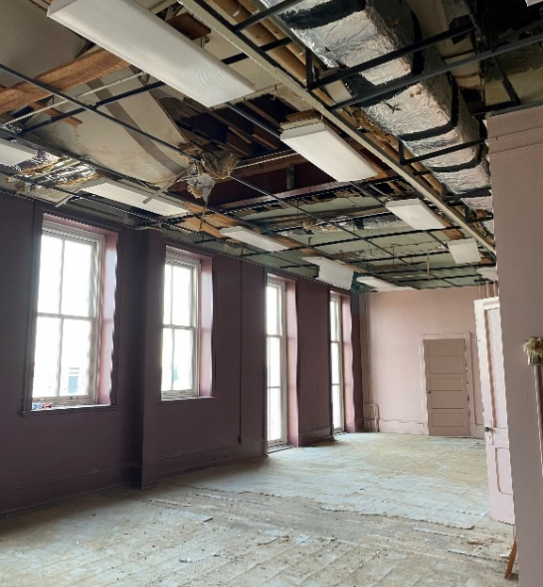
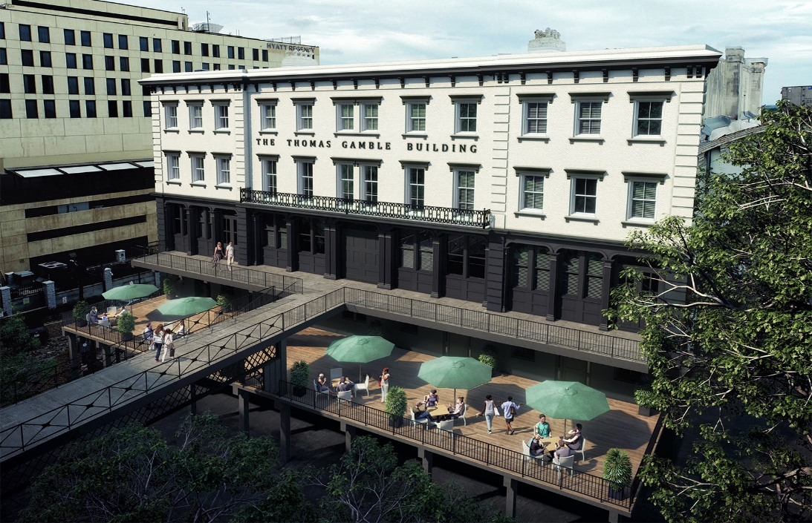
GAMBLE BUILDING RENOVATION
Scope:
Interior and exterior renovations including MEP systems, building structure, building envelope, ADA, and life safety improvements to create a modern office space for staff
Estimated Project Costs:
Design $ 625,000
Construction $12,700,000
Other Project Costs $ 1,575,000
Estimated Project Schedule:
Design Completion – Q3 2023
Start of Construction – Q1 2024
Completion – Summer 2025
City of Savannah / Office of Infrastructure & Development/ Office of Capital Projects Management

Slide 26
OFFICE OF CAPITAL PROJECTS MANAGEMENT
QUESTIONS?

