Slide 1


City Council Meeting
May 22, 2025

Slide 2
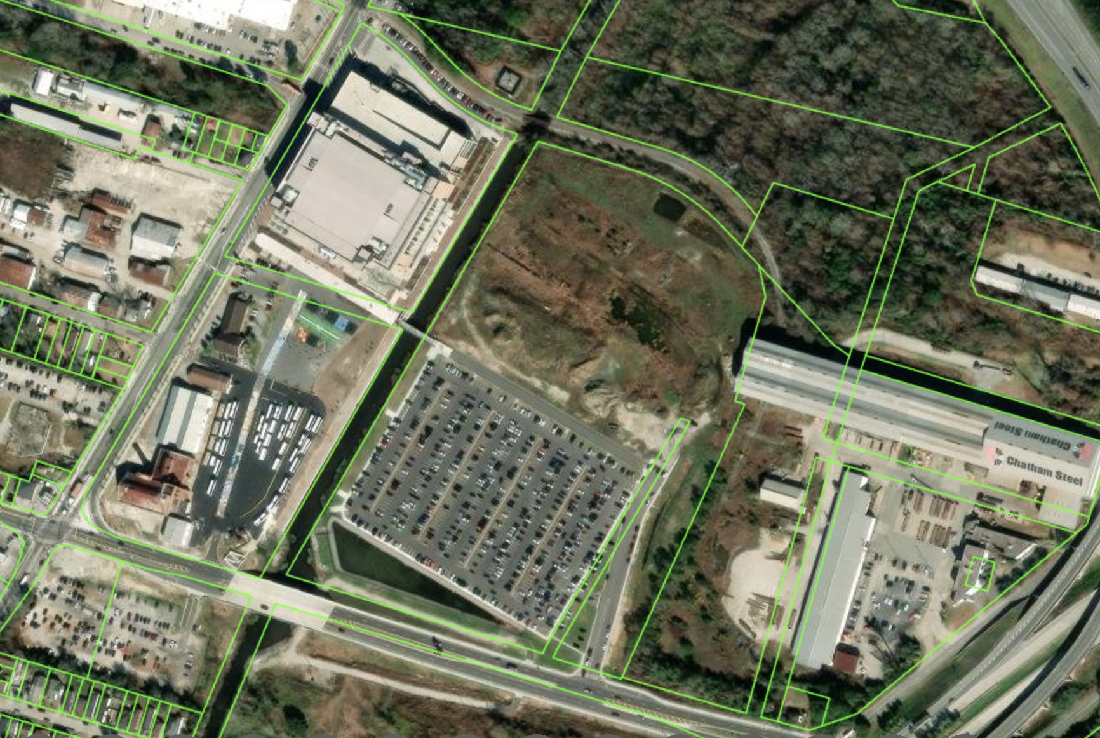
Westside “Arena” Surface Lot Project

Slide 3
Presentation Agenda
Recommendation Framework
Project Timeline Review: 2019 – 2025
What are our Legal and Environmental Obligations?
Hindsight, Cost Saving Measures, & Accountability
What is the Consequence of Doing Nothing?
Three Possible Council Actions
Financial Implications of Council Actions
Recommended Path: The Budget & Timeline
Discussion / Q & A

Slide 4
Recommendation Framework
What is the most prudent path forward Financially
What is the most prudent path forward legally
What is the most prudent path forward environmentally
What accountability actions need to be made

Slide 5
Project Timeline Review – 2019
The then-City Manager authorized for the City’s annual contracted civil engineer, CHA (previously known as Wolverton), to assess potential surface parking lot options to accommodate the parking requirements of the new Arena. The cost for this evaluation was $125,000 sourced from the Parking Fund.
The City identified the Tenenbaum site as the most suitable option and initiated discussions with the owner regarding a possible agreement.
Staff opted to explore a lease arrangement rather than an acquisition due to concerns over possible environmental issues.
On August 29, 2019, the Council approved a land lease between the City and Tenenbaum, Inc., which was signed and became effective on September 10.
The lease term was set for 5 years, with an option to extend for an additional 5 years, making a total of 10 years.
The initial rental rate was established at $696,000 per year.
The Due Diligence Period was designated as 90 days, concluding on December 9, 2019.
The lease could be terminated during the due diligence phase.
The City Council approved a First Amendment to the lease agreement, signed and effective as of November 14, 2019.
This First Amendment extended the Due Diligence Period to May 29, 2020.
There were no changes made to the rental rate, terms, or other conditions.
Due Diligence was conducted to outline preliminary contamination boundaries on the site.
The City Council also approved the 2020 Adopted CIP Budget, which allocated $5 million for the Westside Surface Lot project.

Slide 6
Project Timeline Review – 2020
The Council has approved a Second Amendment to the Lease Agreement, which became effective on May 28, 2020.
  This amendment establishes that the lease term will begin on the 21st day following the final decision from the Environmental Protection Division (EPD) of the Georgia Department of Natural Resources regarding the proposed environmental remediation plan, as well as the 21st day after the US Army Corps of Engineers issues a final decision on the proposed use/plan.
  The annual rent has been reduced to $525,000.
  The City retains the right to terminate the lease if the EPD does not approve the environmental remediation plan or if the Corps of Engineers does not issue the required permit.
  Additionally, the amendment includes a Financial Assurance provision, requiring the City to provide regulators with financial assurance for the costs associated with the implementation, maintenance, and monitoring of the remediation plan throughout the lease term. Tenenbaum, Inc. will be responsible for all such costs after the lease expires.
The draft environmental remediation plan (CAP/VIRP) was approved and signed by the then-City Manager and submitted to the Georgia EPD on June 12, 2020.
The preliminary due diligence results were reported, leading to the development of a Corrective Action Plan, which outlined that the City would: Remove contamination exceeding specific thresholds; Encapsulate any remaining contamination below certain thresholds using an asphalt-paved parking lot; Restrict the deed to allow only parking lot usage; and Implement institutional controls and periodic reporting.
The Georgia EPD, in collaboration with the EPA, approved the environmental remediation CAP on October 21, 2020.
The US Army Corps of Engineers provided a jurisdictional determination on September 23, 2020, confirming there were no jurisdictional wetlands that would be affected by the project.
The estimated construction cost provided by consultants was reported to be $5.7 million.
Based on the information above, the City has moved beyond due diligence and commenced construction and remediation activities.

Slide 7
Project Timeline Review – 2021
Georgia EPD grants City approval to start construction/remediation on the south half of the proposed parking lot while delineation continues on the north half, which was much more heavily contaminated than the south side.
Bids for remediation/construction were solicited, and work was awarded to APAC at $9 Million in May 2021.
  $5 Million funding was existing as approved in 2020 Adopted CIP Budget.
  $2.5 Million was allocated in the 2021 Adopted CIP Budget
  $1.75 Million was a later budget Amendment in May 2021 to funding the increased cost based on bids received.
  Total funding authorized was $9.25 Million.

Slide 8
Project Timeline Review – 2022 - 2023
2022:
The south-half of the proposed parking lot is completed in June 2022.
Total cost for contractor and consultants on the south-half lot was $6.3 million.
Environmental delineation of north-half continued.
2023:
Environmental delineation of north-half continued.
City Council approved 2023 projected budget, which includes an additional $6.5 Million to cover estimated remediation costs for the north-half lot.

Slide 9
Project Timeline Review – 2024
City Manager recommends and City Council approves a “Revised, Amended and Restated Land Lease” to the original lease agreement, which was effective March 8, 2024.
  The revised agreement extends the base term for 10 years and 2, 5-year periods for a potential total of 20 years through 2050.
  Tenenbaum, Inc. affirms it provided regulatory authorities a notice of release of regulatory substances on the site
  City reaffirms it will pay cost to implement, maintain, and monitor the EPD approved remediation plan during term of the lease.
  Tenenbaum, Inc. affirms it will pay cost to implement, maintain, and monitor the EPD approved remediation plan after City lease expires.
  City provides financial assurance for its obligations.
  City has right of first refusal to acquire the site if Tenenbaum receives an offer to buy.
City Manager recommends and City Council approves $4.5 Million change order to parking lot remediation/construction contract in February 2024.

Slide 10
Project Timeline Review – 2025
In February 2025, City Manager moves project oversight and management to Planning and Economic Development Service Center.
February 2025, City Council approves Program Management Assistance for all city horizontal construction projects, including the Westside Surface Lot.
City Staff discover cost overruns by contractors, estimated at $1.9. million above the authorized contract amount (City has not approved payment of that overrun).
Project evaluation was conducted resulting in a proposed settlement agreement with Terracon and APAC that provide price concessions and better management practices moving forward.
City negotiated a reduced per ton hauling fee from $377 to $287.50 by contracting separately with Waste Management.
City consultants identified a reduction in the materials to be hauled from the site from 15,500 tons to 4,000 tons.
Revised cost proposal from APAC, Terracon, and Waste Management to complete project is an additional $11 Million.
City Council holds Workshop on issue May 22, 2025.

Slide 11
Is the City Obligated to Remediate the Site?
The first documentation of the City’s assumption of obligations for the remediation of the property occurs in the Second Amendment to Land Lease approved May 28, 2020.
The Second Amendment revised the commencement date to begin on the later of certain approvals, one of which was the GAEPD approval of a Voluntary Investigation and Remediation Plan (VIRP). The City as Tenant was obligated to submit the VIRP to GAEPD by June 8, 2020. A provision was added requiring City to provide any financial assurance required by GAEPD for the VIRP or by USEPA for a corrective action plan (CAP).
A subsequent Revised, Amended and Restated Lease further amended the original Lease effective as of November 1, 2020. This document stipulates the VIRP was submitted by Landlord as prepared by Tenant’s consultants, that Tenant has the responsibility for filing any other reports to GA EPD and US EPA regarding environmental work performed at the Property, and that Tenant is performing environmental work at its sole cost and expense during the term of the lease.
The VIRP application to GAEPD was dated June 12, 2020, and GAEPD approval was issued to the City October 21, 2020.
A PCB Remediation Waste Cleanup and Management Plan was submitted to USEPA on January 31, 2022 by the City’s consultants. USEPA issued an Approval of PCB Cleanup Activities to the City and Tenenbaum, Inc. on May 25, 2022.

Slide 12
Hindsight
As I’ve stated to Council before, I believe the primary miscalculation of this project was approaching this as a construction project and NOT as an environmental remediation project.
We brought on environmental remediation experts who found that removal and disposal of a large quantity of soil that was not verified to be contaminated above the target threshold (and therefore likely did not have to be hauled away and disposed of as hazardous waste) led to increased costs on the project.
USEPA and GAEPD regulations call for the removal of identified contaminated soil by way of “delineation sampling” and after removal conduct “confirmation sampling” to determine whether any more contamination remains and must be removed.
City contractors were following this process early on; however, the excavation contractor was then advised to take out and haul away soil based on “visual cues” – i.e., color, texture, smell, etc., which led to an escalation of hauling and disposing costs.
When the excavation contractor submitted pay requests for $1.9 million over and above the obligated contract amount, City procurement staff raised red flags, leading to the City bringing in the outside experts.

Slide 13
Accountability & Cost Saving Measures
The remainder of the work in this contract modification has been significantly reduced based on our experts' evaluation of methods going forward and reducing material removal from 15,500 tons to 2,500-4,000. This reduction stopped a further expense of $4 million+ based on the original rates.
We were able to move to a direct charge arrangement with Waste Management for the T&D, eliminating the contractor markup and reducing the haul rate from $377 per ton to $287.50 per ton, yielding an additional savings of ~$225,000 - $360,000.
Review of bids and bills from both original vendors indicate possible overbilling and inflated rates. The vendors are on notice that future billing and bid rates will be scrutinized.
Dismissing these parties from the project and rebidding or bringing in others would cost the City substantially more than completing with them and cause undesirable delays, so our outside legal counsel has pressed both vendors to provide discounted rates for completion of this work. These discounted rates reduced the cost to complete this project by another $500,000 to $1 million, and further savings to the City are expected overall as the vendors have adjusted their bidding and billing practices for all projects going forward.
The indemnities under our existing contracts remain in effect, and we have the leverage to impose the rate reductions without providing any release to the vendors. Options for pursuing recourse against the contractors are still available.

Slide 14
Can We Just Stop Work and Move On?
ACCORDING TO OUR EXPERT LEGAL CONSULTANTS: “The City cannot just cease work and let the property sit as it is. As referenced previously, the City has accepted contractual obligations under the Lease and would be subject to an action for breach if it failed to follow through. Even if the City could posit a legal argument to void the Lease or certain provisions, the VIRP with GAEPD and PCB CAP with USEPA are separate obligations.”
“At this point, there is soil stockpiled with PCBs and other contaminants at levels which require disposal in a hazardous waste landfill, and the remaining exposed soil has been confirmed by sampling to contain contaminants at levels which must be capped under both USEPA and GAEPD regulations. The City conducted the action creating the stockpile, so the City is the generator of that waste and has responsibility for disposing of it in accordance with USEPA regulations.”
“While the contamination was already existing at this location for decades before the City’s involvement, the waste material is now stockpiled, and residual contaminated soil is exposed to the elements. The stockpile is covered, but that covering is not designed to be permanent and requires maintenance to keep it effective. Leaving the property as it currently sits could result in exposing citizens to the contamination through the effects of wind and rainfall, and direct exposure if site security is not maintained.”
“The City is required to submit quarterly updates to USEPA and semi-annual reports to GAEPD. If either regulatory agency were advised that the City was ceasing work at the site, we could expect immediate action to enforce the obligations of the existing agreements, or revocation of the “voluntary” agreement and direct orders to abate conditions causing potential risk to human health and the environment. If the VIRP is abandoned, GAEPD will list the site on the Haz Site Inventory (State Superfund List), which could expose the City to another claim from the Tenenbaums for allowing that to occur.”

Slide 15
What Actions Can Council Take?
Action 1: Do Nothing: disapprove funds and contract modifications (Not recommended, not feasible)
Action 2: Meet Environmental Obligation Without Adding Parking (Not recommended)
Action 3: Meet Environmental Obligation by Capping with Parking Lot and Recoup as Much Expense as Possible (RECOMMENED)

Slide 16
Action 1: Do Nothing (NOT RECOMMENDED)
City Council can vote to disapprove any additional budget allocation or contract modifications, effectively ceasing all work at the site. This action causes significant legal and environmental challenges, as well as puts the City at risk to be ordered to spend the same and likely more money to cure the issues.
Decision Matrix
Financially Prudent? | NO
Environmentally Prudent? | NO
Legally Prudent? | NO
Does it Provide Accountability? | This actions shifts accountability and liability solely to the City

Slide 17
Action 2: Remediate with No Parking
City Council can vote to approve the budget amendment and contract modifications but specify that the northern portion of the parcel not be capped with parking, but instead with a clay cap with soil and vegetation.
Decision Matrix
Financially Prudent? | NO
Environmentally Prudent? | YES
Legally Prudent? | YES
Does it Provide Accountability? | Renegotiations with Contractors has reduced cost to complete considerably, essentially keeping the remaining work at cost for the contractors. City retains right to pursue recourse.

Slide 18
Action 3: Remediate & Cap with Parking (Recommended)
City Council can vote to adopt budget amendment and contract modification, approving completion of the project with the ability to recoup as much cost as possible while putting the entire site to use.
Decision Matrix
Financially Prudent? | YES
Environmentally Prudent? | YES
Legally Prudent? | YES
Does it Provide Accountability? | Renegotiations with Contractors has reduced cost to complete considerably, essentially keeping the remaining work at cost for the contractors. City retains right to pursue recourse.

Slide 19
Action 2 vs Action 3: Financial Implications
Action 2
Action 3
(Recommended)

Slide 20
Significant Reduction in ROI with No Additional Parking
Action 3
(Recommended)
Additionally: Action 2 does not achieve positive cash flow. Action 3 achieves a cash positive state within two years and takes a large chunk out of the development costs by the end of the lease.

Slide 21
Project Budget (with Action 3 Costs)

Slide 22
Action 3: Remaining Project Timeline
By July
Remediation \ Water Disposal
Fence Removal
By Sept
Place Borrow Excavation \ Elliptical Pipe
Back Basin \ Site Lighting
Grading \ Clay Cap
By Dec
By Oct
Sidewalks \ Curb & Gutter
Drainage Swales \ Asphalt Paving
Dress Site
Install ballast stones in basin
Install Trees & Shrubs
Install Benches \ Final Seeding

Slide 23
Discussion

Slide 24
City Council Meeting
May 22, 2025

