Slide 1

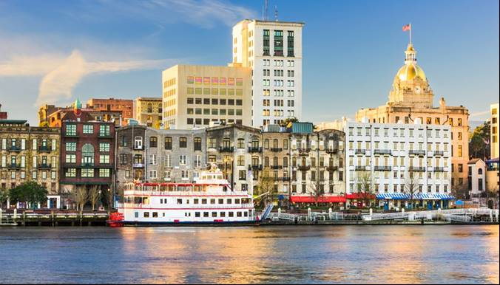

Savannah, Georgia
Financial & Compliance Audit - December 31, 2023
Presented by:
Trey Scott
(912) 232-0475

Slide 2
Purpose of Today’s Presentation
    Overview of:
    Mauldin & Jenkins
    Annual Comprehensive Financial Report
    Audit Opinion (Financial / Compliance)
    Financial Statement Highlights
    Other Audit Communications
    Other Matters (New Standards)

Slide 3
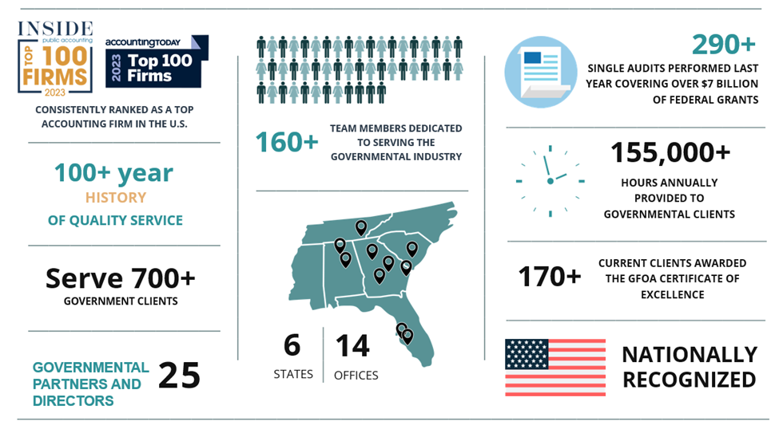
Engagement Team = Large Regional Firm
Notes:
4 offices in Georgia including Savannah.
4 other offices in the Southeast.

Slide 4
Audit Opinion
City = responsible for financial statements (ACFR).
M&J = to express an opinion.
Auditing Standards = GAS
Clean Opinion =
Financial Statements - The financial statements of Savannah, Georgia are considered to present fairly, in all material respects …...
Federal Pgms. of ~$16.6M with 2 Major Programs (CDBG; EDA) = ~$4.8M - Complied, in all material respects…..
Notes:
Savannah’s Finance Department led by David Maxwell puts the CAFR together and we do the audit.

Slide 5

Award for ACFR
Savannah has prepared an Annual Comprehensive Financial Report FY 2023.
Awarded Certificate of Achievement for Excellence in Financial Reporting from the Government Finance Officers Association (GFOA).
Notes:
Savannah’s Finance Department led by David Maxwell puts the CAFR together and we do the audit.

Slide 6
Entity-Wide Financial Statements
$2.6 billion = total assets
  $1.6 billion = capital assets, net of A/D
$.6 billion = total liabilities
$2.0 billion = net position (or equity)
$567 million = revenues (~$9 M inc.)
$443 million = expenses (~$65M inc.)
$124 million = result = net change
Notes:
Savannah is a very large city government, and the numbers support that notion.
Bottom line is very much needed when you look to the future cash flows needs.

Slide 7
Capital Asset Activity – Govt Wide – Last 5 Years

Slide 8
General Fund Financial Statements
$213.2 million = total assets
$155.5 million = total liabilities
$57.7 million = fund balance (3.1 months = 95 days)
$53.9 million = unassigned (2.9 months = 89 days)
$280.2 million = revenues & other fin sources
$275.5 million = expenditures & transfers out
$4.7 million = net increase in fund balance
Notes:
12/31 = fattest time of year.
Income and Expenses Include transfers in and out …….
Savannah has around 80 days of fund balance.
Good but not Great.

Slide 9
Revenues & Expenditures Over the Past 5 Years
Notes:
Upward trend noted and needed for plans and commitments looking forward.
Prepare for disaster contingencies, recessions and other matters could develop.

Slide 10
Water / Sewer Financial Statements
$658.6 million = total assets ($485M = net capital assets)
$65.4 million = total liabilities
$593.2 million = net position (or equity)
$119.0 million = total revenues & other sources
$94.5 million = total expenses & other uses
$24.5 million = increase in net position
$8.1 million = Inc. in Cash Flows

Slide 11
Pension & OPEB Trust Funds Financial Statements
$549.2 million = net position (or equity)
available to fund participants
$24.1 million = total contributions
$61.0 million = net investment income (py loss of $101M)
$48.2 million = total benefit & admin expenses
$36.9 million = increase in net position
Pension 91% funded ($564 Liab. – $514 Funded = $50 Net Liab.)
OPEB 149% funded ($81 Liab. - $120 Funded = $39 Net Asset)
Notes:
Look long-term to evaluate current status.

Slide 12
Pension and OPEB Funding –
Past 5 Plan Years
Notes:
Upward trend noted and needed for plans and commitments looking forward.
Prepare for disaster contingencies, recessions and other matters could develop.

Slide 13
Other Communications
We are required to present information relative to the audit process and its results.
Significant areas addressed in our reports:
  Judgments & estimates;
  Audit adjustments;
  Independence;
  Other.

Slide 14
New Financial Reporting GASB Standards
  #100 – Accounting Changes and Error Corrections (2024)
  #101 – Compensated Absences (2024)
  #102 – Certain Risk Disclosures (2025)
  #103 – Financial Reporting Model Improvements (2026)
Notes:
M&J Partner Joel Black just took the helm as Chairman of GASB.
We are encouraged with GASB’s future.

Slide 15
Newsletters, Free Continuing Education, Closing
Newsletters
Written by M&J on topics pertinent
to local governments in Georgia.
Free Continuing Education
Since March 2009, quarterly
continuing education is provided
by M&J to government clients.
Closing
Thanks, Questions, Thoughts.

Slide 16
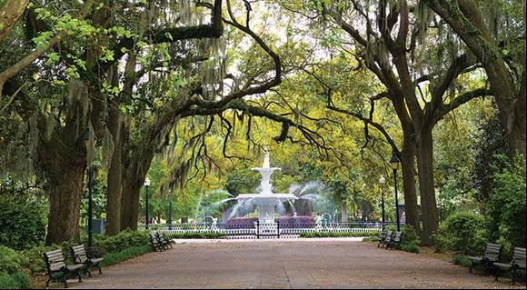
Savannah, Georgia
Financial & Compliance Audit - December 31, 2023
Presented by:
Trey Scott

