Slide 1
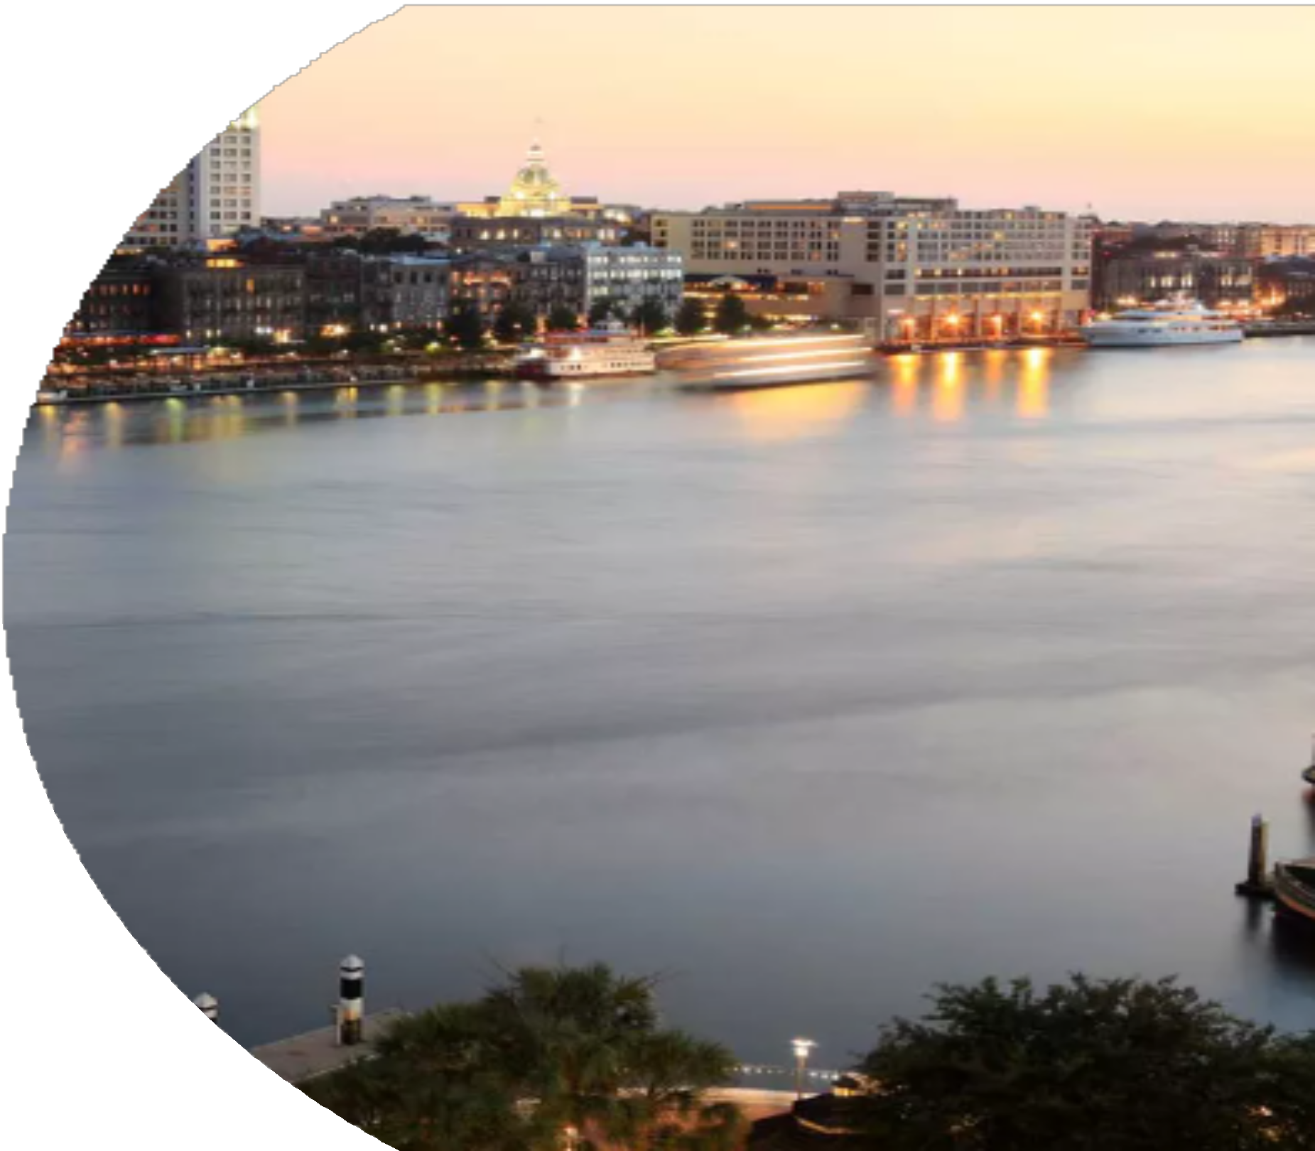
100% SAVANNAH
2022 COUNCIL UPDATE
City of Savannah Office of Sustainability April 13, 2023

Slide 2
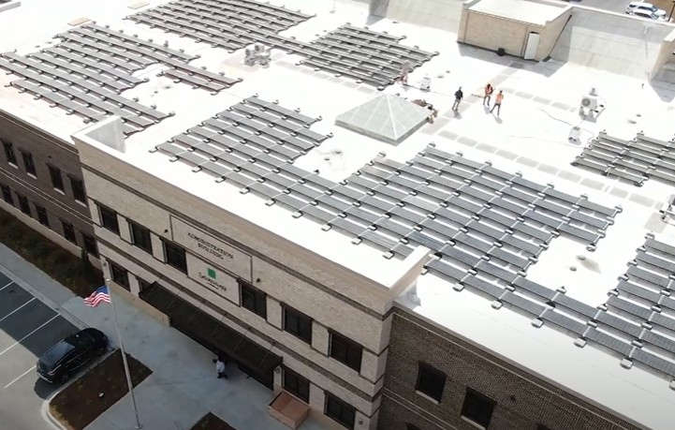
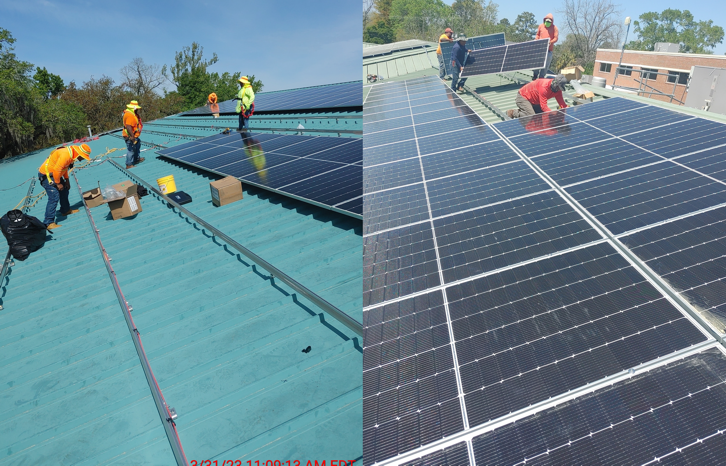
CITY SOLAR PROJECT
Approved in July 2022
19 facilities, 1.7 MW
2 complete, 3 underway

Slide 3
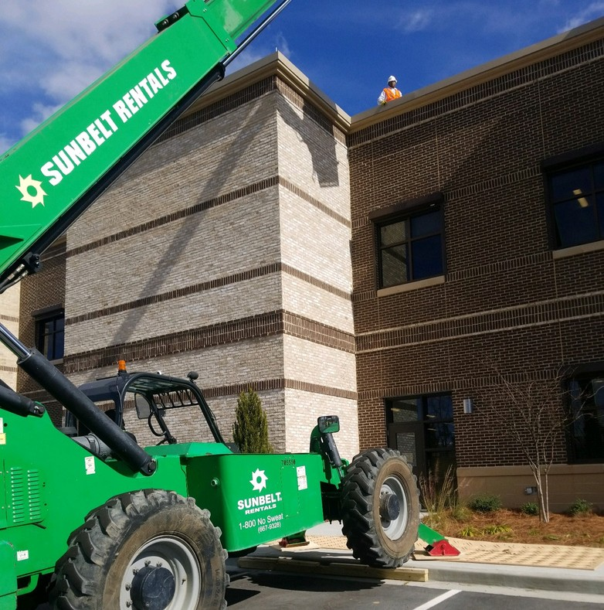
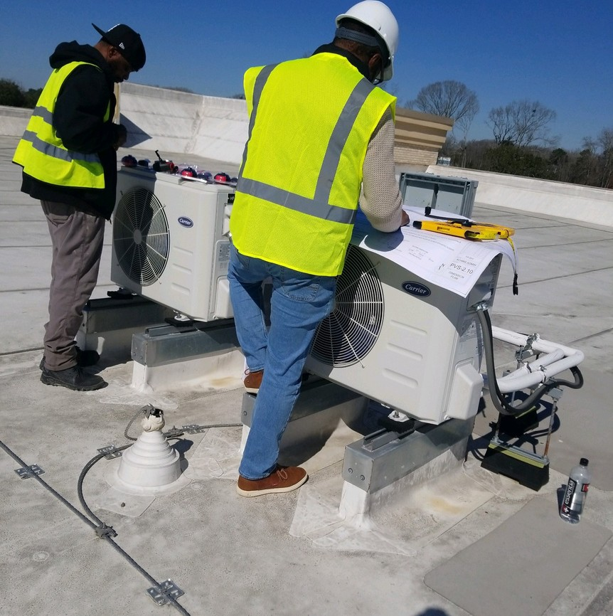
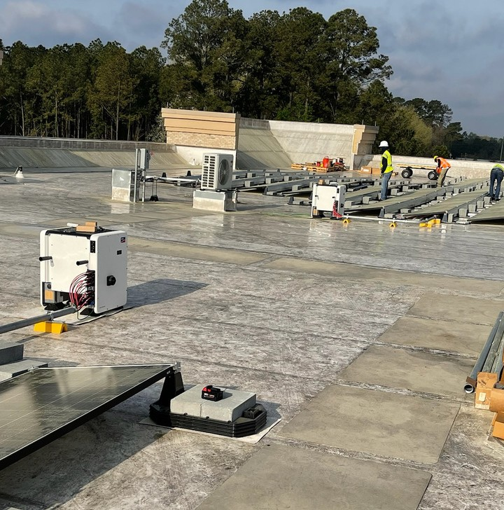
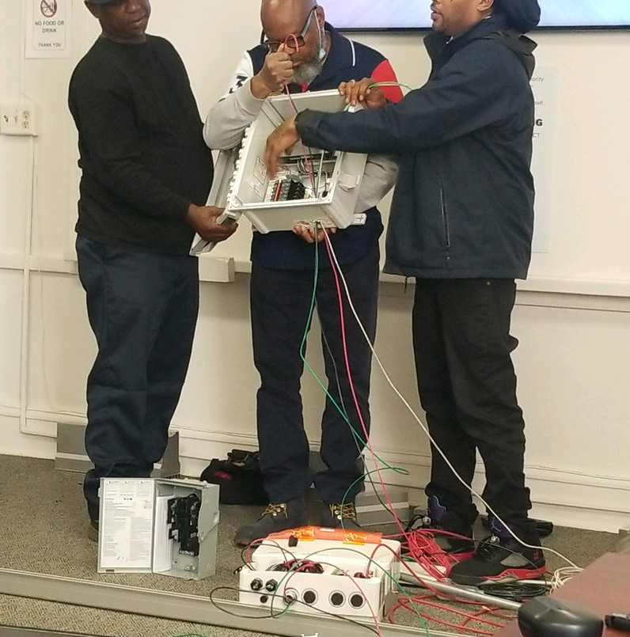
WORKFORCE TRAINING

Slide 4
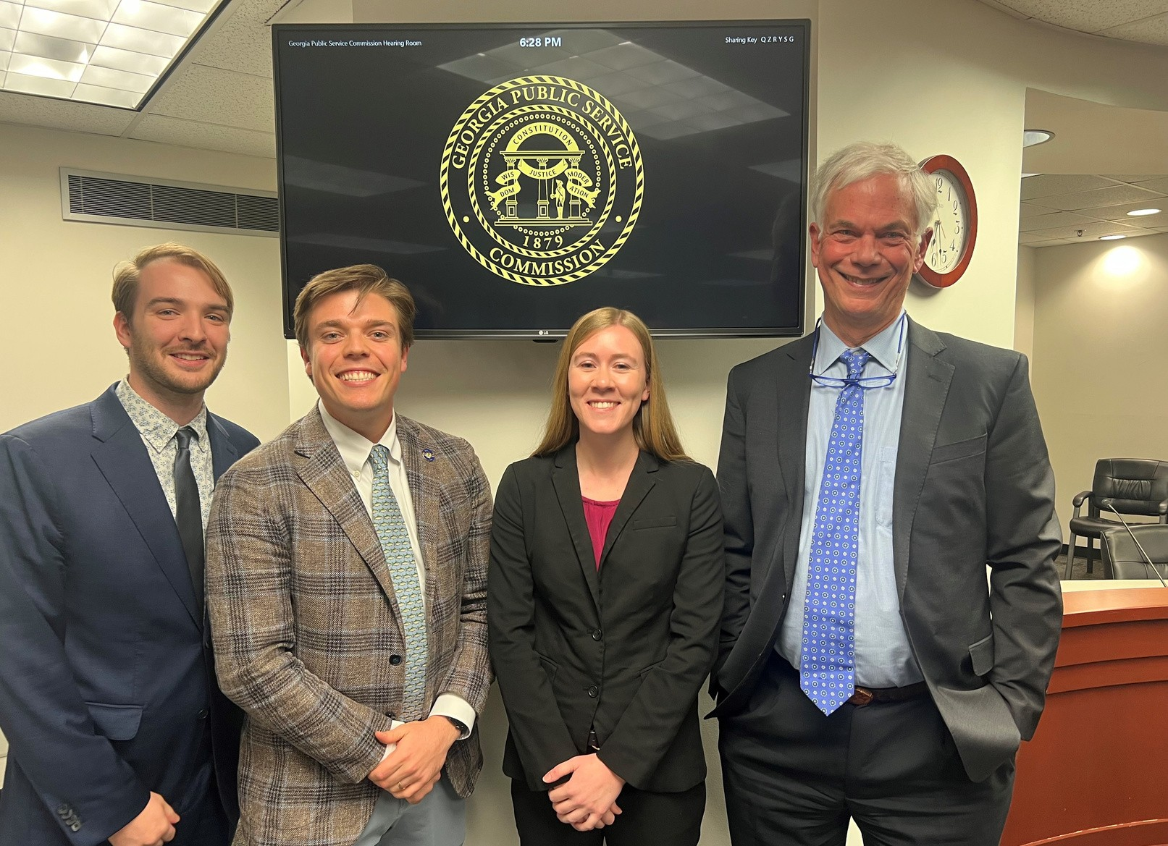
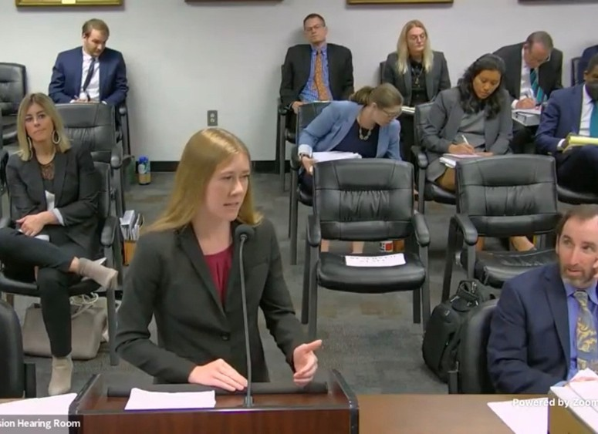
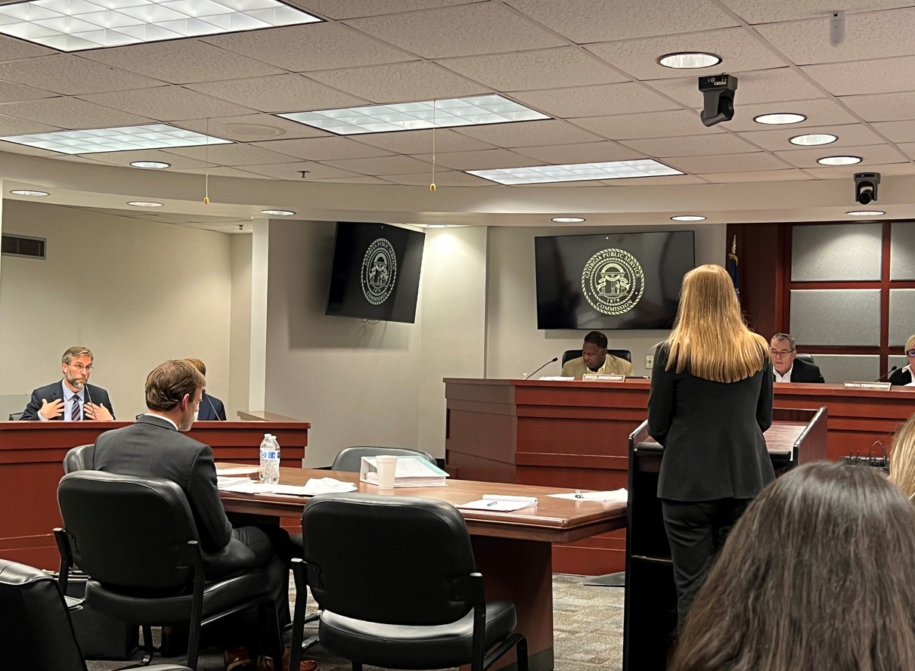
GEORGIA POWER IRP AND RATE CASE
Ratepayer savings of > $1.1 billion over a 3 year period
4 additional cents per kWh for solar exported to the grid, plus improved community solar programs
15% increase in energy efficiency targets

Slide 5
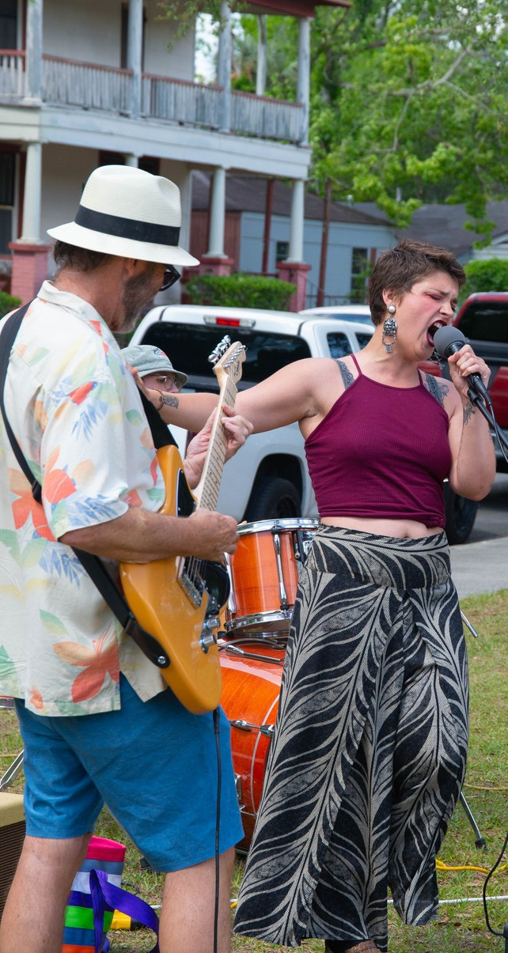
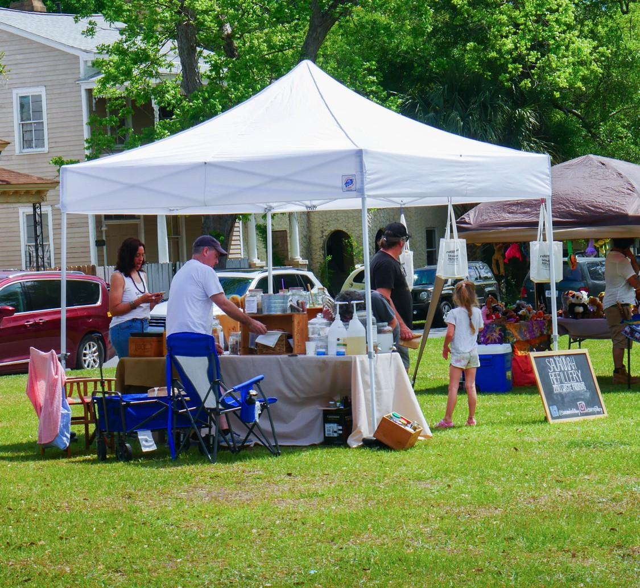
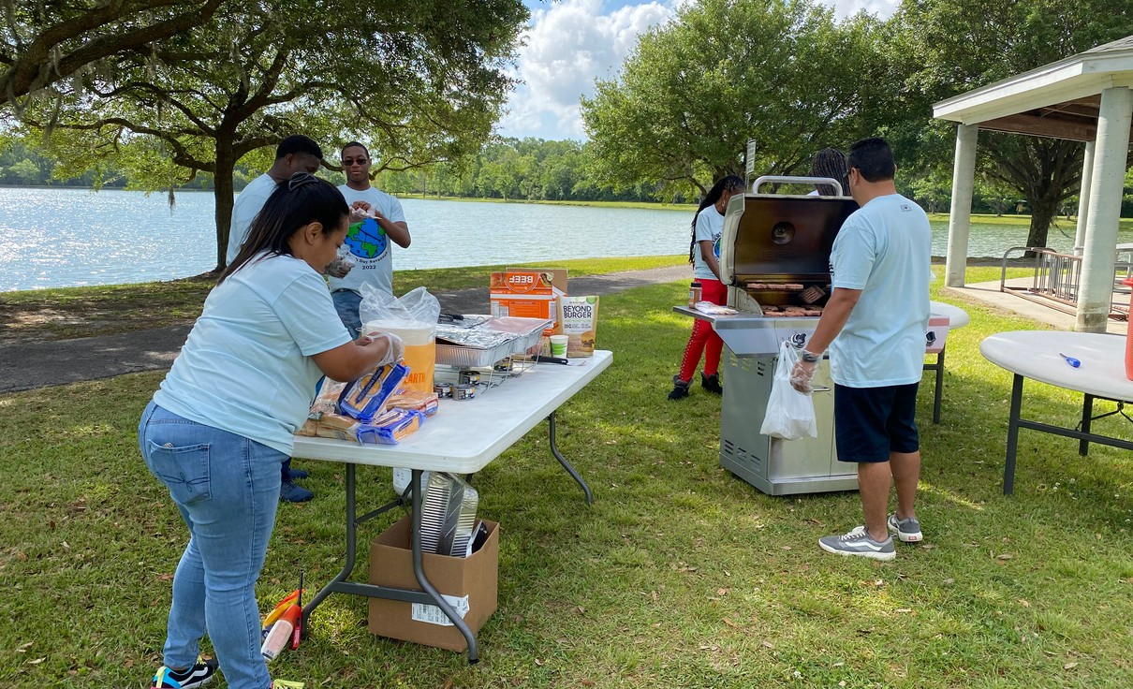
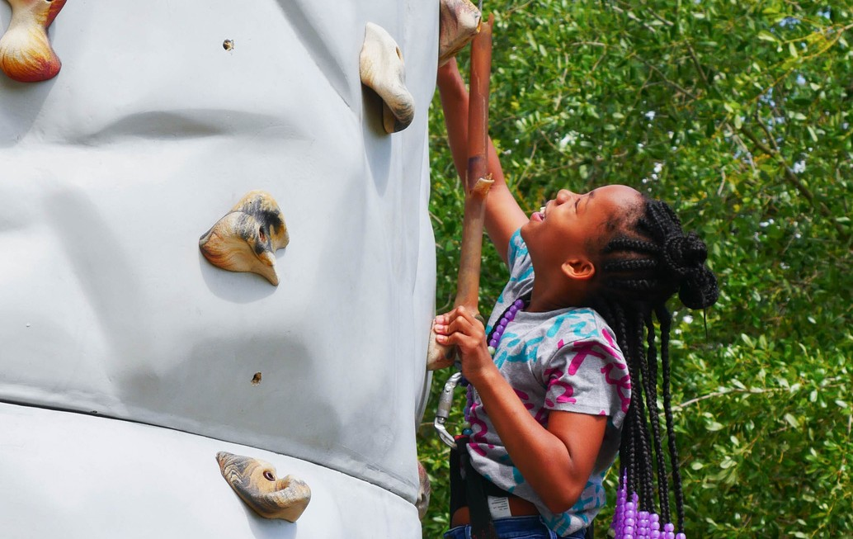
EARTH DAY 2023
Friday, April 21, 2023
4 pm - 8 pm Daffin Park Food, live performances, family fun, community resources, environmental education

Slide 6
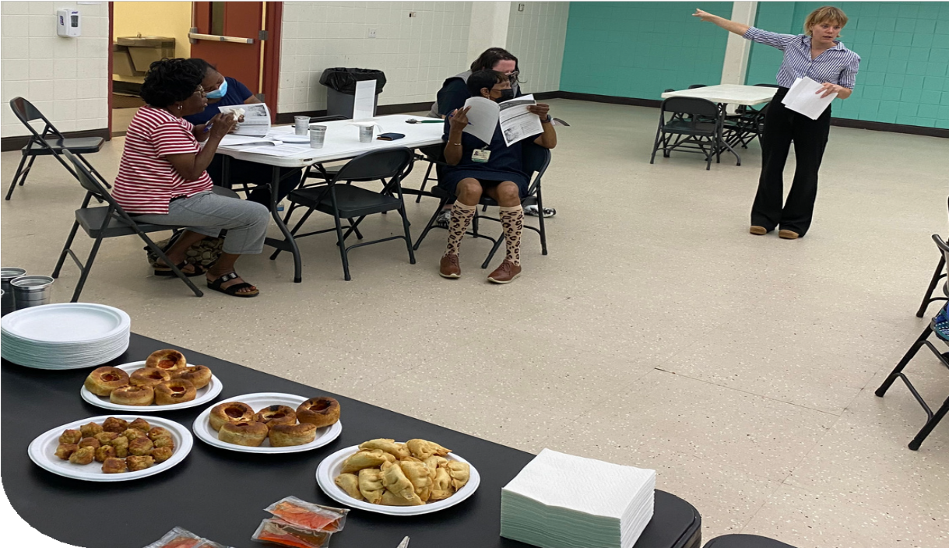
COMMUNITY ENERGY EFFICIENCY WORKSHOPS
16 Workshops
200+ residents
60+ sign ups

Slide 7
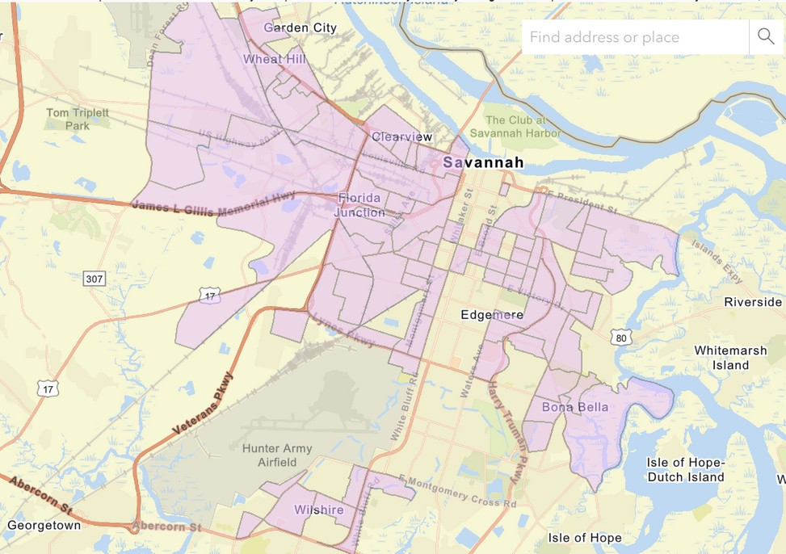
EPA ENVIRONMENTAL JUSTICE GRANT
Proposal is to establish a 100% Savannah Energy Efficiency Program and support related workforce training efforts
This program will have more flexible income restrictions, offer more efficiency measures, and serve the homes with the greatest need

Slide 8
How You Can Help
1
Community Engagement
2
Relationships and Partnerships
3
Funding and Other Resources

