Slide 1
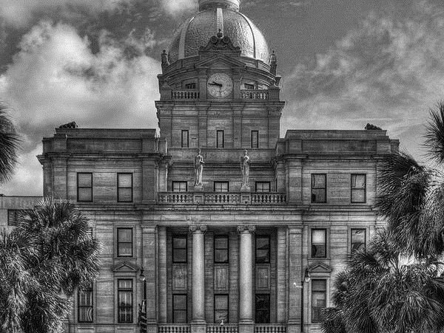
2025 MID-YEAR
FINANCIAL UPDATE
Sancia Joseph-Jarvis
INTERIM SENIOR BUDGET DIRECTOR
savannahga.gov

Slide 2
Agenda
State of the Budget
Enterprise Funds
Revenue Ordinance Changes
01
02
03
04
05
06
FY25 Adopted Budget recap
General Fund
Millage Rate

Slide 3
Budget by the Numbers
$11.1M 3% Salary Adjustment & Classification and Compensation Study
12.20
Budgeted Millage Rate
$291M of General Fund Spending
$602M
NO DRAW
on General nor Enterprise Fund Reserves
$140M
of Capital Improvements Projects
*Includes Potential Bond Issuances
$109.8M
of Property Tax Revenue

Slide 4
Where Does The Money Come From?

Slide 5
State of the Budget
Finances remain stable
Sales Taxes; Strained by Costs
40% of General Fund Expended
Property Tax has collected 18.03% of the budget
Debt Service is
Funded Adequately
Pension is Healthy
& Stable
Rising Electricity
Costs
40.48% Excise Tax Revenue Collected
AA+ Credit
Worthiness
General Fund Revenue Collection
reached 31.35%
Notes:
Excise Tax includes Hotel/Motel, Auto Rental, Occupancy, Beer Taxes, Liquor Taxes, Wine Taxes, and Mixed Drink Taxes
Generally there are four financial metrics which are core barometers of the City’s fiscal health and sustainability: Pensions, Debt, Stability of Reserves and the Structural balance between revenues and expenditures.
Through the first half of the year, our finances remain on solid footing with the Adopted financial plan, realizing favorable spending results.
Pension stability is in tact and

Slide 6
General Fund Revenues- January through May
Notes:
So how are we doing so far? Over the six-year period from 2020 to 2025, general fund revenues have shown a consistent upward trend, with a minor dip in 2024. Despite the slight decline in 2024 , the overall revenue growth from 2020 to 2025 totals approximately $33.97 million, representing a 59.5% increase over the six-year period. The rebound in 2025 reaffirms the general upward momentum in the city's revenue base.

Slide 7
General Fund Revenues- January through May
Taxes
Notes:
Now that we know where the General Fund revenue stands when compared to previous years, we can look at where the revenues come from. Like any other municipal government, the City of Savannah generates most of its revenues from taxes. This year and every year prior, over half of the General Fund Revenue are generated from taxes.
The overall revenue growth of 3.8% from May 2024 to May 2025 was driven primarily by higher property taxes, other taxes, and a substantial increase in grant revenue. Offsetting factors included a drop in sales tax and decreases in fees and penalties. These mixed trends indicate stable core revenues with some volatility in non-recurring sources and economic-sensitive categories.

Slide 8
General Fund Revenue Variances-2024 vs 2025
Category | May-24 | May-25 | Variance
Property Taxes | 19,126,864.74 | 20,010,823.48 | 883,958.74
Sales Tax | 27,942,240.39 | 27,126,448.54 | (815,791.85)
Other Taxes | 6,024,825.19 | 6,660,596.13 | 635,770.94
Licenses & Permits | 11,562,077.73 | 11,301,235.94 | (260,841.79)
Fines & Penalties | 2,461,950.53 | 2,260,205.38 | (201,745.15)
Inspection & Dev Fee | 2,427,375.25 | 2,021,233.58 | (406,141.67)
Leisure Servc Fees | 435,517.85 | 498,689.22 | 63,171.37
Fees For Oth Services-GF | 1,045,407.74 | 1,041,728.69 | (3,679.05)
Other User Fees | 510,119.84 | 722,098.77 | 211,978.93
Other Grant Revenue | 1,076,273.76 | 4,114,911.98 | 3,038,638.22
Interfund Services | 3,255,548.80 | 4,123,740.00 | 868,191.20
Sanitation Revenue | 27,473.90 | 27,211.16 | (262.74)
Parking Service Rev | (20.00) | - | 20.00
Civic Ctr Revenue | 6,475.00 | 12,850.00 | 6,375.00
Interest/Dividends | 3,845,419.11 | 3,482,933.96 | (362,485.15)
Gain/Loss Surplus | 275,054.00 | 26,881.00 | (248,173.00)
Contribution From Other Fund | 7,731,666.13 | 7,657,309.51 | (74,356.62)
Grand Total | $87,754,269.96 | $91,088,897.34 | $3,334,627.38

Slide 9
General Fund Share of Hotel/Motel & Sales Taxes January through May
Notes:
While not perfectly synchronized year to year, the overall trend indicates that Local Option Sales Tax and Hotel/Motel Tax revenues generally move in the same direction, driven by shared underlying factors such as tourism volume, economic activity, and consumer confidence. This relationship supports the use of these indicators for forecasting and cross-validating economic performance in the local economy.
2023 to 2024: Continued growth was observed, albeit at a slower pace
2025: A slight dip in Local Option Sales Tax (–2.9%) was observed, while Hotel/Motel Tax remained virtually flat (↑ 0.1%). This may suggest a short-term decoupling, potentially due to shifts in consumer behavior, inflation, or sector-specific slowdowns.

Slide 10
General Fund Expenditure Performance 2023-2025 Year-over-Year
($ in Millions)* | 2023 May Act a | 2024 May Act b | 2025 May Act c | Variance to 2023 c-a | Variance to 2024 c-b
Personnel Services | 49.43 | 59.58 | 66.81 | 17.38 | 7.24
Outside Services | 12.56 | 12.97 | 14.08 | 1.52 | 1.10
Commodities | 2.90 | 3.68 | 3.45 | 0.55 | (0.22)
Internal Services | 12.04 | 12.95 | 14.83 | 2.79 | 1.87
Capital Outlay | 0.07 | 0.16 | 0.17 | 0.10 | 0.01
Interfund Transfers | 8.12 | 14.71 | 11.23 | 3.11 | (3.48)
Other Expenses | 5.80 | 5.47 | 6.77 | 0.97 | 1.30
Total | 90.93 | 109.52 | 117.34 | 26.41 | 7.82
*Numbers are subject to rounding
Notes:
Between May 2023 and May 2025, total expenditures rose from $90.93 million to $117.34 million, an overall increase of $26.41 million or 29.0%. The rise is largely driven by increases in Personnel, Internal Services, and Outside Services, reflecting upward cost pressures and increased salaries.
From May 2023 to May 2025, the City experienced nearly 30% growth in expenditures, with Personnel costs alone accounting for two-thirds of the total increase. Operational costs such as services and internal charges also grew in tandem,. The temporary surge in Interfund Transfers in 2024 may indicate a one-time funding.

Slide 11
General Fund Expenditure Performance-January through May

Slide 12
Enterprise Funds-Revenue May 2024 vs May 2025
Notes:
Total enterprise fund revenues increased from $66.06 million in May 2024 to $76.77 million in May 2025, reflecting a growth of $10.71 million or approximately 16.2% year-over-year. This growth was driven primarily by significant gains in Water and Sewer, Civic Center, and I & D Water revenues.
The year-over-year enterprise revenue growth of 16.2% demonstrates strong financial performance across core utility and service operations. Significant gains in Water and Sewer and Civic Center operations
Civic Center-The most significant driver is the timing of when OVG settles-up. Despite the crazy variance between May of this year and May of last year, At this time last year, because of accruals, the theater income account (45513) was negative $848K, compared to positive $552K this year.
I&D Water-Revenue increased by $732,432 (20.9%).
Parking Services-
Sanitation-
Water and Sewer Fund-FY-24: $35,252,317 to $42,626 332 FY-25: Increase of $ 7,374,015 a 20% increase

Slide 13
Enterprise Funds-Expenditure Performance May 2024 vs May 2025
Notes:
Total enterprise fund expenditures increased from $58.65 million in May 2024 to $63.08 million in May 2025, marking a year-over-year increase of $4.43 million, or approximately 7.6%. Enterprise fund expenditures rose moderately by 7.6% from May 2024 to May 2025. The majority of this increase was driven by Water & Sewer and I&D Water, indicating higher operating in core utility services. This expense graphs mimics the enterprise revenue graph with the Wate and Sewer Fund growing at a much faster rate.

Slide 16
2025 Millage Rate
David Maxwell
Sr. Director, Financial Services
savannahga.gov

Slide 17
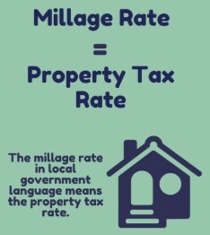
On Today's Council Agenda . . .
Financial related items of note on today's council agenda include the following:
A first reading of the revenue ordinance adopting the final millage rate for 2025 at 11.749 mills, the 2025 rollback rate.
A first reading of two revenue ordinance amendments increasing user fees for:​
Bacon Park Golf Course​
Sewer Utility Connection Fees for the Southwest Quadrant of Savannah (new connections only)​

Slide 18
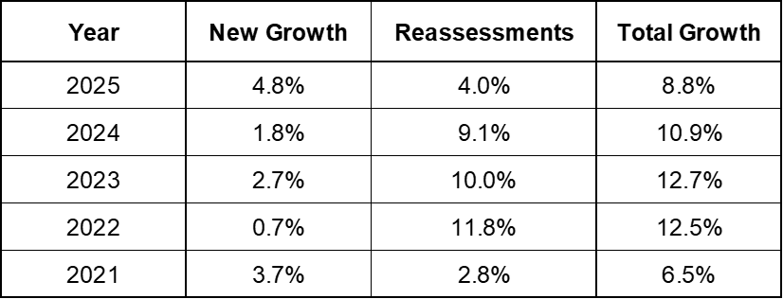
2025 Final Millage Rate Recommendation is 11.749 mills:
The 2025 tax digest shows substantial growth compared to the prior year, totaling 8.8%.
4.8% is new growth (new or improved properties)
Added $441 million to the digest or about $5.38 million in new taxes
2025 adopted budget assumed 3.0% growth
4.0% is revaluation of existing properties (inflation)
The rollback rate removes additional tax collections due to revaluation increases.
Adopting the rollback rate of 11.749 mills will:
Result in the lowest millage since 1987 (11.30 mills).
Generate an estimated $103.3 million in tax revenue.
Achieve the 2025 budgeted tax revenue amount of $101.6 million.

Slide 19
Revenue Ordinance Changes
David Maxwell
Sr. Director, Financial Services
savannahga.gov

Slide 20
Other Revenue Ordinance Amendments for Consideration:
Bacon Park Golf Course Fees:
This facility is leased to a private operator and over $3 million has been invested in course operations and capital improvements since 2013. Most of this investment occurred in 2013 through 2016.
The operator is responsible for day-to-day operation of the facility and, in turn, collects user fees from patrons. The fees are adjusted from time to time with City approval to allow the facility to remain financially viable.
Surveys show that the requested fees are comparable to other local golf courses. Bacon Park Golf Course has not increased fees in several years.
Sewer Connection Fees:
Connection fees provide the City a mechanism to recoup the cost of upfront capital expenditures needed to extend service or to increase service capacity to serve new users connecting to the system.
The fees are assessed to new users within the geographic boundary serviced by the infrastructure based on the cost to construct the Travis Field Treatment Plant and conveyance appurtenances.
Southwest Quadrant Service Area: from $900 to $2,726
Travis Field Treatment Plant Service Area: from $2,600 to $3,049

Slide 21
Questions?
savannahga.gov

