Slide 1
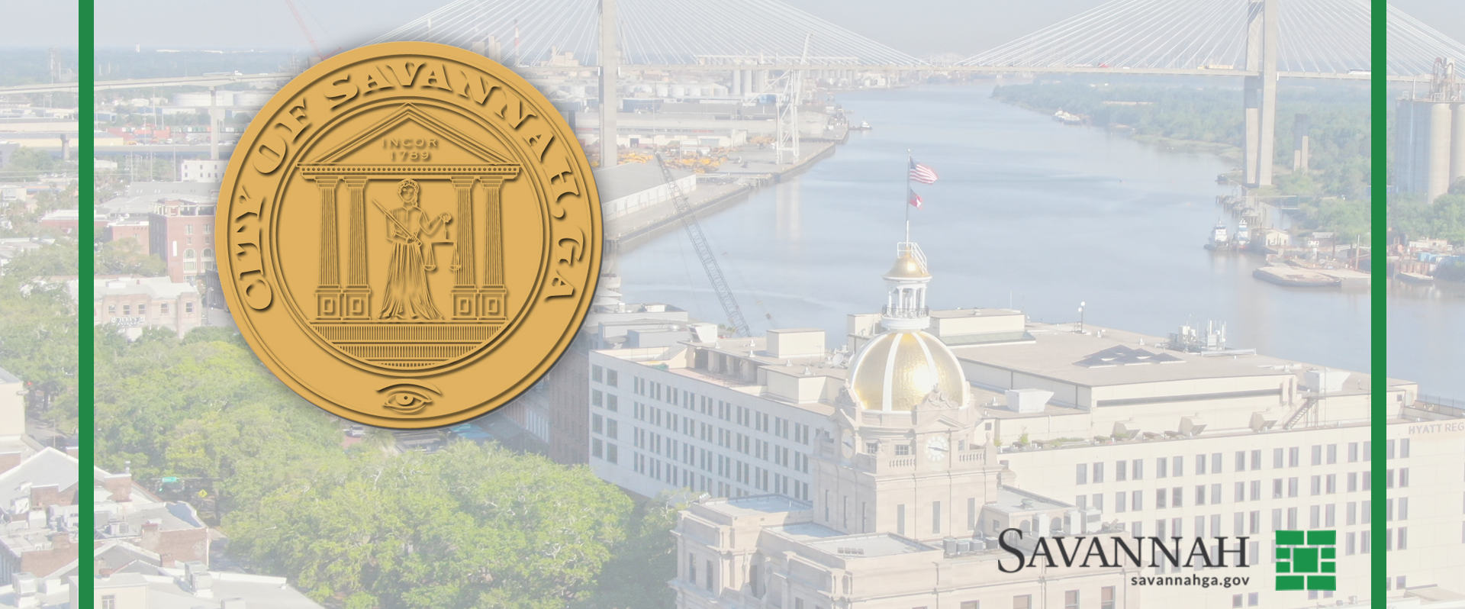
City Council Workshop
May 8, 2025

Slide 2
Special Purpose Local Option Sales Tax
SPLOST 8
City Council Workshop
May 8, 2025

Slide 3
Chatham County SPLOST 8 Proposed Timeline
Chatham County
SPLOST 8 Proposed Schedule
March 31
Calling All Managers SPLOST 8 Meeting (County/City Managers)
May 2
Chatham County Mayors & City Managers Meeting
May 23
Municipalities provide approved project list to County
June 13
Commissioners vote to approve County List and IGAs
July 16
Municipalities approve IGAs
July 18
Last day for Board of Commissioners to vote to call for election
July 25
Public notice of Election Call
October 4
Publication in paper begins
November 4
Election Day
RECAP

Slide 4
Chatham County Mayors & City Managers Meeting 5/2/25
Discussion Points:
Group keyed in on 3 key decision points
What should the total SPLOST 8 projection be?
How do we structure an IGA?
What metric should we use to determine jurisdiction pro-rata share?
Working answers to those questions were:
$650 - $700 million total
Two-tiered IGA
Distribution 1: priority projects of County-wide significance
Distribution 2: pro rata distribution to jurisdictions for the remaining collection
2020 Census, then 2030 census

Slide 5
Potential Tier 1 Projects Discussed
Benton & Highlands Blvd (Savannah & Port Wentworth)
Civic Center Redevelopment (Savannah)
President Street RailX Flyover (Savannah, County, Tybee)
Juvenile Court Expansion (C0unty)
Tybee Beach Renourishment (Tybee)
Quacco Rd. (Pooler)
Hutchinson Island Road Improvement (Savannah)

Slide 6
County’s SPLOST Projection

Slide 7
The Planning Process
RECAP
Generate list of the City’s capital needs.
Projects already approved or in some phase of planning.
Unmet capital needs already recognized and communicated as important by City Council.
Consider alternative funding mechanisms to support those needs.
Capital budget plan, impact fees, tourism product development, municipal bonds, etc.
Seek City Council guidance on priority funding areas, how SPLOST dollars should be invested, and any additional capital needs.
Seek community input on priority funding areas and how SPLOST dollars should be invested.
Develop possible SPLOST 8 funding scenario for City Council consideration based on collective feedback and critical needs.
Revise draft funding scenario as necessary based on City Council feedback.
Finalize and approve the City’s proposed SPLOST 8 Projects List.

Slide 8
SPLOST 8 Survey Results: Side-by-Side Comparison
INVESTMENT CATEGORIES: PRIORITY RANKING
COMMUNITY RANKING | Combined | Priority |  | CITY COUNCIL RANKING | Combined | Priority
Investment Category | Ave | Ranking |  | Investment Category | Average | Ranking
Stormwater/Drainage | 2.53 | 1 |  | Stormwater/Drainage | 2.89 | 1
Community Development | 2.90 | 2 |  | Public Safety | 2.89 | 2
Traffic & Transportation | 2.92 | 3 |  | Traffic & Transportation | 3.00 | 3
Public Safety | 3.60 | 4 |  | Community Development | 3.22 | 4
Parks & Recreation | 3.61 | 5 |  | Parks & Recreation | 4.00 | 5
Municipal Investments | 4.78 | 6 |  | Municipal Investments | 5.67 | 6
$100 SPENDING DISTRIBUTION
 | COMMUNITY |  | CITY COUNCIL
$100 FUND DISTRIBUTION | Percent |  | Percent
Investment Category | of Total |  | of Total
Stormwater/Drainage | 27% |  | 14%
Public Safety Facilities | 15% |  | 15%
Traffic & Transportation | 19% |  | 15%
Community Development | 17% |  | 33%
Parks & Recreation | 14% |  | 16%
Municipal Investments | 8% |  | 7%
Total | 100% |  | 100.0%
533 Total valid Community Feedback Surveys were completed.
273 surveys completed online.
260 surveys completed in-person at various meetings
(neighborhood association meetings, district stormwater meetings, community centers)
District Breakdown
District 1 | 27%
District 2 | 25%
District 3 | 20%
District 4 | 10%
District 5 | 11%
District 6 | 9%
Don't Know | 2%

Slide 9
SPLOST 8 Funding Scenario
Provides a starting point for City Council discussion/ deliberation.
Primary Considerations in Scenario Development:
Project addresses major capital need already recognized and communicated as important by City Council.
Project is already approved, is in some stage of planning, is part of an established plan, or is a funding obligation.
City Council and community feedback on areas of investment and funding levels.
Attempts to achieve District parity
Projects not included because of having alternative funding mechanisms/opportunities, not as high a priority or urgency, didn’t align closely with survey results.

Slide 10
DRAFT – POTENTIAL SPLOST 8 List Example
-Needs to amount to no more than $261 Million (Savannah could receive more depending on IGA, but likely not less than this.

Slide 11
SPLOST 8
Funding Scenario
Review & Discussion

Slide 12
City Council Workshop
May 8, 2025

