Slide 1
Special Purpose Local Option Sales Tax SPLOST
March 27, 2025
City Council Workshop

Slide 2
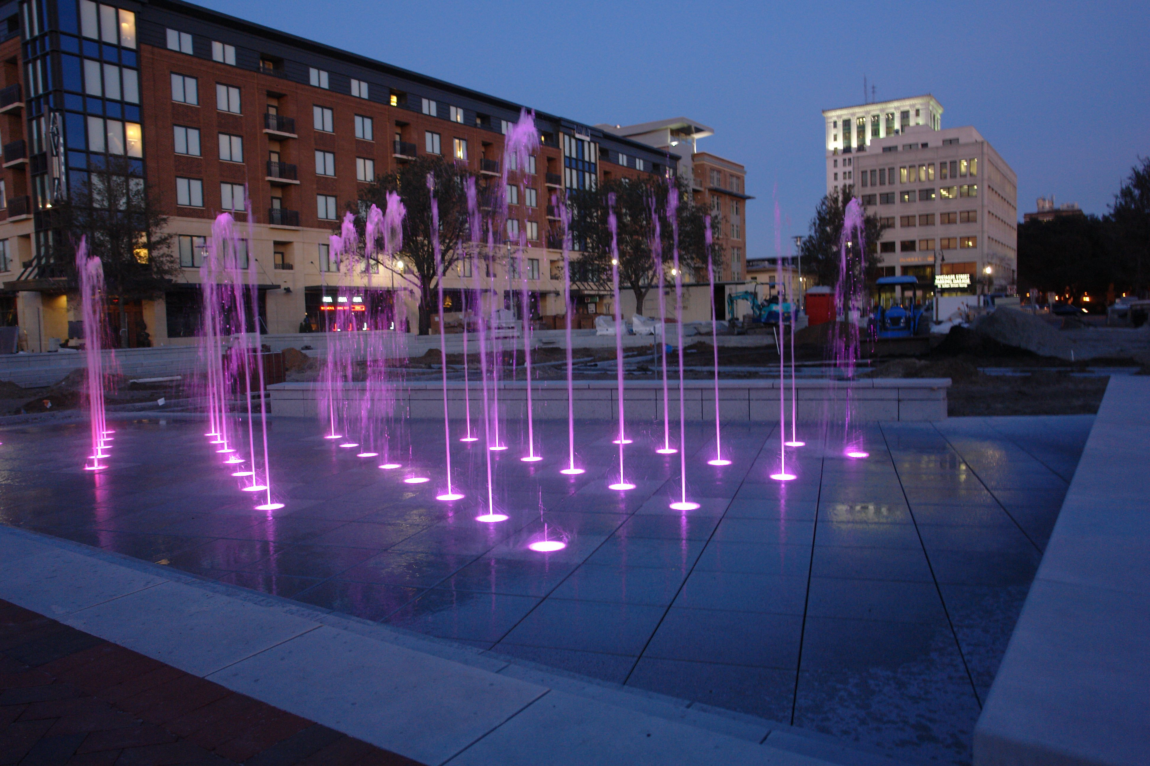
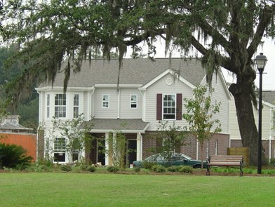
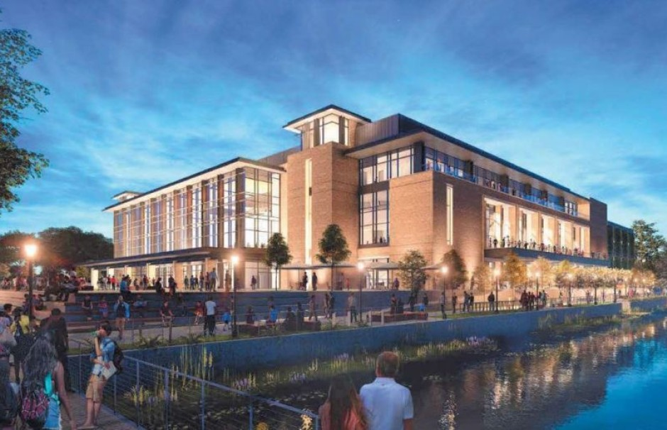
What is SPLOST?
SPLOST is a one percent county sales tax used to fund capital outlay projects for local governments
SPLOST was enacted in Georgia law in 1985 and requires voter approval to enacted a county-wide penny sales tax.
Since 1985, SPLOST has generated nearly $700 million dollars in capital project funding for the City of Savannah
In Savannah, nearly 40% of sales tax are paid by visitors, not Savannah residents

Slide 3
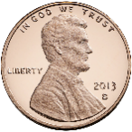
Chatham County Sales Tax
7% Sales tax in Chatham County
State of Georgia
Chatham County
4¢
3¢
+
LOST
ESPLOST
SPLOST
1¢
1¢
1¢

Slide 4
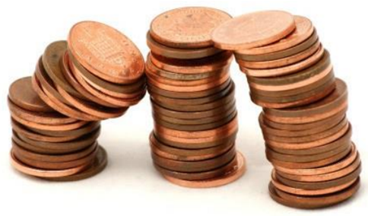
What Can SPLOST be Used For?
Capital projects approved by voters via referendum
Capital projects are permanent in nature such as
Drainage Improvements
Public Facilities
Community Parks
Recreation
Roads, Streets and Sidewalks
NOT allowed to balance the City’s budget or to cover general operating or maintenance expense
Without SPLOST, capital project will be funded primarily by property taxes

Slide 5
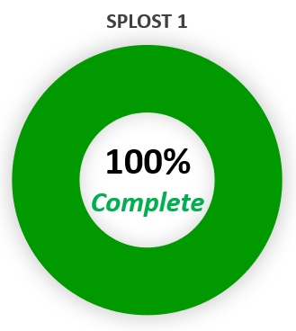
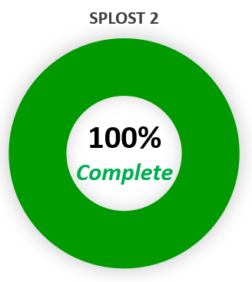
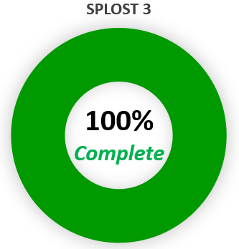
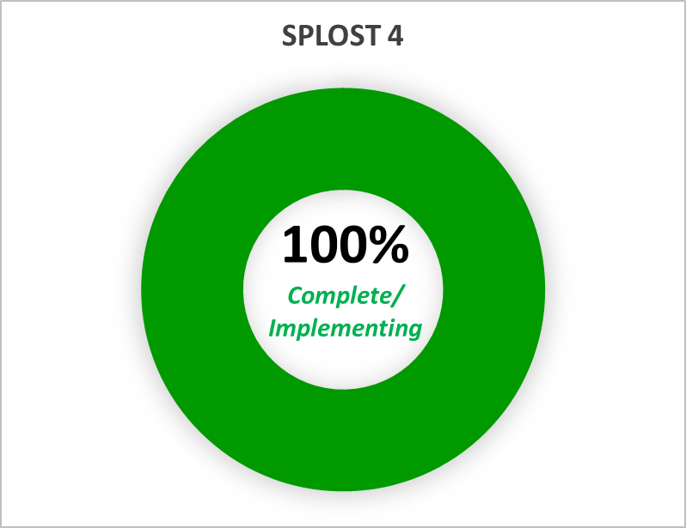
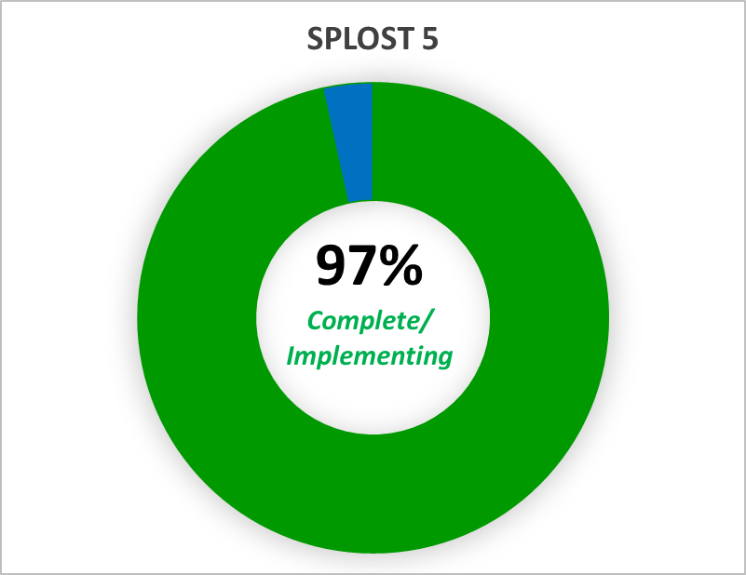
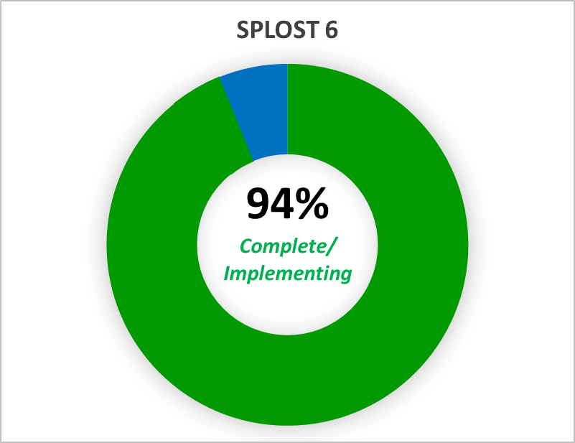
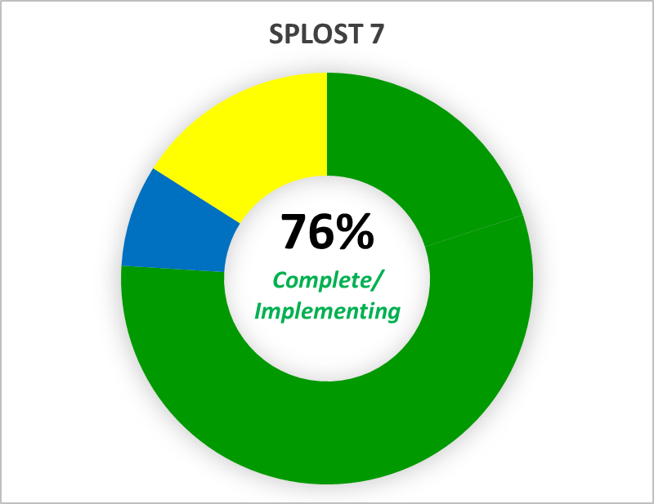
SPLOST Through the Years
SPLOST 1
(1985-1993)
SPLOST 2
(1993-1998)
SPLOST 3
(1998-2003)
SPLOST 4
(2003-2008)
SPLOST 5
(2008-2014)
SPLOST 6 (2014-2020)
SPLOST 7 (2020-2026)
= CONCEPTUAL/PLANNING
= DESIGN/PRECONSTRUCTION
= COMPLETE/CONSTRUCTION & IMPLEMENTATION

Slide 6
SPLOST 1 and 2
82 Projects Completed
Savannah’s Unpaved Streets
Annexed areas
Infrastructure
$17 million collected
SPLOST 1
(1985-1993)
SPLOST 2
(1993-1998)

Slide 7
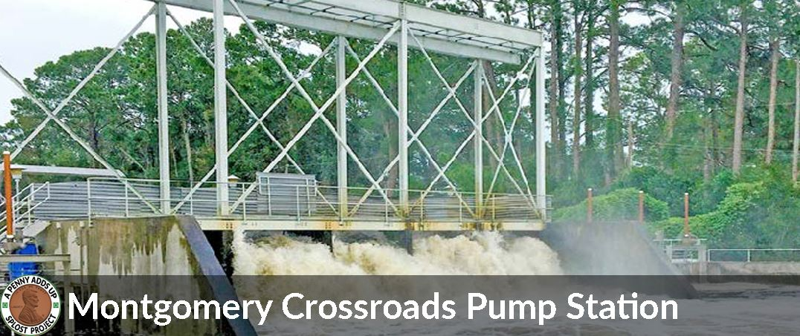
SPLOST 3 (1998-2003)
75 Projects Completed
Stormwater Drainage
Bilbo Basin
Casey South
Springfield Canal
Derenne Pump Station
Westside Pump Station
Mongomery Pump Station
Mohawk Lake
SCADA Upgrades
Street and Sidewalks
$93M Collected

Slide 8
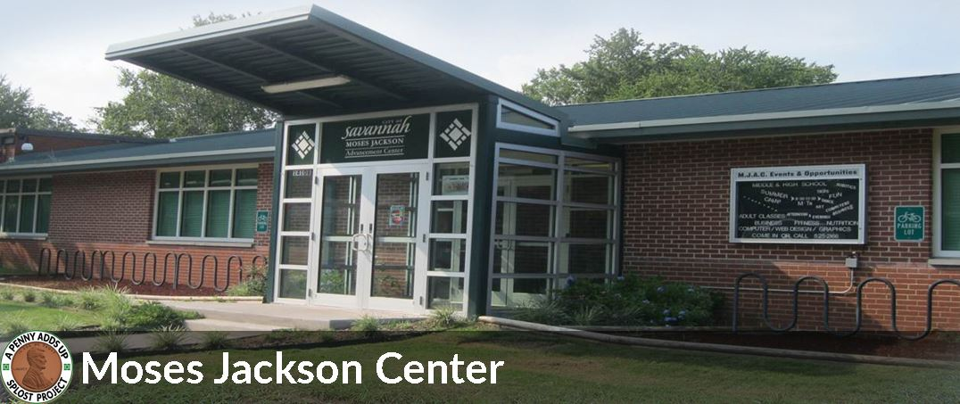
SPLOST 4 (2003-2008)
85 Projects Completed
Stormwater Drainage
Community Redevelopment
Ellis Square Redevelopment
Moses Jackson Advancement Center
MLK Streetscape
Augusta Ave Revitalization
Water Avenue Improvements
Cann Park Improvements
Tatemville Sound Wall
Recreation
Bacon Park Tennis Courts
Feiler Terrace Park
Street and Sidewalks
Transportation
President Street
$106 Million

Slide 9
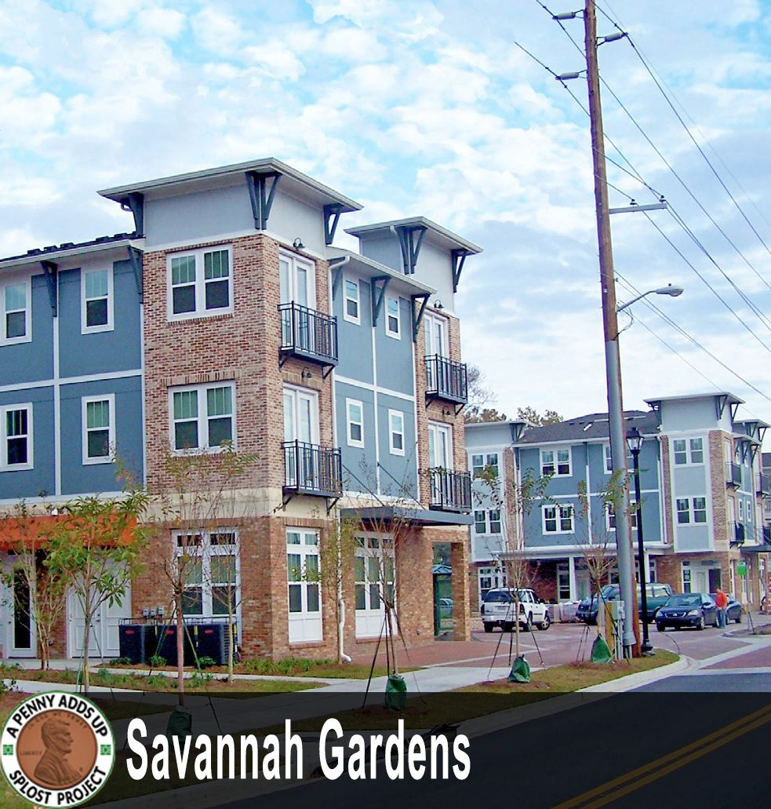
SPLOST 5 (2008-2014)
$119 Million
Drainage
Large Community Assets
Arena
Cultural Arts Center
Coffee Bluff Marina
Children's Museum
Public Safety
Camera Master Plan
Housing
Savannah Gardens

Slide 10
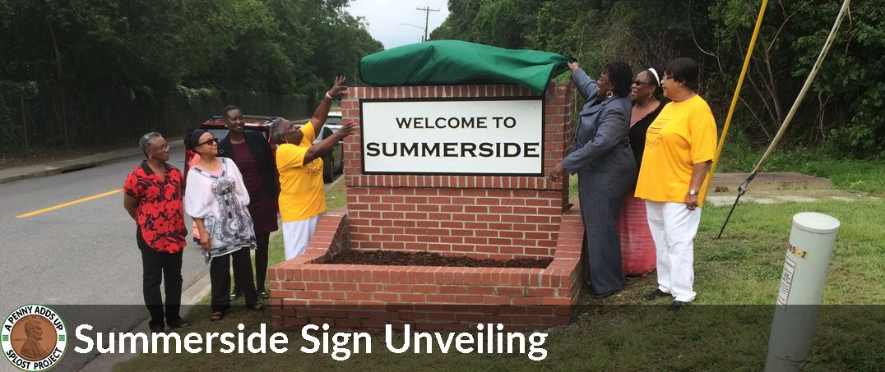
SPLOST 6 (2014-2020)
$190 Million Collected
Neighborhood and Recreation Focus
Playgrounds
Improved Athletic Fields
Edgemere Sackville Recreation
Grant Center Gym
Hitch Village Redevelopment
Pennsylvania Family Resource Center
Summerside recreation
Lavida Property Acquisition

Slide 11
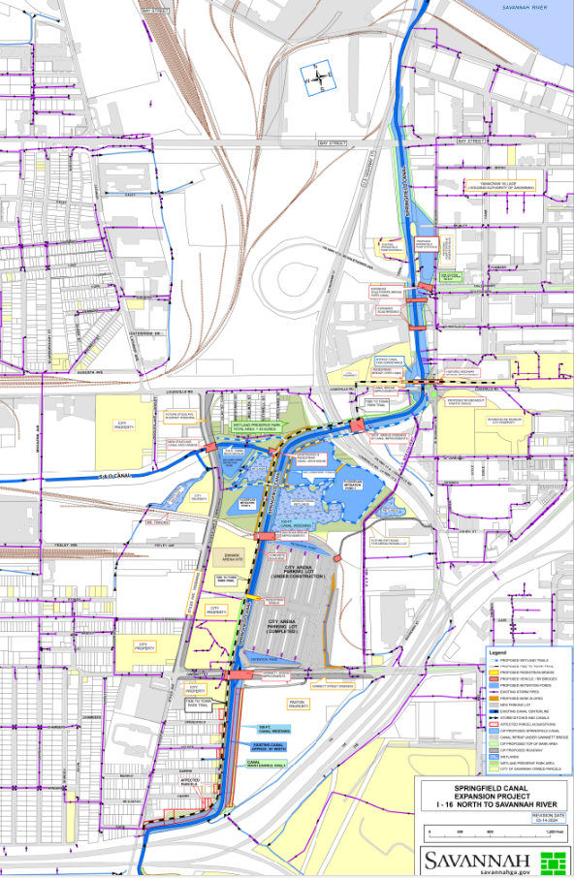
SPLOST 7 (2014-2020)
$190 Million
Infrastructure/ Drainage
Springfield Canal
Traffic Calming
Street repaving
City Hall Renovations
Pool Improvements
Sidewalks
River walk Extension

Slide 12
Questions

