Slide 1
SAVANNAH PUBLIC ART MASTER PLAN
City Council Update
March 13, 2025

Slide 2
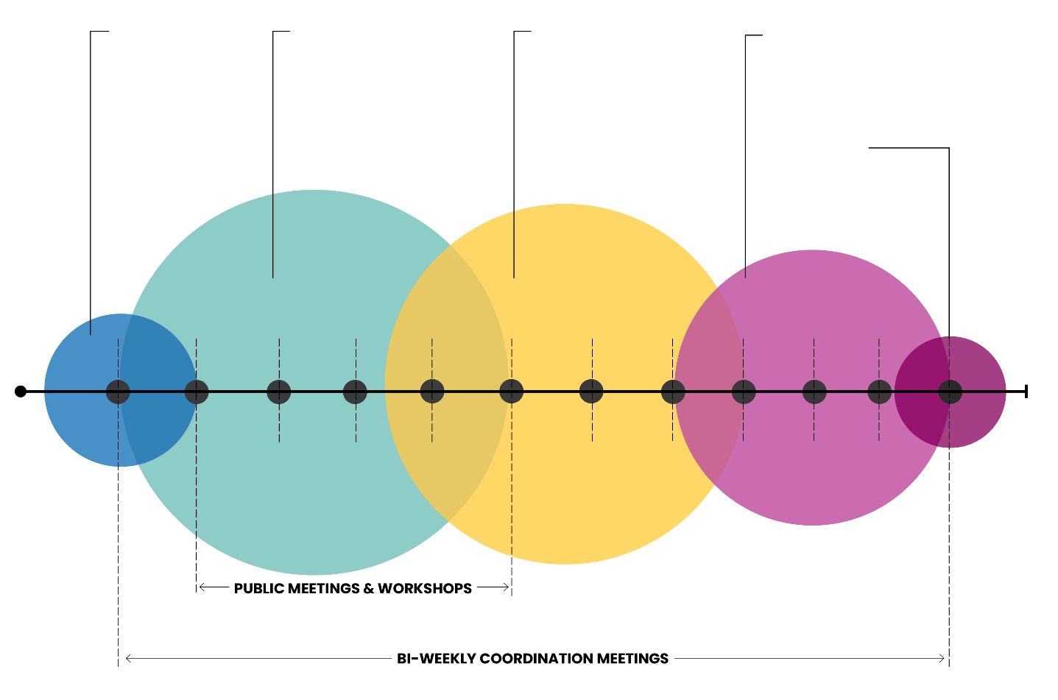
TIMELINE
PHASE 1:
MOBILIZATION
PHASE 2:
COMMUNITY DIALOGUE & ENGAGEMENT
PHASE 3:
SYNTHESIZE IDEAS & DEFINE STRATEGY
PHASE 4:
INITIAL RECOMMENDATIONS
PHASE 5:
FINAL REVIEW & RECOMMENDATION
October
November
December
January
February
March
April
May
June
July
August
September

Slide 3
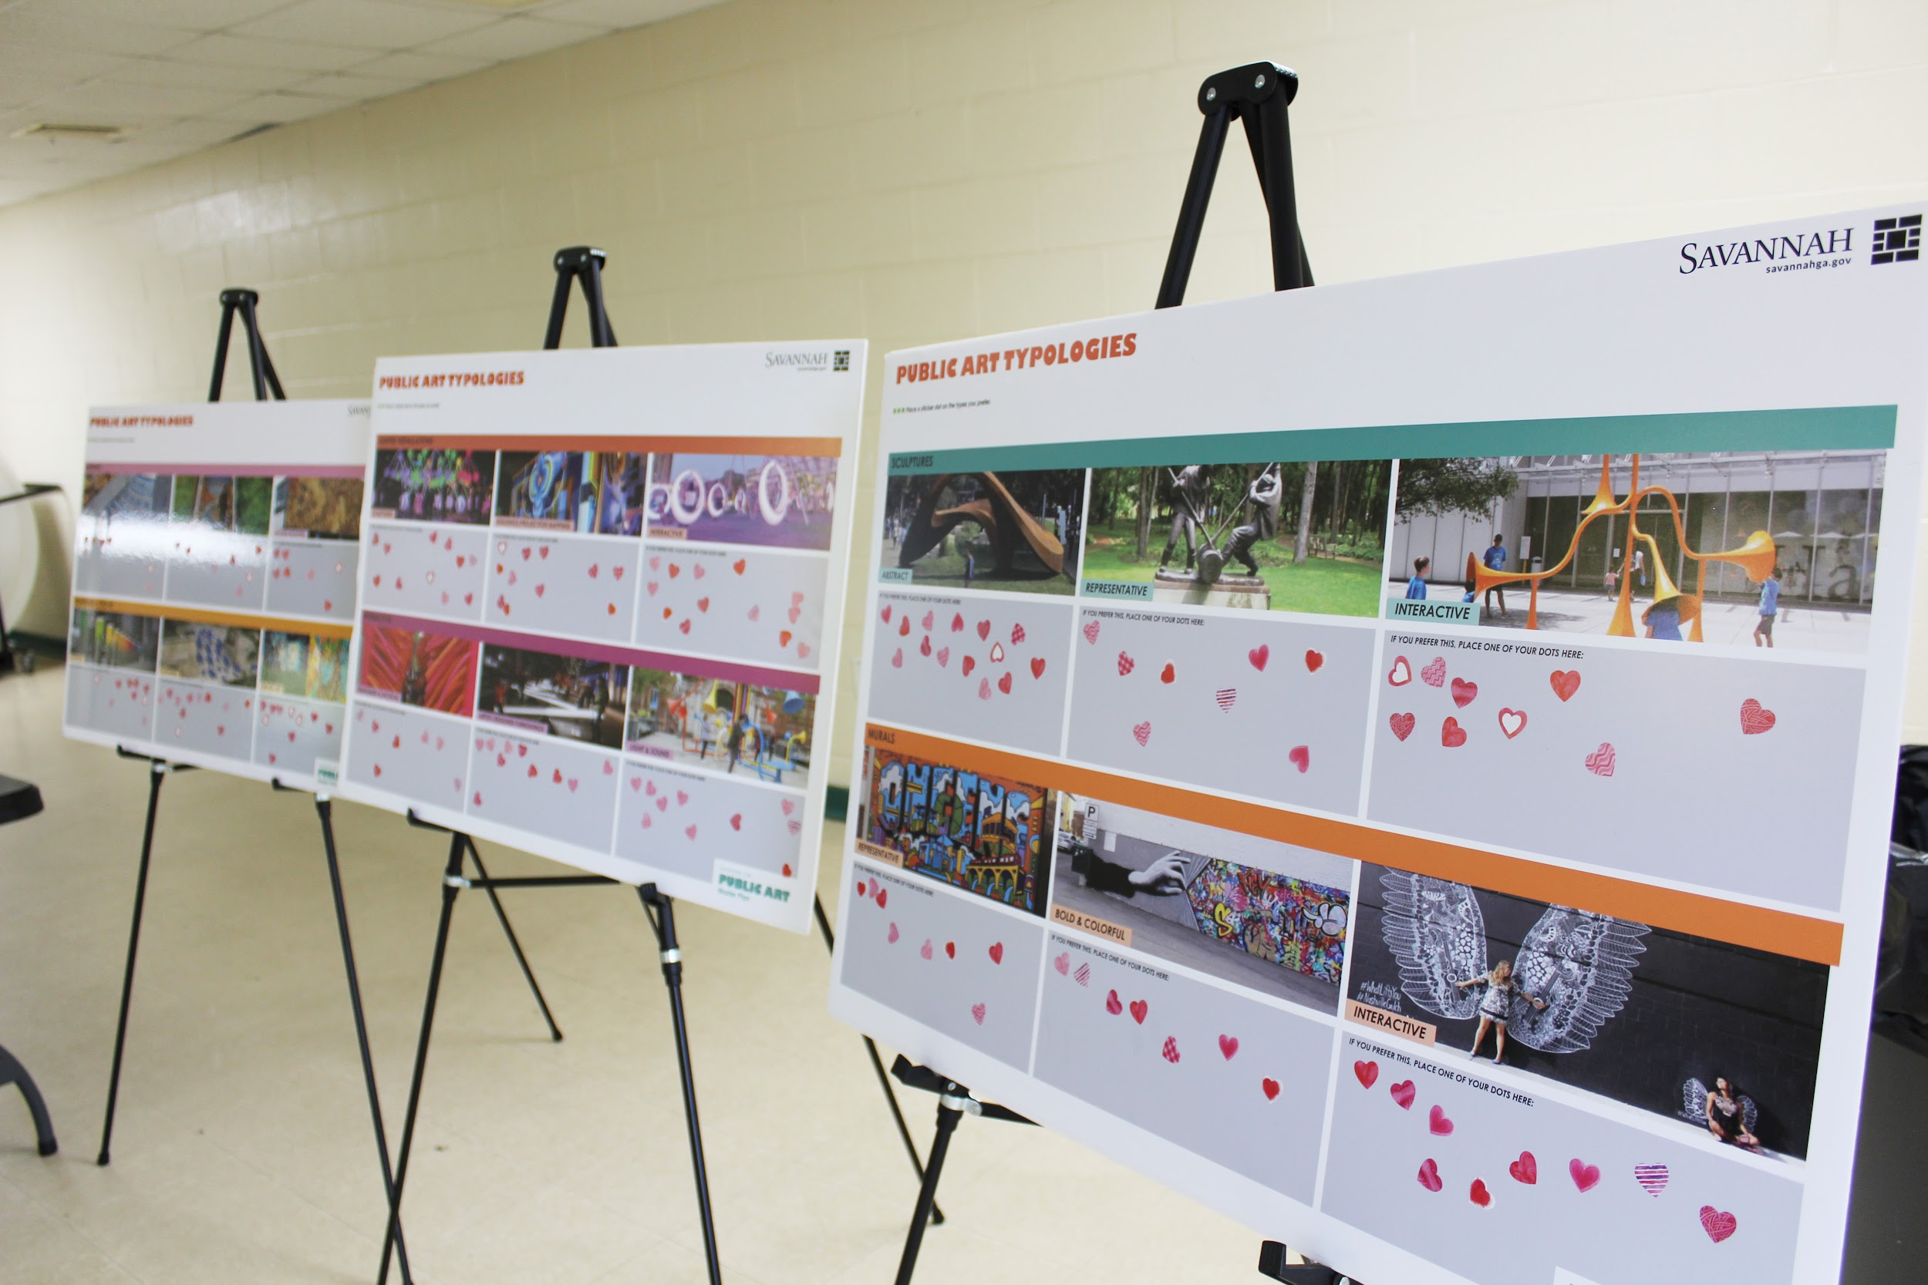
COMPLETED PROJECT TASKS
Project Mobilization
Conducted a 3-day discovery visit in November
Developed a project brand, website, and collateral
Hosted first Steering Committee meeting
Completed Community Engagement
Visited for Engagement kick off in February
Released a public survey, received 425+ responses
Public press event with performances and remarks from City leadership
Completed 25 Stakeholder one-on-one conversations
Hosted 6 district-specific Focus Groups and 6 Community Workshops - engaged over 100 participants combined
Hosted second Steering Committee meeting
Notes:
Amanda

Slide 4
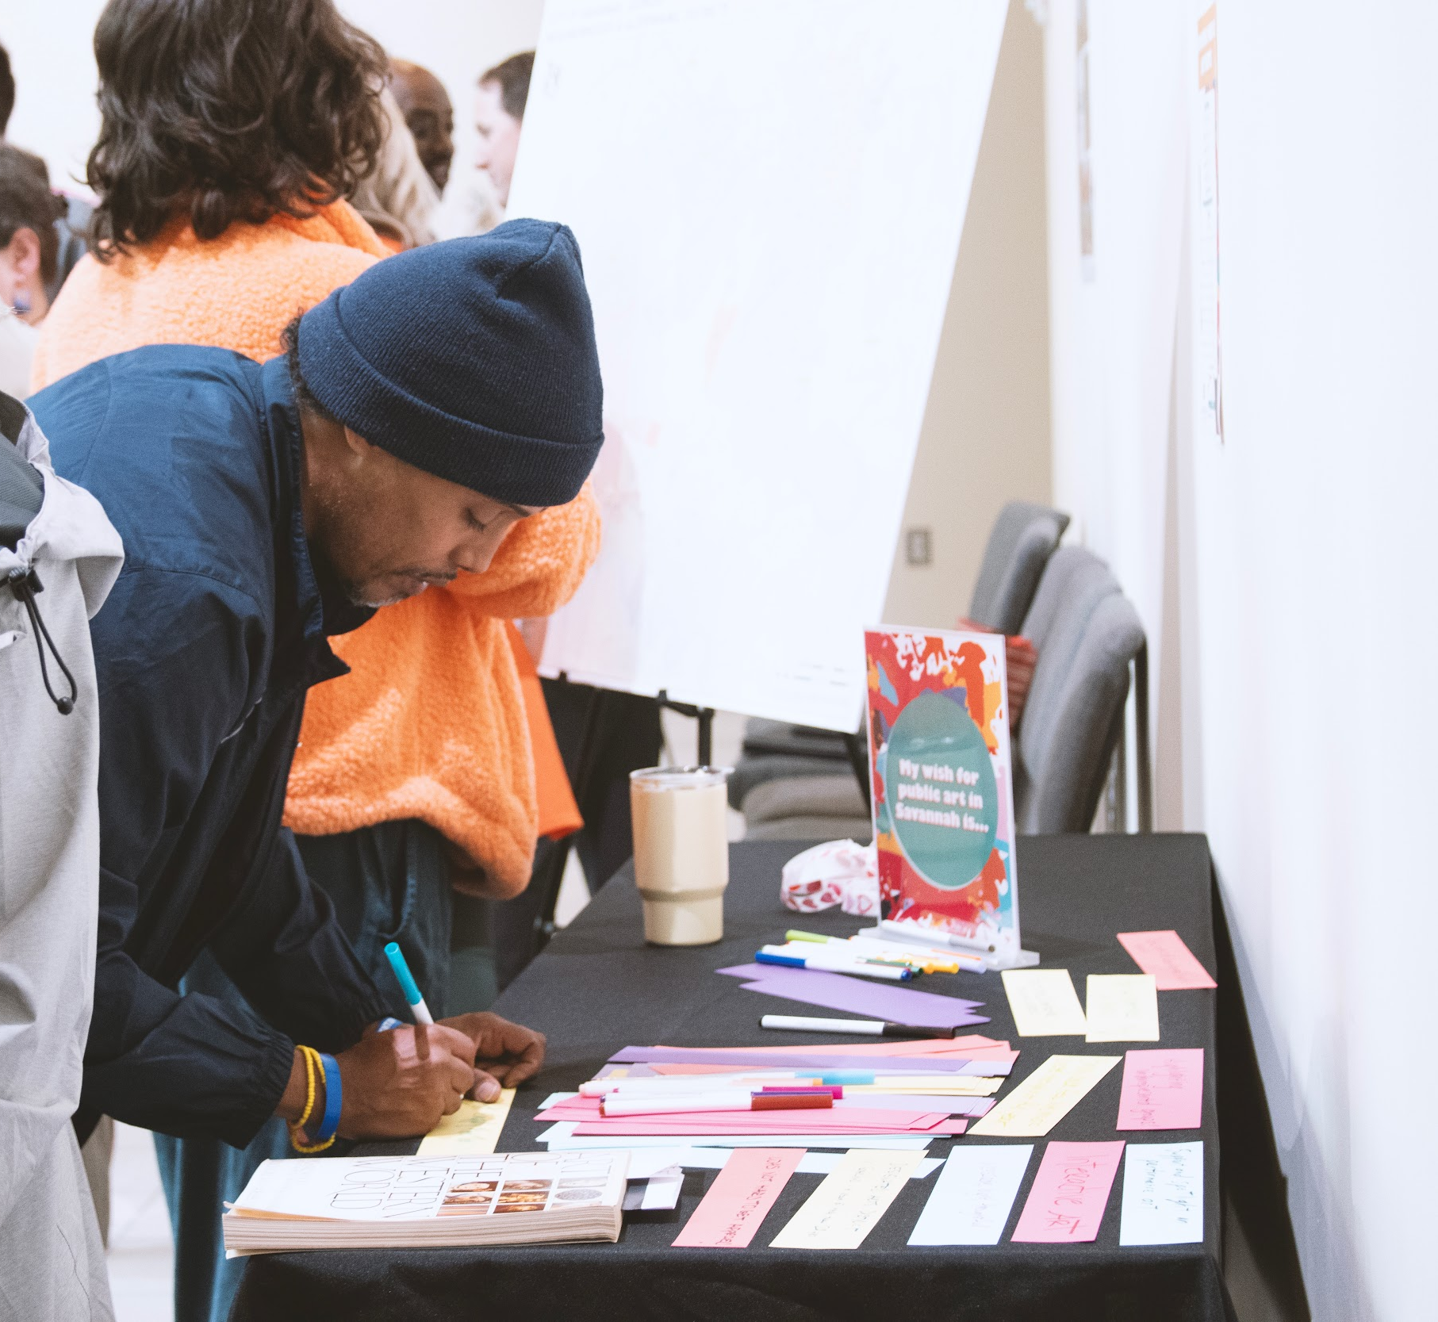
NEXT STEPS
Develop a Listening Summary
Analyze survey findings
Summarize community feedback, identify the City’s unique characteristics and needs
Develop a vision statement and guiding principles for the Plan
Third Steering Committee meeting
Evaluate Assets
Understand current collection
Define the goals and objectives of the Savannah Public Art Master Plan
Begin Writing Recommendations
Locations for public art
Public art project ideas
Public art themes
Administrative and process recommendations
Fourth Steering Committee Meeting
Final Plan Review
Presentation
Notes:
Amanda

Slide 5
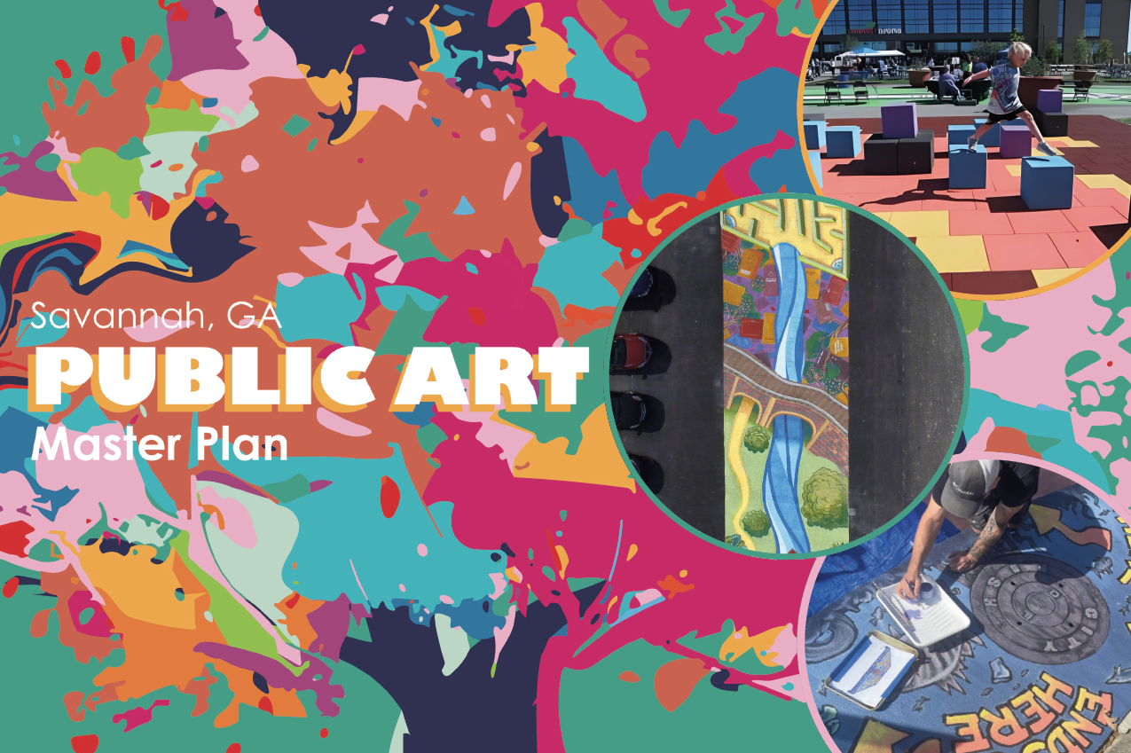
Take the Public Art Survey!

