Slide 1
Cuyler-Brownville Housing Initiative
$20M+ Planned Housing Partnerships and Investments
City Council Workshop
January 12, 2023
$14,000,000 Renovation of Charity Hospital & Florance Street Elementary School by Mercy Housing.
  Mercy secured highly competitive tax credit award from GA Department of Community Affairs.
  City approved $526,000 SAHF loan to help Mercy secure the tax credit award.
$2,700,000 Awarded by Governor’s office to Mercy Housing earmarked for the renovation of 23 row houses in the 600 block of West 41st Street.
  City wrote letter of support to help Mercy secure award.
  Mercy in the process of identifying additional funding necessary for renovation.
$6,000,000+ partnership offered by the Galvan Foundation for mixed-income, affordable, and workforce housing in Cuyler-Brownville as part of a desired multi-year investment in the neighborhood.
  Housing Savannah, Inc. Board Members worked throughout 2022 to help develop partnership.

Slide 2

The Galvan Foundation, headquartered in New York, has a core mission investing in:
              Advocacy
              Community Development
              The Arts
Galvan made a $50,000 donation to the Savannah Affordable Housing Fund (SAHF) in February 2022 after learning about the work of the Housing Savannah Task Force and the City’s commitment to addressing the community’s housing and neighborhood needs.
Shortly thereafter, Galvan President T. Eric Galloway and Vice President Dan Kent approached Housing Savannah, Inc. Board members to discuss Galvan’s interest in making a larger, neighborhood specific, investment.

Slide 3
Galvan identified the historic Cuyler-Brownville neighborhood as the one in which it would like to be a partner making a multi-year commitment to improving housing and quality of life.
Galvan is prepared to begin this by investing $6,000,000+ for mixed-income, affordable, and workforce housing in Cuyler-Brownville including:
  Investing $5,000,000+ that it will use to develop housing on 19 vacant City owned properties (18 vacant lots and 1 house) that it would like to purchase from the Land Bank Authority.
  Gifting $1,000,000 to the SAHF to launch the Cuyler-Brownville Homes Initiative (CBHI) for:
      Homeowner (owner-occupied) home repairs.
      First time home buyer down payment assistance.
      Rental property improvement loans to small landlords.
      Loans for the renovation of vacant houses and/or construction of new housing.
CHSA and the City’s Housing & Neighborhood Services Department will work with the neighborhood association to market these housing opportunities to neighborhood residents and others.

Slide 4
The 19 properties that Galvan would like to purchase and develop are outlined in Blue.
Properties outlined in Red are those Mercy is going to renovate.
Two properties outlined in Orange are houses NIA is developing for sale to first time buyers.

Slide 5
The 19 properties that Galvan would like to purchase and develop will:
Include housing for rent and for purchase by first time homebuyers.
Be affordable to households with incomes at or below 120% of area median income (AMI).
  Includes 51% of dwellings being targeted to household with incomes at or below 80% AMI.
Rental housing for persons with incomes at or below 80% AMI:
  Rents will be at or below HUD published fair market rents.
  Renters with Housing Choice Vouchers who pay 30% of their income for rent will be welcomed.
Home buyer housing for persons with incomes at or below 80% AMI:
  Sale prices will be at or below FHA sale price limits.
  Home buyers will be able to use CBHI, DreamMaker, and Housing Choice Voucher down payment assistance and gap financing to help make mortgage payments affordable.
  Mortgage payments are expected to range between $1,100 and $1,300 monthly.
  First 3 houses to be built on Lavinia Street with construction expected to begin in March.

Slide 6
Galvan Housing Experience & Investments Include:
Home improvement program providing grants for essential repairs.
Foreclosure prevention program.
Developing 18 buildings that provide 1,400 units of affordable and supportive housing.
Creating and preserving 340 units of scattered site mixed-income and special needs housing and a 25 room shelter for persons experiencing homelessness.
Developing 70,000 square feet of commercial & community space in historic buildings and neighborhoods including a:
    Library
    Day care center
    Senior center
    Early college center for Bard Early College
    Alternative education center
    After school program center
    Head start center
    Non-profit office space
    Non-profit grocery store
    Commercial space for small businesses
    450 seat theatre
    32 room hotel

Slide 7
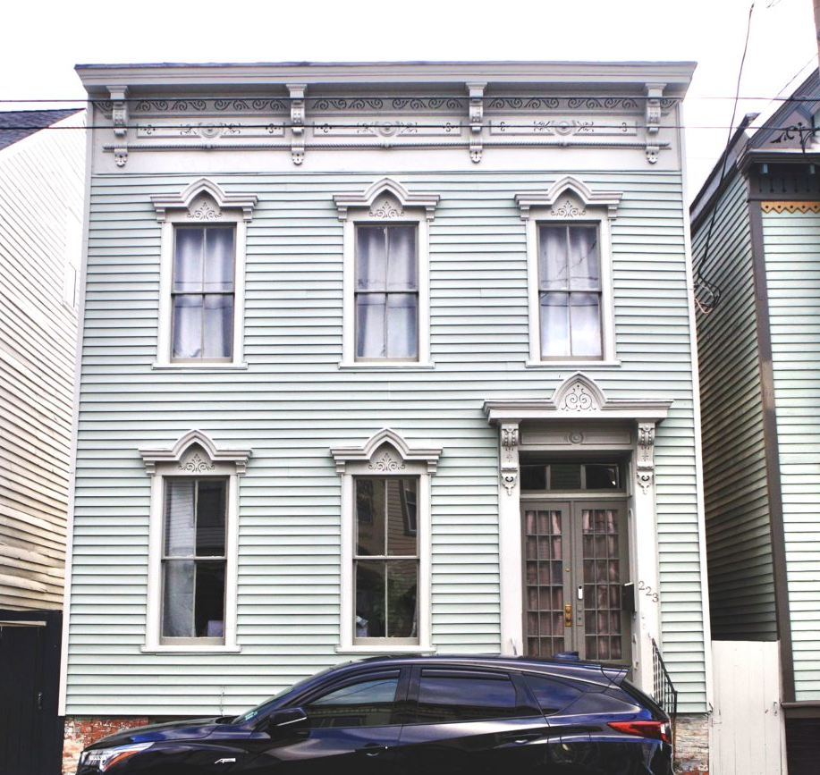
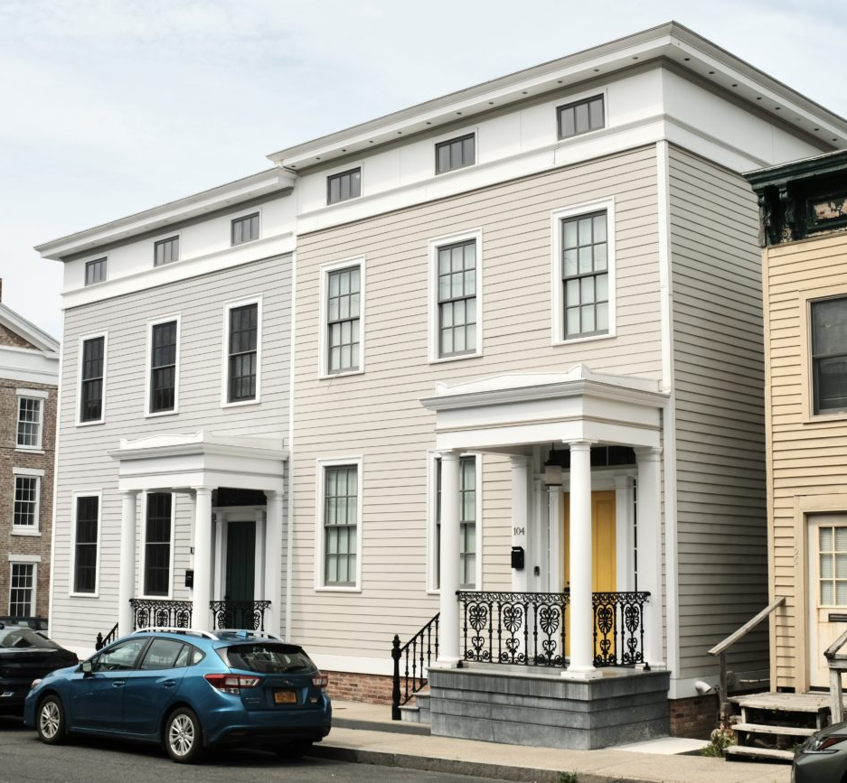
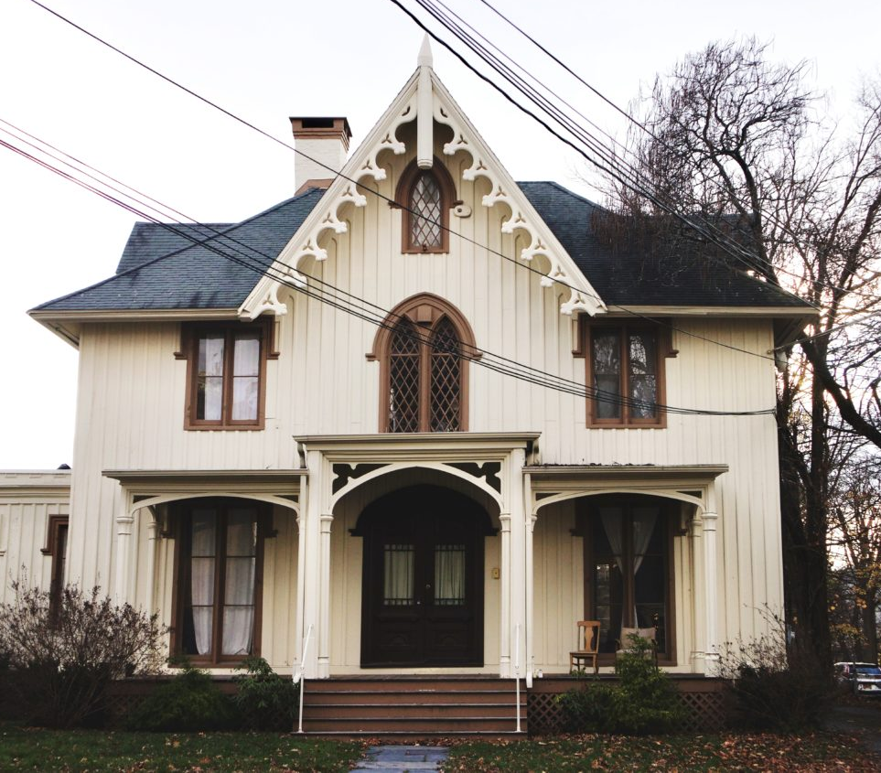
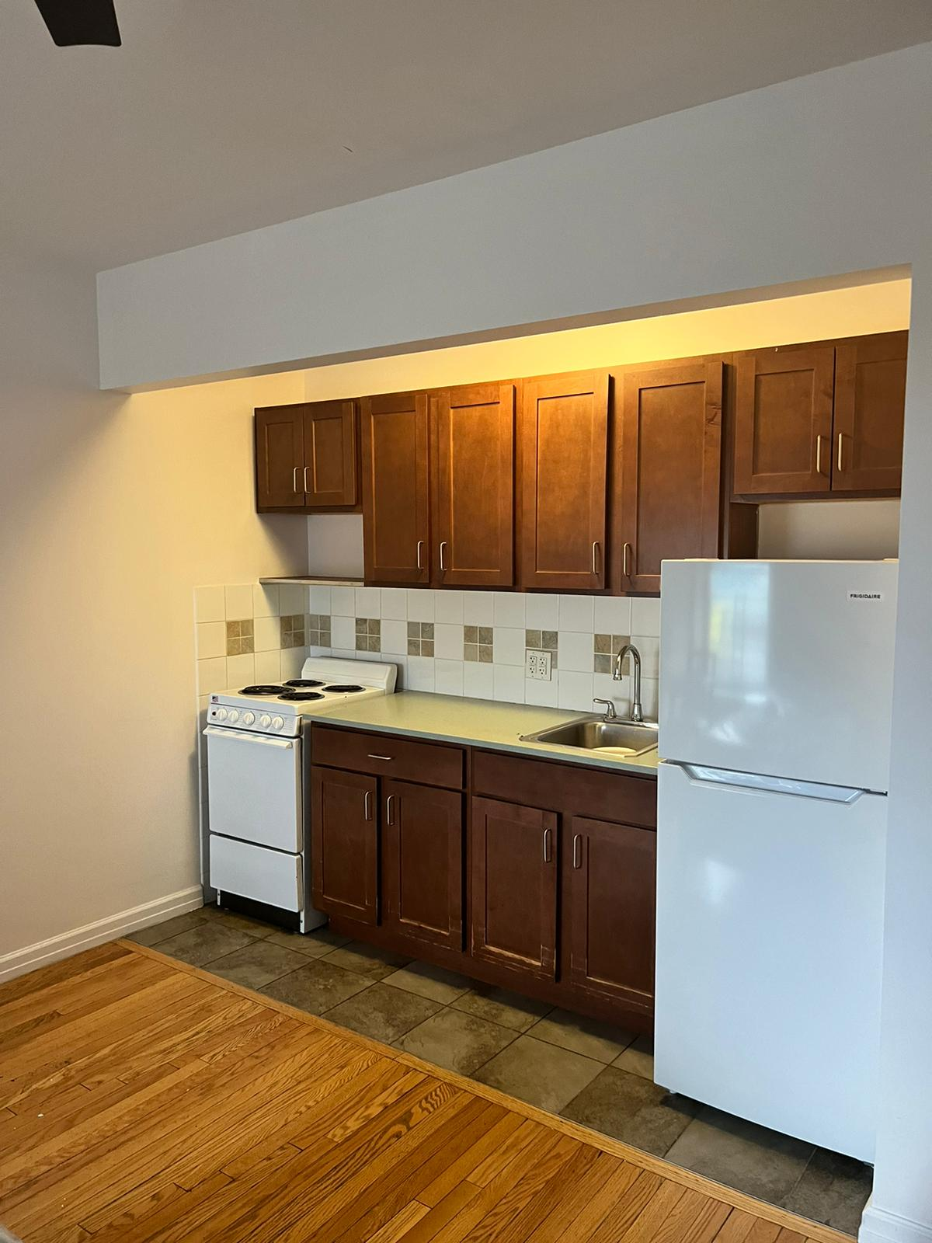
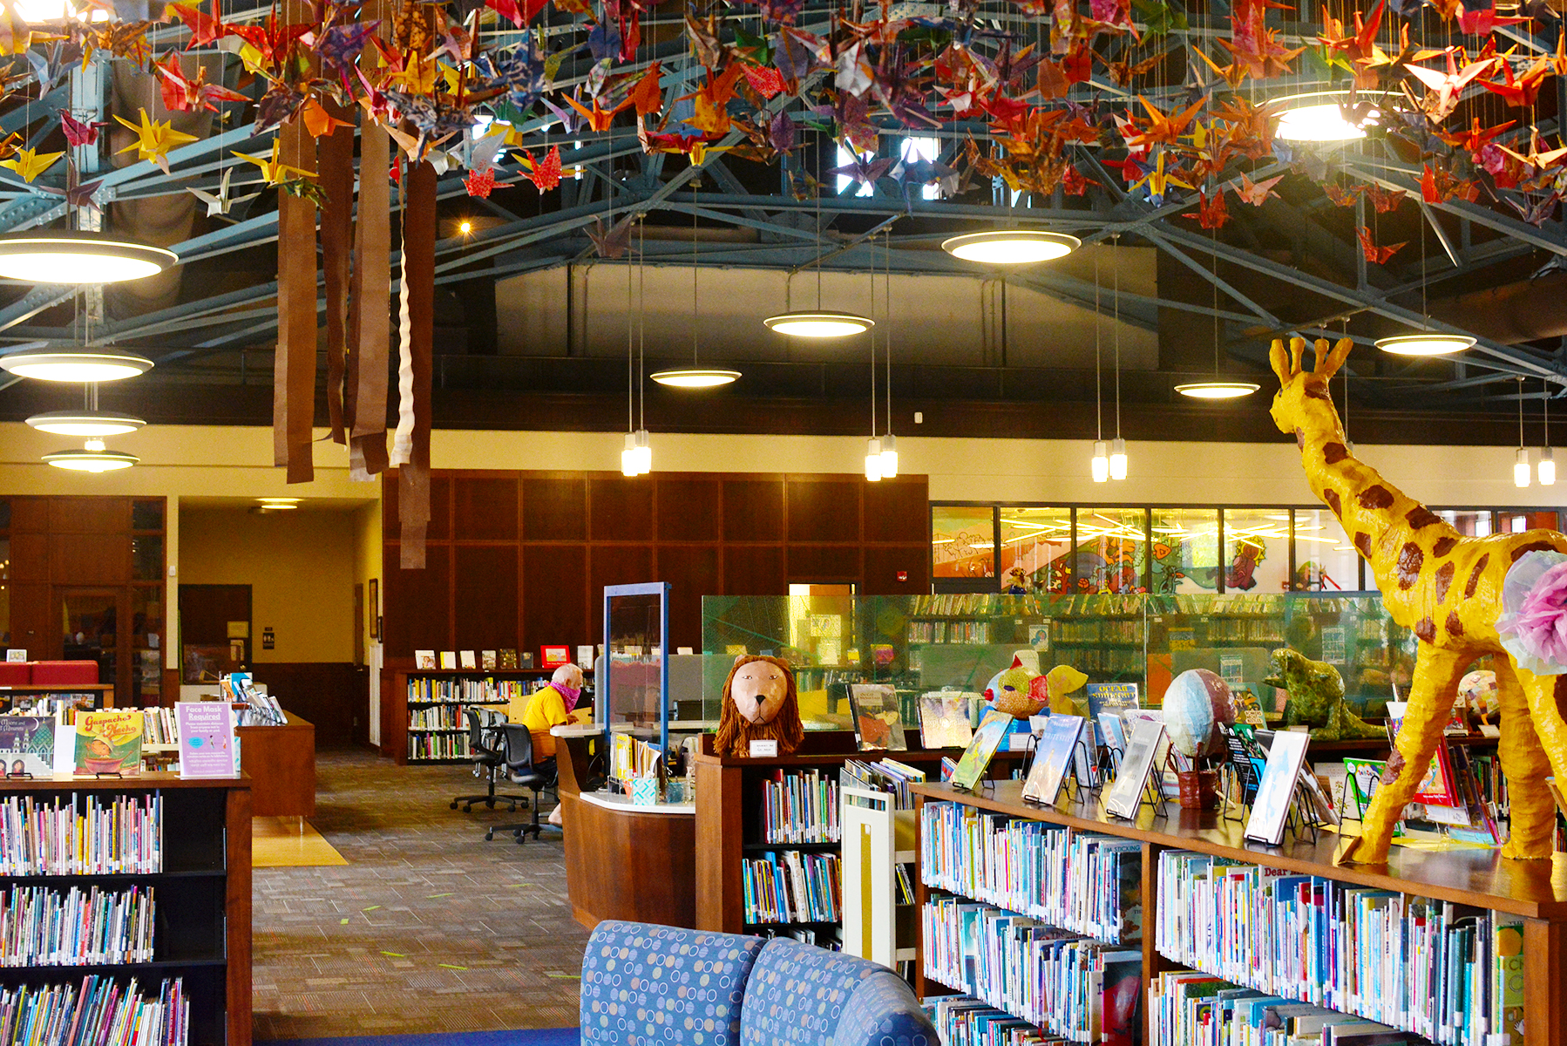
Galvan
Housing
&
Community
Investments

Slide 8
City Council Action Required
For $6M+ Galvan Partnership & Investment
Approve transfer of 19 vacant Cuyler-Brownville properties to the Land Bank Authority.
  Land Bank Authority will sell the properties to Galvan when ready for development.
  Land Bank Authority will finance the sale of the properties to Galvan where necessary to aid with affordability.
  Land Bank Authority will return 90% of Sale Proceeds to the City for the purchase of other vacant properties.

