Slide 1
CITY OF SAVANNAH TRAFFIC CALMING POLICY
City of Savannah / Office of Infrastructure & Development

Slide 2
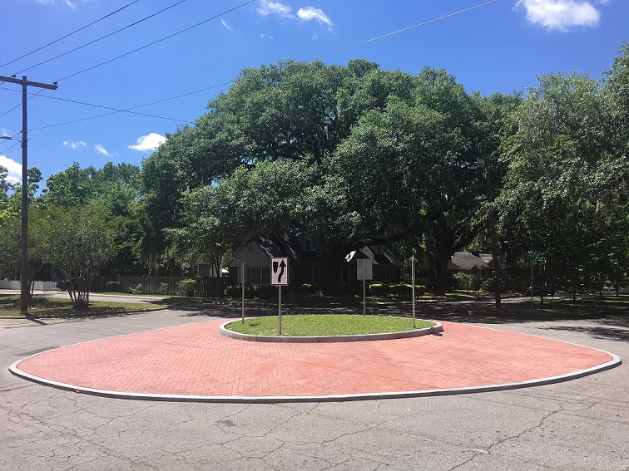
Mission Statement
It is the policy of the City of Savannah to reduce the speed and/or volume of traffic through the modification of driver behavior in our neighborhoods.
GOALS
Resident safety and quality of life
Reduce traffic impact on residential neighborhood streets
Modify driver behavior via engineered traffic calming solutions.

Slide 3
Committee Membership
Nine members appointed, one each, by the Mayor and Aldermen for 3-year staggered terms.
The committee members shall be educated on the traffic calming policy and the variety of measures that calm traffic.

Slide 4
Traffic Calming Committee
MEMBER | APPOINTMENT | TERM ENDING
James (Mickey) Rountree, Jr. Mayor’s Appointee | 06/21/18 | 12/31/21
Nelson Gassman At-Large Post 1 Appointee (Resides in District 2) | 06/21/18 | 12/31/21
Danielle S. Paul, Chairperson At-Large Post 2 Appointee (Resides in District 3) | 07/06/17 | 12/31/20
Pastor Marsha Buford District 1 Appointee | 07/06/17 | 12/31/20
Jamie Parks District 2 Appointee | 03/12/20 | 12/31/21
Susan Atkinson District 3 Appointee (Resides in District 2) | 07/06/17 | 12/31/20
(Vacant) District 4 Appointee | 12/06/18 | 12/31/21
Mable Hudson District 5 Appointee | 12/06/18 | 12/31/21
Gerald Sheffield District 6 Appointee | 5/15/20 | 12/31/21

Slide 5
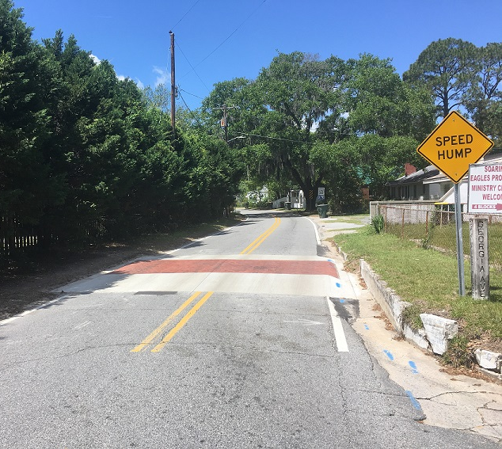
The Traffic Calming Policy Seeks To
Maintain or improve resident quality of life and neighborhood livability by reducing the impact of vehicular traffic on residential neighborhoods through reductions in traffic volumes and/or speed;
Maintain or improve the safety and attractiveness of neighborhood streets for pedestrians and bicyclists;
Ensure that permanent traffic calming measures are designed in conformance with sound engineering practices;

Slide 6
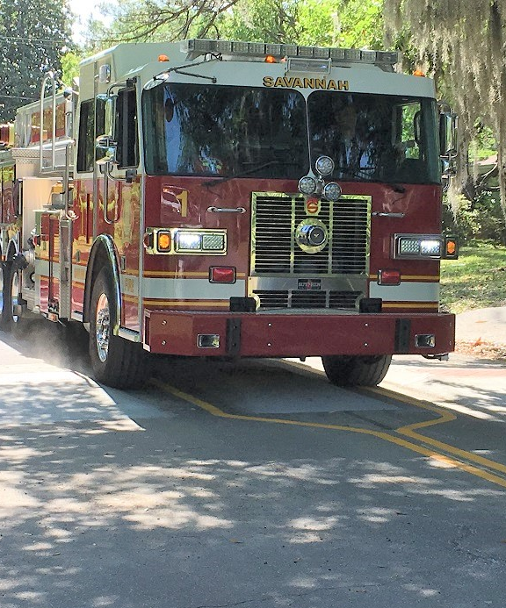
The Traffic Calming Policy Seeks To
Require citizen involvement in the application of the traffic calming program, from the initial request through implementation of selected device(s);
Ensure that emergency vehicle access is preserved at levels that meet national response standards;
Address speeding issues on one street with consideration of the effects to traffic on adjacent streets; and
Effectively prioritize validated citizen traffic calming requests.

Slide 7
Implementation of the Traffic Calming Policy
Submission of Traffic Calming Requests
Directly through the City’s Traffic Calming webpage or
Download from the Traffic Calming webpage, complete and return via email or
Request a hard copy from Mobility Services, complete, and return via postal mail.

Slide 8
Implementation of the Traffic Calming Policy
Traffic Calming Committee Review for Eligibility
Only residential streets with speed limits of 30 mph or less, AND
Minimum 1000’ in length with through interconnectivity, AND
Not a primary emergency response route or transit route, AND
Maximum width of 40’, AND
Traffic calming is likely to resolve the problem(s)
Valid requests are forwarded to the Mobility Services for evaluation.

Slide 9
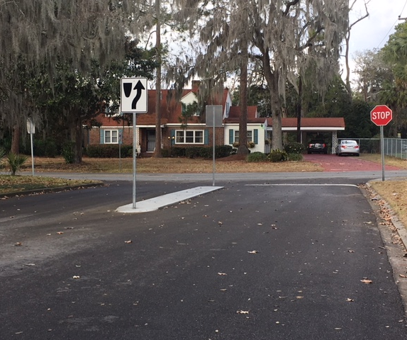
Implementation of the Traffic Calming Policy
Mobility Services Data Collection
Speed and volume data
Crash analysis
Site visit to evaluate neighborhood conditions
Sidewalk availability
Nearby schools
Nearby parks
Other relevant site characteristics
Staff report returned to Traffic Calming Committee

Slide 10
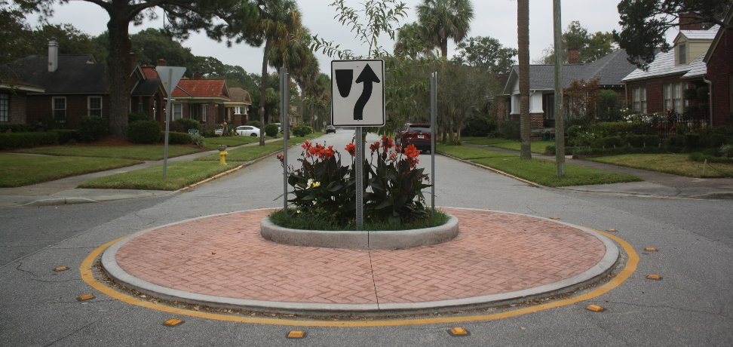
Implementation of the Traffic Calming Policy
Traffic Calming Committee Report Review and Recommendation
Committee review and discussion of the Needs Assessment
Committee votes to “Recommend” or “Not Recommend” that the requested traffic calming project be placed on the City of Savannah’s Priority List of Traffic Calming Projects.
Requests “Not Recommended” may re-submit for consideration after 1 year.
Requests “Recommended” for plan development are sent to Mobility Services for Plan Design.

Slide 11
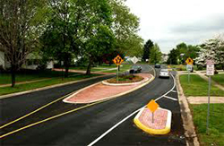
Implementation of the Traffic Calming Policy
Mobility Services Plan Design
Measures and documents street geometry and identifies potential conflicts
Block length
Driveway widths and offsets
Lot widths
Flooded intersections & parcels
Fire hydrants
Manholes
Storm inlets, etc.
Selection of traffic calming measures and placement options.
When possible, staff prepares two or more plan options from which residents may choose. Most often, conflicts constrain design to one plan.

Slide 12
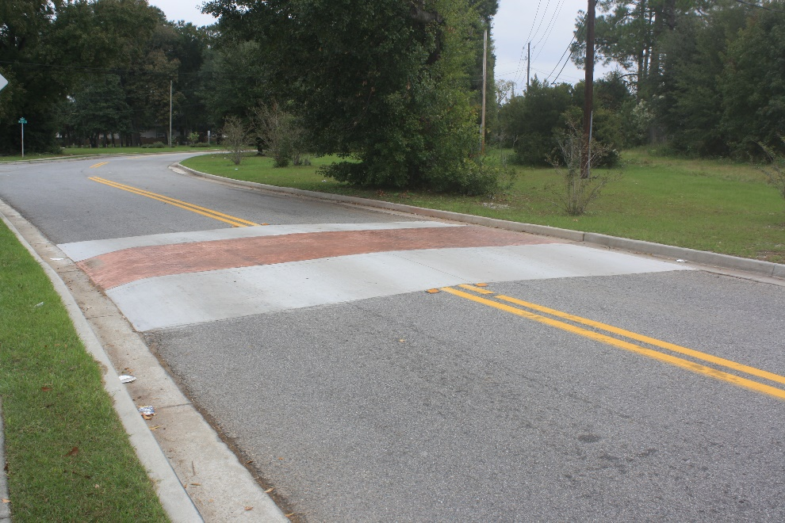
Implementation of the Traffic Calming Policy
Committee Plan Presentation (Pre-Covid)
Traffic Calming Committee invites the requestor to its next meeting, presents proposed traffic calming plan(s), and answers any questions.

Slide 13
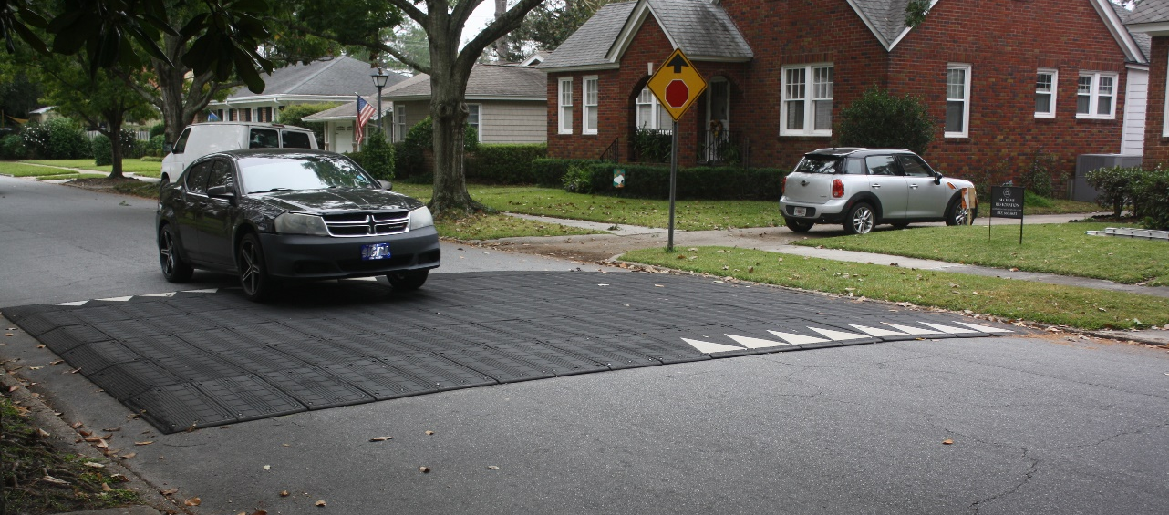
Implementation of the Traffic Calming Policy
Citizen Action
Citizen has 30 days to secure signatures to move forward with 90-day temporary measures.
Upon completion of the 90-day trial, citizen has 30 days to secure signatures to move forward with permanent measures.

Slide 14
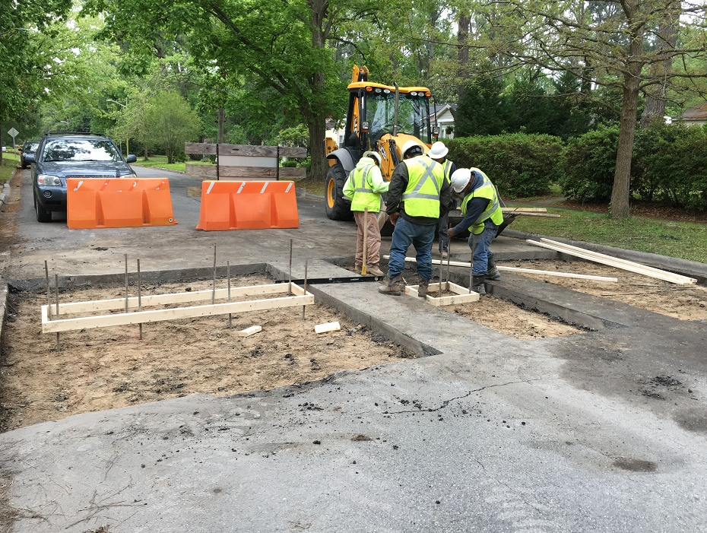
Implementation of the Traffic Calming Policy
Construction Phase
After resident signatures have been received, Mobility Services schedules and oversees construction of permanent measures.

Slide 15
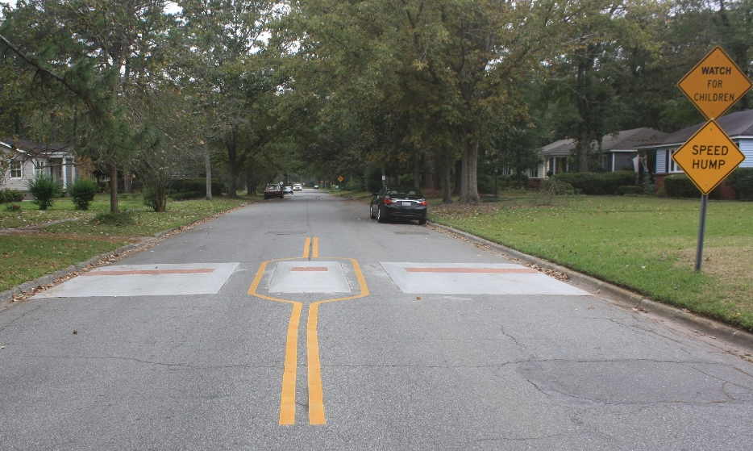
Implementation of the Traffic Calming Policy
Appeal
Citizens may appeal final recommendations made by the Traffic Calming Committee to the Mayor and Alderman. Appeals should be made directly to the Mayor and Aldermen.

Slide 16
Traffic Calming Policy Comparison
 | SAVANNAH, GA | CHARLESTON, SC | GREENVILLE COUNTY, SC | ATHENS-CLARKE COUNTY, GA | DEKALB COUNTY, GA | GREENVILLE, SC
STREET SPEED LIMIT | Speed Limit of 30 MPH or less | Speed Limit of 30 MPH or less |  |  | Speed Limit of 30 MPH or less | No street speed limit requirements
SPEED QUALIFIER | 85th percentile speed must be more than 5 MPH over the posted speed limit (for applications based on speeding concerns) *SOP |  | Speed Only Method - 85th percentile speed must be more than 10 MPH over the posted speed limit. OR Volume and Speed Method - If the 85th percentile speed is at least 15 mph over the posted speed limit, the Volume must be at least 600 vehicles per day If the 85th percentile speed is at least 9 mph over the PSL, the Volume must be at least 800 vehicles per day | 85th percentile speed greater than 32.5 mph | 85th percentile speed must be more than 11 MPH over the posted speed limit OR The volume of vehicles must be greater than anticipated when compared to the Institute of Transportation Engineer’s Trip Generation Rates for the number of homes on the street | For streets with less than 300 vehicles, The 85th percentile speed must be 10 mph over the posted speed limit.
AVERAGE DAILY TRAFFIC (ADT) | 750 (for applications based on cut-through traffic) *SOP | 350 |  | 500 |  | 300-2000 to be eligible for review.
STREET MINIMUM LENGTH | Streets must be a minimum 1000’ in length with through interconnectivity |  | The minimum length of road or segment shall not be less than 1000 feet |  |  | N/A
STREET MINIMUM WIDTH | Streets must not exceed 40’ in width
STREET TYPE | Residential & not a primary emergency response route or transit route | Residential | Residential | Residential | Residential

Slide 17
Status Update
Project | Status | Estimated Cost
200-300 blocks East 52nd Street | Construction Ready | $19,000
North Fernwood Drive | Construction Ready | $30,000
Elgin Street | Temp. Measure Ready | $47,500
400-500 blocks East 52nd Street | Collecting Signatures | $38,000
600-700 blocks East 52nd Street | Collecting Signatures | $45,000
100 block East 65th Street | Design Complete | $19,000
200-300 blocks East 65th Street | Design Complete | $28,500
00 block East 66th Street | Design Complete | $38,000
100 block East 56th Street | Design Complete | $28,500
00 block East 63rd Street | Design Complete | $19,000
2100 – 2300 blocks East 42nd Street | Design Complete | $38,000
Lexington Avenue | Design Complete | $57,000
 | TOTAL | $407,500

