Slide 1
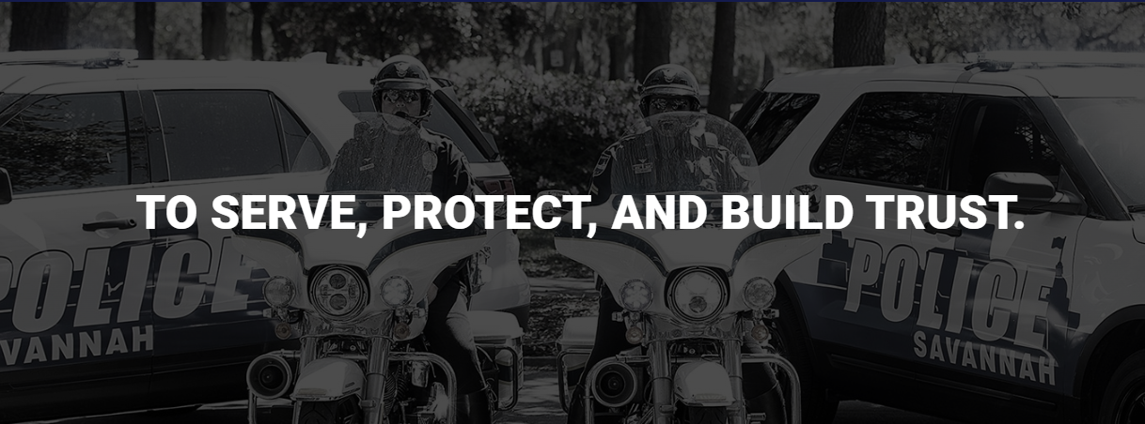
Savannah Police Department
City of Savannah City Council Workshop January 26, 2023
Notes:
Mr. Mayor
City Council
Mr. Manager -
Thank you for the opportunity to present today. I will begin by recapping how we ended last year regarding PART I crimes – then discuss strategies – and lastly, several initiatives moving forward.

Slide 2
Savannah Police Department
Total Part One Crimes
2020
-
2022
Change
Change
2022
2021
2020
21 to 22
vs. 2020
HOMICIDE
32
34
31
-
2
1
RAPE (Carnal) *
64
51
59
13
5
RAPE (Other Penetration) *
21
21
25
0
-
4
COMMERCIAL ROBBERY
30
39
65
-
9
-
35
STREET ROBBERY
174
157
158
17
16
RESIDENTIAL ROBBERY
30
41
24
-
11
6
317
265
323
52
-
AGG ASSAULT w/GUN NON
6
DOM
AGG ASSAULT w/GUN DOM
51
34
44
17
7
AGG ASSAULT w/o GUN NON
259
216
230
43
29
DOM
AGG ASSAULT w/o GUN DOM
272
273
275
-1
-
3
TOTAL VIOLENT
1,250
1,131
1234
11%
1%
COMMERCIAL BURGLARY
183
152
150
31
33
RESIDENTIAL BURGLARY
456
428
478
28
-
22
SUDDEN SNATCHING
92
58
41
34
51
SHOPLIFTING
1,010
1,118
857
-
108
153
THEFT FROM VEHICLE
1,445
1,270
960
175
485
THEFT FROM YARD
516
511
483
5
33
THEFT FROM BLDG
406
453
459
-
47
-
53
OTHER LARCENY
253
318
225
-
65
28
AUTO THEFT
580
461
413
119
167
AUTO THEFT, OTHER VEHICLE
187
160
103
27
84
TOTAL PROPERTY
5128
4929
4169
4%
23%
TOTAL PART I
6378
6060
5403
5%
18%
Notes:
Compared to 2021 - Crime with the most significant increases included -
Agg w/ gun non-domestic ---increased by 20%
Agg w/o gun non-domestic ---increased by 20%
Theft from Vehicle (primarily unlocked vehicles) ---increased by 14%
Auto Theft (vehicles had keys easily accessible and/or left running) -----increased by 26%
Overall, violent crime increased by 11%, property crime increased by 4%, and total part one crimes increased by 5%.

Slide 3
Gun Theft and Recovery
Guns Reported Stolen
Month Reported Stolen | # of Guns | Month Reported Stolen | # of Guns
January | 25 | July | 70
February | 27 | August | 50
March | 35 | September | 23
April | 54 | October | 40
May | 58 | November | 43
June | 58 | December | 26
Overall Total: 509
Guns Stolen Out of Vehicles
Method | # of Guns
Locked | 30
Unlocked | 241
Overall Total: 271
Notes:
In 2022 -
We had a reported 509 guns stolen.
Out of the 509, 271 were stolen from a vehicle.
And out of the 271 – 241 were stolen from unlocked vehicles.

Slide 4
Homicide Clearance Rate
 | Homicides | Arrests | Exceptionally Cleared | Open | Clearance Rate
2022 | 32 | 26 | 1 | 7 | 84%
2021 | 34 | 29 | 1 | 10 | 88%
2020 | 31 | 25 | 0 | 12 | 77%
2019 | 24 | 19 | 6 | 8 | 79%
2018 | 28 | 19 | 7 | 9 | 68%
National Homicide Clearance Rate: 64%
Notes:
1. We ended the year with a 84% Homicide clearance rate.
2. The national clearance rate is 64%.
3. There were 25 cases in 2022 closed by arrests and 2 cases from 2021 solved in 2022.

Slide 5
Traffic Fatalities
YEAR | TOTAL FATAL WRECKS | PEDESTRIAN-INVOLVED
2022 | 14 | 5
2021 | 20 | 6
2020 | 14 | 3
2019 | 14 | 4
2018 | 14 | 9
2017 | 24 | 6
Notes:
In 2022, we had a total of 14 traffic related deaths in which 5 were pedestrian involved.
We are still focusing on councils Vision 0 priority to eliminate all traffic fatalities and sever injuries, while increasing safe, healthy, equitable mobilty for all.

Slide 6
Special Investigations Section
 | Total
Felony Arrests | 246
Misdemeanor Arrests | 21
Felony Arrest Warrant | 716
Misdemeanor Arrest Warrant | 4
City Ordinance Marijuana | 75
Guns Recovered | 193
Guns Recovered Stolen | 27
Cocaine Recovered | 1459.71
Crack Recovered | 304.6
Pills | 741.5
Marijuana | 18699.837
Other Drugs/Codeine | 507.72
 | Total
Meth | 338.8
Fentanyl (grams/pills) | 430.6
Traffic Citations | 102
Stolen Auto Recovery | 11
THC Products (units/oil) | 15.1
MDMA (grams/pills) | 469.2
Formulytic Entries | 54
eTraces Initiated | 742
Search Warrants | 48
Money Recovered | $65,088.00
Notes:
The Special Investigations Section, which specifically focuses on violent / drug / and gang related crime had -
716 felony arrets
Recovered 193 guns (27 stolen)
Recovered over 1,400 grams of cocaine in addition to other drugs

Slide 7
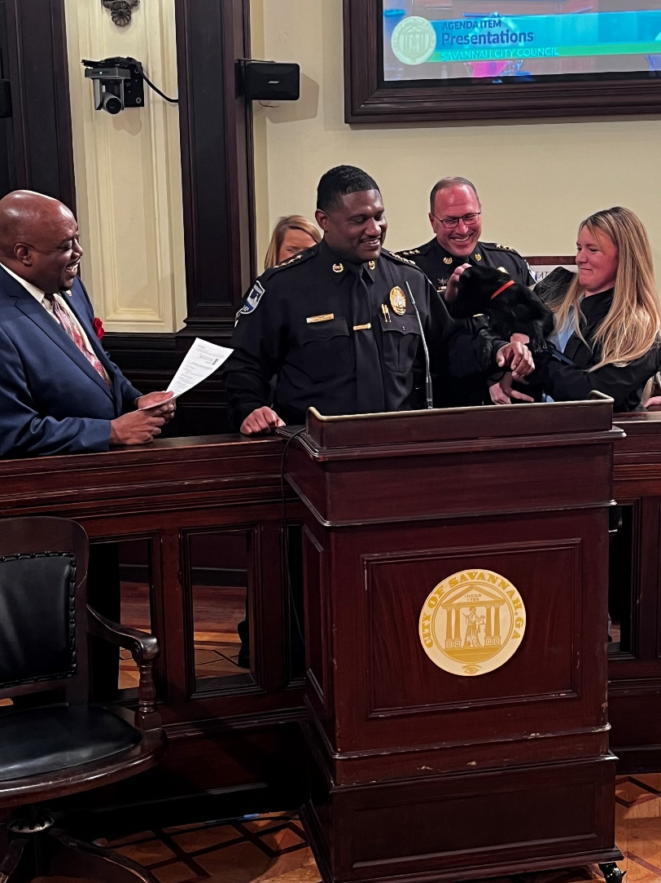
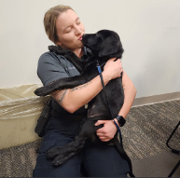
Behavioral Health Unit
Launched: September 2020
Commanded by Asst. Chief Robert Gavin
Corporal Julie Cavanaugh, Ofc. Amber Beasley and Goose
Angela Spivey, LPC – Gateway Community Service Board
2 new BHU Officers will begin Feb. 2023
4 BHU officers will expand afternoon and weekend hours
Expanded Clinician Hours (BHCC increasing staff to be on street)
To date, BHU:
Interacted with 387 unique individuals
Completed 123 follow-ups
Connected 238 individuals to services
Only 19 individuals served ended in arrest, half were due to prior warrant or parole violations
Notes:
I'm excited to announce that the Behavioral Health Unit will add two officers next month.
This will expand BHU's hours to include evening and weekend hours.
Read "to date stats"

Slide 8
Crime Reduction and Prevention
Crime Reduction & Prevention
Data Driven Strategies
Leveraging Technology
Holistic Approach
Community Partnerships & Relationships
Recruitment Retention
&
Training
Transparency
&
Accountability
Notes:
PULL UP MAIN BUBBLE
One of our main priorities, is to reduce, prevent, and eliminate the fear of crime in our City.
The fact is, there isn't a panacea, or "one size fits all" to accomplish this.
The development and implementation of a comprehensive strategy is absolutely necessary.
There are Six Guiding Pillars to SPD's Crime Reduction and Prevention Strategy
PULL UP EACH ONE AND READ.

Slide 9
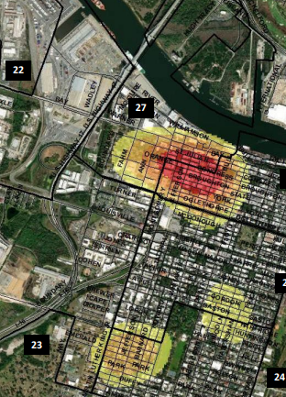
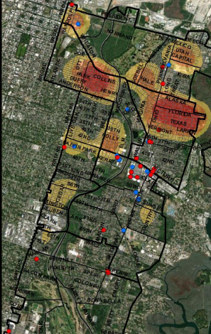
Data Driven Strategies
Lenny B. Gunther, Chief of Police
Savannah Police Department
Notes:
Pillar I – Data driven strategies.

Slide 10
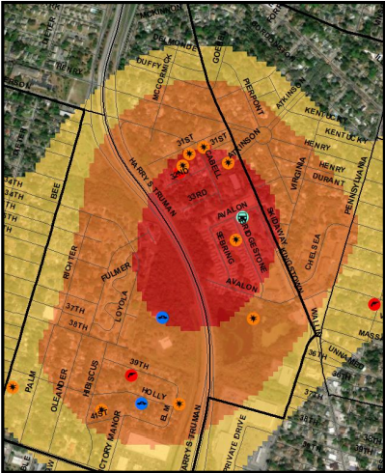
Data Driven Strategies
Micro hotspots and activities
Proactive presence to targeted areas.
Actionable intelligence and strategic deployments
Prolific offenders
Notes:
Data Driven Strategies – utilizing past and present crime history we will focus on the [micro] areas and population that are responsible for most of the crime.
The data driven strategies will enable us to focus and provide proactive presence to the targeted areas.
Intel analysts are decentralized into the precincts and provide real time intel to officers and detectives in the field to enhance proactive crime suppression efforts.
The data driven strategies are constantly accessed and focused on actionable intelligence and strategic deployments.
This actionable intelligence streamlines our efforts to identify and focus on prolific offenders, areas and activities.

Slide 11
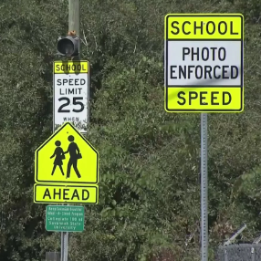
Leveraging Technology
Lenny B. Gunther, Chief of Police
Savannah Police Department
Notes:
Pillar 2 - Leveraging Technology –
A comprehensive crime reduction strategy must utilize cutting edge technology to maximize our efforts and constantly increase our effectiveness and efficiency.
These technologies include NIBIN, FLOCK, ShotSpotter, CAD/RMS, BWC's, Brief Cam, School Zone Cameras.

Slide 12
Leveraging Technology
ShotSpotter- 4.5-mile expansion extended to all precincts.
School Zone Cameras- Ten locations went live in Oct. 2022. Four additional locations will be activated in first quarter 2023.
• Totals tickets issued 11/2022 thru present = 8,609
E- Citations- Improves officer court efficiencies and effectiveness.
Year | Total E-Citations
2021 | 5,819
2022 | 13,953
Notes:
ShotSpotter - The 4.5-mile expansion extended ShotSpotter to all districts within the city facilitating quicker, more accurate response to gunfire incidents; enhanced ability to render aid, collect evidence, and catch criminals in the act of violence.
Total ShotSpotter coverage for the city is now is 9.52 miles
Our school zone cameras went live in Oct. Four additional cameras will be activated during the 1st quarter of this year.
In 2022 – we issued over 13, 000 E-Citations.

Slide 13
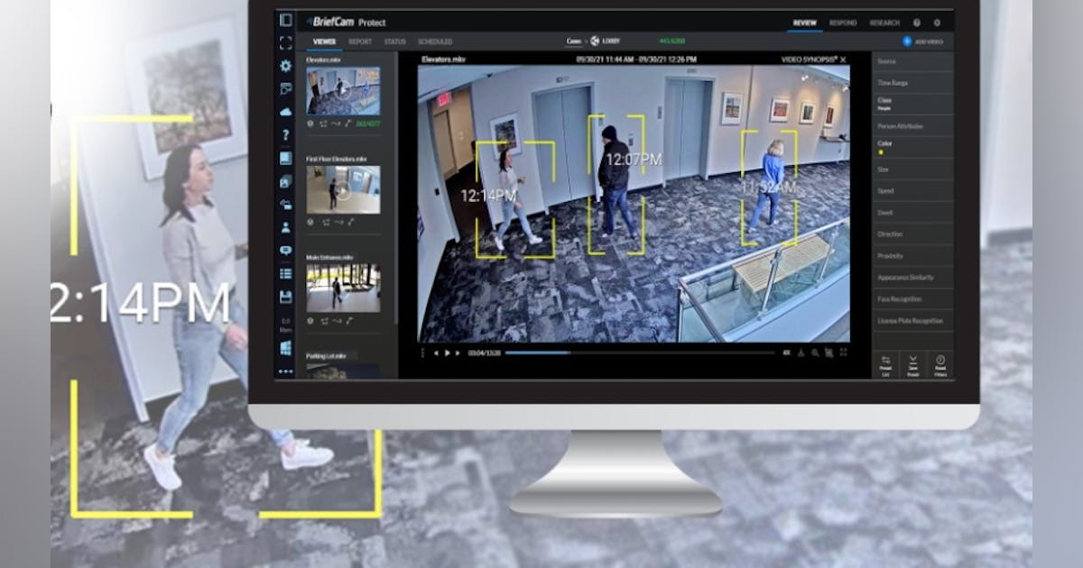
Leveraging Technology
CAD / RMS-
CAD will be active in the 3rd Quarter of 2023
RMS will be active 1St Quarter of 2024
BriefCam-
Real Time Searches
Reducing Hours and Staff
FLOCK –
32 FLOCK Additions
Real Time Alerts
TI Training Simulator
Notes:
The CAD / RMS project is moving ahead. These improvements will change how SPD collects data and how we can use it to address crime trends while also communicating with other law enforcement agencies in our area.
Brief Cam
Allows for quick searches of camera footage in investigations and observation of events in real time, reducing hours of time and staff that currently required.
Flock -
the addition of 32 FLOCK additions cameras throughout the city has been a substantially impactful tool in investigations and the capture of homicide and violent crime suspects. Total # of FLOCK – 54
Our Training Simulator which focuses on Crisis decision making will be available for officers to train on next month.

Slide 14
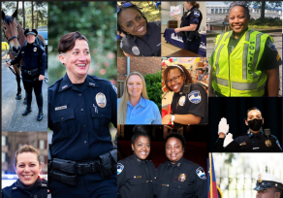
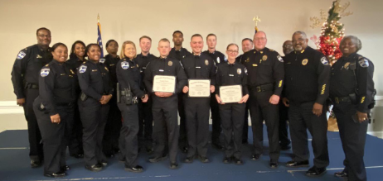
Recruiting, Retention, and Training
Lenny B. Gunther, Chief of Police
Savannah Police Department
Notes:
Pillar 3 - Recruitment / Retention and Training – in order to efficiently protect and serve our community, we must retain, recruit and TRAIN the best and qualified officers. Our department must also be a mirror image of our community.
Historic investments have also been adopted and implemented (such as salary increases, bonuses, updated equipment, the purchasing of vehicles, and the implementation of a lateral entry program).

Slide 15
Recruitment
TOTAL STAFFING: authorized staffing is 537 (sworn)
408 officers
129 vacancies
Officers in training: 25
Upcoming graduation dates: April 3rd, July 5th, September 25th
Reorganization:
Hired a civilian recruitment specialist
Reducing hiring process time
Utilizing recruiting “Teams” to move applicants through phases quicker and thoroughly
Use of digital advertising and focused recruiting events has shown increases in applications
More local recruiting emphasis
Female and minority hiring focus
New branding marketing material
Updates to website for ease of use
Notes:
Review Slide
Note – Academy / Recruit Orientation Course / Patrol School

Slide 16
Retention Initiatives
Police Officer signs 2-year commitment agreement, then receives
$4,000 @ 3rd year anniversary
$2,500 @ 4th year anniversary
$2,500 @ 5th year anniversary
$2,500 @ 6th year anniversary
Equipment / Training:
Purchase 106 new police cruisers to meet take-home vehicle agreements
Provide outer carrier vests for patrol officers
Purchase more desirable Class C uniforms
Funding secured in budget for enhanced officer training
Notes:
Officers sign a two year commitment agreement upon hire and then receive a series of retention bonuses starting at $4,000 at year 3. After 6 years, the total received will be $11, 500.
We have also invested in equipment and training to include
106 vehicles / outer carrier vests / uniforms / and budgeted for enhanced officer training.

Slide 17
Training
Going forward, training will focus on:
Leadership
Diversity, Equity and Inclusion
Cultural Competence
Communication
Tactics and Decision Making
Officer Health and Wellness
Notes:
We will focus our training on topics relevant to law enforcement and our relationship w/the community.
The overall goal of the Health and Wellness initiative is to create an atmosphere where SPD employees have sufficient access to both physical fitness and health awareness programs to help navigate and alleviate stressors.
Re-implement the Fitness Incentive Program.
Extend the SPD Gym hours.
Implement a Stress Management Program.
Create Relaxation Rooms in precincts and SPD buildings to provide employees with break space following critical incidents or stressful situations that cause anxiety.
Offer weekly workout sessions (low, medium, and high impact) on various days and times so all employees will have an opportunity to take part.

Slide 18
Holistic Approach
Lenny B. Gunther, Chief of Police
Savannah Police Department
Notes:
Pillar 4 – Holistic Approach.

Slide 19
Holistic Approach
Prevention
Intervention
Enforcement
Redirection
Root Causes of Crime
Connect Individuals to Resources
Network of Care
Youth Focus
Reduce Crime
Notes:
Holistic Approach – this is where Prevention / Intervention / Enforcement / and Redirection – Re-entry cross paths. Law enforcement alone cannot implement sustainable crime reduction [violent] strategies. We, as a City, must focus on the root causes of crime and connecting individuals to needed resources.
Our partnerships include the ONESE office, [BHU] city departments, community leaders, business and faith community, non – profits and civic agencies, social service agencies etc. Its about creating and maintaining a network of care that focuses on our most as risk population with a specific focus on our youth.
The collaborative goal must be to break the cycle of violence, treat trauma, and be victim focused. Equally as important, is to recognize that individuals that have been incarcerated and released to our community – need a path forward. Working with our network of care is critical to reduce recidivism and successful reentry. This is a priority and goal of Savannah Impact.
Also, Ensuring that our local, federal, and state partnerships are strong and intimately focused on reducing crime in Savannah. The goal is to share intelligence, collaborate on special operations, and maximize resources.

Slide 20
Notes:
Pillar 5 - Accountability and Transparency - I have both because the fact is they aren't mutually exclusive of one another.

Slide 21
Transparency and Accountability
Culture of Transparency and Accountability
Performance evaluations
Assessing and measuring outputs
Timely and Accurate Communication
Internal Processes
Command Level Responsibility and Accountability
Notes:
Accountability and Transparency –
The Savannah Police Department must create and embrace a culture of accountability and become more transparent.
Most importantly, transparency and accountability starts at the top of an organization – with me.
We will assess and measure our efforts and strategies through CompStat, shoot reviews, intel reports, internal meetings and feedback garnered from the community.
When significant events occur in the community and or involve the department, timely and accurate communication of the facts to our stakeholders / community members is paramount.
We will also be publishing internal data on our website soon. I will discuss that shortly.
Command level officers will be responsible [and held responsible] for developing targeted strategies with input from staff and external partners. Performance evaluations will be used to measure officers’ productivity and aligning goals.
* Note – we are redeveloping CompStat to focus deeper on accountability measurables ( UOF / Crash data/Community engagement efforts – problem oriented policing projects/clearance rates etc.).

Slide 22
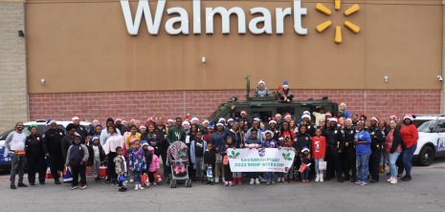
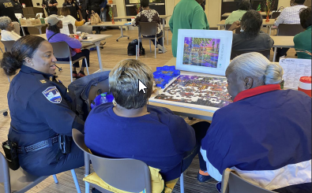
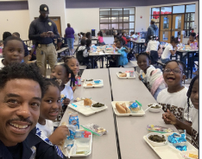
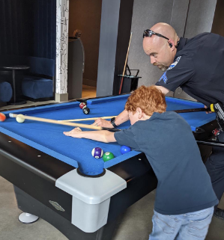
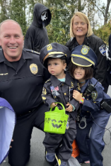
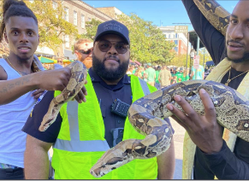
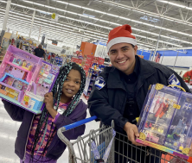
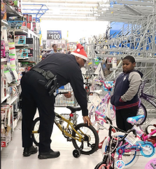
Community Partnerships and Relationships
Notes:
Pillar 6 - Community Partnerships and Relationships
The reduction and prevention of crime is contingent on the relationships that SPD has in our community. Positive engagement with our residents and visitors solidifies our credibility and legitimacy. Together, we will develop innovative ways to engage and empower our community.
By reinforcing a shared responsibility mindset, we will develop collaborative problem-solving strategies. We must prioritize proactive engagement and utilize a targeted approach - focusing on our most challenged areas and populations.
Although we have designated Neighborhood Resource Officers, we are redefining the role that all officers are NRO's. We don't want the responsibility to [proactively] engage community members to be the responsibility of several officers. All officers (including myself/Command) are responsible to engage and empower residents and visitors. The goal is to be solution oriented / knowledgeable of city and local resources / and to not only crime address crime – but also quality of life issues. *

Slide 23
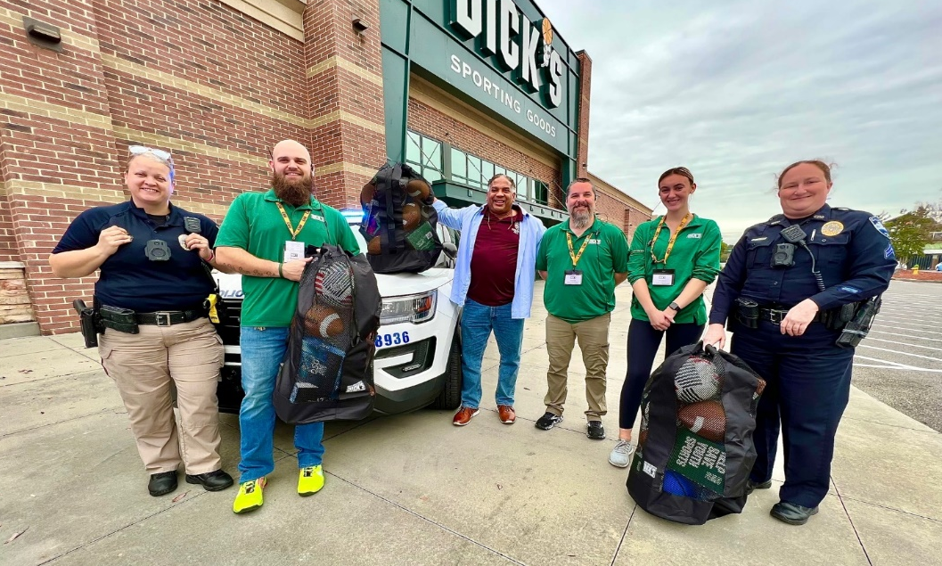
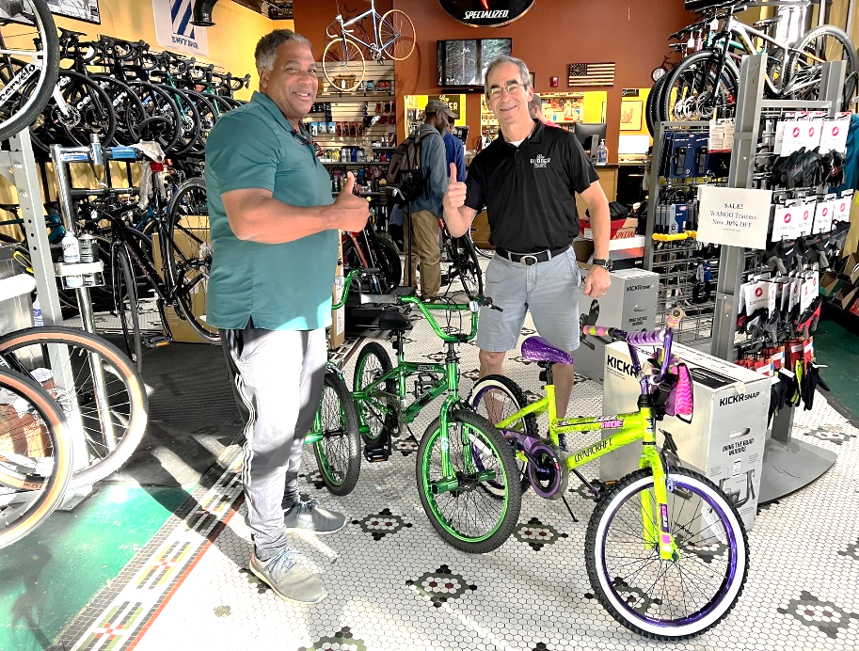
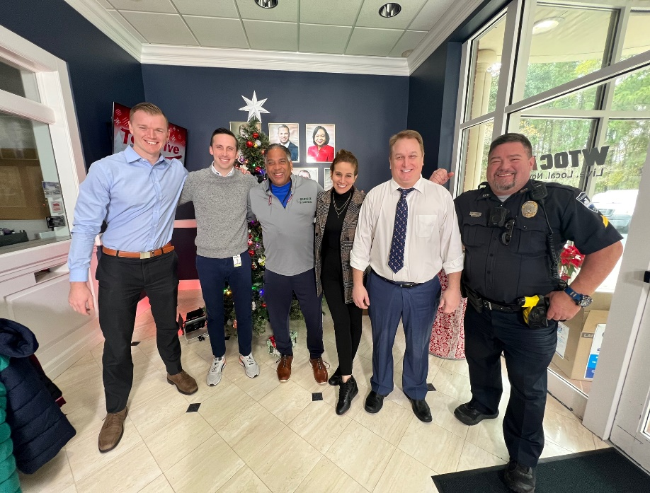
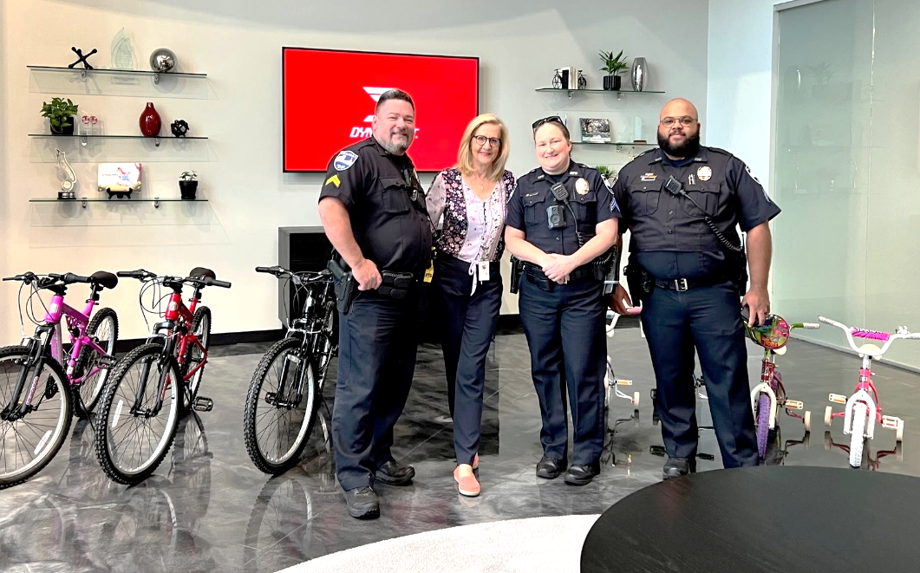
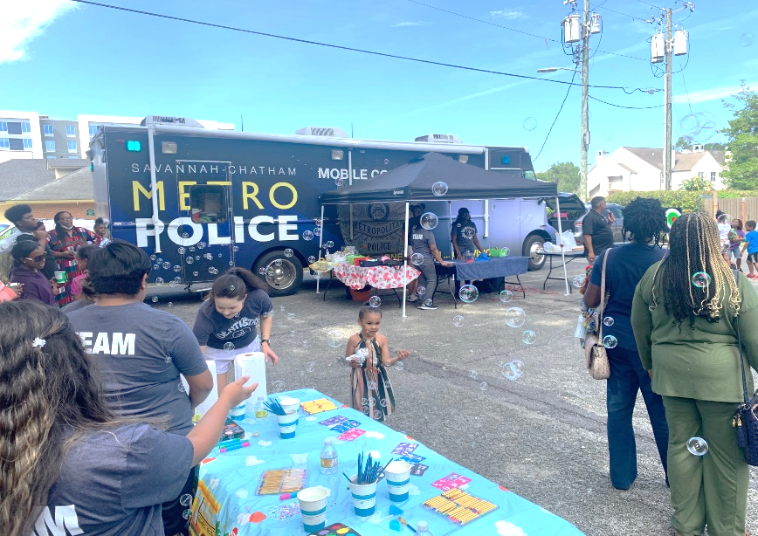
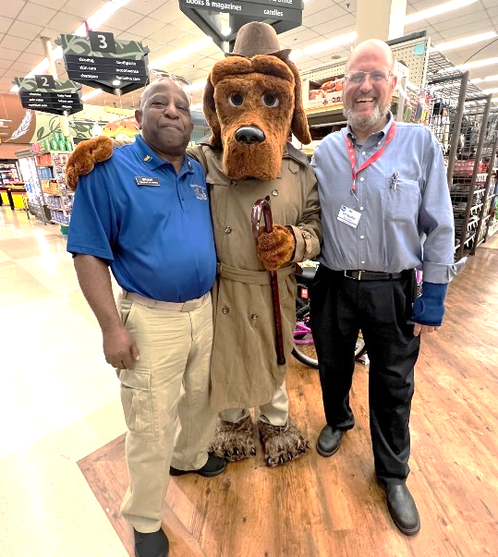
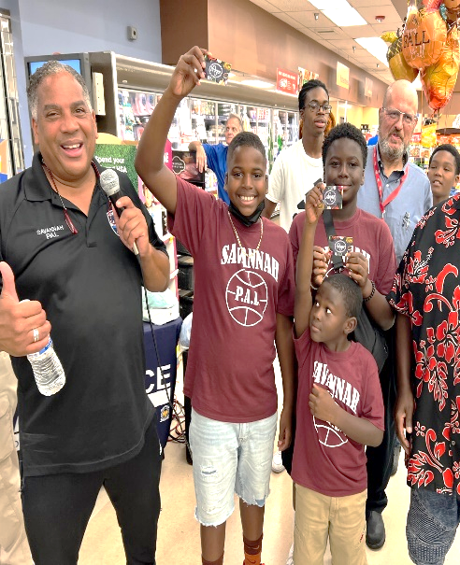
Business Partnerships
Notes:
Here are some examples of our community engagement efforts.

Slide 24
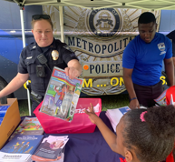
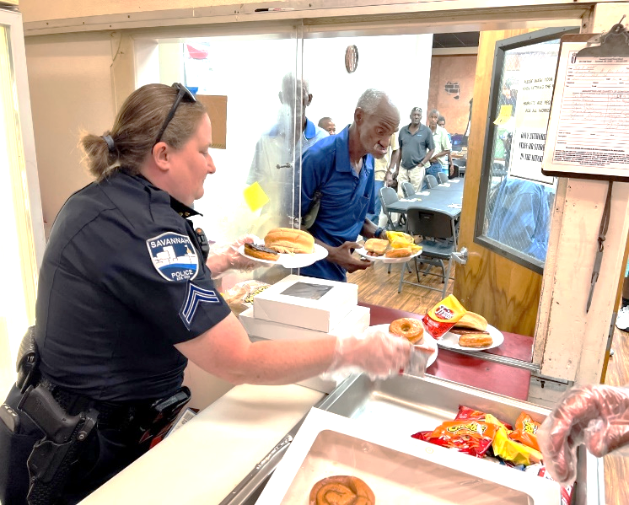
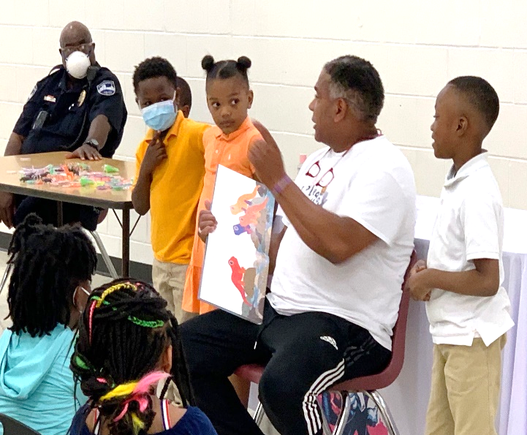
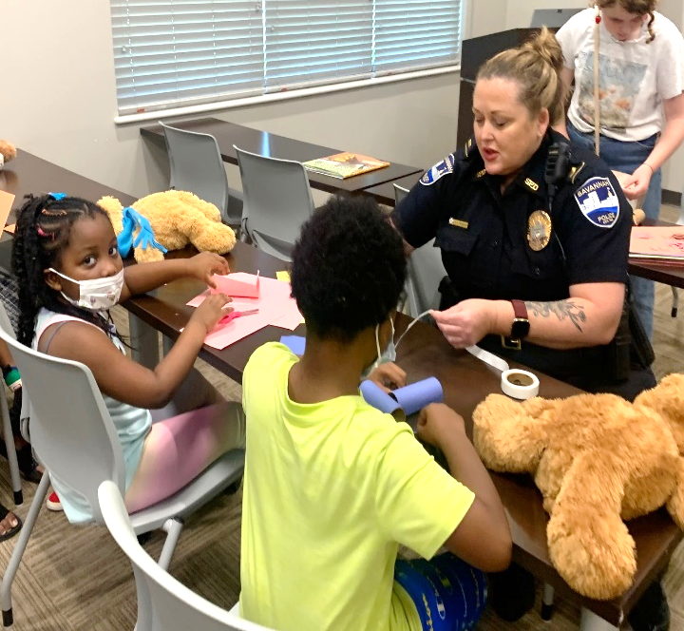
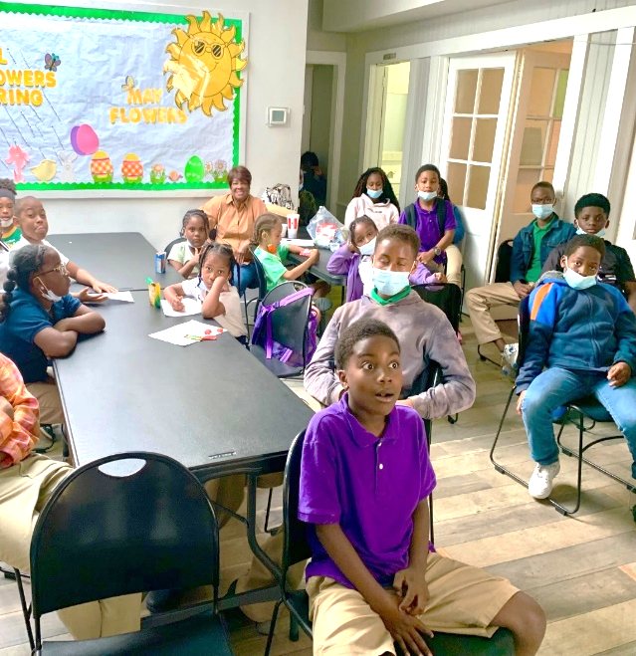
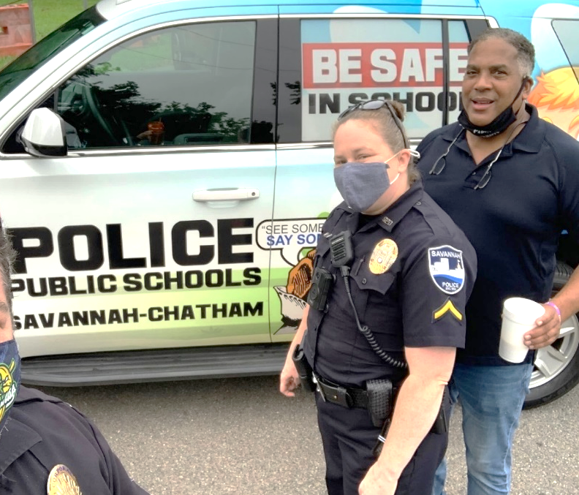
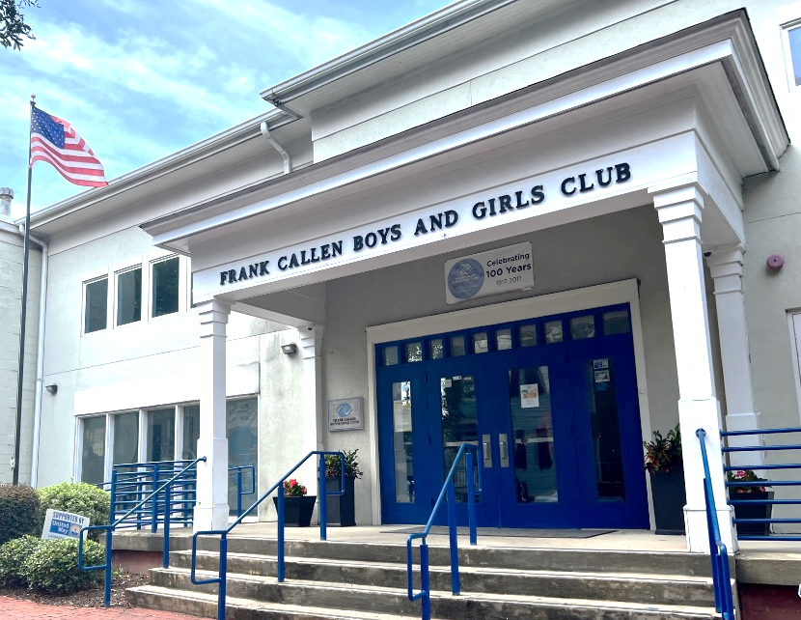
Community Partnerships

Slide 25
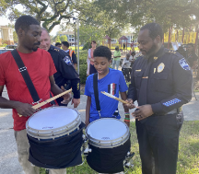
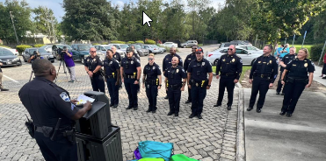
Roll Call in the Street
Notes:
The very popular Roll Call in the Streets will be back in the Spring.

Slide 26
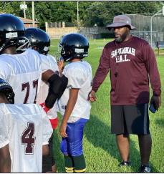
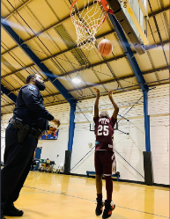
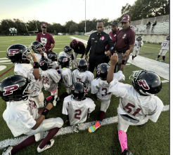
Police Athletic/Activities League (PALS)
Notes:
The PALS is back and stronger than ever.

Slide 27
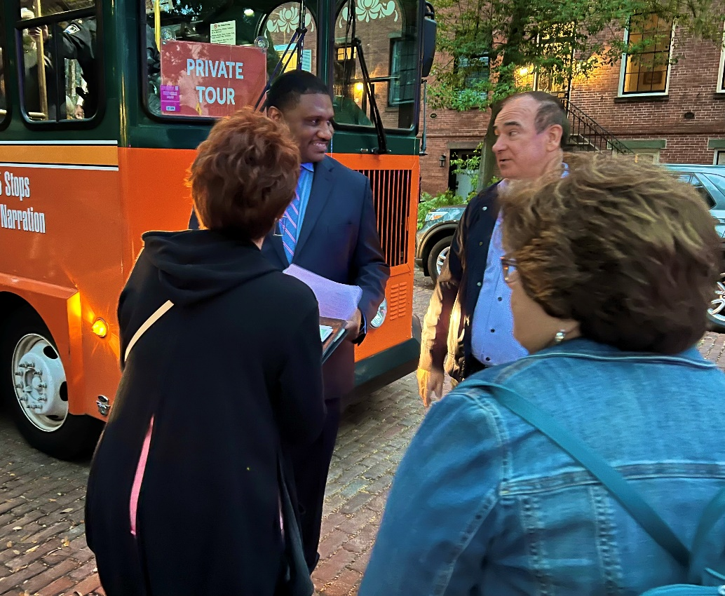
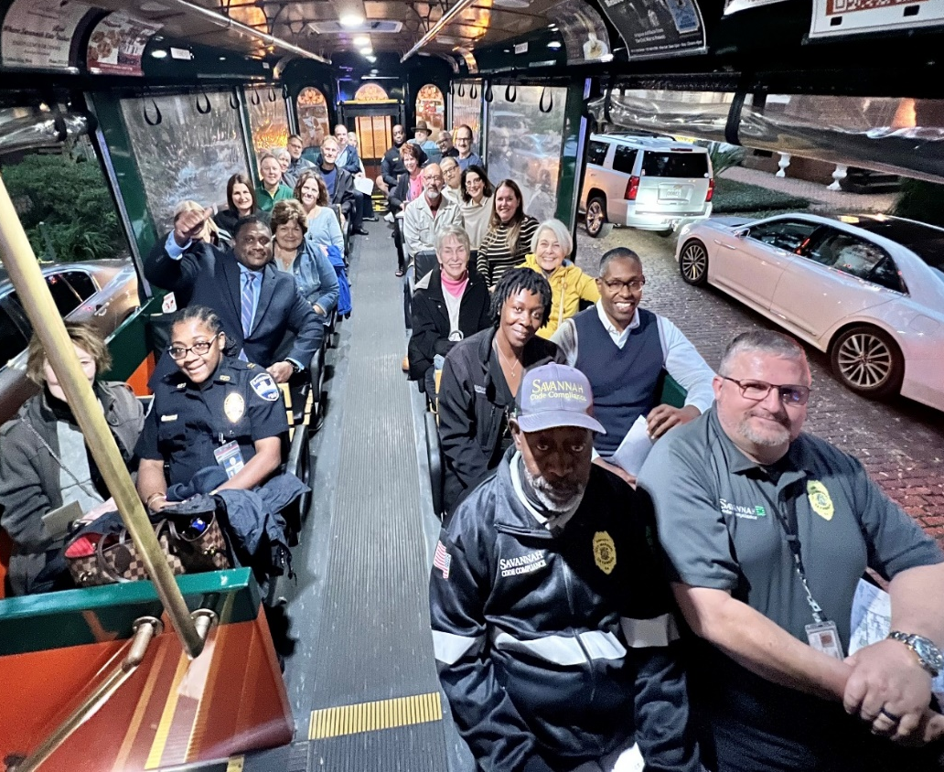
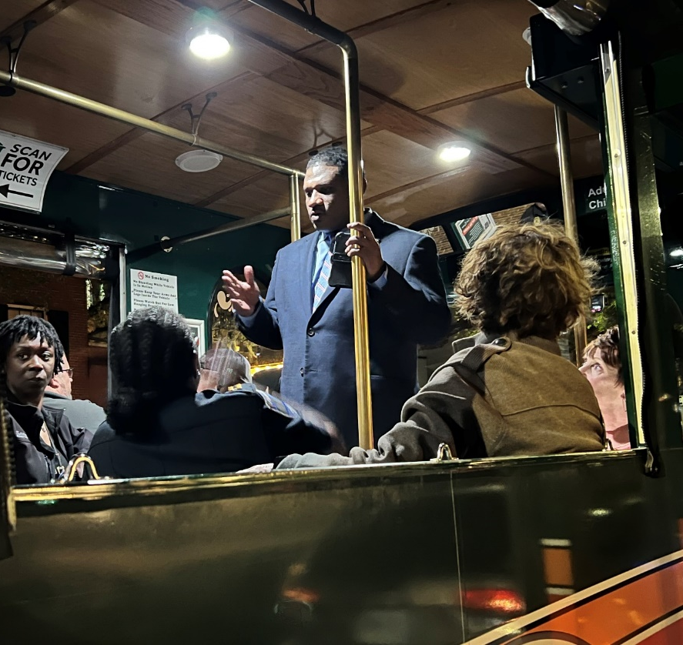
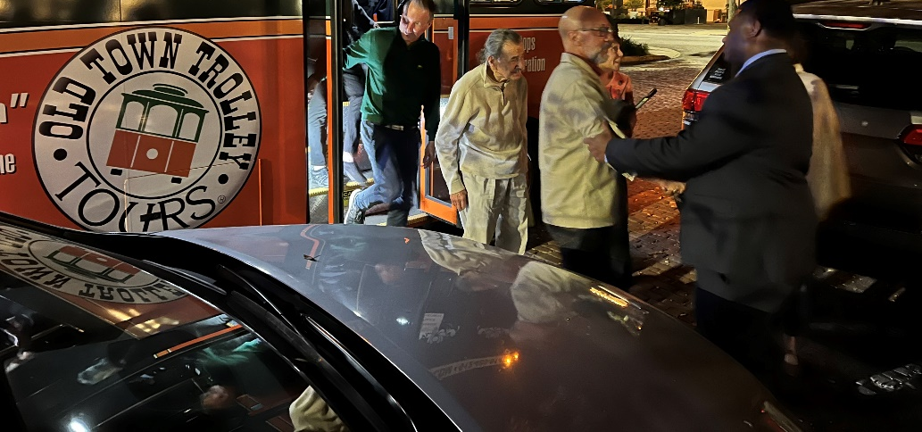
Tour and Talk
Notes:
We began this mobile – personal tour and talk last year and are planning to continue it in all of our districts. The tour consists of COS staff, neighborhood leaders and residents having a conversation about crime, quality of life issues, and most importantly – how we can work together.

Slide 28
Moving Forward
and
Achieving Service Excellence
Notes:
I will now change pace – and discuss several initiatives that we are working towards this year to continue our priority of achieving service excellence.

Slide 29
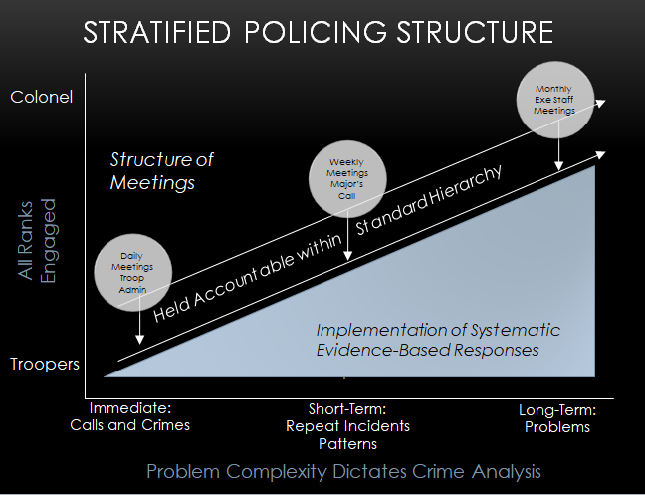
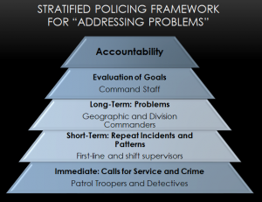
Stratified Policing
Innovative, Evidence – Based Organizational Framework
Proactive Crime Reduction
Increased Accountability
Working with the Community
Held Accountable
Notes:
Stratified Policing is an innovative, evidence – based organizational framework with specific methods designed to transform a police department’s day-to-day operations.
The goal is to create permanent changes that institutionalize proactive crime reduction strategies which will result in a long-term impact on crime.
Stratified policing will bring about organizational changes that focuses on the systematic reduction of violent crime, improved communication, and transparency (internally and externally with the community), as well as increased accountability for a new and elevated level of proactive crime reduction activity.
Officers will become more efficient in the use of their time and more effective because they are collaborating both with internal units and working with the community to solve problems.
Supervisors and commanders will become more engaged in crime reduction and will be held accountable on a consistent basis.

Slide 30
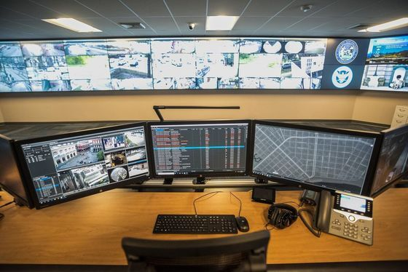
Real Time Crime Center (RTCC)
Cloud Based Platform to view both public, city, and community video sources for incident situational awareness and investigations.
Expedite Intelligence Gathering and Efficiency
Community – Facing Portal
Notes:
We are working with the City Manager towards his priority of the implementation of RTCC. Phase I is a cloud based platform that extracts and unifies live video, data, and sensor feeds from virtually any source – enhancing the situational awareness and investigative capabilities of law enforcement. The video collaboration platform will expedite intelligence gathering and efficiency of response to situations as they unfold throughout the community.
Further, the platform is tied to community – facing website portal for video camera registry allowing officers a tool for identifying the location of cameras in proximity to incidents, as well as a means for efficient outreach by officers to collect recorded video and image files from camera owners both public and private.

Slide 31
Community Board
Non-Profit and Community Organizations
Local, State, and Federal Law Enforcement Partnership
Community Members and City Leadership
Within the Community - For the Community
Notes:
We must engage our community stakeholders, city departments and the members of the police department in a directed and strategic approach to problem-solving.
We must understand what we are doing, with whom we are doing it, why we are doing it, and the outcome of the interaction.
A board will be created consisting of non-profit and community organizations, local, state, and federal law enforcement partnership, community members and city leadership to establish goals and do work within the community, for the community, to address community issues, crime, and giving a voice to the marginalized communities throughout our city.

Slide 32
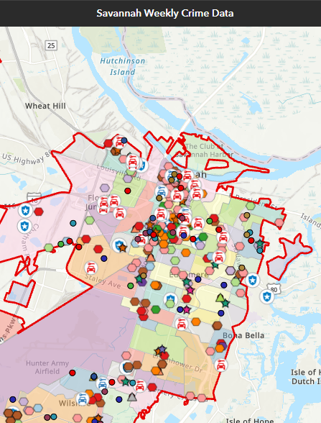
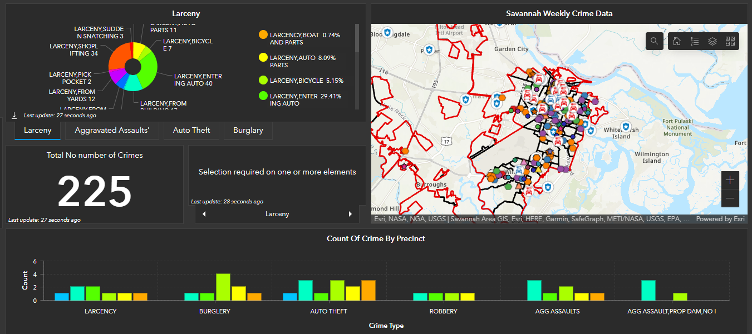
Dashboards
Forward Facing and Transparent Department
Provide Community Feedback
Various Displays
Notes:
SPD will become a more customer – driven / forward facing and transparent department. We will develop and make available data sets in the form of dashboards that will be housed on our website. The various dashboards will display crime statistics, use of force incidents, clearance rates, arrests, and traffic data.

Slide 33
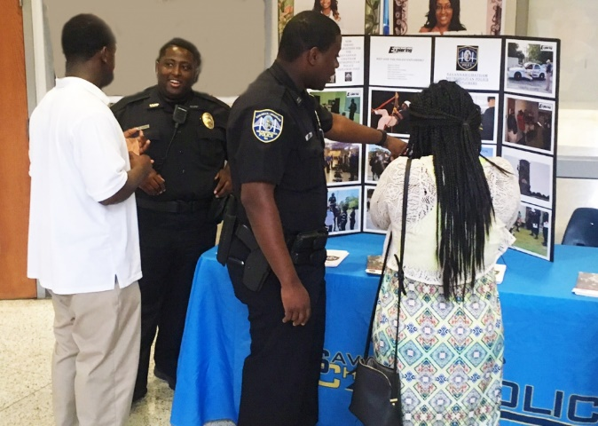
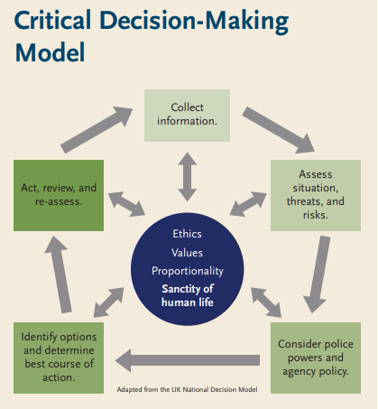
Cadet Program and ICAT
Cadet Program
Positive Engagement with Young Adults
Guidance and Mentoring
Right Path vs. Wrong Path
ICAT: Integrating Communications, Assessment, and Tactics
Department wide training
De-escalation of Critical Incidents
Critical Decision-Making Model
Notes:
Cadet Program - SPD will renew and restart it’s Cadet program which recruits young adults 16-20 years old who are interested in pursuing a career in law enforcement. This engagement will provide the “recruits” with a unique view of our department and serves to keep them from going down the wrong path.
ICAT - is a training program that provides first responding police officers with the tools, skills, and options they need to successfully and safely defuse a range of critical incidents.
Developed with input from hundreds of police professionals from across the United States, ICAT takes the essential building blocks of critical thinking, crisis intervention, communications, and tactics, and puts them together in an integrated approach to training.
ICAT is designed especially for situations involving persons who are unarmed or are armed with weapons other than firearms, and who may be experiencing a mental health or other crisis. The training program is anchored by a Critical Decision-Making Model that helps officers assess situations, make safe and effective decisions, and document and learn from their actions

Slide 34
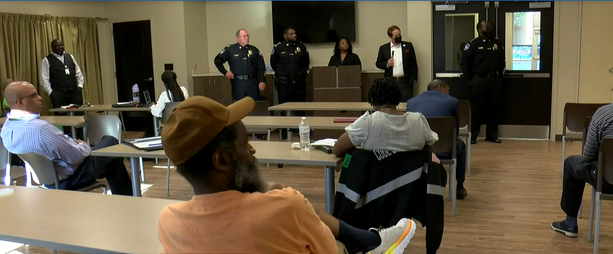
Eyes & Ears Program and Community Conversations
Eyes and Ears Program
If You See Something – Say Something
Force Multiplier
Shared Responsibility
Community Conversations
Community Forums
Improve & Strengthen Relationships
Accountability
Notes:
We are in the process of implementing a comprehensive Eyes and Ears program which will utilize : our local university's security and transportation staff, mass transit, hotel and business employees, share ride companies (Uber / Lyft), Amazon drivers, postal employees, COS staff and Community members.
Community Conversations Coming Soon
SPD will host community forums (in collaboration w/neighborhood presidents and leaders ) to not only develop shared goals and responsibilities, but to also improve and strengthen relationships. These community policing plans will foster buy – in and accountability. we need to have these crucial conversations to continue to deepen are relationship w/all of our neighborhoods.

