Slide 1
Savannah Fire Department City Council Presentation January 26, 2023 FIRE Chief eLZIE KITCHEN JR.

Slide 2
MOTTO
"...committed to those we serve"
VISION
MISSION
VALUES
We are committed to serving our community while preserving life and property.
We are committed to serving Savannah by continuously improving with a culture that encourages innovation, professionalism, and inclusion.
Communication
Open Minded
Motivated
Mastery of Skills
Integrity
Teamwork
Trust
Dedication

Slide 3
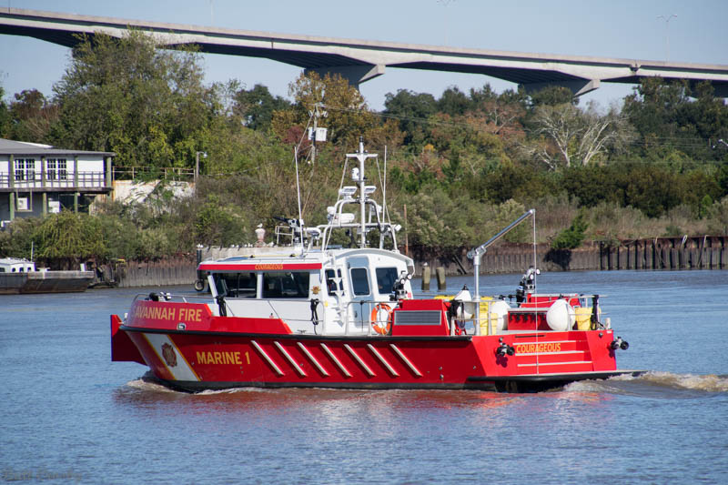
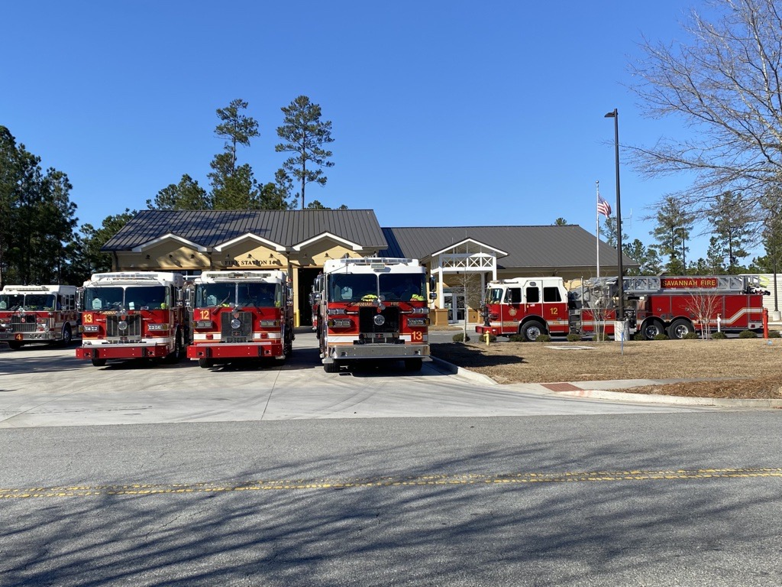
resources
326 Sworn Personnel
24 Administrative Staff
15 Fire Stations
15 Engines
5 Ladders
2 Heavy Rescues
2 Marine Units
6 Industrial Firefighting Equipment

Slide 4
Savannah Fire is the ONLY stand-alone department out of 30,000 departments that hold all 3 levels of accreditation
Only 300 departments
accreditation
Successfully passed the CFAI’s Annual Compliance Report
Marine program received re-accreditation from the National Association of State Boating Law Administrators (NASBLA)

Slide 5
RECOGNIZING OUR SAVANNAH FIRE FAMILY
Promotion of 9 SFD personnel including 3 Captains, and 6 Fire Engineers*
*FIRST Female African-American Fire Engineer
PROMOTIONS
RETIREMENTS
Proud to recognize the retirement of 8 SFD firefighters with between 15 and 28 years of service to the department combined 113 years of service/experience
PARTNERSHIPS
Critical Incident Stress Management (CISM) Team partnered with SPD to obtain Enhanced Critical Incident Training (E-CIT)
Partnered Red Cross
COMMENDATIONS
24 firefighters received commendations at the annual SFD Award Ceremony
Notes:
CISM / Peer Resource website
University of Kentucky

Slide 6
operations

Slide 7
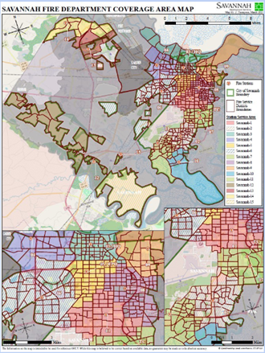
3-year incident data
Savannah Fire Department 3-year Incident Analysis
Years | Fires | Technical Rescues | Hazardous Materials | Emergency Medical | Non-Fires | Total Incidents
2022 | 908 | 257 | 766 | 5,120 | 5,047 | 12,098
2021 | 858 | 183 | 671 | 5,166 | 4,333 | 11,211
2020 | 920 | 187 | 688 | 1,531 | 4,217 | 7,543
Totals | 4,532 | 970 | 3,566 | 16,105 | 21,208 | 46,381
12,098 Total Incidents = 35,044 Total Apparatus Moves

Slide 8
2022 Response analysis
44.45% EMS/Rescue
11.36% Good Intent
7.51% Fires
6.95% Service Calls
29.74% All Other Types

Slide 9
2021 v. 2022 fires
5.8% Increase in total calls for service (12,098)
3.6% Decrease in Structure Fires

Slide 10
2022 fire analysis
SFD adopted NFPA 1710 to establish staffing and response benchmarks
Evaluation of response is based on 90th percentile
First unit arrived on scene 87% of the time within 4-minutes
Effective Response Force (ERF) meets the 8-minute benchmark 85% of the time.
10
Notes:
According to the Savannah Chamber of Commerce, the most recent data compiled shows Savannah has an average of 8 million visitors annually. Savannah’s tourists enjoy year-round activities. Although the busiest months in terms of visitation are April, May, and June, tourism activity is spread fairly evenly across the year.
This would equate to an average of approximately 670K visitors per month, 154K per week, or 22K per day.
For overnight visitors, the mix is 89% leisure travel and 11% business and business-leisure

Slide 11
Special operations
Hazardous materials
Technical rescue
Swift water rescue
Gas leaks, various
Marine rescue
11

Slide 12
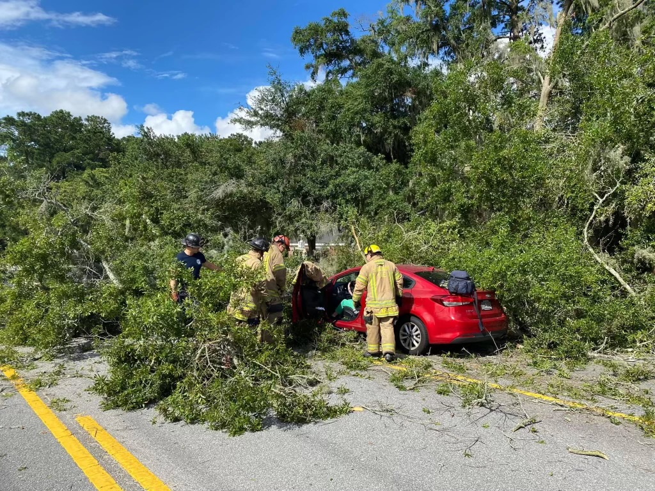
Special ops incidents

Slide 13
EMERGENCY Medical services

Slide 14
EMS 2022
SFD completed second full year of EMS expansion
129 CPR Administrations
126 Narcan Administrations
Total EMS Calls:
2022: 5120
2021: 5,166
2020: 1,531
Notes:
237% increase 2020 to 2021

Slide 15
Savannah fire saves
12 lives saved via swift fire and water rescue responses
LIVES SAVED
3rd year with ZERO Fire Deaths
National average for CPR survivability is 12%
Currently SFD has a 14% survivability year to date
The highest monthly survival rate was May at 33%.
3 family pets including cats & dogs
ANIMALS SAVED

Slide 16
Advantages of SFD response to EMS incidents
Strategically located stations, trained firefighters, and equipped to quickly reach service call areas
4 minutes average response time compared
Enable CEMS to transport the patient rapidly
Provide an EMS force multiplier administered care
Partnership enables the closest SFD and CEMS units for EMS incidents
EIGHT CRITICAL INCIDENTS
BURNS
CARDIAC ARREST
CHOKINGS
DROWNINGS
ELECTROCUTION
SHOOTING
STABBING/CUTTING
UNCONSCIOUS PERSON
Notes:
Because fire stations are strategically located and firefighters are trained and equipped to quickly reach a service call, they can, and often do when appropriate, provide the quickest response to an emergency.
SFD average response time 4 minutes, allowing patient care to begin
CEMS standard response time is 8 minutes in the City of Savannah proper
12 minutes in the annexed areas of Northwest Chatham County and Southwest Chatham County
Enable CEMS to transport the patient rapidly.
The cost for this service is minimal and will be for fuel, apparatus maintenance, and an increase in EMS supplies.
Public Safety is achieved when City Government and the Community work together to create a City where people feel safe in their neighborhoods and where the crime rate is low.
On any given day, the public’s safety is of primary importance in the minds of City leaders as they put policies in place, allocate resources and work to provide protection and enforcement for Savannah’s residents, businesses, and guests.
Emergency Medical Calls were evaluated by the University of Georgia’s (UGA) Savannah Fire Department (SFD) Organizational Assessment.
In the City of Savannah’s Savannah Forward: Strategic Plan 2017-2020, the following objectives were established
Strategic Goal: #1.4 Medical 911 BLS and ALS Support Services
By 2023, Savannahians making 911 calls for an emergency medical incident will receive first responder or higher-level services within 5 minutes or less, at least 90% of the time.
Objective 1 - EMS Response Ready by 2021
Objective 2 - EMT-Basic Response by 2023
Strategic Goal: #1.5 Fire Rescue Department Advanced Life Support Services
Objective 3 - ALS Response by 2025, the Fire Rescue Department shall provide an advanced life support (ALS) response within 8 minutes at least 90% of the time.
Savannah Fire started shift-friendly EMT courses in 2018
The new Fire Chief arrived in 2019 and began discussions with Chatham Emergency Medical Services (EMS) and the Chatham County E911 Center
Savannah City Council agreed to implement a new emergency medical services partnership starting November 2, 2020, as part of their effort to enhance City services
In 2021 SFD was ready to expand EMS delivery beyond auto accidents to the community.
SFD collaborated with Chatham Emergency Services and the Chatham County E-911 center to develop a response strategy with agencies working in unison to provide life-saving care.
This is well ahead of the proposed implementation date in 2023
All three partners have diligently worked to develop a strategy to enhance response.
Savannah Fire will be responding with CEMS on the following EMS call types:
Burns
Cardiac Arrest
Choking
Drowning/Water Rescue
Drug Overdose
Electrocution
Shooting
Stabbing
Traumatic Injury
Unconscious Person
CEMS can requested SFD for other call types
Partnership enables the closest SFD and CEMS units for EMS incidents
SFD started responded to EMS incidents in December 2021

Slide 17
logistics

Slide 18
2022 fire prevention

Slide 19
2022 fire prevention
Increased total revenue received from 2021 to 2022 by $189,183 (72%)
Fire Inspection Fees increased by 504%
Fire Protection fees increased by 8.6%
Fire Incident Report fees increased by 175%
Fire Equipment User fees increased by 724%
Notes:
Fire protection Fees = Elba Island, Warehouse rentals

Slide 20
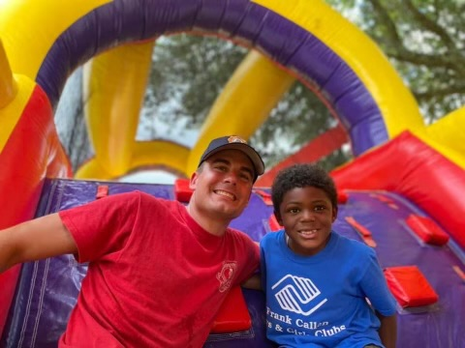
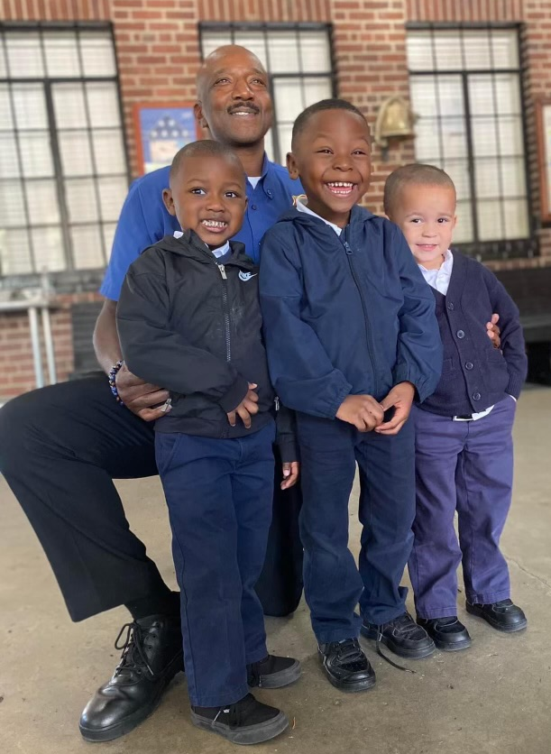
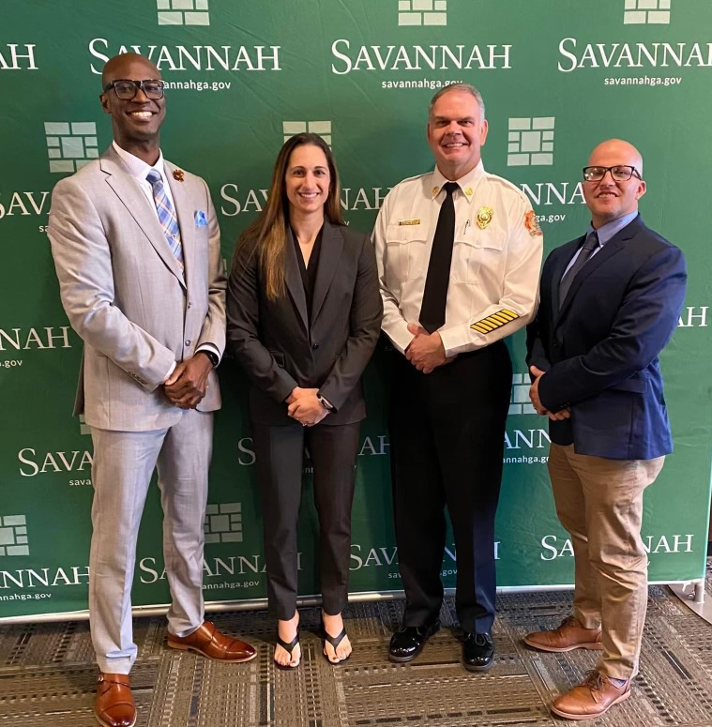
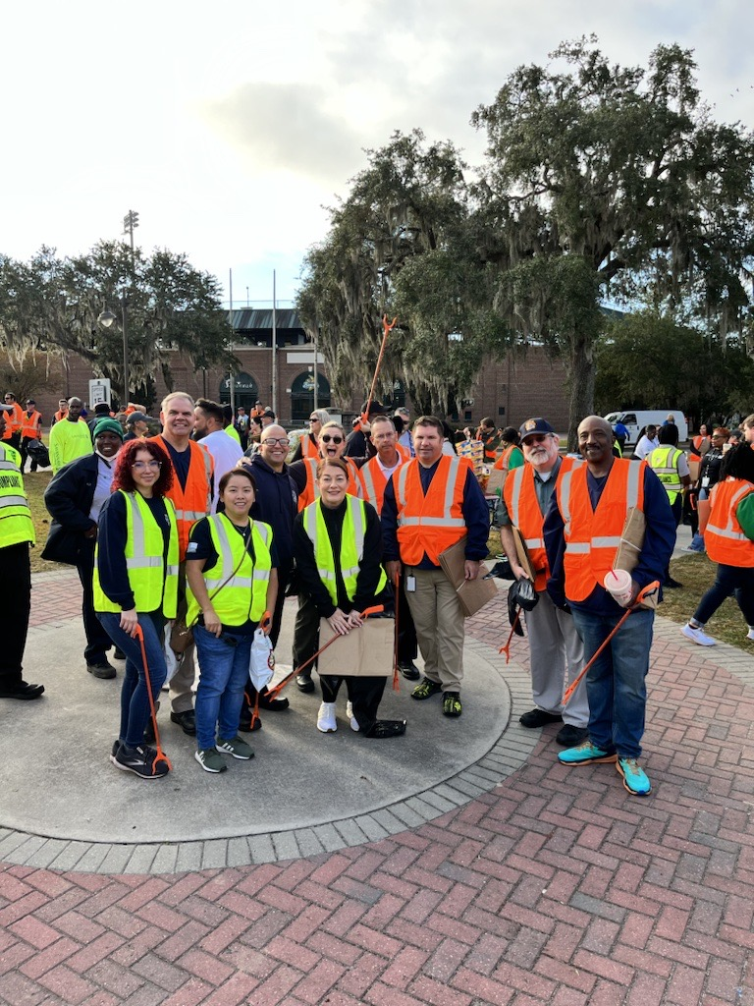
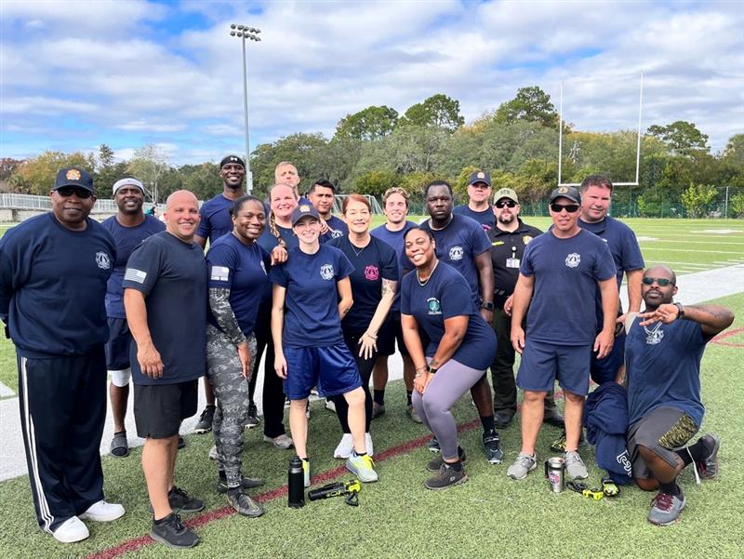
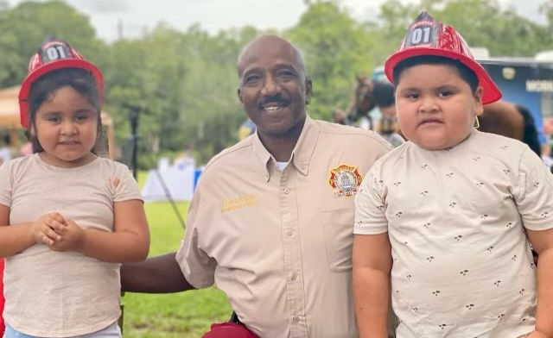
Engaging

Slide 21
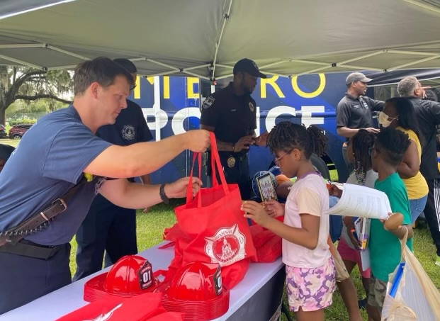
Educating
SFD continues to provide safe, accessible Public Fire Safety Education Events.
Fire Personnel participate in:
Community Fire Blitz events
Neighborhood Association Meetings
Station Tours
School Visits (Friendly Firefighter)
Blood Pressure Screening Clinics
Home Safety Checks

Slide 22
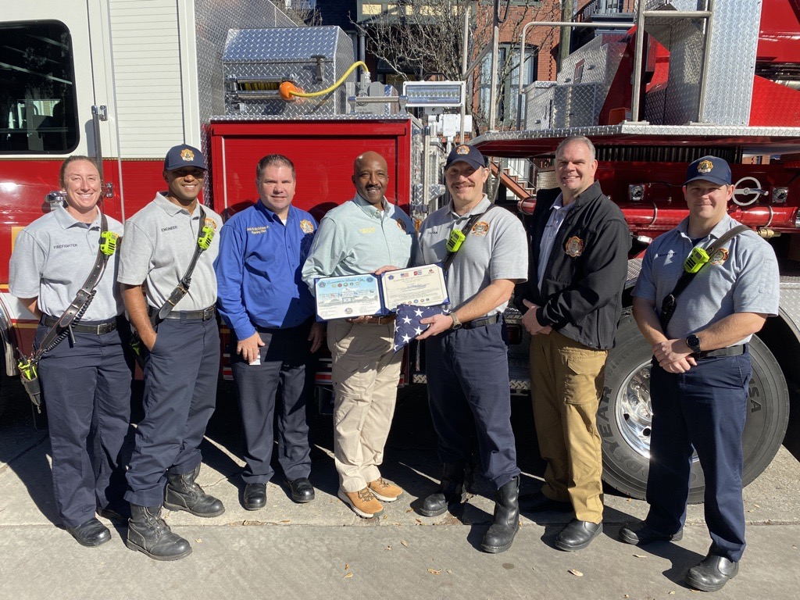
Savannah fire serves
Captain Scott Boyd presents SFD with flag & certificate obtained during his deployment in the United States Coast Guard
City Council presented an award to Captain Irving Nichols, Fire Engineer Darren Lampley and Advance Firefighter Logan Gutierrez
2 lives were saved in a fire in July 2022 as a result of Fire Safety Education provided and fire alarms installed on May 21, 2022, during blitz in Avondale neighborhood

Slide 23
2022 Training
Savannah Fire Department’s
Training Division
has logged an impressive
102,357 Hours

Slide 24
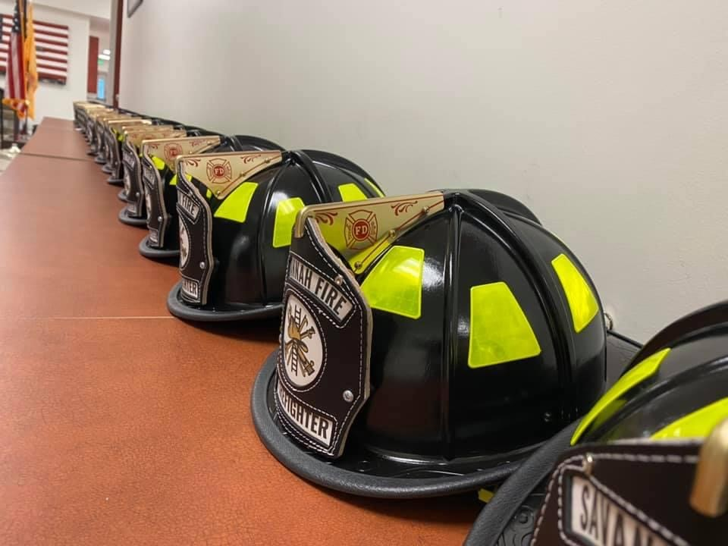
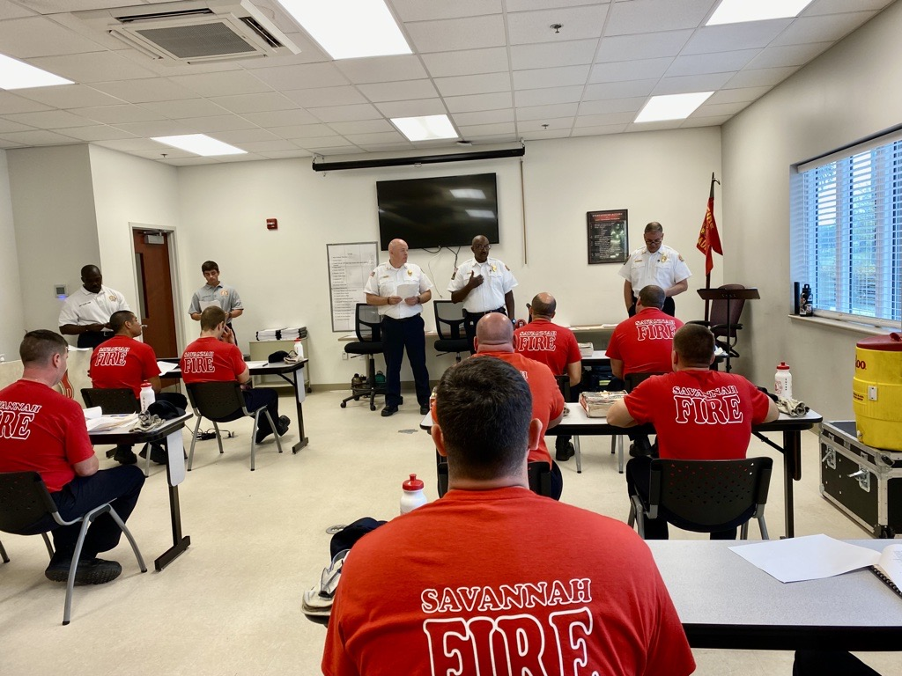
Career development
15 Certified Instructor I
19 Certified Fire Officer I
10 Certified Fire Officer II
8 Certified EMT
8 HazMat Tech
2 Fire Life & Safety Educator
1 Certified Youth Fire Setter
1 Certified Fire Investigator
10 New Hires Certified to FFI, FFII, HazMat Awareness & Operations, and First Responder

Slide 25
Emergency management

Slide 26
Only 300 departments
Protecting our community
Emergency preparedness earned the City of Savannah the National Weather Service Storm Ready designation
EM Director spearheaded the development of a municipal Emergency Management program caucus as part of the International Association of Emergency Managers (IAEM)

Slide 27
Community collaborations
PROVIDED EFFECTIVE COORDINATION FOR LARGE-SCALE INCIDENTS
Evacuation & shelter in place exercise
Public INFORMATION OFFICERS tabletops
Mass rescue operations exercise w/uscg
INFRASTRUCTURE & DEVELOPMENT • SPD • E911 • CEMA
GEMA • RED CROSS • GEORGIA PORTS • OTHER COMMUNITY PARTNERS
27

Slide 28
Future vision

Slide 29
Vision 2023 and beyond
INTERNAL
EXTERNAL
Continue to follow my 100-Day Plan
Reorganize the organizational chart
Work with the DEI Officer to examine and revise SFD’s policies, practices, and procedures through a DEI lens
Review the response packages
Implement a QRV pilot program
Develop the first Public Safety facility at New Hampstead
Explore other revenue sources
Apply for SAFER and AFG grants
Develop “Camp Ignite" and “Explorer Program” (w/ Boys Scout)
Offer hands only CPR and stop the bleed at community events
Work with HR to assist in providing hands only CPR, stop the bleed, and active shooter training to City staff
Work with Chatham E911 to implement CAD
Start the accreditation process for SFD’s police department
Notes:
My plan will serve as a guide for me through the first 100 days in my new role. The plan consists of goals and objectives to identify and engage key stakeholders and build relationships, understand your perspectives, and gain traction quickly so I can set up a foundation for long-term success in the organization.
Meet with the Crews at their Stations
Revise the Strategic Plan to provide a roadmap for the Department’s mission, vision, and values. Ensure it aligns with the City’s goals and objectives.
he guiding principles of this
document will provide a framework for how we diversify the department, improve working
conditions for all members, and provide even better service to the community.
Work with the DEI Officer to examine and revise SFD’s policies, practices, and procedures through a DEI lens
Engage neighborhood organizations and community members in the hiring process to enhance the diversity of recruit classes and to highlight the importance of inclusivity and community partnerships.
Start the accreditation process for SFD’s police department.
Camp Ignite: teen girls a chance to see what life is like as a first responder. Women make of 5% of the Fire service.
for girls age 15-18 years old to participate in fire related activities. Our mission is to introduce young women to the fire service through activities such as:
Providing hands on experience in a positive, team building environment;
encouraging and supporting self-confidence and a can do work ethic;
Experiencing structural firefighter activities;
Experiencing rope/ocean rescue activities;
Experiencing SLO City Ladder Truck Operations;
77.3% of Firefighters are White (Non-Hispanic), making that the most common race or ethnicity in the occupation. Representing 6.91% of Firefighters, Black (Non-Hispanic) is the second most common race or ethnicity in this occupation. This chart shows the racial and ethnic breakdown of Firefighters

Slide 30
Thank you

