Slide 1
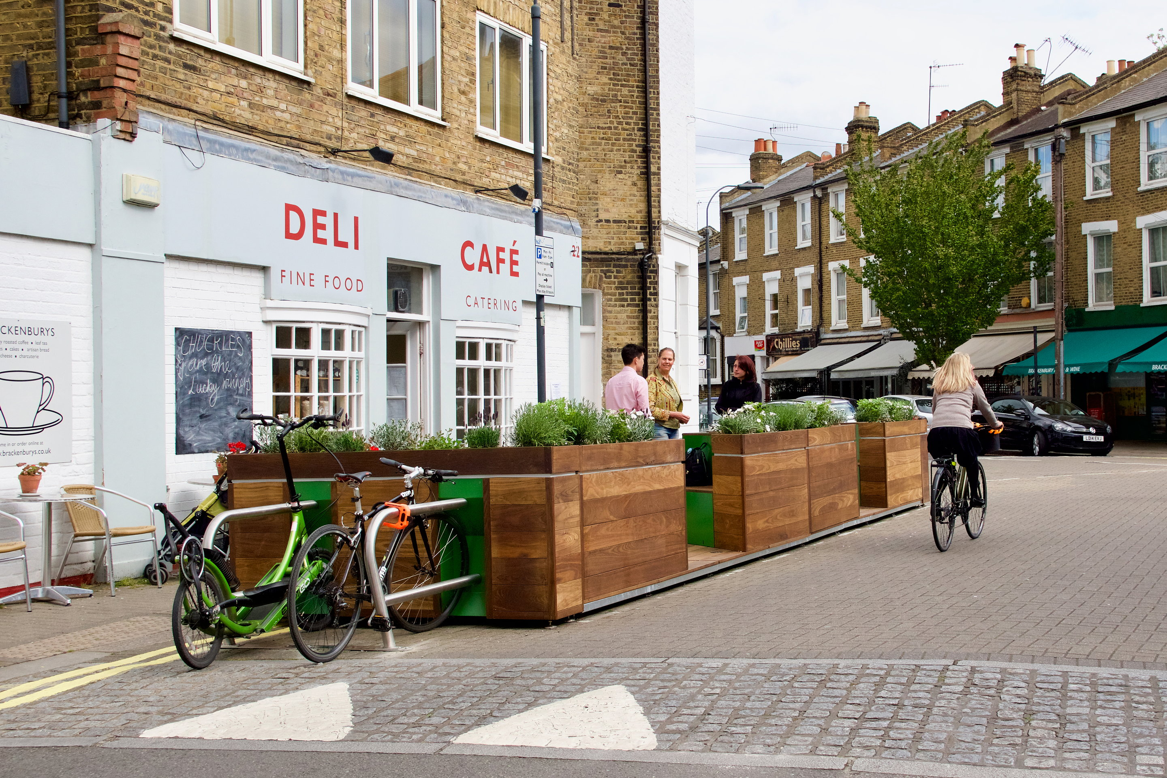
Parklet Program
City of Savannah Office of Special Events, Film, and Tourism

Slide 2
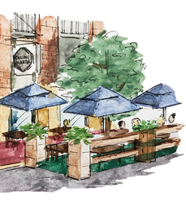
What is a Parklet?
Parklets are public seating platforms that convert curbside parking spaces into vibrant community spaces. Also known as street seats or curbside seating, parklets are the product of a partnership between the city and local businesses, residents, or neighborhood associations.
Most parklets have a distinctive design that incorporates seating, greenery, and/or bike racks and accommodate unmet demand for public space on thriving neighborhood retail streets or commercial areas. A Parklet may be thought of as semi-permanent, but must be designed for quick and easy removal in case of an emergency, or other reasons such as utility work, without damaging the curb or street.
City of Savannah Office of Special Events, Film, and Tourism Parklets

Slide 3
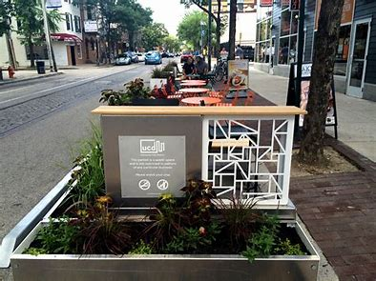
Parklet Pilot Program
In response to the COVID-19 pandemic, the City of Savannah initiated a Parklet Program in June of 2020.
extended the program several times during 2020-2021
48 approved applicants - 60 applicants total
Remove all parklets by March 8th, 2021 on Broughton Street
Remove all parklets by July 1, 2021
City of Savannah Office of Special Events, Film, and Tourism Parklets

Slide 4
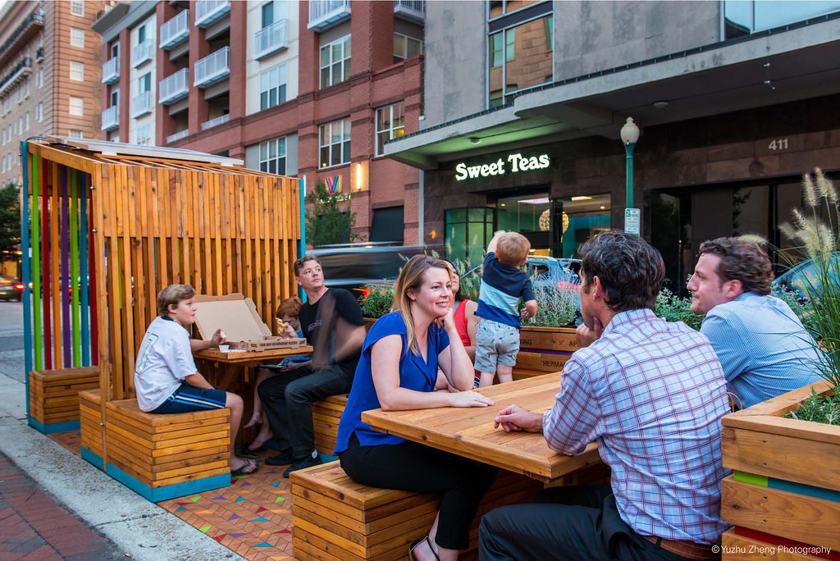
Development Process
Researched parklets nationally
Restaurant owner input was gathered
Met with Restaurant Association Leadership
National Association of City Transportation
Officials- Guidelines and regulations for safe and effective parklets
Received input from essential City departments- Parking Services, Traffic Engineering, Mobility and Parking, and Stormwater on the needs and design of a parklet
City of Savannah Office of Special Events, Film, and Tourism Parklets

Slide 5
Development Process
Developed a policy based on those needs and national guidelines
Restricted the use of Broughton Street based on the new streetscapes' layout and the extended sidewalk capacity, which allows for more café seating
Development of Pricing- researched the price of parklets in other cities, the price per square foot of restaurant real estate in Historic Savannah, calculated and confirmed the cost of parking spaces in Downtown Savannah
City of Savannah Office of Special Events, Film, and Tourism Parklets July 8, 2022

Slide 6
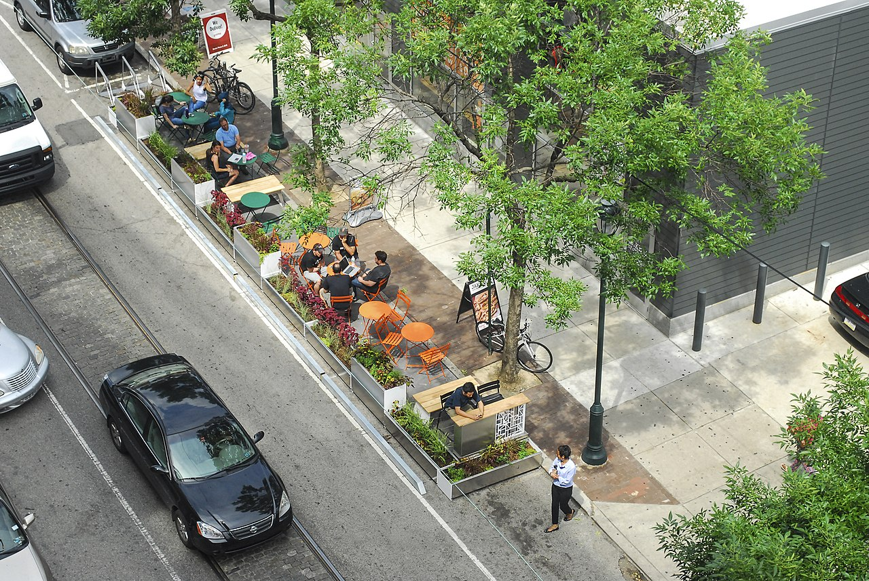
Parklet Locations
Approved Parklet Locations
Within on-street parallel or angled public parking spaces
In areas with existing pedestrian activity due to the presence of retail, mixed-use, commercial or high-density residential development
On streets with a posted speed limit of 25mph or less
(30mph on a case-by-case basis)
In spaces where parking is permitted during all
hours of the day/night.
City of Savannah Office of Special Events, Film, and Tourism Parklets July 8, 2022

Slide 7
Parklet Highlights
Prohibited Parklet Locations
Any State Route
Broughton Street – Sidewalk Cafés permitted with wider sidewalks
Within 10’ of a City stormwater catch basin
Within 30 feet of stop signs, yield signs or traffic signals
Within 20 feet of crosswalks
Within 15 feet of driveways or bus stops
In parking spaces with a running slope greater than or equal to 5%
Above utility holes or other utility access
Within 15 feet of fire hydrants, stand pipes, or Fire Department connections
Where resurfacing or other street improvements are scheduled to occur within 1 year
In loading zones, freight zones, tour stands, or accessible parking spaces
In any location deemed to be a traffic safety hazard by the City’s Traffic Engineering Department.
City of Savannah Office of Special Events, Film, and Tourism Parklets

Slide 8
Parklet Highlights
Design Guide
Dimensional Requirements
To ensure visibility to moving traffic and parking cars, parklets must be buffered using a wheel stop at 4 feet from each end of the parklet.
Parklets shall have a minimum width of 6 feet, including all associated buffers and materials, but shall not extend beyond the width of the parking stall.
Parklets may convert up to two (2) consecutive parallel parking spaces or up to four angled parking spaces, and may vary according to the site, context, and desired character of the installation, as permitted by the City.
City of Savannah Office of Special Events, Film, and Tourism Parklets

Slide 9
Parklet Highlights
Design Guide
Dimensional Requirements
Additional shy distance (space left between vehicles and pedestrians as they pass each other) from travel lanes may be required when the adjacent street has a speed of 25mph or greater.
25mph roadway—1’ minimum buffer from adjacent travel lanes
30mph roadway—2’ minimum buffer from adjacent travel lanes
Any overhead elements projecting over the sidewalk must provide a minimum of 108 inches of vertical clearance and may not interfere with the visibility of any traffic or wayfinding signage.
City of Savannah Office of Special Events, Film, and Tourism Parklets

Slide 10
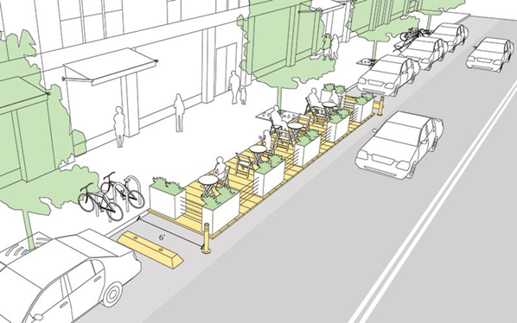
City of Savannah Office of Special Events, Film, and Tourism Parklets

Slide 11
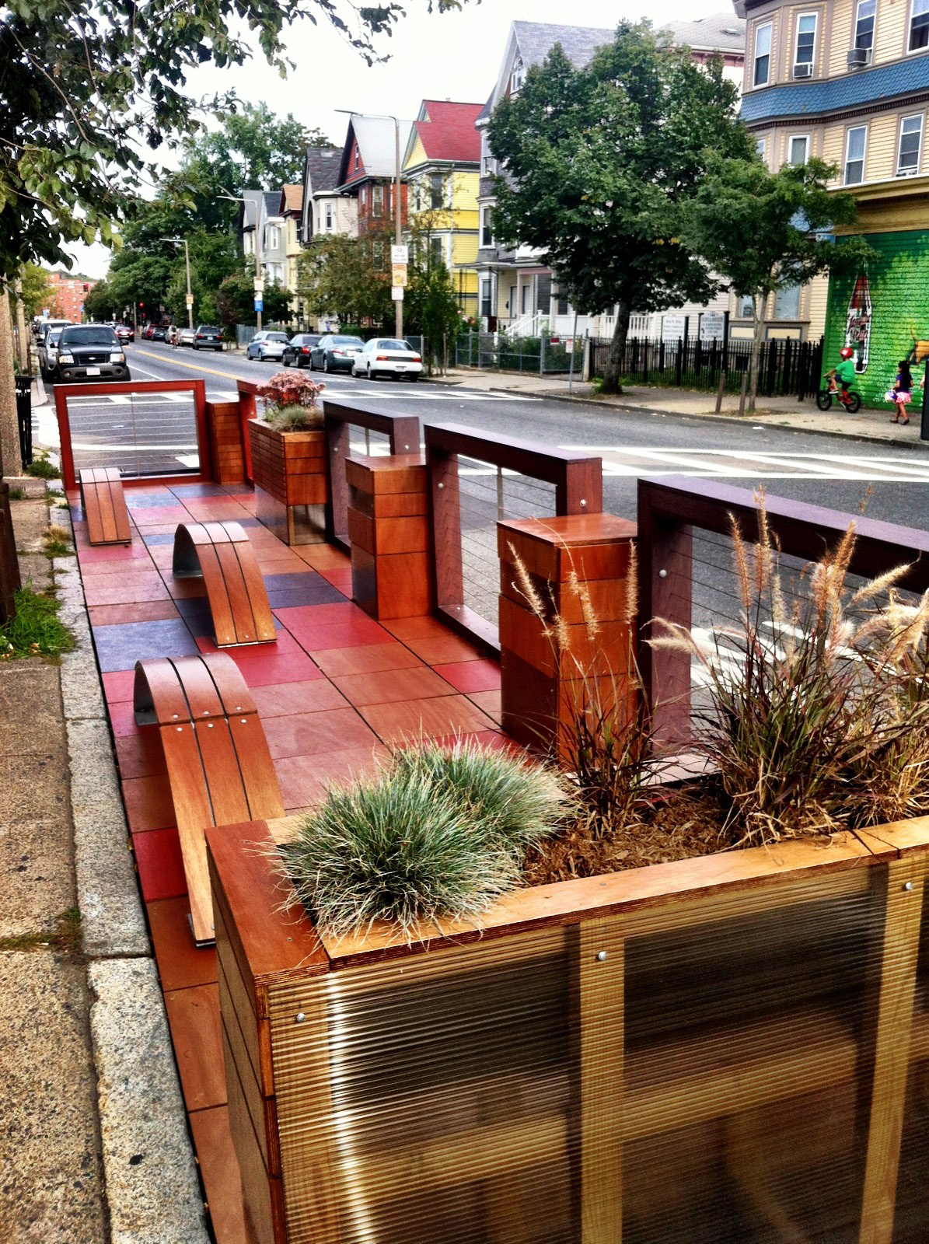
Parklet Highlights
Design Guide
Design Requirements
Parklets shall:
Be visually distinguishable from any adjacent private cafes or seating areas
Have vertical elements that make them visible to traffic, such as flexible posts or bollards
Maintain a visual connection from the street to the sidewalk
Remain visually permeable to allow views into the space from both the sidewalk and roadway. Continuous opaque walls above 36 inches that block the view from the street into the Parklet are prohibited
Maintain adequate sight distance from any driveway or street intersection
City of Savannah Office of Special Events, Film, and Tourism Parklets

Slide 12
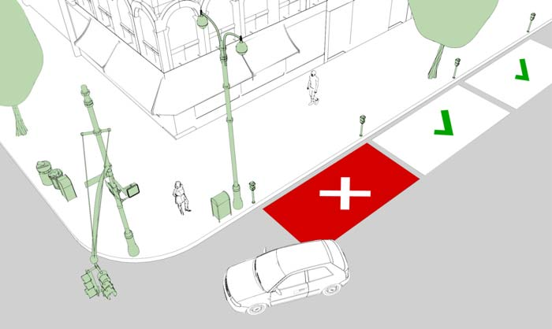
https://nacto.org/publication/urban-street-design-guide/interim-design-strategies/parklets/
City of Savannah Office of Special Events, Film, and Tourism Parklets

Slide 13
Parklet Highlights
Design Guide
Design Requirements
Parklets shall:
Shall be buffered from adjacent parking spaces and vehicular travel lanes. Such buffers may take the form of planters, railing, cabling, or other mechanisms deemed appropriate by the City.
Have the ability to be completely removed within 48 hours of notice without damaging any curb, sidewalk, drainage structure, or underlying roadway. (all parklet items and materials must be stored and secured out of the City’s right-of-way.)
Maintain adequate sight distance from any driveway or street intersection.
No portion of the Parklet may be glued, nailed, bolted, cemented, or otherwise affixed to the street or curb.
City of Savannah Office of Special Events, Film, and Tourism Parklets

Slide 14
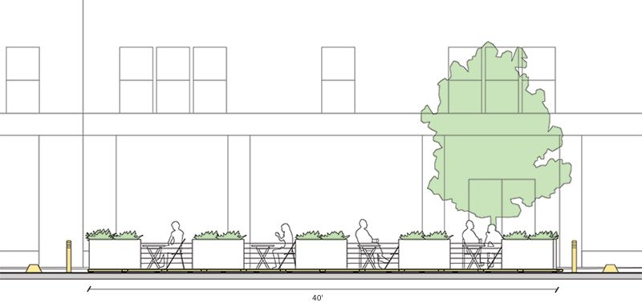
Parklet Highlights
Design Guide
https://nacto.org/publication/urban-street-design-guide/interim-design-strategies/parklets/
City of Savannah Office of Special Events, Film, and Tourism Parklets

Slide 15
Parklet Highlights
Design Guide
Construction Requirements
Parklets must be constructed to be load bearing to a maximum of 750 lbs. per square foot.
Parklets shall maintain a flush transition at the sidewalk and curb to permit ease of access and avoid tripping hazards.
The design of a parklet shall not inhibit the adequate drainage of stormwater runoff. Channels between the base street and the platform must allow for the free flow of stormwater to facilitate drainage.
Sheet flow drainage in streets and curb lines shall not be obstructed.
Stormwater structures, to include catch basins and manholes, shall not be covered or obstructed.
Each Parklet shall be designed to be accessible in accordance with the Americans with Disabilities Act (ADA).
Parklet platforms must not exceed a 2% cross slope.
Reflective elements shall be installed on Parklet corners for visibility.
City of Savannah Office of Special Events, Film, and Tourism Parklets

Slide 16
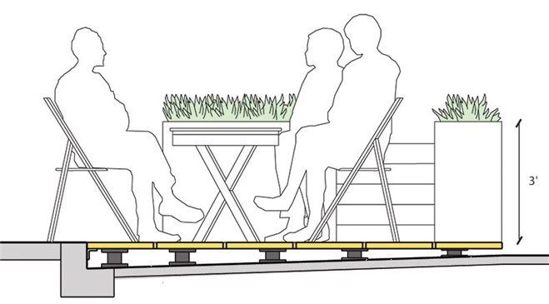
Parklet Highlights
Design Guide
https://nacto.org/publication/urban-street-design-guide/interim-design-strategies/parklets/
City of Savannah Office of Special Events, Film, and Tourism Parklets

Slide 17
Parklet Fee Structure
Application and Permit Processing Fee | $300.00
Parking Space Rental First Space / year | $3,000.00
Parking Space Rental Second Space / year | $1,500.00
$8.22/day – 1 Space per Day
$12.33/day – 2 Spaces per Day
City of Savannah Office of Special Events, Film, and Tourism Parklets

Slide 18
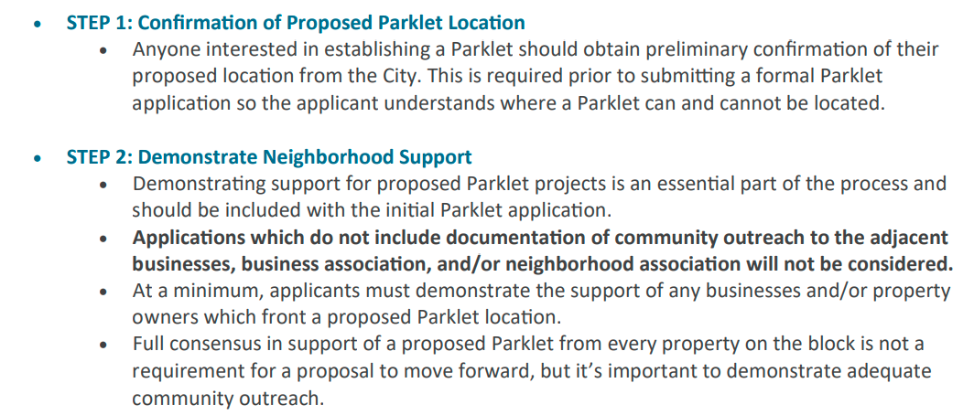
Parklet Highlights
How to obtain permission for a Parklet?
City of Savannah Office of Special Events, Film, and Tourism Parklets

Slide 19
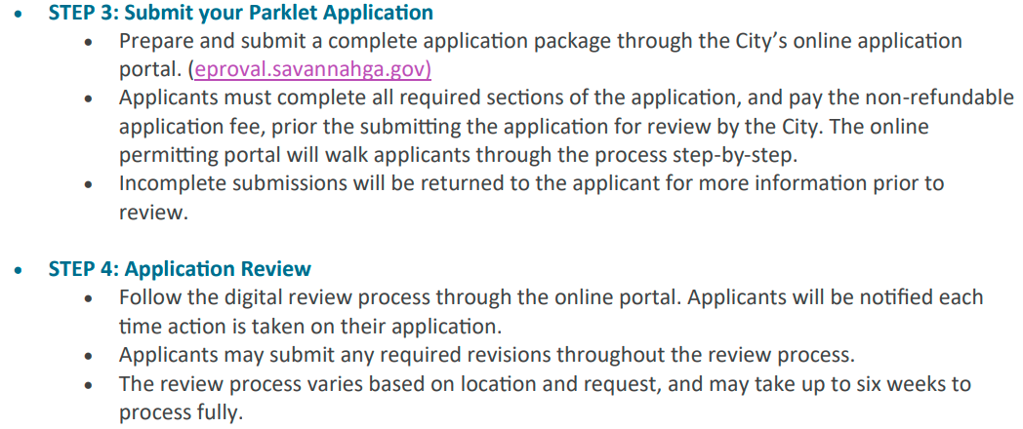
Parklet Highlights
How to obtain permission for a Parklet?
City of Savannah Office of Special Events, Film, and Tourism Parklets

Slide 20
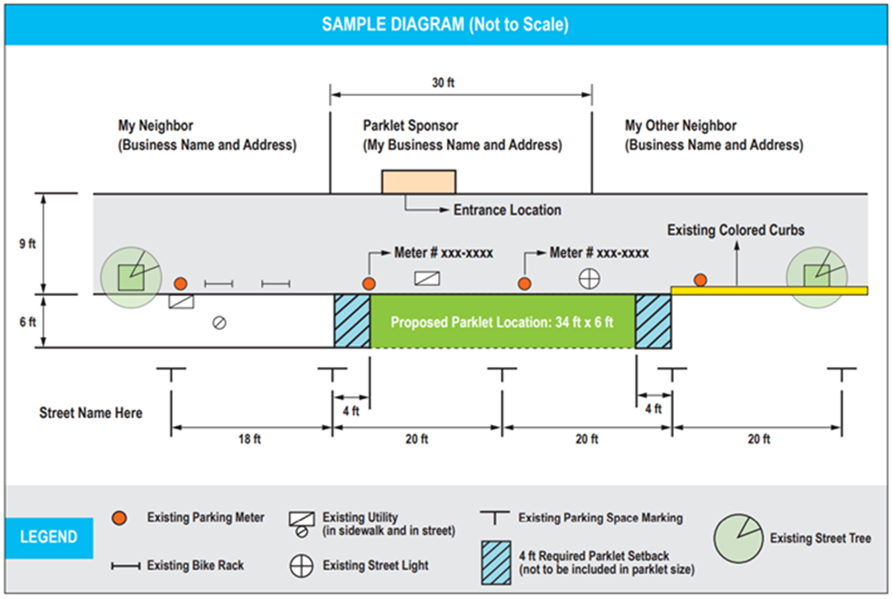
Parklet Highlights
How to obtain permission for a Parklet?
City of Savannah Office of Special Events, Film, and Tourism Parklets

Slide 21
Parklet Highlights
Issues Still to be Considered
Fees for Parklets
Design Guidelines for Furniture
Dispensing Alcohol
Approvals on Blocks
City of Savannah Office of Special Events, Film, and Tourism Parklets

