Slide 1
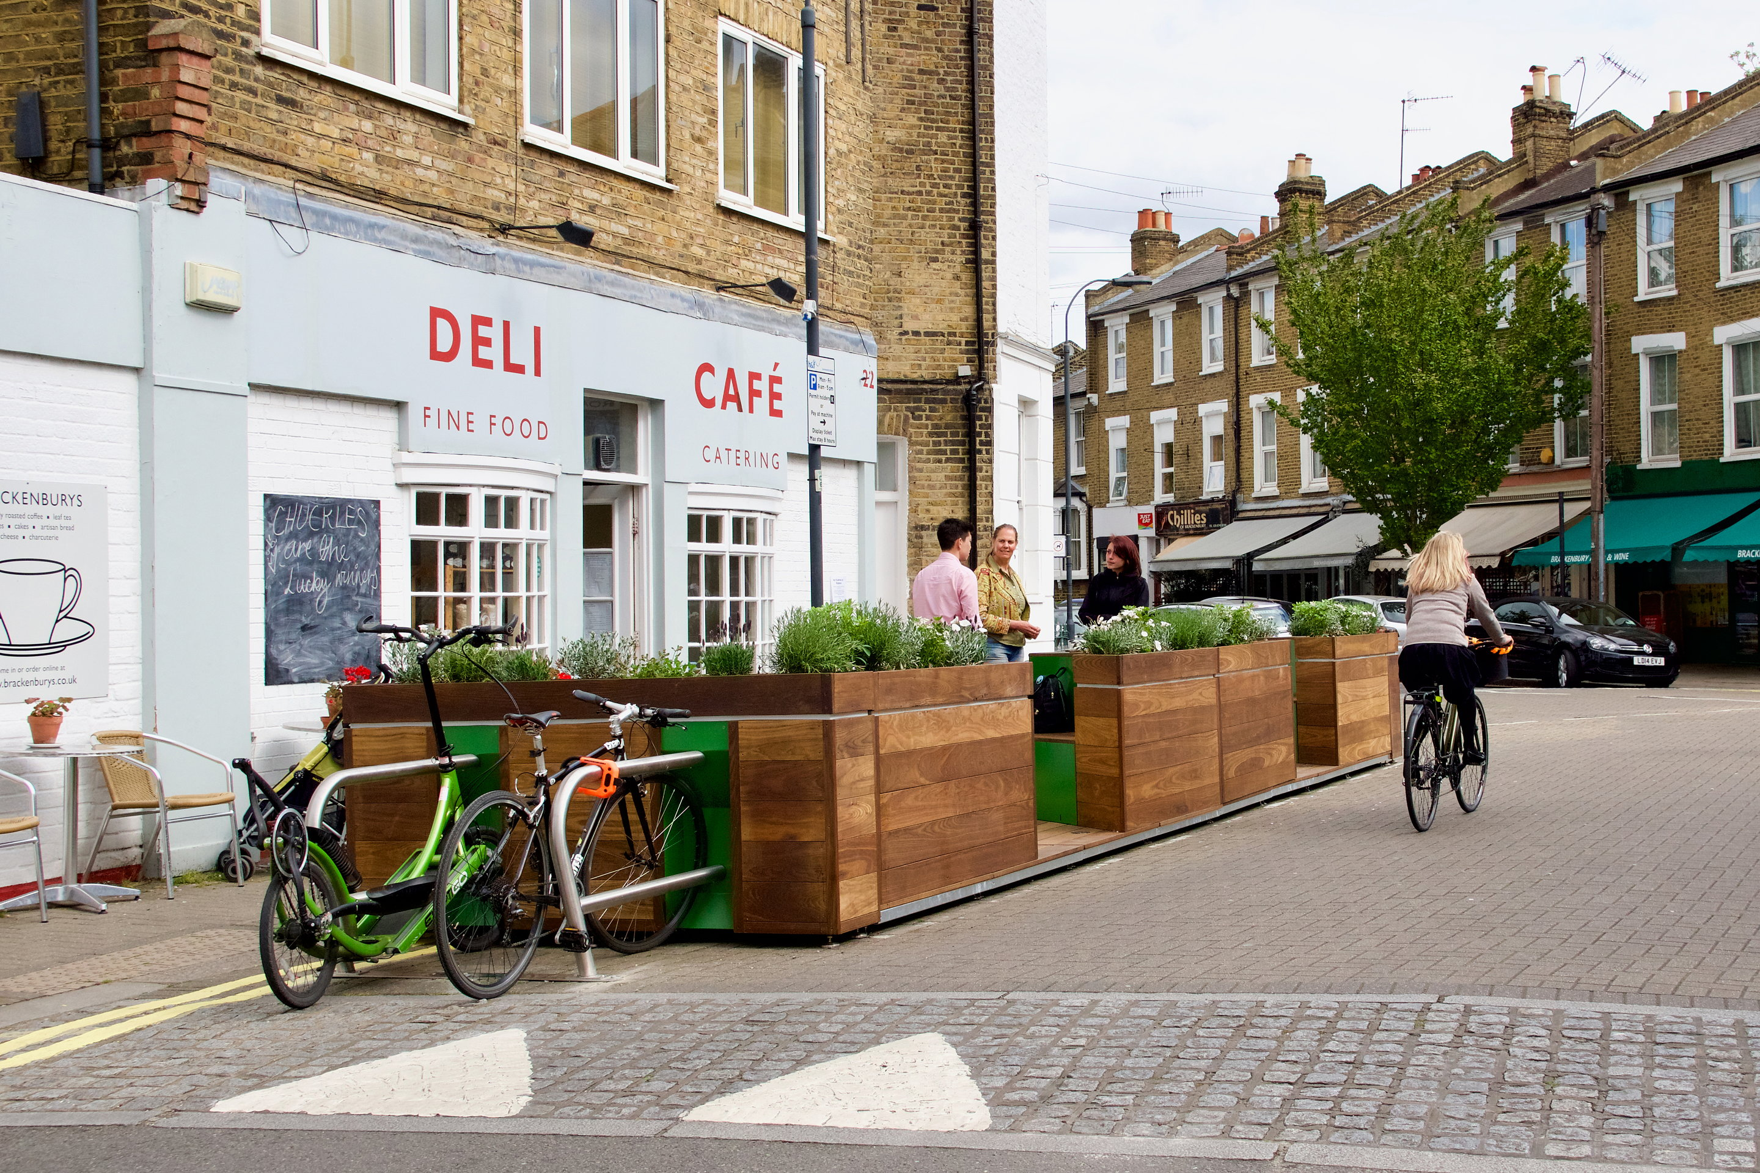
Parklet Program
City of Savannah Office of Special Events, Film, and Tourism

Slide 2
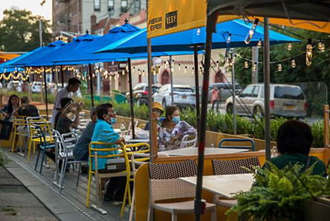
What is a Parklet?
Parklets are public seating platforms that convert curbside parking spaces into vibrant community spaces. Also known as street seats or curbside seating, parklets are the product of a partnership between the city and local businesses, residents, or neighborhood associations.
Most parklets have a distinctive design that incorporates seating, greenery, and/or bike racks and accommodate unmet demand for public space on thriving neighborhood retail streets or commercial areas. A Parklet may be thought of as semi-permanent but must be designed for quick and easy removal in case of an emergency, or other reasons such as utility work, without damaging the curb or street.
City of Savannah Office of Special Events, Film, and Tourism Parklets

Slide 3
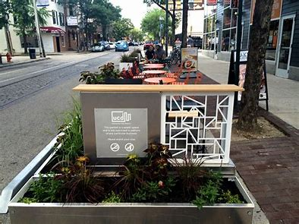
Parklet Pilot Program
In response to the COVID-19 pandemic, the City of Savannah initiated a Parklet Program in June of 2020.
48 approved applicants
60 applicants total
City of Savannah Office of Special Events, Film, and Tourism Parklets

Slide 4
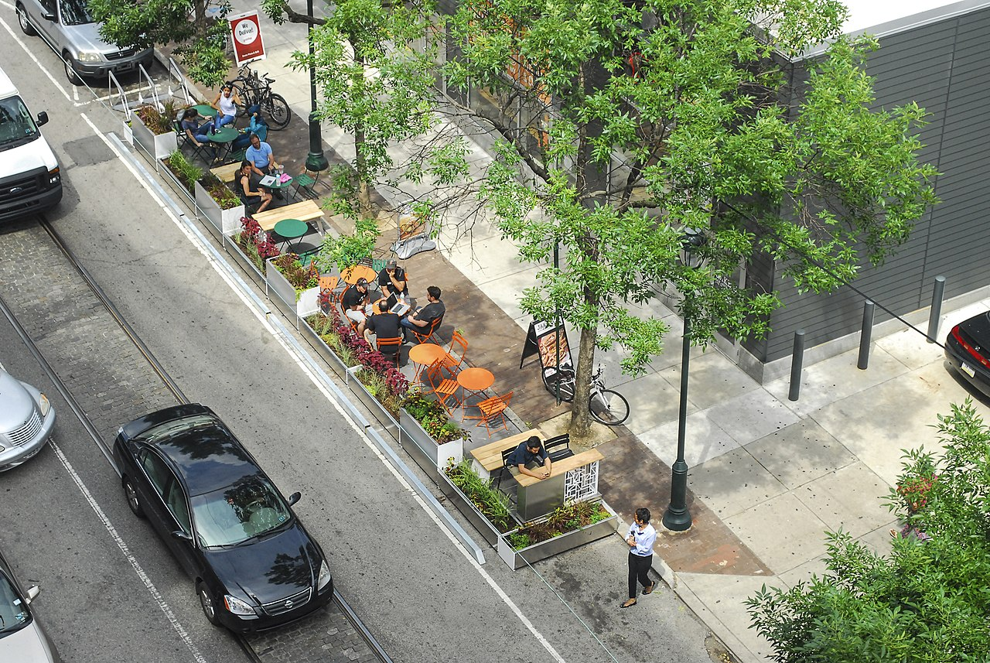
Parklet Locations
Approved Parklet Locations
Within on-street parallel or angled public parking spaces
In areas with existing pedestrian activity due to the presence of retail, mixed-use, commercial or high-density residential development
On streets with a posted speed limit of 25mph or less
(30mph on a case-by-case basis)
In spaces where parking is permitted during all
hours of the day/night.
City of Savannah Office of Special Events, Film, and Tourism Parklets July 8, 2022

Slide 5
Parklet Highlights
Prohibited Parklet Locations
Any State Route
Broughton Street – Sidewalk Cafés permitted with wider sidewalks
Within 10’ of a City stormwater catch basin
Within 30 feet of stop signs, yield signs or traffic signals
Within 20 feet of crosswalks
Within 15 feet of driveways or bus stops
In parking spaces with a running slope greater than or equal to 5%
Above utility holes or other utility access
Within 15 feet of fire hydrants, stand pipes, or Fire Department connections
Where resurfacing or other street improvements are scheduled to occur within 1 year
In loading zones, freight zones, tour stands, or accessible parking spaces
In any location deemed to be a traffic safety hazard by the City’s Traffic Engineering Department.
City of Savannah Office of Special Events, Film, and Tourism Parklets

Slide 6
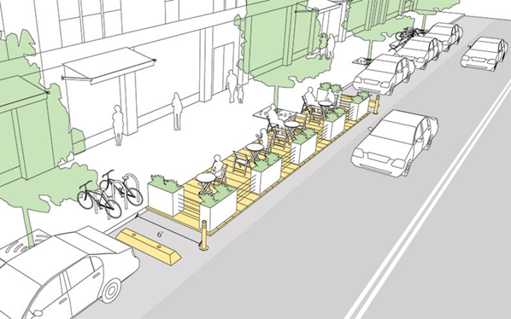
City of Savannah Office of Special Events, Film, and Tourism Parklets

Slide 7
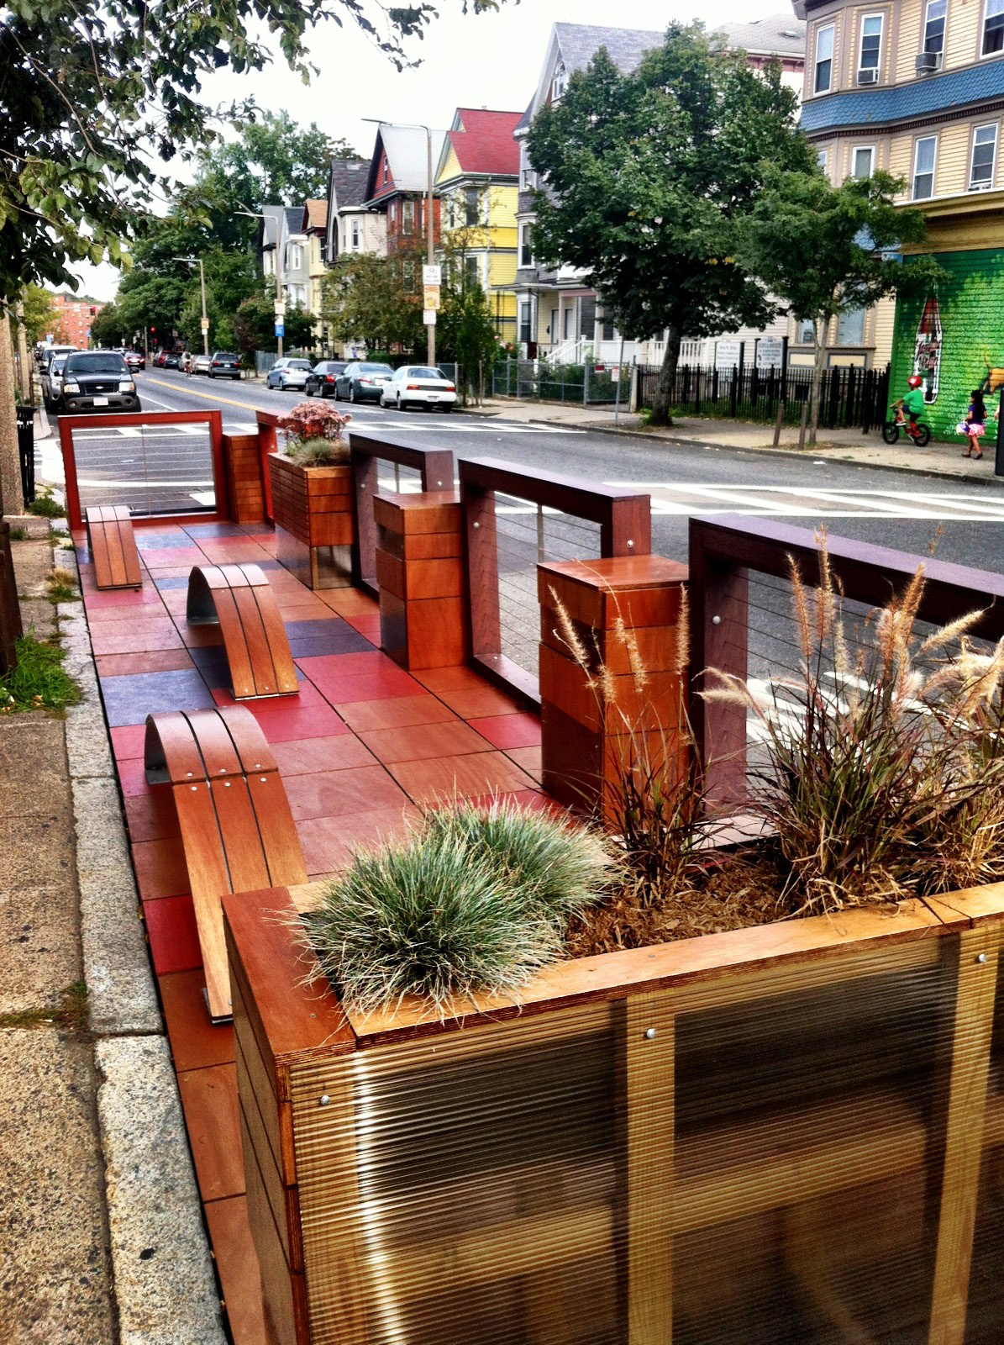
Parklet Highlights
Design Guide
Design Requirements
Parklets shall:
Be visually distinguishable from any adjacent private cafes or seating areas
Have vertical elements that make them visible to traffic, such as flexible posts or bollards
Maintain a visual connection from the street to the sidewalk
Remain visually permeable to allow views into the space from both the sidewalk and roadway. Continuous opaque walls above 36 inches that block the view from the street into the Parklet are prohibited
Maintain adequate sight distance from any driveway or street intersection
City of Savannah Office of Special Events, Film, and Tourism Parklets

Slide 8
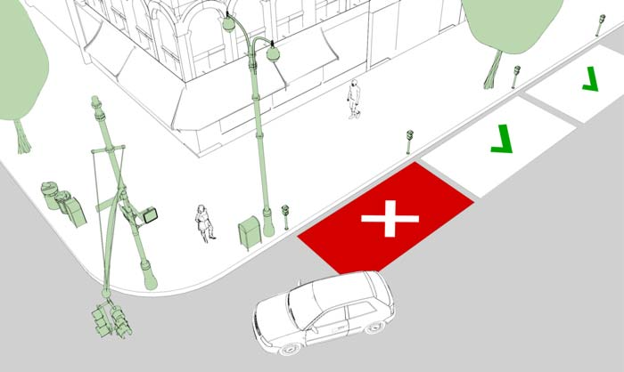
https://nacto.org/publication/urban-street-design-guide/interim-design-strategies/parklets/
City of Savannah Office of Special Events, Film, and Tourism Parklets

Slide 9
Parklet Highlights
Design Guide
Construction Requirements
Parklets must be constructed to be load bearing to a maximum of 750 lbs. per square foot.
Parklets shall maintain a flush transition at the sidewalk and curb to permit ease of access and avoid tripping hazards.
The design of a parklet shall not inhibit the adequate drainage of stormwater runoff. Channels between the base street and the platform must allow for the free flow of stormwater to facilitate drainage.
Sheet flow drainage in streets and curb lines shall not be obstructed.
Stormwater structures, to include catch basins and manholes, shall not be covered or obstructed.
Each Parklet shall be designed to be accessible in accordance with the Americans with Disabilities Act (ADA).
Parklet platforms must not exceed a 2% cross slope.
Reflective elements shall be installed on Parklet corners for visibility.
City of Savannah Office of Special Events, Film, and Tourism Parklets

Slide 10
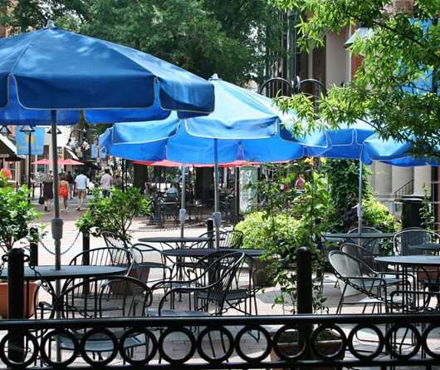
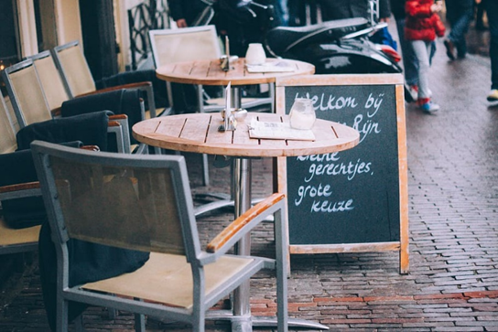
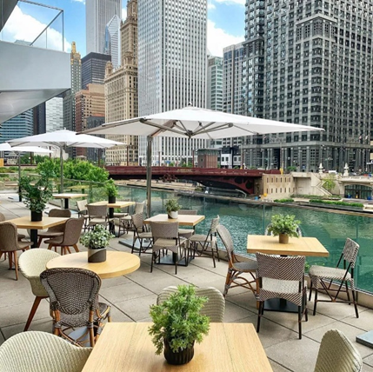
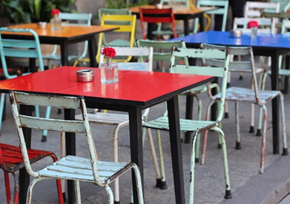
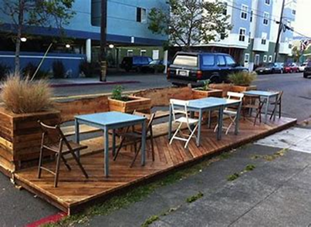
Appropriate Furniture
Design Guide
City of Savannah Office of Special Events, Film, and Tourism Parklets

Slide 11
Fee Structure
City | Application Fee | Annual/Monthly Fees | Other Fees | Annual Cost
Philadelphia | $125 | N/A | N/A | $125
Bend, Oregon | $225 | $110/month | N/A | $1,545
San Francisco, CA | $312 | $312/year | $248 (inspection) | $1,072
Milwaukee | $500 | $20/month | N/A | $740
San Mateo, CA | $500 | $250/month | N/A | $3,500
Morgan Hill, CA | $615 | N/A | $2,000 (deposit) | $2,615
Arlington, VA | $2,100 | N/A | $500 (renewal) | $2,600
Fort Lauderdale, FL | $100 | $650/year | N/A | $750
City of Savannah Office of Special Events, Film, and Tourism Parklets

Slide 12
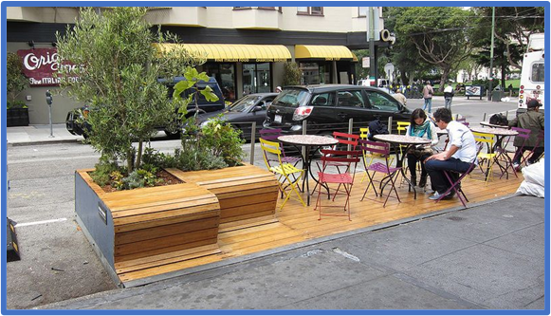
Fee Structure
What did we consider?
Average annual revenue generated for one metered space in the core of downtown - $2,000 - $4,000
Average size of parking space downtown 8x12 – 144 square feet
Average cost of restaurant space downtown $20 - $24 per square foot
Restaurant cost of 144 Square feet at $20/sf - $2,880/ month or $34,650/ year
City of Savannah Office of Special Events, Film, and Tourism Parklets

Slide 13
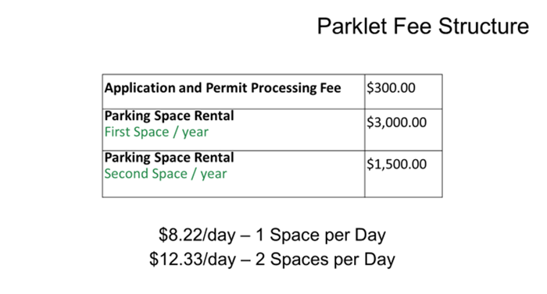
City of Savannah Office of Special Events, Film, and Tourism Parklets

Slide 14
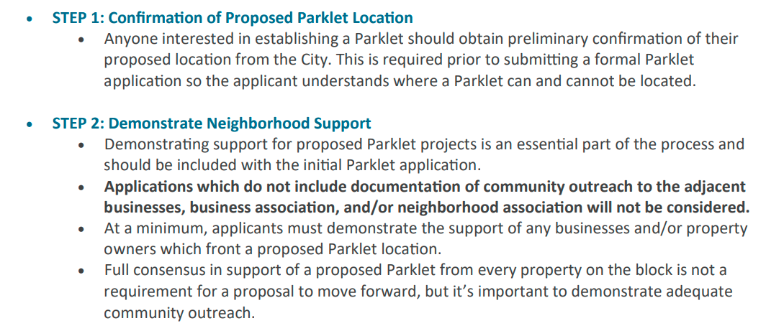
Parklet Highlights
How to obtain permission for a Parklet?
City of Savannah Office of Special Events, Film, and Tourism Parklets

Slide 15
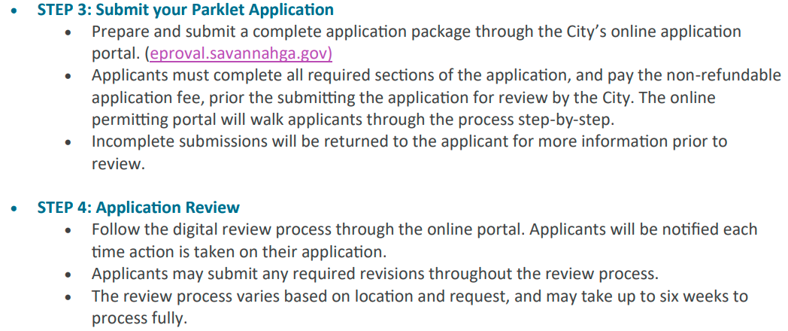
Parklet Highlights
How to obtain permission for a Parklet?
City of Savannah Office of Special Events, Film, and Tourism Parklets

Slide 16
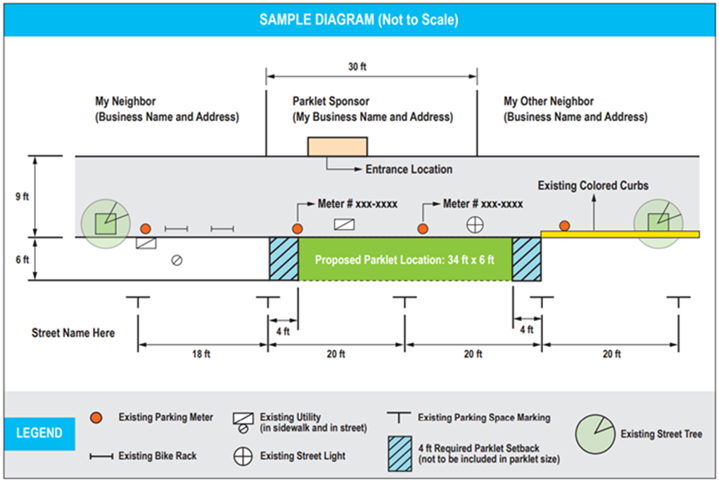
Parklet Highlights
How to obtain permission for a Parklet?
City of Savannah Office of Special Events, Film, and Tourism Parklets

Slide 17
Parklet Highlights
Next Steps
City Council Agenda – 12/22/22 – First Reading
City Council Agenda – 1/5/23 – Second Reading
Questions?
City of Savannah Office of Special Events, Film, and Tourism Parklets

