Slide 1
Office of Neighborhood Safety & Engagement (ONSE)
February 24, 2022
John Bush, ONSE Director
The Office of Neighborhood Safety and Engagement (ONSE) is dedicated to reducing crime and increasing neighborhood safety through a collaborative approach, developing and implementing community-wide crime reduction strategies and goals, and working directly with City departments, concerned citizens, and partner organizations to identify and connect individuals to community supports.
City of Savannah / Community Services / Office of Neighborhood Safety and Engagement

Slide 2
Top Three Goals
ONSE
Keeping young people alive
Keeping young people out of jail
Keeping young people safe at home, school or the workplace
City of Savannah / Community Services / Office of Neighborhood Safety and Engagement

Slide 3
Strategies for Meeting These Goals
Pursue a “Whole of Government” approach to violence prevention and response
Convene local government, education, law enforcement, court system, social services, healthcare system, etc.
Formalize partnerships (Memoranda of Understanding)
Employ local and national best practices with proven results
PAL, Cure Violence, Credible Messengers, Violence Interrupters, SIP
Target young people most at-risk of being a victim or perpetrating gun violence (often the same individuals)
Connect young people to resources that de-escalate tensions and redirect behaviors towards positive outcomes
Create a Space for Collaboration (37th & Waters Avenue)
Resource local organizations already doing this work
City of Savannah / Community Services / Office of Neighborhood Safety and Engagement

Slide 4
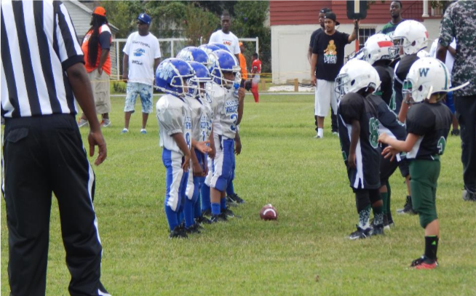
Partnerships: Who We Need to Help With This Work
Key Community Partners
Parents & Families
Youth organizations
Coaches & sports organizations
Faith community
Business community
Military
Non-profit organizations
Neighborhood organizations & other volunteer groups
Key Government Partners
Public Safety
Community Services
Education System
Health Care Services
Court System
Family and Children Services
Public Housing Authority
Homeless Authority

Slide 5
Funding Credible Programs & Initiatives: A Continuum of Service Needs
Prevention
Intervention
Redirection
Progression
The act of stopping something from happening or arising | The process of taking action on something in order to affect its outcome | The act of assigning or directing something to a new or different place or purpose | Moving gradually towards a more advanced state; forward or onward movement
Program Guidelines are currently under development
Application Process Priorities : An extended application period, an easy-to-understand proposal process, and training and development for organizations
City of Savannah / Community Services / Office of Neighborhood Safety and Engagement

Slide 6
Gun Violence…
Is a public health problem
Is transmitted by a small group of people
Can be stopped
Thank You!
City of Savannah / Community Services / Office of Neighborhood Safety and Engagement

