Slide 1
Seeking an oasis in food deserts: How residents shaped our approach to making healthy foods accessible

Slide 2
The Problem:
Food selection for residents within Savannah's food deserts is a choice between convenience, quality, price and proximity that perpetuates social and health-based inequities.

Slide 3
This is Rasheeda
She's a single mom who lives in West Savannah without personal transportation. She and her three small children walk across busy West Bay Street to grocery shop, only buying enough food for one day of meals.
Unless someone is available to give her a ride to a grocery store in another area of the city, she can only purchase what she can carry while pushing a stroller and walking with her two older children.

Slide 4
"You have to choose between health and hunger."

Slide 5
Phases of the Program:
The program consists of three major components, each working together as an impact-driven, people-centered collaborative process that required substantial thought and teamwork.

Slide 6
Phases of program

Slide 7
Phases of Program: Understand the Problem
Problem framing, research, data externalization and problem reframing
Mind mapping to identify problems, issues, considerations and assumptions about the assigned problem
Team problem frame ranking to gain consensus on which problem frame should be the subject of in-depth research
Build a research plan and interview guide prior to stakeholder fieldwork
Develop themes and insights from stakeholder interviews to refine the data
Reframe the problem from common themes in data points and build design criteria

Slide 8
Phases of Program: Understand the Problem
Design Criteria: Our Design Must…
Allow persons living in a food desert to have access to fresh and healthy food conveniently, consistently, and inexpensively
Deliver long-term sustainability
Provide delightful food choices for people with diverse cultural and ethnic backgrounds
Demonstrate the value of healthy foods for residents and encourage them to make healthy food choices

Slide 9
Phases of Program: Generate and Test New Ideas
Ideation, prototyping, testing and refinement and portfolio of initiatives
Generate ideas for solutions through insight combination and asking, “How might we…?” questions
Idea generation through co-creation with local partners and residents
Idea prioritization through ranking and impact measurement
Identification of assumptions and development of prototypes for testing with the community
Development of a portfolio of initiatives

Slide 10
Phases of Program: Deliver Initiatives
Pilot, implementation routines, track progress and measure impact
Prioritization of ideas to build a balanced portfolio of common and predictable solutions coupled with new and unexpected solutions
Development of an impact measurement framework
Implementation planning and the 30-60-90-day plan
Personal commitments to continue the program where possible from staff participants

Slide 11
Ideas and Long-term Impact:
Backyard Orchards
Property tax breaks for local farms to distribute produce in designated areas.
"Small Grocer" designation
Incentivizing businesses that work to improve healthy food access.
Updated Recipes
Organize a ride share program to get people without transportation to existing grocery stores.
Healthy Corner Stores
Community Garden Network
Urban Agriculture
New Zoning
Notes:
The team’s drive toward long-term impact included fostering an environment that would create a healthier population in West Savannah by making healthy foods accessible. This included ensuring residents spend a smaller proportion of their income on healthy foods and reducing or eradicating food deserts in West Savannah. To achieve this, we developed ten prioritized ideas and rated them along the bold-practical continuum.

Slide 12
Challenge Statement
"How might we envision and implement socially equitable land-use regulations that eradicate food deserts?"

Slide 13
Savannah small grocer designation
Introducing...
A new zoning designation, coupled with incentives, that encourages grocers with smaller footprints to locate adjacent to, or on, residential parcels as an accessory use with design standards. This smaller store would feature competitive pricing and a comparable variety of products when compared to a larger chain store. The goal is to make the shopping experience appealing to customers and the business model appealing to entrepreneurs or potential grocers.

Slide 14
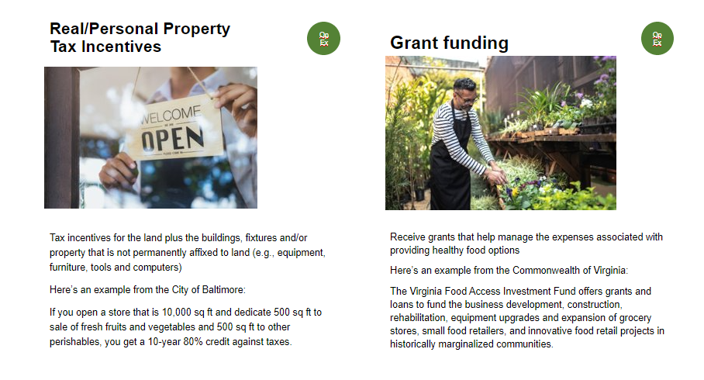
Small grocer designation prototype
To test the small grocer designation, the team created two sets of idea cards. One set to gather insight from residents about the characteristics they want inside and outside of a store, and a second set to understand what business incentives might encourage development in West Savannah.

Slide 15
Challenge Statement
"How might we facilitate access to locally-grown produce to West Savannah residents?"

Slide 16
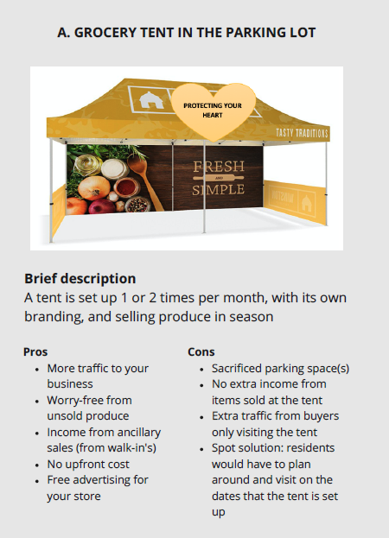
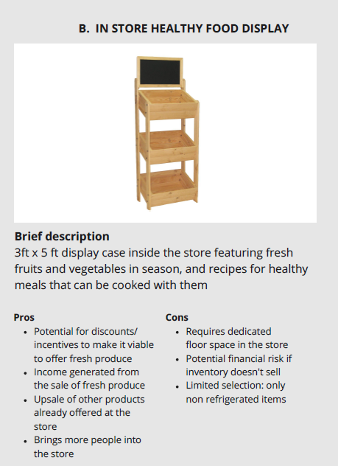
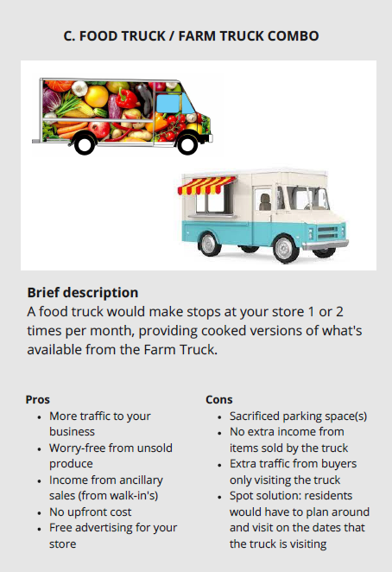
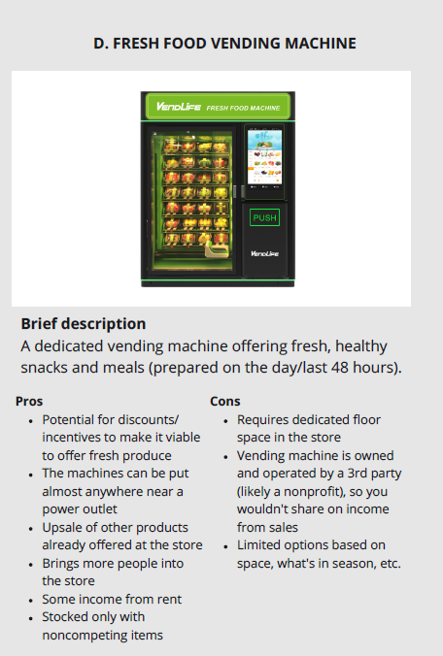
Healthy corner store initiative
We tested with several store owners to get their opinions about what they think would work best, and we were surprised to learn they preferred an idea we didn't expect – the fresh food vending machine.

Slide 17
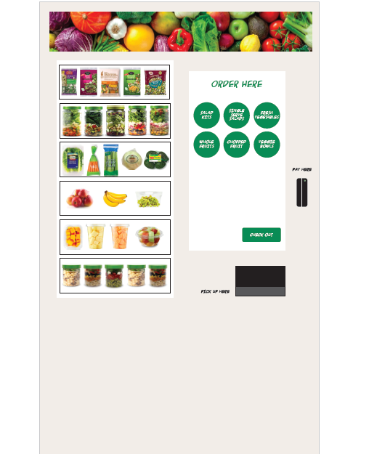
Healthy vending machine prototype
One option to improve healthy food selection at corner stores that proved popular with business owners and residents is a healthy vending machine. It would provide chopped fruits and vegetables, prepared salads and whole fruits and vegetables that are regularly restocked by a third-party vendor.

Slide 18
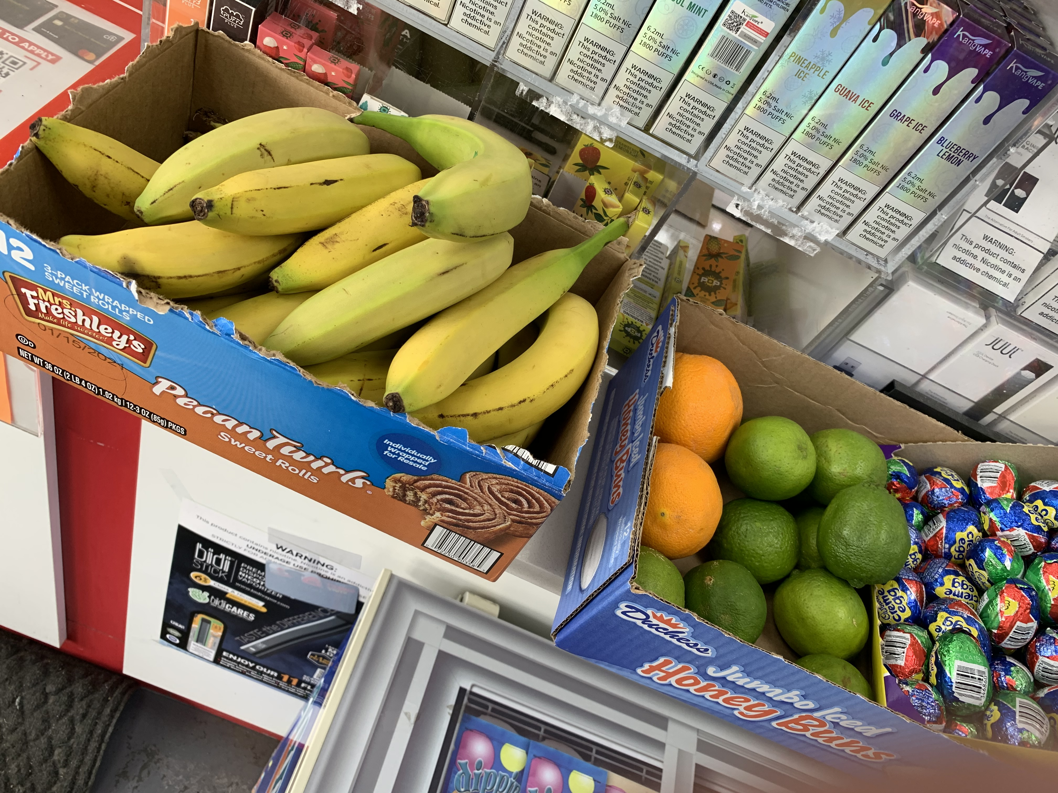
Healthy vending machine prototype

Slide 19
Healthy vending machine prototype
Digital touchscreen, including the date when each item was placed in the machine, nutritional facts ang price
Accept EBT for payment
Recyclable container. Residents can bring back the container and a credit would be given to the customer for their next purchase.

Slide 20
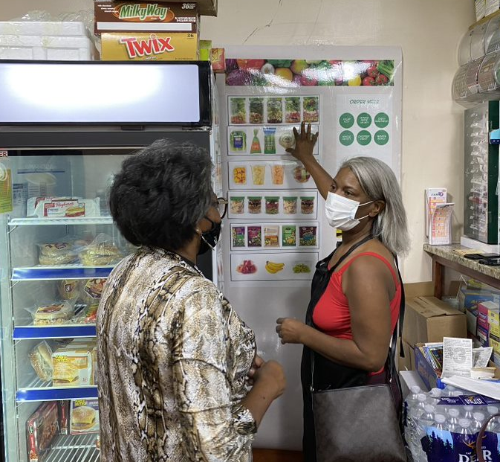
Meet Stephanie
Stephanie is one of many residents our team included in our tests.
She thinks a healthy food vending machine is a great alternative to the typical microwavable foods available in convenience store vending machines now and an excellent option to supplement a grocery store.

Slide 21
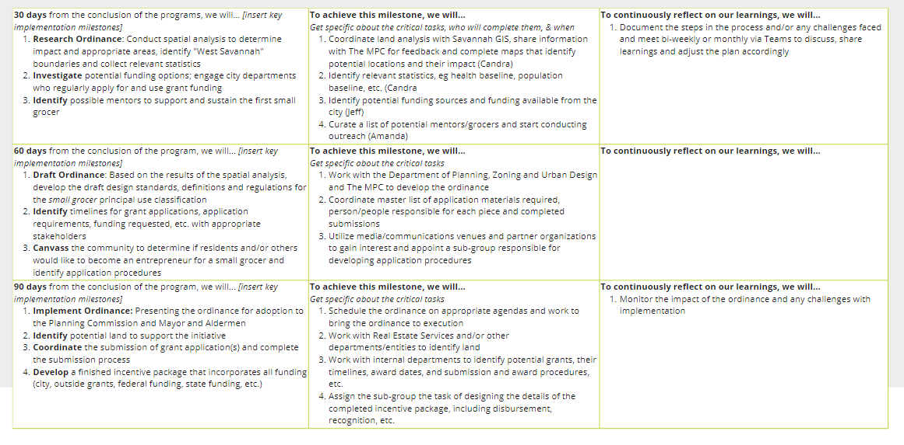
Timelines for implementation- small grocer

Slide 22
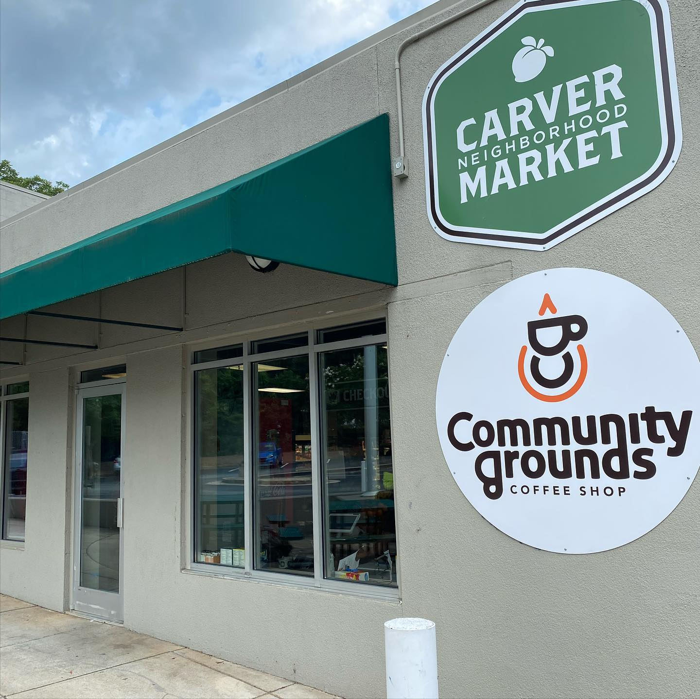
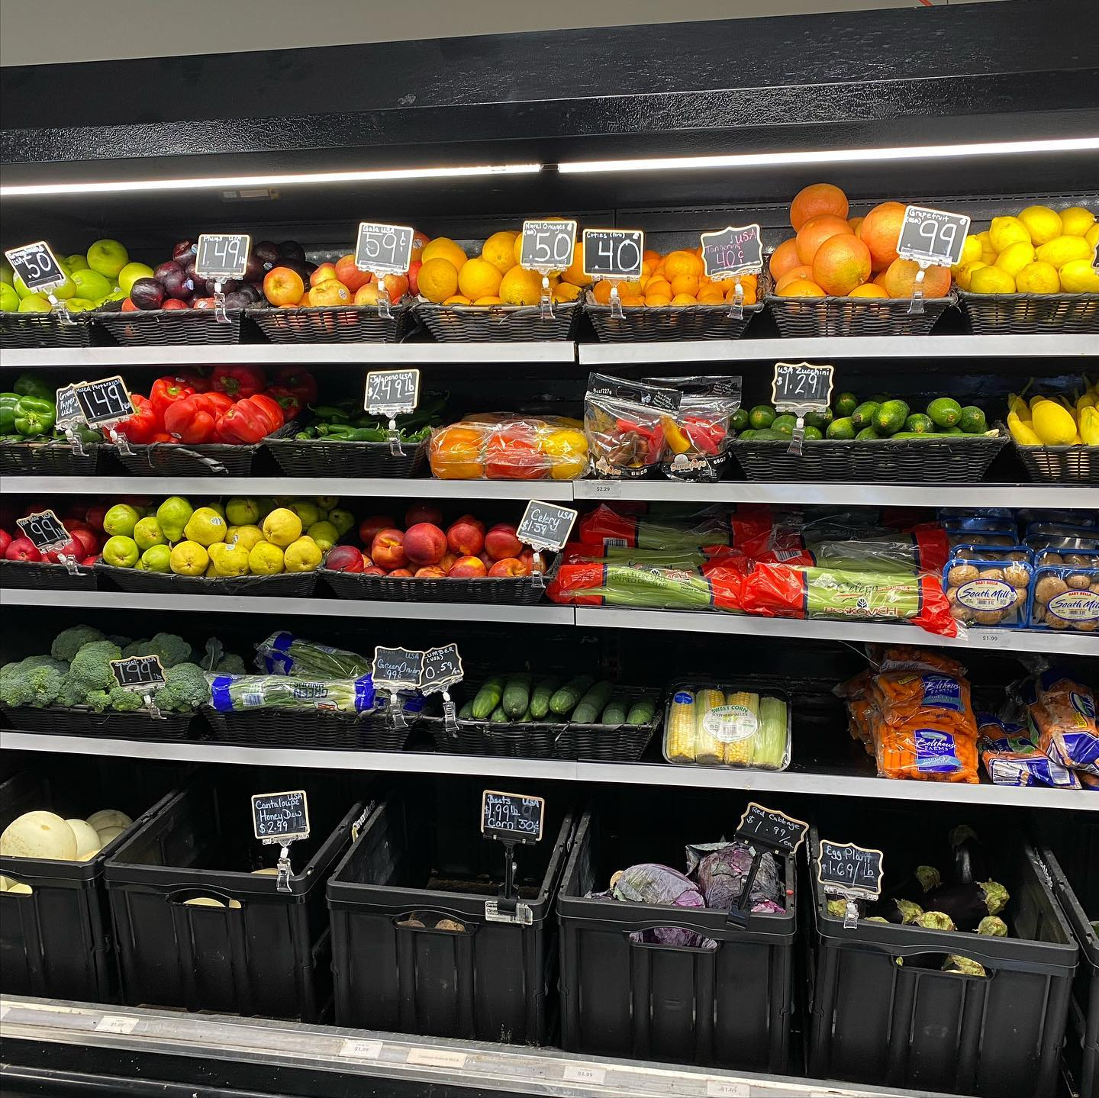
Timelines for implementation- small grocer

Slide 23
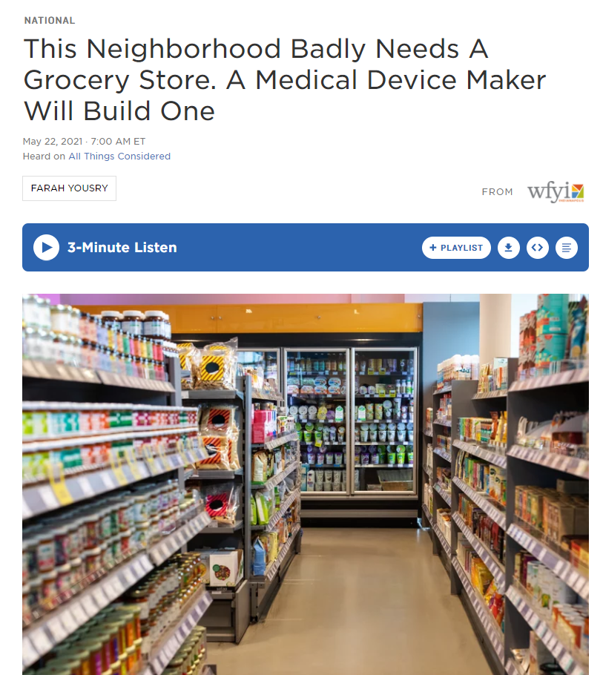
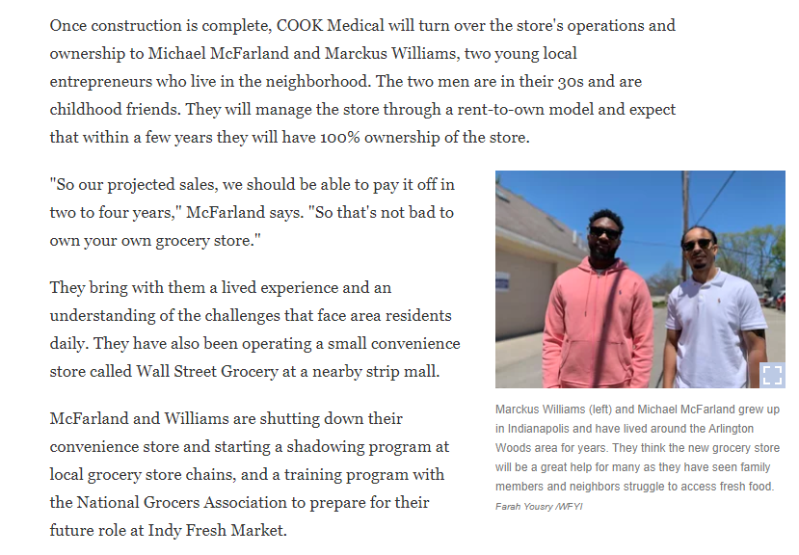
Timelines for implementation- small grocer

Slide 24
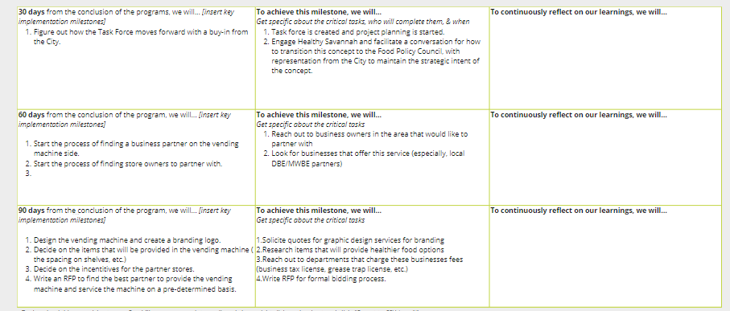
Timelines for implementation – vending machine

Slide 25
Discussion

