Slide 1

Development
Impact Fees
City Council Workshop
December 8, 2022

Slide 2


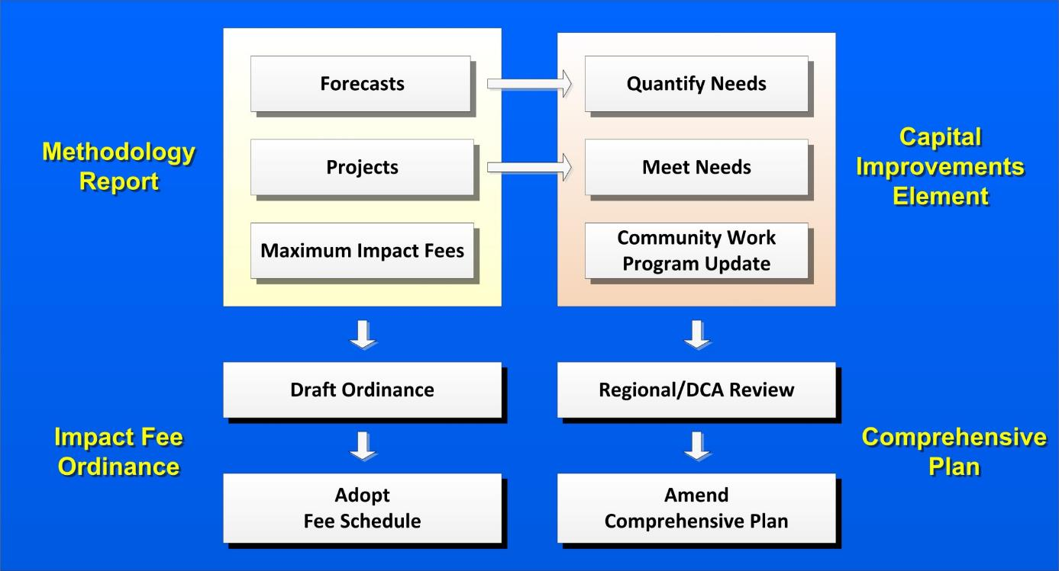
DRAFT

Slide 3

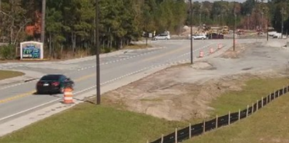

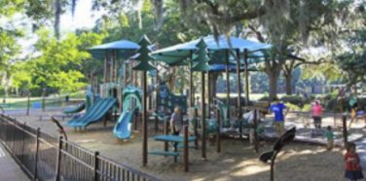
2023 - 2027 Community
Work Program
  Impact Fee Eligible Projects
    Public Facility Category
    Implementation Year(s)
    Responsible Party
    Cost Estimate
    Funding Sources
Law
Enforcement
Road Improvements
Fire
Protection
Parks &
Recreation

Slide 4
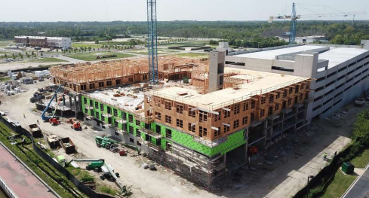
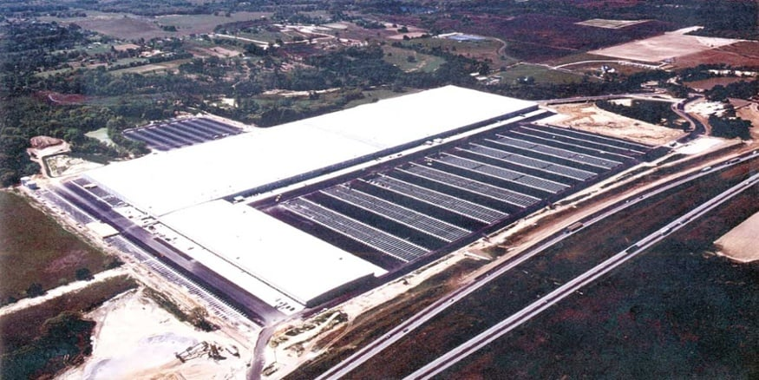
Update on Process
September 8: Council approved the CIE
September 11: CIE submitted Coastal Regional Commission (CRC) & Department of Community Affairs (DCA)
October 12: CRC hosted regional hearing
November 23: Comments received from DCA
Addressing comments and resubmitting CIE to DCA
Anticipating DCA approval within a few weeks

Slide 5
Impact Fee Reductions
Eliminated projects from the Road Improvements Public Facility Category
Impact fees can only be used for added capacity to support new growth
Maintenance projects cannot be supported
Reduced the project total from $24,913,956 (21.5%)

Slide 6
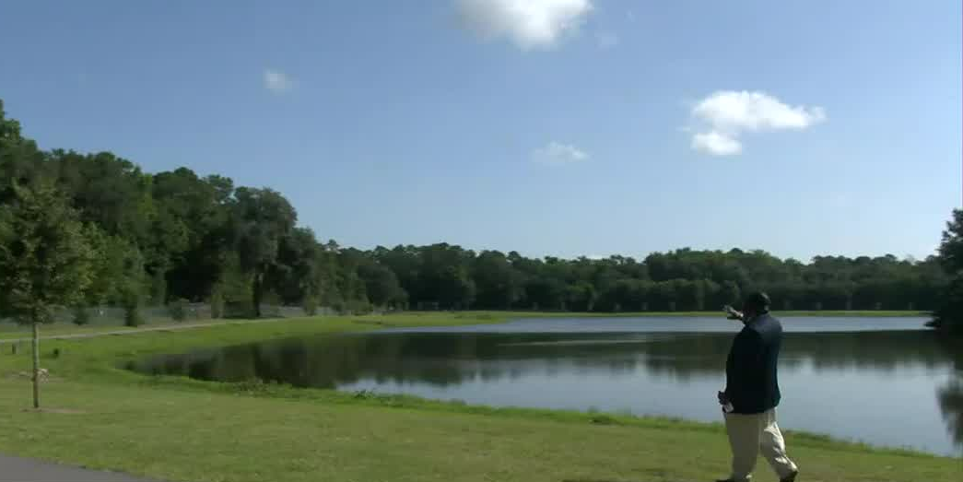
Impact Fee Reductions
Updated discount rate based on the Georgia 1 Fund which will serve as the impact fee interest-bearing account
Now reflects current market conditions (higher interest rate and construction costs)
Included SPLOST credit applicable to Parks & Recreation Public Facility Category
Reduced project costs by 9%

Slide 7
Impact Fees for Selected Land Uses (100% of Maximum Fees before reductions)

Slide 8
Impact Fees for Selected Land Uses (100% of Maximum Fees After 9% Reduction)

Slide 9
Impact Fees for Selected Land Uses (Reduction to Parks & Recreation Only)

Slide 10
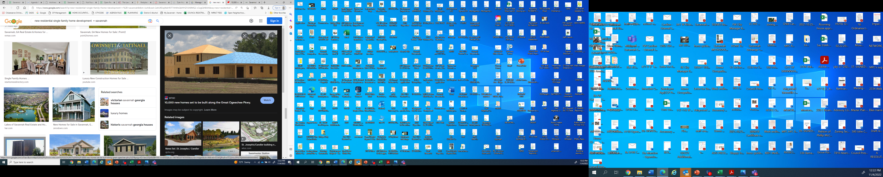
Exemptions: Affordable Housing
City Council may grant exemptions for:
  Business development project representing “extraordinary economic development and employment growth”
  Residence or housing project increasing the supply of housing that would be affordable to disadvantaged individuals or families
Recommend a 25% reduction for affordable housing projects
Affordable housing defined as:
  All low-income housing tax credit (LIHTC) and similarly financed housing that has long term affordability requirements imposed by the federal, state, or local governments;
  10 or more dwellings where
    Rents to be at or below FMRs for a period of 15 years (deed restricted)
    Sale price of homes to be at or below 80% of FHA limits for a period of 15 years (deed restricted)

Slide 11

Additional Considerations & next Steps
Phased implementation process:
  Year 1: 50% of impact fee of $1,966
  Year 2: 75% of impact fee of $2,948
  Year 3: 100% of impact fee of $3,931
Planning Commission considers CIE January 10
City Council convenes Public Hearing #1 January 12
City Council convenes Public Hearing #2 January 26
City Council considers CIE January 26
City Council considers resolution
for affordable housing exemption January 26

