Slide 1
ADDRESSING HOMELESSNESS
A PATH FORWARD
Savannah City Council Workshop: May 12, 2022
Office of Community Services

Slide 2
HOMELESSNESS KNOWS NO BOUNDARIES & HAS NO PREFERENCES It impacts EVERYONE men AND women, old AND young, regardless of race.

Slide 3
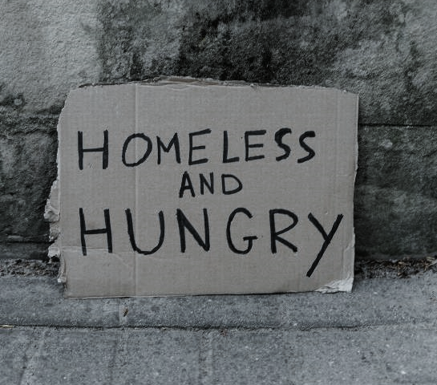
PRIORITY NEEDS Planning, Resource Development, and a Coordinated Service Delivery System
HUMAN SERVICES
HOUSING

Slide 4
Improving the delivery of Human Services
Homeless Continuum of Care

Slide 5
The McKinney-Vento Homeless Assistance Act as amended by S. 896 HEARTH Act of 2009
Established the Continuum of Care Program administered by the U.S. Department of Housing and Urban Development (HUD). The CoC Program is designed to promote a community-wide commitment to the goal of ending homelessness and to provide funding for those efforts.
In 2020, local homeless services providers were surveyed and identified the need for the City of Savannah to serve as a Convener and provide leadership in developing a shared vision and plan to end homelessness in Savannah and Chatham County. This need was restated in an August 24, 2021, meeting of service providers convened by Mayor Van Johnson.

Slide 6
Homelessness Continuums of Care (CoC) manage: - Communication - Collaboration - Coordination - Consensus - Collective Action
Primary Roles
Gathering and analyzing information to determine the local needs of people experiencing homelessness
Implementing strategic responses and evaluating performance/results
Setting the local process for applying, reviewing and prioritizing project applications for funding each year in the Continuum of Care Program Competition
Major Functions
Administration and operation of the CoC
Designating and operating the Homeless Management Information System (HMIS) for the CoC
Continuum of Care planning
Preparing and submitting the local application for funds in accordance with 24 CFR 578.7 and 578.9.

Slide 7
The Savannah-Chatham County CoC Initial Governance Structure
Success of the CoC depends upon the strength of each of these components
and particularly the CoC Board.
CoC Board
13-15 elected and appointed positions nominated by CoC general membership and
CoC General Membership
Relevant organizations and individuals committed to ending homelessness in Chatham County.
Committees & Work Groups
Diverse stakeholders consisting of a combination of any of the following: persons with lived experience, board members, general members, funded providers, Collaborative Applicant CoC staff members.
Collaborative Applicant
HMIS Lead
The eligible entity designated by the CoC to collect and submit the required Continuum of Care Application information for all projects the CoC has selected for funding in HUD’s annual CoC process and apply for CoC planning funds on behalf of the CoC.
The eligible applicant or contractor designated by the CoC to manage the CoC’s Homeless Management Information System (HMIS) on the CoC’s behalf.
Composed of representatives of community or other local organizations, individual community members, representatives of projects serving homeless subpopulations in Chatham County and at least one homeless or formerly homeless individual.
Any person or representative from relevant organizations in Chatham County interested in homelessness, advocacy, ending homelessness and poverty.

Slide 8
Initial Savannah-Chatham County CoC Board Structure
13-15 elected and appointed positions nominated by CoC general membership
Composed of representatives of the community or other local organizations, individual community members, representatives of projects serving homeless subpopulations in Chatham County and at least one homeless or formerly homeless individual.
What’s Missing?
Representatives of key governmental agencies
Why is it important?
Governmental agencies institute critical public policies that impact homeless populations
Governmental agencies manage essential public services that impact homeless populations
Governmental agencies manage critical public dollars that can help support solutions to homelessness

Slide 9
May 5, 2022: CoC approves amendment of Governance Charter:
13-15 elected and appointed positions nominated by CoC general membership
Composed of representatives of community or other local organizations, individual community members, representatives of projects serving homeless subpopulations in Chatham County and at least one homeless or formerly homeless individual.
Community
Seats
No Change
Adds government seats to the CoC Board
Renames CoC Board to Savannah-Chatham County Interagency Council on Homelessness
10 appointed positions representing individual governmental agencies
Composed of executive level managers/ directors of key agencies with responsibility for managing critical public policies and services.
Government
Seats
New Addition

Slide 10
City of Savannah
Chatham County Government
Chatham County Hospital Authority
Chatham Emergency Management Agency
Department of Behavioral Health and Developmental Disabilities
Department of Community Supervision
Department of Family and Children Services
Department of Labor
Department of Public Health
Department of Veterans Affairs
Housing Authority of Savannah
Savannah/Chatham County Board of Education
Possible Governmental Agencies
with critical roles and services impacting persons experiencing homelessness

Slide 11
Role of the Interagency Council on Homelessness
Provides ongoing leadership and acts on behalf of the CoC to carry out the CoC’s mission, goals and priorities
Develops a public presence amongst business and nonprofit leaders in order to advocate for community-wide solutions to ending homelessness and improving housing resources
Provides professional staff support to assist the Board and Officers in fulfilling Board responsibilities and achieving CoC goals

Slide 12
2022 City of Savannah Capacity Building Funds ($500,000) - UPDATE -
Two Upcoming Requests for Proposals
Addressing “Gaps” in the Local Service Delivery System
Daytime Shelter and Supportive Services:
Shelter from weather conditions
Food, clothing, and personal hygiene necessities
Intake and case management services
Connection to supportive services
Street Outreach and Transportation:
Outreaching to individuals experiencing homelessness
Providing transportation to connect individuals to services

Slide 13
Today’s City Council Agenda
A Resolution of Support
Recommendation to Approve a Resolution supporting the new
Savannah-Chatham County Interagency Council on Homelessness/ Continuum of Care (ICH/CoC).
The proposed Resolution:
Formalizes the City of Savannah’s role and participation in the ICH/CoC
Directs the City Manager to provide administrative support for the Board
Support will be provided by the new Senior Policy Advisor on Homelessness position approved by City Council in the City’s 2022 Budget.
The new position will ensure homelessness receives the daily attention required to address needs and implement solutions to homelessness.

Slide 14
Housing for Persons experiencing homelessness
Housing Savannah Action Plan

Slide 15
2022 Housing Developments 79 Dwellings Underway & On The Drawing Board That Benefit Persons and Families Experiencing Homelessness
Savannah Gardens 6 Houses for Families Experiencing Homelessness
Dundee Cottages 38 Cottages for Persons & Families Experiencing Homelessness
916 MLK 35 Studio Apartments for Persons Experiencing Homelessness

Slide 16
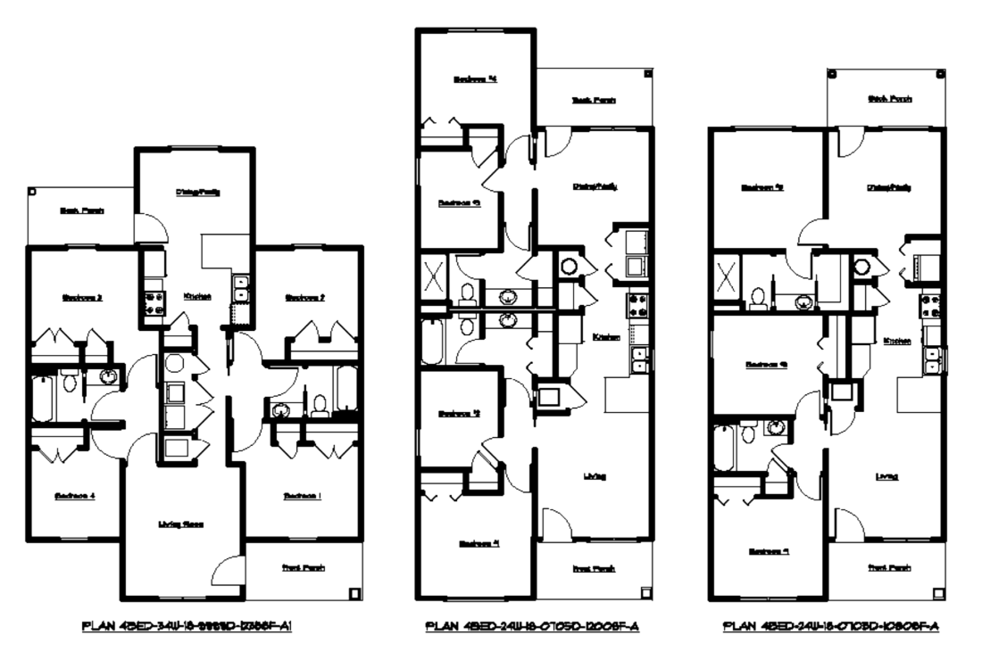
Savannah Gardens
District 3
FY 2022 Budget at Work
6 New Houses for
Families Experiencing Homelessness
CHSA Development is providing lots at Savannah Garden for the construction of at least 6 new homes for families experiencing homelessness.
City is providing CDBG-CV funds for construction.
Family Promise will select the families and provide supportive services.
First four houses are underway and expected ready for occupancy in August.

Slide 17
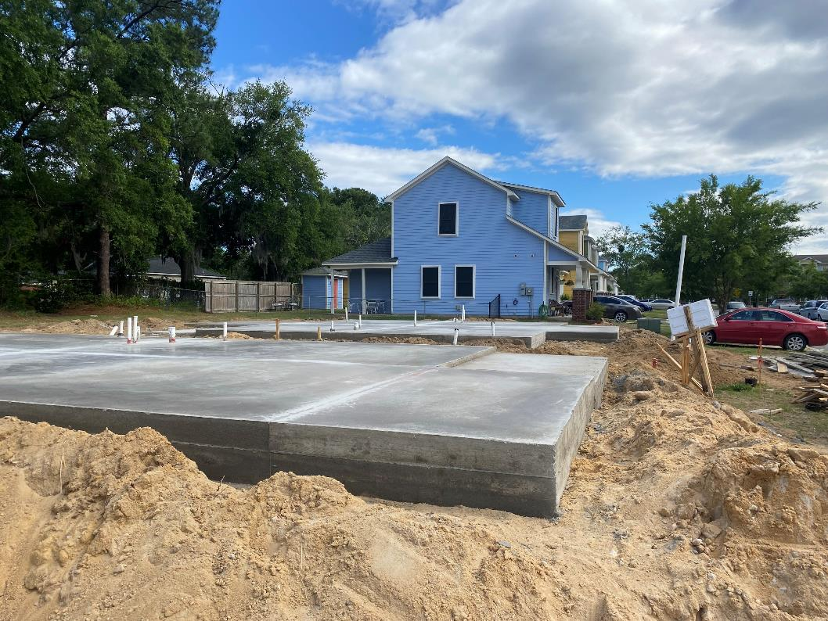
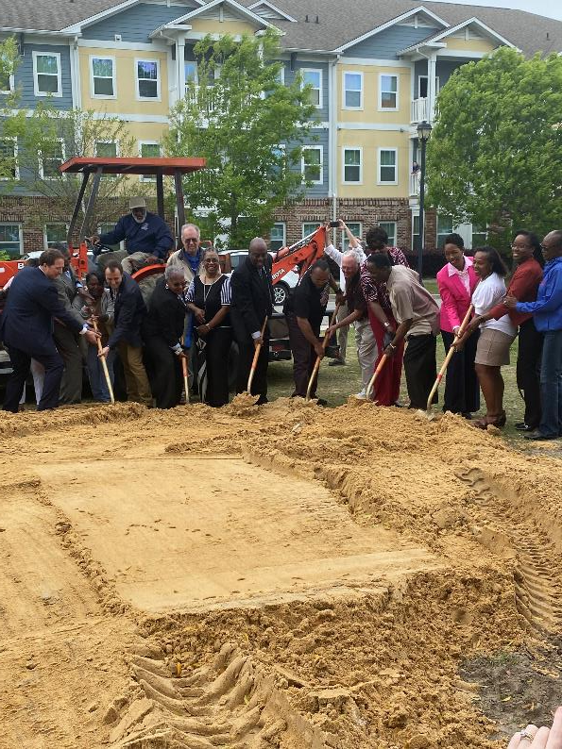
Savannah Gardens Houses Under Construction
Following March 23 Groundbreaking

Slide 18
Dundee Cottages
District 3
FY 2022 Budget at Work
38 PSH Cottages & Community Facility for Persons Experiencing Homelessness
City owned property.
Projected Development Partners & Sequence:
City (Install Site Infrastructure on City Land—SPLOST).
Land Bank Authority (City Transfers Land to LBA with LBA Providing Ground Lease to CHSA).
CHSA Development (Oversees Vertical Construction—SAHF/CHSA).
Homeless Provider (Acquires Vertical Improvements—Possible CHSA & HOME-ARP).
City Retains Ownership of Land via Land Bank Authority.
Engineering 95% complete.
Site Work Infrastructure Construction Start Anticipated for July 2022.
Cottage and Community Building Construction Anticipated for March-June 2023.
Cottage Occupancy Anticipated to Begin in July 2023.

Slide 19
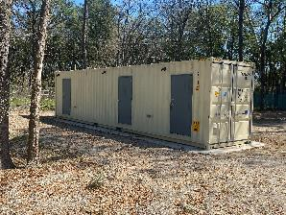
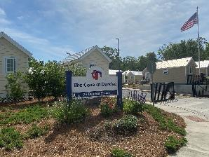
Dundee
Cottages
District 3

Slide 20
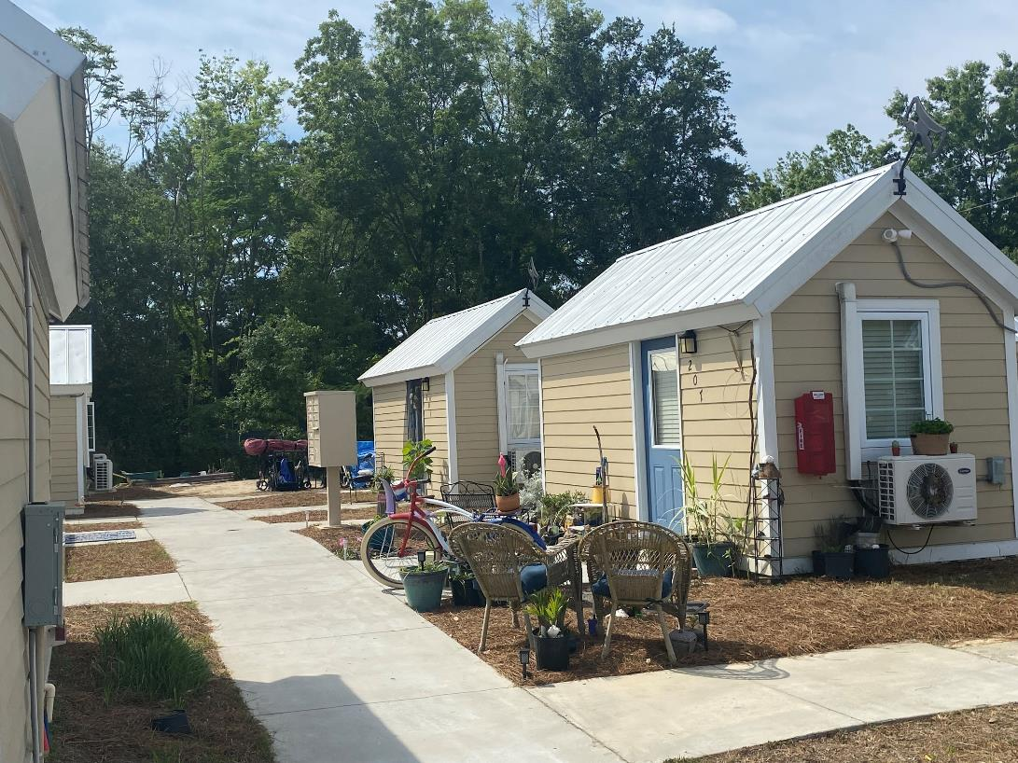
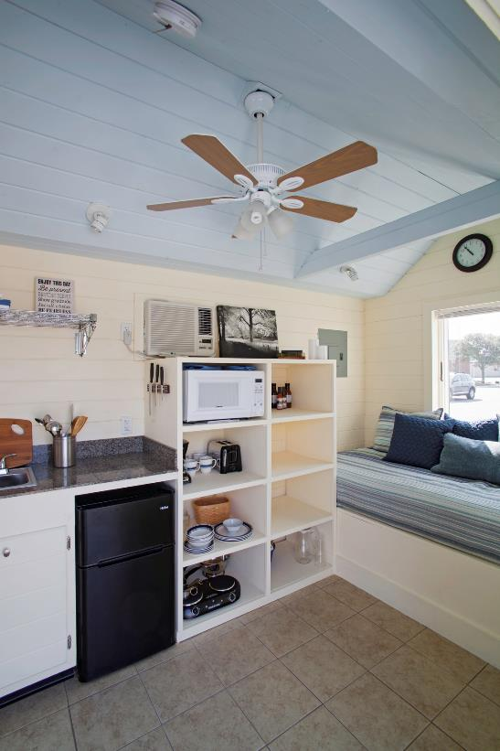
Dundee Cottages Builds Upon The Cove

Slide 21
Dundee Cottages
District 3

Slide 22
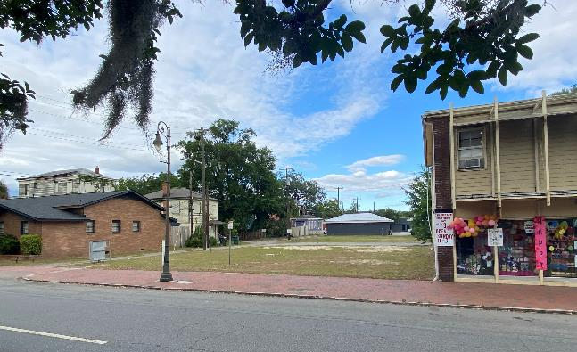
916 MLK & Adjoining Properties
District 2
Proposed Development to Include
35 Studio Apartments
City owned Property.
Provides affordable housing option in an area. experiencing development of significant market driven, high cost, rental housing.
Potential housing for persons entering the workforce, including:
After experiencing homelessness
After returning from incarceration
Community space for supportive services.
Seek appropriate zoning.
Release RPF and award project in 2022.
Possible funding options include SAHF and HOME-ARP.

Slide 23
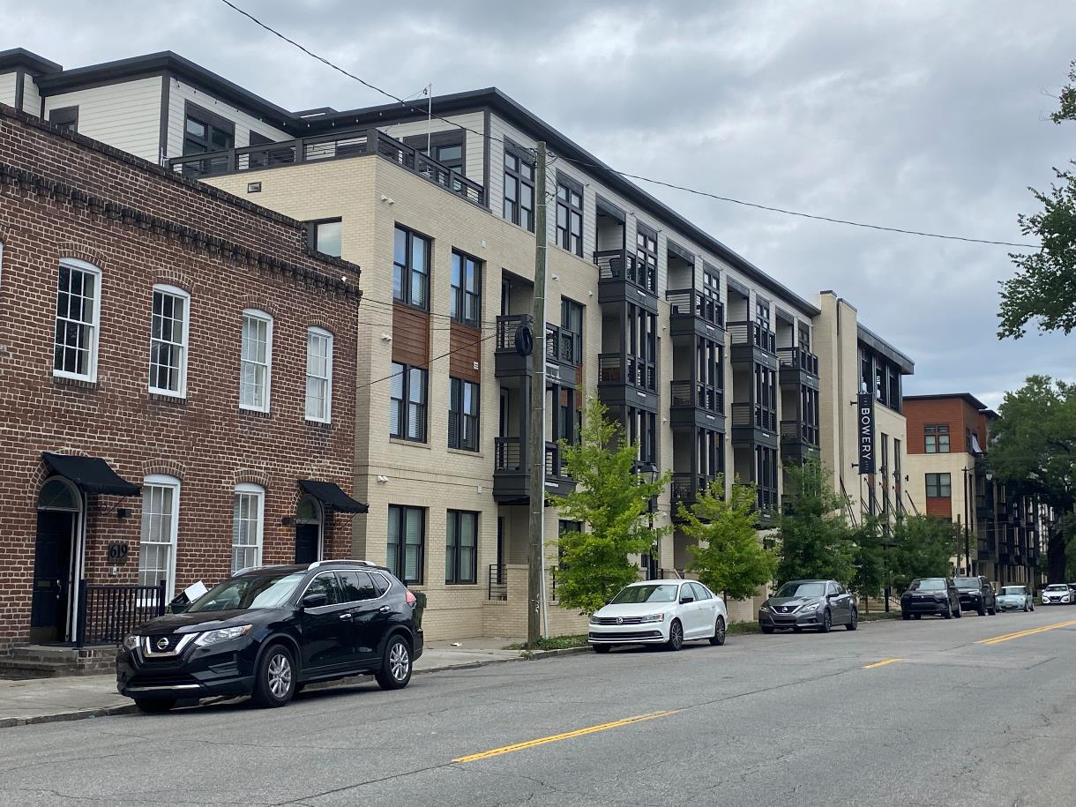
916 MLK Possibilities

Slide 24
Questions?
ADDRESSING
Putting
the
Together
Pieces
HOMELESSNESS

