Slide 1
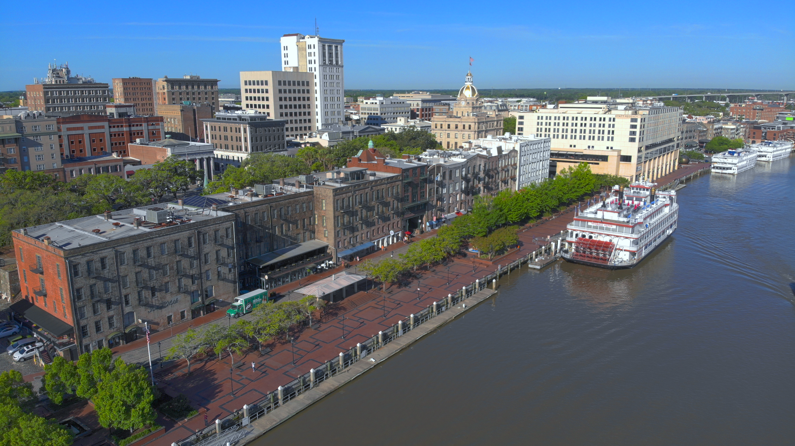

2022 Mid-Year Financial Update

Slide 2
Bottom Line Up Front
The Good News:
  Revenues are up
  Squeaky clean audit
  Good fiscal health
  Solid planning for the future
Our Challenges:
  Demand for our services is up
  Costs everywhere are rising
  Fierce competition among employers in job market
  Uncertain economic times ahead

Slide 3
Our Opportunity
Lower the Tax Rate for Residents
  Reduce Millage to lowest rate since 1987 (@ 12.20)
  Lower taxes for nearly 20,000 households
Be Aggressive with Public Safety
  Increase pay for Police & Fire by 7/30/22
  Create new pipelines & incentives for recruitment/retention
Be Smart & Flexible in Uncertain Times
  Increase Focus on Equity & Effective Service Delivery
  Meeting Emergent Needs & Retiring Liabilities Now
  Maintaining Healthy Reserves & Strong Credit Ratings

Slide 4
Starting Pay Proposal for Police Officer Recruitment & Retention
Rank | Current | Proposed
Officer | $44,330 | $50,013
Corporal | $56,280 | $62,422
Sergeant | $67,335 | $74,156
Lieutenant | $80,400 | $85,947
Captain | $96,480 | *$96,480
Major | $106,530 | *$106,530
Asst. Chief | $120,600 | *$120,600
The approximate cost of the police proposal is $3,378,867 annually.
Notes:
To address the ongoing staff shortages and challenges with law enforcement across the country and locally, the Office of Human Resources conducted its annual salary review of public safety market peers. The assessment aims to ensure the City's sworn personnel compensation remains competitive and supports SPD recruitment and retention goals.
*Command Staff Note: The survey's primary purpose is to assess the starting salaries for the rank of police officer. However, all other ranks, including the ranks of Captain and above, were also reviewed. The ranks of Captain and above are at 100% of the market, meaning Captain and above are among the highest paid in our region. For this reason, these ranks remain unchanged.
Current vacancy rate savings will fund program implementation and future funding will be incorporated in the FY’23 budgeting process. The initiatives will take effect July 31, 2022.

Slide 5
Starting Pay Proposal for Adv. Firefighter Recruitment & Retention
Rank | Current | Minimum
Adv. Firefighter | $44,330 | $48,000
Fire Engineer | $58,290 | $61,408
Fire Investigator | $58,290 | $61,408
Fire Prevention Inspector | $58,290 | $61,408
Fire Captain | $75,375 | *$75,375
Battalion Chief | $85,425 | *$85,425
Asst. Chief | $110,550 | *$110,550
The approximate cost of the Fire proposal is $896,488 annually.
Notes:
To address the ongoing staff shortages and challenges with law enforcement across the country and locally, the Office of Human Resources conducted its annual salary review of public safety market peers. The assessment aims to ensure the City's sworn personnel compensation remains competitive and supports SPD recruitment and retention goals.
*Command Staff Note: The survey's primary purpose is to assess the starting salaries for the rank of Advance Firefighter. However, all other ranks, including the ranks of Captain and above, were also reviewed. The ranks of Captain and above are at 100% of the market, meaning Captain and above are among the highest paid in our region. For this reason, these ranks remain unchanged.
Current vacancy rate savings will fund program implementation and future funding will be incorporated in the FY’23 budgeting process. The initiatives will take effect July 31, 2022.

Slide 6
Police Officer Recruitment & Retention Incentives
I. $5000 New Hire Sign-On Bonus Program:
  $1,000 @ hire
  $1,000 @ after Patrol Officer Training phase (approximately 34 weeks)
  $1,000 @ 1st year anniversary
  $2,000 @ 2nd year anniversary
II. $5000 Retention Incentive Program:
  Police Officer signs 2-year commitment agreement
  $2500 @ 3rd year anniversary
  $2500 @ 4th year anniversary
  Police Officer signs 2-year commitment agreement
  $2500 @ 5th year anniversary
  $2500 @ 6th year anniversary
III. Lateral Entry Program: The program will allow certified candidates to join SPD
and be compensated based on years of previous law enforcement experience.
Notes:
To address the ongoing staff shortages and challenges with law enforcement across the country and locally, the Office of Human Resources conducted its annual salary review of public safety market peers. The assessment aims to ensure the City's sworn personnel compensation remains competitive and supports SPD recruitment and retention goals.
Command Staff Note: The survey's primary purpose is to assess the starting salaries for the rank of police officer. However, all other ranks, including the ranks of Captain and above, were also reviewed. The ranks of Captain and above are at 100% of the market, meaning Captain and above are among the highest paid in our region. For this reason, these ranks remain unchanged.

Slide 7
FY 2022 – Final Millage Rate

Slide 8
2022 Millage Adoption
2022 Adopted Budget set a tentative millage rate at 12.739 for budget development purposes
County Assessor’s office completes development of the taxable property tax digest – June 2022
  City of Savannah sets a final millage rate for 2022 and complies with all State of Georgia requirements for adoption – July & August 2022
  Legally required notices published in newspaper beginning July 7, 2022
2023 Budget Development – using 2022 adopted millage

Slide 9

Property Taxes
General Fund’s largest revenue source
Millage Rate adopted by Mayor and Aldermen
Millage rate applies to real property, personal property
Millage rate applies to public utilities, railroad equipment, mobile home, legacy vehicles
Values set by the County’s Assessor's Office
Notes:
General Fund’s largest revenue source which accounts for 33.2% of the 2022 adopted budget and $83,009,304 budgeted for 2022 in collections across all types.
Millage rate adopted by Mayor and Aldermen of City of Savannah, in which the process is dictated by state law.
Millage rate applies to: Real property such as land and buildings; Personal property such as boats, business furniture & fixtures, aircraft, etc.; Public utilities such as airlines, telephone, electric, etc.; Railroad equipment; Mobile homes; and Legacy vehicles

Slide 10
City of Savannah – Tax Digest Results
Modest growth has occurred each year since 2017, annual average of 6%
Much of the growth in 2022 is attributable to significant increases in reassessment value
The assumed collection rate for projections is 88%

Slide 11
Property Tax Projection
 | Millage Rate | Taxable Assessed Value | 2022 Revenue Projection | 2022 Adopted Budget | Variance with Budget
2022 Budgeted Millage Rate | 12.739 | $7,368,703,803 | $82,464,420 | $75,693,499 | $6,770,921
2022 Proposed Millage Rate | 12.200 | $7,368,703,803 | $78,975,267 | $75,693,499 | $3,281,768

Slide 12
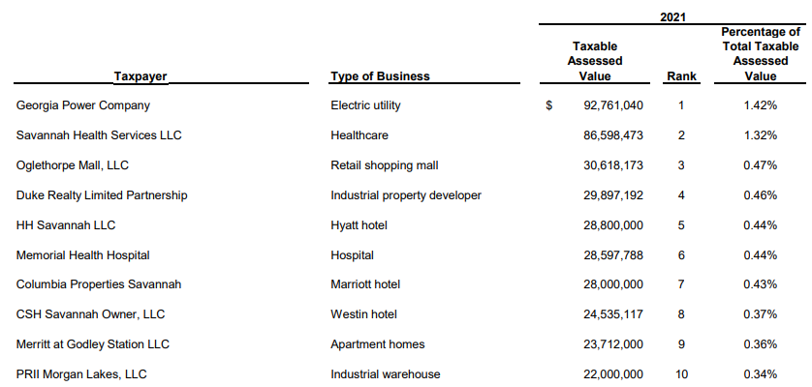
Largest Property Taxpayers

Slide 13
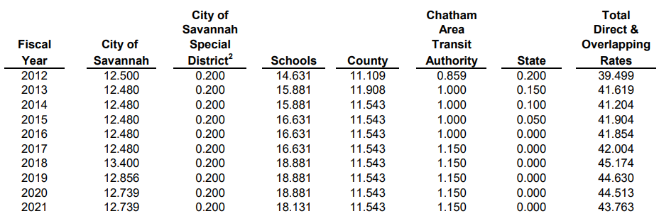

City of Savannah, Georgia
Direct & Overlapping¹ Property Tax Rates, Last Ten Fiscal Years

Slide 14
2022 Property Tax Calendar
Initial Consideration | Budget Retreat-November 2021
Receive Digest from Chatham County | June 1, 2022
Workshop Discussion | July 14, 2022
Advertisement of 5-Year History, 1st and 2nd Public Hearing | July 7, 2022
Public Hearing 1 | July 14, 2022
Public Hearing 2 | July 28, 2022 (Special Meeting)
Public Hearing 3/Adoption of Millage Rate | July 28, 2022
Begin 2nd Installment Property Tax Billing | September 15, 2022
2nd Installment Property Tax Bills Due | November 15, 2022
Notes:
Public hearings and final rate adoption:
July 14, 2022 (workshop and council meeting)
July 28, 2022 (council meeting)
Second installment property tax bills are issued – September 2022
Second installment property tax bills are due – November 2022

Slide 15

FY 2021
YEAR END FINANCIAL RESULTS

Slide 16
What is the Annual Comprehensive Financial Report (ACFR)?
It is not the budget, which presents planned revenues and expenditures of certain funds.
The ACFR reports the actual financial condition of the government based on what actually happened. Unlike the budget, the ACFR reports all the funds of the City.
The ACFR is prepared under the accounting and reporting standards outlined by the Government Accounting Standards Board (GASB).
The report is prepared by the City and is then audited by external auditors using generally accepted auditing standards.
The Annual Comprehensive Financial Report is divided into three sections:
  The Introductory Section includes information about the City’s organizational structure, the principal officials, and summarized data reflecting the financial condition of the City, including an analysis of the general government operations, enterprise operations, debt administration, and investment portfolio.
  The Financial Section includes the independent auditors’ report, the management discussion and analysis (MD&A), the basic financial statements, and notes to the financial statements. The basic financial statements include columns of aggregate data that have been summarized from the more detailed statements which follow.
  The Statistical Section includes selected financial data trends of the City and its operations, along with local demographic and economic information that may be of interest to potential investors of our bonds and to other readers. The data also reflects 10-year revenue and expenditure information for various categories of City operations.
Notes:
NOTE: ACFR (ack-fur) – Annual Comprehensive Financial Report is the recommended initialism/order replacing “CAFR” which sounds like a racial slur in some languages.

Slide 17
2021 Financial Results Highlights
Entity Wide Results (ACFR pages 15 and 16)
Assets and deferred outflows of resources exceeded liabilities and deferred outflows by $1,683,612,990 (net position)
Net Position Consists Of:
  Unrestricted of $248,626,647
  Restricted of $158,434,046
  Net capital assets of $1,276,552,297
Total net position increased by $99,938,977 during 2021
  80.1% of the increase is attributable to governmental activities
  19.9% is attributable to business-type activities

Slide 18
Entity-wide Revenues

Slide 19
Entity-wide Expenses

Slide 20
2021 General Fund Comparative Results -
Revenues

Slide 21
2021 General Fund Comparative Results –
Revenues

Slide 22
2021 General Fund Comparative Results -
Expenditures

Slide 23
2021 General Fund Comparative Results –
Expenditures

Slide 24
2021 General Fund Comparative Results – Fund Balance

Slide 25
2021 General Fund Comparative Results – Total Fund Balance

Slide 26
2021 General Fund Comparative Results – Fund Balance

Slide 27
Business-type Funds –
2021 Operating Results

Slide 28
Benefit Trust Funds – 2021 Operating Results

Slide 29
2021 Debt Activity - Governmental

Slide 30
2021 Debt Activity – Business Type

Slide 31
STATE OF THE BUDGET
through May 31st

Slide 32


Budget by the Numbers
FY 2022 Totals at a Glance
FY 2022 Approved Budget
$479M
FY 2022 Authorized Positions
2,478.94 FTEs
FY 2022 Funding Sources
Tax Supported 71.4%
Grants 0.4%
Fees/Other 28.2%

Slide 33
2022 Adopted General Fund
Budget Overview
Budget Goals
Equitable Path to Sustained Recovery & Growth
Healthy & Vibrant Neighborhoods
Gun/Violent Crime Reduction
Affordable Housing Investments & Homelessness Solutions
Effective & Reliable City Services
Organizational Investments
Notes:
Per the City Manager’s message, this budget strives to provide an equitable path to recovery & sustained growth while making strategic investment in our neighborhoods. The FY22 budget funds holistic strategies to reduce gun violence and violent crime, including facility and technology investment, as well as neighborhood safety and engagement. We are making unprecedented investments in affordable housing collaborative initiatives to provide scaled solutions where they’re needed most, from preserving existing affordable housing stock to supporting our neighbors experiencing homelessness. The FY22 budget also aims to get us “back to basics” by investing in our infrastructure and City service deliverables, as well as investing in our workforce.

Slide 34
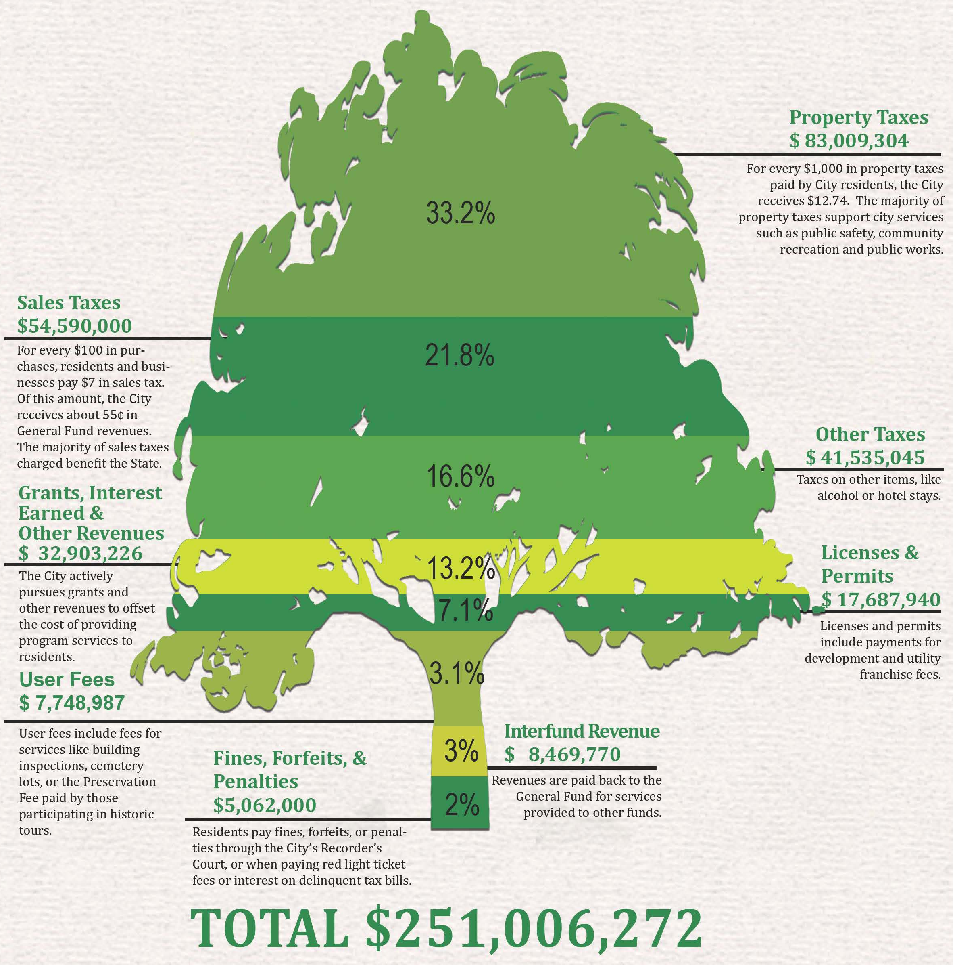
Where Does The Money Come From???
Notes:
Property-related and Sales Tax revenues make up 55% of Total Revenues which offset 49% of Total Expenditures attributed to workforce needs alone.

Slide 35
General Fund
All Revenues - January through May
Notes:
The economic recovery trends we saw in FY21 continue through May of FY22, with General Fund revenues actualizing at their highest level since before the 2018 recession, 6% above FY17 totals through May.

Slide 36
General Fund – January through May
Revenue Variances – 2021 v 2022
Revenue Category | FY2022 | FY2021 | Variance ($)
Property Tax | $19,517,543 | $16,456,078 | $ 3,061,465
Sales Tax | 26,309,600 | 20,948,420 | 5,361,179
Other Taxes | 8,539,562 | 7,587,225 | 952,337
Hotel/Motel & Auto Rental | 7,160,962 | 3,925,161 | 3,235,801
Lic/Permits, Fees & Fines | 10,871,964 | 9,742,775 | 1,129,190
Recreation Fees | 321,849 | 167,179 | 154,670
Inspection Fees | 2,160,673 | 2,051,059 | 109,615
Public Safety Reimb | 537,499 | 489,005 | 48,494
Grants | 276,484 | 298,215 | (21,731)
Interfund Revenues | 3,467,094 | 3,339,178 | 127,917
Other Revenues | 1,373,868 | 2,316,763 | (942,895)
Total | $80,537,098 | $67,321,056 | $13,216,041
Notes:
FY22 GF revenue collections through May are up in nearly every category, with increases in Hotel/Motel, Sales Tax, and Property Tax the primary drivers of the $13m increase. INTERNAL NOTE: The tax accounts don’t show the difference between private and commercial property taxes, so I would not recommend showing a breakdown – we don’t have the info to communicate things like the delinquent tax account increase is driven by hotel properties rather than private.
That is more an internal note, if the question is about the delinquent tax account, then it can be mentioned it is a result of commercial businesses paying back taxes, and we should not expect the same growth in FY23. (SJJ)

Slide 37
General Fund Portion of Hotel/Motel Taxes & LOST
January through May
Notes:
Year-over-year trends for LOST and Hotel/Motel/Auto revenue collections through May demonstrate the link between our tourism industry and our sales tax performance, with both showing recovery and growth as we move through this economic volatility.

Slide 38
Expenditure Performance
2020–2022 Year-over-Year
($ in Millions) | 2020 May Act a | 2021 May Act b | 2022 May Act c | Variance to 2020 c-a | Variance to 2021 c-b
Personnel Services | $ 48.8 | $ 47.5 | $ 47.9 | $ (0.9) | $ 0.4
Outside Services | 10.5 | 9.6 | 9.4 | (1.1) | (0.2)
Commodities | 2.4 | 2.0 | 2.8 | 0.4 | 0.8
Internal Services | 10.3 | 12.0 | 12.0 | 1.7 | -
Capital Outlay | - | - | 0.1 | 0.1 | 0.1
Interfund Transfers | 2.5 | 7.7 | 56.5 | 54.0 | 48.8
Other Expenses | 4.1 | 3.7 | 4.1 | - | 0.4
Total | $ 78.6 | $ 82.5 | $132.8 | $ 54.2 | $ 50.3
Notes:
Now that we have reviewed the revenue flows in, let’s look at the other side of the coin, which is cash going out. When we look at how our operating costs are performing through the first five months of 22 as compared to the two prior fiscal periods, we can start to see trends in how the economic climate is impacting our operations. (click)

Slide 39
Expenditures Performance
2020–2022 Year-over-Year
($ in Millions) | 2020 May Act a | 2021 May Act b | 2022 May Act c | Variance to 2020 c-a | Variance to 2021 c-b
Personnel Services | $ 48.8 | $ 47.5 | $ 47.9 | $ (0.9) | $ 0.4
Outside Services | 10.5 | 9.6 | 9.4 | (1.1) | (0.2)
Commodities | 2.4 | 2.0 | 2.8 | 0.4 | 0.8
Internal Services | 10.3 | 12.0 | 12.0 | 1.7 | -
Capital Outlay | - | - | 0.1 | 0.1 | 0.1
Interfund Transfers | 2.5 | 7.7 | 56.5 | 54.0 | 48.8
Other Expenses | 4.1 | 3.7 | 4.1 | - | 0.4
Total | $ 78.6 | $ 82.5 | $132.8 | $ 54.2 | $ 50.3
Notes:
Even with Public Safety step increases and a cost-of-living adjustment bringing all employees to a minimum of $15/hr, the FY22 actuals through May for our primary expense category, Personnel, are tracking fairly level with the FY21 actuals, and behind FY20 actuals through May. Level/decreasing actuals for personnel costs after increasing budgeted wages City-wide demonstrates the staffing challenges we are currently facing. Similarly, decreases in outside services reflect reduced contractor availability rather than reduced unit costs or reduced City demand. Businesses nationwide are experiencing the same staffing and procurement challenges as the City. Supply chain challenges likely depressed FY21 actuals through May, and while some lags persist, improving supply chain conditions coupled with inflationary unit cost pricing has increased FY22 actuals for Commodities by 40% over FY21 and 17% over FY20 Actuals through May. (click)
INTERNAL NOTE: Although staffing challenges exist nationwide, please the state of Georgia unemployment is 3% as of May 2022. (SJJ)

Slide 40
Expenditures Performance
2020–2022 Year-over-Year
($ in Millions) | 2020 May Act a | 2021 May Act b | 2022 May Act c | Variance to 2020 c-a | Variance to 2021 c-b
Personnel Services | $ 48.8 | $ 47.5 | $ 47.9 | $ (0.9) | $ 0.4
Outside Services | 10.5 | 9.6 | 9.4 | (1.1) | (0.2)
Commodities | 2.4 | 2.0 | 2.8 | 0.4 | 0.8
Internal Services | 10.3 | 12.0 | 12.0 | 1.7 | -
Capital Outlay | - | - | 0.1 | 0.1 | 0.1
Interfund Transfers | 2.5 | 7.7 | 56.5 | 54.0 | 48.8
Other Expenses | 4.1 | 3.7 | 4.1 | - | 0.4
Total | $ 78.6 | $ 82.5 | $132.8 | $ 54.2 | $ 50.3
Notes:
The dramatic increase in the Interfund Transfers FY22 actuals through May is due to the unprecedented contribution to capital, primarily due to the $39M ARPA revenue replacement dedicated to capital improvements, as well as the $7m investment in the SAHF. Note: This is the actualization of the transfer from the General Fund to the Capital Fund. The projects and initiatives therein are still in progress. Additional adjustments to increase the contribution to capital are anticipated to address priority projects, infrastructure needs, and environmental challenges, as well as existing project budgets that will require additional funding due to contractual service and commodity price inflation. INTERNAL NOTE: at least $11.5M pending, not shown in this total: the FY22 Q1 CIP BA includes $1m GF to Gwinnett St, Q2 CIP BA includes $2.5m to Benton Blvd, and we have $2.3m for the riverwalk, $300k+ for Cleland St, $500k for waterworks lot, pending, plus at least $2.5m for Southside Comm ctr & $700k for Dundee, and maybe $1.7m for Dawes prefunding.

Slide 41
General Fund Budget Stable through first five months of operations
Positive variances in revenue base resulting from growth will allow city to:
- Sustain planned capital investments
- Attract high quality personnel
- Flexibility to weather economic volatility and upcoming recession
- Explore innovative ways to address challenges
- Retain a diverse and safe work environment
Notes:
In summary, the state of the General Fund Budget is stable at Mid-Year primarily due to positive variances from growth in the Digest that we are hoping will be realized by year-end, coupled with continued discretion related to spending for the remaining six months in the fiscal year, although inflation is a negative factor in which we must monitor. This will allow for further stability to implement Public Safety pay incentives, which the City Manager mentioned earlier in the presentation. This will allow the City to continue the loved services to residents and visitors.
"2022Approved Budget" "2022 Mid-Yr Forecast"
Personnel Costs
Outside Services
Commodities
Internal Services
Capital Outlay
Interfund Transfer (Balancing line: 10,183,439-11099234 equals $915,795
Other Expenses
Total

Slide 42
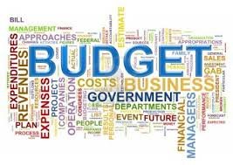

FY 2023 Budget Plan
Notes:
Now its time for us to take everything we have discussed up to this point and apply it to key decision making that will impact the remaining half of this year, but will also set our financial position for the upcoming FY 2023.

Slide 43

Developing the Budget Plan
Set the Millage Rate
Address Budget Challenges & Opportunities
Review of Chatham County Board of Assessors’ 2022 Tax Digest
Comply with State Law Requirements
  Host Public Hearings
  Ratify Millage Rate Adoption
Report, Implement and Administer
Develop a baseline projection of revenues and expenditures
Establish priorities and develop strategies, implementation plans and timelines to achieve them that are SMART
Identify and evaluate budgetary challenges to achieve desired outcomes
Develop short and long-term strategies in response to multi-year planning related to budget position, structural position, and community goals in a quantified, analytical, and logical manner
Notes:
How do we begin putting the pieces together that will enhance the building blocks of the Proposed Budget for next year? #1 – We need to set the Millage Rate – We have a few action items to be completed and David will walk us through that timeline.
#2- We need to address challenges & opportunities raised as a part of the budget development process. Today’s discussion on budget planning will be the first of three information sessions we plan to have with you before December.

Slide 44

Budget Development began after Council Visioning Session Feb 7, 2022
Budget Policy
All funds are required to balance
Expenditure budgets for enterprise operations must be funded either exclusively or primarily by user fee revenues
  Water/Sewer
  Sanitation
  Mobility and Parking
  Civic Center
Each activity within a fund is advised to prepare a performance plan consisting of goals, objectives and specific benchmarks to be considered for adequate levels of funding in the full scope of the operating budget
Allocations are based on a long-range financial plan which includes an unassigned fund reserve
Funding ongoing expenses with non-recurring or one-time revenue sources is not a recommended practice

Slide 45
OPPORTUNITIES & CHALLENGES

Slide 46
Budget Challenges
Budget Goals
Inflation/Rising Costs
  Personnel
  Commodities
  Outside Services
Environmental Challenges
Deferred Capital Investment
Operation & Maintenance of New Capital Assets
LOST Share Renegotiation
Equitable Path to Sustained Recovery & Growth
Healthy & Vibrant Neighborhoods
Gun/Violent Crime Reduction
Affordable Housing Investments & Homelessness Solutions
Effective & Reliable City Services
Organizational Health
Notes:
Annually, we re-evaluate our Multi-Year Financial Plan as it relates to our financial net position and community goals. As we collaborate to achieve an equitable path to sustained recovery & growth that results in healthy neighborhoods, violent crime reduction, affordable housing investments and homelessness solutions that make us more effective and efficient while funding necessary organizational investments, we have existing challenges such as: Price inflation impacting our procured goods and services as well as our personnel related to the great resignation impacting recruitment and retention. FY22 expenses, not including annual singularities such as one-time ARPA capital investments and accounting transfers, are budgeted 3.7% above the FY21 adopted budget. However, these increases are primarily for planned service delivery enhancements and resumption of activities reduced or suspended through the pandemic, rather than to account for inflation. So in our 2023 planning approach, additional revenue will be required to address continued rising costs within the operating and capital plans in order to achieve the service goals upon which the budget plan is being built.

Slide 47
Budget Challenges
Budget Goals
Inflation/Rising Costs
  Personnel
  Commodities
  Outside Services
Environmental Challenges
Deferred Capital Investment
Operation & Maintenance of New Capital Assets
LOST Share Renegotiation
Equitable Path to Sustained Recovery & Growth
Healthy & Vibrant Neighborhoods
Gun/Violent Crime Reduction
Affordable Housing Investments & Homelessness Solutions
Effective & Reliable City Services
Organizational Health
Notes:
Coastal environmental challenges, particularly related to drainage and redevelopment of underutilized sites, require additional geotechnical investment and remediation to complete projects that support our strategic goals, particularly in the areas of recovery & growth, healthy neighborhoods, housing solutions, and effective City services. Longstanding deferred maintenance and investment shortfalls have similarly resulted in increased costs for correction, as well as procurement costs that have increased since project budgets were originally established. These findings will likely result in our capital investment needs this year to surpass our original GF allocation by $10M. (GF: $10M; ARPA: $39M)

Slide 48
Budget Challenges
Budget Goals
Inflation/Rising Costs
  Personnel
  Commodities
  Outside Services
Environmental Challenges
Deferred Capital Investment
Operation & Maintenance of New Capital Assets
LOST Share Renegotiation
Equitable Path to Sustained Recovery & Growth
Healthy & Vibrant Neighborhoods
Gun/Violent Crime Reduction
Affordable Housing Investments & Homelessness Solutions
Effective & Reliable City Services
Organizational Health
Notes:
We have followed prudent fiscal practices by largely investing one-time revenues in one-time initiative start-up costs and capital investment. However, we will need to ensure that we continue to plan and budget for maintenance and operation of new facilities, infrastructure, technology, and service-delivery initiatives brought online as a result.

Slide 49
Budget Challenges
Budget Goals
Inflation/Rising Costs
  Personnel
  Commodities
  Outside Services
Environmental Challenges
Deferred Capital Investment
Operation & Maintenance of New Capital Assets
LOST Share Renegotiation
Equitable Path to Sustained Recovery & Growth
Healthy & Vibrant Neighborhoods
Gun/Violent Crime Reduction
Affordable Housing Investments & Homelessness Solutions
Effective & Reliable City Services
Organizational Health
Notes:
Another challenge that we have to factor in is that we are in LOST negotiations with the county and our neighbor municipalities, and we expect a reduction in the City of Savannah share which will impact our revenue base for a 10-year period. Similarly, we are also awaiting the outcome of TSPLOST as it has the potential to positively impact our Five-Year Capital Improvement Plan Budget.

Slide 50
Budget Opportunities
Stronger than anticipated economic recovery
  11.3% increase in FY22 budgeted revenue
  19.6% increase in FY22 revenue collections thru May
Hotel/Motel
Sales Tax
Property Tax
Notes:
So as we work our way through this approach, we also have a keen outlook on where our bright spots are peeking through or where we can strengthen the City's financial position. We call these opportunities. The strongest opportunities from a financial mindset help us to address our budget challenges. FY21 revenues, particularly for revenue streams related to the City’s tourism industry, were budgeted anticipating pandemic-related economic cooling. As we saw strong recovery through FY21, we budgeted FY22 non-ARPA revenues 11.3% higher than FY21. Actual FY22 collections through May lead FY21 collections through May by 19.6%, primarily driven by Hotel/Motel, Sales, and Property tax performance.

Slide 51
Budget Opportunities
Fund Necessary Adjustments
Make Additional Investments
Maintain Fiscally Responsible Multi-year Plan
Reduce the Millage
Notes:
The current revenue trend provides us the opportunity to fund necessary budget adjustments addressing increased costs, make additional investments to address staffing and public safety goals, and still lower the millage rate while maintaining fiscally responsible multi-year planning.

Slide 52
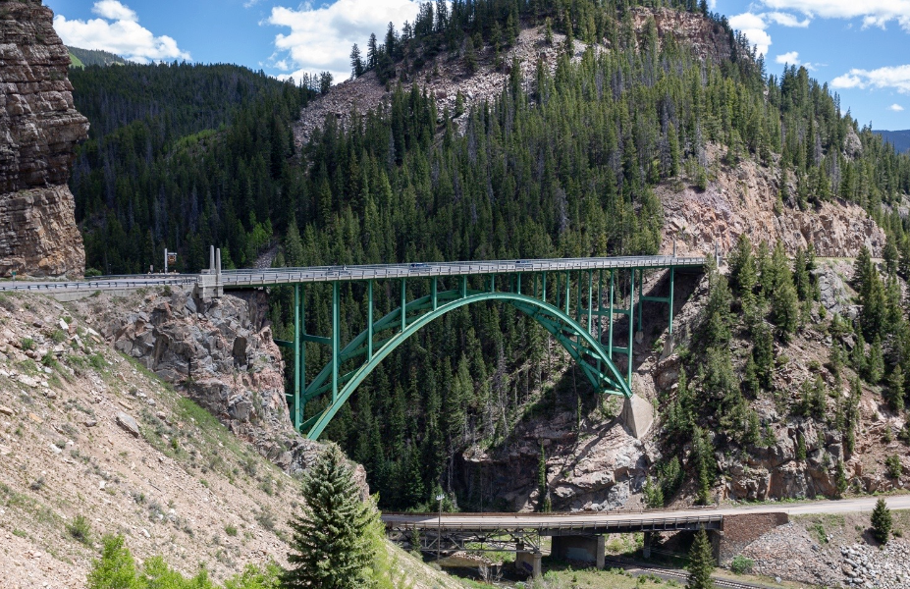
Budget Opportunities
Budget Process
  Alignment between current assets, resources needed, and service delivery outcomes
  Department-identified efficiencies
Current Assets/
Where We Are
Service Delivery Goals
Budget/
Resources
Notes:
Although revenues are currently trending strong, economic cooling or potentially a recession can be reasonably expected. So our FY23 budget process seeks to connect resources requested with service delivery outcomes so that if our revenue trend reverses, we know the workplan impact if we have to reduce our expenses. The City Manager has also tasked the departments with identifying efficiencies that will reduce costs or make us more effective without impacting service delivery.

Slide 53
What is our Multi-Year Planning Approach FY2023-FY2027?
Baseline Diagnosis 2023-2027
Diversify Revenue Streams
Increase Operational Efficiencies
Increase Capital Investments
Implement Risk Management Strategies
Notes:
The purpose of the baseline projection is to allow leadership to understand the magnitude of potential long-term deficits and the future impact of decisions made this year.
Capital contributions are not enough. Stormwater Management is a major area of risk throughout our community and we have sustained major claim settlements of $25M over the last ten years.

Slide 54
General Fund Forecast
FY22 is a preliminary estimate
Notes:
The five-year General Fund forecast, demonstrates how the adoption of the millage rate presented today impacts the future financial stability of the City. It is important to note at the reduced millage rate of 12.200, the General Fund is balanced from 2023-2027, although we must continue to monitor the forecast, as economic activity changes over time. At a millage rate of 12.200 the City will be able to continue making sound investments in housing and homelessness, capital investments such as the widening of Benton BLVD, and investments in Team Savannah.
A multi-year financial plan helps us think through our financial position and community goals in a quantified, analytical, logical way:
A baseline projection is like the diagnosis your doctor gives you after a physical. It reflects the City’s current condition, absent significant changes
For revenues, this means no assumed changes in tax rates;
For expenditures, this means no assumed new hiring or workforce adjustments that deviate from recent trends
Growth rates have been applied to project revenues and expenses in future years, which reflect inflation, known or assumed growth in revenue collections and expenses, and other known events

Slide 55
Breaking the Cycle
Embrace a long-term financial planning approach includes a menu of initiatives, treatment options, and corrective actions to balance policy & operational goals
  A “get through the year” approach will not address several broad issues, challenges, or goals & desires
What we are doing today, plan to do tomorrow, and hope to do in the future
Planning & Performance
Capital Improvement Program
Targeted Workforce Initiatives
Equity & Community Wellbeing
Housing & Neighborhoods
Deferred Maintenance & Aging Infrastructure Needs
Poverty & Economic Opportunity
Notes:
This is my mental Vision Board as the Budget Director because what we are doing today, plan to do tomorrow and hope to do in the future is impacted by our long-term planning approach on a continuum.

Slide 56
A Plan for Fiscal Sustainability
Based on larger strategic goals, the FY 2023 Budget Proposal seeks to outline a series of opportunities in the following areas:
Modernizing services to ensure services provided to citizens are cost-efficient and effective
While efforts are focused on areas where the City currently spends the most, we cannot overlook opportunities to leverage existing assets or generate additional revenue in order to provide services
The ultimate goal is to free up sufficient fiscal capacity to impact the baseline forecast and solve its most pressing issues, including the need to continue investments in current strategies under way that are intended to revitalize neighborhoods and enhance equity
Notes:
In Summary, our ongoing plan for fiscal sustainability into FY23 is to continue modernizing services where possible, leverage existing assets or diversify our revenue base to reduce reliance on our tax payers to positively impact the baseline and sustain continued investments.

