Slide 1
2020 Budget Update Putting the pieces together
Council Workshop October 22, 2020

Slide 2
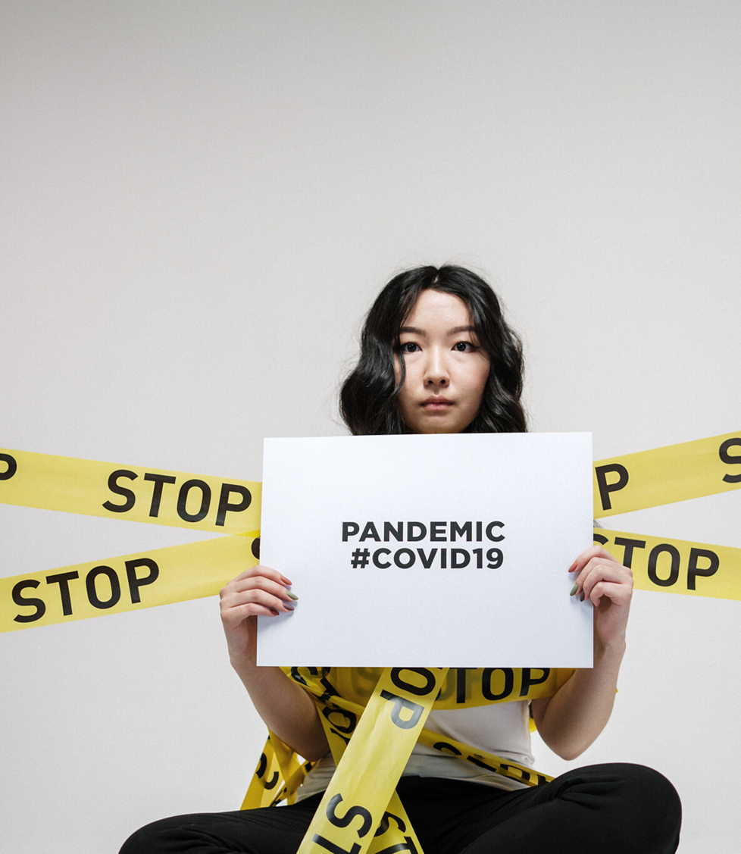
What is the Big Picture….
Revenues are projected to be app. $7.5M lower than the original budget.
Expenditures are projected to be $3.5M lower than the original budget.
Projected revenues and expenditures are NOT balanced by $4,010,035.
This imbalance will be addressed over the remaining fiscal period according to our Re-Balancing Strategy discussed at mid-year.
Notes:
Note: The projected GF net deficit of $4.5M does not include any subsidies to Special Revenue/Enterprise Funds that will be needed in final balancing. I.e., Haz-Mat, Civic Center, and Grant Funds.

Slide 3
Mid-year Budget Update sounded an alarm of a nearly $13.2M net deficit. After deploying a tiered strategic approach, Updated revenue and expense projections for the General Fund show a net operating deficit of $4M
 | Adopted Budget | Updated Projection | Variance
2020 Revenue | $208,263,831 | $200,674,935 | $7,588,896
2020 Expenses | $208,263,831 | $204,684,970 | $(3,578,861)
Net Surplus/(Deficit) |  | $ (4,010,035)
Notes:
Include Note: Projections are at the budgeted millage rate of 12.856.

Slide 4
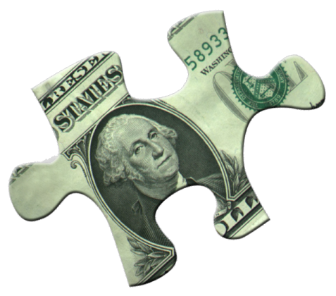
Tier 1 Strategy: (Rebalancing based on revised projections)
$4.5 mill personnel cost savings due to natural attrition
1% - 3% cut to Operations
$500,000 OPEB draw
$456,800 GO Bond Debt Service
Draw from surplus property sale holdings
Tier 2 Strategy: (Revenue projections worsen)
Additional Draw from surplus property sale holdings
Tier 3 Strategy: (Draw from Reserves)
Draw from Sales Tax Stabilization Reserve
Tier 4 Strategy: (Draw more from Reserves)
Employee Furloughs
Draw from GF Unreserved Fund Balance
Tier 5 Strategy: (Worst-case scenario)
Reduction-In-Force(Lay-offs), Property Tax Increase, Privatization of Services
Notes:
Due to changes in the allowable CARES ACT reimbursement strategy, we were not able to realize the $4.5M in personnel cost savings since Hazard Duty Pay was not deemed reimbursable. Actuals were able to be reduced by $2.37M (so almost there but not quite). Hazard Pay for GF cost us $1.13M ($1.57M city-wide)

Slide 5
THANK YOU

