Slide 1

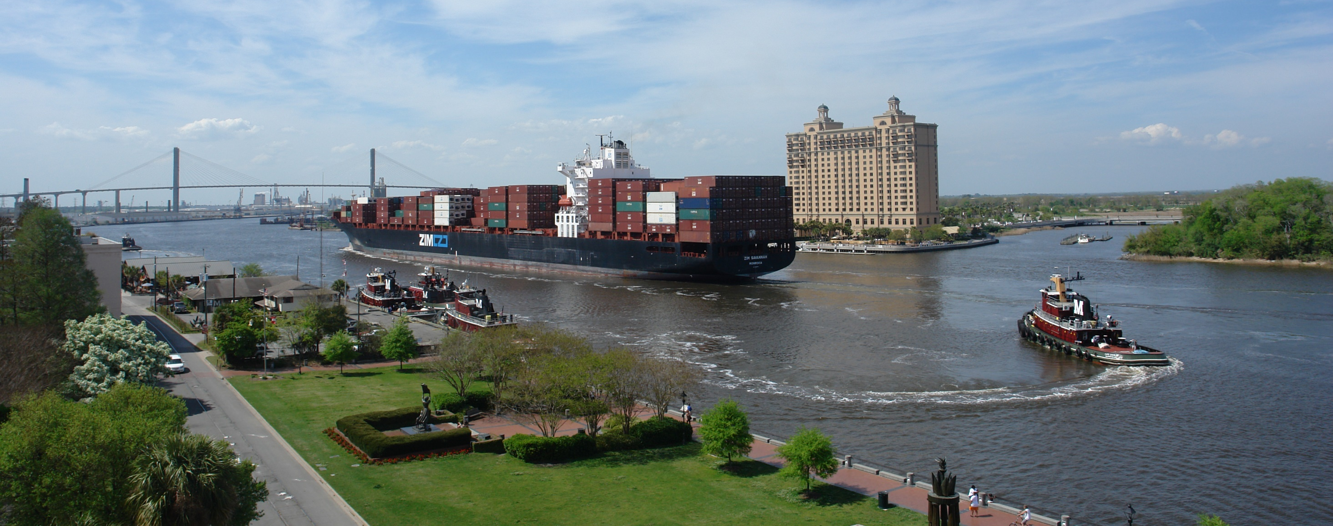
Enterprise Fund Overview
2018 Preliminary Budget
November 21, 2017

Slide 2


What is the Water and Sewer Fund?
A business-type enterprise fund
A separate, self balancing set of accounts for rate making purposes
Assets owned by the fund include:
  Water wells = 50
  Elevated tanks = 8
  Miles of water lines = 980
  Miles of sewer lines = 850
  Lift stations = 196
Value of fixed assets at 12/31/2016:
Land $ 1,976,460
Operating plants 522,440,410
Machinery and other 8,019,381
Total $ 532,436,251

Slide 3

Public Works and Water Resources
CITY OF SAVANNAH, GEORGIA
WATER SYSTEM PRODUCTION AND NUMBER OF SYSTEM CUSTOMERS
LAST 10 CALENDAR YEARS
 |  | Ground Water Production |  |  |  | Surface Water Production
 |  | Daily |  | Peak |  | Daily |  | Peak |  | Number of |  | Number of
 |  | Average |  | Day |  | Average |  | Day |  | Water |  | Sewer
Year |  | (MGD) |  | (MGD) |  | (MGD) |  | (MGD) |  | Accounts¹ |  | Accounts¹
2007 |  | 25.59 |  | 34.17 |  | 29.92 |  | 44.06 |  | 88,891 |  | 86,533
2008 |  | 25.03 |  | 33.70 |  | 28.43 |  | 42.20 |  | 90,398 |  | 87,975
2009 |  | 23.39 |  | 31.55 |  | 27.51 |  | 38.16 |  | 91,722 |  | 89,162
2010 |  | 23.36 |  | 32.97 |  | 32.53 |  | 43.67 |  | 91,931 |  | 89,388
2011 |  | 22.86 |  | 31.82 |  | 30.00 |  | 43.55 |  | 92,130 |  | 89,573
2012 |  | 21.88 |  | 29.92 |  | 29.11 |  | 43.03 |  | 92,438 |  | 89,882
2013 |  | 21.59 |  | 31.49 |  | 28.70 |  | 41.29 |  | 92,509 |  | 89,939
2014 |  | 21.71 |  | 31.21 |  | 29.89 |  | 39.65 |  | 93,713 |  | 91,141
2015 |  | 20.42 |  | 28.79 |  | 30.71 |  | 42.36 |  | 94,545 |  | 91,955
2016 |  | 22.44 |  | 30.75 |  | 34.18 |  | 51.11 |  | 95,228 |  | 93,302
¹ | Water and Sewer account counts based on the total dwelling units served.

Slide 4

Strategies for Water and Sewer Rates
The water and sewer fund should be self supporting
  New growth pays its own way – connection fees, tap fees, etc.
  Maintenance and repairs should be fully funded in order to provide for efficient system operations
Systematic, small rate adjustments as opposed to large, haphazard increases
Limited reliance on borrowed funds; however, financial conditions should allow for inexpensive credit when required (bond rating)
Long term planning to provide funding for the capital needs of the fund

Slide 5

Water and Sewer Rate Setting
Encompasses the following:
Assumptions for new growth
Assumptions for water/sewer usage
Assumptions for increased costs
Assumptions for rate increases
Assumptions for capital needs
Assumptions for borrowing costs
Cash flow needs
Coverage requirements for bond covenants

Slide 6
Water and Sewer Operating Net Revenues
Projected Coverage for Water and Sewer Fund
Years ended December 31
Amounts in Thousands (000)
 |  | Actual | Actual | Actual | Actual | Projected | Projected
 |  | 2013 | 2014 | 2015 | 2016 | 2017 | 2018
Water sales |  | $ 20,230 | $ 19,488 | $ 19,018 | $ 21,894 | $ 21,860 | $ 22,639
Sewer sales |  | 31,587 | 32,731 | 33,116 | 36,097 | 37,842 | 39,129
Connection fees |  | 3,951 | 4,897 | 4,791 | 4,136 | 4,222 | 4,222
Miscellaneous |  | 1,317 | 4,802 | 4,745 | 4,060 | 4,922 | 5,053
 | Gross revenue | 57,085 | 61,918 | 61,670 | 66,187 | 68,846 | 71,043
Operating expenses |  | 37,134 | 38,851 | 40,841 | 40,340 | 43,597 | 45,467
 | Net revenue | 19,951 | 23,067 | 20,829 | 25,847 | 25,249 | 25,576
Debt service |  | 2,360 | 4,760 | 4,537 | 6,037 | 3,231 | 4,851
 | Total debt service | 2,360 | 4,760 | 4,537 | 6,037 | 3,231 | 4,851
Amount available for capital program |  | $ 17,591 | $ 18,307 | $ 16,293 | $ 19,810 | $ 22,018 | $ 20,725

Slide 7
Water and Sewer Debt Outstanding
The Water and Sewer system issues revenue bonds to raise funds within the capital markets. These bonds are issued by the City of Savannah and are security solely by the net revenues of water and sewer system. The system receives its own credit rating as such from the major rating agencies. The current bond ratings are: Moodys (Aa1) and Standard & Poors (AA+)
In addition to the payable amounts listed above, the fund has contracted with GEFA (Georgia Environmental Finance Authority) for a $28 million loan to construct a new biosolids handling facility at the President Street Wastewater Treatment Plant. The City began drawing down this loan in 2017 and will begin debt service payments at the time of facility completion at 1.03% interest. This project was necessary due to federal clean air standards.

Slide 8
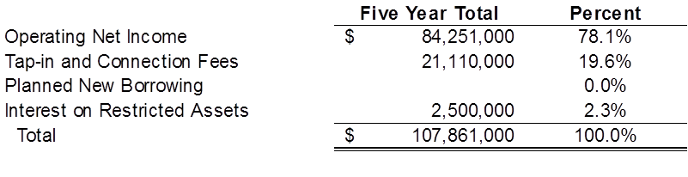

Water and Sewer Capital Plan

Slide 9
Water and Sewer Rate Plan

Slide 10
Water and Sewer Rate Plan

Slide 11
How Do Our Water and Sewer Charges for the Median Customer Compare?
The biennial survey – which notes again this year that water and wastewater rate increases outpaced the Consumer Price Index -- is a joint effort of AWWA and Raftelis Financial Consultants, a national leader in conducting surveys and analyzing water, wastewater, and stormwater rates and charges.
Among all utilities that responded -- using the benchmark usage level of 7,480 gallons – the median monthly charge was $34.61 last year for water, and $42.20 for wastewater.

Slide 12
Issues affecting Water and Sewer utility rates within the City of Savannah system
Increases in the cost of electricity, chemicals and fuel
Further groundwater use restrictions
Reuse water production and distribution capital costs
Total maximum daily load (TMDL) standards and more stringent sewage treatment requirements
More stringent air pollution requirements

Slide 13
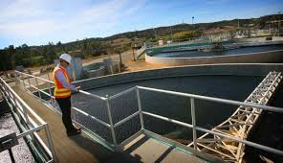

Water and Sewer Capital Plan
Major projects include:
President Street Biosolids Handling Facility
Crossroads/Travis Field Wastewater Treatment Plant Expansion/Construction
Reuse Water Lines
President Street Plant Expansion/Upgrades and Capital Maintenance

Slide 14
WATER/SEWER FUND
USE AND SOURCE OF FUNDS
FY 2018 Proposed: | $ 71,026,971
FY 2017 Amended: | $ 68,680,256
SOURCES
USES

Slide 15
WATER/SEWER FUND
BUDGET HIGHLIGHTS & CHALLENGES
BUDGETED FTEs | FY16 | FY17 | FY18
Water Fund | 129 | 129 | 137
Sewer Fund | 139 | 139 | 139
TOTAL WATER/SEWER FUND | 268 | 268 | 276
STAFFING
FY18 Net Position Change:
+8
Notes:
+10 Utility Billing
+1 W/S Director Office (Laura Walker)
-3 ACM Utility Services (department eliminated – all positions move to GF in various departments/offices)

Slide 16
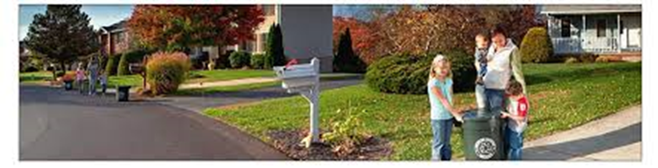
Sanitation (Solid Waste) Financial Plan

Slide 17
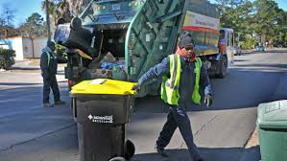
Sanitation (Solid Waste) Financial Plan
What services are accounted for in the City’s Sanitation Fund?
Sanitation Management
Residential Refuse
Refuse Disposal (Dean Forest Landfill)
Street Cleaning
Commercial Refuse
Recycling and Litter Services

Slide 18
Sanitation (Solid Waste) Financial Plan
Residential Services Include:
  Weekly Curbside Residential Refuse Collection
    About 50,871 customers
  Semi-monthly Curbside Recycling
  Bulk Item Pickup
  Yard Waste Removal
  Litter Removal
  Illegal Dumpsite Cleanup
  Special Event Cleanup and recycling (St. Patrick’s Day, Rock and Roll Marathon)
  Recycling Education and Outreach Program
Commercial Services Include:
  Commercial Refuse Collection
    About 1,100 customers
  Container Repair
  Construction and Demolition Waste
    Provides 20-yard and 30-yard roll-off containers

Slide 19
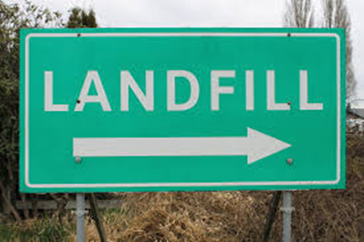
Sanitation (Solid Waste) Financial Plan
Issues Affecting Sanitation System Costs
City’s existing landfill capacity at Dean Forest site is projected to be exhausted in near term
Permitting process to create new landfill capacity at Dean Forest site has been under way for several years
Significant costs for the development of the new landfill site are expected to be incurred in 2017-2018
Landfill costs do not end when the capacity is exhausted – landfills incur significant costs during closure and post closure monitoring, which can last for 30 years

Slide 20
Sanitation (Solid Waste) Financial Plan
Issues Affecting Sanitation System Costs
Capital cost of 2017-2018 expansion at Dean Forest site is approximately $22.5 million.
  Current capital plan includes $21.5 million contribution from the Landfill Depletion Fund and $1 million in 2003 RRDA Bond funds to finance the landfill expansion.
  The current plan does not include any borrowing, though this may become necessary.
The estimated cost of closure and post closure care for the Dean Forest Landfill facility is approximately $24.8 million. This will be the next large financial challenge.

Slide 21

Sanitation (Solid Waste) Financial Plan
Issues Affecting Sanitation System Costs
Bonds related to the Sanitation Fund are issued through the Resource Recovery Authority.
Bonds are secured by a contract with the City of Savannah, which guarantees debt payments.
Debt service on existing bonds will be retired as of 2019.

Slide 22
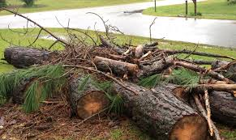
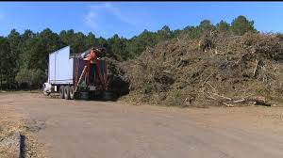
Sanitation (Solid Waste) Financial Plan
Issues Affecting Sanitation System Costs
Clean up costs from Hurricane Matthew:
About $8 million of the federal portion has been received to date.
Another $1.7 million has been requested but not received as of yet.
Remaining amount will be received at grant close-out.
Clean up costs from Hurricane Irma are expected to total about $650,000.

Slide 23

Sanitation (Solid Waste)Financial Plan Update
Planned Rate Adjustments (3.0% for 2018)
Comparison to private haulers for residential garbage and recycling services, in addition to the County’s 2017 solid waste fee of $14.50/month:
Hauler A = $33.33/month ($47.83 w/solid waste)
Hauler B = $34/month ($48.50 w/solid waste)
Hauler C = $37/month ($51.50 w/solid waste)
Hauler D = $40/month ($54.50 w/solid waste)
Hauler E = $45.50/month ($60.00 w/solid waste)

Slide 24
SANITATION FUND
USE AND SOURCE OF FUNDS
FY 2018 Proposed: | $ 29,336,159
FY 2017 Amended: | $ 31,905,326
SOURCES
USES

Slide 25
SANITATION FUND
BUDGET HIGHLIGHTS & CHALLENGES
BUDGETED FTEs | FY16 | FY17 | FY18
Administration | 7 | 7 | 8
Residential/Commercial Refuse | 128 | 128 | 128
Recycling & Litter | 33 | 33 | 33
Street Cleaning | 22 | 22 | 22
Property Maintenance/Code Enforcement | 31 | 31 | 0
TOTAL SANITATION FUND | 221 | 221 | 191
STAFFING
FY18 Net Position Change:
-30
Notes:
31 Positions to Code Compliance– General Fund
1 New Position Added – Environmental

Slide 26
General Fund Supported Debt Update

Slide 27
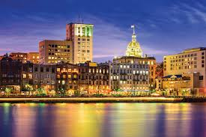
General Fund Supported Debt Update
Last update provided to Council on 4/18/2017, since then:
Issued 2017 General Obligation Bond of $2 million to partially fund downtown streetscapes project
Issued Downtown Savannah Authority, Series 2017 Bond of $6.585 million to partially fund the widening of Gwinnett Street near the new arena site
Currently in the process of issuing the Downtown Savannah Authority, Series 2018A bonds of approximately $14 million to fund the purchase of the riverwalk extension and other pedestrian improvements on the west end of River Street
Still to come, a final $2 million GO bond issue in 2018 to complete the planned $14 million in funding for downtown streetscapes (River, Bay and Broughton)

Slide 28
General Fund Supported Debt Update

Slide 29

General Fund Supported Debt Update
Debt Service Paid by the General Fund Related to Planned and Currently Outstanding Debt

