Slide 1
Savannah City Council Workshop Earline W. Davis, Executive director March 24, 2022
Mayor Van R. Johnson, II
Jay Melder, City Manager
Aldermen
Kesha Gibson-Carter, Post 1 At-Large Alicia Miller Blakely, Post 2 At-Large
Bernetta B. Lanier, District 1 Detric Legget, District 2
Linda Wilder-Bryan, District 3 Nick Palumbo, District 4
Dr. Estella Edwards Shabazz, District 5 Kurtis Purtee, District 6

Slide 2
Housing Authority of savannah
The Housing Authority of Savannah (HAS) was created in 1938 as a public housing authority under the laws of Georgia, through a Resolution that supported the creation of a body that would address the shortage of safe and sanitary housing in the City.
HAS’s mission has grown as the Authority continues to address the housing needs of Savannah’s low income population while also focusing on educational, job training, and self-sufficiency needs of its residents.
The Housing Authority of Savannah is governed by a five-member Board of Commissioners. In accordance with Georgia Code, Chapter 3, Article 1, Part 3. Section 8.-3-50 (a) (1), the Mayor of the City of Savannah appoints these members to the Housing Authority’s Board. Commissioners serve 5-year terms.

Slide 3
HAS provides housing assistance through a diverse portfolio of affordable housing programs
PORTFOLIO PART I
PUBLIC HOUSING, RENTAL ASSISTANCE DEMONSTRATION (RAD), MIXED FINANCE
Conventional Public Housing properties Total Units
Yamacraw Village 315
Simon Frazier Homes 236
Horace Stillwell Towers 210
Pickens Patterson Terrace 76
Single Family Homes 60
897
RAD Section 8 / Project-based Voucher
Total Units
Herbert Kayton Homes 164
Mixed-Finance / Mixed-income properties Total Units
The View at Oglethorpe I 72
The View at Oglethorpe II 100
River Pointe I 206
River Pointe II 74
Sustainable Fellwood I 110
Sustainable Fellwood II 110
Sustainable Fellwood III 100
Ashley Midtown I 168
Ashley Midtown II 38
The Veranda at Midtown 100
1,078

Slide 4
HAS provides housing assistance through a diverse portfolio of affordable housing programs
PORTFOLIO PART II
HCV, HOMEOWNERSHIP, TAX-EXEMPT BONDS
2017 - 2021 HAS-issued Bonds Total Units
Woodlands at Montgomery 246
Waters at Gateway 276
Preserve at Chatham Parkway 144
Westlake Apartments 100
Paradise Savannah 56
SNAP (Victorian District Homes) 233
Ogeechee Place 204
Savannah Summit 138
1397
Housing Choice Vouchers Program
Program type Total Count
Tenant-based Vouchers 2,569
Project-based Vouchers 601
Emergency Housing Vouchers 53
Veterans Affairs Supportive Vouchers 137
Shelter Plus Care Vouchers 112
Single Room Occupancy Units 20
3,492
Among which 96 are participants of the Homeownership Program utilizing their vouchers as part of monthly mortgage payments to purchase a home. Since inception in 2004, the program has assisted 168 families in reaching their homeownership goals.

Slide 5
HAS Former public housing communities 2002 – 2018 inventory removals
PH Community | Year Built | Number of Demolished Units | Year of Demolition
Fellwood Homes and Annex | 1940 | 303 | 2007
Garden Homes and Annex | 1940 | 315 | 2002
Francis Bartow Place | 1942 | 94 | 2005
Fred Wessels Homes* | 1954 | 44 | 2018
Robert Hitch Village | 1955 | 337 | 2010
Stubbs Tower | 1970 | 210 | 2007
Edgar Blackshear Homes* | 1984 | 26 | 2018
*partial demolition | TOTAL DEMOLISHED UNITS
1,329

Slide 6
The redevelopment of public housing communities and issuance of bonds
New Communities | Year Built | Total number of new units | HAS participation
Sustainable Fellwood I, II and III | 2009 - 2012 | 320 | Co-Developer, Lender, Ground Lessor
Ashley Midtown I and II | 2004 - 2008 | 206 | Co-Developer, Lender, Ground Lessor, Special Limited Partner
The Veranda at Midtown | 2007 | 100 | Co-Developer, Lender, Ground Lessor, Special Limited Partner
The View at Oglethorpe I and II | 2017 - 2018 | 172 | Co-Developer, Lender, Ground Lessor, Member of General Partner
Woodlands at Montgomery | 2019 | 246 | Bond Issuer
Waters at Gateway | 2018 | 276 | Bond Issuer, Co-Developer, Ground Lessor, Member of General Partner
Preserve at Chatham Parkway | 2018 | 144 | Bond Issuer
Ogeechee Place (construction underway) | 2022 (Fall completion) | 204 | Bond Issuer
 | TOTAL # OF NEW UNITS |  | *1,668 total units, of which 132 are market-rate
1,668*
Between 2002 and 2003, HAS also issued bonds for the development of the Oaks at Brandlewood and Bradley Pointe Apartments, which remained affordable for several years until their recent conversion to market, unrestricted developments.

Slide 7
PRESERVING affordable housing through the STRATEGIC UTILIZATION OF CAPITAL FUNDS, THE CONVERSION OF PUBLIC HOUSING COMMUNITIES TO PROJECT-BASED ASSISTANCE (SECTION 8), AND ISSUANCE OF BONDS FOR RENOVATION OF AFFORDABLE COMMUNITIES
Former Community | New Community Name, if applicable | Preservation Strategy | Number of Preserved Units
Fred Wessels Homes | River Pointe I | Rental Assistance Demonstration (RAD) – conversion from PH to Section 8 PBRA, 2016 | 206
Edgar Blackshear Homes | River Pointe II | Rental Assistance Demonstration (RAD) – conversion from PH to Section 8 PBRA, 2016 | 74
Herbert Kayton Homes | N/A - same | Rental Assistance Demonstration (RAD) – conversion from PH to Section 8 PBV, 2018 | 163
Yamacraw Village | N/A | Maintenance under PH – slated for Demolition & Redevelopment | 315
Simon Frazier Homes | N/A | Maintenance under PH – under analysis for Repositioning | 236
Horace Stillwell Towers | N/A | Maintenance under PH – under analysis for Repositioning | 210
Pickens Patterson Terrace | N/A | Maintenance under PH – under analysis for Repositioning | 76
Single Family Homes | N/A | Maintenance under PH – under analysis for Repositioning | 60
Rose of Sharon Apartments | N/A - same | HAS bond issuance, 2006 | 217
Westlake Apartments | N/A - same | HAS bond issuance, 2019 | 100
Ponderosa Apartments | Paradise Savannah | HAS bond issuance, 2020 | 56
SNAP | N/A - same | HAS bond issuance, 2020 | 233
Savannah Summit | N/A - same | HAS bond issuance, 2021 | 138
 |  | TOTAL PRESERVED UNITS
2,084

Slide 8
Measuring current impact
1,668 new units
2,084 preserved units
2,891 Voucher holders
Total = 6,643 households (or 26,572 housed persons, considering an average of four persons per household)

Slide 9
East savannah gateway redevelopment summary
172 units built on Hitch footprint (The View at Oglethorpe I and II)
327 units proposed on vacant land of former Hitch, Wessels and Blackshear sites
= Total of 499 new units
Additionally, a portion of the Hitch site is under a ground lease for development of the following:
Early Early Learning Center
Library
Recreation Facility (YMCA)
Adult Education Facility (Goodwill Excel Center)

Slide 10
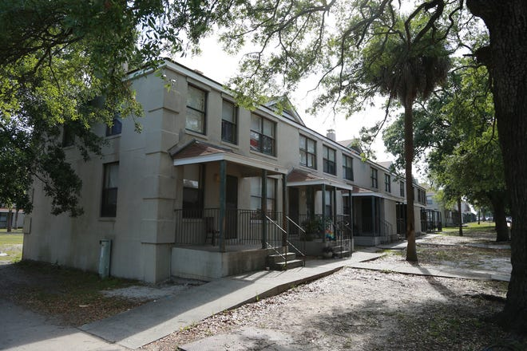
Yamacraw village: Eligible for demolition slated for redevelopment
1. Profile and Status
Year Built: 1941
Number of Units: 315
Unit mix:18 one-bedroom, 138 two-bedroom, and 159 three-bedroom units
Capital Needs Assessment: Completed in 2019, concluding renovation of property is infeasible, not cost-effective
Current Status: Inventory Removal Application for Demolition being finalized by HAS – forecasted submission to HUD in the spring of 2022

Slide 11
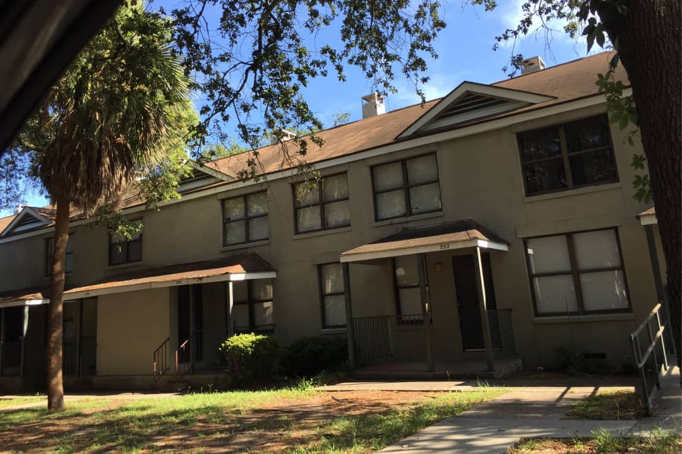
Yamacraw village: Eligible for demolition slated for redevelopment
2. Important Section 18 regulations
All residents in good standing with their lease at the time of HUD approval are eligible for full relocation assistance, which include relocation to comparable unit and payment of actual and reasonable relocation expenses
Relocation can begin 90 days after HUD approval
Disposition of land based on commensurate public benefit, HAS authorized to exercise an exception to the offer of sale to established resident organizations

Slide 12
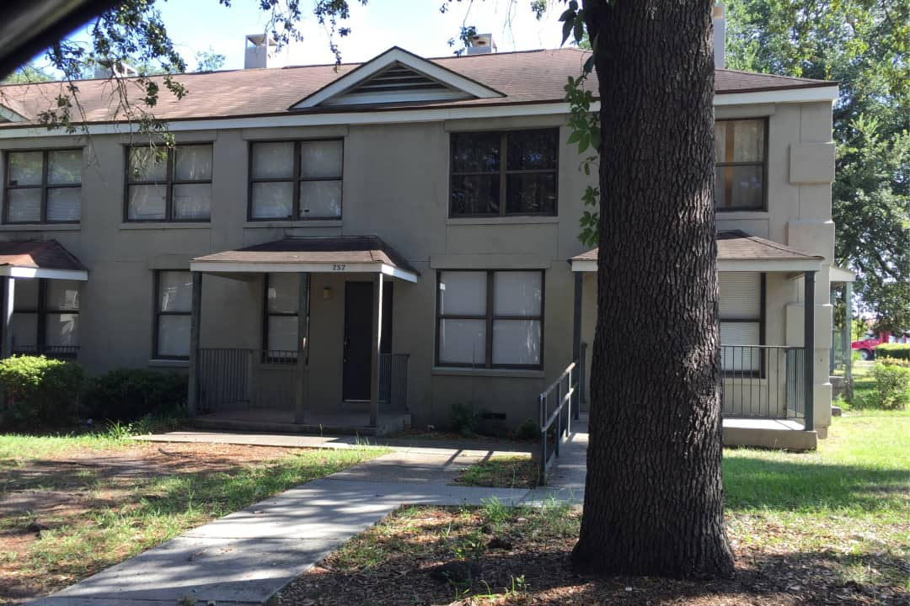
Yamacraw village: Eligible for demolition slated for redevelopment
3. Redevelopment
HAS plans to issue an RFQ (Request for Qualifications) as soon as demolition begins, for selection of a partnering Master Developer
Engagement with Developer will initiate the pre-development phase for the site; HAS will invite stakeholders, including the City of Savannah, to participate in planning process
Redevelopment to be potentially funded by a blend of tax credit equity (LIHTC / NMTC), private loans and HAS Replacement Housing Funds

Slide 13
Section 18 (public housing inventory removals) regulation on relocation eligibility
Occupied units at the time of SAC approval are eligible to receive portable TPVs (Tenant Protection Voucher), if meeting HCV program criteria
Other residents (rejecting a voucher, or not meeting program criteria) are eligible for relocation to a comparable public housing unit or project-based unit managed by HAS
HOUSING CHOICE VOUCHER PROGRAM FAIR MARKET RENTS
0 Bedrooms | $880
1 Bedroom | $937
2 Bedrooms | $1067
3 Bedrooms | $1466
4 Bedrooms | $1713
5 Bedrooms | $1970
6 Bedrooms | $2227
7 Bedrooms | $2484
HOUSING CHOICE VOUCHER PROGRAM PAYMENT STANDARDS
0 Bedrooms | $968
1 Bedroom | $1030
2 Bedrooms | $1173
3 Bedrooms | $1612
4 Bedrooms | $1884
5 Bedrooms | $2167
6 Bedrooms | $2449
7 Bedrooms | $2732
MINIMUM RENT | $50
Effective 10/01/21

Slide 14
Breaking-down ‘affordability’ into two scenarios
Family #1: Eligible for a public housing, deeply subsidized unit
Family #2: Eligible for a RAD unit financed with LIHTC and Project-Based Rental Assistance
A single mother of three children works part-time and has an annual salary of $13,744, which makes her household eligible to occupy a three-bedroom public housing unit where she will pay in rent 30% of her income. She is also eligible to receive an annual deduction of $1,440 ($480 per child), plus a monthly utility allowance of $113, hence she will pay $195 in rent monthly. If her incomes goes up, or down, she needs to report to management so her rent can be adjusted.
$25,011 is the annual salary of a single mother of three children, qualifying the household to lease a RAD / LIHTC three-bedroom unit where the mother will pay in rent 30% of her income. She is also eligible to receive an annual deduction of $1,440 ($480 per child), plus a monthly utility allowance of $219, hence she will pay $370 in rent monthly. If her incomes goes up, or down, she needs to report to management so her rent can be adjusted.

Slide 15
Thank you!
Time for Questions and Answers

