Slide 1
2022 Legislative Agenda November 23, 2022
Notes:
Here today to present the City’s draft legislative agenda
Each year we forumalte the City’s Legislative Agenda with three primary inputs
City Council Members Legislatives priorities
City Staff’s input on state law and pocilies that impact the services they provide
Consultation with our partners at Georgia Municipal Association of potential opportunities that maybe present.

Slide 2
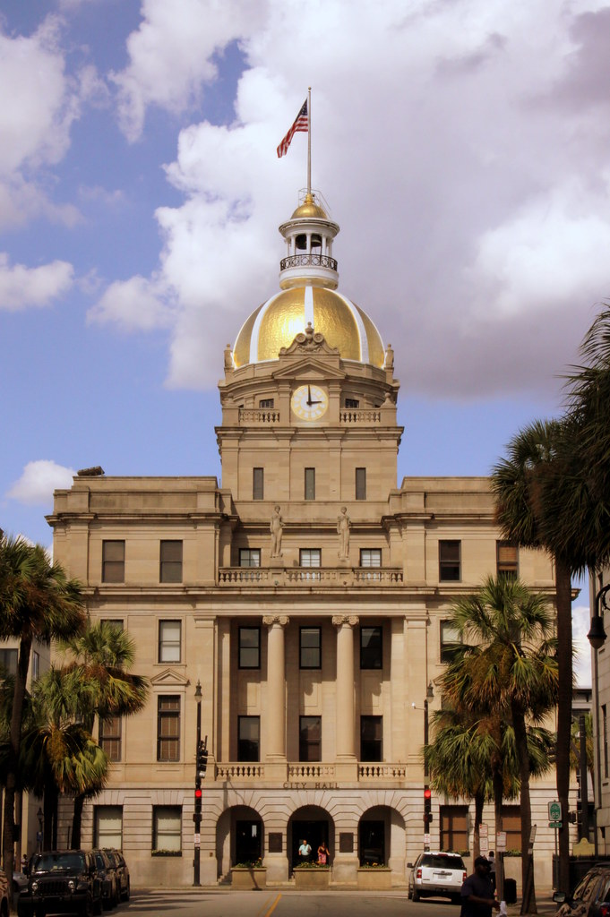
Legislative Calendar
September 30th Memo sent to City Council requesting Legislative Priorities
November 19th City Council provided draft Legislative Agenda
November 23rd TODAY- Workshop and Discussion
November 24th Survey to City Council on Legislative items
December 9th Legislative agenda on City Council’s meeting agenda
January 10th Georgia Legislative Session Starts (40 days)
February 3rd Savannah Chatham Day at the Capital

Slide 3
Clarity to the Taxpayer Bill of Rights Advertisement
Legislative Agenda
The “Taxpayer Bill of Rights” is designed to notify the public that the overall digest has increased in value. However, the wording of the notice fails to differentiate the difference between increased millage rates and increased assessed value, confusing the public.

Slide 4
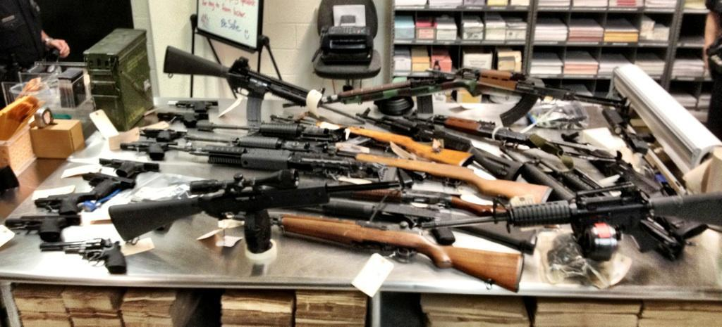
Confiscated Weapons
Legislative Agenda
Allow local governments to choose whether they’ll sell confiscated weapons at auction or have them destroyed.
Notes:
State law passed in 2012 requires all law enforcement agencies in Georgia to auction off most of the guns they confiscate to licensed gun dealers if they cannot return them to the lawful owners. Savannah Police seize hundreds of guns per year. Gun-related violence is the most pressing public safety issue in Savannah today. There are far too many guns on Savannah’s streets and requiring law enforcement to reintroduce confiscated weapons into the community works against the efforts made by our law enforcement professionals.
The City requests that the law be changed to allow local jurisdictions the option to destroy confiscated weapons or sell them at auction.

Slide 5
3. Hotel Motel Tax
Legislative Agenda
The City of Savannah would like to move from its currently grandfathered State authorization paragraph permitting Hotel-Motel tax at the 6% rate, into the updated State authorization paragraph allowing City Council to set the Hotel-Motel tax rate between 6% and 8%.

Slide 6
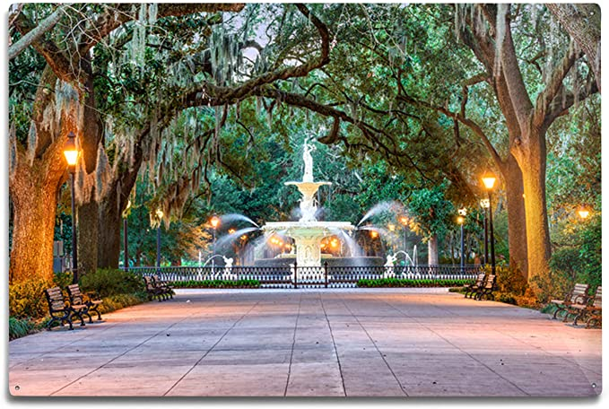
Local Control Of Monuments
Legislative Agenda
The City requests that the State allow Cities to have local control of the placement of monuments and memorials.

Slide 7
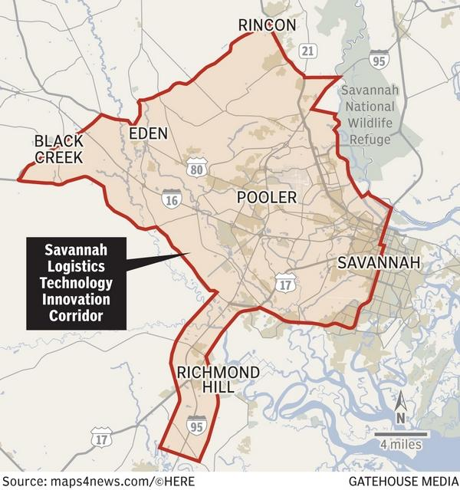
Logistics Technology Corridor
Legislative Agenda
Adopt economic incentives to enhance Georgia’s logistics technology corridor that includes logistical technology job training, an innovation center, and foundation for the region becoming the global leader of logistics innovation.

Slide 8
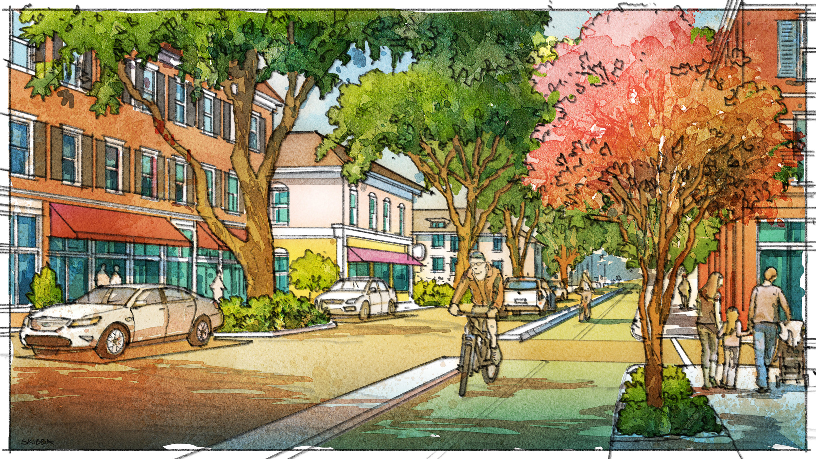
Savannah Development and Renewal Authority
Legislative Agenda
Lower the required number of board members for the Savannah Development and Renewal Authority from 25 to 17.

Slide 9
Workforce Housing Initiatives
Legislative Agenda
Long-term Lease Agreements to help lower housing development costs
Expand Enterprise Zones to include an option that provides incentives for workforce housing
Allow Savannah to use Housing Opportunity Bonds

Slide 10
HOME RULE ITEMS Local control of our existing laws and policies This section outlines current laws and policies we have identified that we need to protect from state involvement or over-reach. As a local government, we believe we know what works best for Savannah and request the state allow us to legislate our own solutions.
Legislative Agenda
Abandoned Shopping Cart Ordinance
Short-Term Vacation Rentals
Minimum Wage

Slide 11
ADVOCACY ITEMS This section outlines items that may benefit citizens of the City of Savannah but are not directly related to municipal services or control.
Legislative Agenda
Anti-Gentrification Policies
Rent Control Management
Sustainability Initiatives
Behind-the-Meter Solar Programs Caps
Community Solar Programs Access

Slide 12
Questions and Discussion
Legislative Agenda

