Slide 1
Savannah-Chatham Metropolitan Police Department
City of Savannah City Council Workshop January 18, 2018
“To Serve, Protect and Build Trust”

Slide 2
Topics:
Part One Crime Analysis
Technology Update
Youth & Community Outreach
Recruiting and Retention

Slide 4
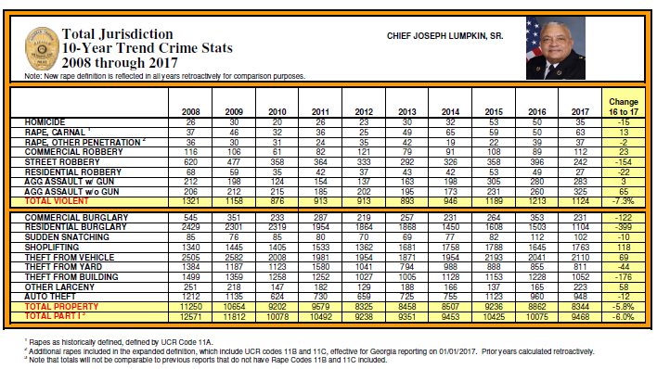
*Preliminary data will be finalized prior to Jan. 31.
COS Strategic Plan Goal: Public Safety 1.2, 1.3

Slide 5
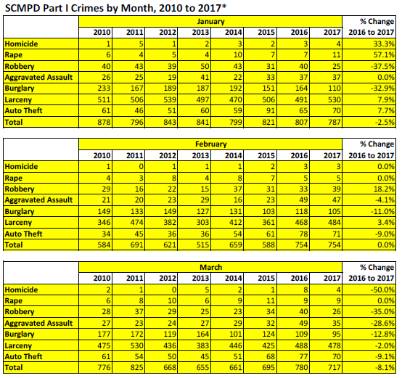
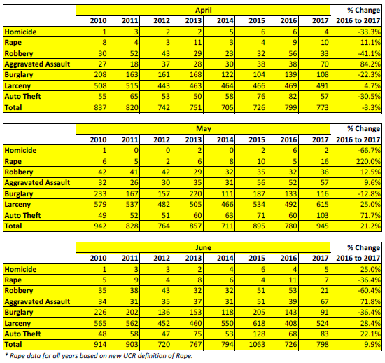
COS Strategic Plan Goal: Public Safety 1.2, 1.3

Slide 6
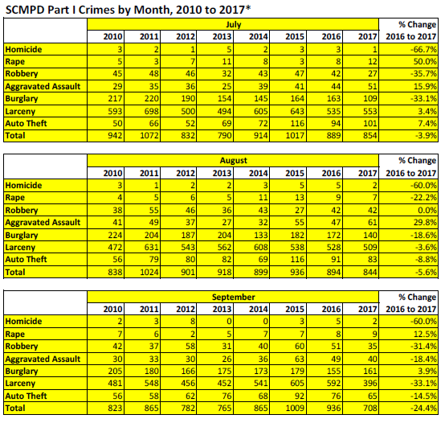
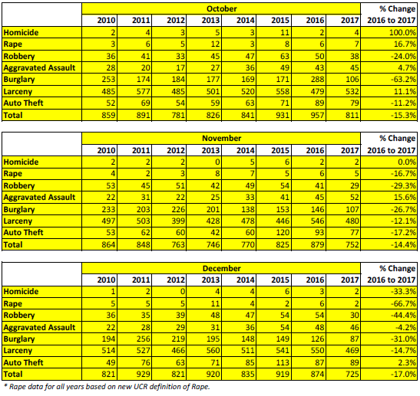
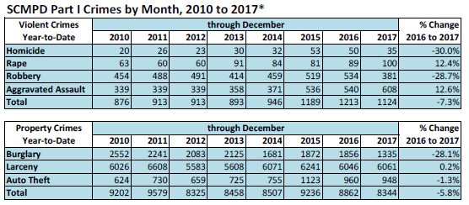
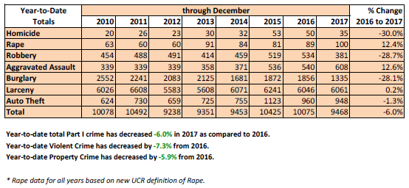
COS Strategic Plan Goal: Public Safety 1.2, 1.3

Slide 7
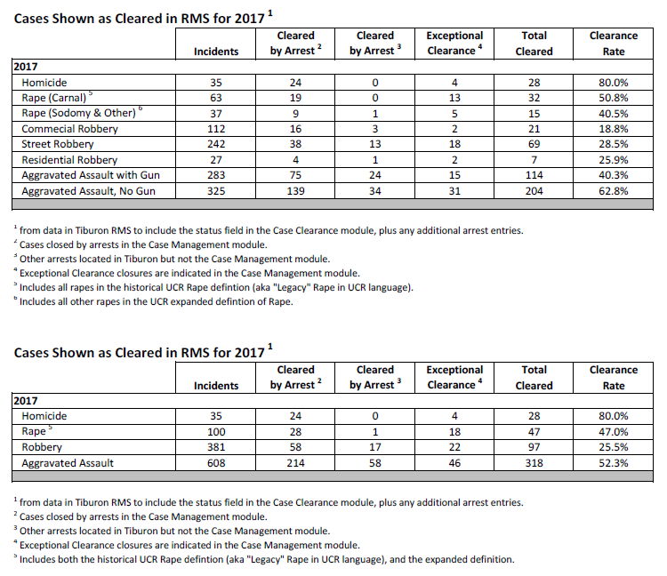

Slide 8
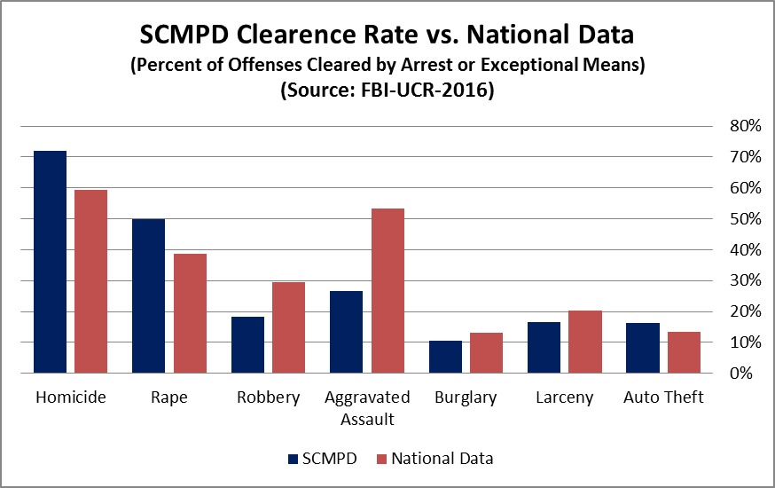
COS Strategic Plan Goal: Good Government 5.1

Slide 9
DNA Testing Results
DNA contract was signed 3/9/17 and expires 3/9/18.
The original amount approved by City Council was $110,250 and based off estimates from 2016. Learning curve was much steeper than expected. SCMPD was one of the first agencies nationally that applied this technology to gun cases. Processes in place to increase efficiency.
20 cases have been submitted. The defendant’s DNA was found in 15 cases.
Improved efficiency and greater number of cases will be submitted in 2018 if contract is retained.
COS Strategic Plan Goal: Public Safety 1.2, Good Government 5.1

Slide 10
DNA Testing Results – Success Cases
Stephen Walker (CRN 170310208) – During a task force, SIU officers located a vehicle that had previously fled from a traffic stop. They attempted to stop it again, but it fled. It was located parked in front of a residence with Mr. Walker standing near the vehicle. A firearm was located in the front seat of the vehicle. He denied driving the vehicle or possessing the gun and no evidence to connect him to the vehicle or firearm. A search warrant was obtained for his DNA and sent to the lab. His DNA was found on the gun and the U.S. Attorney’s Office accepted the case. He has pled guilty in Federal Court and is awaiting sentencing. He is an armed career criminal facing at least 15 years.
Johnny Brinson (171005118) – Officers responded to a domestic dispute between a female and Mr. Brinson. She claimed that he threatened her with a gun. A gun was located in the residence. Mr. Brinson denied making any threats or possessing the gun. The U.S. Attorney’s Office is generally very reluctant to take cases related to domestic violence as victims and witnesses often recant. The case was presented to the U.S. Attorney’s Office and tabled pending DNA results. DNA was recovered from the gun and it matched Mr. Brinson. This case has now been accepted and Mr. Brinson is a 5 time convicted felon, who is currently on probation, and has a previous possession of a firearm by a convicted felon conviction.

Slide 11
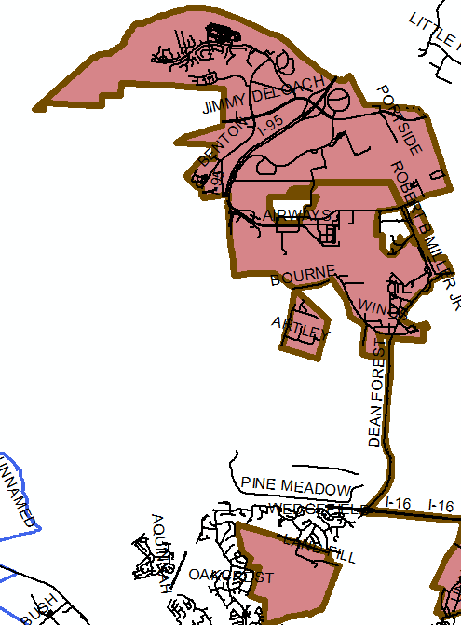
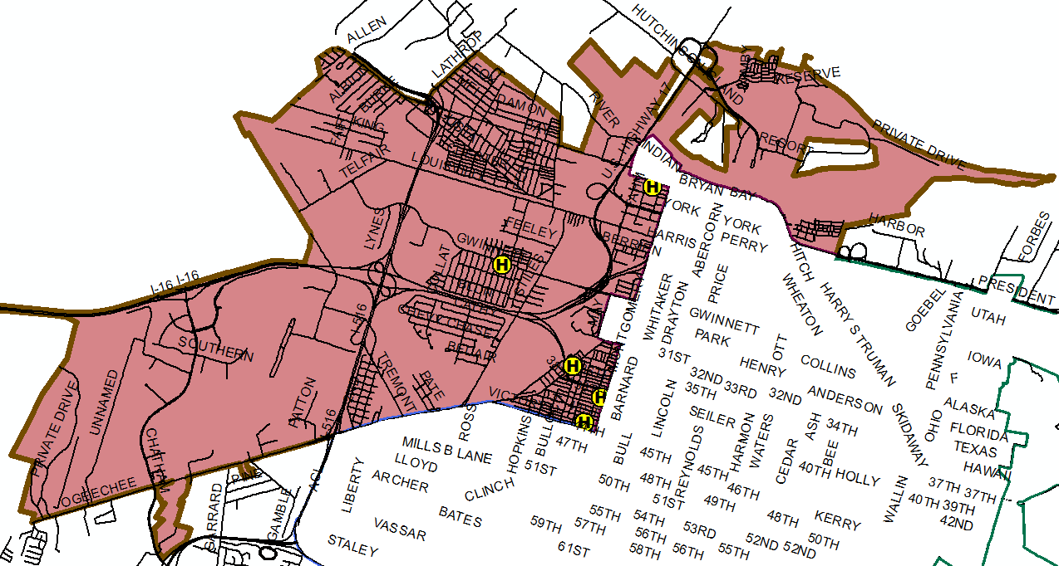
Aldermanic District 1
6 Homicides
6 Rape 11A
6 Rapes 11B & 11C
02/17/17, 22:30
170217202 (double)
2 B/M, Tori Plummer, 35, & Erick Lawrence, 25, Drug Related
524 Yamacraw Village, City
03/06/17, 17:04
170306121
Kevin Jackson, 16, B/M, Robbery Attempt, 804 Crosby St
06/23/17, 19:50
170623174
Shep Morrell, 72, B/M,Unknown
512 W 38th St
08/03/17, 16:30
170803134
Dontray Hart, 21, B/M, dispute w/ acquaintance
W 35th St/Ogeechee Rd
06/06/17, 22:12
170606148
Brittini Brown, 26, B/F, Group/Gang Related
612 w 42ND St, City

Slide 12
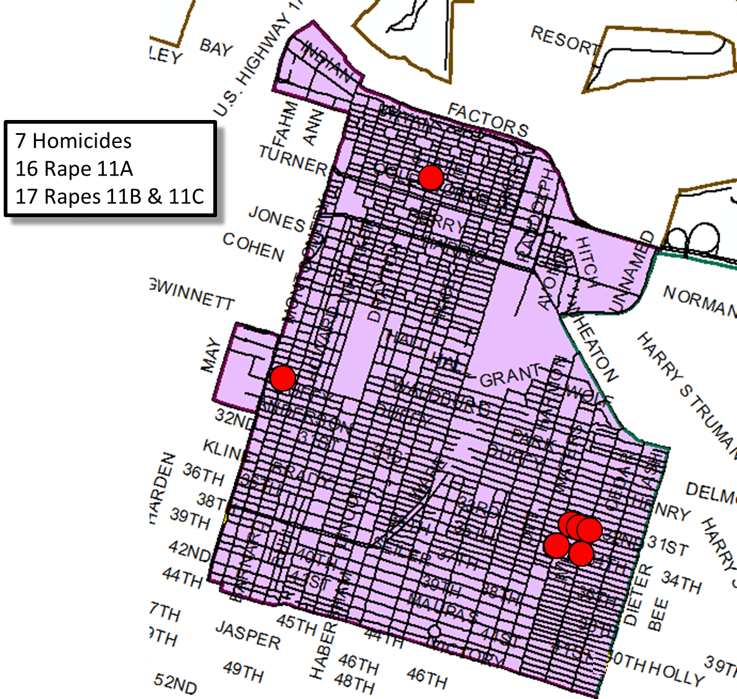
10/29/17, 08:00
17029029
Matthew Harrington, 32, B/M, Unknown
400 Blk W Bolton St, City
Aldermanic District 2
04/24/17, 01:28
170424008 – Triple Homicide
2 BM’s (William Mullins, 24, & Courtney Germany, 31), 1 BF (Shayla Curtis, 18), Group/Gang Related 1110 E 31st St, City
10/08/17, 02:50
171008029
Sean Brooks, 27, B/M, Fight,
Waters/33rd St, City
03/05/17, 09:21
170305057
Saundra Thomas, 47, B/F, Unknown
1511 E 34th St, City
12/30/17
171230028
Eric Jenkins, 38, B/M
Montgomery/W. Park, City
09/17/17, 01:20
170917015
Jaheim Morris, 167 B/M, Fight
Dieter/33rd St

Slide 13
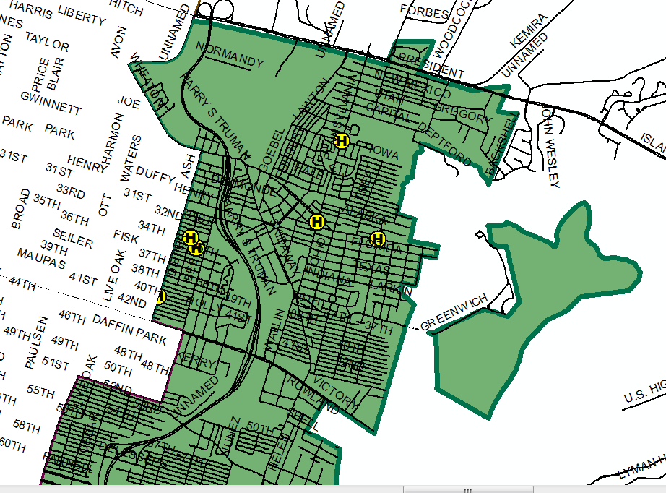
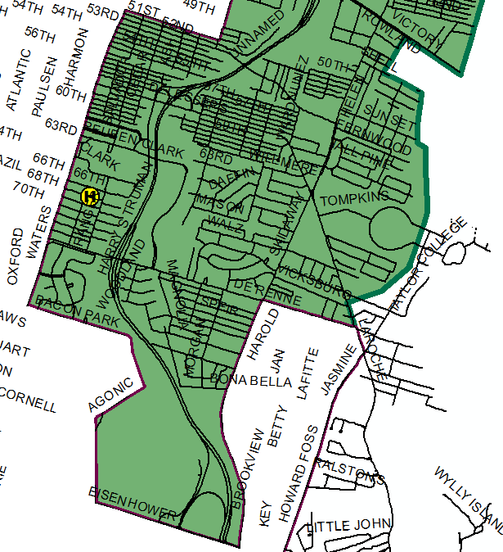
01/10/17, 12:15
170110075
Joseph Billings, 56 W/M, Fight ,
President/Truman
Aldermanic District 3
8 Homicides
5 Rape 11A
7 Rapes 11B & 11C
02/16/17, 12:00
170216086
Tristan Gray, 17 B/M, Robbery Attempt, 922 Pennsylvania Ave, City
9/13/17
170913072 Arraffi Williams, 18, B/M, Group/gang
E. 40TH/Ash, City
05/05/17, 22:46
170505233 (double)
B/M, (Desmond Lanier, 25, & Clarence Fleming, 23) unknown circumstances Georgia/Mississippi Ave. City
12/15/17
171215032
Theron Warren, 40, B/M
1206 E. 67th Street
08/25/17, 00:25
170825005
Raphael Morrell, 28, B/M, Dispute, Acquaintances, 500 Pennsylvania Ave #1918, City
03/05/17, 09:21
170305057
Saundra Thomas, 47, B/F, Unknown Circumstances
1511 E 34th St, City

Slide 14
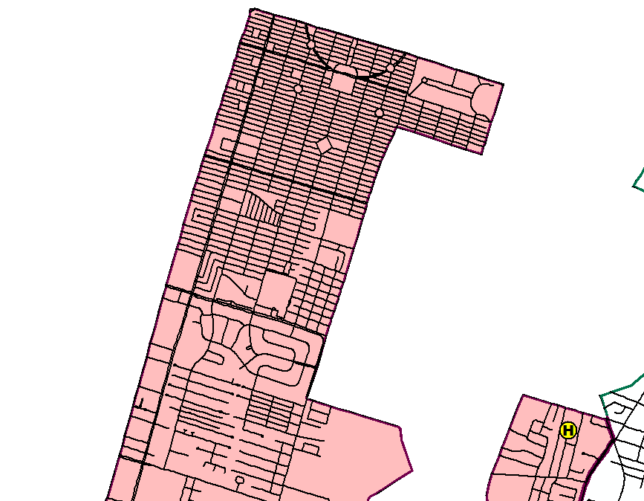
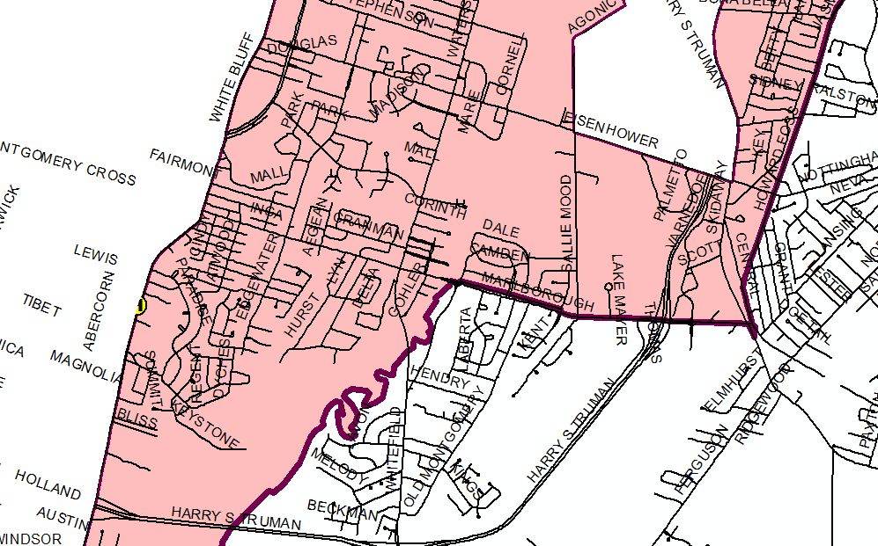
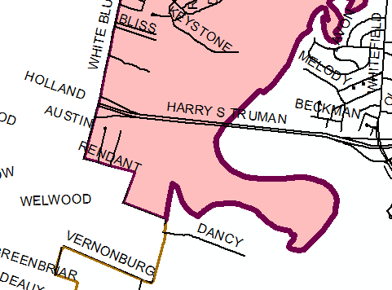
Aldermanic District 4
1 Homicide
4 Rape 11A
10 Rapes 11B & 11C
10/08/17, 18:53
17108142
Shawn Rhinehart, 22 B/M, Unknown, 5513 Betty Dr, City

Slide 15
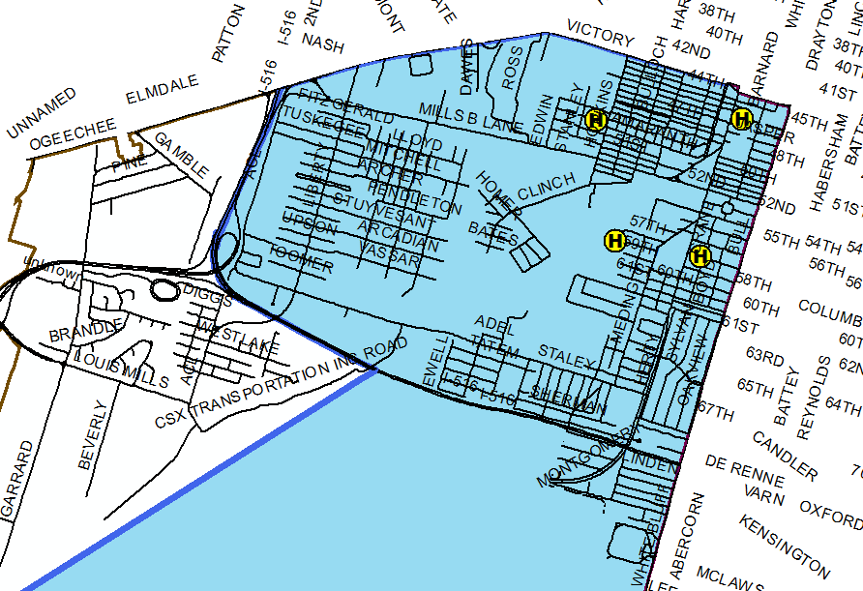
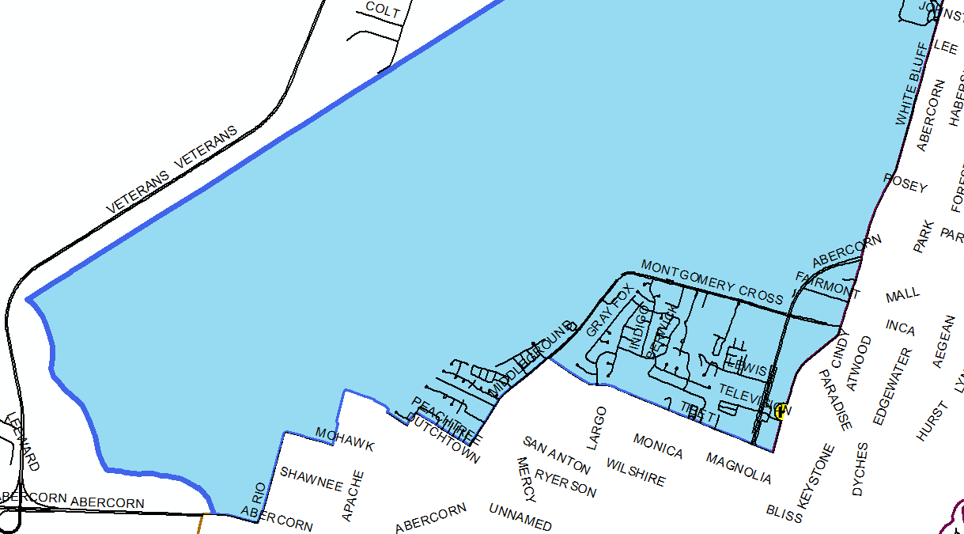
Aldermanic District 5
5 Homicides
3 Rape 11A
5 Rapes 11B & 11C
11/01/17,
171101009
John Hunter, 21, B/M
301 W. 45TH St., City
06/30/17, 08:15
170630032
Marquice Allen, 34, B/M, domestic, 1117 W 49th St
06/27/17, 01:00
170627006
Joshua Williams, 24,B/M, unknown circumstances
714 W 57th St
04/30/17, 22:12
170430160
Carlton Frazier, 37, B/M, unknown circumstances
208 W 57th St, City
06/11/17, 23:53
170612001
Daylon Thomas, 18, B/M, unknown circumstances
9111 White Bluff Rd, City

Slide 16
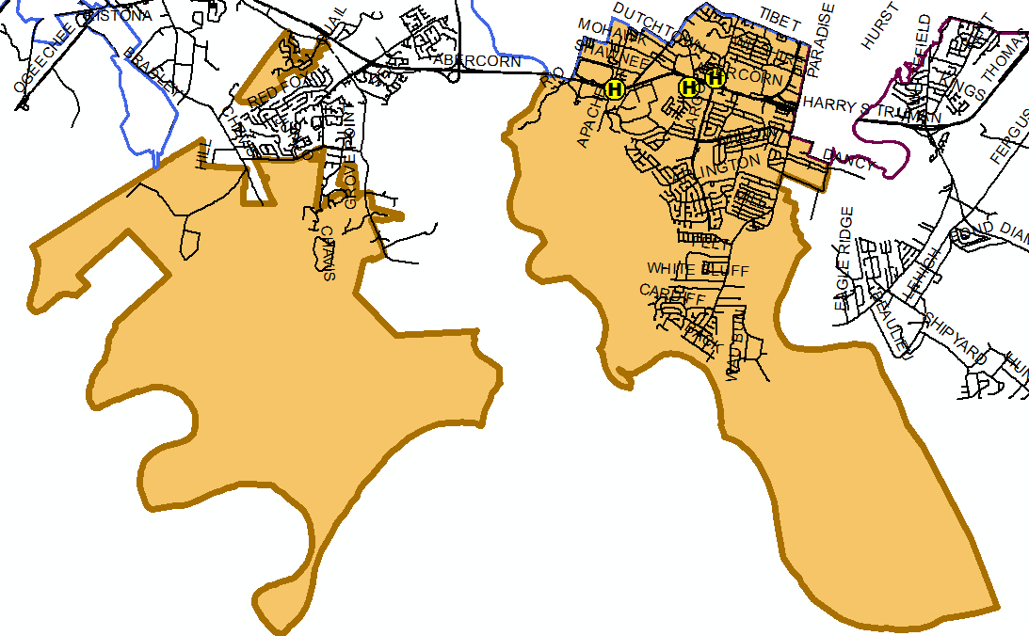
11/02/17
1701102115
, City
10/21/17, 22:51
171021170
George Akins Jr, 15, B/M, Fights
13100 Abercorn St, City
01/24/17, Unk Time
170124117
Wynesha Medley, 26, B/F, Domestic
1230 Mercy Blvd, City
3 Homicides
4 Rape 11A
5 Rapes 11B & 11C
Aldermanic District 6

Slide 17
National Network Definition of “Group”
All gangs are groups, but not all groups are gangs.
Both are dangerous if they have a criminal nexus.
An exclusive focus on gangs, which is often understood to include notions like organization and leadership, will exclude a significant number of groups that contribute heavily to serious violence, such as loose neighborhood drug crews or robbery crews.
Many (and often most) such groups will not fit the statutory definition of gang. Nor will they meet even the common perception of what constitutes a gang.
Such groups may or may not have a name, common symbol, sign or tags, an identifiable hierarchy, or other shared identifiers.

Slide 18
Crime Factors in the United States
Populations density and degree of urbanization
Variations in composition of population, particularly youth concentration
Stability of population w/ respect to residents’ mobility commuting patterns and transient factors
Modes of transportation and highway system
Economic conditions, including median income, poverty level and job availability
Cultural factors and educational, recreational and religious characteristics
Family conditions with respect to divorce and family cohesiveness
Climate
Note: Based on national historical data

Slide 19
Crime Factors in the United States
The effective strength of law enforcement
Administrative and investigative emphases of law enforcement
Policies of other components of the criminal justice system (i.e. prosecutorial, judicial, correctional, and probational)
Citizens’ attitudes toward crime
Crime reporting practices of the citizenry
COS Strategic Plan Goal: Public Safety 1.2
Note: Based on national historical data

Slide 20
Technology

Slide 21
Automatic Vehicle Location (AVL) Completed
Originally purchased due to merger
Implemented during 2017
Since implementation AVL is being used:
Provide accountability, effectiveness and efficiency
Officer deployment and management
Possible Future Applications
Enhance dispatch capacity with closest unit option
Decrease response time per Berkshire I
Foundational to Real Time Crime Center
COS Strategic Plan Goal: Public Safety 1.3, 1.1
Good Government 5.4

Slide 22
sUAS (Drones) Awaiting Funding
Being used increasingly by public safety
Research completed
Awaiting funding
Funding potential from forfeited funds
Anticipate launching program 2018
Primary uses
Crash scene documentation
Search & rescue
Tactical operations
COS Strategic Plan Goal: Infrastructure 1.1
Good Government 2.4

Slide 23
Expansion of Security Cameras Researching
SCMPD & COS IT are currently working on a project that will permit integration of external business cameras
Project will start small, with opportunity for growth
Anticipate public unveiling second half of 2018
COS Strategic Plan Goal: Public Safety 1.2, 1.3
Infrastructure 2.6

Slide 24
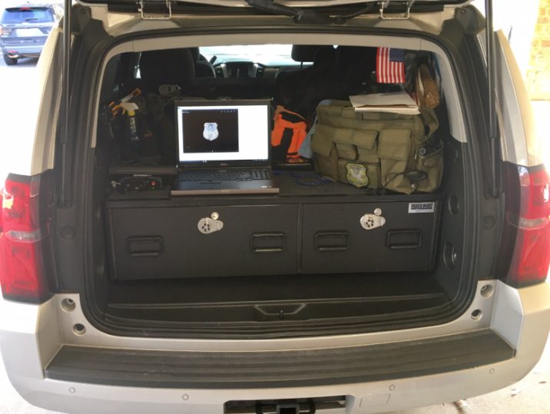
Mobile Investigation Work Platform- Underway
Brings work space to the crime scene
Phase 1: Allow violent crime detectives to commence appropriate case reporting in the field and on-scenes
Phase 2: Foundational to developing and sustaining 21st Century technology and productivity enhancements such as digital warrants system.
Phase 3: Best Practice grounded and productivity oriented
Anticipate phase 1 being
operational 2Q 2018
COS Strategic Plan Goal: Public Safety 1.1, 1.2
Joseph H. Lumpkin, Sr., Chief of Police Savannah-Chatham Metropolitan Police Department

Slide 25
Records Management System- PRIORITY
RMS houses all of the SCMPD’s data & provides an informational foundation
Police reports, tickets, field interviews, etc.
Used to track crime statistics, analytics & investigations
Our current system is NOW approximately 30 years old and has not been updated in 11 years
In 1Q 2015 our RMS vendor was purchased by another company
Not funded in 2018 budget
COS Strategic Plan Goal: Public Safety 1.1, 1.2, 1.3

Slide 26
Digital Asset Management- PRIORITY
SCMPD currently stores most data in different “silos” & DVDs- including 110 terabytes of body-worn camera video
One Example- over 400,000 files within our BWC system without long-term capacity/ management
Centralized repository for casefiles & digital evidence
Eliminate our “silo” evidence problem
Reduce reliance upon paper files & copying to DVDs
Provide D.A.’s Office direct digital access to case files
Reduce and eliminate error factors
Not funded in 2018 budget
COS Strategic Plan Goal: Public Safety 1.1, 1.2, 1.4
Infrastructure 2.5

Slide 27
Real Time Crime Center (RTCC)- Future
RTCC provides rapid and actionable information to field units
Provides background information
Assists in locating individuals and vehicles
Leverages existing technologies (next slide)
Preliminary cost of $1-2 million
Already have facility that could be repurposed
Would provide 16 hours of coverage a day.
Would require command and control software for system integration
COS Strategic Plan Goal: Public Safety 1.1, 1.2
Infrastructure 2.6
Good Government 5.2

Slide 28
Real Time Crime Center (RTCC) Future
Records Mgt. System
Electronic Evidence Mgt.
Automatic Vehicle Locator
Computer Aided Dispatch
Command & Control
ShotSpotter
License Plate Reader
Video Mgt. System
Analytics
Internal Cameras
External Cameras
Historical
& Live

Slide 29
Youth & Community Outreach

Slide 30
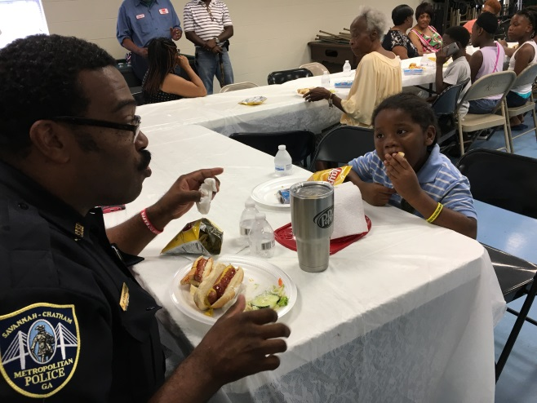
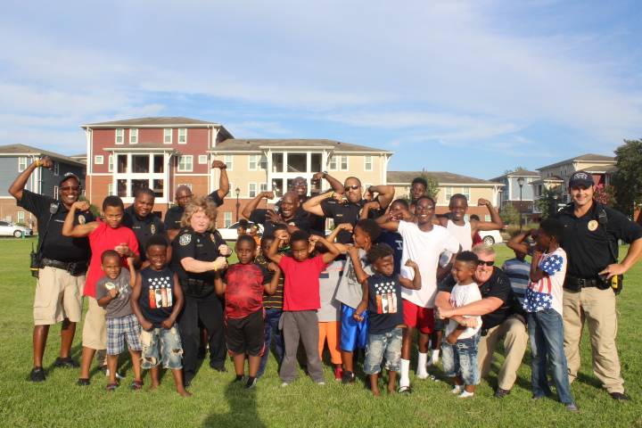
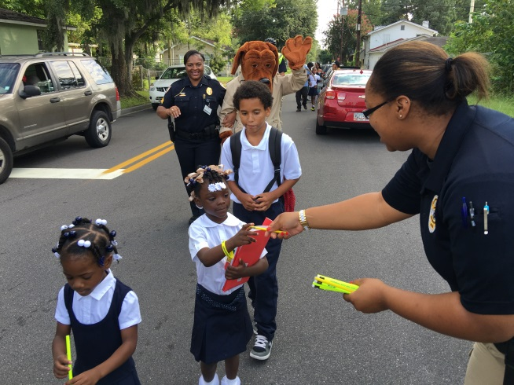
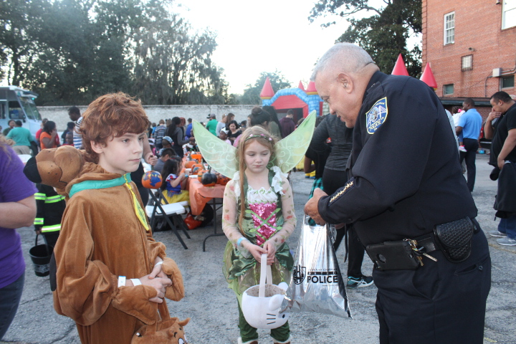
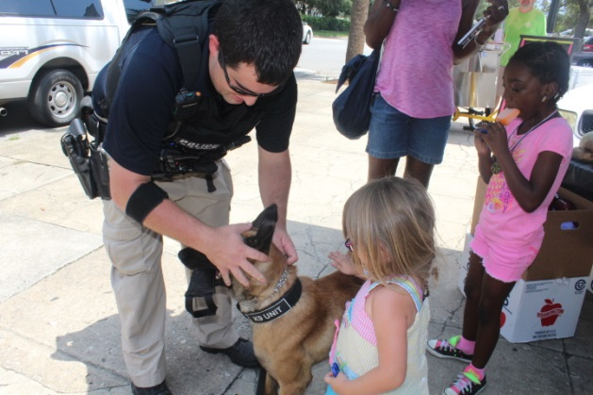
Community Outreach

Slide 31
SCMPD Youth and Community Outreach Programs
Explorers Program
PAL Summer Camp
Caught Doing Good
Juvenile Officer Program
Pumpkin Painting with Police
Roll Call in the Streets
Coffee with a Cop
National Night Out
Reading to students
The Law and Your Community program for parents

Slide 33
Importance of Mentorship with At-Risk Children
Enhancing Factors
Reducing Risk Factors
Enhance academic achievement
Connectedness to family or adult outside of family
Commitment to school and interest in higher education
Reduce poverty rate to below state average
Substance use or abuse
Poor behavior control
Poor academic achievement
Low parental involvement
Association with delinquent peers or gangs
History of violent victimization or exposure to violence

Slide 34
Mentorship – How to Help
Increase the number of mentorship programs
Become a mentor
Sponsor a child to join a mentorship program

Slide 35
One Mind- IACP Best Practices In Progress
Goal: Increase the number of successful outcomes for interactions between law enforcement and those with mental illness.
Current National Status: Approximately 25 percent of those killed annually by law enforcement are mental health consumer or in a mental health crisis.
Benefit: Increase officer and community safety, enhance community-police trust, create sustainable partnerships with mental health professionals.

Slide 36
Recruiting & Retention

Slide 37
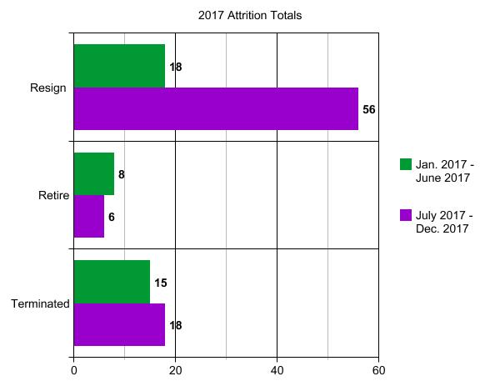
Retention
2017 Totals
Resign: 74
Retire: 13
Termination: 33

Slide 38
New Hires Gantt Chart
180 days
9 days
56 days
40 days
75 days
175 days
6 days
July Class of 18
Jun 23 - Mar 2
55 days
40 days
Orientation
Jun 23 - Jul 6
75 days
GPSTC Academy
Jul 7 - Sep 29
175 days
Patrol School
Sep 30 - Nov 24
9 days
PTO
Nov 25 - Mar 9
56 days
September Class of 14
Sep 18 - May 25
45 days
Orientation
Sep 18 - Sep 27
80 days
GPSTC Academy
Sep 28 - Dec 15
175 days
Patrol School
Dec 18 - Feb 9
7 days
PTO
Feb 10 - May 25
57 days
Today
40 days
2017
2018
75 days
Jun
Jul
Aug
Sep
Oct
Nov
Dec
Jan
Feb
Mar
Apr
May
Nov 24
Feb 9
2016
July Class on Patrol
18 officers
September Class on Patrol
14 officers
2017
Oct 10
June Class on Patrol
15 officers

Slide 39
APPLICATIONS RECEIVED
2014
Oct. 10-Nov. 9 28
Nov. 10-Dec. 9 26
2015
Dec. 10-Jan 9 20
Jan. 10-Feb. 9 32
Feb. 10-Mar. 9 27
Mar. 10- Apr. 9 75
Apr. 10-May 9 92
May 10-Jun. 9 71
Jun. 10-July 9 97 July 10-Aug. 9 122
Aug. 10-Sep. 9 181
Sep. 10-Oct. 9 151
Oct. 10-Nov. 9 142
Nov. 10-Dec. 9 104
2016
Dec. 10-Jan. 9 104
Jan. 10-Feb. 9 105
Feb. 10-Mar 9 77
Mar. 10-Apr 9 72
Apr. 10-May 9 65
May 10 – Jun 9 77
June 10-July 9 75
July 10-Aug. 9 76
Aug. 10-Sept. 9 60
Sept. 10-Oct. 9 49
Oct. 10 – Nov. 9 52
Nov. 10—Dec. 9 61
2017
Dec. 10-Jan. 9 48
Jan. 10-Feb. 9 67
Feb. 10-Mar. 9 57
Mar. 10 -Apr. 9 62
Apr. 10-May 9 62
May 10 –Jun 9 46
Jun 10 –July 9 50
July 10 – Aug. 9 64
Aug. 10- Sept. 9 63
Sept. 10-Oct. 9 55
Oct. 10 – Nov. 9 66
Nov. 10 –Dec. 9 32
Dec. 10—Jan. 9 2018 55

Slide 40
QUESTIONS?

